Slide 1

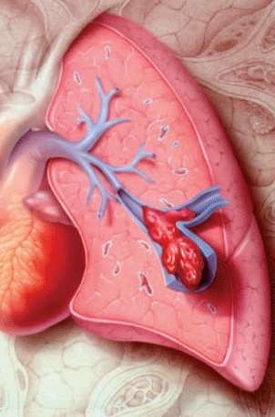
Pulmonary Embolism
1

Slide 2

Objectives
Overview of pulmonary circulation
Pulmonary embolism
Definition & Sources
Risk factors & aetiology
Pathogenesis
Clinical presentation
Differential Diagnosis
Investigations
Management
Complications
Prevention
2

Slide 3

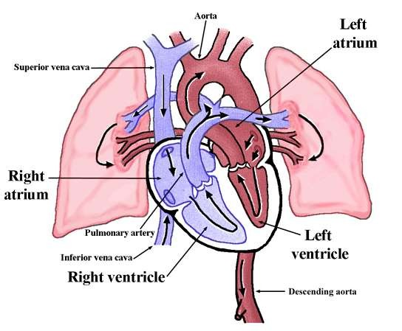
Pulmonary circulation
3

Slide 4

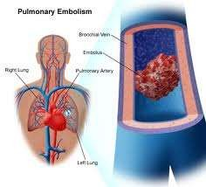
Pulmonary Embolism
Occlusion of a pulmonary artery(ies) by a blood clot.
Results from DVTs that have broken off and travelled to the pulmonary arterial circulation.
PE is one of the leading causes of preventable deaths in hospitalized patients.
4
20/01/2016

Slide 5
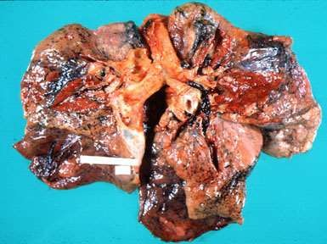
5

Slide 6




Source
DVT
IEC of the right side of heart
Air embolism
Fat embolism
Amniotic fluid embolism
Septic embolism
Tumor embolism
6

Slide 7





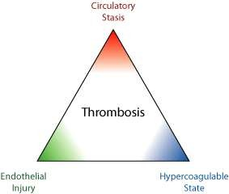
Risk Factors
Virchow’s Triad
7

Slide 8
Risk Factors
VTE is most prevalent in three clinical conditions:
Major surgery (particularly if it is cancer related or involves the hip or knee)
Acute stroke
Major trauma (especially spinal cord injury)
8

Slide 9
Risk Factors
Prior DVT or PE
Congestive Heart Failure
Malignancy
Obesity
smoking
Estrogen, OCP, HRT
Pregnancy
Lower limbs injury
Orthopedic Surgery
Prolonged immobilization, travel
Surgery requiring > 30 minutes general anesthesia
9

Slide 10




Risk Factors Cont’d
Age > 40
Venous Stasis
Factor V Leiden mutation
Protein C deficiency
Protein S deficiency
Antithrombin deficiency
Prothrombin G20210A mutation
Anticardiolipin antibodies
SLE, APS
Hyperhomocystinemia
10

Slide 11
Risk Factors Cont’d
ICU-related factors:
Immobility
Neuromuscular paralysis (drug-induced)
Central venous catheters
Severe sepsis
11

Slide 12





Clinical Presentation
Small PE: Asymptomatic, SOB, chest discomfort.
Medium PE: SOB, Haemoptysis, Pleuritic chest pain, Tachycardia, Tachypnea, Pleural rub.
Massive PE: Shock, Severe central chest pain, Syncope, Pallor, Sweating, Central cyanosis, Elevated JVP, Loud P2, S2 split, gallop rhythm.
DVT

Slide 13


Differential Diagnosis
Myocardial Infraction
Pleurisy
Pneumonia
Bronchitis
Pneumothorax
Costochondritis
Rib #

Slide 14







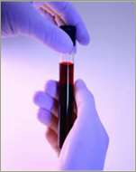
Investigations
Laboratory:
CBC, Coagulation profile, ESR, LDH, ABG
D-dimer:
Sensitive but not specific
Up to 80% of ICU patients have elevated D- dimer in the absence of VTE
More than 500 Mg/mL

Slide 15






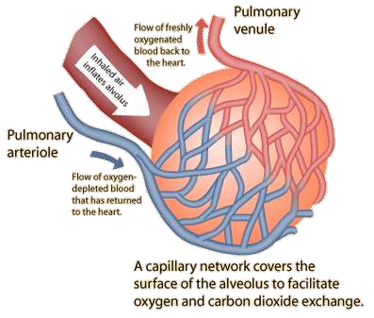
Alveolar-Arterial O2 Gradient
A-a O2 gradient = PaO2 (alveolar) - PaO2 (arterial)
Gradient > 15-20 is considered abnormal.
16

Slide 16

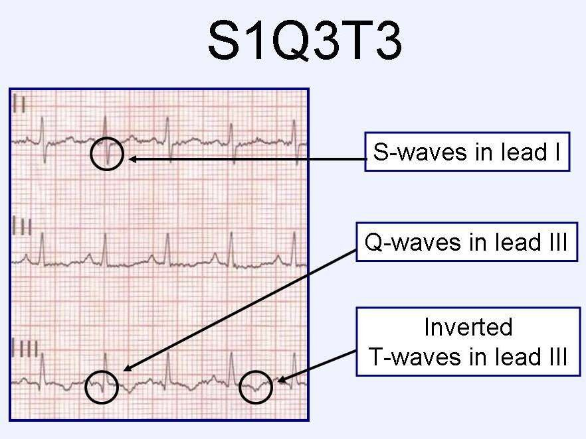
ECG

Slide 17

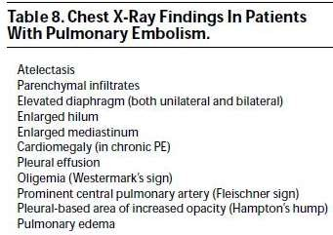
Imaging Investigations

Slide 18
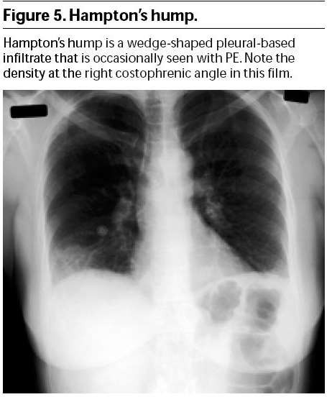

Slide 19




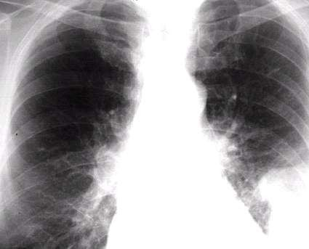
Westermark’s sign
20

Slide 20



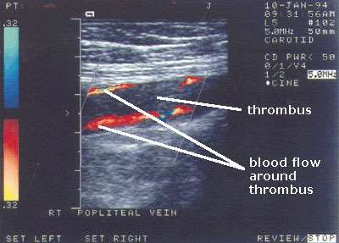
Lower limb venous system Ultrasonography & Doppler
21

Slide 21

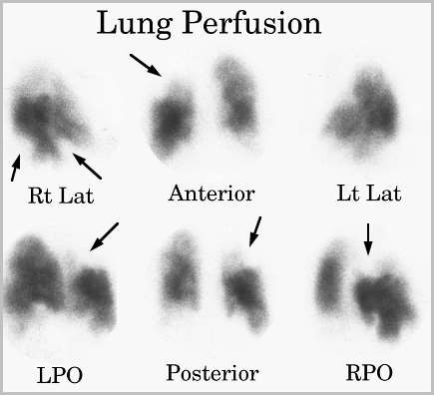
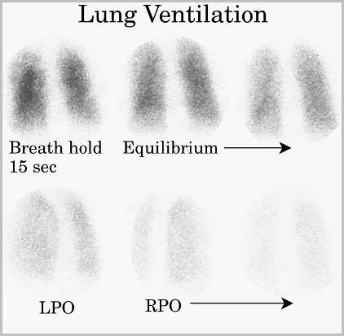
Ventilation/Perfusion Ratio

Slide 22

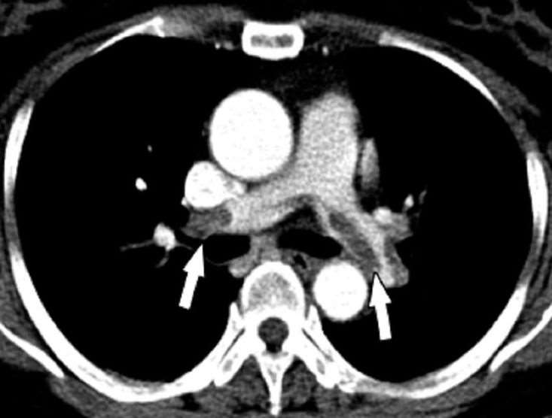
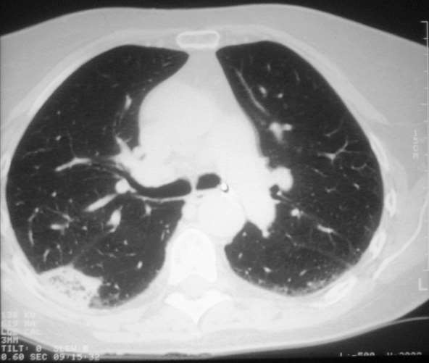
CT Pulmonary Angiography

Slide 23

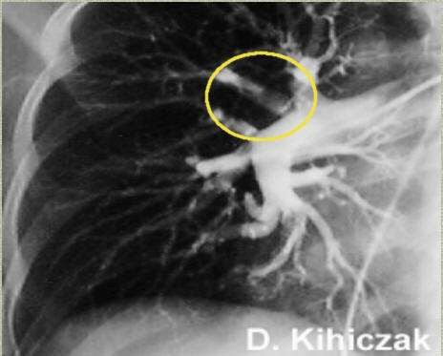
Pulmonary Angiography

Slide 24

Other Tests
Echocardiography
Mc conells sign
Acute RV dysfunction
Cardiac troponin

Slide 25
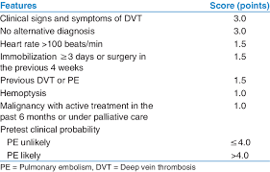
Wells score

Slide 26

Management
Emergency management
Further management: Anticoagulation, Thrombolysis, ......

Slide 27


Resuscitation
ABC
Oxygen 100%
IV access. Send baseline bloods, including clotting profile. Perform ECG
Analgesia: Pethidine, Morphine 5-10 mg IV
Management of cardiogenic shock (fluids and inotropes- Dobutamine)
20/01/2016

Slide 28

Thrombolytic Therapy
Streptokinase, Urokinase, Alteplase
,Recombinant tissue plasminogen activator
Streptokinase 250,000 U over 30 mins
Aim to: Relieve pulmonary vasculature obstruction, Improve right ventricular efficacy, Correct the hemodynamic instability.
28

Slide 29


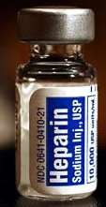
Anticoagulant Therapy
Heparin
5000-10000 Units IV Loading Dose Then 1000 Units/hr IV infusion drip
Duration: 7-10 days OR till clinical improvement
Follow up by PTT (1.5-2.5)
29
20/01/2016

Slide 30






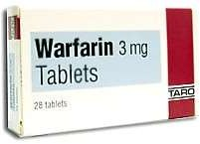
Anticoagulant Therapy Cont’d
Warfarin
2.5-7.5 mg/day Orally
Started with Heparin (5-7 days to start acting)
Duration: 3-6 months
Monitor INR (2-3)
30

Slide 31
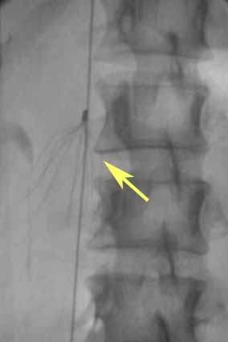
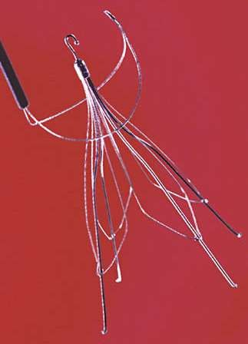
Recurrent DVT & PE: Vena cava filter
3
1

Slide 32

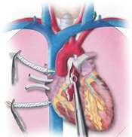
Embolectomy
Surgical Embolectomy
Catheter Embolectomy
Massive life-threatening PE

Slide 33

Complications
Chronic pulmonary hypertension
Respiratory failure
Congestive heart failure
Recurrence

Slide 34


Prevention
Prophylaxis is the single most important measure for ensuring patient safety in hospitalized patients
Compressive stockings, Aspirin, Anticoagulation
Management of risk factors
Follow up

Slide 35
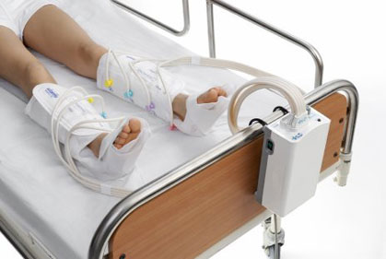
Sequential Compression Device (SCD)

Slide 36
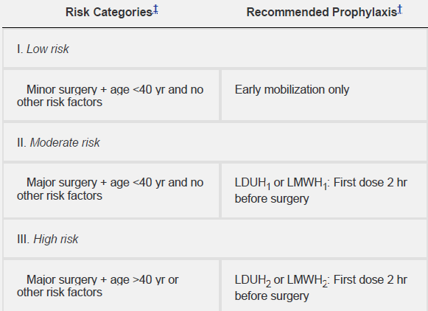
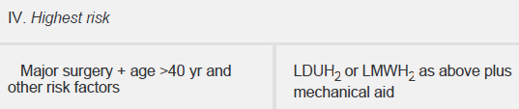
35 20/01/2016

Slide 37
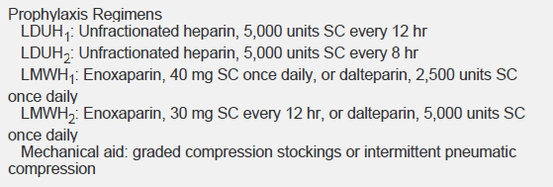

36 20/01/2016

Slide 38

37

