Slide 1
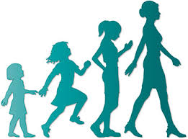
PUBERTY & ADOLESCENCE

Slide 2
ADOLESCENT (latin word:to grow)
ADOLESCENCE OR PUBERTY represents the transitional period linking childhood to adulthood and involves physical,biological and psychosexual changes in a girl.
Varies between the age of 13 and 16 years
10-20% of world population comprises adolescents
Duration of puberty lasts about 2-3 years,and the pubertal changes occur slowly over this period.
WHO Defined Adolescence as progression from appearance of secondary sexual characters to sexual and reproductive maturity and development of adult mental processes.

Slide 3
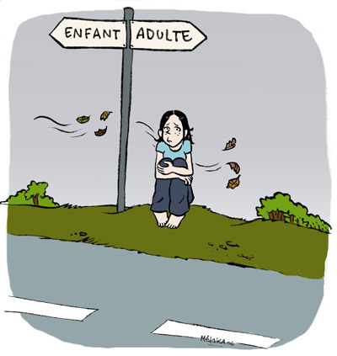
STAGES OF ADOLESCENCE.
EARLY ADOLESCENCE:11-14 YEARS.
MIDDLE ADOLESCENCE:14-17 YEARS.
LATE ADOLESCENCE:18-21 YEARS.

Slide 4
PUBERTY.(LATIN WORD: adulthood)
PUBERTY is the state of becoming functionally capable of procreation.
This is usually accepted as occuring at the age of 12 years in girls and 14 years in boys,but full reproductive capacity is not usually attained until later.
Puberty is characterised by physical sexual differentiation and by the onset of activity of the sex.
Puberty is really the firstpart of adolescence,the remainder being concerned with the mental and emotional adaptation to sexual function and with the development of full maturity.

Slide 5
Pubertal changes.
Physical,endocrinological,genital,psychological and emotional changes that occur during puberty are modulated by the interaction of various hormones secreted through the hypothalamo-pituitary-ovarian axis as well as thyroid and adrenal glands.
However,exact trigger that initiates and stimulates the axis is not known.
Hereditary,environment, nutrition ,emotional stress and childhood illness can influence the onset of puberty.

Slide 6
In developed countries,good nutrition induces puberty at an earlier age.
Stress,vigorous exercise and dieting can delay the pubertal process.
Obesity exerts considerable influence on the onset of puberty.
Leptin is a peptide secreted by the fat cells,which regulates the eating behaviour and energy balance.
Higher its level,earlier is the menarche through stimulation of neuroendocrine chain of events.
Obese girl,growth spurt and menarche start earlier.
However,oestrogen thereby produced closes the epiphyses of bones and final growth gets stunted.

Slide 7
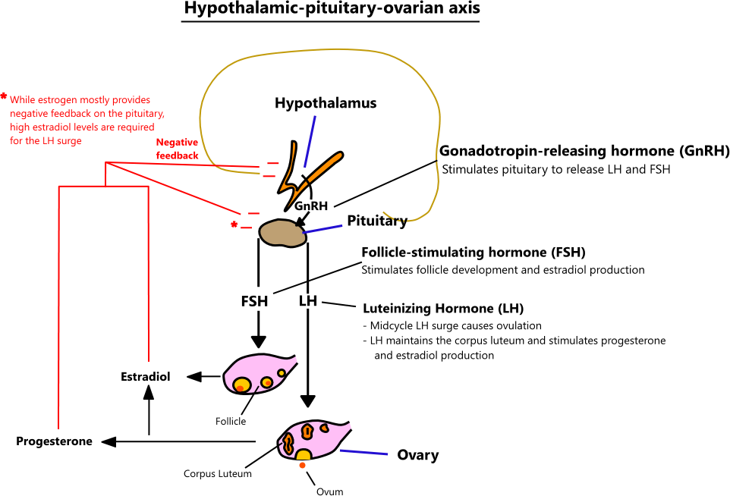

Slide 8
5 changes of puberty in a normal girl.
Physical growth and weight gain,
Development of secondary sex organs and breast development around 10-12 years.
Pubic and axillary hair growth a year later.
Development of ovaries and the genital organs.
Growth spurt and menstruation.

Slide 9
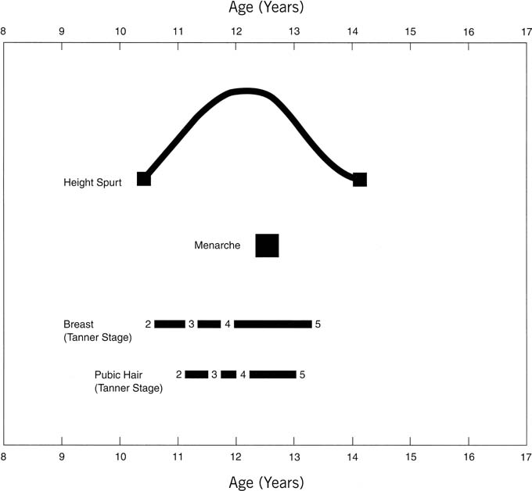

Slide 10
Normal Pubertal Development
CHARACTERISTICS | AGE RANGE.
GROWTH SPURT BEGINS | 8-13 YEARS.
BREAST DEVELOPMENT BEGINS | 12-18 YEARS
BREAST DEVELOPMENT COMPLETE | 14-18YEARS
PUBIC HAIR APPEARS | 9-14 YEARS
MENARCHE | 10-16 YEARS

Slide 11
ADOLESCENCE starts with
THELARCHE(development of Breast buds),
PUBARCHE(development of pubic hair),
ADRENARCHE(development of axillary hair),
MENARCHE(first menstruation).

Slide 12
Tanners stagin of development of breast
Stage | Breast
1 | Elevation of papilla
2 | Elevation of breast and papilla as a small mound increased areolar diameter(9.8 years)
3 | further enlargement without seperation of breast and areola(11.2 years)
4 | Secondary mound of areola and papilla above breast(12.5 years)
5 | Recession of areola to contour of breast (14.6 years)

Slide 13
Tanners staging of development of pubic hair
Stages | PUBIC HAIR.
1 | No pubic hair
2 | Sparse,long pigmented hair mainly along labia majora(10.5 years)
3 | Dark coarse,curled hair sparsely spread over mons(11.4 years)
4 | Adult-type,abundant hair,but limited to the mons(12 years)
5 | Adult type spread in quantity & distribution(13.6 years)

Slide 14
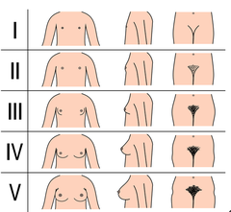

Slide 15
Genital organs.
Vulva develops into labia majora with deposition of fat.
Skin,under the influence of oestrogen,becomes keratinized and resistant to infection
Vaginal mucosa becomes multilayered with formation of superficial layer containing mature squammous cells release glycogen content,appearence of Doderlein’s bacilli forms lactic acid maintains vaginal ph at 4.5
Uterus grows rapidly,so prepubertal ratio of uterus/cervix of 1:1 changes to 2:1 or 3:1
Ovaries enlarge and primordial follicles start growing into graffian follicles,under the hypothalamic and gonadotropin stimulus.

Slide 16
With the HPO axis functioning,and graffian follicular maturation,oestrogen is secreted by the granulosa and this hormone brings about the breast and genital organ changes by entering into the cytoplasmic and nuclear receptors.
Although graffian follicles grow and mature,dominant follicle with ovulation doesnot occur in about 50% cases at menarche.
Ovulation may occur as late as 1-2 years after menarche and until then the menstrual cycles are anovulatory.

Slide 17
MENSTRUATION.
Menstruation (Menarche) and the final growth spurt occur only after the secondary sexual characters(breast and hair) are fully formed in most of the cases.
Oestrogen effect on the closure of epiphyses of the bones determines the final height of the girl.
Menstruation begins when the bone age is around 13-14 years and it is unusual for the menstruation to begin before the bone age of 12.5 years and after 14.5years of age.

Slide 18
If a girl menstruates before the secondary sexual characters develop,it is considered abnormal and is often due to feminizing ovarian tumour/lower genital tract malignancy.
50% girls,menstrual cycles are anovulatory,intial menstrual periods may be irregular,prolonged,scanty or excessive without dysmenorrhoea.
Development of secondary sexual characters and the growth in the height may continue for a few months to a years after the onset of menarche upto the age of 16 years.
Assessment of bone age by x-ray of non-dominant hand,elbow and knee is used to assess pubertal age.

Slide 19
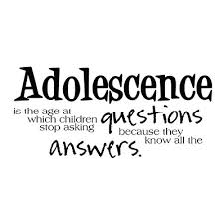
Management.
Girls can be guided regarding the expectation of menarche,personal hygine and nutrition.
Knowledge on sexually transmitted disease(STD).
When promiscuity prevails,barrier method of contraception,OCP are suggested.
This will prevent unwanted pregnancy and MTP

Slide 20
Adolescents gynaecological problems
Precocious Puberty.
Delayed Puberty.
Menstrual Irregularities.
Dysmenorrhoea, Abdominal Pain.
Vaginal disharge.
Acne,
Obesity ,
Unwanted Pregnancy.
Cryptomenorrhoea.

Slide 21
Delayed Puberty.
Puberty(10%)is considered delayed when the secondary sexual characters donot appear by the age of 14 and menarche is not establised by the age of 16 years of age.
Familial /Idiopathic
Delayed puberty cause anxiety to the girl as well to parents.
Family history of delayed puberty in mother/sisters are significant.
Most of the girls develop secondary sexual characters and establish menarche.

Slide 22
Causes of delayed puberty.
Development of secondary sexual characters,but no menstruation.
Either due to absent uterus or due to imperforate hymen or vagina(Cryptomenorrhoea)
Pituitary & hypothalamic inadequacy:The radiography of sella turcica and lower hormonal levels of FSH and LH will confirm the diagnosis.
Ovarian causes(FSH level high)
          Turner’s Syndrome,
          Resistant Ovary,
          Autoimmune disease.

Slide 23

Polycystic ovarian disease(PCOD) and testicular feminizing syndrome.
Malnutrition,
Anorexia nervosa,
Vigorous exercise
Atheletics
Hypothyroidism.

Slide 24

Precocious Puberty.
Precocious puberty is th appearence of appropriate secondary sexual characters before the age of 8 years and occurence of menstruation before 10 years of chronological age.

Slide 25
Causes of precocious Puberty
Most common cause is (75%constitutional(True/complete) due to premature activation of the HPO axis.
Secondary sexual characters appear in their chronological order and regular menstrual cycles are then established.
This cause initial spurt in the height followed by premature closure of epiphysis with the result the ultimate height remains stunted.
It is desirable to suppress the menstruation for few years until right age.

Slide 26
GNRH 100microgram intranasally bd 3-6 months.
Depot GNRH 3.6mg im for 3-6months once a month injection. Pubertal changes resume 3-12 months after stoppage of hormonal theraphy.
Prolonged therapy cause osetoporosis
PSEUDOPUBERTY:
due to gonadotropins/sex steroid stimulation independent of the HPOaxis.
CAUSES:
Pituitary tumours,
encephalitis,
meningitis,
McCune-Albright syndrome,
hydrocephalus.
Ovarian femiizing tumour,(10%)
Adrenal tumours(20%)
Hypothyroidism
Only of one aspect of development of secondary sexual characters occurs. The orderly pattern of puberty is missing.
Rarely,a spurt of oestrogen from graffian follicle cause menstruation.this is followed by amenorrhoea and normal growth pattern, development of secondary sexual characters and onset of menarche

Slide 27
Investigations
Radiography of Pituitary fossa,
CT and MRI.
Ultrasound for ovarian tumours.
Thyroid function test,
Hormonal Profile:FSH,LH,Oestrogen and thyroid hormones.
Radiography for bone age.

Slide 28
Management
Based on the cause
In constitutional precocious puberty,apart from stunted growth,future reproductive capacity is not compromised,and premature menopause is not reported.

Slide 29
Menstrual irregularities
Oligomenorrhoea:
  infrequent menstruation and delay of several months in between is not uncommon in pubertal girls.
  Due to inadequate maturation of HPO axis and inadequate hormonal stimulation
  Menstrual cycles are often anovulatoryin first 1-2 years.
  Causes:
          Mental & physical stress like vigorous exercise,
          Anorexia nervosa(weight <47 kg),
          Hypothyroidism,
          PCOD

Slide 30
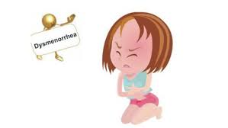
Polymenorrhoea
It is rare and often caused by corpus luteal defect
Treatment:
    Progestogen during the postovulatory phase to prolong the cycle.
    DYSMENORRHOEA
        Primary dysmenorrhoea common in
        Adolescents in characterized by spasmodic
        Pain beginning with the onset of
        Menstruation and lasting for 12-24hrs.
        Caused by PG E2 anf F2alpha
        which cause vasoconstriction and
        Myometrial contractions.
        Pain impair day 2 day activities.

Slide 31
Secondary dysmenorrhoea:
    PID,
    Endometriosis,
    Uterine fibroid,
    TREATMENT:
    Analgesics,
    Anti-inflammatory drugs like Mefenamic acid,naproxen.
    Unicornuate uterus :one sided Dysmenorrhoea
    Abdominal tumour associated with pain:
    Haematometra,
    haematocolpos, ovarian tumours, abdominal tuberculosis.

Slide 32
Vaginal discharge.
Vaginal discharge is physiological
Whitish,mucoid,non smelling and non irritant secretion
Juvenile diabetes and prolongrd antibioyic therapy Can cause monilial vaginitis.
ACNE:
      Common among adolescent girls and creates anxiety and worry over her looks.
      Treatment: 2 mg of cyproterone acetate starting on day 1 of cycle for 21 days cyclically over few months.
      Cimetidine 1.5mg daily (galactorrhoea & expensive)
      Dianette pill 35 micro gram E2.

Slide 33


