Slide 1
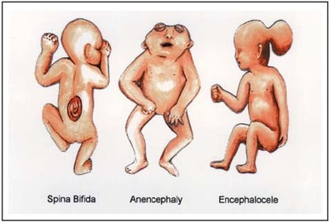
SCREENING FOR NEURAL TUBE DEFECTS

Slide 2
Neural tube defects
These are the defects that result from the incomplete closure of the neural tube by the embryonic age of 26 to 28 days .
Second most common class of congenital anomalies after cardiac anomalies
Incidence being 1.6 per 1000 live births in the United states and 8 per 1000 in the united kingdom

Slide 3
Risk factors
95% of the NTDs occur in the absence of any recognized risk factor of family history, hence the need for routine screening
Specific risk factors include the following:
GENETIC CAUSE
Family history-multifactorial inheritance
MTHFR mutation-677 C-T
Syndromes with autosomal recessive inheritance like
Meckel Gruber
Roberts
Joubert
Jarcho-Levin
HARDE-hydrocephalus-agyria-retinal dysplasia-encephalocele

Slide 4
Aneuploidy
Trisomy 13
Trisomy 18
Triploidy
Exposure to certain environmental agents
Diabetes-hyperglycemia
Hyperthermia
Medications: Valproic acid, Carbamazepine, Coumadin, Aminopterin, Thalidomide, Efavirenz
Geographical region-ethnicity, diet and other factors
UK, India, China, Egypt, Mexico, South Appalachian United States

Slide 5
Recurrence risk of NTDs
4% if the couple had previously a child with anencephaly or spina bifida
5% if one of the parents was born with NTD
As high as 10% if a couple has 2 affected children
With folic acid supplementation the risk after one affected child decreases by 70% i.e to less than 1%

Slide 6
In 1970s Brock and associates observed that pregnancies complicated by NTDs had higher levels of alpha-fetoprotein(AFP) in maternal serum and amniotic fluid
Thus forming the basis for first maternal serum screening test for a birth defect
United kingdom Collaborative study on AFP in relation to NTDs in 1977 also demonstrated the efficacy of maternal serum AFP screening for NTDs
Maternal serum AFP concentration at 16-18 weeks was found to exceed 2.5 multiples of median (MoM) in 88% of the women carrying foetuses with anencephaly and in 79% with spina bifida

Slide 7
Alpha-Fetoprotein(AFP)
Glycoprotein synthesized early in gestation by foetal yolk sac followed later on by the foetal gastrointestinal tract and liver
Major serum protein in the embryo-foetus
Analogous to albumin
It’s concentration increases steadily in the foetal serum and amniotic fluid until 13 weeks and then rapidly declines
On the other hand in the maternal serum it steadily increases in quantity after 12 weeks
Foetal plasma level is about 150 times greater than amniotic fluid concentration and 50,000 times greater than maternal serum concentration

Slide 8
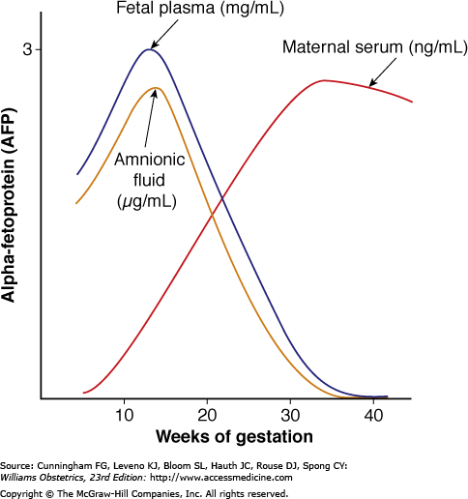

Slide 9
Maternal serum AFP screening
The American College of Obstetricians and Gynecologists (2003) recommend that all women be offered 2nd trimester screening
As a component of multiple marker serum screening between 15 and 20 weeks
Maternal serum AFP is measured in ng/ml and reported as MoM of the unaffected population
With 2.0 or 2.5 MoM as the upper limit of the normal, most laboratories report a
Sensitivity detection rate of 90% for anencephaly and 80% for spina bifida
Positive predictive value of those with AFP elevation who have an affected foetus is only 2-6%
Hence an abnormal screening test must be followed by councelling and consideration for a diagnostic test

Slide 10
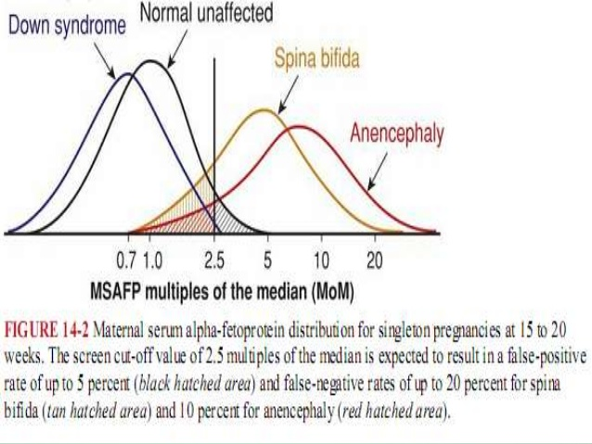
Overlap in AFP distributions in affected and unaffected pregnancies

Slide 11
Factors affecting the maternal serum AFP level:
Maternal weight:
AFP is a foetal product measured in maternal circulation, hence accurate maternal weight reflects the volume of distribution
Gestational age:
MSAFP concentration increases by approximately 15% per week during 2nd trimester
Race or ethnicity:
African-American women have 10% higher serum AFP despite having lower risk of NTDs

Slide 12
Diabetes:
Women with overt diabetes despite having 3-4 fold increased risk for NTDs have 20% lower serum levels of AFP when compared to thenon-diabetics
Multifoetal gestation:
AFP is considered elevated in a twin pregnancy if greater than 3.5 MoM (Parkland hosp), but other laboratories use 4.0 or even 5.0 MoM.
With sonographic examination, we can reliably exclude 3 common causes of AFP elevation i.e underestimated gestational age, multifetal gestation, and foetal demise

Slide 13
Conditions associated with abnormal MSAFP concentration
ELEVATED LEVELS:
Uderestimated gestational age
Multifoetal gestation
Neural tube defects
Gastroschisis
Omphalocele
Low maternal weight
Eosophageal and intestinal obstruction
Liver necrosis
Cystic hygroma

Slide 14
Sacrococcygeal teratoma
Urinary obstruction
Renal anomalies- polycystic kidneys, renal agenesis
Congenital skin defects
Chorioangioma of placenta
Oligohydramnios
Preeclampsia
Maternal hepatoma or teratoma

Slide 15
LOW LEVELS
Obesity
Diabetes
Chromosomal trisomies
Gestational trophoblastic disease
Overestimated gestational age

Slide 16
Evaluation of elevated MSAFP
Women with abnormally elevated MSAFP should be referred for genetic councelling and must be offered a diagnostic test like a sonographical examination and amniocentesis
Those with certain risk factors but with normal serum AFP levels are also offered diagnostic testing
Risk factors include
Personal history of NTD
First degree relative with NTD
Insulin-dependent diabetes
First trimester exposure to medications associated with increased NTD risk

Slide 17
MSAFP determined as a part of multiple marker screening at 15-20 wks
AFP value (MoM) adjusted for maternal age, weight, insulin dependent diabetes
AFP value of < 2 MoM
AFP value of > 2 MoM
Normal screening test
Sonographic examination to verify gest age, to exclude twins or foetal demise

Slide 18
Sonographic examination to verify gest age, to exclude twins or foetal demise
AFP value of < 2.5 MoM
AFP value > 2.5 MoM
Normal screening test
Abnormal result, patient councelled, offered specialized sonography, consideration for amniocentesis

Slide 19
Specialized sonography
Findings seen in cases of NTDs
LEMON SIGN- frontal bone scalloping
BANANA SIGN- bowing of the
cerebellum with effacement of cisterna magna
Small biparietal diameter
Ventriculomegaly
Seen in second trimester foetuses with open spina bifida
Watson and associates reported that 99% of the foetuses with open spina bifida had one or more of these findings
Transverse and saggital views of the spine are used tocharacterize the size and location of spinal defects
Overall NTD risk may be reduced by atleast 95% when no spine or cranial abnormalities are observed

Slide 20
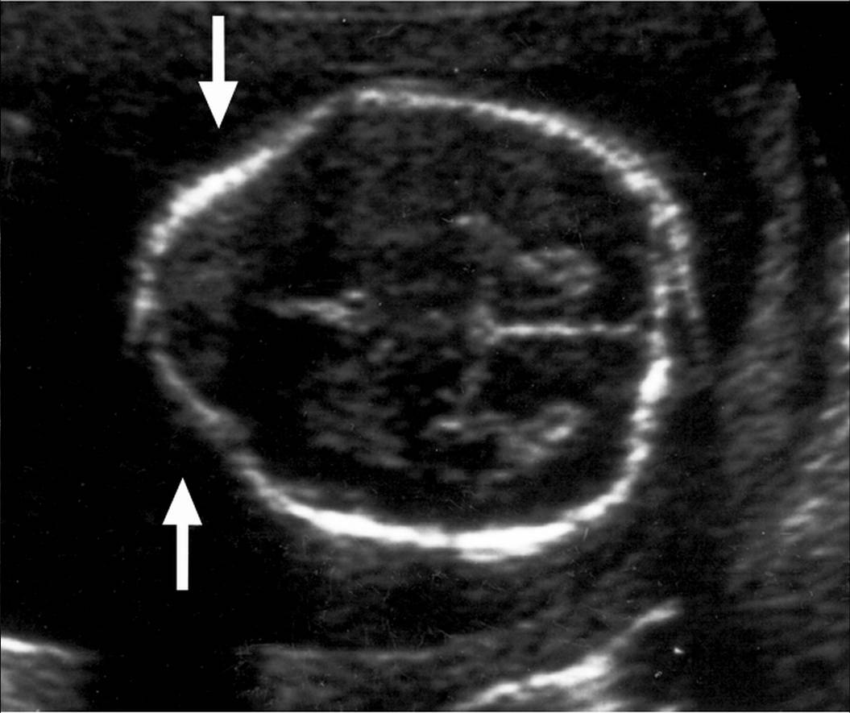
LEMON SIGN

Slide 21
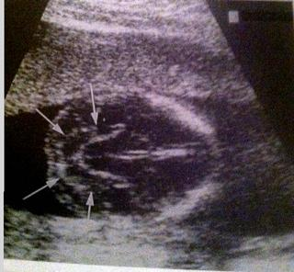
BANANA SIGN

Slide 22
AMNIOCENTESIS
Until recently an elevated MSAFP prompted amniocentesis to determine amniotic fluid AFP level
If this was also elevated, assay for acetylcholinesterase was performed
If positive, was considered diagnostic of NTD
Overall sensitivity is about 98% for open NTDs with false positive rate of 0.4 %
Conditions associated with elevated amniotic fluid AFP levels and positive assay for acetyl cholinesterase include
Ventral wall defects, oesophageal atresia, cloacal extrophy, foetal teratoma, epidermolysis bullosa
It was once considered as the gold standard for diagnosis of open NTDs but in many centres is now replaced by specialized sonography

Slide 23
Unexplained MSAFP elevation
When no foetal or placental abnormality is detected after specialized sonography, with or without amniocentesis, the AFP elevation is considered unexplained.
Such pregnancies are at an increased risk for adverse outcomes like foetal anomaly not detectable prenatally, foetal growth restriction, oligohydramnios, placental abruption, PROM, preterm birth and even foetal death
Prenatal care for such women is usually not altered unless some specific complication arises
Most women with unexplained AFP elevation have normal outcomes

