Slide 1
GROSS ANATOMY OF UTERUS

Slide 2
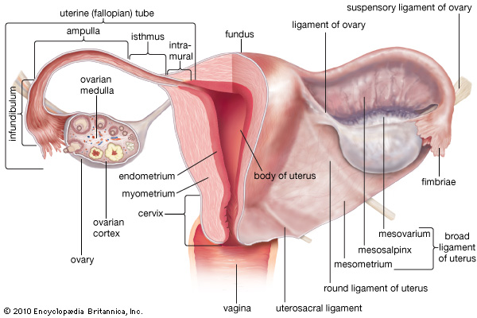
Uterus is a hollow pyriform muscular organ situated in the pelvis between the bladder and rectum

Slide 3
Measurement - it is 8cm long , 5cm long at fundus and its walls are 1.25cm thick.
Its weight varies from50-80gm.
Parts – body or corpus
isthmus
cervix

Slide 4
The body is further divided into fundus , that lies above the opening of fallopian tubes.
The body proper is triangular and lies between the opening of tubes and isthmus.
Isthmus is the constricted part measuring about 0.5cm, situated between the body and cervix. It is limited above by the anatomical internal os and below by histological os (aschoff)

Slide 5
Cervix is fusiform In shape and measures about 2.5cm. It extends from the isthmus and ends at the external os which opens into the vagina .
The part lying above the vagina is supravaginal portion of cervix and the part which lies within the vagina is vaginal portion of cervix.

Slide 6
Anterior relations : above the internal os ,the body forms the posterior wall of the uterovesical pouch.
Below the internal os , it is separated from the base of the bladder by loose areolar tissue
Posterior relations – it is covered with peritoneum and forms anterior wall of pouch of douglas.

Slide 7
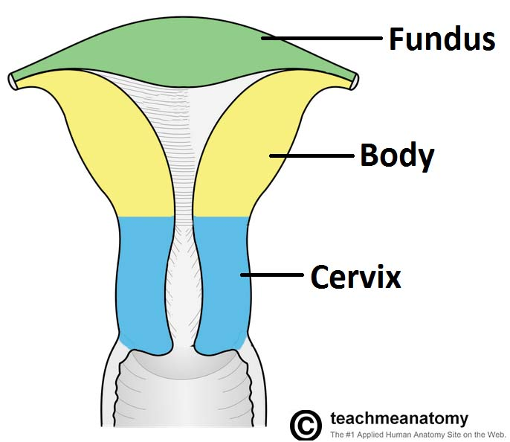

Slide 8
Laterally – the double fold of peritoneum of the broad ligament are attached between which the uterine artery ascend up.
Layers
Parametrium-it is the serous coat which invest the entire organ except on the lateral borders
Myometrium – it consist of thick bundles of smooth muscle fibres held by connective tissues and are arranged in various directions.
During pregnancy,3 different layers can be identified-outer longitudnal, middle interlacing and inner circular
Endometrium- mucous lining cavity is called endometrium . There is no submucous layer

Slide 9
The surface epithelium is a single layer ciliated columnar epithelium .
The lamina propria contains stromal cells,endometrial glands, vessels , nerves.
Glands are simple tubular and lined by mucus secreting non ciliated columnar epithelium
Cervix is composed mainly of fibrous connective tissue. Only posterior surface has peritoneal coat.
Secretion of cervix is alkaline and thick , rich in mucoprotein , fructose and sodium chloride.

Slide 10
The peritoneum covering the superior surface of the bladder reflects over the anterior surface of uterus at the level of isthmus . the pouch so formed,is called utero-vesical pouch.
The peritoneum there after, is firmly attached to the anterior and posterior wall of uterus and upper 1/3 of posterior vaginal wall where from it is reflected over the rectum. The pouch so formed is called pouch of douglas.

Slide 11
Traced laterally , the adherant peritoneum of the anterior and posterior walls of the uterus is continuous laterally forming broad ligament.
Laterally, it extends to the lateral pelvic walls where the layers reflect to cover the anterior and posterior aspect of pelvic cavity.

Slide 12
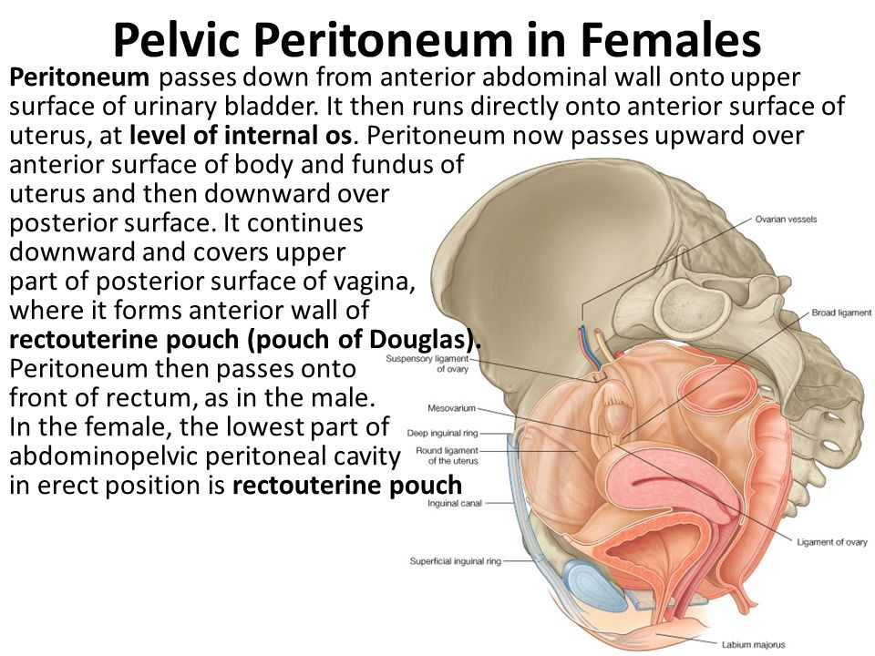

Slide 13
On its superior border ,lies the fallopian tube and on the posterior layer, the ovary Is attached by mesovarium.
It is a short peritoneal fold connecting the anterior border of the ovary with the posterior layer of the broad ligament of uterus.

Slide 14
Fallopian tube
They are paired structures , measuring 10cm and forms the superior border of broad ligament.
4 parts :
intramural or interstitial part – lying in the uterine wall and measures 1.25cm in length and 1mm in diameter
Isthmus –measures 3-4 cm In length and 2mm in diameter.
Ampulla – tortous part 5 cm in length and ends in
Infundibulum measuring about 1.25 cm with diameter of 6mm.

Slide 15
Contents of broad ligament
1. fallopian tube
2. round lig of ovary
3. ovarian ligament
4. uterine vessels
5. ovarian vessels in ip ligament.
6. uterovaginal and ovarian nerve plexus
7. epoophoron
8. paraoophoron
9. lymph nodes and lymph vessels
10.Dense connective tissue or parametrium present on both the sides of uterus

Slide 16
Infundibulopelvic ligament also known as suspensory ligament of ovary .
attachment – medially attached to upper pole of ovary and infundibulum part of tube and laterally attached to lateral pelvic wall.
Contents : ovarian artery
ovarian veins
ovarian nerve plexus
lymphatic vessel

Slide 17
Blood supply
arterial supply – uterine artery
anastomosis between uterine ovarian and vaginal arteries.
Nerve supply – sympathetic
motor – T5 and T6
sensory – T10 to L1
Parasympathetic – S2 , S3 , S4

Slide 18
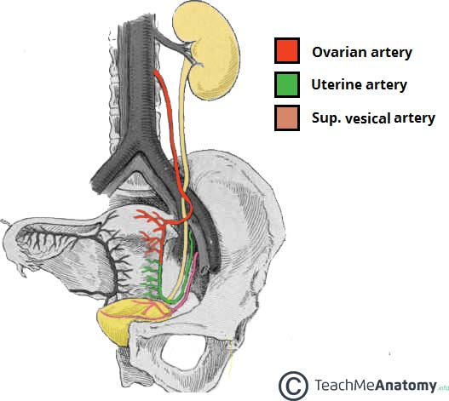

Slide 19
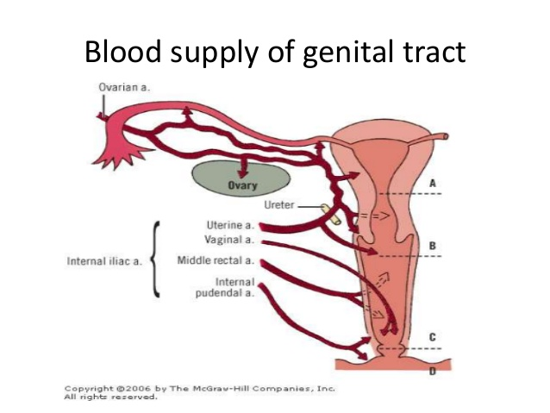

Slide 20
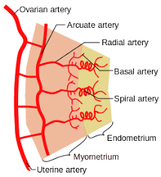

Slide 21
LYMPHATIC SUPPLY
Body – from the fundus an upper part of the uterus , the lymphatics drain into pre aortic and lateral aortic groups of glands
Cornu drains into superficial inguinal gland along the round ligament .
Lower part of the body drains into external iliac groups.
Cervix – on each side, the lymphatics rain into
External iliac , obturator lymph nodes either directly or through para – cervical lymph nodes
Internal iliac groups
Sacral groups.

Slide 22
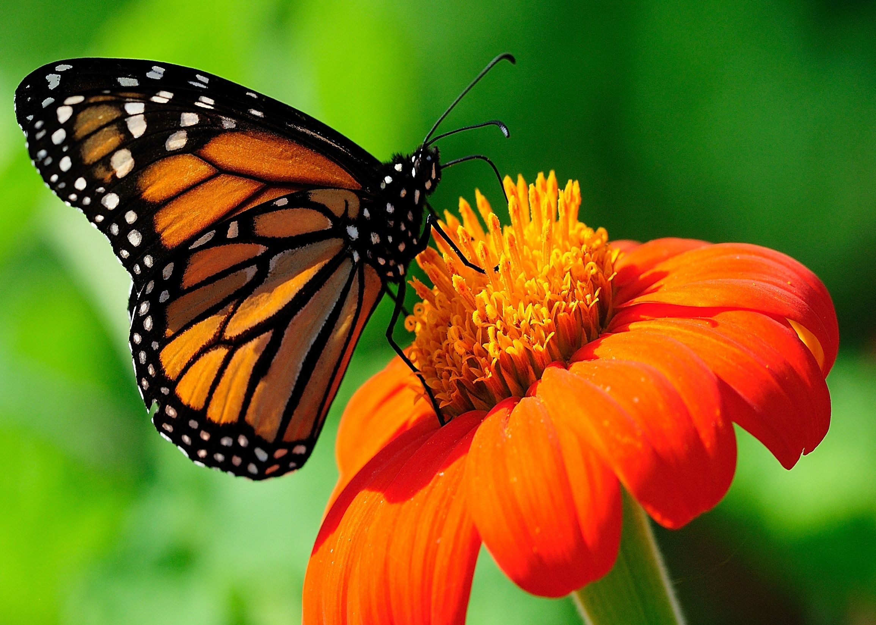
Thankyou

