Slide 1
Temporary methods of Male Contraception.

Slide 2
INTRODUCTION.
Progress in male technology is much less than that of the female.
Age-old standard methods such as vasectomy,condoms and less reliable natural methods.
An increasing emphasis on male involvement in family planning.
Recent studies, suggest that many men & women want to share the responsibilty of contraception .
Standard male methods of contraception account for only 30% of worldwide contraceptive use.

Slide 3
Natural methods.
The withdrawal method(coitus interruptus).
Periodical abstinence particularly in mid cycle
are only two natural methods of contraception for males.

Slide 4
Withdrawal method.(Coitus interruptus)
Coitus takes place in a normal manner but the penis is withdrawn immediately before ejaculation.
The unreliability of this method is obvious,but it has the advantage that it costs nothing and it requires no device.
Pregnancy rate of 25 per 100 women years.

Slide 5
Main causes of failure.
Is not the ejaculation occurs inside the vagina but the prostratic fluid secreted prior to ejaculation,frequently contains active spermatozoa.
This practice may imposes a great strain upon the husband and cause considerable anxiety.
Some couples prefer this method and make no complaints of suffering from anxiety or strain.

Slide 6
Advantages.
No cost,
No contraindications,
No effect on lactation,
No systemic side effects,
No religious bar.

Slide 7
Disadvantages.
Failure rate is high,
Requires motivation,
Only successful in educated couples,
No protection against HIV & STD.
It should be remembered ‘ something is better than nothing’.

Slide 8

CONDOMS.
Introduction:
Condoms are contraceptive sheaths meant to cover the penis during coitus to prevent pregnancy.
BRAND NAMES:Nirodh & Durex.
The name condom is derived from latin word ’condus’ which means receptacle.
In India,spermicidal condoms are supplied in blister packs.
Spermicidal agents:Non-oxynol-9.

Slide 9
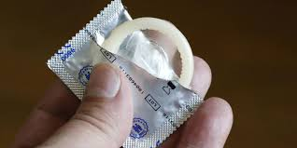
Types & Distribution.
Condoms are mostly made of fine latex rubber and are available in various shapes & colours.
They are circular cylinder,
15-20cm in length,
3-3.5cm in diameter,
0.003-0.007 cm in thickness,
They are closed at one end and open at other with an integral rim.
Some of them are teatended.
They are available in dry or semidry,prelubricated forms,the latter being much more popular.
Silicon is used nowadays to produce semi-dry,prelubricated forms.
Condoms are packed rolled on to the rim,and usually sealed hermetically in aluminium or plastic foil packets of 3-12 or in blister packs.

Slide 10
In India,dry condoms are manufactured and supplied free of cost by the Government under the brand name ‘Nirodh’ through the family welfare clinics.
Some varieties of condoms like ‘Nirodh Deluxe’ and ‘Nirodh lubricated’ are supplied at subsidised rates through chemist’s shops,surgical stores,grocer’s shops and small vendor’s shops.
Non-latex forms of ale condoms are now commercially made of polyurethane.
Polyurethane condoms have a longer shelf life and can be used with oil-based lubricants,which can damage latex condoms.
However they break and slip more often during intercourse or withdrawal than latex condoms.
A new form of male condom made of SEBS,a synthetic material like Tactylon has been developed .

Slide 11
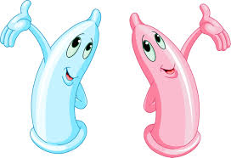
Trade names
Dry type:
  Nirodh,
  Durapac,
  Kohioor.
Prelubricated:
  Nirodh lubricated,
  Durex,
Spermicidal condom:
  Share,
  Rakshak

Slide 12
Average span of life of condoms is 5 years form the date of manufacture.
They should be kept in cool and dryplaces, sunrays,heat and moisture cause deterioration of conditions of condoms.
prevents STD transmitted from skin –skin contact such as HPV and herpes virus.

Slide 13
Uses of condoms.
For 12 ejaculations following vasectomy,as these ejaculations may contain sperms from the ejaculatory duct.
For 3 months ,condom use is advocsted,if sperm antibodies are the cause of infertility.
To prevent transmission of gonococcal,chlamydia,
Syphilis,trichomonal & fungal infection.
Especially ,it has an important role in transmission of HIV from one partner to the other.

Slide 14
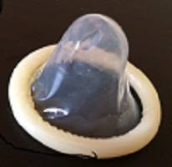
The risk of transmission of infection after one intercourse from male to female is 60-80%
But reduced to 40% with condom use.
The transmission from female to male is 20% and reduced by 75% with the use of condom.

Slide 15
Advantages.
It is easily available,cheap,easy to carry,free from side effects and requires no instruction.
It emphasizes the male involvement in contraceptive effort and is immediately effective.
It prevents sperm allergy.
It has no adverse effect on pregnancy,should the method fail.

Slide 16

The occurence of cancer of the cervix is low amongst women whose partners use condom because sexual transmission of the viral infection causing this disease is prevented.
When used for more than 5 years,barrier methods particularly the condom reduces the chance of developing severe cervical dysplasia & cervical cancer as compared to the use of oral pills or to non-use of contraceptive.
This has been found by the Oxford study in Britain an verified by other studies.

Slide 17
Disadvantages.
The method is only partially reliable,having a pregnancy rate of 10-14 per 100 woman years.
This is due to bursting of the condom or slipping and partly due to non-compliance.
Occasionaly , a women develops vaginal irritation to the latex.(Hypersensitization).
Storage & disposal problems affect village people and reduces use of condoms.
They should be wrapped in apiece of paper and thrown in dustbins or buried underneath soil,but should never be left in commodes/flushing type latrine pans.

Slide 18
Medical eligibility criteria.
CATEGORY 4(Contraindications)
NONE.
Category 3
Allergy to latex.
High risk pregnancy in case of failure,

Slide 19
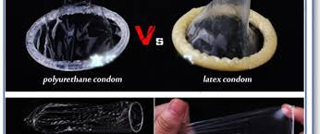
Condom Selection.
Pre lubricated condoms versus non-lubricated; without lubrications, there might be more chance of intravaginal breakage.
Ultrathin condoms are more prone to breakage.

Slide 20
Side effect.
Only one medical condition prevents use of condoms,
Severe allergy.
Latex rubber:
Severe redness,itching,swelling after condom use.

Slide 21
They are also suitable for use in
Old couples,
who have infrequent coitus,
during lactation,
during holidays,
for subjects who cannot tolerate oral pills and IUDs,
For teenagers particularly to prevent illegal pregnancies and
For those who have problems of premature ejaculation.

Slide 22
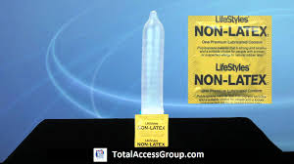
Condoms use during pregnancy ,particularly in the later months, gives some protection against amniotic fluid infections.

Slide 23
Effectiveness
Average failure rate of condom is 12% (WHO)
But only 3% when used correctly & consistenly.
Low failure rates are obtained by those who use good quality condoms regularly & promptly during each act of coitus & spermicidal condoms are used.
Condoms breakage & slippage donot always lead to pregnancy but certainly reduce the protection against pregnancy aswell as STDs including AIDS.sss

Slide 24
Failures are due to
Bursting & slippage of the condom,
Errors in the technique such as
  The condom after some semen has escaped into the vagina,
    Irregular use,
  Escape of semen from the condom owing to delayed withdrawal
  Failure to leave dead space of air in the condom.

Slide 25
Direction of use.
The condom should be put on by unrolling it onto the erect penis after pulling back the foreskin and before there is any contact between the male & female organs.
An air free space should be left by squeezing the tip and holding it up till the condom is unrolled fully for better collection of semen if the condom has got any teat.
A prelubricated condom is preferrable.

Slide 26
It should be used only once.
It should not be inflated to test:
  Vaseline,
  Oils,
  Skin lotions,
  Cold creams,
  Butter or margarine should not be used as they increase the chance of rupture.
If lubrication is needed,glycerine ,K-Y jelly or spermicidal jelly can be used.
Soon after the discharge,the male sould withdraw penis,holding the condom firmly against his body.
The condom should be thrown away & the penis dried before further contact with the female genital areas.

Slide 27
To increase the effectiveness, a dose of spermicidal cream,jelly or foam tablet may be used at the same time.
In case of breakage,slippage or defective use, women should report or use emergency contraception within 72 hours and a spermicidal agent should quickly be inserted into the vagina.

Slide 28
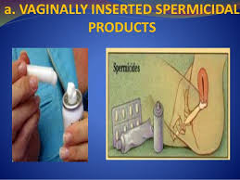
Spermicidal Agents.
Spermicidal agents kill the sperms before the latter gain access to the cervical canal.
The spermicidal agents remians effective for 1-2 hours after the application.

Slide 29
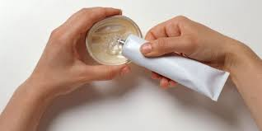
These chemical contraceptives agents contain surfactants such as
Nonoxynol-9,
Octoxynol-9,
Menfegol.
Chemicals capable of destroying sperms incorporated into an inert base.

Slide 30
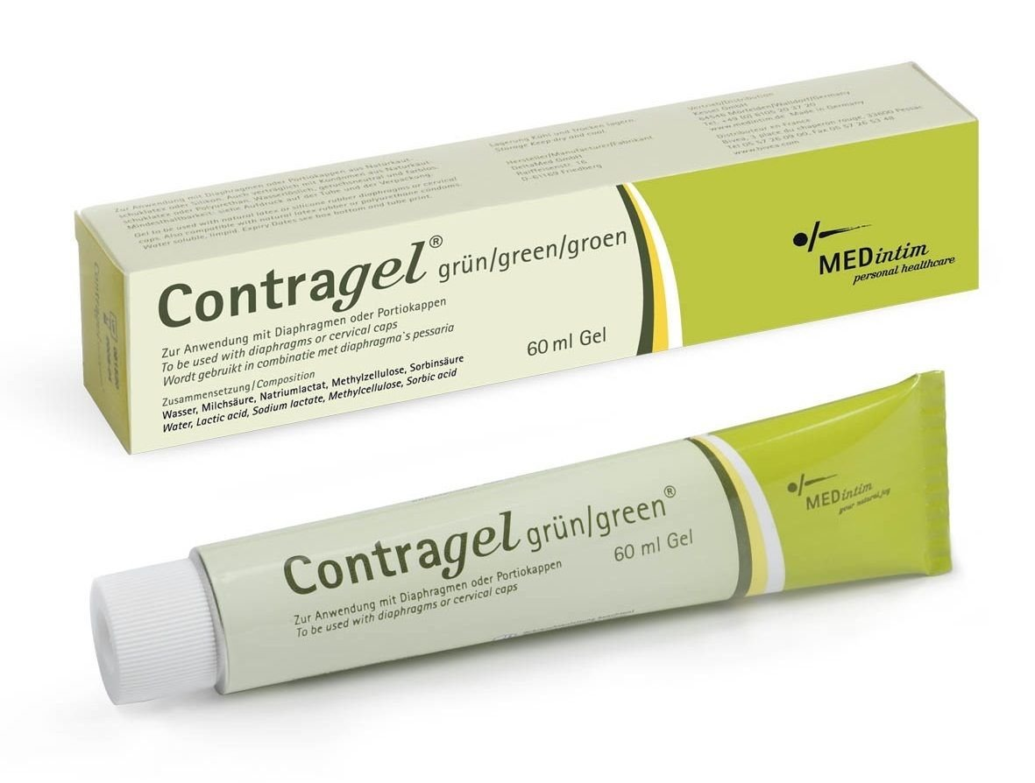
Mechanism of action.
Spemicidal agents contain non-ionic surfactants .
Which alter sperm surface membrane permeability,
Causing osmotic changes resulting in killing of sperms

Slide 31
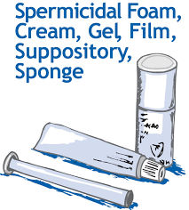
Forms of spermicides.
Chemical suppositories,
Contraceptive creams and jellies,
Foam tablets,
Aerosols or foams,
C-film.

Slide 32
Chemical suppositories.
Also known as contraceptive suppositories,vaginal pessaries or tablets.
Cheapest,most convinent and readily available,but least effective.
Suppositories incorporate spermicidal agent in a base consisting of glycerine,gelatin or wax,melting at body temperature and are meant for manual insertion high up in the vagina about 10-15 min before the sexual act.
Trade names:GP soluble pessaries,Lorophyn & Staycept vaginal pessary,orthtoforms,etc;

Slide 33
Contraceptive creams & jellies.
Spermicidal ingredient is mixed with a gelatinous water-soluble base in jellies and with a stearate soap base in creams.
Jellies liquefy at a lower temperature than most creams and are more suitable for women with dry vagina.
Both liquefy at body temperature and disperse rapidly through vagina.
There is no difference in reliability,cost and method of use between the creams & jellies.
Commercial preparations:volper jelly,koromex cream,Preciptin jelly.

Slide 34
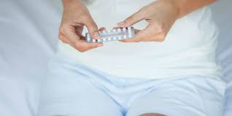
Foam tablets.
They incorporate an active spermicide with foaming ingredients,with effervesce in contact with vaginal moisture.
They are placed deep in the vagina close to the cervix.

Slide 35
Mechanism of Action.
Foam is caused by the action of acid on sodium bicarbonate in the prescence of watery vaginal discharge.
They are more effective than soluble tablets .
Effervescent material is claimed to act as a better physical barrier,occluding the cervix and to enter the interstices where live spermatozoa may remains.
PREPARATIONS:Durafoam tab,Joy tab,Arloid foam tab.

Slide 36
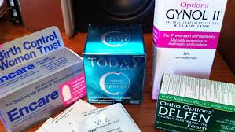
‘Today’-vaginal foam
Superior action is due to a unique combined melting and foaming action that not only immobilises sperm but also blocks their cervical opening.
Tab is used vaginally,about 10 min before act, and the action lasts for 1 hour.
Failure rate:0.3-5 per 100 women years.

Slide 37
Aerosols or foams
Foaming chemical contraceptive creams with a butane propellant contained under pressure in a strong bottles,from which they may be released into an applicator by pressing a valve,for insertion into the vagina.
Slightly more effective than foaming tablets but are less popular .
Trade names:Emco vaginal foam.Delfen vaginal foam.

Slide 38
C-Film.
Also known as contraceptive fim,C-film consists of 5cm squares of water soluble,semitransparent pastic impregnanted with non-oxynol-9.
C-film dissolves rapidly in the vagina and releases spermicide.
It is either placed over glans penis just before coitus or inserted with fingers high up in the vagina,preferably over the cervix 3-4 min before sexual act.
Active for 2 hours,

Slide 39

Methods & direction for Use.
They are inserted with the women lying on her back or standing upright with the left leg placed on a raised platform and bending forward.
The spermicidal agents/tabs are pushed up high in the vagina till they reach near the cervix and should be inserted within half-n-hour before the sexual act,including 10 in to allow tablet melt inside the vaginal canal.

Slide 40
Creams,jellies and foams are inserted through plastic or metal applicators.
The tube is screwed to the applicator and is pressed that plunger goes as far as it can.
The applicator is unscrewed and is introduced into the vaginal canal for about 7-10 cm in the lying position with the body bent forward.
The pluger of the applicator is pushed so that spermicide is placed near the cervix.
½ hour before sexual act.
If intercourse is repeated,full dose of spermicide must be reinforced before habd.

Slide 41
Usually one full applicator is used.
If intercourse is repeated,the full dose of spermicide must be reinforced before hand.
No douching is permitted within 8 hours.
The applicator should be cleaned with soap & water before storage.

Slide 42
Advantages.
Easily available,
easy to use,
No gross medical side effects,

Slide 43
Disadvantages.
By causing irritation and abrasion in chronic use,they can cause vaginal ulceration and perhaps increase the risk of HIV spread rather than prevent it.
Therefore,the spermicidal agents should not be recommended to HIV couples.

Slide 44
Used alone failure rate is high,approximately 30 per 100 women years.
Failure rate is 21%
6% when used correctly & consitently.
When used in conjunction with a mechanical barrier,they give a reliable contraceptive effect.
A new spermicidal cream, Tenofovir,prevents viral attachement to the vaginal mucosa and is non-irritant and is under development.

Slide 45
The use of condoms with spermicidal agents and postcoital agents as back up technique in avoiding pregnancy.
Praneem from neem is spermicidal and prevents transmission of sexually transmitted infections.
This is under trial.

Slide 46
Medical eligibility criteria.
Category 4(contraindications)
Clients with high risk for HIV infection,
Clients who are HIV positive,
Clients who have AIDS.
Category 2 (Advantages outweigh risks)
Clients who have high risk of pregnancy.
Sensitivity to a spermicide,
Cervical cancer.

Slide 47
Supression of spermatogenesis.
Hormonal methods.
Non-Hormonal agents.

Slide 48
Hormonal methods.
Different hormones,used either singly or in combinations:
Androgen:
  Testosterone enanthate.
  Testosterone buciclate,
Progestogen:
  Depot Medroxy Progesterone acetate
  Antiandrogens and progestogen:
  Cyproterone acetate,
  Testosterone undecanote

Slide 49
All these hormones produce their effect and their mostly by inhibiting gonadotrpin LH, which supresses spermatogenesis,as well as FSH, which suppresses testosterone secretion.
They produce azoospermia and oligospermia of varying degrees in the rest.
Anti-spermatogenetic effect is reversible.
No short term bad effects have been observed except lowering of the testosterone level affecting sex masculinism,organs and their functions.
This problem needs replacement of testosterone.

Slide 50
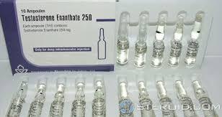
TESTOSTERONE ENANTHATE.
Dosage:
200mg testosterone enanthate weekly causes azospermia in 6-12 months.

Slide 51
SIDE EFFECTS.
Osteopenia,
Liver &Lipid metabolism dysfunction,
(Lowering of HDL)
Prostrate enlargement,
Muscle and behavioural changes.

Slide 52
Testosterone buciclate
600mg testosterone buciclate 3 monthly is also effective through negative feedback mechanism without loss of libido.
Effect lasts for 12 weeks.
This drug alone or in combination with some progestogen may be of immense value for male contraception.

Slide 53
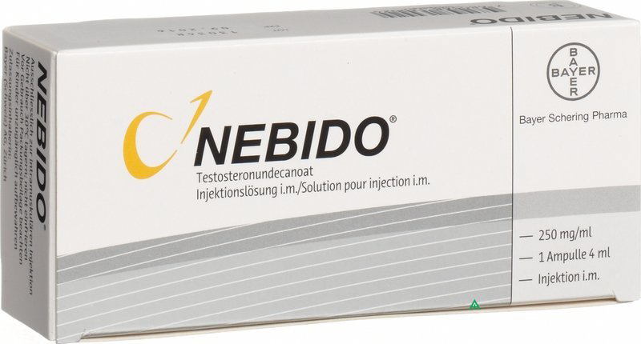
Testosterone undeconate
Instead of weekly injection,testosterone decanoate 1000mg IM followed by 500mg 4 weekly is more convenient for 2 years.
These are biodegradable testosterone microcapsules and testosterone pellets.

Slide 54
Progestogen-androgen combination.
Oral progestogen pills stop spermatogenesis by inhibiting gonadotropins,but physiological replacement of testosterone is essential for sexual functions.
Progestogen pills + testosterone injections or implanrts have great potential for male contraception.
Combined administration of levonorgestrel pill with testosterone inj induces more rapid and effective of spermatogenesis.

Slide 55
This combination reduces the HDL,which protects against coronary heart disease to about the same extent as does testosterone alone.
To avoid adverse effect,a less androgenic progestogen pill,desogestrel+ long acting testosterone that is released slowly,without peaks and troughs associated with TE.
4 implants of 200mg each of testosterone every 4-6months with 300mg Medroxyprogesterone 3 monthly is successful in 96% cases with count is less than 1 million/ml

Slide 56
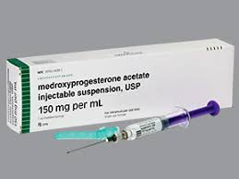
Medroxyprogesterone Acetate.
MPA 250mg intramuscularly with 200mg norethisterone given as weekly injections is reported to supress spermatogenesis

Slide 57
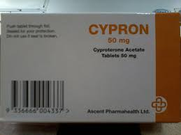
Cyproterone acetate.
Progestogen with anti androgenic property.
CPA, a low dose of 12.5 mg/day+
TE 100mg injection per week for 16 weeks has produced complete azospermia in about 9-10 weeks.
No biochemical ill effect was observed.
Azoospermia has been achieved more readily without any side effects.

Slide 58
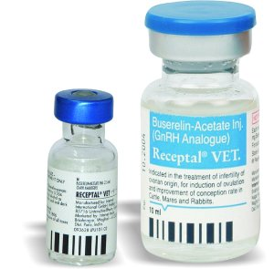
GnRH analogues.
GnRH antagonists is more effective in the suppression of gondotropin and spermatogenesis than GnRH agonists.

Slide 59
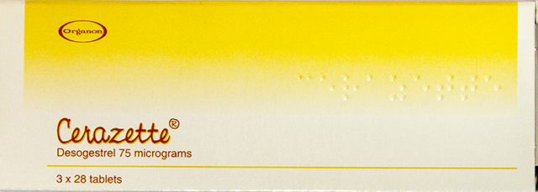
Desogestrel.
It has androgenic property.
75-300mcg daily with subcutaneous pellets of testosterone.
300mcg causes oligospermia,without altering the level of HDL.

Slide 60
The hormonalsuppression of spermatogenesis causes loss of libido and is toxic in high doses.
Besides,the injection of hormones is inconvenient to adminster regularly.
Acne,weight gain and decreased HDL are other side effects.
Immunological methods of suppressing spermatogenesis have not yet been successful.
Synthetic hormone-MENT used as substitute of testosterone-no side effects.

Slide 61
Non-hormonal agents.
Gossypol,
Triptergium wilfordii products,
RISUG(Reversible Inhibition of Sperm Under Guidance),
Intra Vas device,
Plant compound Pills.

Slide 62
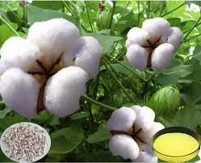
GOSSYPOL.
Its use as a male contraceptive was discovered in china.
Gossypol is a yellow pigment isolated from cottonseed oil.
DOSAGE:It is administered orally 10-20mg daily for 3 months,thereafter 20 mg twice weekly.
It is disequiterpine aldehyde obtained from the seed,stem and roots of the cotton plant and is now available in a highly purified form.

Slide 63
Effects of Gossupol.
Inhibiting spermatogenesis,
Decreasing epididymal sperm motility &
Affecting conversion of proacrosin to acrosin.
Gossypol acetic acid and gossypol formic acid were tried.
Gossypol acetic acid was administered along with potassium supplement.

Slide 64
MECHANISM OF ACTION.
The action is directly on the seminiferous tubules inhibiting spermatogenesis without altering FSH and LH levels.

Slide 65
SIDE EFFECTS OF GOSSYPOL.
Weakness,
Hypokalemia,-→hypokalemic paralysis(1% users),
Permanent sterility in 20% cases limit its use,

Slide 66
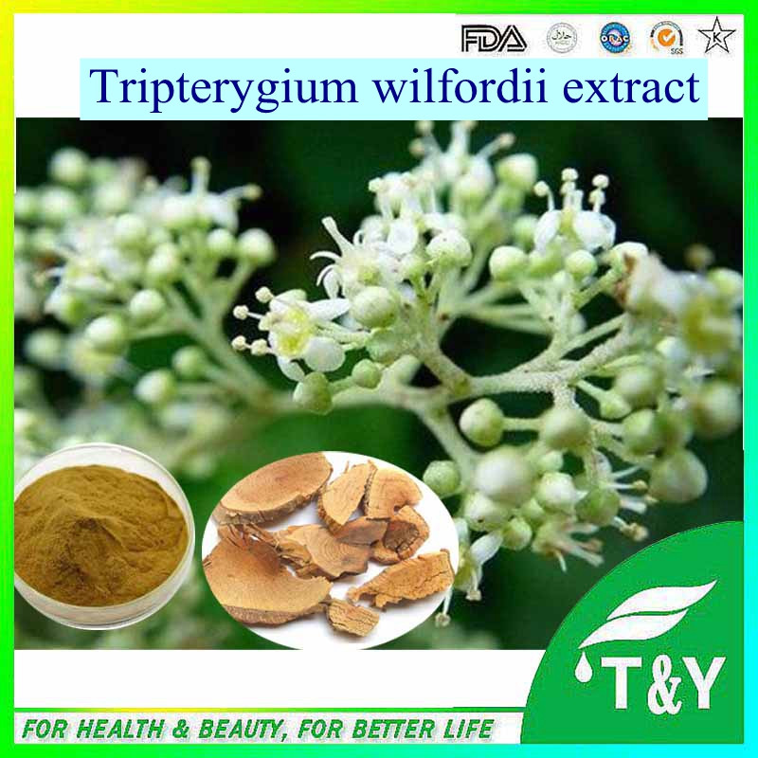
Tripterygium wilfordii products.
T.wilfordii is used in chinese herbal medicine to treat inflammation,rheumatoid arthritis and psoriasis.
The antifertility property of the plant was first reported in china, and its effect on sperm stored in the epididymis.
A compound,triptolide,isolated from the plant’s root,is thought to be the most active agent,it may have an effect late in process of sperm production.

Slide 67
RISUG(Reversible Inhibition of Sperm Under Guidance).
RISUG is a clear polymer gel made of styrene maleic anhydride (SMA) mixed with Dimethyl sulphoxide(DMSO).
It was developed in the Indian Institute of Technology and the AIMS,India.

Slide 68
Mechanism of action.
RSIUG is injected into the vas deferens in the testis,
It when RISUG partially blocks the Vas,
Preventing sperms from coming into the ejaculate.
Studies shows that sperms reappear is flushed out with DMSO or sodium bicarbonate or non-invasively by massage,vibration and the low level electric current.

Slide 69
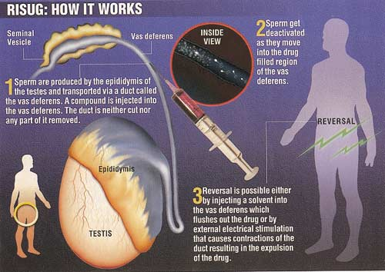

Slide 70
Intra vas device.
Intra vas device (IVD) originally called Shug.
It is a device (plug) that is implanted in the vas deferens.
IVD resulted in no sperm reaching the ejaculted normal numbers of sperm again.
However, the method requires special technological skills like that of the ‘No scalpel method’ of vasectomy.
Wider trials are needed.

Slide 71
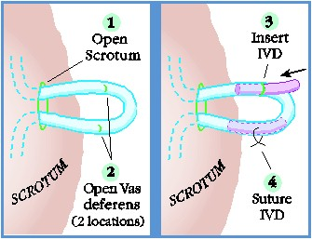
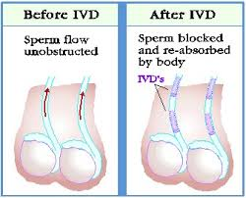

Slide 72
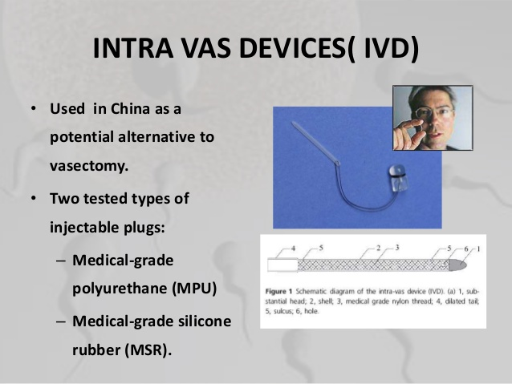

Slide 73
Plant Compound Pills.
Attempts are being made to isolate newer isomers of gossypol and try their antifertility effects.
The toxicity of these products willbe keenly watched,however,the use of gossypol is being discouraged by some workers.
Oral compound such as triptolide,extracted from the chinese plant T.wilfordii is being investigated by the WHO for its anti fertility effect.

Slide 74
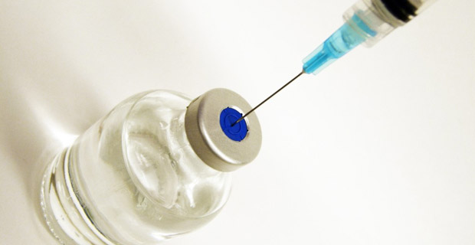
MALE VACCINE.
Antisperm surface antigens so as to develop a contraceptive vaccine which will hinder sperm-egg union without bad side effects.
Antisperm vaccine.

Slide 75
Antisperm vaccine.
Passive or active immunization against FSH has not been successful.
Anti-GnRh vaccines for fertility control has shown bad effects on sex organs of both males & females and inconsisitent effect on spermatogenesis.
Based on the immunological capacities of sperm-surface antigens.
This will prevent conception by hindering sperm-ovum union.s

Slide 76
The feasibilty of development of a antisperm vaccine indicating that auto-or –iso immunity against sperm Ag is a cause of prolonged infertility in some men & women.
Anti-sperm Antibodies provoke immobilisation and /or agglutination of sperms and dimuntion of fertility,treatment of such cases with immune suppressive therapy results in conception.
Following vasectomy,40-60% males develop anti-sperm antibodies,the prolonged effects of these antibodies lead to a high failure rate,following surgical reversal of vasectomy.

Slide 77
Sperm-surface antigens that include PH 20 antigen,95KD antigen and SP10 antigen.
However,identification,purification and synthesis of specific antisperm antigens are all great tasks which have not yet been completed.

Slide 78
An LHRH vaccine has the potentia to block fertility in men and women as well as pets and to treat sex hormone dependent cancers and prostratic hypertrophy.
However,this vaccine may affect sex sterooids,so it is not acceptable for humans.

Slide 79


