Slide 1
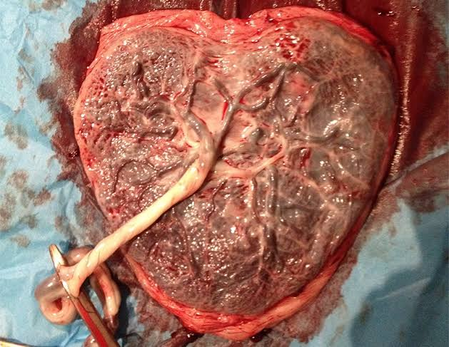
THE PLACENTA

Slide 2
THE PLACENTA
It is a FETOMATERNAL ORGAN
Only eutherian mammals possess placenta
The human placenta is
-DISCOID ( because of its shape)
-HEMOCHORIAL ( because of direct contact of chorion with maternal blood)
-DECIDUATE (because it shed at parturition)

Slide 3
DECIDUA
It is the endometrium of pregnant uterus
Structures of decidua
-superficial compact layer
-intermediate spongy layer ( cavernous layer)
Cleavage of placental separation occurs through this layer
-thin basal layer
regeneration of mucous coat following parturition occurs from this layer

Slide 4
DECIDUA
After interstitial implantation decidual layers are renamed as
- Decidua basalis or serotina
- Decidua capsularis or reflexa
- Decidua vera or parietalis

Slide 5
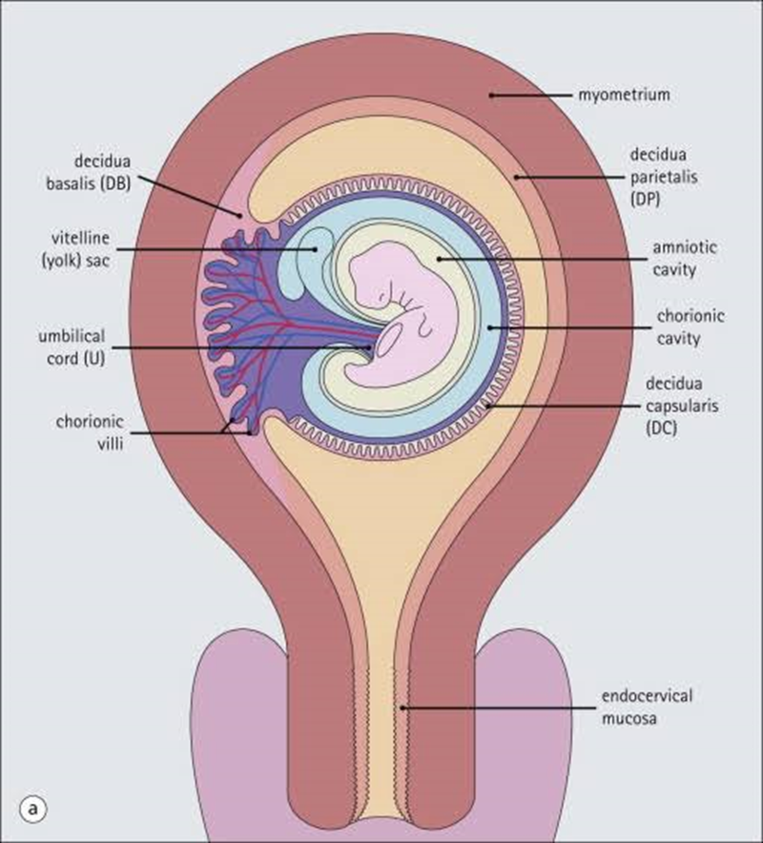
DECIDUA LAYERS

Slide 6
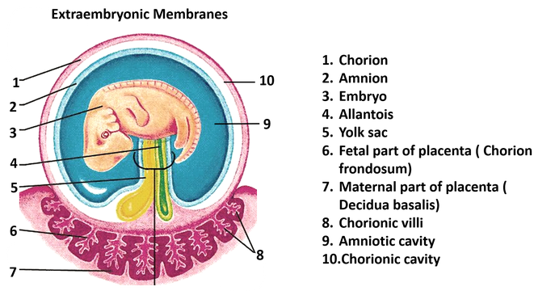
DEVELOPMENT OF PLACENTA
Developed from 2 sources
fetal component - develops from chorion frondosum
maternal component - from decidua basalis

Slide 7
11th day – interstitial implantation is completed
13th day – stem villi develops from trabeculae which connects the chorionic plate with basal plate
21st day – Arterio- capillary-venous system in mesenchymal core of villus is copleted
(thus connection with intraembryonic vascular system is formed through body stalk)
3rd -4th week – multiloculated intervillous space formed lined by syncytium

Slide 8
Untill the beginning of 8th week entire chorionic sac is covered with villi
As the sac grows by 6th week villi in decidua basalis is retained leading to exuberant growth of villi and forms CHORION FRONDOSUM
but viili in decidua capsularis is compressed leading to the convertion of chorion to CHORION LAEVE

Slide 9
CHORION FRONDOSUM
+
DECIDUA BASALIS
DISCRETE PLACENTA
Begins at 6th week and completed by 12th week
Till 16th week there is increase in thickness & circumference
Subsequently increases circumerentially till term

Slide 10
STRUCTURES
Consists of two plates
- CHORIONIC PLATE
- BASAL PLATE
Inbetween the plate lies the intervillus space with stem villi

Slide 11
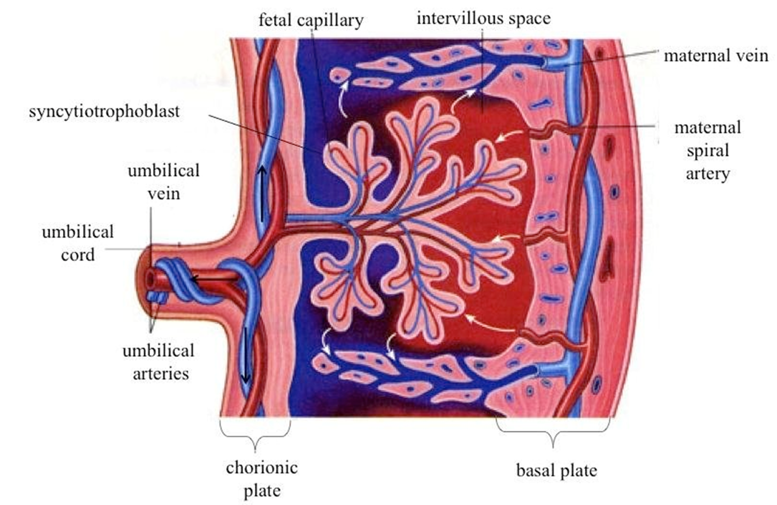

Slide 12
CHORIONIC PLATE
Lined by amniotic membrane
Umbilical cord attached to this plate
Stem villi arrises from this plate
LAYERS
-primitive mesenchymal tissue
- layer of cytotrophoblast
- syncytiotrophoblast

Slide 13
BASAL PLATE
Structures from outside inwards
-compact & spongy layer of decidua basalis
-Nitabuch’s layer
-cytotrophoblastic shell
-syncytiotrophoblast
Spiral arteries from uterine artery perforates basal plate and reaches intervillus space
Decidual septa projects from basal plate into intervillus space and fails to reach the chorionic plate. Space between the septa are COTYLEDONS(LOBES) on maternal side . 15 – 20 in number.

Slide 14
PLACENTAL CIRCULATION
UTEROPLACENTAL CIRCULATION
120-200 spiral arteries opens into intervillous space
Cytotrophoblastic invasion into spiral artries upto interdecidual portion within 12weeks of pregnancy . Musculoelastic media is replaced by fibrinoid material.
Secondary invasion of trophoblast upto radial arteries from 12-16weeks of pregnancy.
Spiral ateries uteroplacental arteries

Slide 15
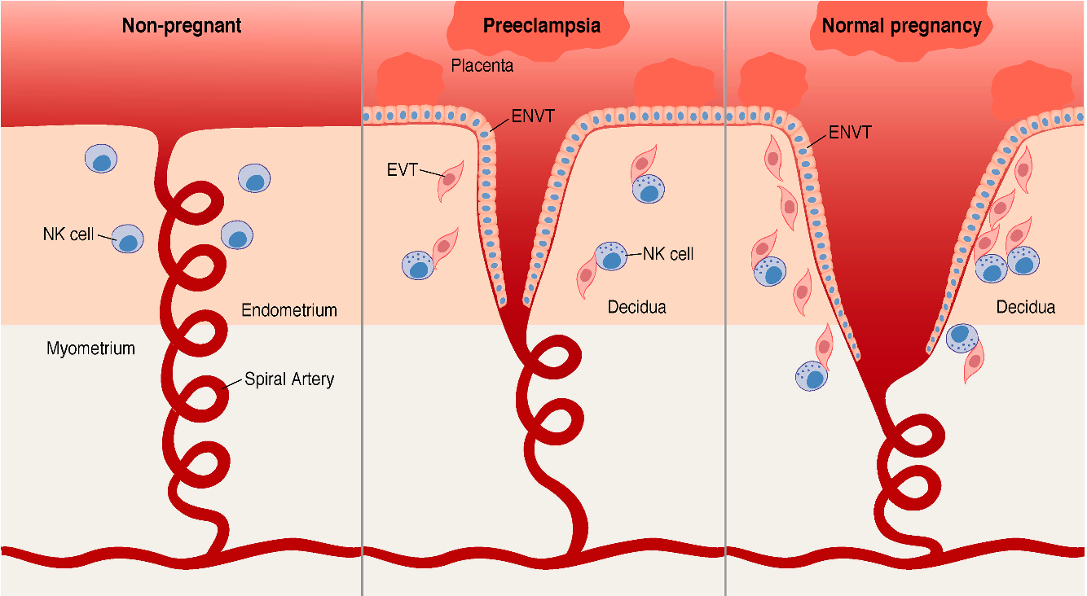

Slide 16
UTEROPLACENTAL CIRCULATION
Volume of mature placenta = 500 ml
Volume in intervillous space = 150 ml
Blood flow in intervillous space = 500-600ml/min
Blood in intervillous space is replaced 3-4 times/min
Pressure in uterine artery = 70-80mmhg
Pressure in intervillous space
during uterine contraction = 30-50mmhg
during uterine relaxation = 10-15mmhg
Pressure in uterine vein = 8mmhg

Slide 17
CIRCULATION IN INTERVILLOUS SPACE
Arterial blood enter the space under pressure
On entering chorion plate dispersion occurs and villi helps in mixing and slowing of blood flow
Stirring by villi and uterine contraction helps migration of blood towards basal plte and to uterine veins
Spiral arteries are perpendicular and veins are parallel to uterine wall.Thus during contraction large volume of blood is available for exchange even though the flow is decreased.

Slide 18
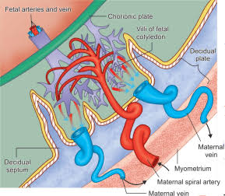
CIRCULATION IN INTERVILLOUS SPACE

Slide 19
FETOPLACENTAL CIRCULATION
Two umbilical artery carry impure blood from the fetus
Two arteries enter the chorionic plate underneath the amnion , each supplying one half of the placenta.
Fetal blood flow through placenta = 400ml/min
Pressure in umbilical artery = 60mmhg
Pressure in umbilical vein = 10mhg
Fetal capillary pressure in villi = 20-40mhg

Slide 20
PLACENTAL BARRIER (PLACENTAL MEMBRANE)
Is a partition between fetal and maternal circulation
It is 0.025mm thick
Layers of placental barrier

Slide 21
PLACENTA AT TERM
Circular disc of 15-20cm in diameter and 3cm thickness at center
Feels spongy 500gm in weight
Occupies 30% of uterine wall
Proportion to the weight of the baby is 1:6 at term
2 surface – fetal & maternal and a peripheral marigin

Slide 22
PLACENTA AT TERM
FETAL SURFACE
Covered by smooth glistening amnion
Umbilical cord attached at or near its center
Branches of umbilical vessels visible beneath the amnion
At term 4/5th of placenta is fetal origin
MATERNAL SURFACE
Rough & spongy . Dull red in colour
Remenent of decidua basalis - thin grayish & shaggy layer
15-20 convex polygonal areas =cotyledons or lobes
1/5th of placenta is maternal origin(only decidua basalis & blood in intervillous space)

Slide 23
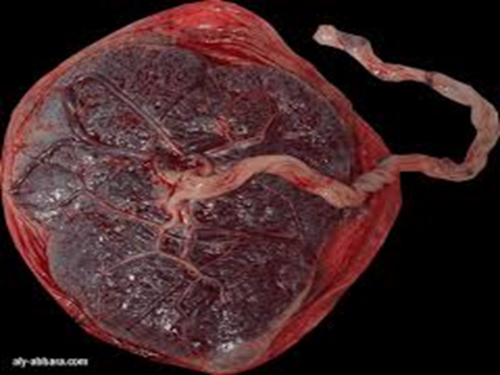
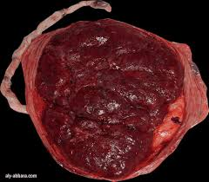
FETAL SURFACE MATERNAL SURFACE

Slide 24
PLACENTAL AGING
Got a limited life span
Aging involves both fetal & maternal component
CHANGES IN VILLI
decrease in thickness of syncytium
Appearance of sycytial knots
Decrease in stromal tissue
Thickening of basement layer of fetal endothelium and the cytotrophoblast
Deposition of fibrin over surface of villi
Some vessels obliterated & capillaries dilated

Slide 25
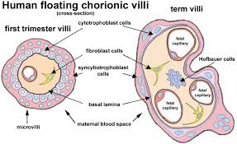

Slide 26
PLACENTAL AGING
DECIDUAL CHANGE
Area of fibrinoid degeneration where trophoblast meets the decidua(NITABUCH’S LAYER)
This is absent in placenta accreta
INTERVILLOUS SPACE
White infarcts- fibrinoid degeneration of syncytium covering the villi ,extending to intervillous space and forms a mass entangling number of villis
Cyst formation or calcification may occur

Slide 27
FUNCTIONS OF PLACENTA
RESPIRATORY , EXCRETORY , NUTRITIVE
ENDOCRINE FUNCTION
IMMUNOLOGICAL FUNCTION
BARRIER FUNCTION
Oxygen supply to the fetus 8ml/kg/min
Cord blood flow of 165-330ml/min

Slide 28
NUTRITIVE FUNCTION
Water & electrolytes = by simple diffusion
Glucose = facilitated diffusion
Aminoacids = active diffusion
Large protein molecules = pinocytosis
EXCRETOR FUNCTION
Urea , uric acid , creatinine = simple diffusion
BARRIER FUNCTION
>500 daltons are held up
Incomplete barrier function , allows passage of antibodies(IgGonly),sedatives,viruse -rubella,smallpox,treponema pallida

Slide 29
ENDOCRINE FUNCTION
Produces protein & steroid hormones
Syncytiotrophoblast is the principle site of protein & steroidhormones in pregnancy
PROTEIN HORMONE
Human chorionic gonadotropin
Human placental lactogen
Pregnancy-specific beta-1 glycoprotein
Early pregnancy factor
STEROID HORMONES
Estrogen
Progesterone

Slide 30
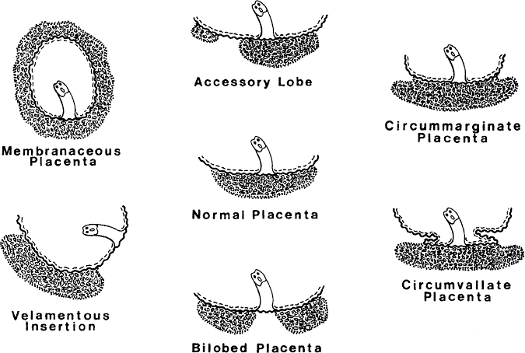
PLACENTAL ABNORMALITIES

Slide 31
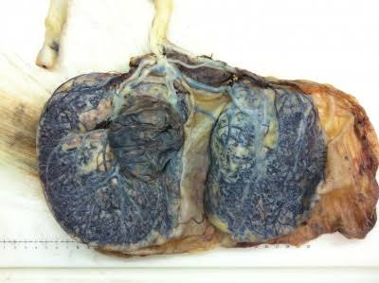
ABNORMALITIES OF PLACENTA
ABNORMAL SHAPE
Placenta bilobata – consists of 2 equal lobes connected by placental tissues

Slide 32
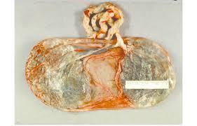
2.Placenta bipartita – 2 equal parts connected by membranes. Umbilical cord inserted in one lobe and branches from vessels cross the membrane to other lobe. Rarely divides into 2.
3.Placenta duplex , triplex – 2 to 3 lobes are separate entirely

Slide 33
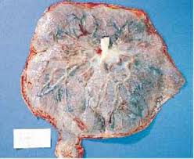
ABNORMAL DIAMETER
PLACENTA MEMBRANACEA
Placenta develops as a thin membranous structure occupying the entire periphery of the chorion. It is large,thin and 30-40 cm in diameter
CLINICAL SIGNIFICANCE
may encroach the lower uterine segment
Imperfect seperation – pph
Chance of retained placenta , manual removal becomes difficult

Slide 34
PLACENTA SUCCENTURIATA
one or more small lobes of placenta may be placed at varying distance from the main placental marigin.
Vessels traverse through membrane to connect main &small lobe
Incidence 3%
Absence of communicating vessels- PLACENTA SPURIA

Slide 35
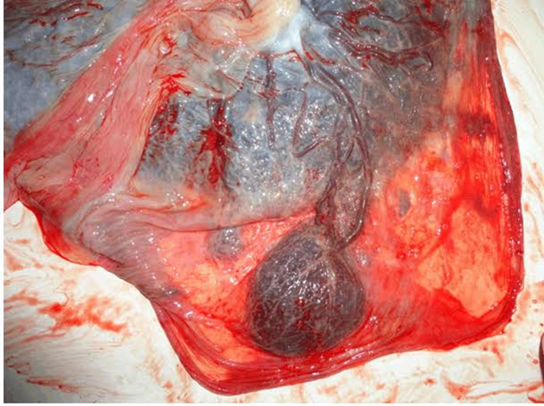
CLINICAL SIGNIFICANCE
Postpartum hemorrhage
Subinvolution
Uterine sepsis
Polyp formation

Slide 36
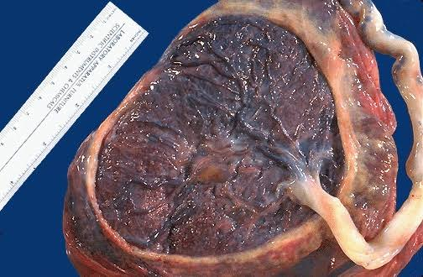
PLACENTA EXTRACHORIALIS
CIRCUMVALLATE PLACENTA
Fetal surface is divided into central depressed zone surrounded by a thickened white ring
CLINICAL SIGNIFICANCE
Antepartum hemorrhage
Growth retardation
Preterm delivery
Retained placenta
2. PLACENTA MARGINATA

Slide 37
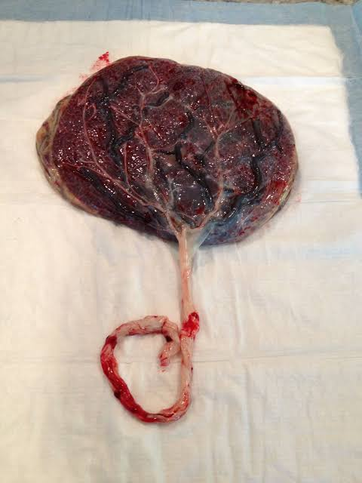
BATTLEDORE PLACENTA
cord is attached to the marigin of placenta
CLINICAL SIGNIFICANCE
associated with low implantation of placenta, there is a chance of cord compression during vaginal delivery

Slide 38
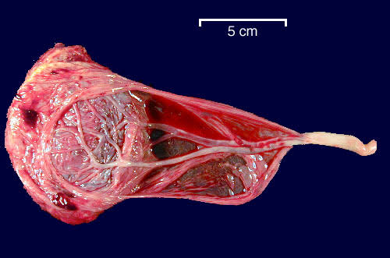
VELAMENTOUS PLACENTA
- cord is attached to the membranes
- branching vessels traverse through the membrane
- vessels in the membrane cross the region of cervical os or below presenting part (VASA PREVIA)

Slide 39
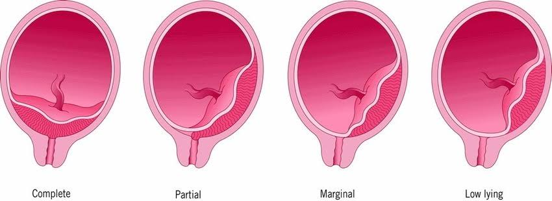
ABNORMAL POSITION
PLACENTA PREVIA- The placenta is partly or completely attached to the lower uterine segment

Slide 40
ABNORMAL ADHESION
PLACENTA ACCRETA – Chorionic villi penetrate deeply into the uterine wall to reach the myometrium , due to the deficient decidua basalis
PLACENTA INCRETA – the villi penetrate deeply into myometrium
PLACENTA PERCRETA – reaching peritoneal coat

Slide 41
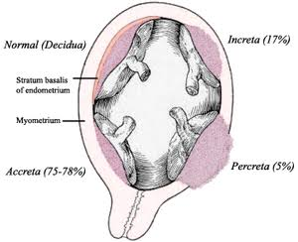

Slide 42
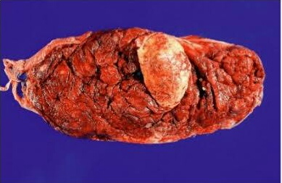
PLACENTAL LESIONS
PLACENTAL INFARCTS
white infarct – due to excessive fibrin deposition(old infarct)
red infarct – due to hemorrhage from maternal vessels of the decidua(fresh)

Slide 43
PLACENTAL TUMOUR
CHORIOANGIOMA – rare benign tumour of placental blood vessels , associated with hydramnios
complication: low birth weight
fetal death / malformations

Slide 44
THANK YOU

