Slide 1
THE UMBLICAL CORD

Slide 2
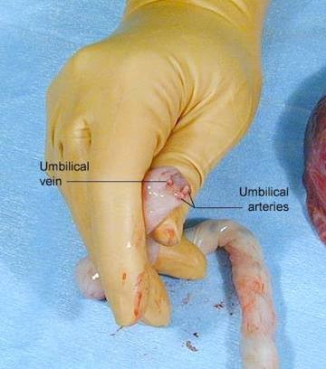
The umblical cord or funis forms the connecting link between the fetus & the placenta through which the fetal blood flows to and from the placenta.
It extends from the fetal umblicus to the fetal surface of the placenta.

Slide 3
CORD DEVELOPMENT.
The umblical cord is developed from the connective stalk or body stalk,which is a band of mesoblastic tissue streching between the embryonic disk and the chorion.
Initially,it is attached to the caudal end of the embryonic disk,but as a result of cephalocaudal folding of the embryo .
Simultaneous enlargement of the amniotic cavity the amnioectodermal junction converges on the ventral aspect of the fetus

Slide 4
As the amniotic avity enlarges out of proportion to the embryo and becomes distended with fluid,
The embryo is carried more and more into the amniotic cavity with simultaneous elongation of the connective stalk,
The future umblical cord.
By the middle of the 3rd month the expanding amnion obliterates the exocoelom,fuses with chorion laeve ,and covers the bulging placenta disc and the lateral surface of the body stalk.
The latter is called the Umblical Cord or Funis.

Slide 5
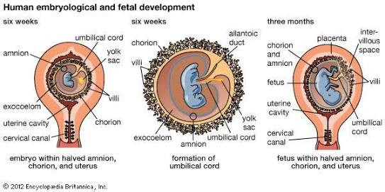
Cord Development.

Slide 6
Structures.
The constituents of the umblical cord when fully formed are as follows:
Covering Epithelium,
Wharton’s jelly,
Blood Vessels,
Remanants of the umblical vesicle (yolk sac) and its vitelline duct.
Allantosis,
Obliterated Extraembryonic Coelom.

Slide 7
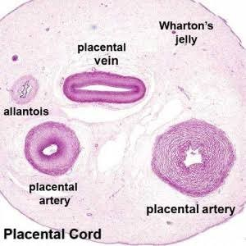

Slide 8
Covering Epithelium.
It is lined by a single layer of amniotic epithelium .
Shows stratification like that of fetal epidermis at term.
WHARTON’S JELLY:
It consists of elongated cells in a gelatinous fluid formed by mucoid degeneration of the extraembryonic mesodermal cells.
Rich in mucopolysaccharides.
Got protective function to the umblical vessels.

Slide 9
Blood Vessels.
Initially there are 4 vessels.2 arteries & 2 veins.
The arteries are derived from the internal iliac arteries of the fetus.
Carry the venous blood from the fetus to placenta. The cord at term normal has 2 arteries and 1 vein .
The Right umblical vein usually disappears during early fetal development (by 4th month) leaving only the original Left vein.
The vein carries oxygenated blood from the placenta to the fetus.
Presence of a single umblical artery is often associated with fetal congential abnormalities.

Slide 10
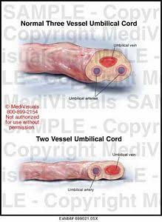
Blood vessel.

Slide 11
Remanants of the umblical vesicle (yolk sac) & its vitelline duct
Obliterated Extraembryonic Coelom:
In the early period,intra embryonic coelom is continous with extraembryonic coelom along with herination of coils of intestine (midgut).
The condition may persist as Congential Umblical Hernia / Exomphalos.

Slide 12
In section of any portion of umblical cord near the center,the small duct of umblical vesicle is usually be seen.
The vesicle is lined by a single layer of flattened /Cuboidal epithelium.
In section just beyound the umblicus.
Allantosis:
A blind tubular structure may be occasionally present near the fetal end which is continuous inside the fetus with its Urachus and Bladder.
Duct representing the allantoic remnant is occasionally found.

Slide 13
Remanant of the yolk sac may be found as a small yellow body near the attachment of the cord to the placenta or on rare occasion,the proximal part of the duct persists as Meckel’s diverticulum.
The intra abdominal portion of the duct of the umblical vessicle which extends from umblicus to intestine,
Usually atrophies and disappears,but ocassionally it remains patent forming the Meckel diverticulum.
The most common vesicular anomaly is the absence of one umblical artery.
May be associated with fetal anomalies.

Slide 14
Remnants & Cysts.
A number of structures are housed in the umblical cord during fetal development & their remenants may be seen when the mature cord is viewed transversally.
Embryo in early development initially have two umblical veins,an umblical vein remenant may be seen on careful examination.
Remnants of vitelline duct,allantoic duct & embryonic vessels
These were not associated with congential malformations or perinatal complications.

Slide 15

Remnants.

Slide 16
Cysts.
Cysts occasionally found along the course of the cord.
The are designated according to their origin.
True Cysts are epithelium lined remnants of the allantoic / vitelline duct
It tend to be located closer to the fetal insertion site.
More common Pseudocysts form from a local degeneration of Wharton jelly and occur anywhere along the cord.

Slide 17
Both have a similar sonographic appearence.
Single umblical cord cysts identified in the first trimester ted to resolve completely,
However,Multiple cysts may Portend Miscarriage or aneuploidy.
Cysts persisting beyound this time are associated with a risk for structural defects and Chromosomal anomalies.

Slide 18
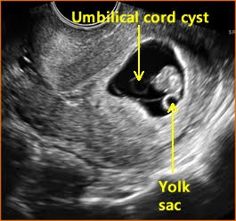
Umblical cord Cysts.

Slide 19
CORD FUNCTION.
The umblical cord extends from the fetal umblicus to the fetal surface of the placenta i.e; chorionic plate.
Blood flows from the umblical vein and take a path of the least resistance via 2 routes within the fetus.
Ductus venosus:
D venosus empties directly empty into the inferior vena cava.
The other route consists of numerous small openings into te hepatic circulation.
Blood from the liver follows into the inferior vena cava via the hepatic vein.

Slide 20
Resistance in the Ductus Venosus is controlled by a spincter i.e; situated at the origin of the ductus at the umblical recess.
It is innervated by the vagus nerve branch.
Blood exists the fetus via the two umblical arteries .
These are anterior branches of the internal iliac artery and become obliterated after birth.
Remanants can be seen as the medial umblical ligament.

Slide 21
Attachement.
In the early period,the cord is attached to the ventral surface of the embryo close to the caudal extremity.
As the Coelom closes & the yolk sac atrophies the point of attachement is moved permantely to the centre of the abdomen at 4th month.
Unlike the fetal attachement,the placental attachement is inconsisitent.

Slide 22
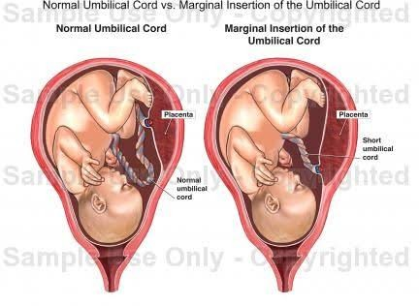

Slide 23
Usually attaches to the fetal surface of the placenta some where between the center and the edge of the placenta called Eccentric Insertion.
The attachement may be
Central,
Marginal
Even on the chorion laeve at a varying distance away from the margin of the placenta called velamentous insertion.

Slide 24
ABNORMALITIES OF THE UMBLICAL CORD.
LENGTH,
COILING,
VESSEL NUMBER,
REMNANTS
CYSTS,
INSERTION,
VASA PREVIA,
KNOTS,
STRICTURES,
LOOPS,
VASCULAR.

Slide 25
LENGTH.
Most umblical cords are 40 to 70 cm long,
Few measure less than 32cm or more than 100cm. Cord diameter has been used as Predictive marker for fetal outcome.
Diameter:1-2.5cm.
Cord length is influenced positively by:
Amniotic fluid volume,
Fetal Mobility.

Slide 26
Short cord.
Short cord may be true(less than 20 cm or 8”)
Or due to entanglement of the cord round any fetal part.
In exceptional circumstances,the cord may be absent & the placenta may be attached to the liver as in exomphalos.
Short cords associated with :
Fetal Growth Restriction,
Congential malformations,
Intrapartrum Distress,
2 fold risk of death

Slide 27
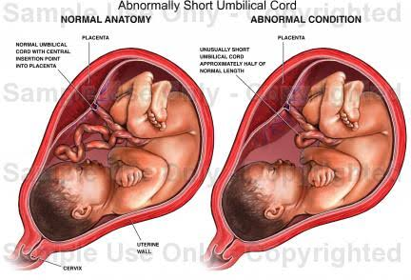
Short cord.

Slide 28
Clinical significance.
Failure of external version,
prevent descent of the presenting part especially during labour,
Seperation of a normally situated placenta,
Favour malpresentation,
Fetal distress.

Slide 29
Long cords.
Excessively long cords are more likely to be linked with:
Cord entanglement,
Cord Prolapse,
Fetal anomalies.
Acidemia,
Demise.
Loop around the neck(20-30%).

Slide 30
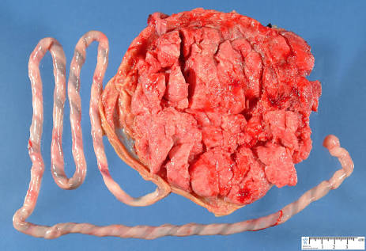
Long cord.

Slide 31
Clinical significance.
The condition may produce sufficent compression on the cord vessels so as to produce fetal distress / rarely death.

Slide 32
But antenatal determination of cord length is techinically limited.
LEAN CORDS:
Poor fetal growth. Large diameter cords are associated with macrosomia.
However,the clinical utility of this parameter an is still unclear.
The umblical arteries donot possess an internal elastic lamina but have got well developed muscular coat.
Help in effective closure of the arteries due to reflex spasm soon after the birth of the baby.
Both arteries & vein donot possess vasa vasorum.

Slide 33
Vessel Number.
The usual arrangement of two thick walled arteries and one thin,larger umblical vein is altered.
The most common abberation is that of Single Umblical Artery
Incidence of 0.063% in live born neonates,
1.92% with perinatal deaths,
3% in twins.
The cord vessel no is a component of the standard prenatal Ultrasound examination.

Slide 34
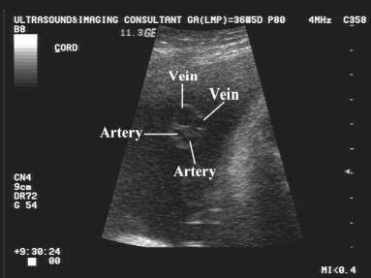
Accessory vessel seen in Congential anomalies

Slide 35
Single umblical artery.
Single umblical artery is present in 1-2% of cases.
Due to failure of development of one artery or due to its atrophy in later months.
Frequently associated with congential malformation of the fetus(20-25%).
Renal & genital anomalies
Its frequently associated with congential malformation of the fetus(20-25%)
Trisomy 18 are common.

Slide 36
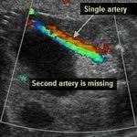

Slide 37
More common in
Twins,
Babie born of women with
Diabetes,
Epilepsy,
Oligohydraminos,
Hydraminos,
Preeclampsia,
Antepartrum Haemorrhage.

Slide 38
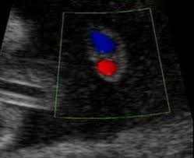
Increased chances of :
Abortion,
Fetal aneuploidy,
Prematurity,
IUGR,
Increased perinatal mortality.

Slide 39
Identification of a single umblical artery frequently prompts consideration of targeted sonography & fetal echo-cardiography.
As an isolated finding (Low Risk Pregnancy) with no apparent anomalies.It doesnot increases the fetal aneuploidy risk.
But fetuses with major malformations frequently have a single umblical artery.
When seen in anomalous fetus,the aneuploidy risk is greatly increased and amniocentesis is recommended.

Slide 40
The most frequent anomalies desribed are cardiovascular & Genitourinary.
Single artery has also been associated with Fetal-growth restriction
Rare anomaly is fused umblical artery with a shared lumen.
It arises from failure of the two arteries to split during embryological development.
The common lumen may extend through the entire cord,but if partial is typically found near the placentation site.
E.g; Higher incidence of marginal or velementous cord insertion ,but not congential fetal anomalies.

Slide 41
Coiling
The umblical vessels spiral through the cord in a sinistral,i.e;left twisting direction.
It shows a spiral twist from the left to right from as early as 12th week due to spiral turn taken by the vessels-Vein around the Arteries.
The number of complete coils per centimeter of cord length has been termed the Umbilical Coiling Index.
A normal antepartrum index derived sonographically is 0.4.
This contrast with a normal value of 0.2 derived postpartrum by actual measurement.

Slide 42
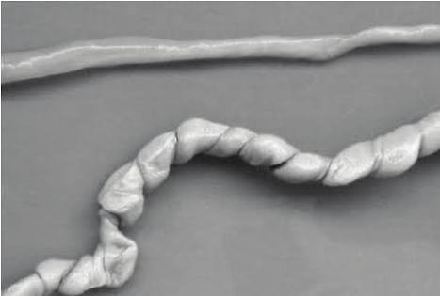
Clinically,hypocoiling has been linked with
Fetal demise.
Hypercoiling has been associated with
Fetal growth Restriction,
Intraparteum fetal acidosis.
Both reported in the settings of trisomic fetuses & with Single Umblical artery.

Slide 43
Insertion.
The cord normally inserts centrally into the placental disc,but eccentric,marginal or velamentous insertions are variants.
The latter two are clinically important in that the cord or its vessels may be torn during labour and delivery.
Marginal insertion is a common variant sometimes referred to Battledore Placenta.
In which the cord anchors at the placental margin.
More frequent with Multifetal Pregnancy especially those conceived using ART and associated with weight discordance.

Slide 44
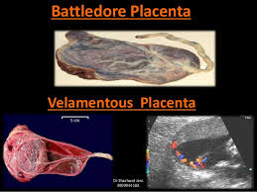
Battledore placenta.

Slide 45
Battledore placenta results in the cord being pulled off during delivery of the placenta.
A velamentous insertion is a variant of considerable importance.
The umblical vessels characterisically spread within its membrane at a distance from the placental margin,which they reach surrounded only by a fold of amnion.

Slide 46


Slide 47
As a result,vessels are vulnerable to compression,which may lead to fetal hypoperfusion and acidemia.
Incidence is approximately 1% more common with placenta praevia & mutifetal gestations.
In prenatal USG,cord vessels with velamentous insertion are seen travelling along the uterine wall before entering the placental disc.

Slide 48
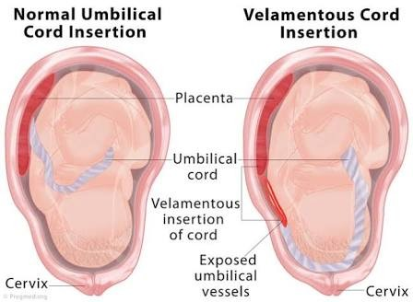

Slide 49
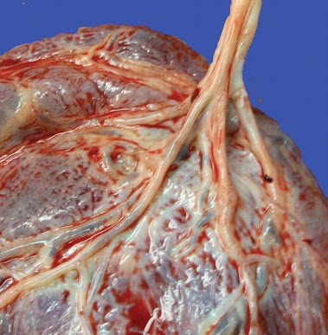
Furcate insertion of cord
Very uncommon Furcate insertion,the topographic site of cord connection onto the placental disc is central,but umblical vessels lose their protective Wharton jelly shortly before they insert.
As a result,they are covered only by an amnion sheath and prone to compression,twisting and thrombosis.

Slide 50
Vasa Previa.
Dangerous variation of velamentous insertion in which the vessels within the membranes overlie the cervical Os.
The vessels can be interposed between the cervix and the presenting fetal part.
Hence,they are vulnerable to compression and also to laceration or avulsion with rapid fetal exsanguination.
Vasa previa is uncommon.

Slide 51
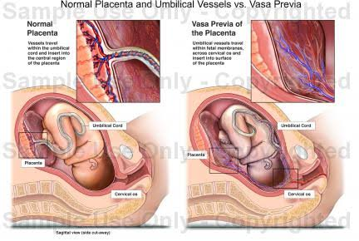
Vasa previa.

Slide 52
Risk factors.
Bilobate or succenturiate placenta,
Second trimester placenta previa with or without later migration.
It also increased in pregnancies conceived by IVF.
Because antepartrum diagnosis has improved perinatal survival compared with intra partrum diagnosis
Vasa previa would be identified early.but this is not possible always.

Slide 53
Clinically,an examiner is ocassionally able to palpate or directly see a tubular fetal vessels in the membranes overlying the presenting part.
With TVS,cord vessels may be seen inserting into the membranes-rather than directly into the placenta-with vessels running above the cervical internal os.
Routine colour Doppler interrogation of the placental cord insertion site,particulary in case of placenta previa or low lying placenta

Slide 54
Once vasaprevia is identified,early scheduled cesarean delivery is planned.
Bed rest apparently has no added advantage.
Robinson & Grobman (2011) performed elective cesarean delivery at 34-35 weeks to balance the risks of perinatal exsanguination versus preterm birth morbidity.
At delivery, the infant is expeditiously delivered after the hysterotomy incision in case a vessel is lacerated during uterine entry.
Whenever there is otherwise unexplained haemorrhage can occur either antepartrum / intrapartrum.

Slide 55
Vasa previa with a lacerated fetal vessels should be considered.
Bleeding is rapidly fatal & infant salvage is not possible.
With less haemorrhage,it is possible to distinguish fetal Vs maternal bleeding.
Various tests relies on characteristically increased resistance of fetal hemoglobin to denaturation by alkaline or acid reagents.

Slide 56
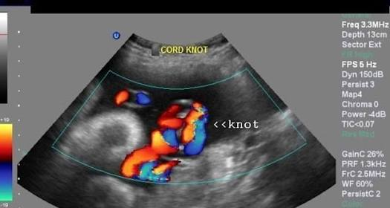
Cord knots.

Slide 57
Knots
Mechanical & vascular abnormalities can impede cord vessel blood flow either toward or away from the fetus and these sometimes cause fetal harm.
True knots are caused by fetal movement and are seen in approximately 1% of birth.
Common and dangerous in monoamniotic twins.
When true knots are associated with singelton fetuses,the still birth risk is increased four to ten fold.
Abnormal fetal heart rate,tracings are more often encountered during labour. However,cesarean delivery rates are not increased and cord blood acid base values are usually normal

Slide 58
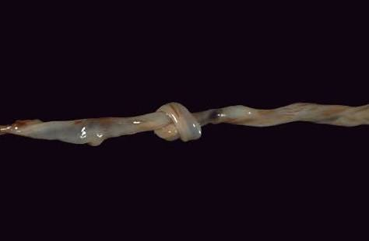
True Knots.

Slide 59
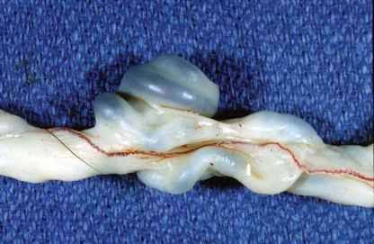
False knots are of no clinical significance and appear as knobs protuding from the cord surface.
These are focal redundancies of a vessel or Wharton jelly.
.

Slide 60
Strictures.
A cord stricture is a focal narrowing of its diameter that usually develops near the fetal cord insertion.
Characteristic pathological features of strictures are absence of Wharton jelly and stenosis or obliteration of cord vessels at narrow segment.
In most instances,the fetus is stillborn.
Even less common is a cord stricture caused by an amniotic band

Slide 61
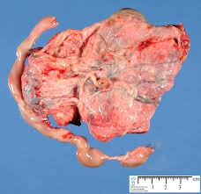
Strictures.

Slide 62
Cord Loops.
Cord loops are frequently encountered and are caused by coiling around fetal parts during movement.
As expected,they are more common with longer cords.
A cord around the neck-a nuchal cord-is extremely common.
One loop is reported in 20 to 30 % of deliveries
Two loops in 2.5 to 5%
Three loops in 0.2 to 0.5%

Slide 63
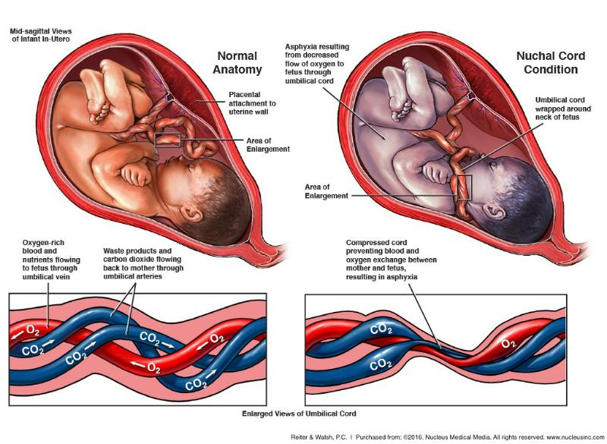
Loops

Slide 64
During labour these loops can result in fetal heart rate decelerations that persists during a contraction.
Up to 20% fetuses with a nuchal cord have moderate to severe variable heart rate decelerations and these are associated with a lower umblical artery pH.
Despite these frequency,nuchal cords are relatively uncommon cause of perinatal outcome.

Slide 65
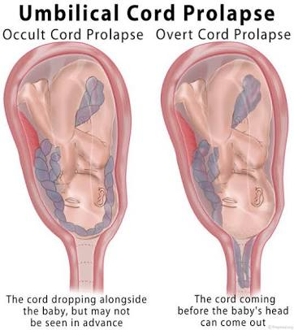
Funic presentation.

Slide 66
A funic presentation describes when the umblical cord is the presenting part in labour.
These are uncommon
Associated with fetal malpresentation.
A funic presentation in some cases identified with placental sonography and colour flow doppler.
Fetal heart rate abnormalities and overt or occult cord prolapse may complicate labour and lead to cesarean delivery.

Slide 67
Vascular.
Cord hematomas are uncommon and have been associated with
Abnormal cord length,
Umblical vessel aneurysm,
Trauma,
Entanglement,
Umblical vessel venipuncture
Funisitis.

Slide 68
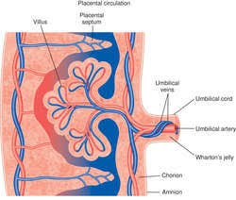
Vascularity.

Slide 69
Umblical cord vessel thrombosis are in utero events.
Approximately 70 % are venous,
20% are venous and arterial,
10% are arterial thrombosis.
Compared with venous thrombosis, those in the artery have higher perinatal morbidity and mortality rates and are associated with fetal growth restriction, fetal acidosis and still birth.

Slide 70
Another rare anomaly is an umblical varix.
Umblical vein varix is a marked focal dilatation that can be within either the intramniotic or fetal intrabdominal portion of the umblical vein.
The latter anomalies are associated with increased rates of fetal structural anomalies and aneuploidy.

Slide 71
Complications.
Complications may include:
Rupture or thrombosis,
Compression of the umblical artery &
Fetal cardiac failure due to increased preload.

Slide 72
They may be visualised during sonography as a cystic dilatation of the umblical vein.
Continuity of the varix with a normal- caliber portion of the umblical vein is confirmed using colour flow doppler.

Slide 73
Aneursym.
The rare umblical artery aneurysm is caused by congential thinning of the vessel wall with diminished support from Wharton jelly.
Indeed,most form at or near the cord’s placental insertion,where support is absent

Slide 74
Associated with
Single umblical artery,
Trisomy 18,
Amniotic fluid volume abnormalities,
Fetal growth restriction and still birth.
At least theoretically,
These aneurysm could cause fetal compromise and death by compression of the umblical vein.
These aneurysm may appear sonographically as a cyst with a hyperechoic rim.

Slide 75
Cord clamping.
Umblical cord is cut between 2 cords
Placed 6 to 8 cm from the fetal abdomen.
For term neonates timing of umblical cord clamping is debatable.
Delayed cord clamping upto 60 sec.
Increases total body Iron store & expand blood volume.
Decreases anaemia incidence in neonate.

Slide 76
Thank you.

