Slide 1
Third stage of labour

Slide 2
Third stage of labour
Begins after expulsion of fetus and ends with expulsion of placenta & membranes (afterbirths).
Duration :15 min.(primigravida multigravida)
AMTSL:5 minutes

Slide 3
Events in Third stage of labour
Placental separation
Placental expulsion

Slide 4
Placental seperation
At the beginning of labour, the placental attachment roughly corresponds to an area of 20cm in diameter.
Ater the birth of the baby, the uterus measures about 20cm vertically and 10cm antero-posteriorly.
The cavity is much reduced to accomodate only the afterbirths.

Slide 5
Mechanism of seperation:
As the placenta is inelastic, it cannot keep pacewith such an extent of diminution resulting in its buckling.
A shearing force is instituted between the placenta and the placental site which brings about its ultimate seperation.
Plane of seperation runs through deep spongy layer of placenta.

Slide 6
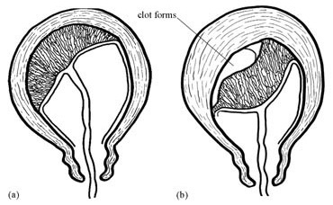
Methods of placental separation
Marginal (Mathews Duncan) seperation
Central ( Schultze) separation

Slide 7
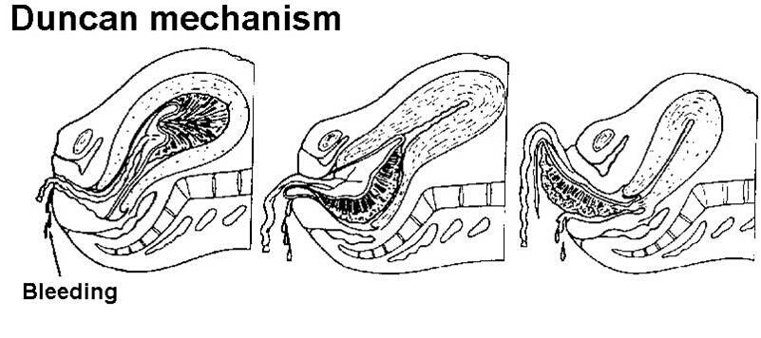
Marginal seperation
Seperation starts at the margin. With progressive uterine contraction, more and more areas of the placenta get seperated.

Slide 8
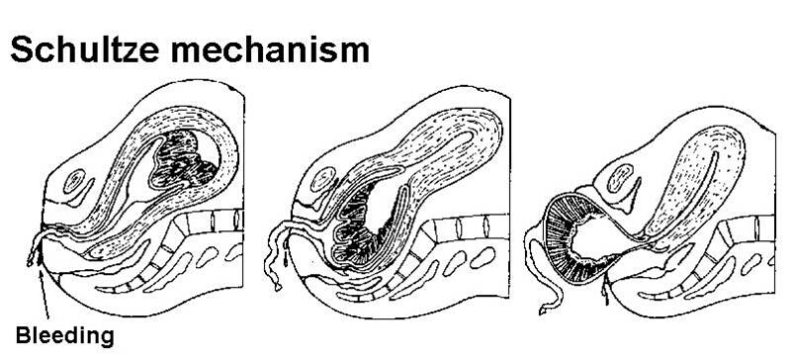
Central seperation
Detachment of placenta starts at the centre resulting in opening up of few uterine sinuses and accumulation of blood behind the placenta (retroplacental heamatoma). With increasing contraction, more and more detachment occurs facilitated by wt of placenta and retroplacental blood until whole of the placenta gets detached.

Slide 9
Placental expulsion
After complete seperation of the placenta, with contraction & retraction of Upper Uterine Segment, Placenta is forced down into LUS/upper vagina.
Thereafter, placenta is expelled by Voluntary contraction of abdominal muscles (bearing down efforts) or by manual procedure

Slide 10
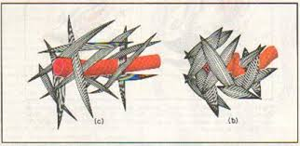
Mechanisms to control bleeding
Effective retraction of uterine muscles : Living ligatures
Thrombosis of torn sinuses
Myotamponade: apposition of walls of the uterus

Slide 11
Clinical course
BEFORE SEPERATION:
For a short time, no pain. However, intermittent discomfort in the lower abdomen reappears corresponding with the uterine contraction.
P/A: uterus feels firm, discoid, non-ballottable, fundal ht reaches below the umbilicus.
P/V:there may be slight trickling of blood, length of the umbilical cord remains static

Slide 12
AFTER SEPERATION:
P/A: uterus becomes globular, firm, ballottable, fundal ht is slightly raised with suprapubic buldge.
P/V:slight gush of vaginal bleeding, permanent lenghthening of the cord
MATERNAL SIGNS:
There may be chills, occasional shivering, slight transient hypotension

Slide 13
Management of third stage
Most crucial stage
Principles:
To ensure strict vigilance
Follow management guidelines
Expectant management
Active management

Slide 14
Expectant management
Look for 3 classic signs of placental separation
  Lengthening of U. cord
  A gush of blood from vagina
  Change in shape of uterine fundus from discoid to globular with elevation of fundal height
Spontaneous expulsion of placenta :20 minutes (no touch/ hands off)

Slide 15
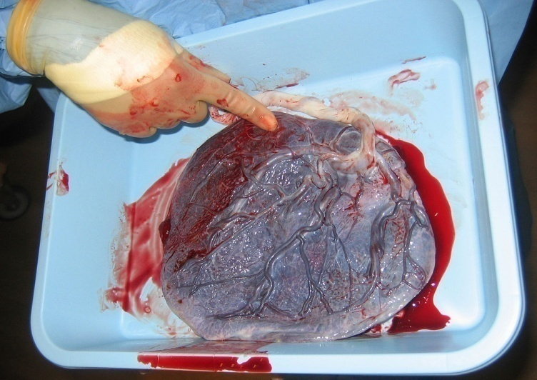
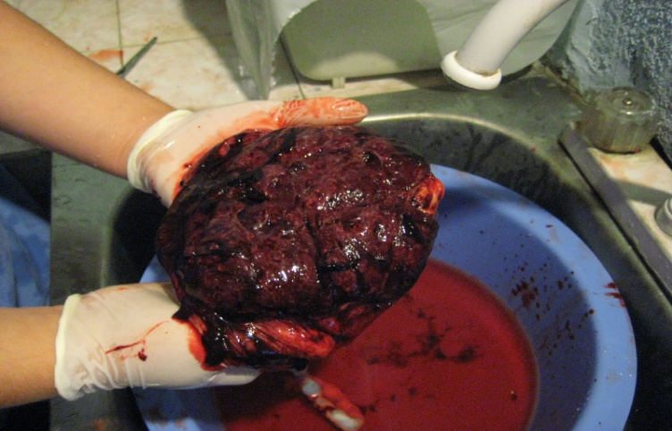
Expectant management
ASSISTED EXPULSION:
CCT
Massage the uterus
Methergin 0.2mg IM/ Oxytocin : 5-10 IU IM or slowly IV
Examination of placenta, membranes, cord
Inspect vulva, vagina & perineum

Slide 16
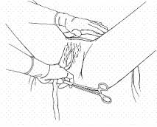
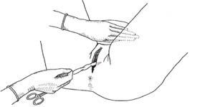
CCT
Modified Brandt Andrews method
Left hand: palmar surface of fingers placed above pubic symphysis. Body of uterus pushed upwards & backwards
Right hand: cord traction in downward & backward direction

Slide 17
Active management
Principle is to excite powerful uterine contractions within 1min of delivery of baby
Advantages: minimises blood loss & to shorten the duration of third stage to half
Procedure:
  Prophylactic uterotonic after delivery of baby
  ( Oxytocin 10 IU,IM/ Methergin 0.2mg IM)
  cord clamping, cutting & Controlled cord traction of umbilical cord.
  Uterine massage

