Slide 1
THROMBOEMBOLISM IN PREGNANCY

Slide 2
INTRODUCTION
Venous thrombosis and pulmonary embolism is considered higher during pregnancy and puerperium.
The incidence of all thromboembolic events is 1 in 1000 pregnancies & about an equal number identified in both antenatal and puerperium
In the study from norway of more than 6,00,000 pregnancies Jacobsen and collegues reported that DVT is more was more frequent in ante partum whereas pulmonary embolism was more common in 1st 6 weeks of post partum.
VTE has decreased in post partum because of early ambulation is more practised. However pulmonary embolism is the most leading cause for maternal death.

Slide 3
PATHOPHYSIOLOGY
In a normal pregnancy there is rise in coagulation factors like 1,2,5,7,8,10& 12.
Plasma fibrinolytic inhibitors are produced by the placenta and protein S is decreased markedly . Fibrinolytic activity becomes normal within 1 hour after the delivery of placenta.
ALTERATION IN BLOOD CONSTITUENTS: actual number of platelets is unaltered or lowered in pregnancy but their width and volume increases.

Slide 4
VENOUS STASIS: It is increased due to compression of gravid uterus to inferior vena cava and iliac veins. This stasis causes damage to the endothelial cells.
THROMBOPHILLIAS: These are hypercoagulable state in pregnancy that increases the risk of venous thrombosis. It may be inherited or acquired.
INHERITERED ___ these are the genetic conditions associated with the deficiencies of anti thrombin 3 , protein C , protein S . Other factors are factor 5 leiden mutation and homocystenemias
ACQUIRED____ are due to presence of lupus anticoagulant and antiphospholipid antibody.

Slide 5
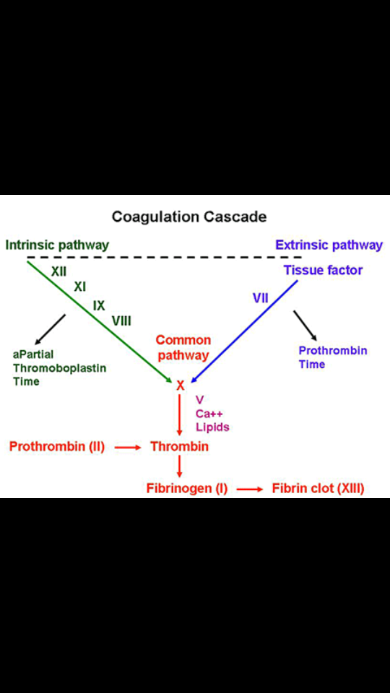

Slide 6
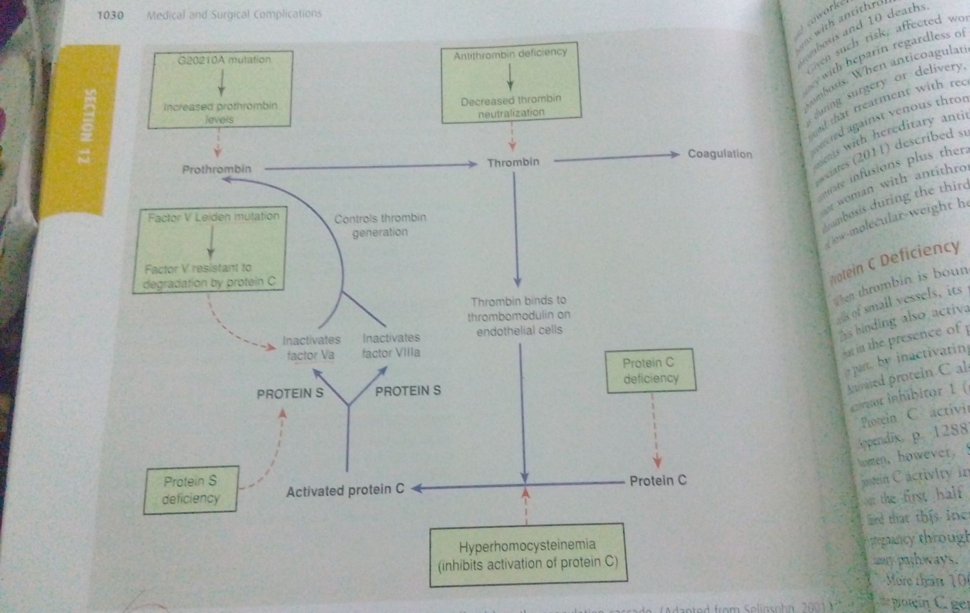
DEFECT IN COAGULATION CASCADE

Slide 7
RISK FACTORS FOR THROMBOEMBOLISM IN PREGNANCY
BASELINE RISK FACTOR
Age >35
Parity >3
Obesity BMI>30
Previous VTE
F/H of thrombophilia
Congenital thrombophilia
Anti thrombin 3
Protein C deficiency
Protein S deficiency
Leiden 5 factor
prothrombin gene mutation
Lupus anti coagulant
Acquired thrombophilia

Slide 8
Risk factors cntu....
RISK FACTORS IN PREGNANCY
Immobilization
Pre eclampsia
Diabetes
Anaemia
Major blood loss
Operative vaginal delivery
Caesarean section

Slide 9
DISEASES
Deep vein thrombosis
Pulmonary embolism
Superficial venous thrombophlebitis

Slide 10
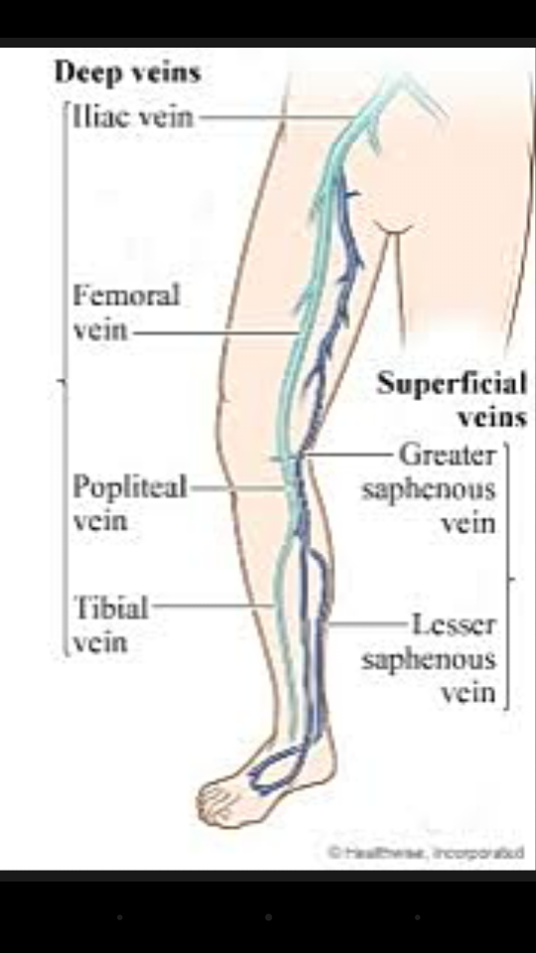

Slide 11
DEEP VEIN THROMBOSIS
During pregnancy , most venous thromboses are confined to the lower extremities
70% cases are located in the illiofemoral veins without involvement of the calf veins.
It occurs with same frequency in the pregnancy and the post partum.

Slide 12
SIGNS AND SYMPTOMS
Depends on degree of occlusion and intensity of inflammatory response.
The left leg is affected commonly probably due to compression of left iliac vein by the right iliac and ovarian artery.
Both of which cross the vein only on the left side .

Slide 13
Signs & symptoms cntu....
Pain in the left leg along with
Swelling
Tenderness
oedema
Rise in temperature
Cool extremity with diminished pulsation
Pain in the calf muscle HOMANS SIGN

Slide 14
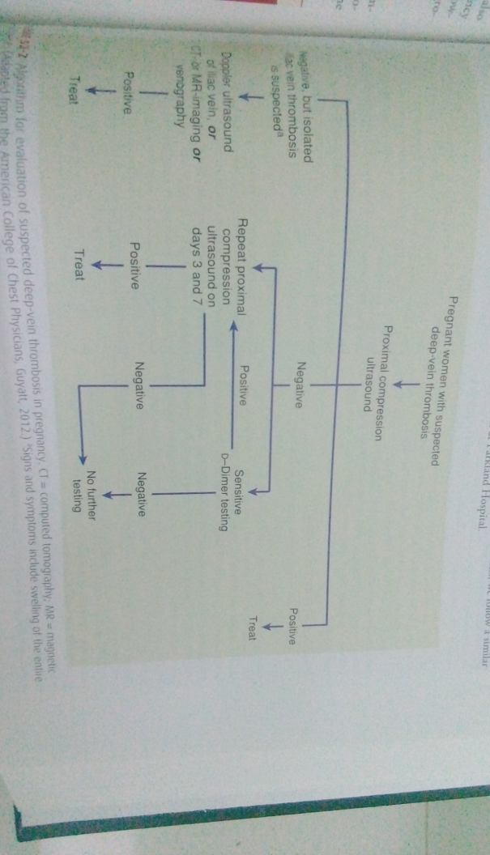
DIAGNOSIS

Slide 15
DIAGNOSIS cntu...
Compression ultrasonography
MRI
d Dimer screening test
Venograhy

Slide 16
COMPRESSION ULTRASONOGRAPHY
It is the initial diagnostic test recommended by ACOG.
It is the first line test
Diagnosed based on non compressiability and echoarchitecture of the thrombosed vein.
Both proximal & distal veins are completely assessed.
The treatment can be withheld if the test is negative and serial USG performed over 7_14 days.

Slide 17
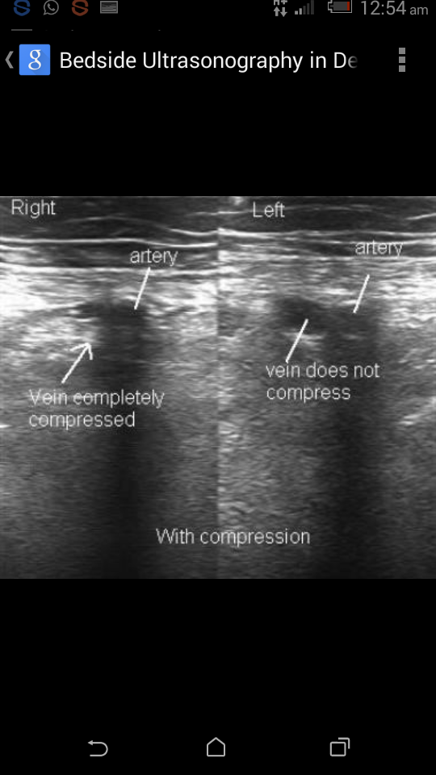

Slide 19
Doppler USG
Soft tissue mass will be seen within the venous lumen.
Non compressibility of the venous lumen in transverse plane under gentle probe pressure.
Overall sensitivity and specificity using USG is 90_100%

Slide 20
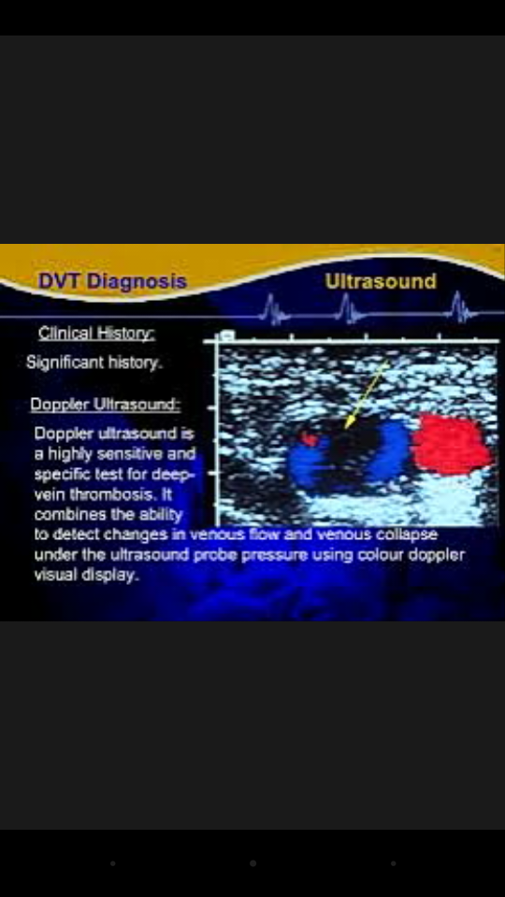

Slide 21
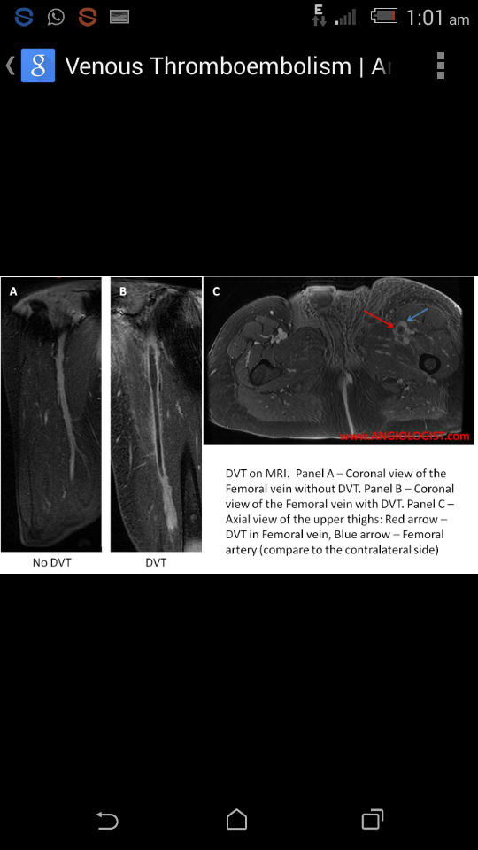

Slide 22
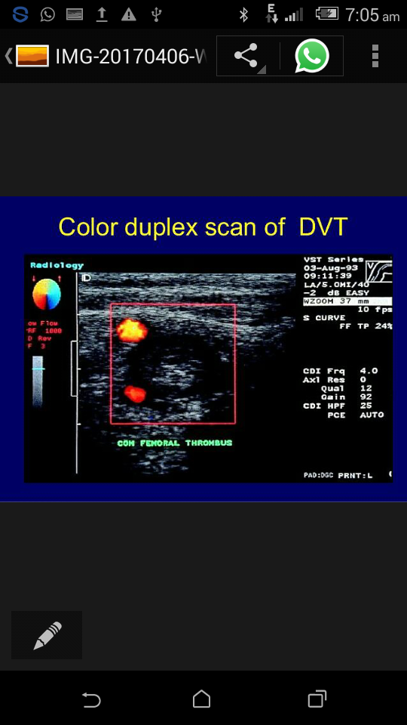

Slide 23
d _ DIMER TEST
This test negativity is highly predictive value and can help to exclude DVT in low probability group.
High d dimer test in other hand is not useful in pregnancy as these levels rise progressively in pregnancy.
It is also elevated in placental abruption , preeclampsia, sepsis syndrome.

Slide 24
VENOGRAPHY
CONTRAST VENOGRAPHY & SERIAL IMPEDENCE PLETHYSMOGRAPHY is also the diagnostic test for DVT in pregnancy.
By injecting non ionic water soluble radio-opaque dye to note a filling defect in the venous lumen is a reliable method.

Slide 25
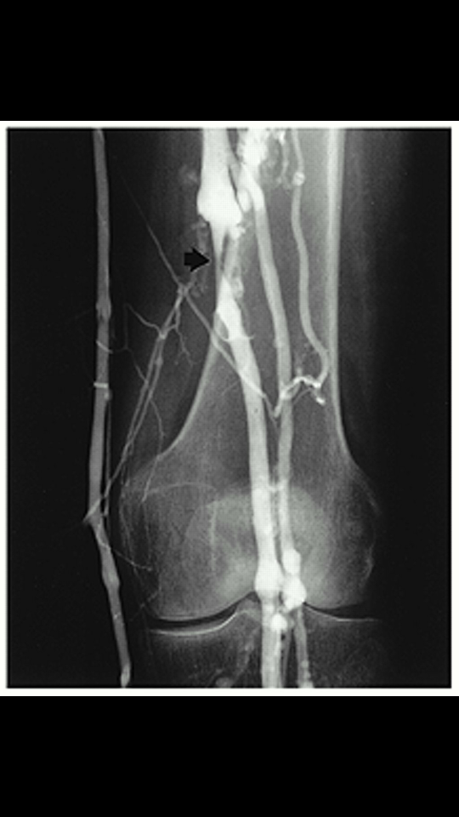
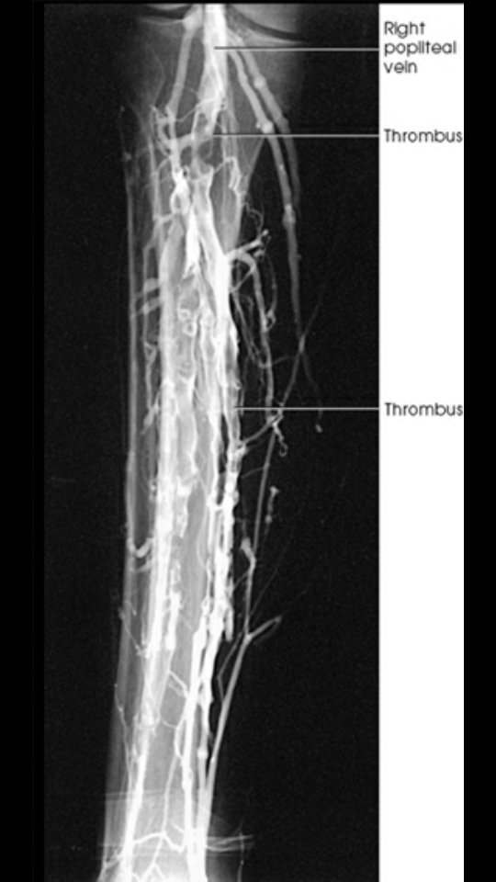

Slide 26
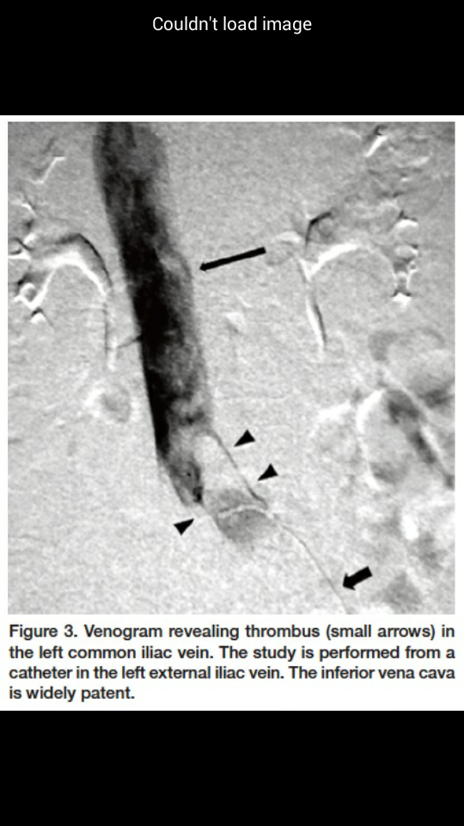

Slide 27
treatment
Unfractionated heparin
Low molecular weight heparin

Slide 28
UNFRACTIONATED HEPARIN
Mainstay of anti coagulant therapy during pregnancy.
No teratogenic effect
Recorded as safety and efficacy in pregnancy
Does not cross the placenta.
Not secreted in milk so given to nursing mothers.
RISK FACTORS
In mother haemorrage , thrombocytopenia & osteoporosis.
SIDE EFFECTS
It inactivates factor 2a and 10a and affects the APTT a measure of thrombin. Therefore when given UFH full doses APTT value should be noted.

Slide 29
LOW MOLECULR WEIGHT HEPARIN
Derived from depolarization of the heparin , which yeilds fragments 1/3 of the size UFH.
LMWH bind less to plasma proteins provide greater bioavilability.
anti coagulant response is predictable so given without monitoring.
Steady state is achieved quickly so complications like haemorrhage is reduced.
Low affinity to platelets & von willebrand factor so reduce thrombocytopenia.
Osteoporosis is also lower
LMWH is preferred than UFH
Commonly used heparin in pregnancy are ENOXIPARIN , DALTEPARIN & TINZAPARIN.

Slide 30
ANTI THROMBOLYTIC ACTIVITY | ENOXAPARIN | DALTEPARIN | TINZAPARIN
PROPHYLATIC
<50 kg | 20 mg/kg | 2500 mg /kg | 3500 mg /kg
50-90 kg | 40 mg/kg | 5000mg/kg | 4500 mg/kg
91_130 kg single/two divided doses | 60 mg/kg | 7500 mg/kg | 7000 mg/kg
HIGH PROPHYLACTIC INTERMITENT DOSE 50_90 kg | 40mg 12 hrly | 5000 mg 12 hrly | 4500 mg 12 hrly
TREATMENT DOSE | 1 mg /kg 12 hrly antenatal 1.5 mg/kg /daily POSTNATAL | 100units /kg 12 hrly OR 200 units /kg/daily postnatal | 175 units / kg BOTH ANTENATAL & POSTNATAL

Slide 31
PULMONARY EMBOLISM
Leading cause for maternal death.
Clinical features depend on the preceding health status and the size of the embolus of the patient.
The incidence in 1 in 7000 pregnancies.
Death occurs suddenly due to shock and vagal inhibition.

Slide 32
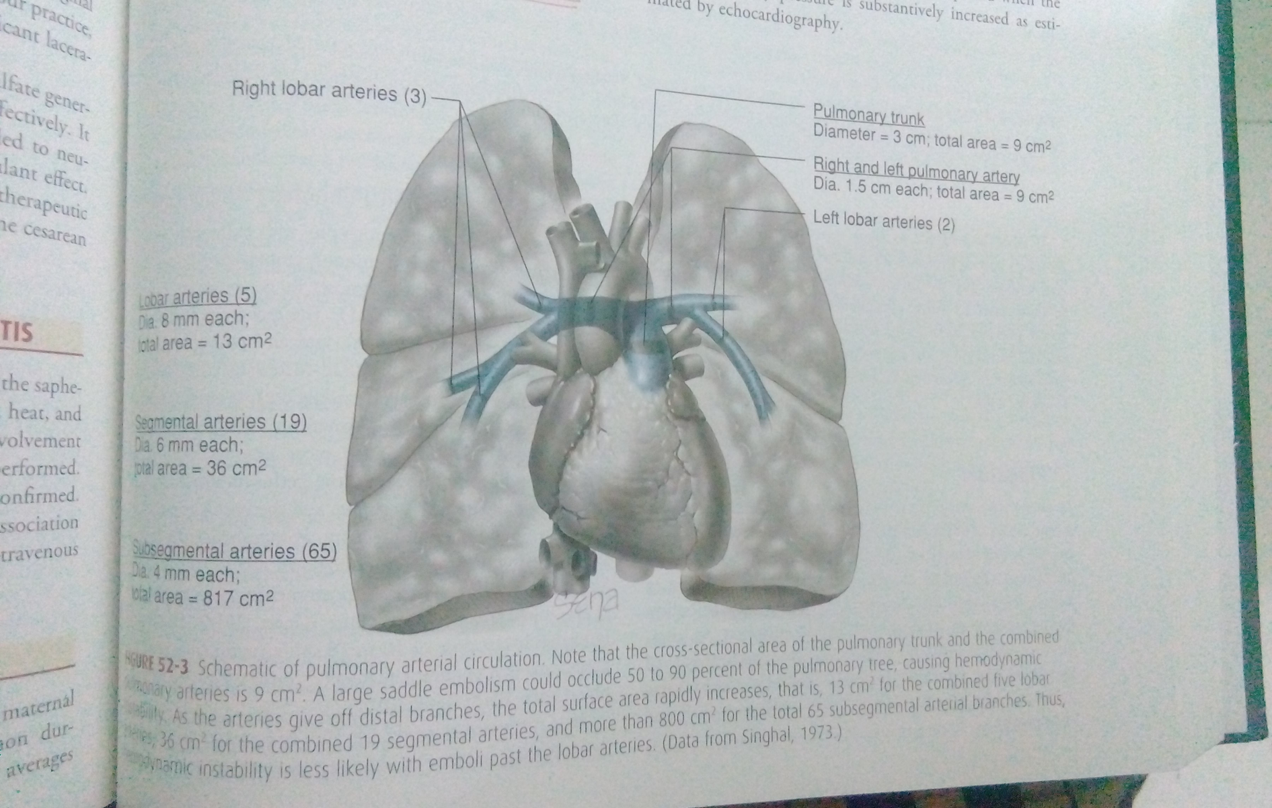

Slide 33
SIGNS AND SYMPTOMS
Tachypnoea
Dyspnoea
Plueritic chest pain
Cough
Tachycardia
Haemoptysis
Rise in temperature >37 degree celcius.

Slide 34
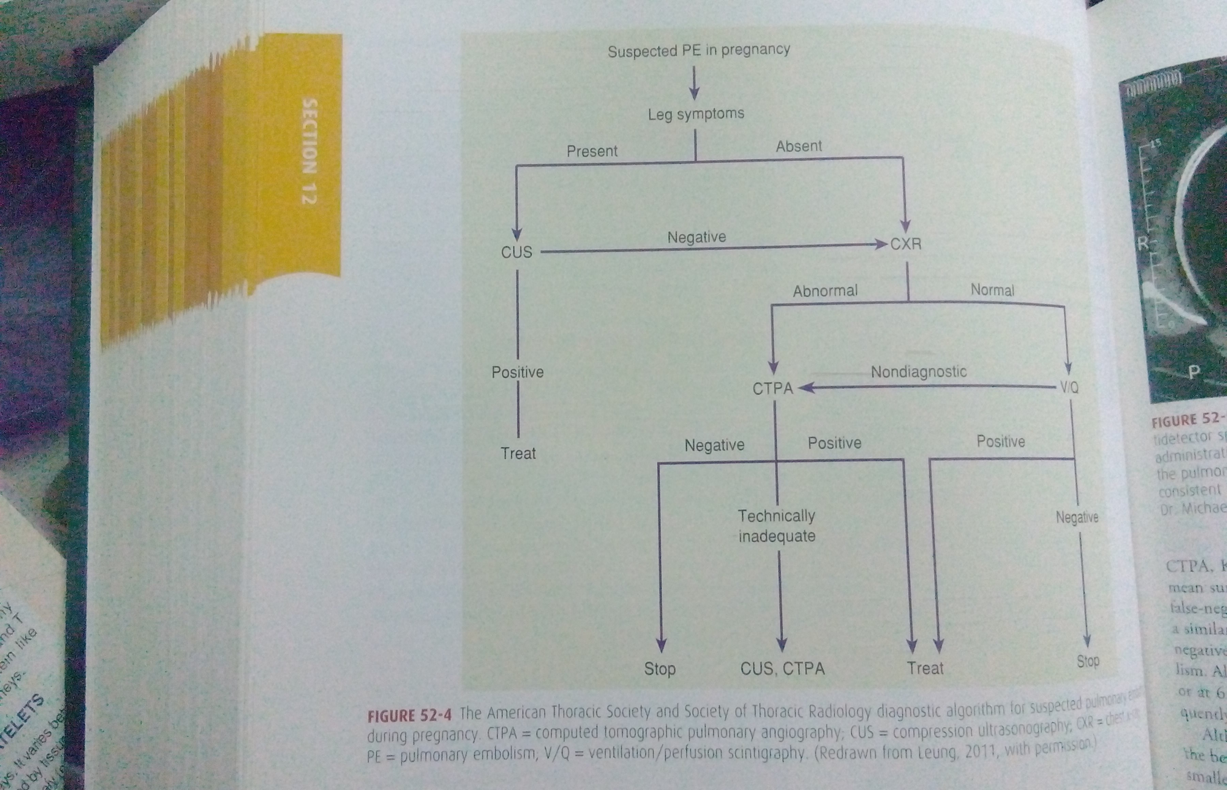

Slide 35
diagnosis
ECG __tachycardia right axis shift , T wave inversion in anterior chest leads.
D dimer ___negative d dimer value may rule out pulmonary embolism.
Arterial blood gas __ almost most women hypoxemic <95% in room air need further investigations.
Doppler USG
MRI
CT
LUNG SCAN _ventilation perfusion scintigraphy
Intravenous Pulmonary angiography

Slide 36
SPIRAL CT
It is the most common employed technique currently.

Slide 37
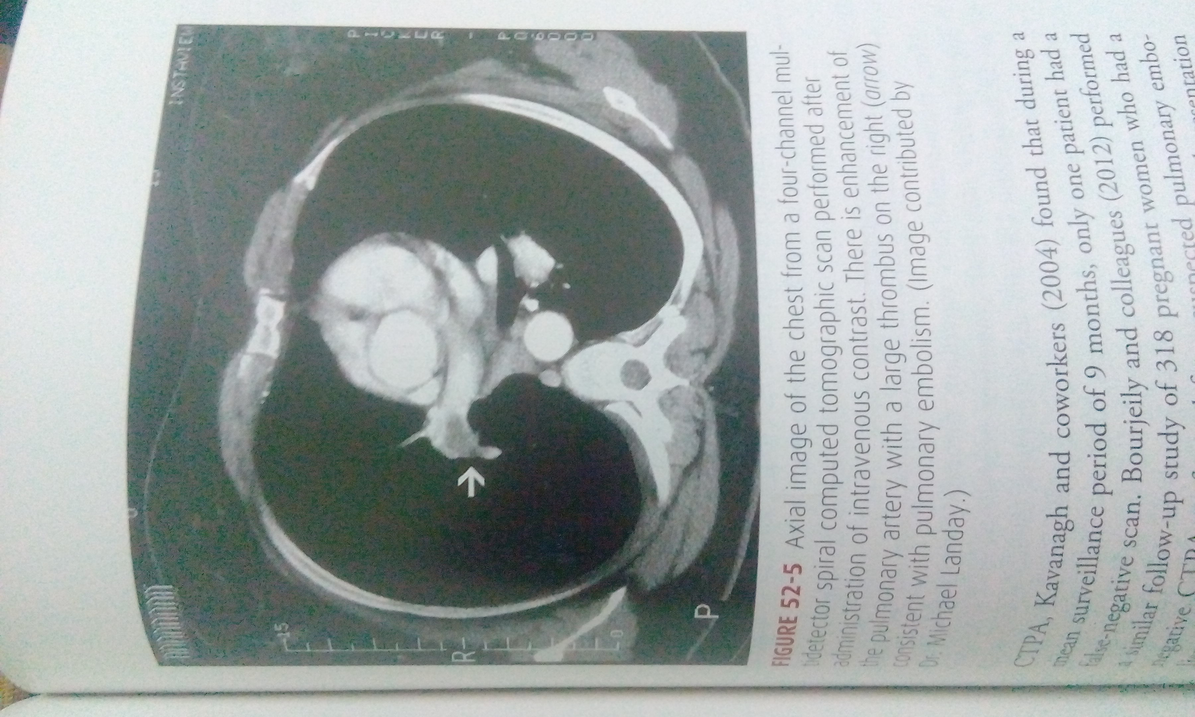

Slide 38
PULMONARY SCINTIGRAPHY
Ventilation perfusion or V/Q scan
It involves a small dose of technetium 99 macroaggregated albumin IV as radiotracer.
ventilation scans with inhaled xenon 133 or technetium 99 were added to perfusion scans to detect abnormal areas of ventilation in areas of normal perfusion.
Treatment can be withheld in normal or non diagnostic scans patients.
If clinical suspicion is more further testing is usually recommended .

Slide 39
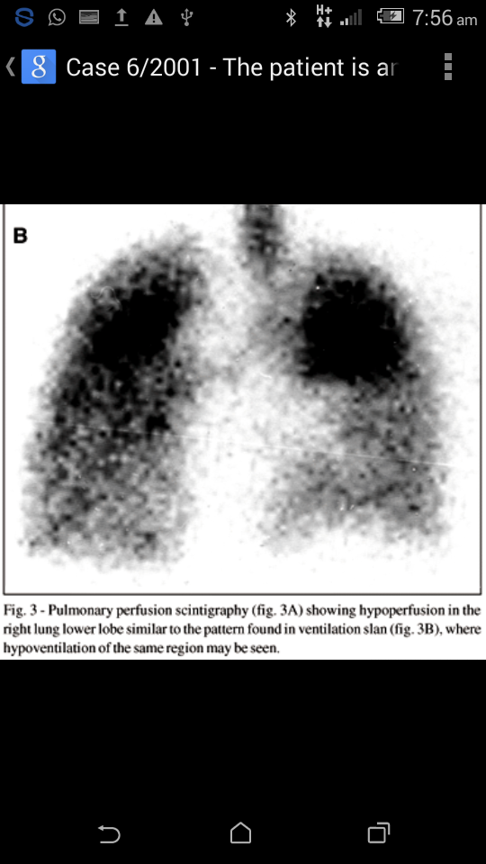

Slide 40
PULMONARY ANGIOGRAPHY
This requires catheterization of the right side of the heart and is the reference test for diagnosis for pulmonary embolism.
But it is uncomfortable , allergy to dye , time consuming & renal failure.
It is reserved for confirmation when less invasive test are equivocal.

Slide 41
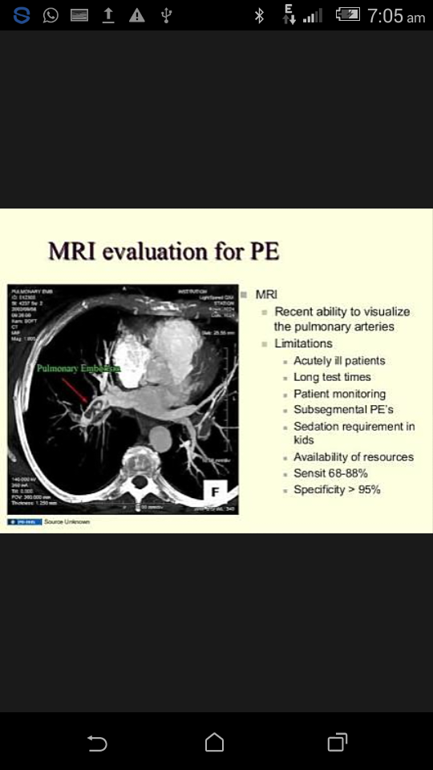

Slide 42
TREATMENT
Resuscitation
Cardiac massage , oxygen therapy , IV heparin bolus 5000 IU and morphine 15 mg IV started.
Heparin therapy is continued upto 40,000 IU /day as to maintain the clotting time to over 12 min for 1st 48 hrs. Its level is maintained 0.2 _0.4 units /ml or APTT value above twice normal.
Iv fluid support & BP is maintained by dopamine or adrenalin.
If recurrent attack necessitate surgical intervention is needed like vena caval filters , embolectomy.

Slide 43
VENA CAVAL FILTERS
Placement of vena caval filters should be considered before surgery .
It has become good outcome
Heparin therapy fail to prevent recurrent pulmonary embolism from pelvic veins or legs or when embolism develops from these site despite heparin treatment these filters are indicated
These devices are inserted through either jugular or femoral vein and can be inserted during labour.
Retrievable filters may be used as a short protection against embolism
These may be removed before they become endothelialized or left in place permanantly

Slide 44
EMBOLECTOMY
It is the emergency procedure.

Slide 45
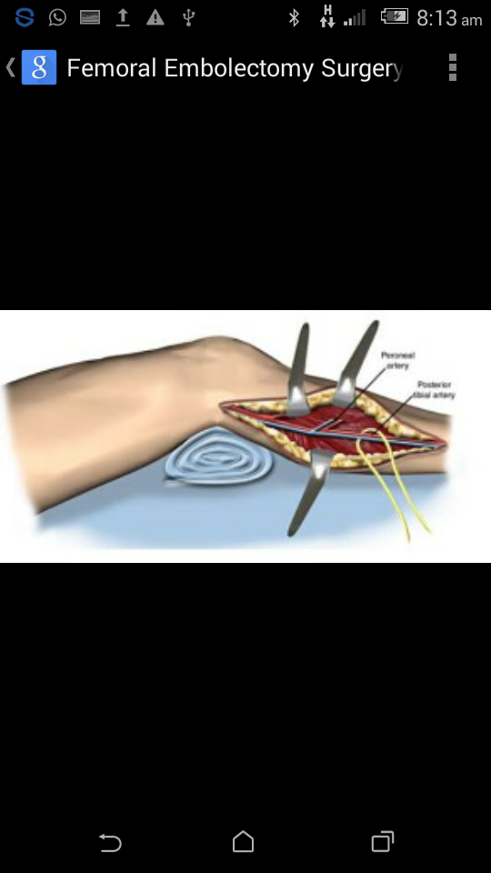
EMBOLECTOMY

Slide 46
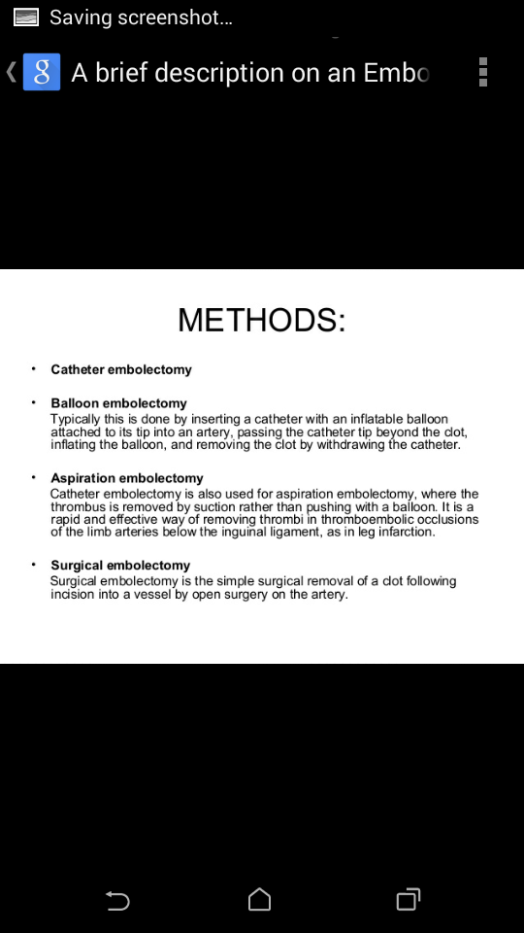

Slide 47
SUPERFICIAL VENOUS THROMBOPHLEBITIS
Thrombosis limited strictly to the superficial vein of the venous system.
Treated with analgesic , elastic support , heat & rest.
If DVT suspected , diagnostic measures are performed.
Heparin is given when DVT is confirmed .
Superficial thrombophlebitis is typically seen in association with varicosities or as a sequela to an indwelling intravenous catheter.

Slide 48
THANK YOU

