Slide 1
ULTRASOUND IN GYNAECOLOGY

Slide 2
Sonography plays an integral role in evaluation of gynaecological diseases.
Both transabdominal and transvaginal approaches are well established techniques for assessing the female pelvic organs.
Doppler sonography helps assess normal and pathological blood flow.

Slide 3
SONOGRAPHIC METHODS
TRANSABDOMINAL:
visualises the entire pelvis and gives a global overview.
LIMITATIONS:
1.needs full bladder
2.obese patients
3.retroverted uterus(fundus may be located beyond the focal zone of transducer)
4.Less effective for characterisation of adnexal masses.

Slide 4
Transvaginal approach:
Higher frequency transducers(5-7.5MHZ)
Much better resolution
Provides better image quality and anatomic detail.
Limitation: Field of vision is limited

Slide 5
Advantages:
1.Examination of patients who are unable to fill bladder.
2.Obese patients
3.Evaluation of retroverted uterus,
4.Better distinction between adnexal masses and bowel loops.
5.Better characterisation of internal characteristics of a pelvic mass.
6.Better detail of the endometrium.

Slide 6
SONOGRAPHIC ANATOMY
Uterus lies in the middle of pelvis with its long axis perpendicularly to probe.
Uterine corps is 7.5-9cm long,4.5-6cm broad and 2.5-4 cm thick.
Multiparity increases all measurements by 1-2cm.
Size of corpus to cervix = 2:1 ratio
Uterine cervix has a length and diameter of 2.5cm and divided into vaginal and supravaginal part.
Uterine arteries run along the sides of the cervix .

Slide 7
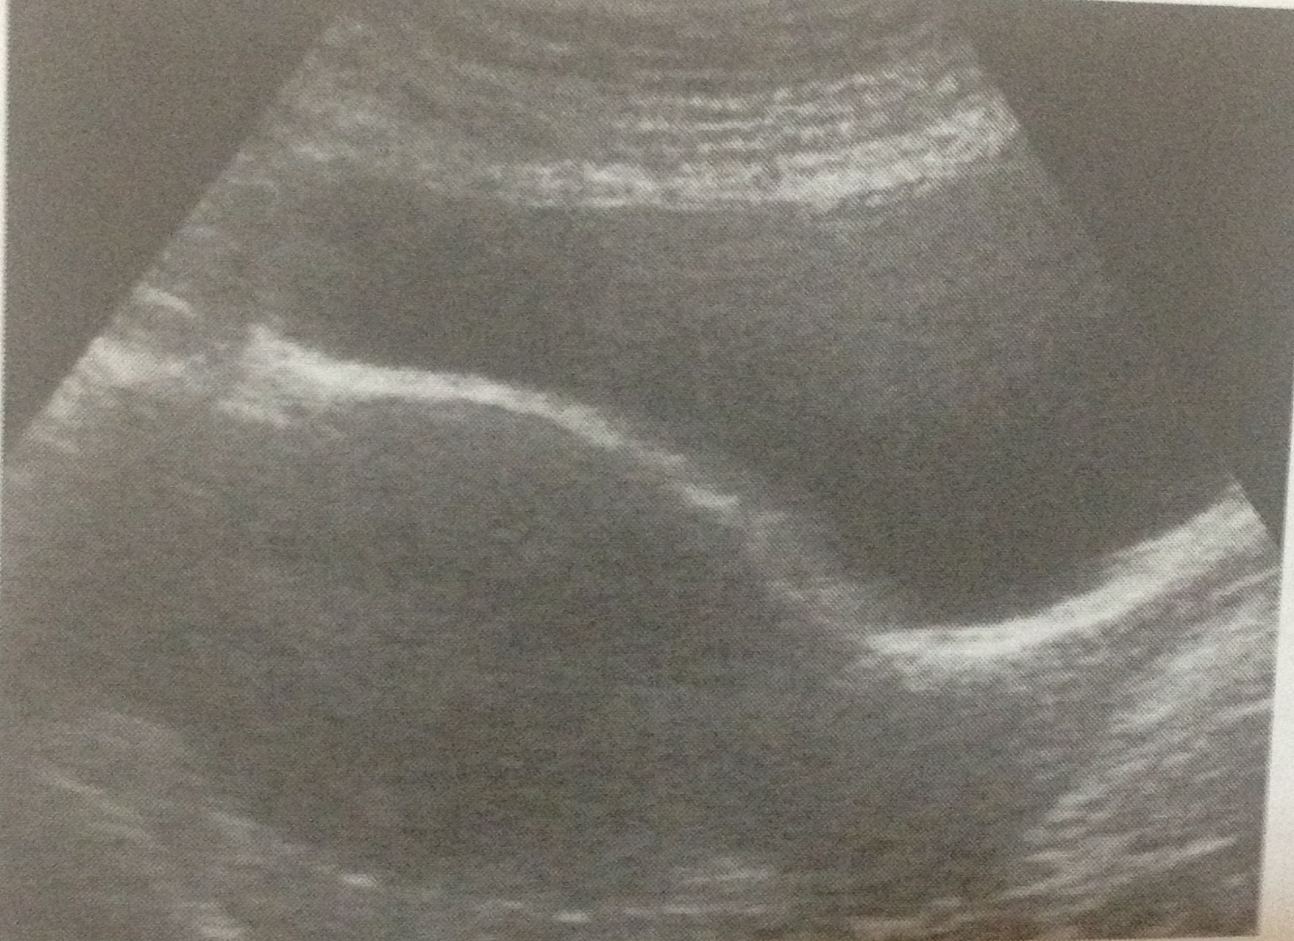

Slide 8
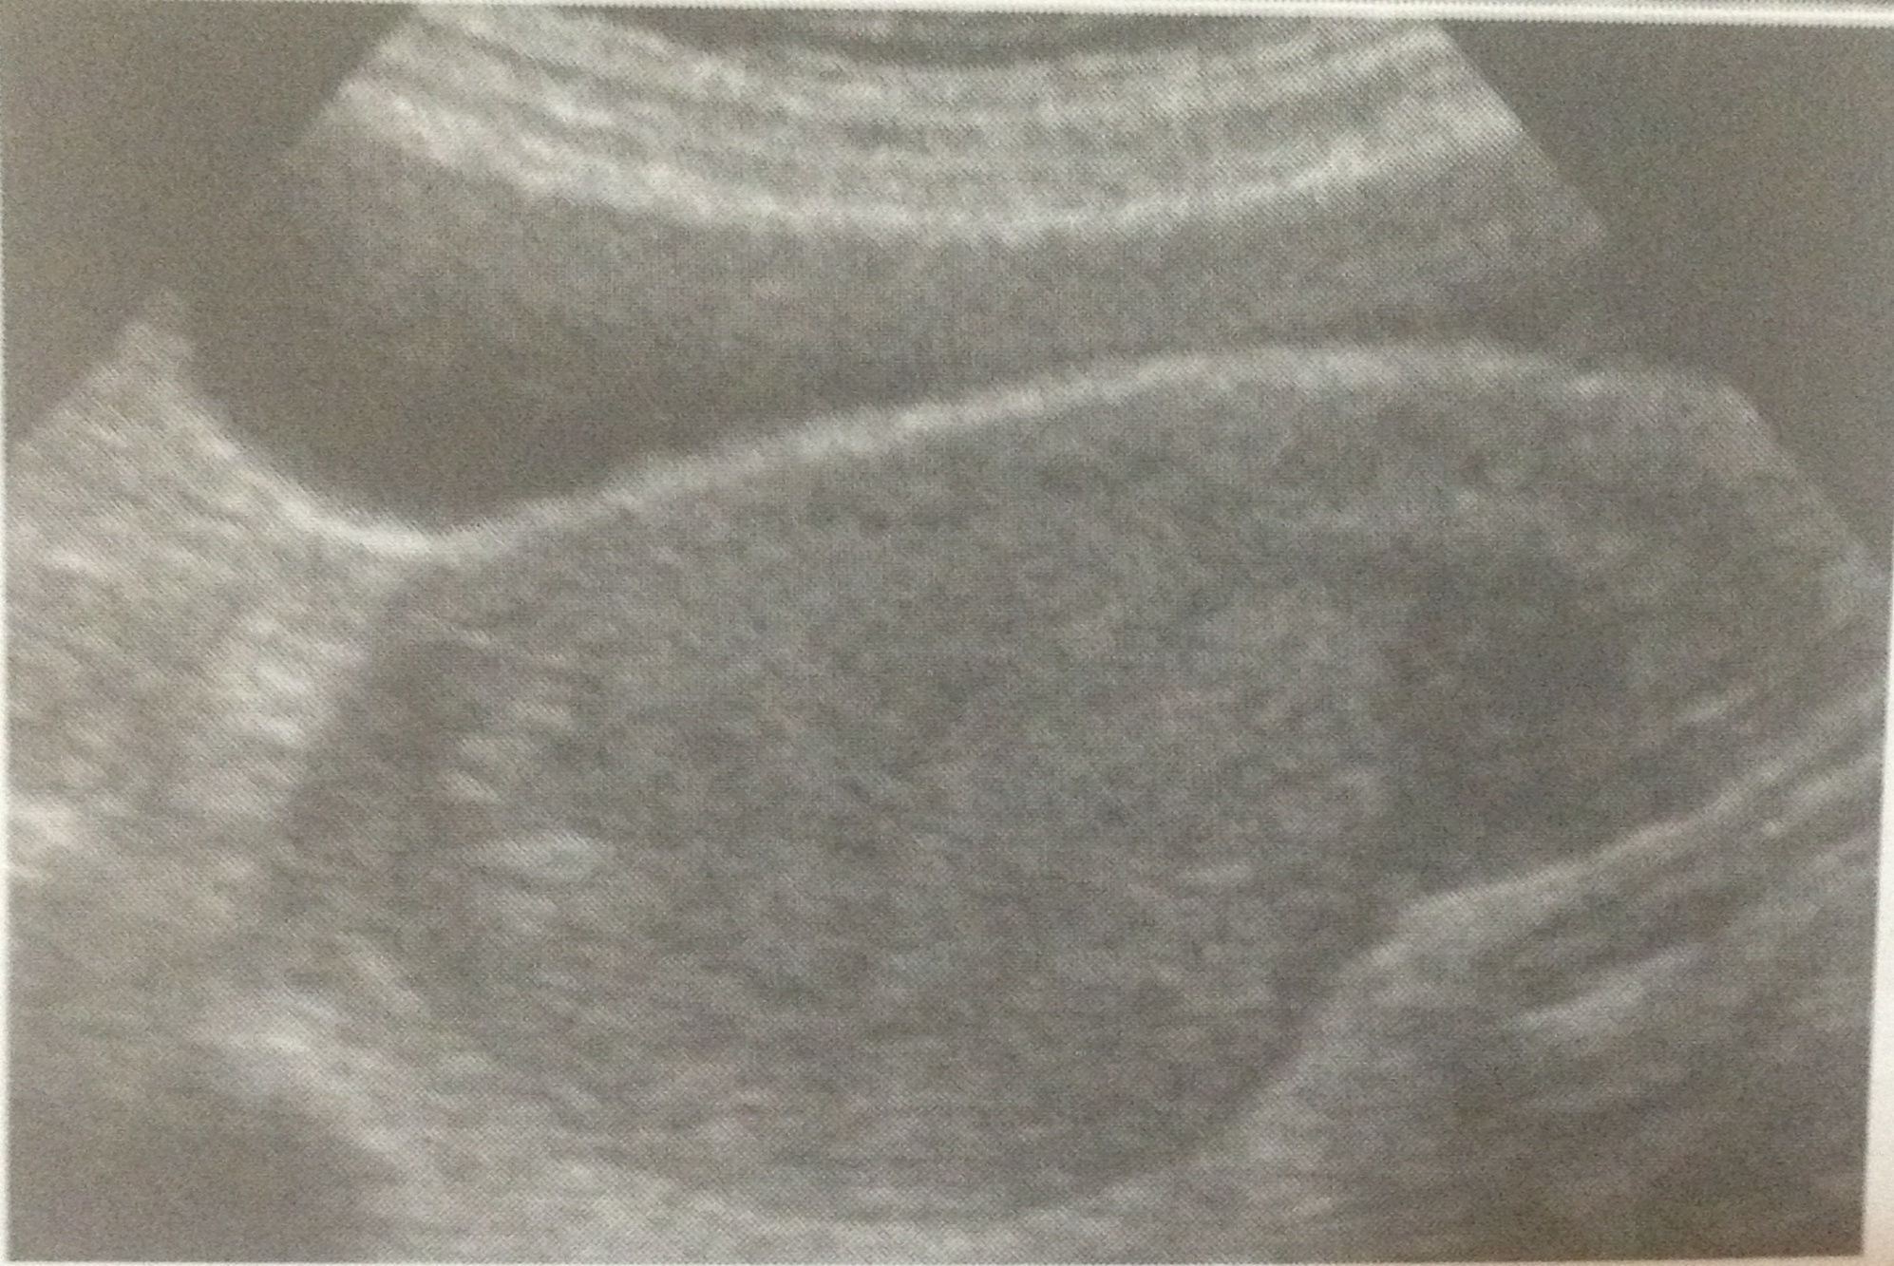

Slide 9
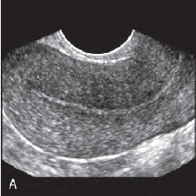
ENDOMETRIUM
MENSTRUAL PHASE:-
Thin,broken Echogenic line.
EARLY PROLIFERATIVE PHASE:-
Hypoechoic thickening(4-8mm)

Slide 10
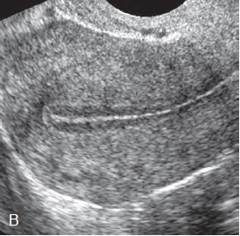
PERIOVULATORY PHASE:
Triple layer (6-10mm)

Slide 11
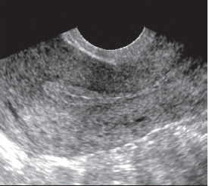
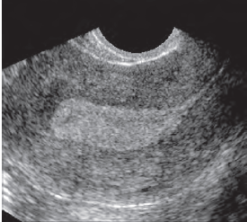
Secretory phase
Hyperechoic thickening(7-14mm)

Slide 12
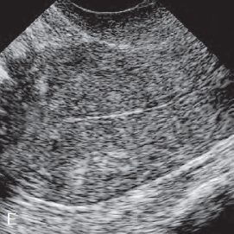
POST MENOPAUSAL
Size of the uterus and cervix gradually decrease,ratio 1:1
Endometrium becomes thin and atrophic with mean ET of 2.8 ±1.8mm

Slide 13
Leiomyoma
Sonographically leiomyoma have variable appearances
Leiomyoma are most often hypoechoic or heterogenous in structure.
They frequently distort the external contour of the uterus.
They tend to be avascular,but the surronding pseudocapsule is very capsular.
Start the examination by performing a TAS,bcos large fibroid may outwith the pelvis and will be missed if we do TVS only.
The focal range of transvaginal probe is usually a maximum of 10cm.
In colour doppler- little blood flow within fibroid and ample blood flow in pseudocapsule.

Slide 14
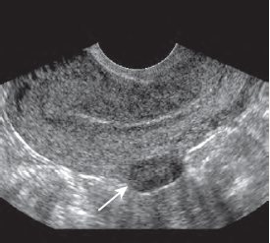
Localised hypoecoic subserosal fibroid

Slide 15
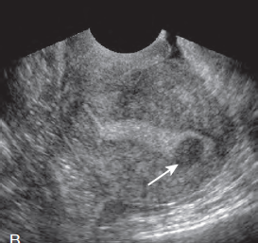
Hypoecoic submucosal fibroid

Slide 16
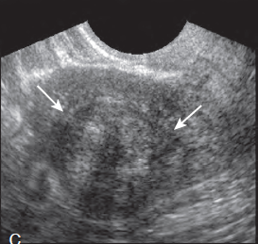
Intramural fibroid

Slide 17
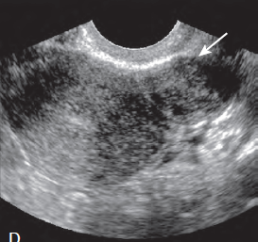
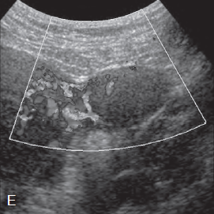
Pedunculated subserosal fibroid

Slide 18
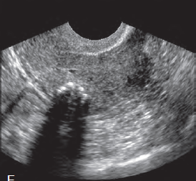
Fibroid with calcification causing posterior shadowing

Slide 19
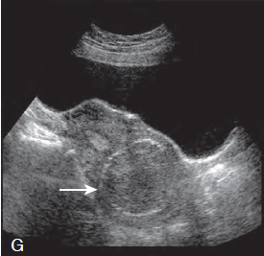
Calcified fibroid with curvilinear peripheral calcification

Slide 20
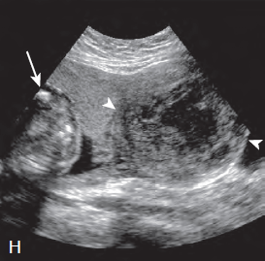
Fibroid with cystic degeneration in pregnancy

Slide 21
Checklist for suspected fibroids
Perform a TAS first.
Describe the location and 3D measurements
Check that fibroids are contiguous with the uterus.
Identify ovaries sepatately.

Slide 22
ADENOMYOSIS
Adenomyosis can occur in both diffuse and nodular forms.
More common – diffuse – composed of widely scattered adenomyotic foci within the myometrium.
Nodular- consists of circumscribed nodules called adenomyomas.

Slide 23
SONOGRAPHIC FEATURES
Diffuse enlargement
Diffuse heterogenous myometrium
Asymmetrical thickening of myometrium
Inhomogenous hypoechoic areas
Myometrial cysts.
Poor definition of endometrial-myometrial border
Focal tenderness elicited by vaginal transducer.
Subendometrial echogenic linear striations.
Subendometrial echogenic nodules.

Slide 24
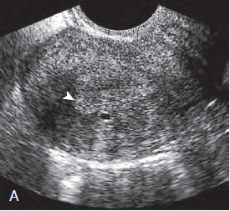
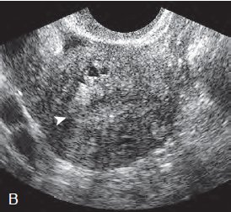
Subendometrial cyst Poorly defined endometrial border

Slide 25
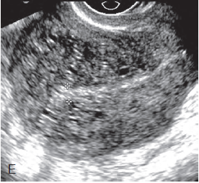
Diffuse heterogenous myometrium with multiple cysts and poorly defined endometrial borders

Slide 26
ABNORMAL ENDOMETRIAL APPEARANCE
ENDOMETRIAL POYP:-
Polyps are solitary or multiple,soft,sessile and pedunculated tumors containing hyperplastic endometrium.
The best possible image is obtained during early proliferative phase or during secretory phase after injection of sterile saline into uterine cavity.
It can be difficult to distinguish them from submucous fibroids but these tend to be more hypoechoic

Slide 27
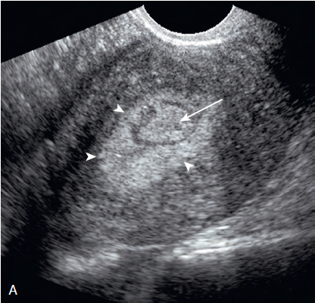
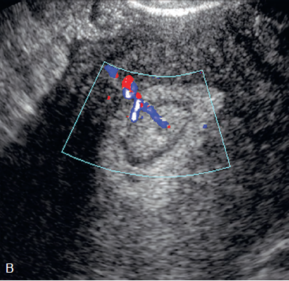
TVS SHOWING THICKENED ENDOMETRIUM WITH CENTRAL ROUND POLYP

Slide 28
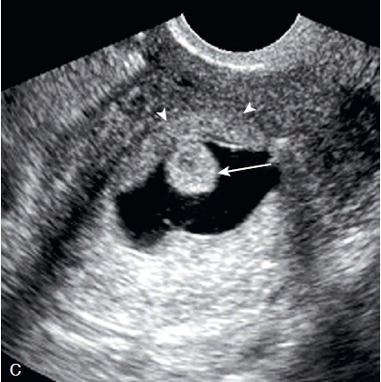
Sonohysterogram confirms polyp

Slide 29
ENDOMETRIAL HYPERPLASIA
Endometrial thickness more than 14 mm in premenopausal woman and more than 5 mm in postmenopausal woman should be further investigated.
USG imaging reveals thick, inhomogenous endometrium with small cysts.

Slide 30
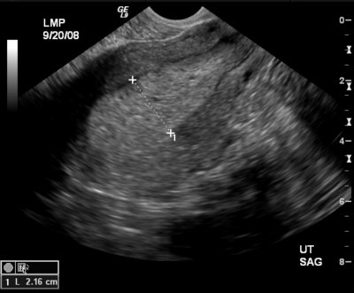

Slide 31
ENDOMETRIAL CARCINOMA
USG shows thickened endometrium with inhomogenous ,hyperechoic structure.
If there is myometrial invasion present typical subendometrial halo lost.
Typical sign of endometrial carcinoma is neovascularisation.

Slide 32
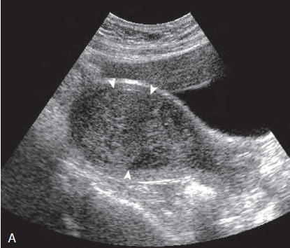
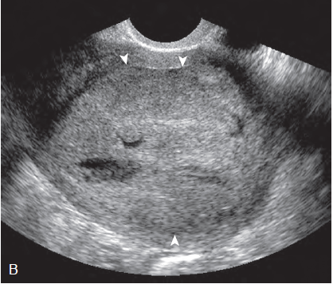

Slide 33
IUCD
IUCDs are readily demonstrable on both TAS and TVS.
They appear as highly echogenic linear structure in the endometrial cavity.
MIRENA may be difficult to visualise sonographically.
3D are extremely useful in providing a complete assessment of IUCD location.

Slide 34
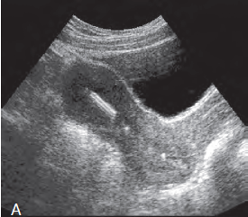
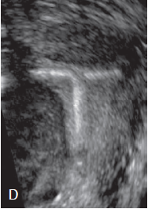
IUCD IN NORMAL PLACE

Slide 35
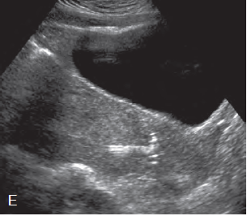
Upside down position

Slide 36
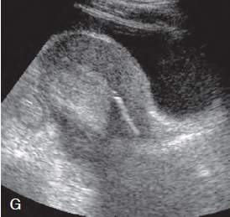
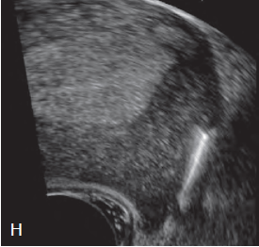

Slide 37
NORMAL OVARIAN APPEARANCE
Ovaries may not be seen in TAS ,a TVS is usually necessary and better to visualise ovaries
Average ovarian size is 3*2*2 cm.
Mean ovarian volume 1.2 to 5.8cc.
But an ovarian volume more than 8.0 cc is definitely considered normal.
Post menopausal ovary:
Aftermenopause ovaries atrophies andfollicles disappear.
Hence it is difficult to visualise.

Slide 38
Non neoplastic lesions
Functional cysts:
Functional cyst of ovary include follicular,corpus luteum and theca lutein cysts.
Follicular cyst occur when a mature follicle fail to ovulate or involute.
Normal follicle can vary upto 2.5 cm,a follicular cyst cannot be diagnosed until it is greater than 2.5cm.

Slide 39
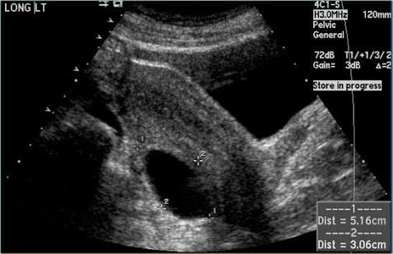
Follicular cyst is ,unilocular, and has a smooth thin wall.

Slide 40
Corpus luteal cyst
Has a thick hyperechoic ,occasionally crenulated wall, and usually has echogenic content.It typically has a pheripheral rim of colour around the wall on colour doppler USG.
Haemorrhagic ovarian cyst can present as a variety of sonographic findings, depending on size and organisation of clot.
Acute hemorrhage appears as an irregular echogenic area resembling a solid mass.
As clots begins to hemolyse ,a reticular network of low amplitude net like strands if often demonstrated.

Slide 41
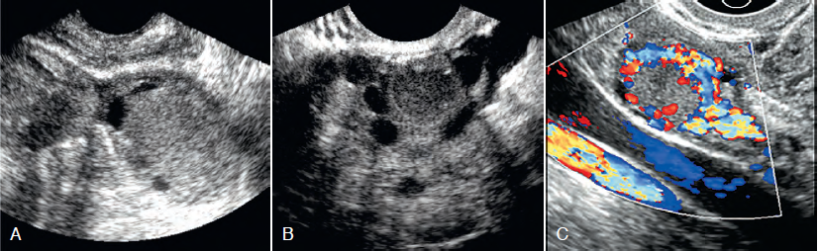

Slide 42
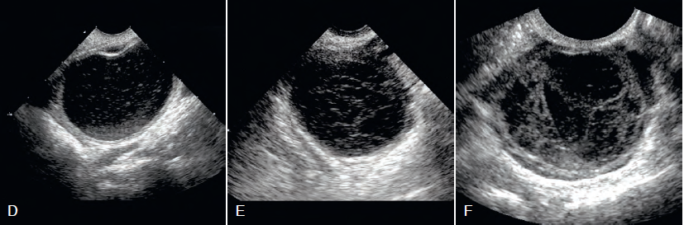

Slide 43
OVARIAN HYPERSTIMULATION SYNDROME
Ovarian hyperstimulation is used when the hyperstimulation is accompanied by fluid shifts.
Clinically three degrees:
MILD: lower abdominal discomfort but no weight gain.Ovaries are enlarged but less than 5cm in average.
MODERATE: weight gain of 5 to 10 lbs and ovarian enlargement between 5 and 12 cm.Patient may have nausea and vomiting.
SEVERE: weight gain >10lb ,severe abdominal pain and distension.Ovaries are greatly enlarged (>12cm).The associated ascites and pleural effusions may lead to depletion of intravascular fluids and electrolytes,resulting in hemoconcentration with hypotension,oliguria and electrolyte imbalance.

Slide 44
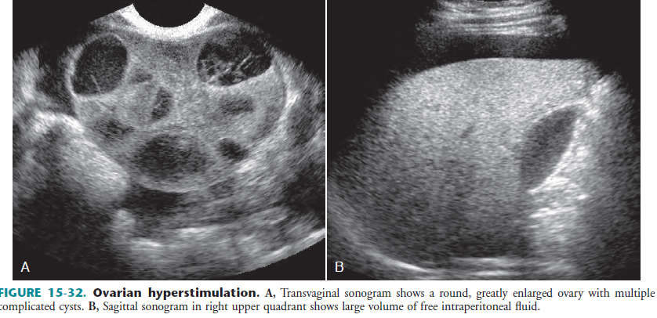

Slide 45
Theca luteal cyst
Largest of the functional ovarian cyst and are associated with high HCG levels.
Typically occurs in GTD but can also seen in OHS as a complication of drug therapy for infertility.
Sonographically , theca luteal cysts are bilateral ,multilocular and very large.
They may undergo haemorrhage ,rupture and torsion.

Slide 46
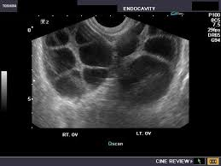

Slide 47
ENDOMETRIOSIS
Two forms have been described
Diffuse and Localised.
Diffuse form are rarely diagnosed by sonography because the implants are too small to be imaged.
Localised form of endometriosis consists of discrete mass referred to as an endometrioma or chocolate cyst.

Slide 48
Endometriomas : usually asymptomatic and are frequently multiple,with variety of appearances from anechoic to solid appearing mass.
Sonographic appearance: well defined,unilocular or multilocular ,predominately cystic mass containing diffuse,homogenous,low level internal echoes.
This is much appreciated on TVS.

Slide 49
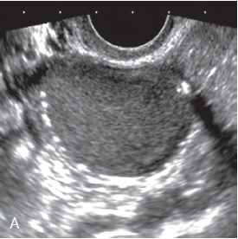
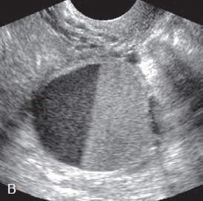

Slide 50
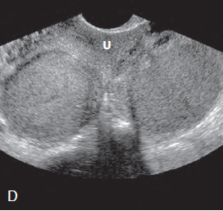
B/L ENDOMETRIOMA

Slide 51
POLYCYSTIC OVARIAN SYNDOME
Bilateral enlarged ovaries containing multiple follicles and increased stromal echogenicity.
Ovaries are more round in shape with follicles usually located peripherally –”String of pearls”
Diagnosis of PCOS should have either 12 or more follicles measuring 2 to 9 mm in diameter or increased ovarian volume greater than 10cc.
These criteria not considered valid if the patient is taking oral contraceptives or there is a dominant follicle greater than 10 mm.

Slide 52
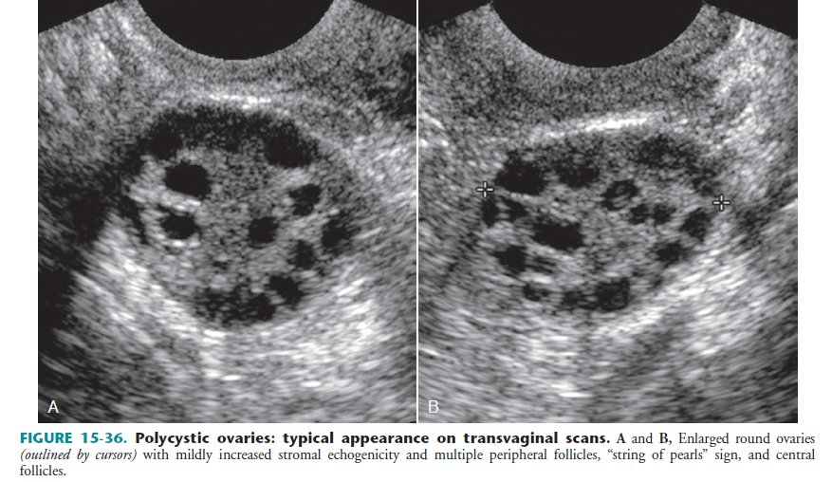

Slide 53
OVARIAN TORSION
Sonographic findings are variable depending on the duration and degree of vascular compromise and whether an adnexal mass is present.
The ovaries are enlarged.
Multiple cortical follicles in an enlarged ovary are considered a specific sign,although they are not always present.
Multifollicular enlargement is due to transudation of fluid into follicles from circulatory impairment.
Doppler shows absent flow or circular or coiled twisted vessels within vascular pedicle.
Most constant finding is UNILATERAL ENLARGED OVARY.

Slide 54
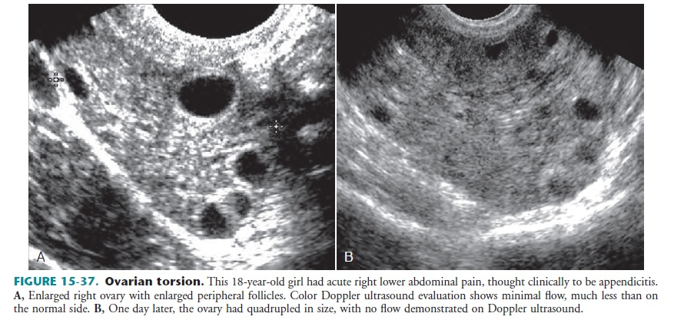

Slide 55
Abnormal ovarian appearance-benign or malignant
Measure the ovary in three dimensions if possible.
Measure the thickness of the wall of the cyst. More than 3 mm is suggestive of malignancy.
Check the lining of the cyst to see if it is nodular with papillary projections.
Look at the septa dividing the locules. Numerous thick , irregular septa are more suggestive of malignancy.
Solid components-suggestive of malignancy.

Slide 56
Contd…
Check for ascites.
If you suspect malignancy ,do an abdominal scan to check for liver mets.

Slide 57
Ovarian cancer
Histologically epithelial neoplasms represents 65% to 75% of ovarian tumors and 90% ovarian malignancies.
The remaining neoplasm consists of germ cell tumors(15-20%), sex cord sromal tumors(5-10%) and metastatic tumors(5-10%).
Sonographically ovarian ca presents as adnexal mass.
Well defined anechoic lesions are more likely to be benign.
Whereas lesions with irregular walls, thick irregular septations,mural nodules and solid echogenic elements favour malignancy.

Slide 58
Colour doppler helps in distinguish between benign and malignant ovarian masses.
Malignant tumor growth depends on angiogenesis with development of abnormal vessels.
Malignant masses ill have internal neovascularisation .
Malignant lesion will have more central flow whereas benign lesions tend to have peripheral flow.

Slide 59
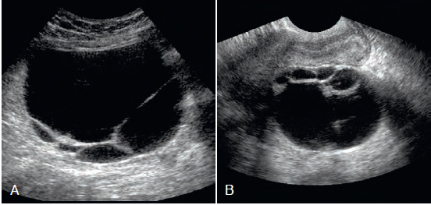
Serous cystadenoma:large,thin walled,unilocular with thin septations.

Slide 60
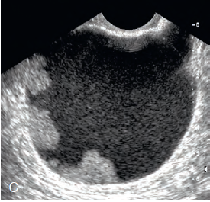
Serous cyatadenoma of low malignant potential

Slide 61
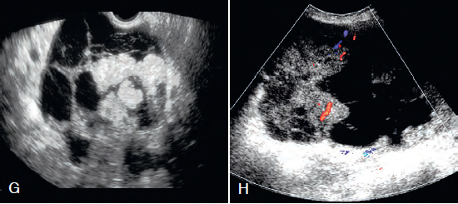
serouscystadenocarcinoma

Slide 62
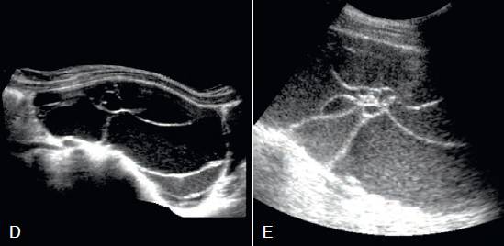
Mucinous cystadenoma

Slide 63
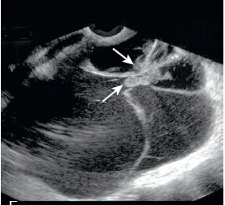
Mucinous cystadenocarcinoma

Slide 64
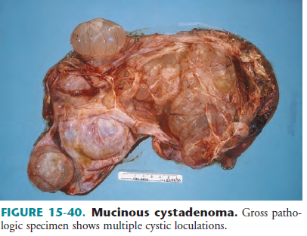

Slide 65
DERMOID CYST
They have a variable appearance ranging from completely anechoic to completely hyperechoic.
Specific features:
Dermoid plug
Tip of iceberg sign
Mobile spherules
Dermoid mesh
Fat fluid level ith echogenic nondependant layer.

Slide 66
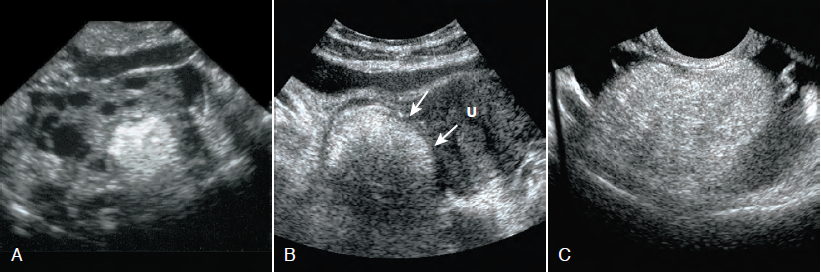

Slide 67
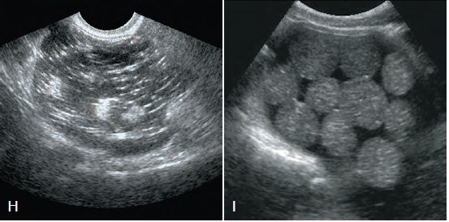
Dermoid mesh

Slide 68
Fallopian tube
Normal fallopian tube is difficult to identify by TAS or TVS unless it is dilated or surrounded by fluid.
Sonographic findings of PID:
Endometritis-endometrial thickening or fluid.
Pus in cul de sac
Periovarian inflammation-enlarged ovaries ith multiple cysts
Pyo or hydrosalphinx- fluid filled fallopian tube with or without internal echoes.

Slide 69
Contd…
Tubo-ovarian complex- fusion of inflamed dilated tube and ovary.
Tubo-ovarian abscess – complex multiloculated mass with variable septations,irregular margins, and scattered internal echoes.

Slide 70
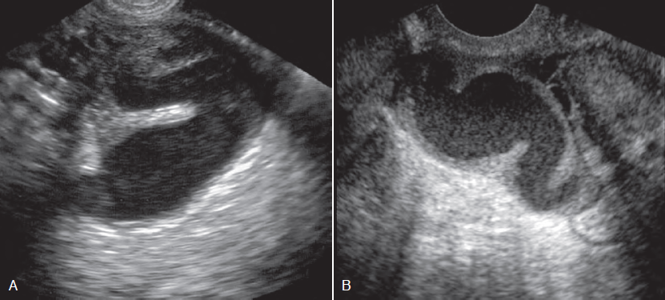


Slide 71
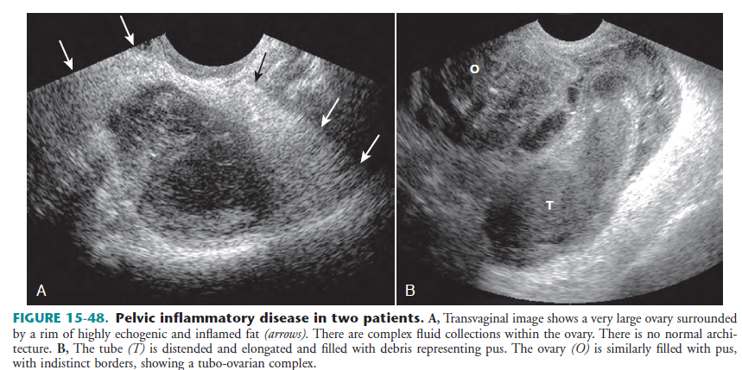

Slide 72


