Slide 1
UTERINE MALFORMATIONS.

Slide 2
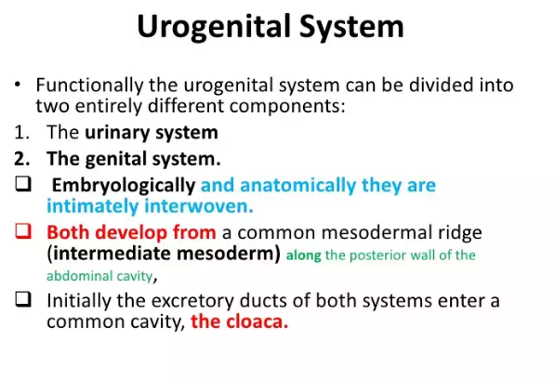
EMBRYOGENESIS.

Slide 3
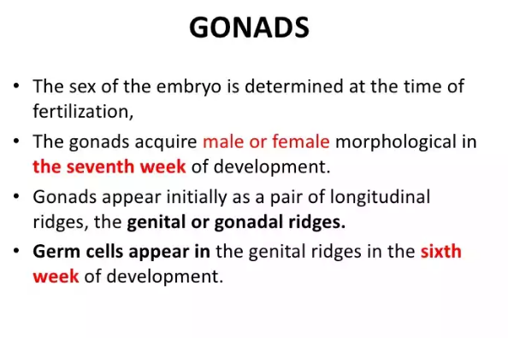

Slide 4
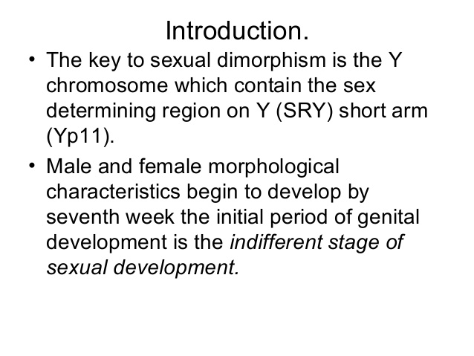

Slide 5
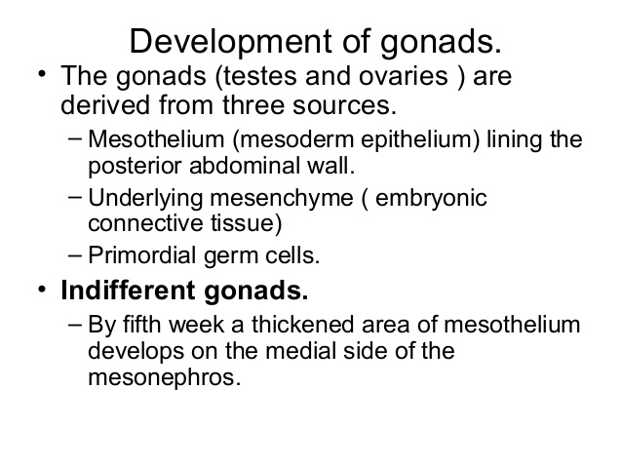

Slide 6
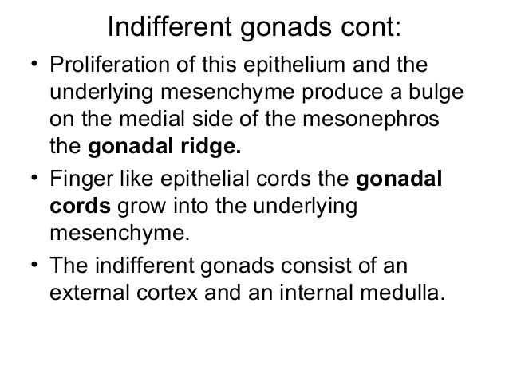

Slide 7
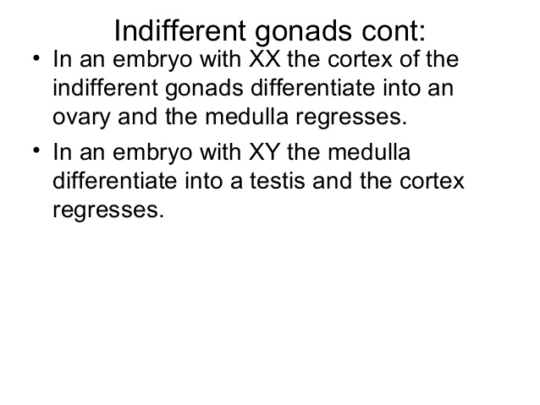

Slide 8
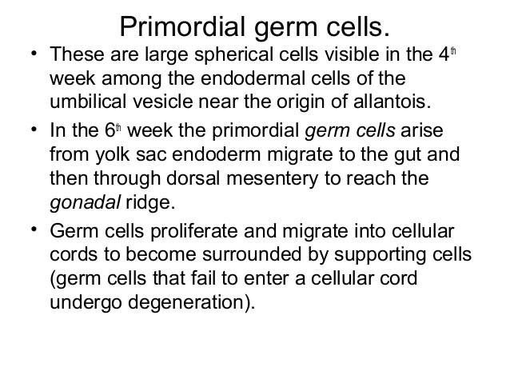

Slide 9
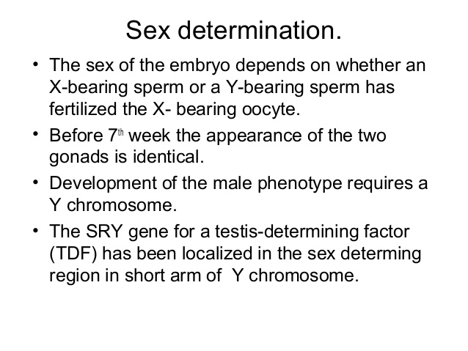

Slide 10
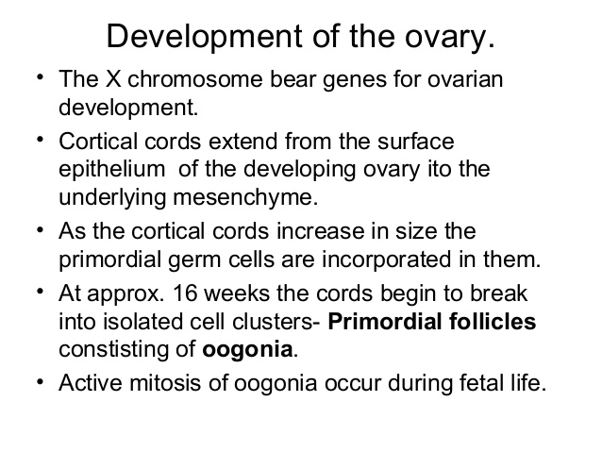

Slide 11
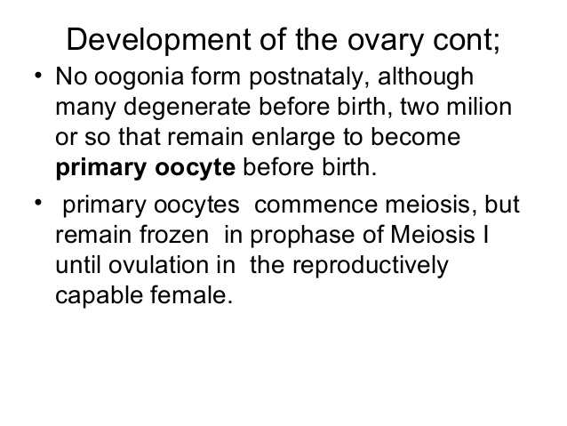

Slide 12
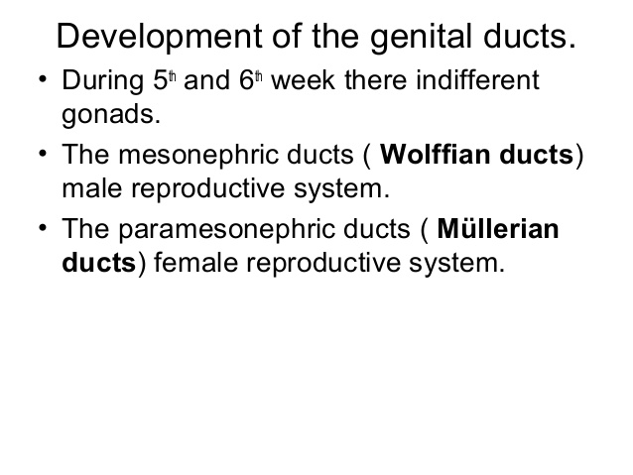

Slide 13
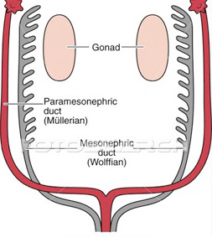

Slide 14
Paramesonephric ducts.
Paramesonephric ducts are present in intermediate mesoderm.
They are formed by invagination of coelemic epithelium,
They lie lateral to mesonephric ducts.here the ducts of the two sides meet and fuse in the middle line to form utero-vaginal canal(uterine canal).
The caudal end of this canal comes in contact with the dorsal wall of definitive urogenital sinus.
It give origin to uterine tubes, uterus ,part of vagina.

Slide 15
Female sexual development doesnot depend on presence of ovaries or Hormones.
Uterine tues develop from unfused cranial parts of mullerian ducts.
Original points of invagination of ducts into coelomic epithelium remains as the abdominal openings of tubes.
Caudal fused portion of these ducts form the uterus and vagina(upper part).
Fusion of mullerian ducts also brings together a peritoneal fold that forms broad ligament and two peritoneal compartments(Rectouterine pouch,Vesico-uterine pouch).

Slide 16
Development of Uterus
Epithelium of uterus develops from fused paramesonephric ducts.
Myometrium is derived from surrounding mesoderm.
As thickness of myometrium increases,unfused horizontal parts of two paramesonephric ducts come to be partially embedded within its substance and help to form the fundus of uterus.
The cervix can soon be recognized as a seperate region.
In fetus,cervical part is larger than body of uterus.

Slide 17
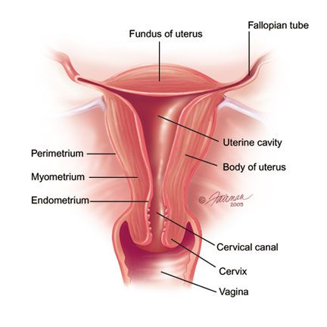

Slide 18
Development of vagina.
Fibromuscular wall of vagina is derived from surrounding mesenchyme.
Uterovaginal primodium with urogenital sinus form sinus tubercle induce formation of paired endodermal growth of sinovaginal bulb.
Sinovaginal bulbs fuse to form the lumen of the vagina.
Until late fetal life,lumen of vagina is seperated from the cavity of urogenital sinus by a membrane, the Hymen.(derived from invagination of the posterior wall of the urogenital sinus)
Upper 2/3rd from mullerian duct.
Lower 1/3rd from Urogenital sinus.

Slide 19
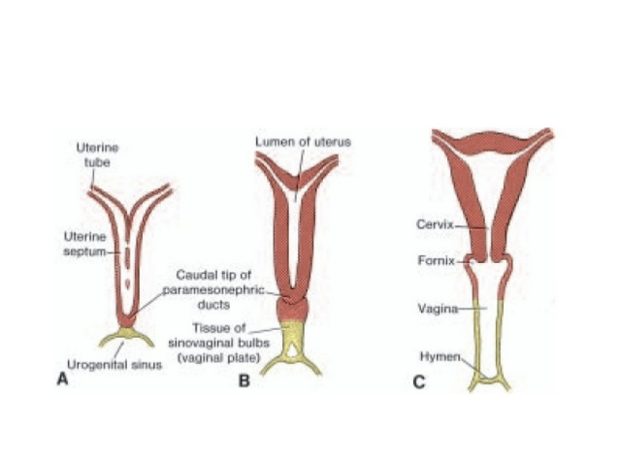

Slide 20
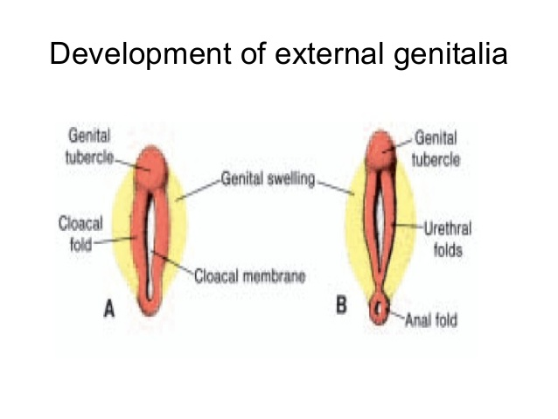

Slide 21
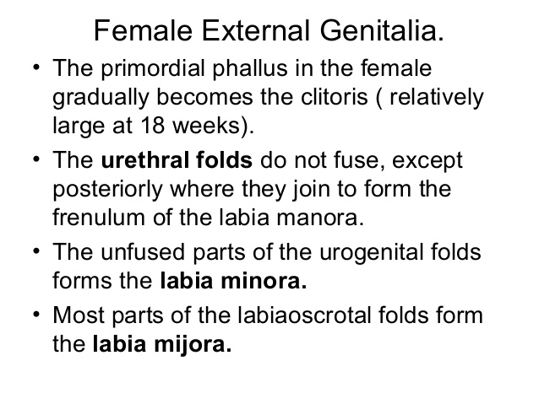

Slide 22
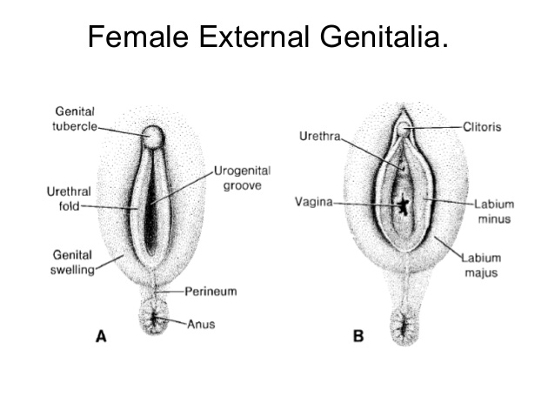

Slide 23
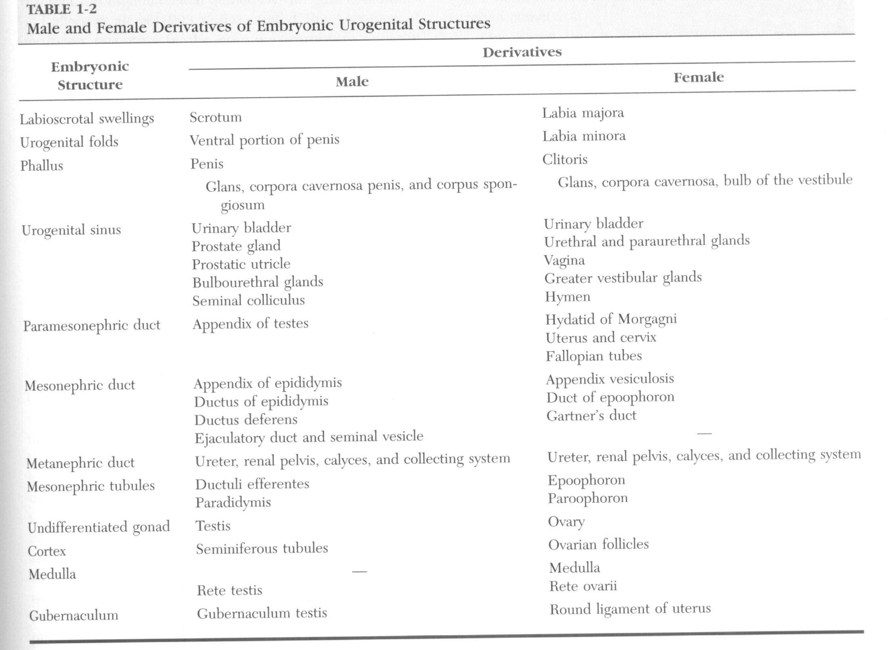

Slide 24
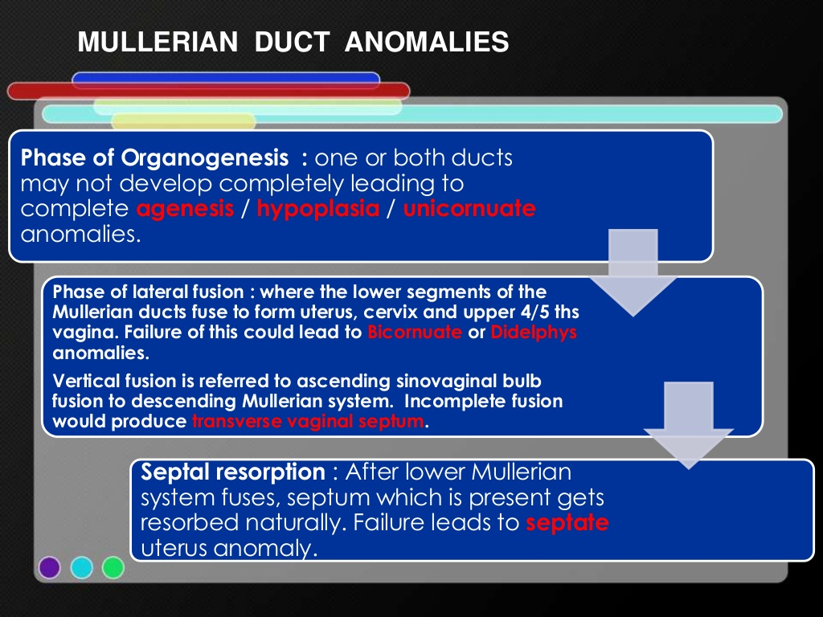

Slide 25
CLASSIFICATION | ANOMALY
Class-1(Agenesis/Hypoplasia) Segmental/complete mullerian agenesis/aplasia) | Vaginal Cervical Fundal Tubal Combined.
Class -2(Unicornuate) | Communicating Non-communicating No cavity With/without rudimentary horn.
Class-3(Didelphys) | Uterus didelphys
Class-4(Bicornuate) | Complete Partial.
Class-5(Septate) | Complete Partial.
Class-6(Arcuate) | arcuate
Class-7(DES-related) | DES-related T-shaped uterus with or without dilated horns.

Slide 26
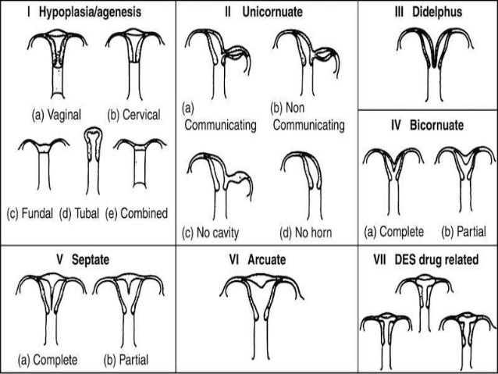

Slide 27
Absence/incomplete development of Both Mullerian ducts(Class-1)
Pathology:
Complete failure in development of the mullerian ducts results in abscence of the fallopian tube,uterus and most of the vagina(Mayer-Rokitansky-kuster-Hauser(MRKH)syndrome)
In such cases vulva is likely to be normal and there may be depression of variable depth representing the lower( urogenital sinus) part of the vagina.
It is usual to find such a depression covered with a normal hymen.

Slide 28
The patients have a normal female karotype.
Renal ectopy/agenesis,skeletal abnormalities,as well as cardiac anomalies are associated.
Mutifactorial mode of inheritance.
MRKH Syndrome has been linked with decreased galactose-1-phosphate uridyl transferase activity leading to increased intrauterine galactose exposure.
An association with MHC Ag has also been reported.
Poorly formed ducts of full length resulti in hypoplasia of the whole genital tract.
Incomplete development sometimes affects the lower parts of the ducts only.

Slide 29
Clinical aspects:
Primary Amenorrhoea(age:15-18 years)
Growth & secondary sexual characteristics are normal.
L/E: small vagina pouch .
On Rectoabdominal examination:Uterus cannot be palpated.
Ultrasound:Confirms the absence of the uterus and demonstrates the ovaries.ocassionally,the rudimentary horns can be seen.
If ultrasound is inconclusive MRI or laproscopy is required.
MRI is the IDEAL method for demonstrating uterine malformation.

Slide 30

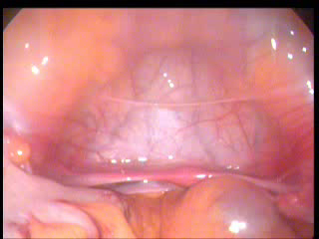

Slide 31
Chromosomal analysis is not usually required in these patients.
Renal anomalies are the most common associated features seen in 40%of cases,ranging from complete agenesis to malposition(usually a pelvic kidney),to substle architectural alteration.
Skeletal abnormalities can involve the spine,limbs or ribs.
These are seen in 10-15% of patients.
Subclinical auditory defects.

Slide 32
ABSENCE/INCOMPLETE DEVELOPMENT OF ONE MULLERIAN DUCT(CLASS 2)
PATHOLOGY:
Absence of one mullerian duct results in a unicornuate uterus with only one fallopian tube.
The cervix & vagina may be normal in appearence and function but they represent strictly only one half of the fully developed organs.
A true unicornuate uterus is rare and is usually with absence or gross malformation of the renal tract on the side of the missing mullerian ducts.

Slide 33
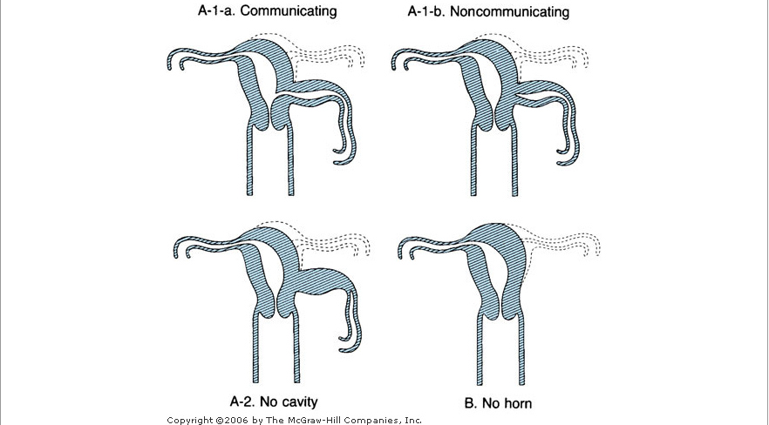
Unicornuate Uterus.

Slide 34
Symptoms:
Incidental finding discovered by chance/as a result of pregnancy complications.
Dysmenorrhoea (pain is limited to the side on which the horn is present)
Favours abortion, Premature labour.
Breech presentation of the foetus.
Fundal insertion of the placenta.
But uterus usually contracts efficently in all stages of labour.

Slide 35
Signs.
Uterus which leans well to one side of the pelvis and which cannot be straightened should always be suspected as being cornuate.
Hysterosalpingographs
  Cannot distinguish between true and apparent unicornuate deformity.

Slide 36
Treatment.
No treatment needed.
The rudimentary horn of an apparent unicornuate uterus have to be excised if it causes symptoms.

Slide 37
Uterus Unicornis:
Body and cervix of the uterus have been developed from one mullerian duct only and there is a rudimentary horn to one side of it,the cavity of which usually fails to communicate with either the developed horn or the vagina.
Ocassionally,the uterus may be itself may be a rudimentary organ or it may be infantile and very underdeveloped.
More rarely still,there may be a complete absence of the uterus in some cases.

Slide 38
Uterus Unicollis:
Pregnancy is extremely rare in this type of deformity.
Pregnancy in the rudimentary horn is attended with grave risks.

Slide 39
Imperfect fusion of the mullerian ducts
Pathology:
Failure of fusion of the mullerian ducts occurs in varying degrees.
Demonstrated 10-15% fertile women are affected.
Uterus didelphys(class-3)
Bicornuate uterus(class-4)
Septate and subseptate uterus(class-5)
Arcuate uterus(class-6)
DES-related Anomalies(class-7)

Slide 40
Uterus Didelphys.(Class-3)
If the two mullerian ducts remains seperate, the two halves of the uterus remain distinct and each has own cervix.
Patients have no difficulties with menstruation and coitus.
One sided is obstructed and symptomatic
Increased risk of
    miscarriage,
    malpresentations(Breech) and
    premature labour.
Majority have no reproductive difficulties.

Slide 41
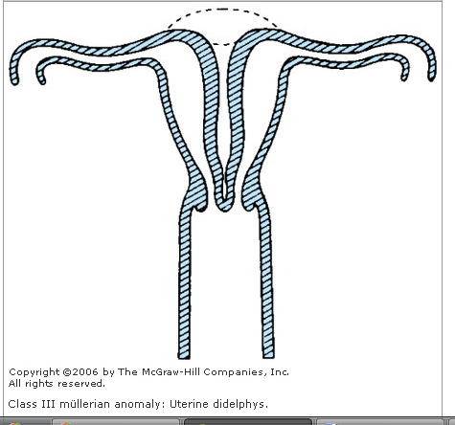
Uterus Didelphys

Slide 42
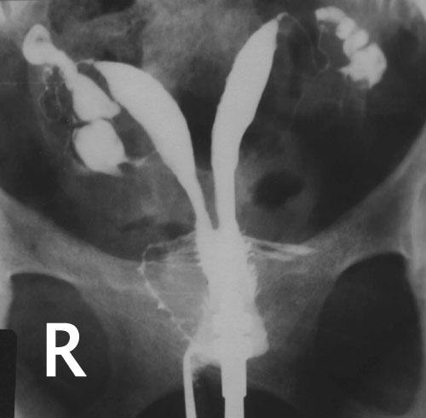
HSG in Uterus didelphys

Slide 43
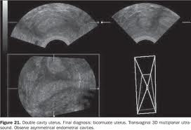
USG in Uterus Didelphys.

Slide 44
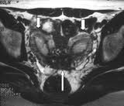
MRI in Uterus Didelphys.

Slide 45
Complications:
Non-gravid uterus –fibroid.
Seperately palpable-ovarian mass.
Mistaken diagnosis of extrauterine gestation.
Menstruation can occur even during pregnancy.
IUGR,
PRETERM DELIVERY,
MALPRESENTATIONS.

Slide 46
BICORNUATE UTERUS (Class -4)
Upper parts of the uterine portions of the mullerian ducts remain distinct,while the lower parts undergo imperfect fusion.
Cervix is single,but divided by a median septum and this sepum continue into the vagina and divides it too.
Deep depression at the fundus.
Repeated poor pregnancy outcome

Slide 47
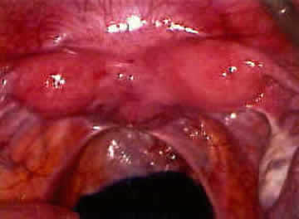
Laparoscopic appearence of Bicornuate Uterus.

Slide 48
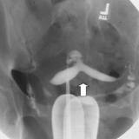
HSG in Bicornuate Uterus.

Slide 49
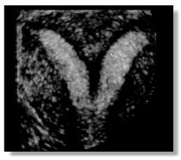
USG in Bicornuate Uterus.

Slide 50
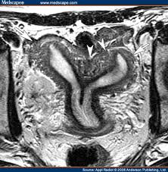
MRI in Bicornuate Uterus.

Slide 51
Septate and subseptate uterus(Class-5)
Uterus septus:
Uterus presents the normal shape externally with no depression at the fundus ,but a septum streches right upto
external os dividing the body of uterus and cervical canal into two halves.
The vagina is single.
Uterus subseptus:
Septum doesnot extend to the entire length of the uterine cavity , being confined to the upper portion for a variable distance.

Slide 52
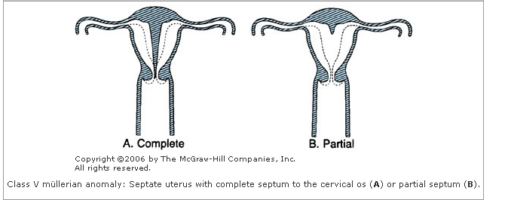

Slide 53
UTERUS SEPTUS AND SUBSEPTUS..
In some, pregnancy and labour proceed normally.
Sometimes,Repeated abortions may occur.
Malpresentations especially Breeech, may be more frequent.
Placenta may be retained or adherent and it is during the manual removal of the placenta that the condition is generally diagnosed.

Slide 54
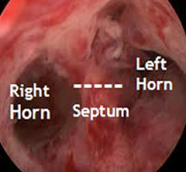
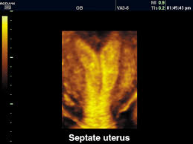
Septae uterus.

Slide 55
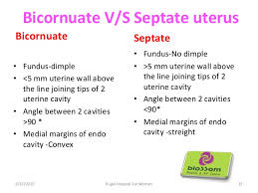

Slide 56
Arcuate uterus(Class -6)
This is the low grade of abnormality.
Uterus is normal,except for a slight depression in the midline over the fundus giving it a saddle shaped or arcuate appearence.

Slide 57
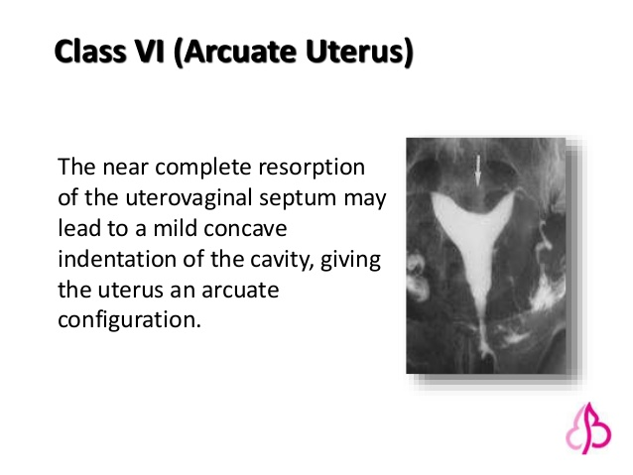

Slide 58
Deformities in combination.
Uterus bicornis unicollis:
  Same as Uterus bicornis bicollis,except that there is one cervical and vaginal canal.
  Duplication and Diverticula of Mullerian Ducts:
  If mullerian ducts are duplicated, a true double uterus with 4 fallopian tubes can result but extremely rare.
  More common:Diverticula of the ducts which give rise to
  Accesory abdominal ostia of the tube,
  Acessory tubes,
  Diverticula of the tube,
  Uterine diverticulum/Acessory horn(MULLEROMA)third horn is not a supplied with a fallopian tube or round ligament.If functional it can cause severe dysmenoorhoea.

Slide 59
DES-related Anomalies(Class-6)
Women who are exposed to Diethylstilboestrol(DBS) in utero.
Benign vaginal adenosis,
Cervical hoods,
septae,
Collars.
T-shaped uteri,wide lower segments & constriction bands.
High incidence of perifimbrial paratubal cysts.
Vaginal clear cell carcinoma is very rare.

Slide 60
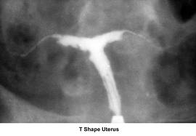
T-Shaped Uterus.
Management:
Lateral Metroplasty.
Encerclage is mandatory in event of Pregnancy.

Slide 61
Causes:
Mullerian ducts are ordinarilly pulled together by subperitoneal fibromuscular tissue and defect in this process is a cause of these malformations.
Uterus didelphys and bicornuate uterus often unusally thick and strong round ligaments and a tough vesicorectal fold running between each horn,may be that these prevent the mullerian ducts coming together.

Slide 62
Symptoms:
Menstrual:
Menstrual cycle is usually normal.
  Primary amenorrhoea
  Outflow obstruction
Menorrhagia:
  Because of larger bleeding surface offered by two well-developed uterine horns.
  SpasmodicDysmenorrhoea:
  Unusual arrangement of the musculature and by abnormal contractions.
  Un equal development of the two horns can be manifested by one sided dysmenorrhoea.
  Failure to contain flow:
  Failure to control menstrul outflowby means of a single intravaginal tamponade(Septae vagina &Uterus didelphys)

Slide 63
Coital
Dyspareunia:
    Vaginal septum cause difficulty in coitus
    One half of the vagina is then usually dilated and the septum is pushed to the side.
    Bleeding:
    attempts at coitus or at insertion of a tampon sometimes cause bleeding from a vessel in the lower edge of the septum.

Slide 64
Obstetrical causes
Infertilty :
  Only form of malfusion that lower the infertility is a fully septate vagina.
  coitus may happen in half which doesnot communicate with cervix/uterus(Developed)/doesnot serve the ovary which has ovulated in that particular cycle.
  Cornual pregnancy/Ectopic pregnancy
  Site of the conceptus:if both horns are well developed successive pregnancy not necessarily from same cavity.
  Sacculation of the Uterus:
  Either organic/functional abnormality during pregnancy.
  Saccule is sited on the line of the mullerian ducts it may be a manifestation of a fusion defect.

Slide 65
Abortion and Premature Labour:
Uterus is malformed.
Inadequate streching and hypertrophy to accomodate the pregnancy,poor implantation,placentation on a septum.
Uterine malformation cause late than early abortions,because of associated incompetent os.
Malpresentation:
Fundal /cornual insertion of the placenta, are often explained by an abnormality of uterus.
Subseptate/bicornuate deformity: Transverse lie.
Uterus Didelphys/Unicornuate uterus: Breech prsentation.
Transverse lie resists version.
H/o malpresentations in several Pregnancy raise suspicion of uterine malformations.

Slide 66
Inefficent uterine action:
More common in 3rd trimester.
Manual removal of placenta (bicornuate/septae/subseptae uterus)
Incidence of postpartrum haemorrhage increased.
If horns completely seperate expulsive action is good.
High vaginal septum can prevent cervix from dilating.
Obstructed Labour:
Non pregnant horn of uterus didelphys enlarges during pregnancy due to hormonal influences as the pregnant horn.
It remains low in pelvis which obstructs the delivery of the foetus

Slide 67
Ruptured uterus.
Dystocia .
Foetal growth restriction
Evaluvation of mullerian anamolies:
Clinical evaluvation
  History,
  Examination of secondary sexual characteristics.
  External genitalia
  Per vaginal & Per rectal examination.

Slide 68
Investigations:
Ultrasound –Pelvic and Renal.
Magnetic Resonance Imaging.
Laprascopy,
Hysteroscopy,
Hysterosalpingogram

Slide 69
Management
Mangement depends on type of anomaly.
Rudimentary horn with signs of obstruction should be excised
Uterine septum can be excised hysteroscopically.
Strassman meteroplasty consists of wedge resection of the septum and reconstruction ot uterus(Bicornuate uterus)

Slide 70
SURGICAL MANGEMENT.
CLASS | MANAGEMENT
CLASS-1 | RECONSTRUCTION OF VAGINA EXCISION OF SEPTUM
CLASS-2 | EXCISION OF RUDIMENTARY HORN
CLASS-3 | EXCISION OF VAGINAL SEPTUM OCASSIONALLY METROPLASTY
CLASS-4 | STRASSMAN METROPLASTY
CLASS-5 | HYSTEROSCOPIC SEPTAL RESECTION
CLASS-6 | NO SURGERY REQUUIRED
CLASS-7 | DEPENDS ON ANAMOLY MAY NOT REQUIRE SURGERY

Slide 71


