Slide 1
ANTEPARTUM FETAL SURVEILLANCE

Slide 2
CLINICAL EVALUATION.
AT FRIST VISIT:
Initial antenatal examination should be carried out in first timester.
A record of size of uterus following Bimanual examination/ USG.
Estimates correct duration of gestation.

Slide 3
Parameters.
Maternal weight gain
Blood pressure,
Assessment of the size of the uterus and height of the fundus,
Clinical assessment of excess liquor,
Abdominal girth.

Slide 4
Maternal weight gain.
Average wt gain:1 kg a fortnight,
Excess weight gain:
Excess fluid retention-sign of preclampsia.
Weight gain falling/less than normal:
IUGR.

Slide 5
Blood pressure.
Bp <12 weeks to differentiate preexisting chronic HT from Pregnancy induced HT.
Hypertension impair fetal growth.

Slide 6
Assessment of uterine size & Ht of fundus.
Height of fundus is documented at each visit.
The top of fundus is measured from the superior border of the symphysis pubis(bladder should be empty) using a tape.
After 24 weeks of pregnancy the distance measured in cm normally corresponds to the period of gestation in weeks.
A variation of 1-2cm is acceptable.

Slide 7
Date of LMP a measurement of symphysis-fundal height in later month of pregnancy is an useful screening test for further investigation.
If the measurement falls below the 4 Cms,FGR is suspected & more specific investigations done.

Slide 8
Clinical assessment of excess liquor.
Scanty liquor in the last trimester.
Indicates placental insufficency.

Slide 9
Abdominal girth.
This is measured as lower border of umblicus.
Girth increases steadily upto term.
If the girth gradually diminishes beyound term or earlier suscipion of placental insufficency.
Done in high risk cases:
Preclampsia,
Chronic HT,
IUGR.

Slide 10
Why Antepartrum fetal surviellance Important?
30% antepartrum fetal deaths due to asphyxia
(IUGR,post dates),
30% maternal complications:
Preclampsia,
Placental abruption,
DM.
15% congential malformations & abnormalities,
5% infection.

Slide 11
50% first trimester spontaneous abortion,
5% stillborn infants have chromosomal anomalies.
Congential anomalies:
Chromosomal:numerical (47XXX)
Structural (translocations)
Single gene(cystic fibrosis)
Polygenic & multifactorial(NTDs)
Teratogenic disorders(Drugs).

Slide 12
Special Investigations
Biophysical tests,
Biochemical tests.

Slide 13
Early Pregnancy.
Biochemical tests
Maternal serum alpha fetoprotein (MSAFP)
Triple Test,
Acetyl cholinesterase,
Inhibin A,
Prenatal genetic testing:
Amniocentesis,
Chorionic villous sampling.

Slide 14
MSAFP
AFP is an oncofetalprotein.
Highest level in fetal serum & amniotic fluid is reached around 13 weeks,
Elevated in:
Wrong gestational age,
Open Neural tube defects,
Multiple pregnancy,
Rh Isoimmunisation,
IUFD,
Anterior abdominal wall defects,
Renal anomalies.

Slide 15
Low levels:
Trisomies(Down;s syndrome),
GTN.

Slide 16
Triple tests.
Combined biochemical test includes
MSAFP,
hCG and
UE3.
Detection of Trisomy 21,
Done between 15-20 weeks of gestation,
Risk ratio of 1:250 or greater amniocentesis is suggested.

Slide 17
AFP:
High in Neural tube defects,
Failure of the fetus abdomen to close.
HCG:
Low levels:
Miscarriage,
Ectopic Pregnancy.
High levels:
Molar pregnancy,
Multiple Pregnancy.
Estriol:
Low:Down’s syndrome.

Slide 18
Acetyl choline esterase.
Elevated in Neural tube defects.
Better diagnostic value than AFP.

Slide 19
Inhibin A
Dimeric glycoprotein.
Produced by corpus luteum and the placenta.
Increased in Down’s syndrome.
Triple test +Inhibin A=Quadruple Test.

Slide 20
Prenatal genetic diagnosis:
Amniocentesis:
Invasive procedure
Performed between 14 and 16 weeks.
Under USG guidance.
Fetal blood obtained in this procedure are subjected to cytogenetic analysis.
Eg; Down’s syndrome,
Turners syndrome.

Slide 21
Chorionic villous sampling.
Carried transcervically between 10-12 weeks
Trans abdominally from 10 weeks to term.
Complications:
Fetal loss,
Oromandibular defects,
Maternal cell contamination
Anti D Ig 50 ug IM administered following the procedure to Rh –ve woman.

Slide 22
Biophysical.
USG :
10-14 weeks can detect fetal anomalies
CRL smaller than GA is associated with chromosomal anomalies.
Absence of nasal bone on USG at 10-12 weeks is associated with fetal Down syndrome.

Slide 23
Objectives:
Preventionof fetal death,
Avoidance of unnecessary interventions.

Slide 24
Biophysical tests
Biophysical profile is a screening test for uteroplacental insufficency.
Biophysical tests:
Fetal movement count,
Fetal biophysical profile,
CTG,
Doppler usg,
NST,
Vibroacoustic stimulation test.s

Slide 25
Fetal movement count.
Less than 10 movements occur during 12 hrs,
On 2 successive days.
No movement is perceived even after 12 hrs in a single day.
DFMC:3 counts each of 1 hour duration are recommended.countsX4 gives daily DFMC.
Less than 10 in 12 hrs indicates fetal compromise.

Slide 26
Loss of fetal movements.
Increased fetal movements-maternal hypoglycemia,
Reduced:
Fetal sleep,
Fetal anomalies,
Anterior placenta,
Hydraminos,
Obesity,
Drugs,
Chronic smoking,
Hypoxia.

Slide 27
NST
CONTINUOUS ELECTRONIC MONITORING OF FETAL HEART RATE ALONG WITH RECORDING OF FETAL MOVEMENTS.
Reactive: when 2 or more accelerations of more than 15 beats per minute above the baseline and longer than 15 sec in duration are present in a 20 min observation.

Slide 28
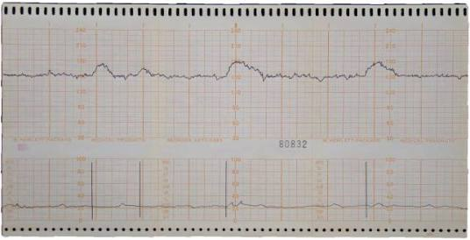
Reactive NST

Slide 29
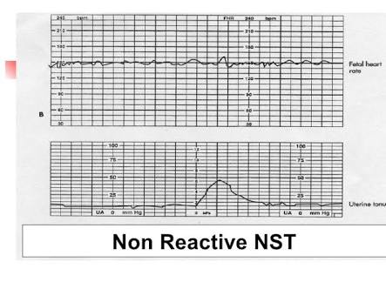
Non reactive.
Absence of any fetal reactivity.

Slide 30
Types of Decelerations.
Early deceleration:Head compression,
Late deceleration:Fetal Hypoxia,
Variable deceleration:Cord compression

Slide 31
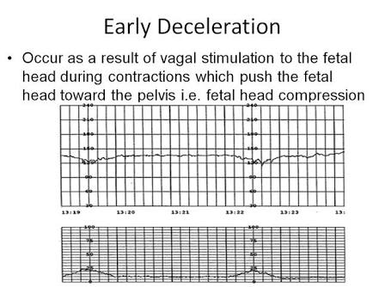
Early Deceleration.

Slide 32
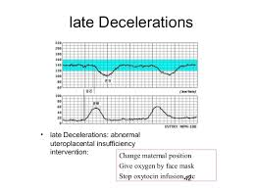
Late deceleration.

Slide 33
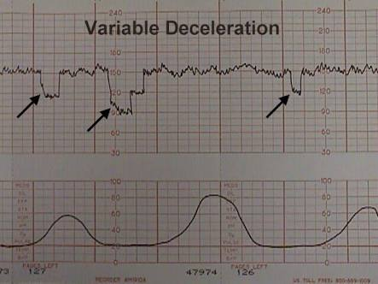
Variable deceleration.

Slide 34
Fetal BPP.
For high risk pregnancy,
Frequency weekly after a normal NST and twice weekly after an abnormal test.
Modified BPP:
NST,
AFI

Slide 35
CTG
>32 WEEKS
Base line heart rate :110-150 bpm,
Baseline variability :5-25 bpm,
2 or more accelerations during a 20 min period.

Slide 36
USG
IUGR with serial measurement BPD,AC,HC,FL and AFI.
Ac is single measurement –Fetal nutrition.

Slide 37
AFV
AFV is dependant upon fetal urine,output,pulmonary fluid production and fetal swallowing.
Decreased(AFI</5) in fetal hypoxia and placental insufficency.
A vertical pocket of AF >2cm is normal.

Slide 38
Other investigations
Test for pulmonary maturity,
Assessment of severity of Rh iso immunisation.

Slide 39
Pulmonary maturity.
Estimation of pulmonary surfactant:
Lecithin:Spinghomyelin ratio
Shake test or Bubble test.
Serial dilutions of amniotic fluid mixed with 95% ethanol for 15 sec presence of bubbles as meniscus in 15 min presence of surfactant.
Presence of phosphatidyl glycerol,
Saturated phosphatidyl choline,
lamellar body,

Slide 40
Assessmentof severity of Rh isoimmunization.
Amniocentesis fro estimation of bilirubin in amniotic fluid by spectrophotometry analysis 450nm
Prediction of fetal haemolysis.

Slide 41
THANK YOU.

