Slide 1
Ambiguous genitalia
Chair-person :- Dr Virupaksha (Associate professor)
Presenter- Dr Anupama.N.K
Dr Vinodini

Slide 2
NORMAL EMBRYOLOGY
Urogenital tract is functionally divided into
1. urinary system
2. genital system
Both developed from intermediate mesoderm and extends along entire embryo length. Initially longitudinal ridge of this intermediate mesoderm develops along each side of the primitive abdominal aorta called urogenital ridge

Slide 3
Primordial germ cells first appears in outer ectodermal layer of the embryo.
At 40 days gestation ; germ cell migrate along the hindgut to the urogenital ridge then divided into nephrogenic and genital ridge
At 60 days gestation ; nephrogenic ridge develop into mesonephric kidney(mesonephros) and paired mesonephric ducts (wolffian duct)

Slide 4
Mesonephric ducts connects mesonephric kidneys to cloaca.
Cloca – common opening into which embryogenic urinary, genital, and alimentary tract join.
Ureteric bud arises from mesonephric duct at approximately 5th week of fetal life.
Ureteric bud lengthens to become metanephric duct (ureter) and differentiate to metanephros eventually become functional kidney.

Slide 5
Paired paramesonephric ducts (mullerian duct) develop from invagination of coelomic epithelium around 6 week and grow along the side of mesonephric ducts
Caudal portion of mesonephric ducts approximate one another in midline and end behind cloaca.
Cloaca divided by formation of urorectal septum (7th week) and separated to create rectum and urogenital sinus

Slide 6
Urogenital sinus is divided into 3 parts
1. cephalad portion ------- urinary bladder
2. middle/pelvic portion---------female urethra
3.caudal/phallic part--------------distal vagina , greater vestibulae (bartholin) ,urethral, and paraurethral (skene) glands

Slide 7
Normal sexual development
It is the presence or the absence of the Y chromosome which determines whether the undifferentiated gonad becomes a testis or the ovary. This is the fundamental principle of sexual development.
The chromosomal sex is defined at fertilization. The first stage of gonad is the indifferent stage which begins at the 5th week of intrauterine life. The gonad at this time possesses a cortex and a medulla.

Slide 8
Sexual differentiation can be considered at five levels for ease of understanding- chromosomal or genetic sex, gonadal sex, internal genital sex, external genital sex and sex of rearing.

Slide 9
In presence of SRY gene(sex determining region on Y chromosome)
primitive fetal gonad differentiate into testis
testis secrete testosterone

Slide 10
Testosterone converted to DHT by enzyme 5 alpha reductase
DHT causes enlargement, rugation and fusion of labio-scrotal fold into scrotum, fusion of ventral surface of the penis to enclose penile urethra, finally enlargement of phallus, ultimately develop to male external genitalia.

Slide 11
In presence of testosterone wolffian duct develop into vasa-deferens, seminiferous tubule, and prostate

Slide 12
In absence of SRY gene
ovary spontaneously develop from the bipotential primitive gonads

Slide 13
In the absence of fetal testicular secretion of mullerian-inhibitory substances leads to development of normal uterus, fallopian tube, posterior 3rd vagina and wolffian duct degenerate.
Total absence of androgen --external genetalia appears female

Slide 14
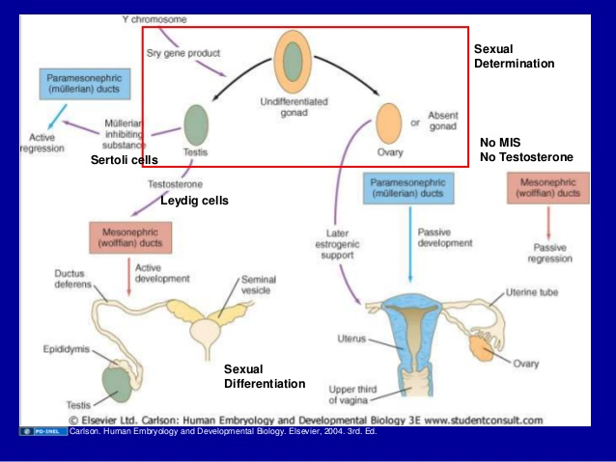

Slide 15
Ambiguous genitalia
Defined as presence of both male and female external and or internal genital organs in the same individual causing confusion in diagnosing true sex

Slide 16
Classification
category 1 : female pseudo hermaphroditism
category 2 : male pseudo hermaphroditism
category 3 : disorder of genetic or gonadal development
A) gondal digenesis
B) true hermaphroditism
C) emgryogenic testicular regression

Slide 17
Female pseudohermaphroditism/ female intersex
Autosomal recessive disorder
Karyotype(46XX)
Virilization of external genitalia
Phenotypic appearance of external genitalia (masculinized) due to excessive androgen exposure.
Ovaries, uterus, cervix, and upper vagina present.
Potentially fertile

Slide 18
Aetiology
1. Androgen induced
  Congenital Adrenal Hyperplasia
  Aromatase difieciency
  Androgens from the mother
2. Non androgen induced(associated with other malformations)

Slide 19
Fetal congenital adrenal hyperplasia (androgenital syndrome)
It is the commonest type of female intersex and accounts for about half of all the cases of ambiguous genitalia
Autosomal recessive disorder resulting in enzyme deficiency(21 hydroxylase) in cortisol synthesis in the adrenals.
This in turn causes decreased cortisol production which leads to elevated ACTH levels and increased androgen production which leads to the virilisation of a female fetus

Slide 20
degree of virilisation ranges from mild clitorial enlargement to appearance of male phallus with a penile urethra and fused scrotum with raphe
incidence- 1 in 12,000 live birth

Slide 21
There are three enzyme deficiencies reported
21 hydroxylase deficiency
11 hydroxylase deficiency
3 beta hydrogenase deficiency

Slide 22
21 hydroxylase deficiency
This enzyme deficiency accounts for 90% of all CAH cases
There is an increase in progesterone and 17 alpha hydroxyl progesterone resulting in increased production of androstenedione and subsequently testosterone

Slide 23
At the same time there is failure of conversion of progesterone to 11 deoxycorticosterone and this can result in aldosterone deficiency. This occurs in about to thirds and is inherited as an autosomal recessive disorder.
The gene is identified on the short arm of chromosome 6.

Slide 24
Three forms of CHA
Simple virilising form
  This is the commonest form and presents usually as ambiguous genitalia in the new-born. There is great variation in the degree of masculinisation. The internal genitalia will be normal

Slide 25
Salt loosing type
  In this form the neonates develop dehydration, hypotension and hyponatremia in addition to virilisation. The virilisation is more severe in these types and the salt loosing crises are common between 6 and 14 days of age

Slide 26
Non classical or late onset CAH
  There is no genital ambiguity at birth and usually presents as androgen excess at puberty. There may be premature pubarche, acne, hirsutism, and menstrual abnormalities. This condition may resemble polycystic ovary syndrome

Slide 27
Diagnosis at birth
Enlarged clitoris
Presence of penile urethra or hypospadias
Metabolic abnormality ---- hyponatremia, hyperkalemia
Hypotension
Fusion of the labia minora

Slide 28
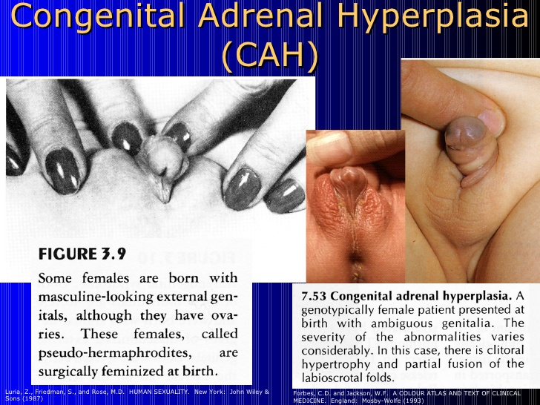
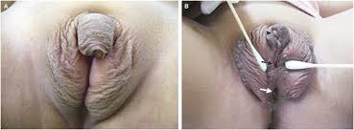

Slide 29
Investigation
Ultrasound
Sex chromatin study reveals positive barr body
Karyotype (46XX)
17 hydroxy –progesterone elevated (>800ng/dl)
Salt loosing syndrome – low sodium and chloride
raised potassium
Urinary excretion of pregnanetriol and 17 ketosteriods elevated
ACTH stimulation test ----- shows abnormal high response of 17-OHP

Slide 30
Goal of treatment
Normal linear growth and bone age development
Long term therapy is required
  Glucocorticoids 10-15mg/m2/24hrs
  glucocorticoid replacement therapy adequacy monitored by determining serum concentration of adrenal precursors including androstenidione and 17-OHP for 21-hydroxylase.
  Assessment of skeletal age, bone age determination required as a reflection of appropriate therapy
  In stressful condition to avoid adrenal insufficiency higher dose of glucocorticoid is required
  In severe emergency condition subcutaneous glucocorticoid is used

Slide 31
Mineralocorticoid therapy for salt losers
Flurocortisone 0.1-0.2mg/24hours often with sodium chloride supplementation in infancy and early childhood
Monitored with serum sodium and potassium and plasma renin activity levels.
Prenatal treatment with dexamethasone to supress fetal ACTH-induced androgen production ----- reduce/eliminate the ambiguity of external genitalia in affected female fetus begins at approximately 7 week gestation

Slide 32
Recontructive surgery
Aim :- 1. to correct structural abnormality
2. to ensure good cosmetic result
3. adequate sexual function
Feminizing genitoplasty
1. to decrease enlarged clitoral size
2. maintain vascularity and sensory innervation
3. to reduce and feminize labioscrotal fold
4. to address urogenital sinus (create a separate vaginal introitus in the perineum)

Slide 33
11 hydroxylase deficiency
This causes elevated levels of 11 deoxycorticosterone, which in turn has salt retaining properties leading to hypertension
At the same time androstenedione and testosterone levels are increased resulting in ambiguous genitalia

Slide 34
The diagnosis is clinched by finding high levels of 11 deoxy cortisol.
Treatment is by replacing glucocorticoids. Prenatal diagnosis is possible by chorionic villus sampling and DNA testing. The gene has been located on the long arm of chromosome 8 but not associated with HLA

Slide 35
3 beta hydrogenase deficiency
This is the rarest form and causes the severe salt loosing type of syndrome.
The risk of death is highest in this type
There is an increase in the pregnenelone and 17 hydroxyl pregnenolone

Slide 36
There is also increased production of dehydroepiandrosterone (DHEA) which causes mild virilisation.
Diagnosis is by finding increased levels of DHEA
Treatment is similar to other forms with glucocorticoids. The gene has not yet been isolated

Slide 37
Aromatase deficiency
Aromatase enzyme catalyses the conversion of testosterone to estradiol and androstenedione to estrone in many tissues like the gonads, placenta, brain, liver, and adipose tissue.
This is an autosomal recessive condition
The mother may show virilisation during pregnancy and the baby is usually born with ambiguous genitalia
There will be high sereum levels of androgens

Slide 38
Androgens from the mother or non adrenal causes
Androgen secreting tumours are rare in pregnancy but can occur in the ovary and adrenal
In the ovary, androgens may be secreted by an arrhenoblastoma or Krukenberg tumour or Luteoma of pregnancy
Luteoma of pregnancy is an ovarian pseudo tumour made up of hyperplastic leutinised theca cells that regresses after delivery

Slide 39
Another condition less frequently associated with virilisation is hyperreactio luteinalis
Maternal exposure to drug such as testosterone, danazol, norethindrone can also cause virilisation of female fetus.
These cases are self limiting and need no treatment, rarely surgical correction may be needed in infancy

Slide 40
Ambiguous genitalia associated with anomalies
Ambiguous genitalia have been described in association with multiple abnormalities usually urinary and gastrointestinal tract.
They have also been described in association with VACTERIAL syndrome (vertebral, anal, cardiac, tracheo-oesophageal, renal and limb)

Slide 41
Male pseudohemaphroditism
Inherited as X-linked recessive gene
Karyotype (46XY)
Inability of end organs to respond to androgens
Phenotypically and psychologically female
Underdevelopment of male external genitalia due to relative deficiency of testosterone production

Slide 42
For male development to occur testosterone should be secreted by the testes, the enzyme 5 alpha-reductase should be present and the androgen receptor should also be present. Thus, male intersex can occur due to faults at three levels. The karyotype will be 46XY but the degree of masculinisation may not be complete.

Slide 43
AETIOLOGY
Failure of testicular development
  XY gonadal dysgenesis
  Mixed gonadal dysgenesis
  True hermaphrodite Drash syndrome
  Frasier syndrome
  Campomelic dwarfism
Leydig cell hypoplasia

Slide 44
Androgen insensitivity at the target site
  Complete AIS
  Partial AIS
Enzyme errors in testosterone production
  5 alpha-reductase deficiency
  17 alpha-hydroxylase deficiency
  17 alpha-hydroxyl steroid dehydrogenase deficiency
  3 alpha-hydroxyl steroid dehydrogenase deficiency
  Congenital lipoid adrenal hyperplasia

Slide 45
XY GONADAL DYSGENESIS (SWYER’S SYNDROME)
This condition is characterised by streak gonads, no breast development, normal mullerian structures and normal female external genitalia.
The usual presentation is as primary amenorrhoea with no secondary sex characters and they are likely to have been brought up as female.

Slide 46
Embryonic failure of gonads is suggested as the cause. This is thought to be due to mutations of the SRY gene. There is no testosterone and so wolffian structures do not develop.
As there is no antimullerian factor, the mullerian ducts develop and there is a uterus and tubes. They are often taller than average. It is easier to continue the sex of rearing as female.

Slide 47
As there is a uterus, cyclical oestrogen progesterone therapy will provoke menstruation. Regarding future fertility they can conceive with ovum donation and IVF.
The presence of a Y chromosome indicates that there is a high risk of gonadal tumours like gonadoblastoma and dysgerminoma and hence gonadectomy must be performed as soon as diagnosed. The risk is about 30%.

Slide 48
LEYDIG CELL HYPOPLASIA
Here the karyotype is XY and testes are present. But there is a defect in the Leydig cell receptor for LH and hCG.
This causes a failure of testosterone secretion and thereby the phenotype is female. So the presentation is as a female with primary amenorrhoea and absent secondary sex characters. Sometimes it may present as ambiguous genitalia.

Slide 49
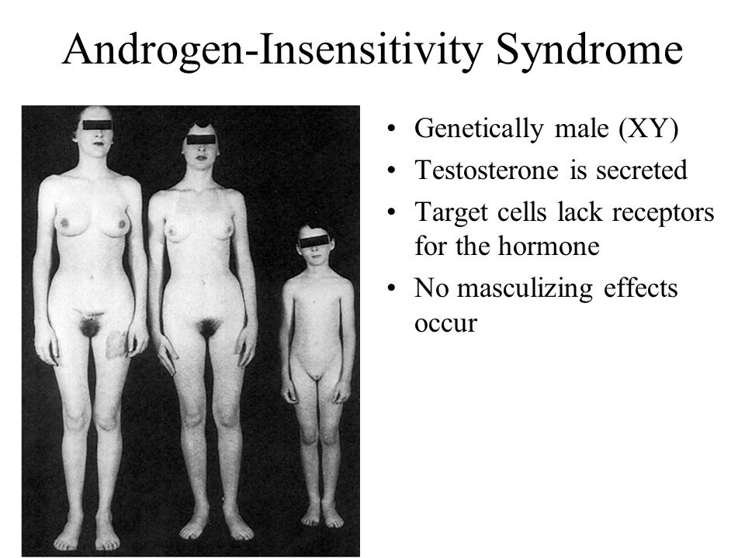
ANDROGEN INSENSITIVITY SYNDROME
(AIS)

Slide 50
Sinnecker’s classification of AIS
Grade of AIS | Phenotype
Type 1 | Normal male phenotype with impaired spermatogenesis
Type 2 | Male genitalia with hypospadias, micropenis and a bifid scrotum (Reifenstein syndrome)
Type 3 | Ambiguous genitalia
Type 4 | Female genitalia with virilisation like clitoromegaly and partial labial fusion
Type 5 | Complete AIS or a normal female phenotype and female external genitalia with no virilisation

Slide 51
Complete AIS
This was previously called Testicular Feminisation syndrome and is inherited as an X-linked trait. The term is stigmatising and hence the accepted terminology today is AIS.
Siblings may also be affected. The main pathology is the absence of the cytosol receptor which is necessary for the actions of testosterone. Here the chromosome is 46XY. The testes may be situated either intra-abdominally or in the labia or in an inguinal hernia.

Slide 52
As the androgen receptor is absent, there is insensitivity to testosterone and the woiffian structures do not develop and so there are no male internal genital organs.
The testes produce both testosterone and mullerian inhibiting factor. The presence of the latter prevents development of the mullerian structures and so there is no uterus.

Slide 53
Again, due to the absence of the receptor, external genitalia are of the female type and the phenotype is female. Other areas like the brain also show female development. The result is a female (physically and psychologically) with normal stature and adequate breast development, but no uterus.
It is indeed a cruel irony of fate that these individuals are usually very feminine looking indeed! Breast development occurs by the oestrogen produced from the peripheral conversion of testosterone. The incomplete or partial form of AIS occurs when there is partial sensitivity of the receptor.

Slide 54
Management
Most cases of complete AIS present only at puberty as primary amenorrhea. The sex of rearing would usually have been female and it is best not to change it.
In such cases the gonads are removed after completion of puberty as there is the risk of malignant change (dysgerminoma) in the presence of Y chromosome.
If removed earlier, breast development may not occur. After removal of the gonads, exogenous oestrogens must be prescribed to prevent osteoporosis.

Slide 55
But some clinicians prefer gonadectomy if diagnosed in childhood and then oestrogens are given to induce pubertal changes. Unlike in cases of hypogonadism progesterone is not needed as there is no uterus. The majority will have a very short vagina and so vaginoplasty may be performed if necessary. Vaginal dilatation can be tried as a first line. Individuals with this disorder are completely sterile. Careful psychological assessment and counselling are mandatory both at diagnosis and later on in adulthood.

Slide 56
Partial AIS
For compete masculinisation to occur, the androgen receptor should be present for testosterone to act.
In this condition there is partial sensitivity of the androgen receptor. Hence the clinical picture will vary from complete AIS as described where the phenotype is completely female, to mild androgen resistance where the clinical picture is of a normal male with impaired spermatogenesis

Slide 57
Clinical features
Rarely diagnosed prior to puberty
Primary amennorhea and infertility
Breast development adequate
Nipple– small with pale areola
Eunuchoidal tendency (long arm, big hands, feet)

Slide 58
Axillary and pubic hair---absent /sparse
External genitalia look female
Vagina short and blind
Upper 2/3rd vagina, uterus and tubes absent due to effect of AMH
Gonads(testes)--- placed either in labia/ inguinal canal/ intra-abdominal

Slide 59
Investigation
Sex chromatin negative
Karytype (46XY)
Serum testosterone----- normal
Serum E2 level ---- high
Serum LH level ----- normal/ slightly elevated
Gonadal biopsy ------- seminiferous tubule small , hyalinised
spermatogenesis absent
leydig cell and sertoli cell normal

Slide 60
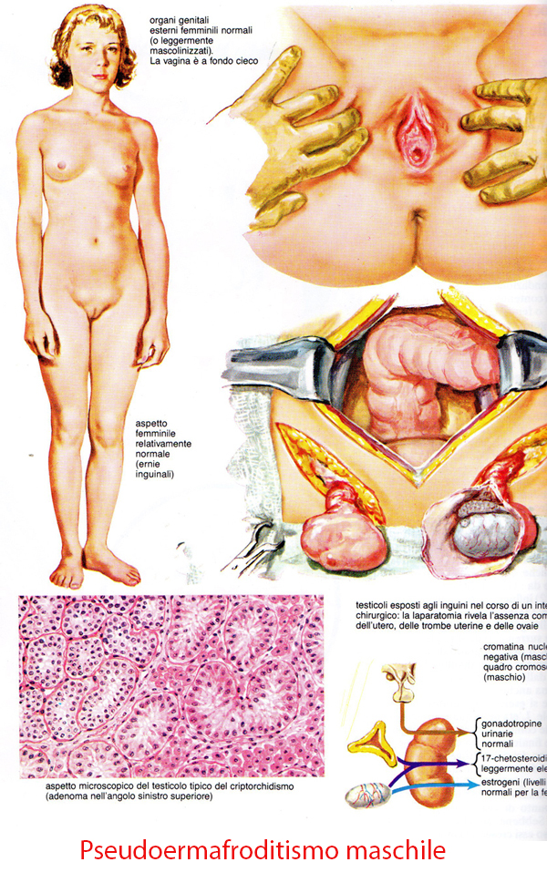

Slide 61
Management may resemble that of complete AIS with prepubertal gonadectomy and hormone replacement especially in those raised as girls, to avoid virilisation at puberty
The difficulty is in the middle grades especially in assigning sex in the neonatal period. Standard treatment, if detected early, has been that gender must be assigned early and hence gonadectomy and reconstruction of genitalia performed before 18 months so that the sex of rearing can be female.
Many affected individuals have opted to change from female to male gender at puberty. Hence nowadays there has been a change in thinking and some clinicians prefer not to perform any irreversible surgery in childhood with a long-term approach in mind

Slide 62
ENZYME ERRORS IN TESTOSTERONE PRODUCTION
5 alpha-reductase deficiency
  Here there is normal testosterone and antimullerian factor production by the testes. Hence the male internal genitalia are normal and the mullerian ducts regress. But testosterone cannot be converted to dihydrotestosterone and so virilisation of the external genitalia does not occur.
  At birth the external genitalia are either female or ambiguous in type. Usually they will be reared as female. Without any treatment, virilisation will occur at puberty with growth of the penis and descent of inguinal testes into the scrotum.

Slide 63
Many cases are described in literature where there has been a change to a male gender at puberty. Several have also fathered children. The standard treatment for these babies, if diagnosed early, has been gonadectomy and reconstructive surgery to bring up the child as a female. This is now being reviewed as in the case of some cases of partial AIS with a long term approach in mind. This is especially important in those cases of ambiguous genitalia seen at birth with a palpable testis. The other name for this condition is ‘penis at 12’ syndrome.

Slide 64
DISORDERS OF GONADAL DEVELOPMENT
GONADAL DYSGENESIS
Patients with female habitus in whom gonads are imperfectly developed.
It is due to cytogenetic abnormality often due to nondisjunction of parental chromosomes leads to abnormal gonadal development and streak gonads(gonads with white dtreaks without any germ cell).

Slide 65
May be either due to the germ cell fail to develop or fail to reach the gonads.
Patients usually present with primary amenorrhoea with delayed secondary sex characters.
In 50 to 60 percent with gonadal dysgenesis the karyotype is 45,XO(Turner’s syndrome).

Slide 66
TURNER’S SYNDROME
CLINICAL FEATURES:-
Patient usually present with primary amenorrhoea with delayed secondary sex characters.
Short stature(height <150cm).
Webbing of the neck.
Cubitus valgus.

Slide 67
Broad shield chest.
Low hair line on the neck.
Lymphedema.
Short fourth metatarsals.
Widely spaced nipples.
Hypothyroidism.

Slide 68
Renal anomolies -horse shoe kidneys,reduplication of renal pelvis and agenesis.
Mental retardation.
Cardiac anomolies - coarctation of aorta,mitral valve prolapse,aortic stenosis are common.
Hearing impairment.

Slide 69
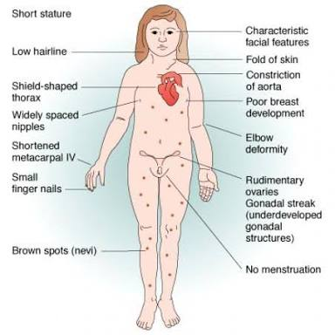

Slide 70
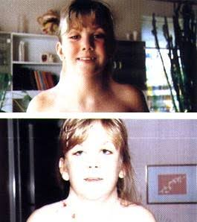

Slide 71
Mastoiditis .
Increased risk of Hypertension , diabetes mellitus , autoimmune disorder like Hashimoto thyroiditis , Addisons disease.
Presents with Hypergonadotrophic hypogonadism state.

Slide 72
This syndrome is usually recognized in childhood but some are not diagnosed until adolescence.
Uterus , vagina and fallopian tubes are present , uterus small but responsive to exogenous oestrogen .
Gonads are streaks(fibrous tissue) without any follicle

Slide 73
Structural abnormality of X chromosome causing short stature is due to Deletion of genetic material from short arm of X chromosome.
Primary amenorrhoea due to loss of long arm near the centromere.

Slide 74
INVESTIGATION
Sex chromatin study-Negative.
Karyotype-45,XO.
Autoantibodies may be present.
Hypoplastic uterus.
Poorly developed ovaries.
Serum FSH-Elevated.

Slide 75
Serum E2-Low.
Serum LH-Elevated.
Growth parameters in case of growth retardation.
Audiogram for hearing impairment patients.
To follow the puberty delay status follow up of annual FSH levels .

Slide 76
MOSAIC KARYOTYPE
Some patients with gonadal dysgenesis have mosaic karyotype 45,XO or 46,XX.
Classic features of Turner’s Syndrome.
Gonads are streaks with few follicles.
Sex chromatin may be doubtful.
Karyotype is 46,XX or 45,XO

Slide 77
Diagnosis of Ambiguous genitalia is by combined approach of Gynaecologist,endocrinologist,geneticist,neonatologist,psychiatrist and urologist if needed.
PHYSICAL EXAMINATION
Presence of vagina or urogenital sinus.
Length of Phallus:-normally newborn Clitoris measures <1cm and penis is <2.5cm in length.

Slide 78
Height and secondary sexual characters.
Urethral meatus:- Opening into the perineal area or into urogenital sinus or hypospadias is noted.
Labioscrotal folds:-degree of fusion.
Location of gonads:-may be felt in the inguinal or in labial region.

Slide 79
TREATMENT
Exogenous growth harmone –increase height.
Low dose oestrogen-conjugated oestrogen 0.625mg orally daily for 25days with Medroxy progesterone acetate 5mg daily for last 10days should be started.
GH therapy-0.1 to0.15 unit/kg/day in improving height prospects.
In some gonadal dysgenesis removal of gonads(gonadectomy).

Slide 80
Klinefelters syndrome
Enuchoid in built
1 in 500 male birth
Common cause of hypogonadism and infertility in male
Infertile with small penis, testes, and varying degree of gynecomastia
Sex chromatin --- positive
Karyotype (XXY or XXXY)
Addition X chromosome arises from non-disjunction in either sperm or egg
15% cases found to be mosaic
Genitalia – small and infantile
Genital duct – wolffian
Serum gonadotropins elevated

Slide 81
TRUE HERMAPHRODITISM
Most common among Bantu tribes in southern part of Africa.
Due to chromosomal defect and genetic cause.
True hermophrodite has both ovarian and testicular gonadal tissue.
The most commonest karyotype is 46,XX,followed by 46,XX/46,XY.

Slide 82
Both the testicular and ovarian tissue are in an individual in different combination.
Unilateral ovatestis with a contralateral ovary or testis ,or bilateral ovatestis i.e.,
→ovatestis on each side(commonest),
→testes on one side and ovary on the other,
→testis or ovary on one side and ovatestis on the other

Slide 83
Gonadal location varies from abdominal to inguinal to scrotal.
The nature of internal ductal system depends on the ipsilateral gonad and its degree of differentiation.
External genitalia are usually ambiguous and usually are undermascunilized due to adequate amount of testosterone.

Slide 84
Male sexual differentiation occurs in presence of a 46,XX karyotype.
In this condition varying length of DNA fron Y chromosome are translocated to the X chromosome during meiosis.
In 60% of 46,XX sex-reversed male,the SRY(sex determining region of Y chromosome) gene is abnormally translocated to the X chromosome.

Slide 85
SRY gene depletion results in normal female phenotype with 46.XY karyotype.
The presence of SRY guides the gonads to develop along testicular line and testicular harmone function is near normal.
Spermatogenesis is absent due to absence of certain genes to the long arm of Y chromosome.

Slide 86
CLINICAL FEATURES
Are not usually diagnosed until puberty.
Testes may be small.
Penis may be small or hypospadias in 10%.
Semen analysis reveals azoospermia due to absent spermatogenesis.

Slide 87
INVESTIGATIONS
Sex chromatin –Positive.
Karyotype -46,XX(70%),rest 46,XY rarely mosaic XX/XY.
Confirmation of diagnosis by gonadal biopsy.

Slide 88
TREATMENT
The change of sex depends on the rearing , psychologic and anatomic sex.
The genetalia inconsistent with sex should me surgically removed or modified.
Depends upon the phenotype and after gonadectomy to be followed by substitution therapy of harmones(oestrogen and progesterone).

Slide 89
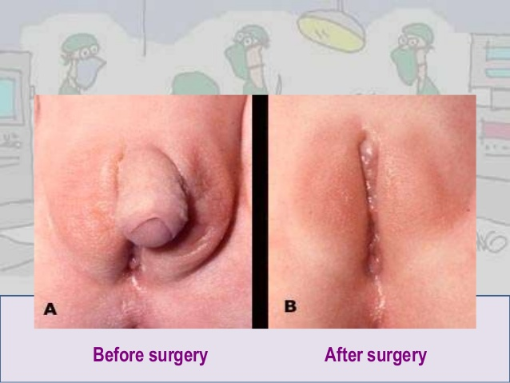

Slide 90
COMPLICATIONS
Complications of ambiguous gentilia includes:
INFERTILITY:-Whether they can have children depends on the specific diagnosis . For example , genetic females with congenital adrenal hyperplasia usually can get pregnant if they so choose.
Increased risk of certain cancers .
May cause sexual dysfunction or disappointing cosmetic result.

Slide 91
FOR GIRLS, the sex organs often work normally despite of ambiguous outward appearance . If a girls vagina is hidden under her skin , surgery in childhood can help with sexual function later.
FOR BOYS, surgery to reconstruct an incomplete penis may improve appearance and make erections possible . Results of surgery are often satisfying , but repeat surgeries may be needed.

Slide 92
THANK YOU

