Slide 1
Mechanism and management of second stage of labor
Presenter- Dr Nisha Buchade

Slide 2
Stage 2 lasts from full dilatation of cervix to the expulsion of baby.
Duration
Nulliparous
Multiparous
Prolonged
Nulliparous >2 hours
Multiparous >1 hour

Slide 3
There are 2 phases
Phase 1/ passive phase/ phase of descent
It extends from the time of full dilatation until further descent of the presenting part begins to distend pelvic floor musculature initiating spontaneous urge to push or bear down .
Physiologically this phase of labor is more an extension of first stage and it’s duration is subject to considerable individual variation , contributing to overall variability seen in the length of second stage.

Slide 4
Phase 2/ active phase
It is heralded by the onset of active pushing in response to spontaneous expulsive urges when they occur after full dilatation.
This phase of labor is associated with great maternal effort and even in normal circumstances a degree of hypoxic stress is imposed on the fetus by the increased frequency of uterine contractions.
So, physiologically it would be more appropriate to record the time spent actively pushing during second stage

Slide 5
Normal physiology
Contraction and retraction in uterine muscles
Contraction of accessory muscles
-The woman in labor holds her breath after taking a deep inspiration thereby fixing the diaphragm in a lower position and contracts the abdominal muscles.
-This action increases the intraabdominal pressure, compressing the uterus and helps in increasing the expulsive force.
- In the later part of second stage, the urge and the pressure becomes involuntary and syncronises with the uterine contraction.

Slide 6
Both these factors reduce uteroplacental perfusion , ultimately reducing oxygen delivery to the fetus.
Healthy fetus have compensatory mechanisms but fetus that is unable to compensate for the reduced oxygen supply during 2 stage can develop added metabolic acidosis.
When the second stage is conducted with the mother in dorsal position , a progressive fetal acidosis can occur but if conducted in a left lateral tilt position this does not occur indicating aortocaval compression as an important contributing factor.

Slide 7
Excessive coaching and loud encouragement to produce sustained valsalva manoever is inappropriate.
This increases intrathoracic pressure decreases venous return and cardiac output, and may reduce uteroplacental circulation.
Along with the sustained increase in intrathoracic intrauterine pressure this may reduce intravillous blood flow to the extend that FHR abnormalities develop and operative interventions are provoked.

Slide 8
Prolonged second stage can be associated with
1.increasing maternal age
2.fetal weight
3.gestation
4.maternal height
Causes
1.uncoordinated uterine activity
2.malposition
3.relative CPD

Slide 9
Epidural analgesia and second stage management
It abolishes the normal expulsive urges that occur during the active phase of second stage.
Decreased muscle tone in the anterior abdominal wall, makes pushing both less effective and misdirected, with parturients tending to push more towards symphysis than the rectum.

Slide 10
Decrease in muscle tone of the pelvic floor may also inhibit or delay anterior rotation of the descending fetal head, resulting in an increased incidence of malrotation
Increasing the duration of phase 1 of second stage with epidural usage can reduce the number of instrumental deliveries without compromising fetal outcome

Slide 11
Fetal monitoring during the second stage
Done by auscultation/ hand held probe every 15 minutes
In high risk every 5 minutes/after every contraction
In presence of meconium, continuous fetal monitoring preferably with the use of a fetal scalp electrode is often recommended.

Slide 12
Fetal heart rate pattern
Fetal heart decelerations are common during second stage and it is important to distinguish between patterns that are benign or well tolerated by a healthy fetus and those that are indicative of progressive fetal hypoxia and require urgent delivery.

Slide 13
Pigmond et al reported that decelerations that occurred with each contraction but with maintainance of normal baseline and baseline variability were well tolerated.
However, progressive tachycardia, progressive bradycardia, loss of variability and widening and deepening of decelerations are all suggestive of progressing hypoxia.

Slide 14
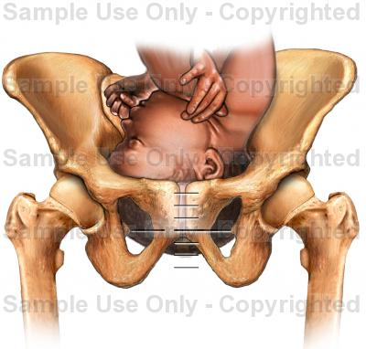
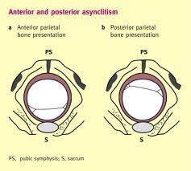
Mechanism of labor
Described by William smellie
It is the way the baby adapts itself to and passes through the maternal pelvis.
Engagement
The fetal head is said to be engaged when the maximum transverse (biparietal 9.5cm) has crossed plane of pelvic brim.
Fetal head normally engages in the transverse diameter of the pelvis.

Slide 15
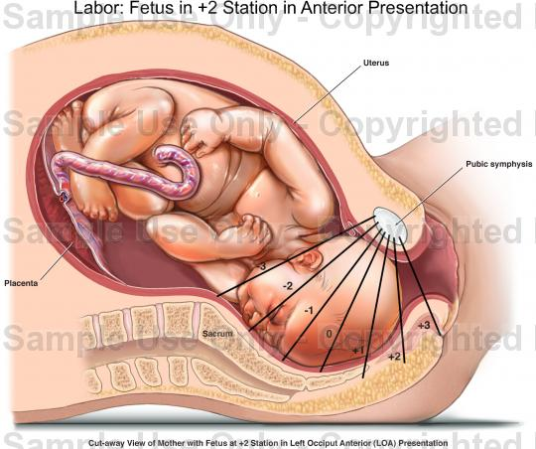
Descent
Gradual descent of the presenting part takes place because of uterine contractions and retractions

Slide 16
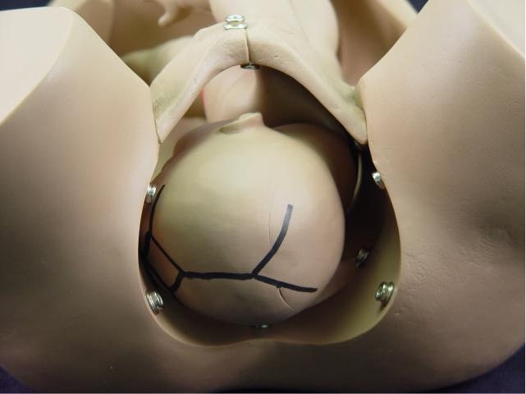
Flexion
Partial flexion exists before the onset of labor.
Resistance to descent leads to increased flexion.
In complete flexion chin approaches the chest.
The effect of flexion is to change the presenting diameter from occipitofrontal of 11 cm to the smaller and rounder suboccipitobregmatic of 9.5 cm.

Slide 17
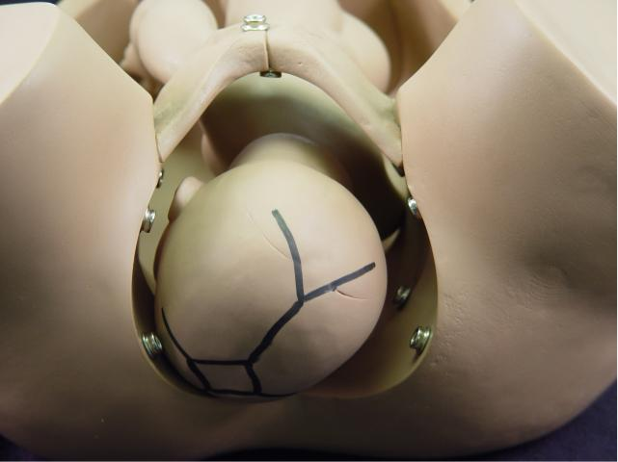
Internal rotation
The long axis of the fetal head must fit into long axis of the maternal pelvis. Hence the head which entered pelvis in the transverse diameter/oblique diameter must rotate internally to the anteroposterior diameter in order to be born.

Slide 18
Theories which explain internal rotation
slope of pelvic floor-
Two halves of levator ani form a gutter and viewed from above, the direction of fibres is backwards and towards the midline.
Thus during each contraction , the head occiput in particular in well flexed position, stretches levator ani particularly that half which is in relation with occiput.
After contraction passes off, elastic recoil of levator ani occurs bringing the occiput forward towards the midline.
The process is repeated until the occiput is placed anteriorly. This is called rotation by law of pelvic floor (hart’s rule)

Slide 19
2. pelvic shape- forward inclination of side walls of the cavity, narrow bispinous diameter and long AP diameter of the outlet result in putting the long axis of the head to accommodate in the maximum available diameter i.e., AP diameter of the outlet leaving behind smallest bispinous diameter.
3. law of unequal flexibility- the internal rotation is primarily due to inequalities in the flexibility of the component parts of the fetus.

Slide 20
Extension
It is the result of 2 forces i.e., uterine contractions exerting downward pressure and pelvic floor offering resistance pressing it upwards and forwards.
It cannot go forward as the nape of neck is fixed against the symphysis pubis, the head therefore follows the curve of the birth canal by the process of extension

Slide 21
The occiput hinges hinges the pubic arch and becomes free thus helping in extension. As a result the chin leaves the chest and vertex stretches the vaginal outlet which is called crowning of head.
Now the vertex, forehead, face and chin successfully glide forward from under the perineum and deliver. The head falls forward and the occiput and the nape of neck is delivered.

Slide 22
Restitution
Since the shoulder remain in the oblique diameter while the head rotates anteriorly the neck becomes twisted . As soon as head is completely delivered and is free outside , it resumes it’s normal position with regard to the shoulders turning the occiput towards mother’s left thigh.
Neck becomes untwisted and the head restores its natural relation to shoulder.

Slide 23
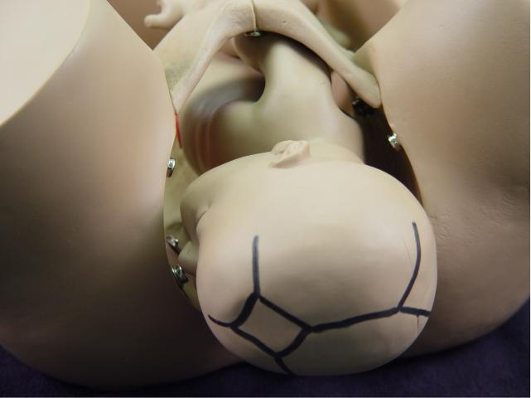
External rotation
It is the outward manifestation of internal rotation of the shoulder. As the shoulder reach the pelvic floor the lower anterior shoulder is rotated forward under the symphysis and the bisacromial diameter turns from left oblique to AP diameter of pelvis. In this way long diameter of the shoulder can fit the long diameter of the outlet.
The head , which had restituted 45 degree to resume it’s normal relationship with shoulder now rotates another 45 degree to maintain it.

Slide 24
Mechanism of delivery of shoulders
As restitution and external rotation are occuring, the shoulders will rotate to assume anteroposterior alignment with the anterior shoulder under symphysis pubis.
The anterior shoulder delivers first and then the posterior shoulder delivers over the fourchette.

Slide 25
Delivery of the fetal body
Under normal circumstances the remainder of the trunk is quickly expelled, perhaps being aided by lateral flexion movements.

Slide 26
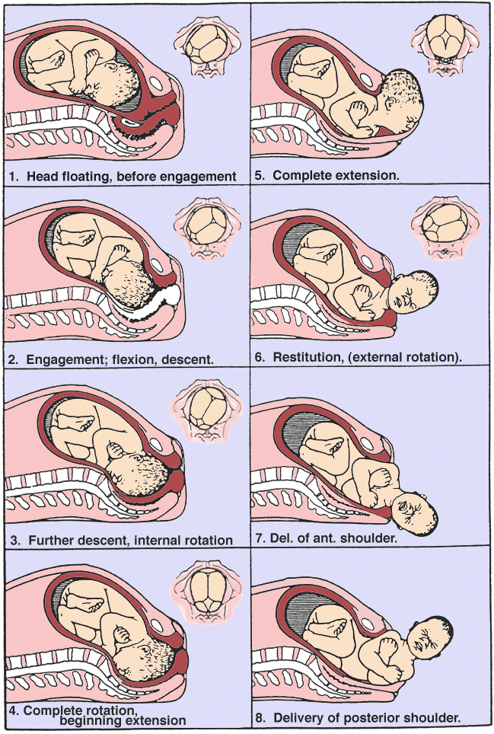

Slide 28
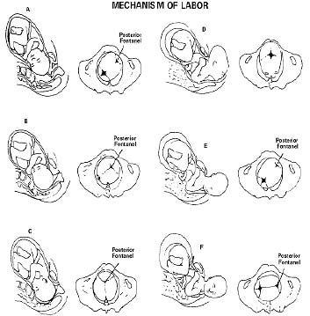

Slide 29
Management
The aim is to allow natural progress and expulsion of the fetus as far as possible.
Power
Pain relief
Partogram- maternal pulse, BP, FHS, uterine contractions

Slide 30
Clinical indicators that the second stage has started
1.there is an increase in bloody show
2.patient wants to bear down with every contraction
3.she feels pressure on the rectum accompanied by desire to defecate
4.nausea and retching occur frequently as the cervix reaches full dilatation.

Slide 31
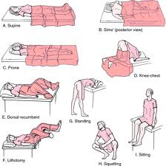
Position for delivery
1. Upright or vertical
Standing
Sitting
Squatting
Upright kneeling position

Slide 32
Advantages
Woman can create 30% more intraabdominal pressure in the vertical than in the horizontal position
Reduction in the length of labor
Lower incidence of instrumental birth
Lower incidence of fetal hypoxia

Slide 33
Disadvantages
It is difficult for the accoucher to control the birth and to manage complication
Impossible to administer sedatives/analgesics during labor

Slide 34
2.Horizontal or semihorizontal
Lateral
Prone
Semirecumbent
Knee elbow
Dorsal
These were developed by obstetricians with the aim of achieving ease and efficiency in dealing with complications and administering drugs to relieve pain.

Slide 35
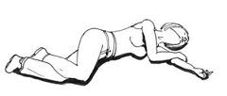
Lateral position
Advantages
Ease , convenience and comfort for the woman
Relaxation of pelvic muscles, which facilitates descent of fetal head
Ease in controlling the head as it advances over the perineum with few lacerations occuring
Natural drainage of secretions or vomitus from the pharynx
Absence of supine hypotension syndrome

Slide 36
Disadvantages
Difficult to handle complicated forceps deliveries
Lacerations of cervix and vagina are awkward to repair
Complications of the third stage are difficult to manage

Slide 37
Dorsal ( supine position)
Women lies on her back with knees flexed
Disadvantages
Episiotomy and forceps operations are not performed easily
Supine hypotension syndrome, fetal hypoxia and bradycardia may result
So a firm wedge placed under the patient’s right side by producing 15 degree tilt reduce the incidence of hypotension.

Slide 38
Lithotomy position
Women lies on her back, her legs in stirrups and her buttocks close to the lower edge of table.
Advantages
Asepsis is more complete
Fetal heart can be auscultated without change of position
Anaesthesia can be provided efficiently
Perineum can be protected and lacerations prevented
Forceps delivery, repair of episiotomy and for the conduction of third stage of labor

Slide 39
Disadvantages
Risk of supine hypotension syndrome
Use of stirrups or leg supports may lead to sacroiliac or lumbosacral strain, thrombosis in the vein of lower limbs and damage to the nerves especially the peroneal as a result of prolonged pressure
There is danger of aspiration of vomitus.

Slide 40
Semisitting position
An adjustable back rest can be used . women are more comfortable with their backs raised at an angle of between 30 degree and 45 degree from horizontal. The efficiency of the expulsive forces are increased by directing them toward the pelvis and by making use of the forces of gravity.
For obstetrician this position is compatible with modern methods of obstetric care.

Slide 41
Cleansing of the vulva and the surrounding parts with sterile solutions
-Catheterization of bladder if patient cannot pass urine. It may cause delay in descent of presenting part and bladder may become persistently atonic in the postpartum period

Slide 42
-woman is encouraged to bear down with every pain. Women are instructed to make 2-3 breath holding pushes each between 15-20 sec in duration for each contraction.
As the widest diameter of the approaches the perineum, mother is advised not to push as the force of contraction alone is sufficient to effect delivery.

Slide 43
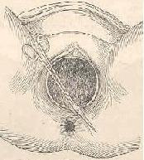
Mediolateral episiotomy often needed to eliminate uncontrolled perineal trauma after infiltration of local anaestetic.
Indications for episiotomy
1.Fetal distress, if the perineum is causing delay in delivery.
2. Maternal exhaustion or distress

Slide 44
3. When the progress has ceased with the head on the perineum
4. Forceps delivery
5. When the bleeding occurs around the fetal head prior to crowning, indicating that tearing has already occurred in the vagina
6. Previous third degree tear or severe scarring the perineum

Slide 45
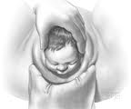
Delivery of the head
Modified Ritgen maneuver
when the head distends the vulva and perineum enough to open the vaginal introitus to a diameter of 5cm or more, a towel draped , gloved hand may be used to exert forward pressure on the chin of the fetus through the perineum just in front of coccyx. Concurrently the other hand exerts pressure superiorly against the occiput.

Slide 46
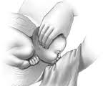
This allows controlled delivery of head and favors neck extension so that the head is delivered with its smallest diameters passing through the introitus and over the perineum.

Slide 47
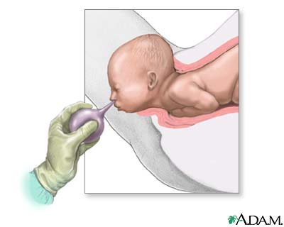
Hand poised method
Simple perineal support
Head should be supported as it restitutes and rotates externally.
The face should be wiped gently and mucus aspirated from mouth and throat.

Slide 48
The region of the neck is explored for the coils of umbilical cord.
If the cord is around the neck loosely it can be slipped over the head.
If it is coiled around the neck tightly , it must be clamped and cut .

Slide 49
Delivery of shouders
After restitution and external rotation wait for next uterine contraction to deliver the anterior shoulder , which appears behind the symphysis pubis.
When the anterior shoulder is delivered, the head is guided upwards towards the mother’s abdomen to allow posterior shoulder to deliver out of the perineum.

Slide 50
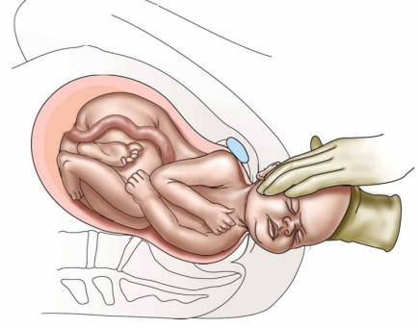
If there is delay in the delivery of the shoulders, the head is held gently by the palm of both the hands and drawn posteriorly until the anterior shoulder is released under the symphysis.
Iv methergin / im oxytocin can be given.

Slide 51
Delivery of trunk
The shoulders are supported with the right hand and the buttocks with the left hand as the trunk is delivered by lateral flexion

Slide 52
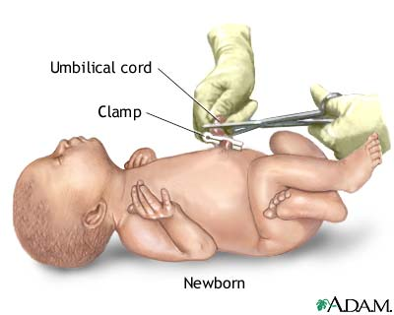
Clamping of the cord
5 cm from the fetal abdomen
Timing- after delivery, the infant is placed at the level of vagina for 3 minutes, the feto placental circulation is not occluded.
80 ml of blood shift to fetus( 50 gm of Fe)

Slide 53
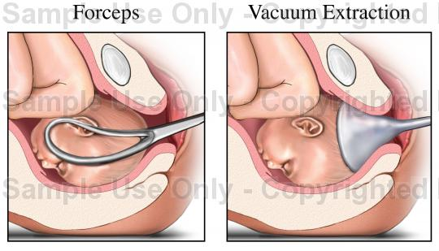

Slide 54
Malposition
Refers to any position of vertex other than flexed occipitoanterior one.
Posterior position of the occiput
Incidence – 15-30%
Etiology
When the forepelvis is narrow there is tendency for the back of the head with its long biparietal diameter to be pushed to the rear so that the front of the head with it’s short bitemporal diameter can be accommodated by the small forepelvis.Hence posterior positions of the occiput are found often in android and anthropoid pelvis.

Slide 55
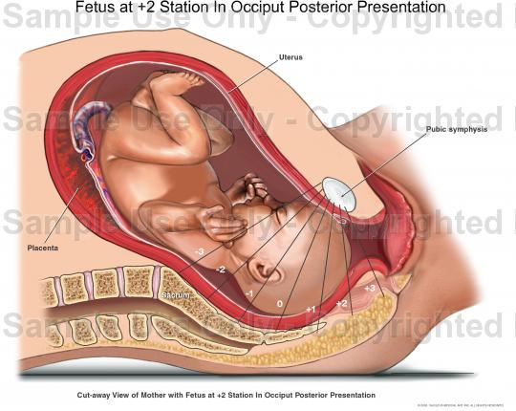
Right occipitoposterior
Rotation of varying degree and direction can take place
A. Anterior rotation
1. Long arc rotation of 135 degree, ROP to ROT to ROA to OA. This occurs in 90% of the OP position. The baby is born as OA.
2. Rotation of 45 degree ROP to ROT. The result is deep transverse arrest.

Slide 56

DTA- the head is deep in the cavity, the saggital suture is placed in the transverse bispinous diameter and there is no progress in the descent of the head even after 1 hour of full dilatation of cervix
b. Posterior rotation of 45 degree- ROP to OP, with occiput turning into hollow of sacrum.
c. No rotation – this position remains ROP

Slide 57
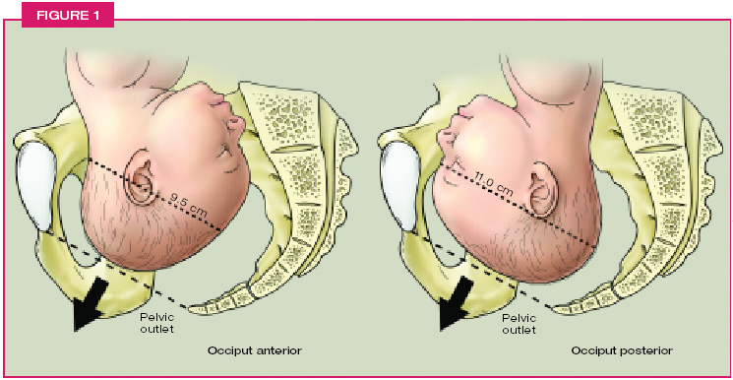
Spontaneous delivery can take place after
Anterior rotation to OA with normal birth
Posterior rotation to OP with face to pubis delivery

Slide 58
Arrest can occur in
1. High in pelvis with failure to engage
2. In the mid pelvis, with complete or partial failure of rotation
Deep transverse arrest ROT
Arrest with saggital suture in right oblique diameter ROP
Arrest with occiput in the hollow of the sacrum, OP
3. Arrest at the outlet

Slide 59
Long arc rotation
Engagement- delayed because of deflexion, suboccipitofrontal(10 cm) /occipitofrontal(11.5cm)
Flexion-partial
Internal rotation- 135 degree
Extension
Restitution
External rotation
Birth of shoulder and trunk

Slide 60
Short arc rotation 45 degree
Descent
Flexion
Internal rotation- bregma behind pubis
Birth of head by 2 mechanisms of flexion
- Good flexion- area anterior to bregma pivots under the symphysis pubis.
Presenting diameter- suboccipitofrontal(10.5)
Bregma- vertex- posterior fontanelle-occciput born by flexion.

Slide 61
- Flexion is incomplete- root of nose pivots under the symphysis
Presenting diameter- occipitofrontal(11.5)
By flexion forehead, bregma, vertex and occciput are born over the perineum.
Once the top and back of head have been born by flexion, the occiput falls back towards the anus and the nose, mouth, chin are born under the symphysis pubis by extension.
Restitution
External rotation

Slide 62
Management of progressing labor
Expectant observation is the best policy
Judicious use of analgesia and sedation
Adequate hydration and nourishment as labor may be long and difficult
When the head is delivered in the posterior position ( face to pubis) large back part of head causes greater stretching and more laceration than does narrow anterior part of the head (bitemporal diameter). So large episiotomy is preferred.

Slide 63
Indications for interference
Maternal distress
It is the fatigue or exhaustion and is accompanied by following signs
Pulse above 100 beats/min
Temperature above 100 º F
Dehydration
Loss of emotional stability

Slide 64
Fetal distress
Irregular fetal heart rate
Fetal heart rate below 100 or over 160 beats/min between contractions
Passage of meconium in a vertex presentation
Lack of progress
The cessation of descent or rotation indicates that labor is arrested and that interference is mandatory.

Slide 65
Reasons for failure of descent and rotation include
Cephalopelvic disproportion
Android pelvis
Ineffective uterine contraction
Deflection of head
Uterine contraction ring preventing the shoulder from rotating anteriorly
Multiparity , pendulous abdomen, poor abdominal and uterine tone
A weak pelvic floor, failure to guide the occiput anteriorly

Slide 66
Methods of operative vaginal delivery in arrested OP position
Vaginal delivery by forceps is the procedure of choice if the following prerequisites have been fulfilled
1. the fetal head must be engaged
2. No CPD
3. Cervix fully dilated
4. Membranes have to be ruptured
5. Accurate diagnosis of position and station is essential

Slide 67
No fetal/maternal distress
1. If uterine contractions are weak, infusion of oxytocin is established.
2. The fetal head is low in the pelvis. Delivery is by forceps.
3. The fetal head is high in the pelvis and disproportion is suspected . ceaserean section is performed.
Fetal distress
Immediate delivery either by forceps or cesarean section.

Slide 68
Face and brow presentations
Etiology
Cephalopelvic disproportion
Fetal conditions
Tumors of the neck eg thyroid
Coils of umbilical cord around neck
Fetal anomalies
Increased fetal mobility
Polyhydramnios

Slide 69
Small or premature baby
Premature rupture of membranes when the head is not engaged. It is trapped in the attitude of extension
Uterine abnormalities
Abnormal placental implantation :placenta previa
Iatrogenic : external version
Idiopathic: nearly 30% are unexplained

Slide 70
Face presentation
Presenting part- area between glabella and chin
Submentobregmatic-9.5 cm ( complete extension)
Incidence- <1%
Higher in multi than primi
Most face presentations are secondary, extension taking place during labor generally at the pelvic inlet.

Slide 71
Anterior face presentation
Left mentum anterior
Mechanism of labor
Extention- enters with chin first
Descent- face is low in pelvis before BPD has passed the brim. When the forward leading edge of the presenting face is felt at the level of the ischial spine. Tracheobregmatic diameter is still above the inlet .

Slide 72
Internal rotation- as it rotates 45⁰ anteriorly towards the symphysis , the long axis of the face comes into the AP diameter of pelvis . with further descent the chin escapes under the symphysis. The shoulders have remained in the oblique diameter so the neck is twisted 45⁰. Chin must rotate anteriorly and under the symphysis or spontaneous delivery is impossible.

Slide 73
Flexion- head is born by flexion. The submental region at the neck impinges under the symphysis pubis. With the head pivoting around this point, mouth, nose, orbit, forehead, vertex and occiput are born over the perineum by flexion. The head then falls back.
Restitution
External rotation

Slide 74
Prognosis
Labor takes longer
More pain and lacerations
Cesarean is preferred
Fetus
Membranes rupture early in labor
Face takes brunt of punishment
Edema of the larynx may result from prolonged pressure of the hyoid region of the neck against the pubic bone.
For the first 24 hours the baby must be watched carefully to detect any difficulty in breathing.

Slide 75
Management of anterior face presentation
Disproportion- cesarean
Normal pelvis- left alone
1.Low forceps
2. If flexion done anterior face is replaced by an occipitoposterior one.Makes it worse if conversion is successful
3. If conversion is partially successful it is converted to brow.

Slide 76
Arrest-
Low in pelvis, below ischial spine- extraction with low forceps
High in pelvis- cesarean section
Transverse face presentation
LMT to LMA to MA

Slide 77
Posterior face presentation (30% of face)
Persistant posterior face presentation become arrested because relatively short neck cannot clear off the total length of sacrum(12cm). as the thorax is thrust in resulting bregmaticosternal diameter (18 cm) to occupy pelvis.. as a result, labor becomes inevitably obstructed.

Slide 78
Mechanism of labor
Long arc rotation ( 135⁰ )
2/3 rd do this
Short arc rotation
45⁰ to posterior become arrested as persistant posterior face presentation

Slide 79
Brow presentation
Attitute of partial ( half way ) extention.
Presenting area- between orbital ridges and bregma
Presenting diameter- verticomental 13.5 cm
Often this position is transitory, head either flexes to an occiput presentation or extends completely and becomes a face presentation.

Slide 80
Left frontum anterior
Extension- head extends and the verticomental diameter presents with the forehead leading the way.
Descent- slow
Internal rotation- 45⁰ so that faces comes to lie behind the pubic symphysis

Slide 81
Flexion- face impinges under the pubis and as the head pivots round this point the bregma, vertex and occiput are born over the perineum.
Extension- the head then falls back in extension and the nose , mouth and chin slip under the symphysis.
Restitution
External rotation

