Slide 1
Pelvic Inflammatory Disease (PID)
CHAIR PERSON-Dr.Jayashree(Assoc.prof)
-Dr.Sowmya.K(Asst.prof)
PRESENTERS-Dr.Triveni.k
-Dr.Neela harika

Slide 2

Galen was a physician, writer and philosopher who became the most famous doctor in the Roman Empire (130ad-210ad)
HISTORY Galen was a physician, writer and philosopher who became the most famous doctor in the Roman Empire (130ad-210ad)
1st to discover about gonorrhoeal pus
1st to state that urine was formed in the kidney
1st to discover that arteries carry blood
1st to discover about gonorrhoeal pus
1st to state that urine was formed in the kidney
1st to discover that arteries carry blood

Slide 3
PID: A Neglected Issue
• Low disease awareness
• Sub-optimal management
• 50% named correct antibiotic regimen
• < 25% examined the sexual partners

Slide 4
Objectives
• What is Pelvic Inflammatory Disease?
• Why is it important to treat timely?
• Causative factors and transmission?
• How does the patient present?
• Treatment Plan?
- Drug therapies
- Surgical procedures
- Follow up
Genital tuberculosis

Slide 5
What is PID ?
• Acute/ Chronic clinical syndrome
• Inflammation of pelvic structures
• Ascending spread of infection from the vagina and endocervix to the endometrium, fallopian tubes, ovaries, &/ or adjoining structures
• Upper genital tract infection, salpingitis endometritis, parametritis, tubo-ovarian abscess & pelvic peritonitis

Slide 6

PID : Definition
Pelvic Inflammatory Disease (PID) comprises a spectrum of inflammatory disorders of the upper female genital tract, including any combination of endometritis, salpingitis, tubo-ovarian abscess, and pelvic peritonitis
Sexually transmitted organisms, especially N. gonorrhoea and C. trachomatis, are implicated in many cases
However, microorganisms that comprise the vaginal flora (e.g., anaerobes, G. virginals, Haemophilus influenzae, enteric Gram-negative rods, and Streptococcus agalactiae) also have been associated with PID
In addition, M. [Mycoplasma] hominis and U. [Ureaplasma] urealyticum might be etiological agents of PID
Center for Disease Control & Prevention (CDC)
Treatment Guidelines 2010

Slide 7

PID : Definition
Pelvic inflammatory disease is an inflammatory process of infectious etiology which shares a common epidemiological profile, which specifically involves at the least the uterine and/or fallopian tube sites, and which may result in relatively comparable long term sequelae
Disease due to bacteria not meeting these requirements will be termed upper female genital tract infection (UFGTI or UGTI) and the designation of specific etiology cited with it
In the future, I-IDSOG-USA will replace definition for PID with the term “upper female genital tract infection,” followed by the name of the etiological agent, followed by the stage of disease
(e.g., UGTI, Neisseria gonorrhoeae, stage III)

Slide 8
PID : Epidemiology
-Actual prevelance not reported
-Wide spectrum of clinical presentation
-Lack of accurate clinical diagnosis
-Upto 2/3 rd of cases go unrecognized
(Wiesenfeld HC et al,2000 )
-Acute PID occurs in about 1-2% of young, sexually active females each year
(Peipert J F et al, 2011)

Slide 9
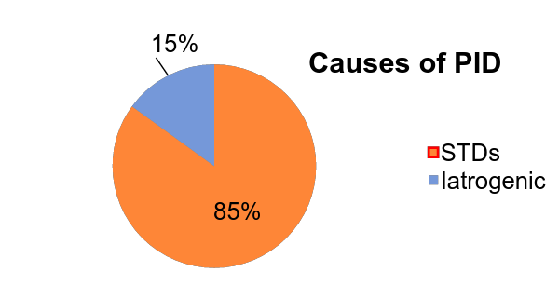
PID : Epidemiology
PID is commonly associated with Sexually Transmitted Diseases (STDs)
Incidence is on rise due to rise in STDs
Among sexually active women: Incidence is 1-2 % per year
About 85% are spontaneous infection in sexually active females of reproductive age
Remaining 15% follow procedures, which favors the organism to ascend up

Slide 10
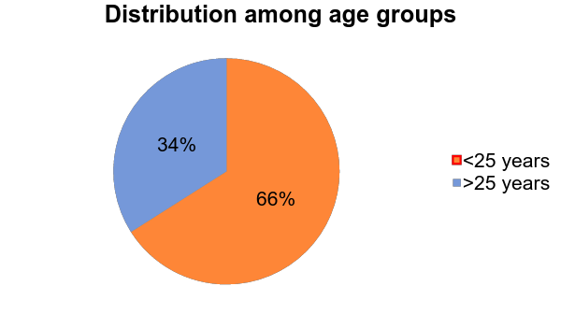
PID : Epidemiology
Iatrogenic procedures: favor organism to ascend
Endometrial biopsy
Uterine curettage
Insertion of IUD
Hysterosalpingography

Slide 11
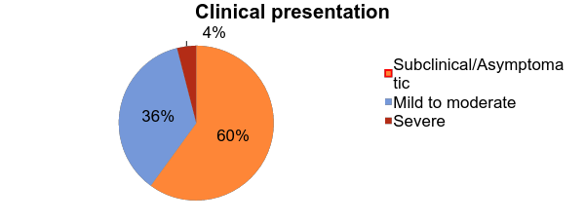
PID : Epidemiology
Many Indian women suffer from PID
Changes in epidemiology of PID
Shift from in-patient PID to out-patient PID
Changes in clinical presentation (less severe: more common)
Shift in the microbial etiology of more Chlamydia trachomatis than gonococcus and others
Overt
40%

Slide 12
INMATE DEFENCE MECHANISM

Slide 13
Defence of the genital tract
As there is free anastomosis between the lymphatics and blood vessels, the infection of one pelvic organ usually spreads to the other more frequently.
There is direct communication of the peritoneal cavity to the anterior through vagina.
Inspite of these, the frequency and intensity of pelvic infection is kept lowered by defence mechanism.

Slide 14
Vulval defence
Anatomic
Opposition of the cleft by labia
Compound recemose type of bartholin gland
Physiologic
Fungicidal action of the secretion of the apocrine glnds
Natural high resistance to the infection of the vulval and perineal skin

Slide 15
Vaginal defence
A.Anatomic
1. Opposition of anterior and posterior walls with its transverse rugae
2. Stratified epithelium devoid of gland
B.Physiologic

Slide 16
Defence of the vagina in relation to age
 | Newborn (0-10 days) | Up to puberty | Childbearing period | Postmenopause
Epithelium | Multilayered | Thin | Multilayered | Thin
Glycogen | ++ | (-) | ++ | (-)
Doderlein’s bacillus | + | (-) | ++ | (-)
pH | Acidic (4-5) | Neutral or alkaline (6-8) | Acidic (4-5) | Neutral (6-7)

Slide 17
The vaginal defence is lost
Following 10 days of tenth till puberty is reached
During reproductive period
During menstruation
Following abortion of child birth
During menopause

Slide 18
Cervical defence
A.Anatomic
1.Racemose type of glands
2.Mucus plug
B.Physiologic
1.Bacterial effect of the mucus

Slide 19
Uterine defence
Cyclical shedding of endometrium
Closure of the uterine ostium of the fallopian tube with slightest inflammatory reaction is endometrium
Tubal defence
A.Anatomic
1.Integrated mucus plical and epithelial cilia
B.Physiologic
1.Peristalsis of the tube and also the movement of the cilia are towards the uterus.

Slide 20
PID : Epidemiology
Risk factors
ACCEPTED | PROPOSED
1. Menstruating teens | 1. Low socio-economic status
2. Multiple sex partners | 2. Early age of sexual activity
3. Prior H/O PID | 3. Urban living
4. Sexually Transmitted Infection | 4. High frequency of coitus
5. Non-use of barrier contraceptive | 5. Use of IUCD
 | 6. Cigarette smoking
 | 7. Substance abuse
 | 8. Douching

Slide 21
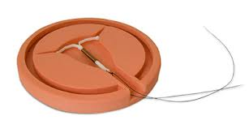

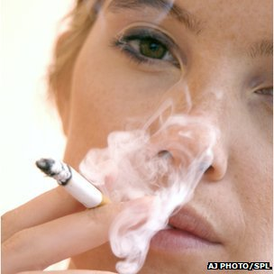


Slide 22

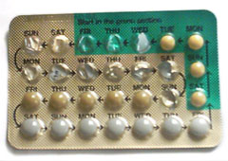
PID : Epidemiology
Protective
Barrier methods: Specially condom with spermicidal chemicals (Nonoxynol-9 which is bactericidal & virucidal)
Oral steroidal contraceptives: -Thick mucus plug (preventing ascend of sperm and bacterial penetration) -Decrease in durationof menstruation (Short interval of bacterial colonization of the upper tract)

Slide 23
3.Women with monogamous partner with vasectomy
4.Pregnancy
5.Menopause
6.Uncommon in women who are not menstruating
7.Husband who is azoospermic

Slide 24
ROLE OF CONTRACEPTION IN PID
Use of combined oral contraceptives has been regarded as protective against symptomatic PID
(Vessy MP,Int J Fertil 2003)
OCP’s increase cervical mucus density,decrease menstrual bleeding,alter uterine activity
Decrease in duration of menstrual flow , shorter interval for bacterial colonization
Inhibits ovulation helps from providing a nidus for tuboovarian abcess formation

Slide 25
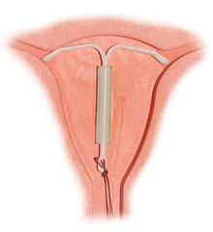
IUCD may be left in situ in mild PID.
Have to be removed in severe PID
IUCD only increase risk of developing PID in first few weeks after insertion
(Grimes DA et al,Lancet 2000)
Prophylactic doxycycline stat dose can be given at the time of insertion
Barrier contraception is protective against PID

Slide 26
PID : Microbiology
Acute PID: Usually polymicrobial
Primary organisms
Sexually transmitted
N. gonorrhoeae: recovered from cervix in 30%-80% of women with PID
C. trachomatis: recovered from cervix in 20%-40% of women with PID
N. gonorrhoeae and C. trachomatis are present in combination in approximately 25%-75% of patients
Secondary organisms
Normally found in vagina
Aerobic: Non-hemolytic streptococcus, E. coli,
Group-B streptococcus & staphylococcus
Anaerobic: Bacteroides species- fragilis & bivius, Peptostrepococcus & peptococcus

Slide 27
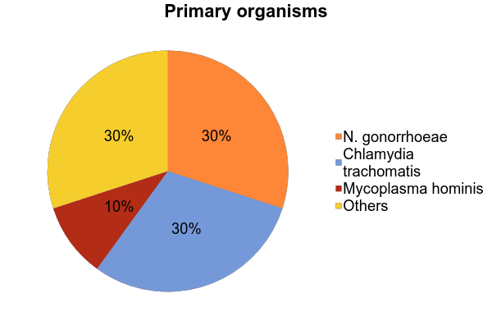

Slide 28
N. gonorrhoeae
gram –ve diplococcus
rapid growth (20-40 min)
rapid & intense inflammatory response
2 major sequelae
infertility & ectopic pregnancy, strong asso. with prior Chalamydia infection

Slide 29
C. trachomatis
produce mild form of salpingitis
slow growth (48-72 hr)
intracellular organism
insidious onset
remain in tubes for months/years after initial colonization of upper genital tract
more severe tubes involvement

Slide 30
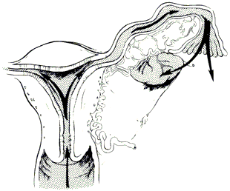
PID : Mode of transmission
Ascending infection (Canalicular spread)
Ascend of gonococcal & chlamydial organisms by surface extension from the lower genital tract through the cervical canal by way of the endometrium to the fallopian tubes
Facilitated by the sexually transmitted vectors such as sperms & trichomonads
Reflux of menstrual blood along with gonococci into the fallopian tubes may be the other possibility

Slide 31
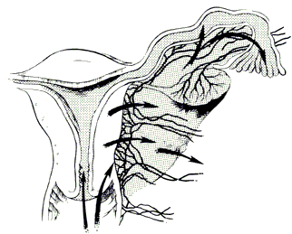
PID : Mode of transmission
Through uterine lymphatic & blood vessels across parametrium
Mycoplasma hominis
Secondary organisms

Slide 32
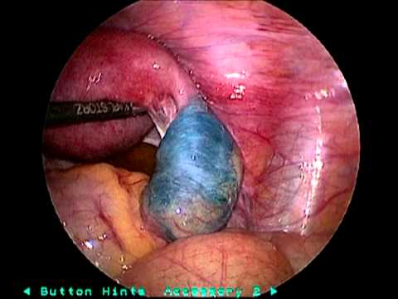
PID : Mode of transmission
Gynecological procedures favoring ascend of infection
E.g. D&C, D&E
Blood-borne transmission
Pelvic tuberculosis
Direct spread from contaminated structures in abdominal cavity
E.g. Appendicitis, cholecystitis

Slide 33
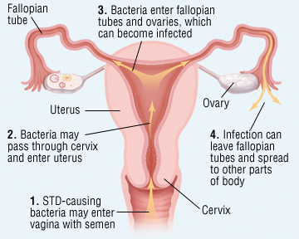
Acute PID : Pathology
Cervicitis
Endometritis
Salpingitis
Oophoritis
Tubo-ovarian abscess
Peritonitis

Slide 34
Acute PID : Pathology
Involvement of the fallopian tubes is almost bilateral
Pathological process is initiated primarily in the endosalpinx
It usually follows menses due to loss of genital defence
Gross destruction of epithelial cells, cilia & microvilli
Acute inflammatory reaction: all layers are involved
Tubes become edematous & hyperemic; exfoliated cells & exudate pour into lumen & agglutinate the mucosal folds
Abdominal ostium: closed by edema & inflammation
Uterine end: closed by congestion

Slide 35
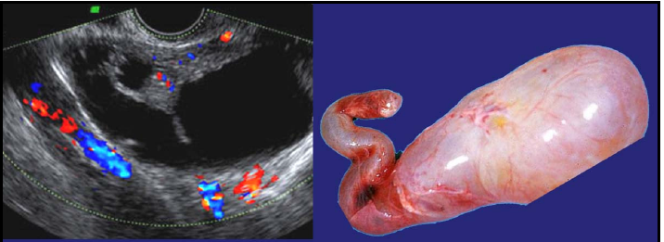
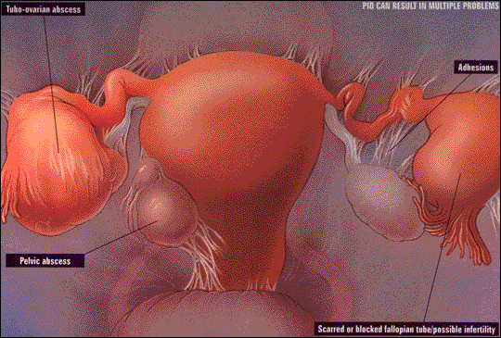
Acute PID : Pathology
Depending on the virulence: watery or purulent exudate
Hydrosalpinx or Pyosalpinx
Deeper penetration & more destruction
Possibilities
Oophoritis
Tubo-ovarian abscess
Peritonitis
Pelvic abscess
or
Resolution in 2-3 weeks with/without chronic sequelae

Slide 36

Acute PID : Presentation & Diagnosis
Diagnosis of Acute PID is difficult because of wide variation & non-specific nature of symptoms & signs
Many women with PID have subtle or mild symptoms
A diagnosis of PID usually is based on clinical findings
Delay in diagnosis and treatment probably contributes to inflammatory sequelae in the upper reproductive tract

Slide 37
Acute PID : Presentation & Diagnosis
History
The patient should be asked about the location, intensity, radiation, timing, duration, and exacerbating and mitigating factors of the pelvic pain: Bilateral lower abdominal & pelvic dull aching pain is characteristic of acute PID
H/O Fever (Oral temperature > 38.3˚C/101F)
H/O Abnormal vaginal discharge
H/O symptoms suggestive of dysuria
Previous H/O abdominal or gynecological surgeries
H/O previous gynecological problem
H/O IUD insertion (6 times higher risk within 20 days)
Social history: Should include patient’s sexual and STDs history & partner’s history in terms of STDs

Slide 38
Acute PID : Presentation & Diagnosis
Fitz Hugh & Curtis Syndrome
Consists of rt. upper quadrant pain resulting from ascending pelvic infection and inflammation of the liver capsule or diaphragm
Although it is typically associated with acute salpingitis, it can exist without signs of acute pelvic inflammatory disease (PID)
Physical examination
Abdominal & pelvic examination is most important
Bilateral abdominal tenderness
Adnexal mass & adnexal tenderness
Cervical motion tenderness
Uterine tenderness
Vaginal mucopurulent discharge

Slide 39
Acute PID : Presentation & Diagnosis
Investigations
Complete blood count
C – reactive protein
Erythrocyte sedimentation rate
Urine Pregnancy Test (UPT), urinalysis
Urine culture
Urine NAATs
Vaginal wet mount
1. WBCs suggest PID
2. Cervical chlamydia and gonorrhea testing
3. Nucleic acid amplification tests (NAATs) for organisms
Faecal occult blood test
Tests for tuberculosis
Tests for syphilis
Tests for HIV

Slide 40
Acute PID : Presentation & Diagnosis
Imaging
Transvaginal ultrasonography is the imaging modality of choice
Trans abdominal ultrasonography for DD
Abdominal CT or MRI : When USG indeterminate
Diagnostic procedures
Culdocentesis
Endometrial biopsy
Diagnostic laparoscopy

Slide 41
Acute PID : Most common DD
Most common DD of acute PID
1. Appendicitis
2. Ectopic pregnancy
3. Endometritis
4. Ovarian cyst
5. Ovarian torsion

Slide 42
Acute PID : diagnostic approach
History, physical examination, & pregnancy test
Evaluate for ectopic pregnancy with quantitative beta-subunit of HCG test and transvaginal USG
Yes
Pregnancy
No
Consider surgical consultation and laparotomy for appendicitis; if diagnosis in doubt, consider USG or abdominal and pelvic CT with intravenous contrast media
Right lower quadrant abdominal pain or pain migration from periumbilical area to right lower quadrant of abdomen?
Yes
No
Yes
Consider PID; obtain transvaginal USG to evaluate for tubo-ovarian abscess
Cervical motion, uterine, or adnexal tenderness?
No

Slide 43
Acute PID : diagnostic approach
Pelvic mass on examination?
Consider ovarian cyst, ovarian torsion, degenerating uterine fibroid, or endometriosis; obtain transvaginal USG
Yes
No
Dysuria and white blood cells on urinalysis?
Evaluate for urinary tract infection or pyelonephritis; obtain urine culture
Yes
No
Transvaginal USG to evaluate for other diagnosis

Slide 44
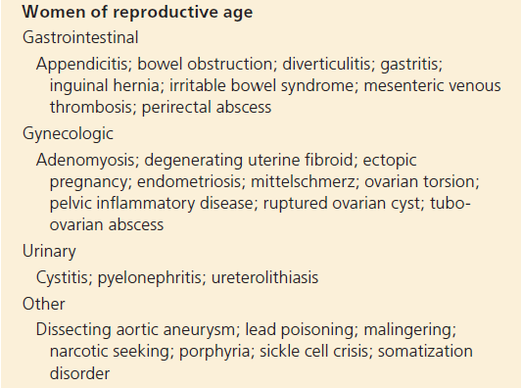
Acute PID : Differential Diagnosis

Slide 45
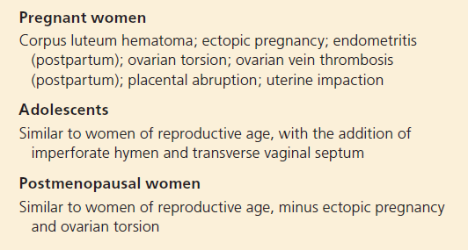
Acute PID : Differential Diagnosis

Slide 46
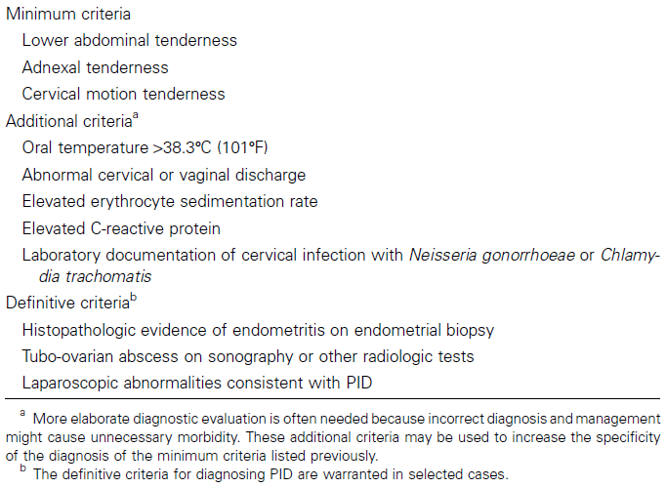
Acute PID : CDC Diagnosis Criteria
3
5
3

Slide 47
Acute PID : Staging
(I-IDSOG-USA recommends following stages)
Stage I
Women who fulfil the CDC major diagnostic criteria and >1 of its minor criteria but who do not have overt peritonitis (as demonstrated by the absence of rebound tenderness) and who have not had any prior documented STD upper tract infections
Stage II
The above criteria, with peritonitis
Stage III
Women with demonstrable tubo-ovarian complex or tubo-ovarian abscess evident on either physical or ultrasonographic examination
Stage IV
Women with ruptured tubo-ovarian abscesses

Slide 48
Acute PID : Management
Therapeutic considerations
Because of the difficulty of diagnosis and the potential for damage to the reproductive health of women (even with mild infection) health-care providers should maintain a low threshold for the diagnosis of PID
PID treatment regimens must provide empiric, broad spectrum coverage of likely pathogens
All regimens should also be effective against N. gonorrhoeae & C. trachomatis
Anaerobic bacteria are also involved in PID – treatment regimens should also cover these
In-patient Vs. out-patient treatment
Oral Vs. parenteral management
Associated management & prevention of recurrence

Slide 49
Acute PID : Hospital admission
(CDC-2015 Criteria)
1. Judgment of the provider
2. Patient meeting following criteria
a. Surgical emergencies (e.g., appendicitis) cannot be excluded
b. Pt. is pregnant
c. Pt. does not respond clinically to oral antimicrobial therapy
d. Pt. is unable to follow or tolerate an outpatient oral regimen
e. Pt. has severe illness, nausea and vomiting, or high fever
f. Pt. has a tubo-ovarian abscess

Slide 50
Acute PID : Management
(Antibiotics for specific pathogen)
Organism | Antibiotics
N. gonorrhea | Cephalosporins, Quinolones
Chlamydia | Doxycycline, Erythromycin & Quinolones (Not to cephalosporins)
Anaerobic organisms | Flagyl, Clindamycin & in some cases to Doxycycline
ß-Haemolytic streptococci. & E. coli | Penicillin derivatives, Tetracyclines, and Cephalosporins., E. Coli is most often treated with the penicillins or gentamicin

Slide 51
Management : Parenteral
Because of the pain associated with intravenous infusion, doxycycline should be administered orally when possible
Oral and IV administration of doxycycline provide similar bioavailability
Parenteral therapy can be discontinued 24 hours after clinical improvement, but oral therapy with doxycycline (100 mg twice a day) should continue to complete 14 days of therapy
When tubo-ovarian abscess is present, clindamycin or metronidazole with doxycycline can be used for continued therapy rather than doxycycline alone because this regimen provides more effective anaerobic coverage
CDC-2015 Regimen A
Cefotetan 2 g IV every 12 hours or Cefoxitin 2 g IV every 6 hours
PLUS Doxycycline 100 mg orally or IV every 12 hours

Slide 52
Management : Parenteral
CDC-2015 Regimen B
Clindamycin 900 mg IV every 8 hours
PLUS Gentamicin loading dose IV or IM (2 mg/kg of body weight), followed by a maintenance dose (1.5 mg/kg) every 8 hours Single daily dosing (3–5 mg/kg) can be substituted
Parenteral therapy can be discontinued 24 hours after clinical improvement
On-going oral therapy should consist of doxycycline 100 mg orally twice a day, or clindamycin 450 mg orally four times a day to complete a total of 14 days of therapy
When tubo-ovarian abscess is present, clindamycin should be continued rather than doxycycline, because clindamycin provides more effective anaerobic coverage

Slide 53
Management : Parenteral
Ampicillin/sulbactam plus doxycycline is effective against C. trachomatis, N. gonorrhoeae, and anaerobes in women with tubo-ovarian abscess
One trial demonstrated high short-term clinical cure rates with azithromycin, either as monotherapy for 1 week (500 mg IV for 1 or 2 doses followed by 250 mg orally for 5–6 days) or combined with a 12-day course of metronidazole
CDC-2015 Alternate Regimens
Ampicillin/Sulbactam 3 g IV every 6 hours
PLUS Doxycycline 100 mg orally or IV every 12 hours

Slide 54
Management : Oral
CDC-2015 Oral Regimen A
Ceftriaxone 250 mg IM in a single dose
PLUS Doxycycline 100 mg orally twice a day for 14 days
With or without Metronidazole 500 mg orally twice a day for 14 days
CDC-2015 Oral Regimen B
Cefoxitin 2 g IM in a single dose and Probenecid 1 g orally administered concurrently in a single dose
PLUS Doxycycline 100 mg orally twice a day for 14 days
With or without Metronidazole 500 mg orally twice a day for 14 days

Slide 55
Management : Oral
The optimal choice of a cephalosporin is unclear; although cefoxitin has better anaerobic coverage, ceftriaxone has better coverage against N. gonorrhoea
The theoretical limitations in coverage of anaerobes by recommended cephalosporin antimicrobials might require the addition of metronidazole to the treatment regimen
Adding metronidazole also will effectively treat BV, which is frequently associated with PID
CDC-2015 Oral Regimen C
Other parenteral third-generation cephalosporin (e.g., ceftizoxime or cefotaxime)
PLUS Doxycycline 100 mg orally twice a day for 14 days
With or without Metronidazole 500 mg orally twice a day for 14 days

Slide 56
Management : Alternate oral reGIMEN Because of emergence of quinolone-resistant
Neisseria gonorrhoea, regimens that include a quinolone agent are no longer recommended
If parenteral cephalosporin therapy is not feasible, use of fluoroquinolones (levofloxacin 500 mg orally once daily or ofloxacin 400 mg twice daily for 14 days) with or without metronidazole (500 mg orally twice daily for 14 days) can be considered if community prevalence & individual risk for gonorrhoea are low
Diagnostic tests for gonorrhoea must be performed before therapy & the patient managed as follows if test is positive

Slide 57
If the culture for gonorrhoea is positive, treatment should be based on results of antimicrobial susceptibility
If isolate is quinolone-resistant N. gonorrhoeae (QRNG) or if antimicrobial susceptibility cannot be assessed, parenteral cephalosporin is recommended.
However
If cephalosporin therapy is not feasible, the addition of azithromycin 2 g orally as a single dose to a quinolone-based PID regimen is recommended

Slide 58


CDC no longer recommends cefixime at any dose as a first-line regimen for treatment of gonococcal infections
If cefixime is used as an alternative agent, then the patient should return in 1 week for a test-of-cure at the site of infection

Slide 59
Management & Follow-up
Out-patient
Oral regimen
In-patient
Parenteral regimen
3 Days (72 hours)
Substantial clinical improvement ????
Defervescence
Reduction in direct or rebound abdominal tenderness
Reduction in uterine, adnexal & cervical motion tenderness
Yes
NO
Admit Out-patient
Switch to oral from parenteral after 24 hours of clinical improvement
If on oral – continue the same
Reassessment of patient & treatment
Additional diagnostic testing
After 6 - months
Repeat testing of all women who have been diagnosed with chlamydia or gonorrhoea

Slide 60
Management : Surgery in Acute PID
Indications
1. Ruptured abscess
2. Failed response to medical treatment
3. Uncertain diagnosis
Type of surgeries
1. Colpotomy
2. Percutaneous drainage/aspiration
3. Exploratory laparotomy
Extend of surgeries
1. Conservation - if fertility desired
2. U/L or B/L Sal.-oophorectomy with/without hysterectomy
3. Drainage of abscess at laparotomy

Slide 61
Management : Surgery in PID
(Main complications in Stage IV PID : Ruptured abscess)
During operation
1. Septic shock
2. Injury to small bowel
3. Injury to rectum
Post-operative
1. Pus collected again
2. Chest empyema
3. Septicemia
4. Septic shock
5.. Recto-vaginal fistula
6. Wound abscess or infection
7. Pneumonia
8. Renal failure
9. Liver failure

Slide 62
Management : Associated treatment
Rest: at home or hospital
Abstinence from sex: till complete cure is achieved
Anti-inflammatory treatment
Estro-progestronics:
- Contraceptive effect
- Protection of ovaries against inflammatory reaction
- Cervical mucus induced by OP have preventive effect against re-infection

Slide 63
PID : Management of Partner
Male sex partners of women with PID should be examined and treated if they had sexual contact with the patient during the 60 days preceding the patient’s onset of symptoms
If a patient’s last sexual intercourse was >60 days before onset of symptoms or diagnosis, the patient’s most recent sex partner should be treated
Evaluation and treatment are imperative because of the risk for reinfection of the patient and the strong likelihood of urethral gonococcal or chlamydial infection in the sex partner
Male partners of women who have PID caused by C. trachomatis and/or N. gonorrhoea frequently asymptomatic
Sex partners should be treated empirically with regimens effective against both of these infections, regardless of the etiology of PID or pathogens isolated from the infected woman

Slide 64
PID : Special situation
Pregnancy
Considerations Maternal morbidity Pre-term delivery
Management Hospitalization & In-patient management Parenteral treatment
HIV infected patient
Considerations No difference in presentation but more likely to have tubo-ovarian abscess The microbiologic findings were similar, except HIV-infected women had higher rates of concomitant M. hominis, candida, streptococcal & HPV infections and HPV-related cytologic abnormalities
Management of immunodeficient HIV-infected women requires more aggressive interventions has not been determined

Slide 65
PID : Special situation
IUD users
Considerations The risk for PID associated with IUD use is primarily confined to the first 3 weeks after insertion and is uncommon thereafter Practitioners might encounter PID in IUD users because it’s a popular method of contraception
Management Evidence is insufficient to recommend the removal of IUDs However Caution should be exercised if the IUD remains in place, and close clinical follow-up is mandatory. If improvement is not seen within 72 hrs of starting treatment then removal of IUCD is considered No data have been collected regarding treatment outcomes by type of IUD (e.g., copper or levonorgestrel)

Slide 66
PID : Special situation
Post-menopausal women
Considerations Rare in these patients Extragenital pathology in addition to genital tract malignancies must be considered in these patients Most commonly due to iatrogenic causes Not typically associated with organisms causing STDs Organisms most commonly encountered are E. coli & Klebsiella Anaerobic organisms are commonly found Tubo-ovarian abscess is common
Management In-patient & parenteral management Surgical exploration should be considered if patient is not improving within 48 hours Management should be aggressive to prevent morbidity & mortality

Slide 67
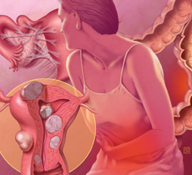
PID : Chronic complications & sequelae

Slide 68
PID : Chronic complications & sequelae
Complications
1. Dyspareunia
2. Infertility : due to tubal factor 12 % after single episode 25 % after two episodes 50 % after three episodes
3. Increased risk of ectopic pregnancy 6-10 % increase in risk following H/O PID
4. Formation of adhesion or hydrosalpinx or pyosalpinx & tubo -ovarian abscess
5. Chronic pelvic inflammation Due to recurrent or associated pyogenic infection/ T.B.
6. Chronic pelvic pain and ill health

Slide 69
Chronic Pelvic Infection
Occurs due to
Following acute pelvic infection
Following low grade infection
Tubercular infection
Pyogenic : Pathogenesis
Both openings of tube are blocked with damage to structures
This can result in hydro or pyosalpinx
Recurrent peritoneal surface infection can result in either flimsy (gonococcal) or dense (non-gonococcal) adhesions with surrounding structures
Resulting fibrosis affects surrounding structures & may result in frozen pelvis
Pyogenic infection

Slide 70
Chronic Pelvic Infection
Symptoms
Chronic pelvic pain
Dyspareunia
Congestive dysmenorrhea
Lower abdominal pain
Menorrhagia
Vaginal discharge
Infertility
Signs
Tenderness on one or both iliac fossa
An irregular tender pelvic mass
PV findings similar to CDC criteria for Acute PID
PR - Involvement of parametrium & uterosacral ligament

Slide 71
Chronic Pelvic Infection
Investigations, imaging & diagnostic procedures
Similar to Acute PID
Management
Antibiotics
Broad spectrum for 3 weeks/ based on C/S
In proved gonococcal infection as CDC guidelines- parenteral
Surgery
Indications
Persistence of symptoms despite conservative management
Recurrence of acute attack
Increase in size of pelvic mass despite treatment
Persistent menorrhagia & deterioration in general health
Infertility

Slide 72
Chronic Pelvic Infection
Surgery
Nature of surgery
Ideal: Hysterectomy with bilateral salpingo-oophorectomy in patients who have completed their family
Pt. who desires to have family
- Salpingolysis
- Salpingostomy
- Tubal anastomosis

Slide 73
PID : Chronic Pelvic Pain
Definition of CPP
Chronic pelvic pain is noncyclic pain that lasts six months or more; is localized to the pelvis, the anterior abdominal wall at or below the umbilicus, or the buttocks; and is of sufficient severity to cause functional disability or require medical care
Pathophysiology of CPP
Not well understood
Definitive diagnosis is not made for 61% of women with chronic pelvic pain
The four most commonly diagnosed etiologies are - Endometriosis
- Adhesions
- Irritable bowel syndrome (IBS)
- Interstitial cystitis

Slide 74
PID : Chronic Pelvic Pain
History
A history of previous sexually transmitted infection
Dyspareunia,
Menstrual irregularity
Backache
Rectal pressure
Pelvic pain with fever
PID should also be considered as a possible cause of CPP in women with a history of any other late sequelae of PID
- Infertility
- Ectopic pregnancy
- Pain with stretching, movements or organ distension
(Peritoneal adhesions)

Slide 75
PID : Chronic Pelvic Pain
Examination
Mucopurulent cervical discharge on pelvic examination
Investigations
Positive gonorrhea or chlamydia testing
Treatment
Appropriate antibiotics are recommended if PID is suspected,
however
Because the pain of CPP tends to wax and wane over time, the resolution of pain following this does not necessarily prove that PID was the cause of the CPP

Slide 76
FOLLOW-UP
● Re-screening for Chlamydia & Gonorrhea
Patient counseling:
- Risk of re- infection and sequel.
- Sexual counseling
- Avoid douching

Slide 77
Management of sex partners
• Examination and treatment if they had sexual contact with patients during the 60 days preceding the onset of symptoms in the patients.
• Empirical treatment with regimens effective against C. trachomatis and N. gonorrhoeae

Slide 78
PID : Prevention
Primary prevention
1. Sexual counseling Practice safe sex Limit number of sexual partners Avoid contact with high risk partners Delay in sexual activity until 16 years of age
2. Barrier methods & oral contraceptives reduce the risk
Secondary prevention
1. Screening for infections in high risk population
2. Rapid diagnosis & effective treatment of STDs & UTI
Tertiary prevention
1. Early intervention & complete treatment

Slide 79
PROGNOSIS
Prognosis is unfavorable here
Pregnancy is rare 5-10%
If occurs chances of Ectopic pregnancy is more 40%
In Uterine pregnancy abortion is likely and pregnancy going upto term is rare almost 1%.

Slide 80
CONCLUSION
PID is mainly caused by N.gonorrhoeaand chlamydia trachomatis follwed by Gardenerella Vaginalis,Streptococci,Stephylococci,E,coli, mycoplasma and anaerobic organisms like bacteroides clostridia or peptostreptococcus.
Acute or chronic PID cases are to be diagnosed and treated promptly and completely to minimize complications and late sequeles.
Triad of lower abdominal pain ,adnexal tenderness and tender cervical movements are considered to be the most important clinical features ofAcute PID.
Rx is according to the guide lines by the centers for disease control. Partner should be treated simultaneously.

Slide 81
Key Points---
Surgical Intervention is needed when there is pelvic abscessor TO ovarian mass, adhesions---intestinal obstruction / general peritonitis.
Chronic PID presents as chronic abdominal pain congestive dysmenorrhoea ,deep dyspareunia,menstrual abnormalities and infertility.
Physical examination reveals adnexal tenderness,massor frozen pelvis. Management is by laparoscopy / laparotomy .Adhesiolysis or salpingo-oopherectomy may be required , rarely hysterectomy may be needed.

Slide 82
THANK YOU

