Slide 1
Pathology of pregnancy
HYDATIFORM MOLE

Slide 2
Definition
Gestational trophoblastic disease (GTD) refers to a spectrum of tumor and tumor like conditions characterised by proliferation of pregnancy associated trophoblastic tissue and progressive malignant potential.
(from BEREK n NOVAK’s )

Slide 3
Modified World Health Organization Classification of Gestational Trophoblastic Disease
Molar lesions
Hydatidiform mole
Complete
Partial
Invasive mole
Nonmolar lesions
Choriocarcinoma
Placental site trophoblastic tumor
Epithelioid trophoblastic tumor – Newer

Slide 4
Hydatiform mole
Defined as an abnormal placenta characterised by 2 features :
Enlarged,oedematous ,Cystic or Hydropic degeneration of chorionic villi which become vesicular.
With Variable amount of trophoblastic proliferation (both cytotrophoblast and synctiotrophoblast )
Absence of blood vessels

Slide 5
All elaborate human chorionic gonadotropin (hCG), which can be detected in the blood and urine at levels considerably higher than those found during normal pregnancy.
In addition to aiding diagnosis, the rise or fall of hormone levels in the blood or urine can be used to monitor treatment efficacy

Slide 6
Incidence
Incidence is high in teenagers and in older women.
1 in 400 pregnancy – in India
It is higher in poorer classes.
Incidence is 10 times higher in Asia than in united states.
Higher the ratio of paternal: maternal chromosomes, the greater is the molar change.
Complete moles show 2:0 paternal/maternal ratio whereas partial mole shows 2:1 ratio.
Mole Due to degenerative lesion though capable of neoplastic change

Slide 7
Risk factors
Extremes of age i.e < 20 yrs and > 35 yrs
Previous H/o molar pregnancy 4-5 times risk
Genetic factors
Low dietary intake of carotene,protein increases the risk
Disturbed maternal immune mechanisms i.e
(1) rise in gammaglobulin level in absence of hepatic disease,
(2) increased association with AB blood group which possess no ABO antibody.
combined Ocps intake has associated with increased risk.

Slide 8
The risk of recurrence of hydatidiform mole in future pregnancy
-after 1 molar pregnancy - 1-1.5 %
-after 2 nd molar pregnancy - 23 %
Rate of subsequent GTN
-following complete mole- 15-20%
-following partial mole - 1-5%

Slide 9
PATHOLOGY OF HYDATIDIFORM MOLE
It is principally a disease of the chorion.
Death of the ovum or failure of the embryo to grow - is essential to develop complete (classic) hydatidiform mole.
The secretion from the hyperplastic cells and transferred substances from the maternal blood accumulate in the stroma of the villi which are devoid of blood vessels.

Slide 10
This results in distension of the villi to form small vesicles.
The distension may also be due to edema and liquefaction of the stroma.
Vesicle fluid is interstitial fluid and is almost similar to ascitic or edema fluid, but rich in hCG

Slide 11
The typical hydatidiform mole is a voluminous mass of swollen, sometimes cystically dilated chorionic villi, appearing grossly as grape like structures.
The swollen villi are covered by varying amounts of normal to highly atypical chorionic epithelium
They resemble hydatid cyst hence the name hydatiform mole.

Slide 12
Hydatidiform Mole
Based on the degree and extent of tissue changes,
hydatidiform moles are categorized as either
Complete hydatidiform mole
2. Partial hydatidiform mole

Slide 13
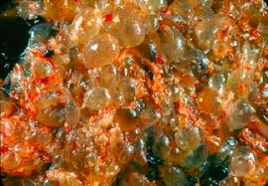
COMPLETE HYDATIDIFORM MOLE
Is associated with an absent fetus/embryo chorionic villi show varying degrees of diffused trophoblastic proliferation and edema of the villous stroma.

Slide 14
In pregnancies before 10 weeks, classic molar changes may not be apparent because villi may not be enlarged and molar stroma may not yet be edematous and avascular.

Slide 15
COMPLETE MOLE –
Where the chorionic villi completely undergoes cystic degeneration
They Are not compatible with embryogenesis and shows complete absence of fetal blood vessles seen in villi and never contain fetal parts.
All of the chorionic villi are abnormal, and the chorionic epithelial cells are diploid (46,XX or, uncommonly, 46,XY).

Slide 16
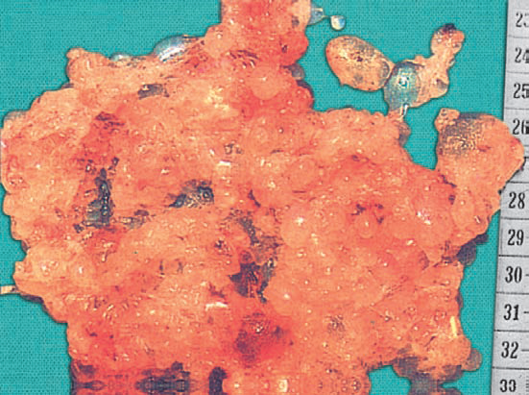

Slide 17
Naked eye appearance :
The mass filling the uterus is made of multiple chains and clusters of cysts of varying sizes.
There is no trace of embryo or the amniotic sac.
Hemorrhage, if occurs, takes place in the decidual space.

Slide 18
It is mainly due to duplication of haploid sperm following fertilization of empty ovum and are 46XX
They are diploid and paternal in origin, paternal chromosomes only present here – this phenomenon termed as androgenesis.
In some cases chromosome may be 46XY due to dispermic fertilization of an empty ovum.

Slide 19
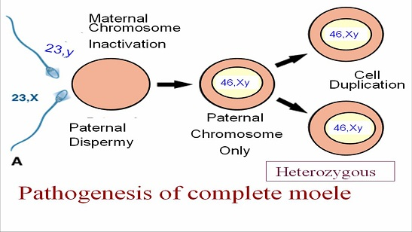
Karyotype
Heterozygous 10%
Pathogenesis of complete H. Mole

Slide 20
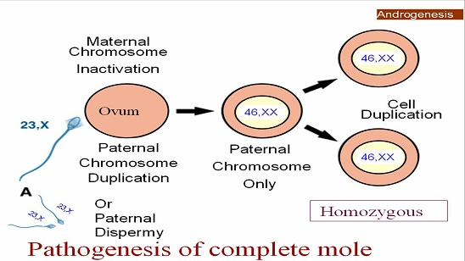
Karyotype
Homozygous 90%
Pathogenesis of complete H. Mole

Slide 21
PARTIAL MOLE /INCOMPLETE MOLE :
Here focal areas undergo degeneration other area remains normal.
It is compatible with early embryo formation and therefore contain fetal parts which may be normal or abnormal, & at least an amniotic sac will be seen.
And has some normal chorionic villi, and is almost always triploid (e.g., 69,XXY)

Slide 22
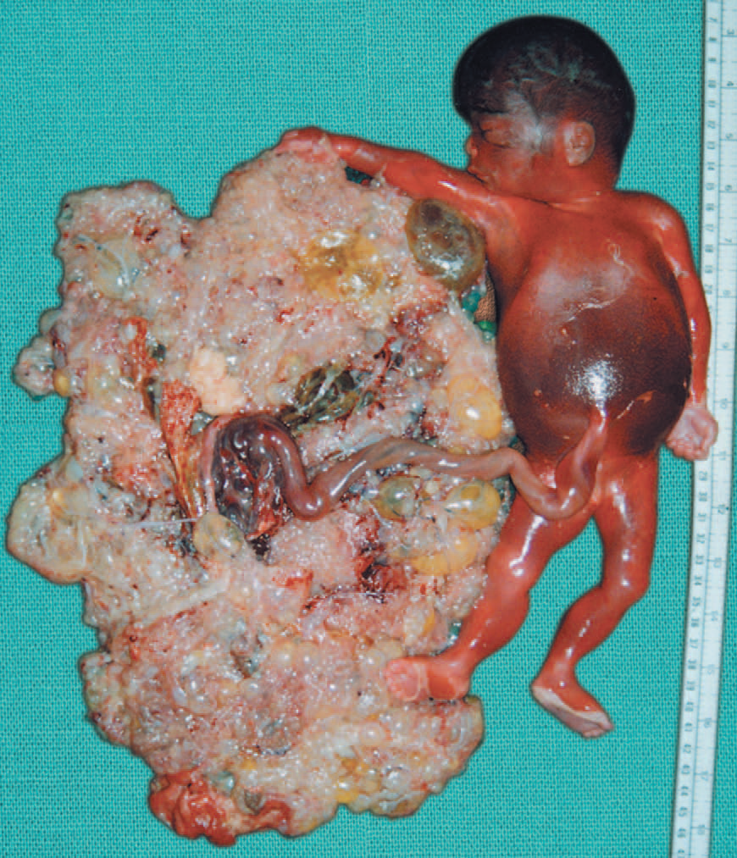

Slide 23
The karyotype is triploid (69XXX or 69XXY) with two sets of paternal haploid genes and one set of maternal haploid genes
Due to dispermic fertilization of an ovum.

Slide 24
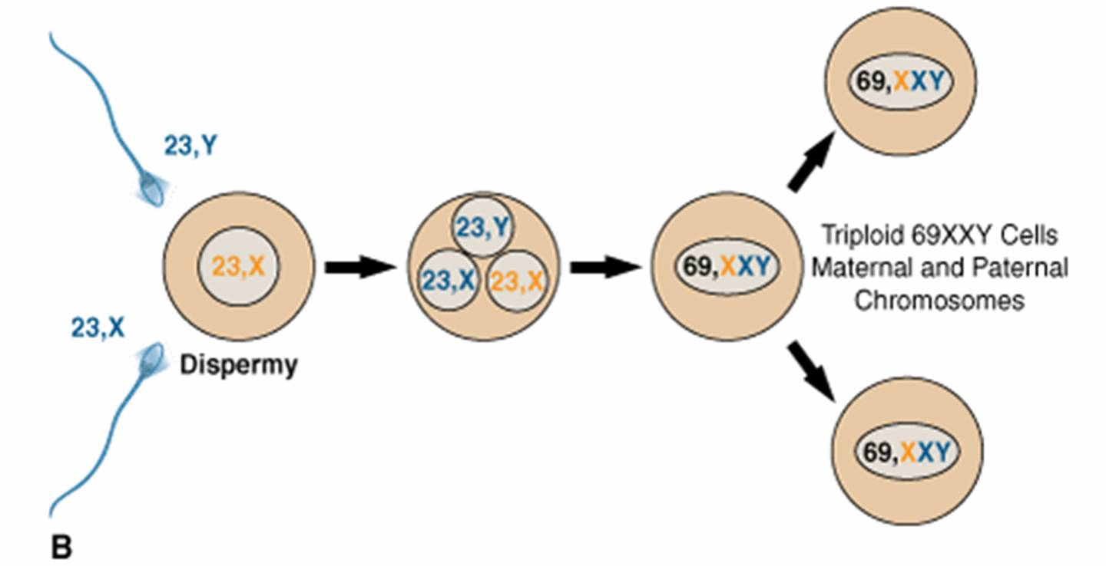
Karyotype
Pathogenesis of Partial H. Mole

Slide 25
Fetus will show features of triploidy or tetraploidy like – multiple malformations,IUGR, and usually dies.

Slide 26
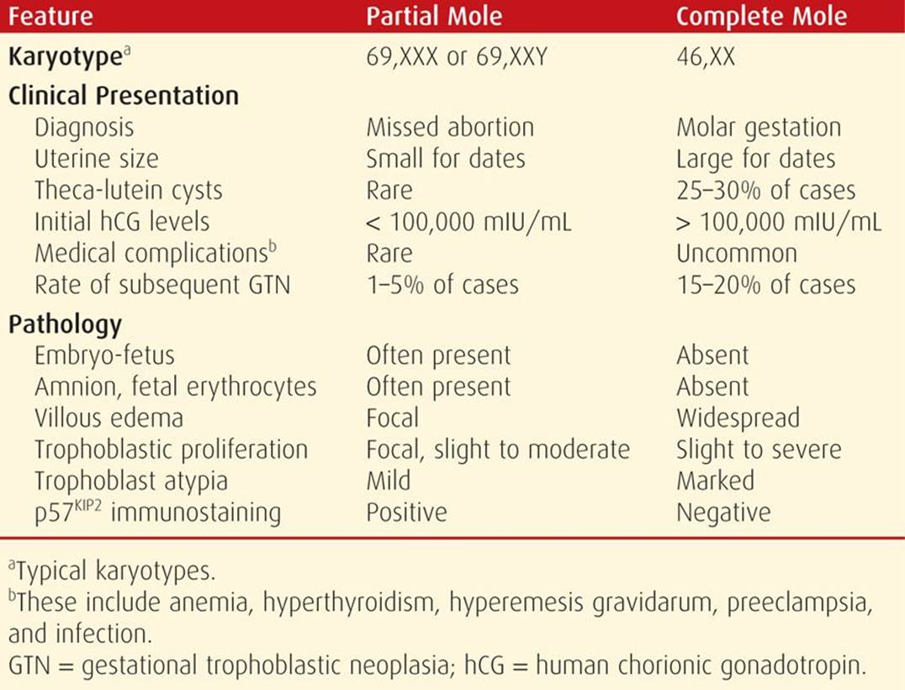

Slide 27
Although molar disease formerly was discovered at 12 to 14 weeks of pregnancy during investigation for a gestation that was “too large for dates,” early monitoring of pregnancies by ultrasound has lowered the gestational age at detection.
In both complete and partial moles, there will be elevation of hCG in the maternal blood and absence of fetal heart sounds which are typical

Slide 28
MORPHOLOGY
The uterus may be of normal size in early moles, but in more advanced cases the uterine cavity is expanded by a delicate,friable mass of thin-walled, translucent cystic structures.
Fetal parts are rarely seen in complete moles but are common in partial moles

Slide 29
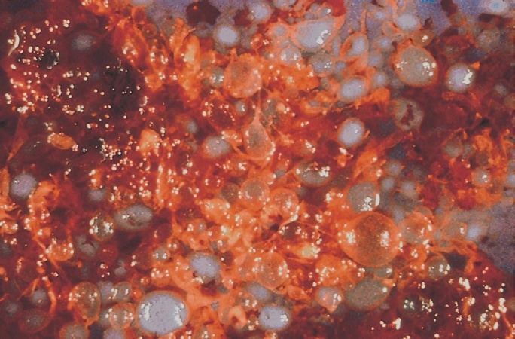
COMPLETE MOLE
consisting of numerous swollen (hydropic) villi.

Slide 30
microscopic examination
complete mole shows hydropic swelling of poorly vascularized chorionic villi with a loose, myxomatous, edematous stroma.
Marked thinning of the stromal tissue due to hydropic degeneration
The chorionic epithelium almost always shows some degree of proliferation of both cytotrophoblasts and syncytiotrophoblasts.
There is absence of blood vessels in the villi which seems primary rather than due to pressure atrophy

Slide 31
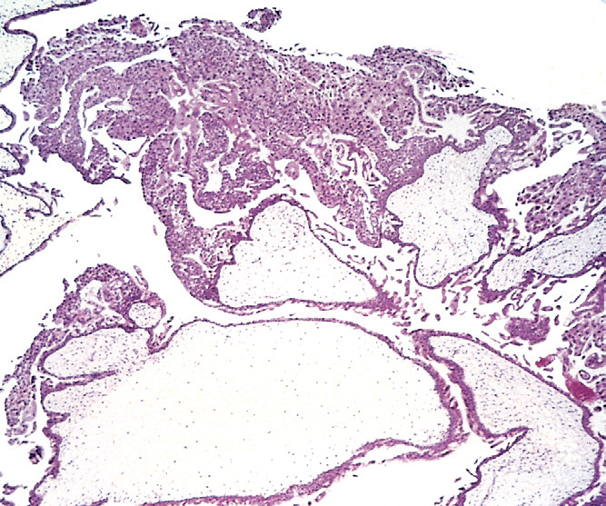
In this microscopic image there is distended hydropic villi (below) and proliferation of the chorionic epithelium
(above) are evident

Slide 32
In partial moles, villous edema involves only some of the villi, and the trophoblastic proliferation is focal and slight.
Microscopic examination : the dilated chorionic villi shows predominant hyperplasia of the syncytiotrophoblast and presence of fetal blood vessels with fetal red blood cells
The villi of partial moles have a characteristic irregular, scalloped margin.
In most cases of partial mole, some fetal cells are present, ranging from fetal red blood cells in placental villi to, in rare cases, a fully formed fetus.

Slide 33
Complete H. Mole
Microscopically Enlarged, edematous villi and abnormal trophoblastic proliferation that diffusely involve the entire villi
No fetal tissue, RBCs or amnion are produced
Macroscopically, these microscopic changes transform the chorionic villi into clusters of vesicles with variable dimensions “ like bunch of grapes"
No fetal or embryonic tissue

Slide 34
Partial H. Mole
Microscopically: The enlarged, edematous villi and abnormal trophoblastic proliferation are slight and focal and do not involve the entire villi.
There is a scalloping of chorionic villi
Fetal or embryonic tissue or fetal RBCs
Macroscopically: The molar pattern did not involve the entire placenta.
Fetal or embryonic tissueor fetal RBCs

Slide 35
Histologic grading to predict the clinical outcome of moles has been supplanted by careful monitoring of hCG levels
Ovarian changes: Bilateral lutein cysts are present in about 50%.
These are due to excessive production of chorionic gonadotropin and they are also observed in multiple pregnancy.
These regress spontaneously within 2 months after expulsion of mole. The contained fluid is rich in chorionic gonadotropin.
It aslo contains estrogen and progesterone.

Slide 36
CLINICAL FEATURES
The patient gives
H/O amenorrhea of 8–12 weeks with initial features suggestive of normal pregnancy but subsequently presents with the following manifestations (often confused with abortion).
The patient becomes sick without any apparent reason

Slide 37
SYMPTOMS
Period of amenorhoea followed by Abnormal Vaginal bleeding
I.e Expulsion of grape-like vesicles per vaginam with vaginal bleeding is diagnostic of vesicular mole.
There may be spotting at times and it may last for weeks.
In between there msy be serosanguinous discharge also.
Lower abdominal pain

Slide 38
Constitutional symptoms like
Vomiting becomes excessive to the stage of hyperemesis in 15% cases. It is probably related to excess circulating chorionic gonadotropins
Breathlessness due to pulmonary embolization of the trophoblastic cells (2%).
Thyrotoxic features of tremors or tachycardia are present on occasion (2%). It is probably due to increased chorionic thyrotropin levels produced by trophoblasts.

Slide 39
Hypertension,albuminuria,edema prior to 20 weeks pregnancy should araise suspicion of a mcolar pregnancy.
Sometimes History of quickening is absent.
Actually in approximately 50% of cases, the mole is not suspected until it is expelled in part or whole

Slide 40
SIGNS
GENERAL PHYSICAL EXAMINATION :
Patient may be pale and mildly anaemic.
Blood pressure may be raised with associated albuminuria if there is associated preeclampsia
There may be tachycardia with or without hypotension.

Slide 41
Severe preeclampsia are relatively common with advanced molar pregnancies.
In continuing twin gestations, severe preeclampsia frequently mandates preterm delivery

Slide 42
On ABDOMINAL PALPATION :
Uterus will be enlarged more than the period of gestaion in 50 % cases. In 35% it corresponds to the gestational period and in rest it may be smaller.
The characteristic boggy or doughy feel of the uterus is suggestive of a molar pregnancy.
Fetal parts are not palpable and fetal heart sounds are not heard.

Slide 43
VAGINAL EXAMINATION :
May reveal the absence of ballotement and the presence of enlarged cystic ovaries.

Slide 44
DIAGNOSIS
If the patient has already started the process of expulsion and vesicles are identified the diagnosis is easy.
In women who have not started to expel the products with clinical features suggestive of molar pregnancy Ultrasound examination will help in the early diagnosis.

Slide 45
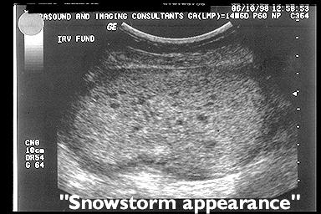

Slide 46
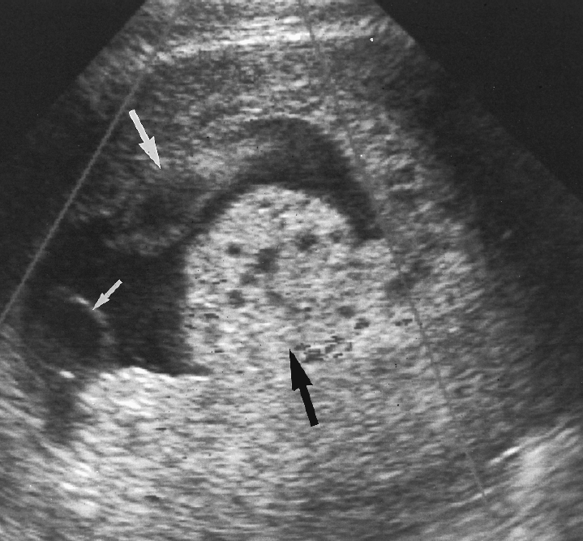
Ultrasound features of partial mole
Classically: A thickened, hydropic placenta with fetal or embryonic tissue with Cystic spaces in the placenta

Slide 47
In complete mole - Echogenic uterine mass with numerous anechoic cystic spaces but without a fetus or amnionic sac.
The appearance is often described as a “snowstorm”In molar pregnancy USG and absence of fetal parts.
A partial mole in USG has features that include a thickened, multicystic placenta along with a fetus or at least fetal tissue.
It may also show the presence of theca luteal cysts in the ovaries.

Slide 48
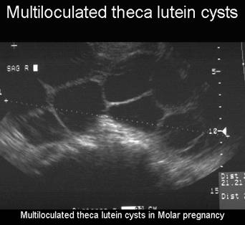

Slide 49
Hence therefore Ultrasound in 1st trimester will rule out hydatiform mole and ectopic pregnancy and confirm a live intrauterine pregnancy

Slide 50
Serum beta HCG levels >1,00,000 mIU/ml – very high indicates - large molar growth inside the uterus.
Complete blood count with platelet count to rule out associated anaemia and coagulation disorders.
Liver function test
Renal function test
Thyroxine levels to rule out hyperthyroidism.

Slide 51
serum free thyroxine (fT4) levels to be elevated and thyroid-stimulating hormone (TSH) levels to be decreased.
Moreover, the serum free T4 levels rapidly normalize after uterine evacuation
Histopathologic evaluation can be enhanced by immunohistochemical staining for p57 expression and by molecular genotyping

Slide 52
p57KIP2 is a nuclear protein whose gene is paternally imprinted and maternally expressed.
This means that the gene product is produced only in tissues containing a maternal allele.
Because complete moles contain only paternal genes, the p57KIP2 protein is absent in complete moles, and tissues do not pick up this stain.

Slide 53
In contrast, this nuclear protein is strongly expressed in normal placentas, in spontaneous pregnancy losses with hydropic degeneration, and in partial hydatidiform moles.
For distinction of a partial mole from a nonmolar hydropic abortus, both of which express p57, molecular genotyping can be used.

Slide 54
Molecular genotyping determines the parental source of alleles.
Thereby, it can distinguish among a diploid diandric genome (complete mole), a triploid diandric-monogynic genome (partial mole), or biparental diploidy (nonmolar abortus)

Slide 55
Differential diagnosis
Threatned abortion
Uterus more than period of amennorhoea
Acute hydramnios
Multiple pregnancy
Tumours complicating pregnancy

Slide 56
Treatment
It consists of two phases :
Immediate evacuation of the mole
Subsequent follow up for detection of persistent trophoblastic proliferation or malignant change.

Slide 57
Before evacuation serum beta HCG level is estimated.
Chest xray is also taken to rule out pulmonary lesions which can present in hydatiform mole.

Slide 58
Suction evacuation is the treatment of choice irrespective of the size of the uterus.
Cervical ripening agents like misoprostol (PGE1) analogues are used to dilate the cervix before evacuation.
Compatible blood has to be arranged and started on I.V fluids before evacuation as there can be heavy bleeding.

Slide 59
Before starting evacuation process
Stabilize the patient
Start her on I.V fluids and blood transfusion if needed.

Slide 60
Oxytocin drip 5 units in 500ml Ringer lactate started as continuous infusion
During evacuation procedure patient should ideally be monitored by pulse oximeter (oxygen saturation).
Use of oxytocin helps the expulsion of moles and reduces blood loss but its routine use is not recommended due to the risks of embolization
Once the evacuation is done ,thorough curetting to be done

Slide 61
Risk of hemorrhage is high especially when the uterus is large.
Intra or post evacuation USG is useful in ascertaining the completeness of evacuation and if necessary check curettage can be done a week later on.
Main complications during evacuation are haemorrhage,perforation as the uterus may be very soft,subinvolution,embolization.
In case of perforation – emergency lapratomy should be done.

Slide 62
All the products of conception to be sent to HPE to confirm the diagnosis and to exclude GTN
In case of RH negative incompatibility – ANTI D prophylaxis to be given for both complete and partial mole.

Slide 63
FOLLOW UP
Detection of malignant change and for prompts instituition of chemotheraphy.
After 48 hrs of evacuation serum beta HCG levels are done
Usually normal levels reach within 8 weeks to 12 weeks.

Slide 64
Risk of developing GTN is greater in 1st 6 months.
If the levels plateau or rise the patient is considered to have GTD and treated accordingly.
Usually pregnancy is avoided in this period.

Slide 65
Surveillance following molar pregnancy
Molar evacuation
Beta HCG after 48 hours of evacuation
Weekly till three negative values
Once in two weeks for three months and monthly for one year

Slide 66
At each visit relevant symptoms like irregular bleeding,persistent cough,hemoptysis,dyspnoea should be asked and enquired.
Per abdomen ad vaginal examination to be done to look for suburethral nodule,bleeding pv,subinvolution
Pregnancy is allowed after the period of follow up is over.

Slide 67
CONTRACEPTION
Untill beta HCG levels are normal , Barrier method is ideal.
Once the levels are normal either combined OCP can be used.

Slide 68
THANK YOU

