Slide 1
Childhood Obesity Dr.Dinesh.k

Slide 2
Definition
Def: Obesity is a state of excess adipose tissue mass.
The most widely used method to gauge obesity is the body mass index (BMI) i.e. kg/cm²

Slide 3
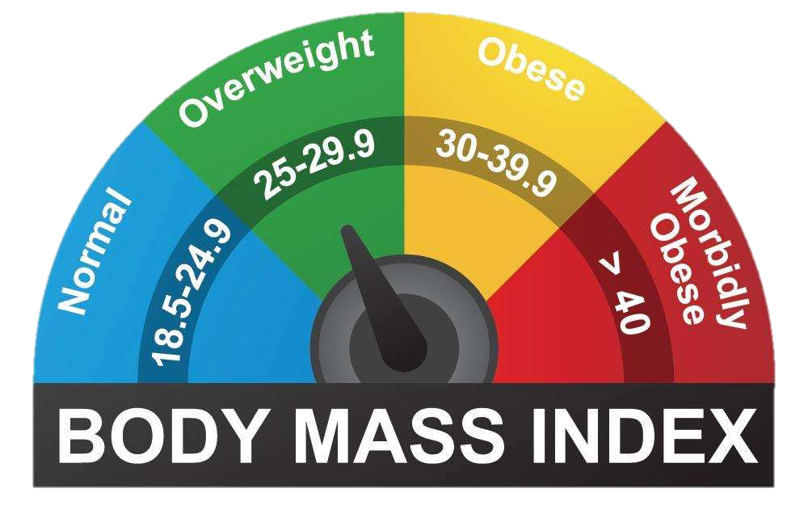
Definition

Slide 4
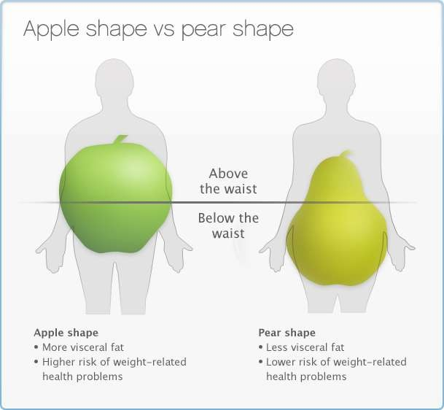

Introduction
The distribution of adipose tissue in different anatomic depots also has substantial implications for morbidity
This distinction is made clinically by the waist-to- hip ratio (WHR)
>0.9 in women
>1.0 in men
ABNORMAL

Slide 5
Prevalence
Estimated that over 12% of the world’s adult population is obese
Estimations in India reveal that 5-12% are obese
⅓ of the adult population of the US → Obese

Slide 6

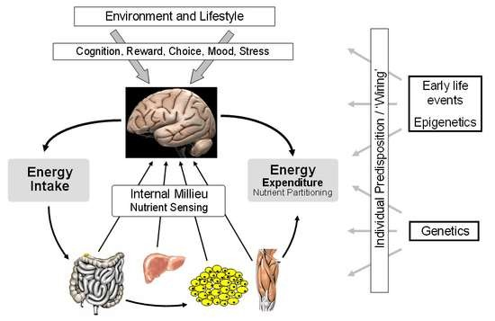
Physiological regulation of energy balance
Body weight is regulated by both endocrine and neural components
Alterations in stable weight by forced overfeeding or food deprivation induce physiologic changes that resist these perturbations

Slide 7












Etiology of obesity
LIFESTYLE
PSYCHOLOGICAL
MEDICAL
GENETIC
OBESITY

Slide 8
Environmental/Psychosocial
Increased caloric intake
Availability, price
Extra 50 cal/day (1 tsp sugar) = 2.25 kg/year
= 25 kg over 10 years
More sedentary
Television/Computer
Emphasis on academics

Slide 9
Medical causes
Cushing’s syndrome
Hypothyroidism
Insulinoma
Craniopharyngioma and other disorders involving the hypothalamus
Drug induced

Slide 10
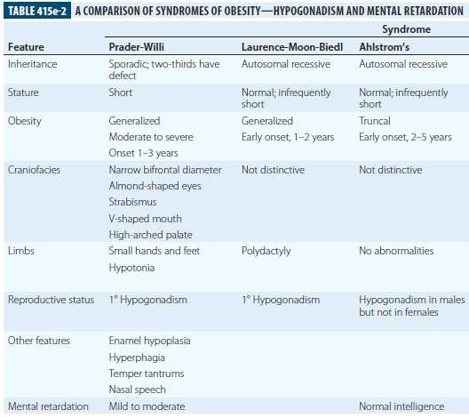

Slide 11
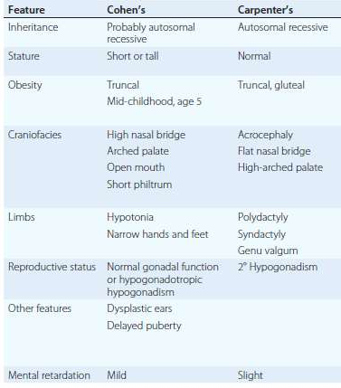

Slide 12

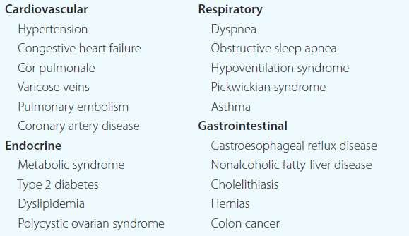
Complications of Obesity

Slide 13

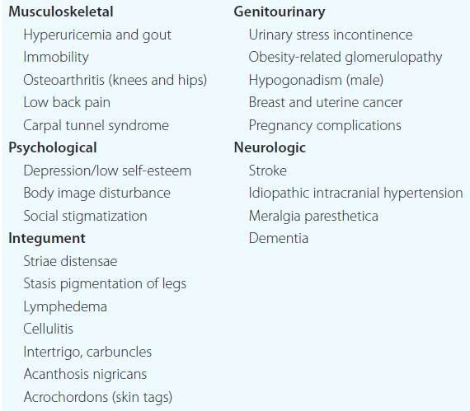
Complications of Obesity

Slide 14



































Complications associated with Obesity
Death Cardiac failure
Pickwickian syndrome
Carcinomas
Cholelithiasis
Cardiovascular disease
DM
Venous insufficiency
Hyperuricemia Hypertension
Hypertriglyceridemia
Duration of obesity

Slide 15

Management of Obesity

Slide 16
WORK UP
Physical exam – Focus on possible complications
Investigations:
Blood sugar, lipid profile, liver function tests
Other tests based on clinical features
TSH, Sleep studies
Dexamethasone suppression test for Cushing’s syndrome*

Slide 17
Treatment
Prevention
Diet
Increased physical activity
Behavior modification
Medicines

Slide 18

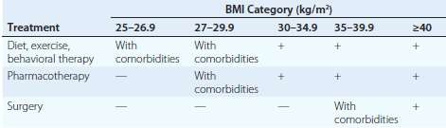
Guide to treatment options

Slide 19


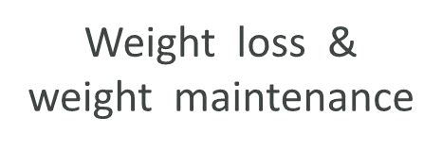








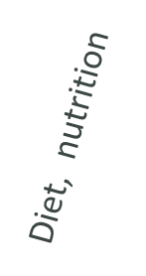







Weight loss & weight maintenance
Integrated weight management

Slide 20
Behaviour modification
Self monitoring of weight
Stress management
Social support

Slide 21
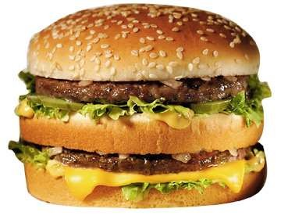
Diet
The primary focus of diet therapy is to reduce overall calorie consumption
Very low energy diets (e.g., 400 to 600
kcal/d)
Low-calorie diets, >800 kcal/d
very low fat diets
very low carbohydrate “Atkins” style diets
Guidelines recommend initiating treatment with a calorie deficit of 500– 1000 kcal/d compared with the patient's habitual diet.

Slide 22
Diet
The revised Dietary Reference Intakes for Macronutrients released by the Institute of Medicine recommends
45–65% of calories from carbohydrates,
20–35% from fat, and 10–35% from protein.
daily fiber intake of 38 g (men) and 25 g (women) for persons over 50 years of age and
30 g (men) and 21 g (women)for those under age 50.

Slide 23
Diet
Low-carbohydrate, high-protein diets appear to be more effective in lowering BMI;
improving coronary heart disease risk factors, including an increase in HDL cholesterol and a decrease in triglyceride levels;
controlling satiety in the short term compared with low-fat diets

Slide 24
Diet
Occasionally, very low calorie diets (VLCDs) are prescribed as a form of aggressive dietary therapy.
The primary purpose of a VLCD is to promote a rapid and significant (13–23 kg) short-term weight loss over a 3- to 6-month period.
These propriety formulas typically supply 800 kcal, 50– 80 g protein, and 100% of the recommended daily intake for vitamins and minerals.

Slide 25
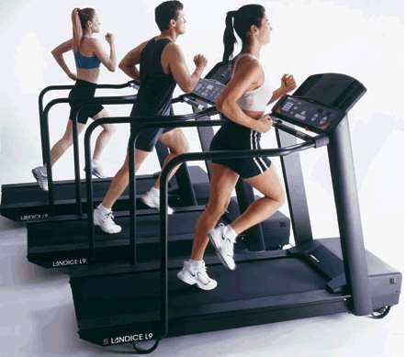
Exercise
Increased energy expenditure is the most obvious mechanism for an effect of exercise
Exercise appears to be a valuable means to sustain diet therapy
Valuable in the obese individual for its effects on cardiovascular tone and blood pressure

Slide 26

Pharmacotherapy
Recommended if BMI >/= 27 with comorbidities or BMI >/= 30
Facts:
Drugs alone cause modest weight loss
Diet with drugs improves efficacy
Effects maintained for duration of treatment only
Long term safety data not available

Slide 27
Pharmacotherapy
Medications for obesity have traditionally fallen into two major categories:
Appetite suppressants (anorexiants)
Gastrointestinal fat blockers

Slide 28
Surgery (MOSTLY IN ADULTS
Indications
BMI > 35 with an associated comorbidity or a BMI > 40 (irrespective)
Repeated failures of other therapeutic approaches
Capability of tolerating surgery

Slide 29
Surgery
Weight loss surgeries have traditionally been classified into 3 categories on the basis of anatomic changes:
Restrictive
Restrictive-malabsorptive
Malabsorptive
Clinical benefits of bariatric surgery in achieving weight loss and alleviating metabolic comorbidities have been attributed largely to changes in the physiologic responses of gut hormones and in adipose tissue metabolism.

Slide 30
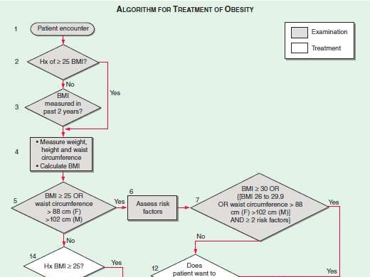

Slide 31
THANK YOU

