Slide 1
Ectopic pregnancy
Chair person:
Dr.Virupaksha (Associate Professor)
Co-chair person :
Dr.Rashmi (Senior Resident)
Presenters: Dr. kaytri
Dr. Amrutha

Slide 2
DEFINITION
“Any pregnancy where the fertilised ovum gets implanted & develops in a site other than normal uterine cavity”.
It represents a serious hazard to a woman’s health and reproductive potential, requiring prompt recognition and early aggressive intervention.

Slide 3
Epidemiology
Incidence
1-2 % of total pregnancy
Recurrence rate – 15% after 1st ectopic, 30% after 2 ectopics
Increasing in incidence
MC cause of maternal mortality during first trimester
Fatality rate :
Current diagnostic and treatment protocols resulted in 10 fold decline in fatality rate during past 35 yrs.

Slide 4
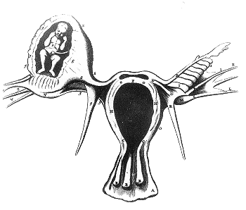
ETIOLOGY:
Any factor that causes delayed transport of the fertilised ovum through the tube.
Fallopian tube favours implantation in the tubal mucosa itself thus giving rise to a tubal ectopic pregnancy.

Slide 5
Normal vs Ectopic implantation
Ovulation→ ovum picked up by fimbria→ swept by ciliary action towards ampulla→ fertilization.
Zygote →cleavage division in (3 -4 days) → morula (8-32 cell stage)→ embryo to uterine cavity for up to 72 hours→ D6 enters uterus→ implantation- uterine cavity in normal positioned pregnancy .
hCG (trophoblast)mother’s serum 1 week after implantation, level doubles every 36-48 hours
Delay or obstruction of the passage of fertilized egg down the fallopian tube to the uterus→ implantation in tube or ovary or peritoneal cavity→ ectopic pregnancy
Eventually fails to develop
hCG fails to raise dramatically

Slide 6
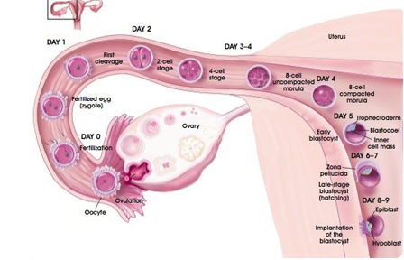

Slide 7
IMPLANTATION SITES
EXTRA
UTERINE
TUBAL
(95%)
ABDOMINAL
(1%)
OVARIAN
(3%)
UTERINE
(1%)
AMPULLARY 70%
INFUNDIBULAR
11%
INTERSTITIAL
2%
ISTHMUS 12%
SECONDARY
PRIMARY
(rare)
ANGULAR
CERVICAL <1%
CS SCAR <1%
CORNUAL
INTRAPERITONEAL
MC
EXTRAPERITONEAL
(broad lig)

Slide 8
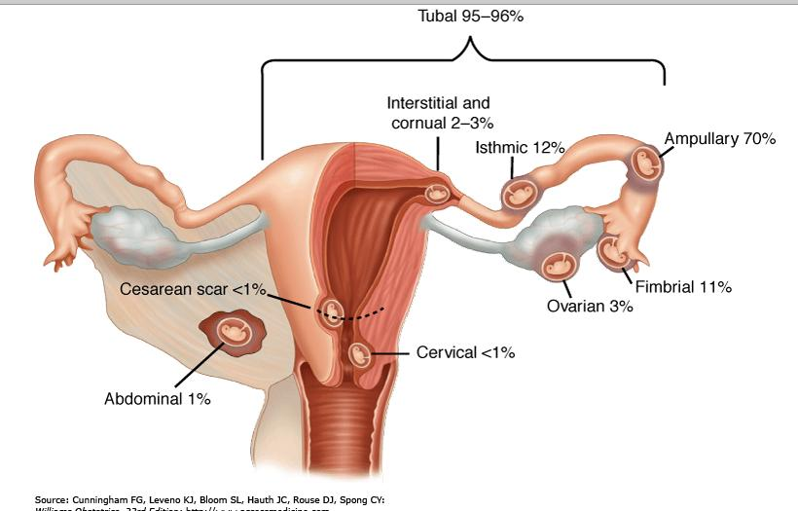

Slide 9
Risk factors
1. Pelvic Inflammatory disease:
The incidence of ectopic pregnancy with laparoscopically confirmed disease- 9.1%
(1 episode-13%, 2 episodes-35%, 3 episodes-75%)
Chlamydia trachomatis is most common organism

Slide 10
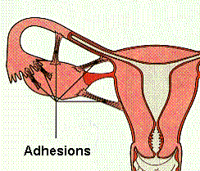
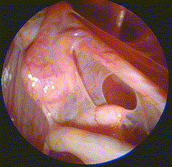
PRIOR H/O PID
Alteration of tubal transport mechanisms
Damage to ciliated surface of endosalpinx
Infections chlamydia, gonorrhoea
intratubal adhesions → partial tubal obstruction
slow the passage of egg →time to implant itself in the tube
peritubal adhesions →restricted tubal motility

Slide 11
2.Tubal surgery(4-5 fold increased risk):
Salpingostomy, neosalpingostomy,
fimbrioplasty, and lysis of peritubal and periovarian adhesions
overall Incidence is 2%-7%
3.Previous Ectopic Pregnancy:
1 previous ectopic -15%
2 previous ectopic- 30%

Slide 12
Contd…
4.Tubal sterilization failure -
10 yr cumulative incidence- 7.3 / 1000 procedures Depends on sterilization technique and age of the patient
Postpartum partial salpingectomy-1.5/1000 procedures
Unipolar coagulation-1.8/1000 procedures
Bipolar coagulation-17.1/1000 procedures
Failure rate based of age of patient : Women younger than 28 yrs>34 yrs

Slide 13
Cont…..
5.Reversal of sterilization:
- Depends on method of sterilization, Site of
tubal occlusion, residual tubal length.
Pomeroy- 6-9%
Ring procedure-5-11%
Reanastomosis of cauterised tube -17%

Slide 14
Cont….
6.Assisted Reproductive technique
Ovulation induction- 1.1-4.6%
IVF-2-8%
Tubal factor infertility-17%
7.Contraceptive Failure
Women who conceived with an IUD are more likely to have an ectopic
LNG-IUS(Mirena): half of pregnancies
COPPER IUD: 1 in 16 pregnancy
Lowest risk – oral contraceptives and barrier methods

Slide 15
Other Risk factors
Age >40 yrs(2.9%)
Previous medical or surgical abortion(3%)
3 or more spontaneous miscarriage(3%)
Genital Tuberculosis
Endometriosis or leiomyoma
Infertility>1 yr- 2.6%
Salpingitis isthmica nodosa
Previous pelvic surgeries
Cigarette smoking(>20 cigarettes/day-3.5%)
DES Exposure in Utero

Slide 16
CONGENITAL CAUSES
Tubal Hypoplasia
Tortuosity
Congenital diverticuli
Accessory ostia
Partial stenosis
Elongation
Intamural polyp

Slide 17
Pathophysiology
The trophoblast develops in the fertilized ovum and invades deeply into the tubal wall.
Following implantation, the trophoblast produces hCG which maintains the corpus luteum.
The corpus luteum produces oestrogen and progesterone which change the secretory endometrium into decidua. The uterus enlarges up to 8 weeks and becomes soft.
The tubal pregnancy does not usually proceed beyond 8-10weeks due to:
> lack of decidual reaction in the tube,
> the thin wall of the tube,
> the inadequacy of tubal lumen,
> bleeding in the site of implantation as trophoblast invades.

Slide 18
PATHOPHYSIOLOGY
Separation of the gestational sac from the tubal wall
Degeneration
Fall of hCG level,
Regression of the corpus luteum
Drop in the oestrogen & progesterone level
Separation of the uterine decidua with uterine bleeding

Slide 19
Fate of tubal pregnancy
1.Tubal mole:
Repeated small hemorrhages occur in chorio-capsular space, separating villi from their attachments.
Fate of mole- a.complete absorption
b.expulsion through tubal ostium-tubal abortion.
Encysted blood in pouch of douglas- pelvic hematocele.

Slide 20
2.Tubal abortion:
This occurs more if ovum had been implanted in the ampullary portion of the tube
Separation of the gestational sac is followed by its expulsion into the peritoneal cavity through the tubal ostium.
Rarely, reimplantation of the conceptus occurs in another abdominal structure leads to secondary abdominal pregnancy.
Tubal abortion more common in ampullary and fimbrial pregnancies.

Slide 21
3-Tubal rupture:
Tubal rupture common in isthmic implantation.
Isthmic rupture occurs at- 6-8 weeks, ampullary at -8-12 weeks, interstitial at 4 months.
Intraperitoneal rupture- most common, rent lies on antimesenteric border of the tube.
Extraperitoneal (intraligamentary)rupture- rent lies on mesenteric border of the tube, results in broad ligament hematoma.

Slide 22
CLINICAL APPROACH
Dignosis can be done by history, detail examination and judicious use of investigation.
H/o infertility, menstrual history, previous surgery, past PID, tubal surgery, current contraceptive measures should be asked.
Wide spectrum of clinical presentation from asymptomatic patient to others with acute abdomen and in shock.

Slide 23
Clinical traid (3As)
Amenorrhoea
Ectopic
Pregnancy
Abdominal pain Abnormal vaginal
bleeding

Slide 24
ACUTE ECTOPIC PREGNANCY
Classical triad is present in 50% of patient with
rupture ectopic.
- PAIN:- most constant feature in 95% patient
- variable in severity and nature.
shoulder pain- referred pain due to diaphragmatic irritation from hemoperitoneum.
- AMENORRHOEA:- 60-80% of patient
- there may be delayed period or slight
spotting at the time of expected menses.
- VAGINAL BLEEDING: - scanty dark brown
Feeling of nausea, vomiting , fainting attack, syncope attack(10%) due to reflex vasomotor disturbance.

Slide 25
O/E:- patient is restless in agony, looks blanched,
pale, sweating with cold clammy skin.
Features of shock, tachycardia, hypotension.
P/A:- abdomen tense, tender mostly in lower
abdomen.
P/S:- minimal bleeding may be present
P/V:- uterus may be bulky, deviated to opposite
side, fornix is tender, cevical motion tenderness present.
Caution: vaginal examination may precipitate more hemorrhage due to manipulation.

Slide 26
CHRONIC ECTOPIC PREGNANCY
It can be diagnosed by high clinical suspicion.
Patient had previous attack of acute pain from which she has recovered.
She may have amenorrhoea, vaginal bleeding with dull pain in abdomen,and with bladder and bowel complaints like dysuria,frequency or retention of urine, rectal tenesmus.

Slide 27
O/E:- patient look ill, varying degree of pallor,
slightly raised temperature. Features of shock
are absent.
P/A:- Tenderness and muscle guard on the lower
abdomen.
A mass may be felt, irregular and tender.
P/V:- Vaginal mucosa pale, uterus may be normal
in size or bulky, ill defined boggy tender
mass may be felt in one of the fornix.

Slide 28
UNRUPTURED ECTOPIC
High degree of suspicion & ectopic conscious clinician can diagnose.
Diagnosed accidentally in Laparoscopy or Laparotomy
C/F – delayed period, spotting with discomfort in
lower abdomen.
P/A- Abdomen may be nontender or mildly tender
P/V – should be done gently
uterus is slightly enlarged and soft
small tender mass may be felt in the fornix

Slide 29














DIFFERENTIAL
DDX
DIAGNOSIS

Slide 30
(1) Gynecologic disorders
Septic Abortion
Threatened Abortion
Twisted Ovarian Cyst
Acute pelvic inflammatory disease
Degenerating leiomyoma
Pyosalpinx
Pelvic Abcess
Rupture of Follicle or Corpus Luteum Cyst
Retroverted Gravid Uterus

Slide 31
(2) NON GYNECOLOGICAL
Acute Pancreatities
Pelvic Abcess
Appendicitis (Perforated)
Perforated Gastric or Duodenal Ulcer

Slide 32
Diagnosis
The diagnosis often presents great difficulty
Usually missed because if it is NOT suspected.

Slide 33
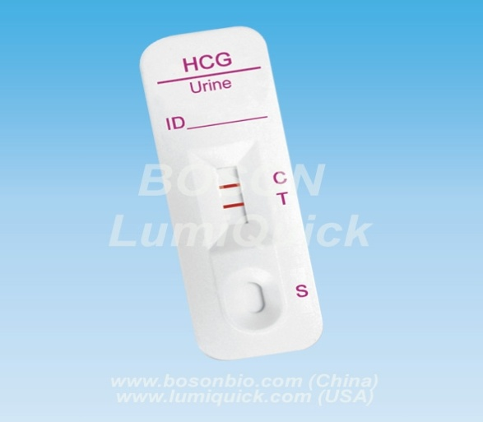
βeta-hCG
The hCG enzyme immunoassay, with a sensitivity of 25 mIU/mL, is an accurate Screening test for detection of ectopic pregnancy.
The assay is positive in virtually all documented ectopic pregnancies.
Quantitative -hCG measurements
are the diagnostic cornerstone
for ectopic pregnancy.
Serum β-hCG (ELISA / RIA) detects very early pregnancy about 10 days after fertilization i.e. before the missed period.
Notes:
β-hCG* Levels Double Every 48 Hrs
< 66% Rise / 48 Hrs Consistent With Ectopic Pregnancy
Single Determination Not Helpful
Best If Done Within Same Laboratory
Never Rules Out Ectopic Pregnancy
* generally greater than > 6 500 miu/mL

Slide 34
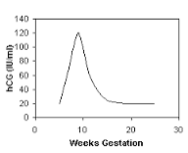
Beta HCG
HCG is produced by syncytiotrophoblast of placenta.
Plasma half life- 36 hrs.
Peak maternal plasma levels reach approximately 100,000 mIU/ml between the 60 th and 80 th day after menses. At 10 -12 weeks, plasma levels begin to decline and a nadir is reached by approximately 16 weeks.

Slide 35
Discriminatory zone:
In the management of suspected ectopic pregnancy there is a serum hCG level at which it is assumed that all viable intrauterine pregnancies will be visualised by transvaginal/ transabdominal ultrasound. This is referred to as the discriminatory zone.
1000-2000 IU/L TVS
5000-6000 IU/L TAS
β-hCG levels still below the discriminatory value, serial β-Hcg and USG should be done.

Slide 36
Doubling sign:
Normal : >66% increase levels every 48 hours (nearly 2X).
Inappropriately rising serum β-hCG levels suggest (but do not diagnose) abnormal pregnancy including ectopic
Do not identify its location.

Slide 37
SERUM PROGESTERONE
The second most common hormone after hCG in pregnancy is progesterone.
Generally, a progesterone concentration of greater than 25 ng/mL is highly correlated with a normal intrauterine pregnancy
while a concentration of less than 5 ng/mL is highly correlated with an abnormal /nonviable pregnancy but it is not 100% predictive.

Slide 38
ultrasonography
Combination of quantitative beta HCG and sonography :
Failure to see Gestational sac at 4-5 wks gestation and at beta hcg 1000-1500iu/l i.e. the discriminatory zone by TVS
Failure to see Gestational sac at 5-6 wks gestation and at beta hcg 6000-6500iu/l i.e. the discriminatory zone by TAS

Slide 39
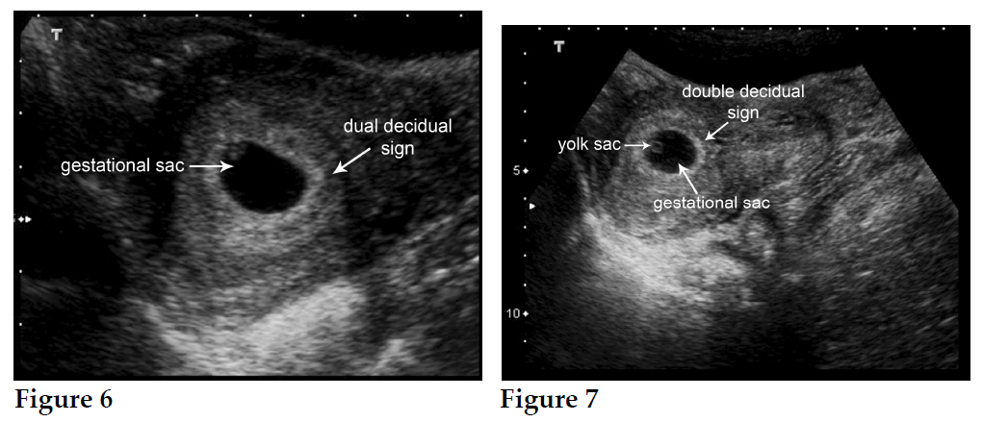
TRANSVAGINAL USG
Endometrial cavity shows trilaminar echo pattern
Identification of double decidual sac sign(DDSS) is the best method to differentiate true sacs from pseudosacs
Pseudogestational sac seen formed by the sloughing of decidua creating an intracavitary fluid collection. it differs from true gestational sac in having only one layer and midline location where as true sac is usually eccentric
Notes:
2-Ultrasound
Abnormal β-hCG can not provide information on the location of the pregnancy
its application to the diagnosis of ectopic pregnancy, alone and in combination with hCG testing, is now the standard of care.
In general,
Transvaginal USG is superior to transabdominal USG
Evidence of an empty uterus,
detection of adnexal masses ,
free
peritoneal fluid
& signs of ectopic
Pregnancy – more reliably established with TVS
Identification of double decidual sac sign(DDSS) is the best method to differentiate true
sacs from pseudosacs
pseudosac, which is a ring-like structure produced on ultrasound by a prominent decidual echo
Presence of free cul-de-sac fluid is frequently associated with ectopic pregnancy-E/o haemoperitoneum
TVS can detect gestational sac at 4 weeks & by TAS at 6 wks
Discriminatory hCG zones:
Diagnosis of ectopic pregnancy is made if there is:
An empty uterine cavity by abdominal sonography with b -hCG value above 6000 mIU/ml.
An empty uterine cavity by vaginal sonography with b -hCG value above 2000 mIU/ml.

Slide 40
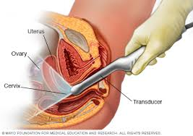
TRANSVAGINAL USG
Decidual cast sometimes seen
Decidual cyst anechoic area at the endometrium-myometrium border
Pouch of douglas may contain free fluid
Observation of gestational sac,
embryo, cardiac activity
outside the uterus.

Slide 41
Following are the spectrum of ultrasonographic findings in ectopic pregnancy
1. Tubal ring
A tubal ring is an echogenic, ring like structure found outside of the uterus that represents an early ectopic pregnancy.having a gestational sac containing an fetal pole or yolk sac or both .( “doughnut’s or bagel’s sign )

Slide 42
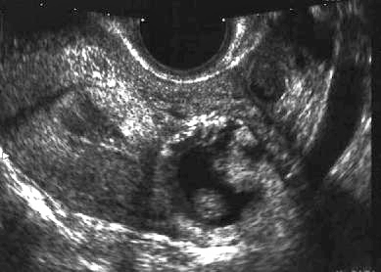
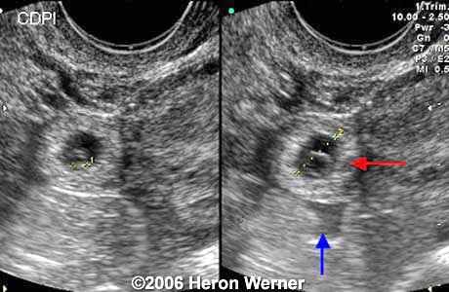
Hyperechoic ring around
gestational sac in adnexal region

Slide 43
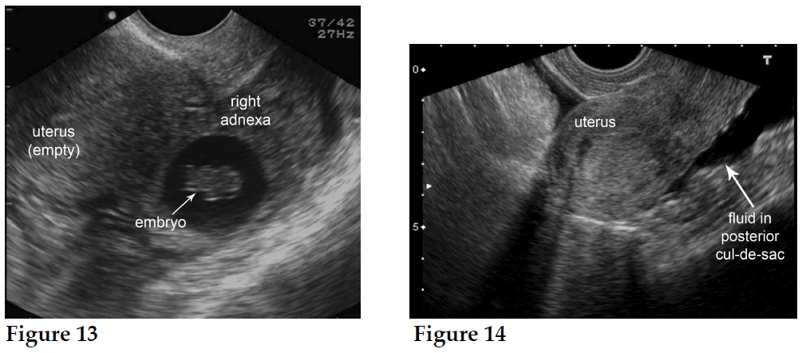
2. Extrauterine mass
The presence of a tender adnexal mass on ultrasonographic images suggests an ectopic pregnancy ans is the most significant ultrasonographic finding for the diagnosis of ectopic pregnancy.

Slide 44
3. Hemosalpinx and ruptured ectopic pregnancy
A hemosalpinx is a condition in which the fallopian tubes may fill with blood or free fluid.
Findings of a ruptured ectopic pregnancy on ultrasonographic images include free fluid or clotted blood in the cul-de-sac or in the intraperitoneal gutters, such as the Morrison pouch.

Slide 45
Tvs and tas
If there is no definite sign of an intrauterine gestation (the empty uterus sign) and the hCG level is below the discriminatory zone, the differential diagnosis includes the following considerations:
1. Normal intrauterine pregnancy too early for visualization
2. Abnormal intrauterine gestation
3. Recent abortion
4. Ectopic pregnancy
5. Nonpregnant patient

Slide 46
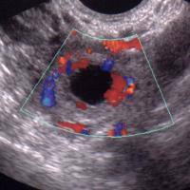
Color Doppler Sonography(TV-CDS):
- Improve the accuracy.
- (ring- of-fire pattern) due to increased blood flow to the tubal mass

Slide 47
culdocentesis
With the use of hCG testing and transvaginal ultrasonography, however, culdocentesis is rarely
indicated.
The purpose of the procedure is to determine the presence of hemoperitoneum which increses the likely hood of ruptured ectopic pregnancy.

Slide 48
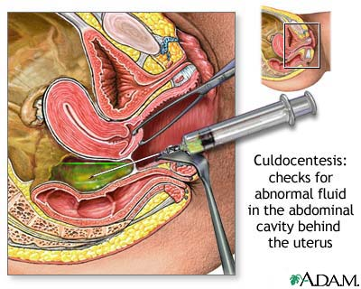
With a 16-18 gauge spinal needle the cul de sac of Douglas may be entered through the posterior vaginal fornix.
If non-clotting blood is aspirated from the Douglas pouch , intraperitoneal haemorrhage is diagnosed.
But if not, ectopic pregnancy cannot be excluded.

Slide 49
Dilatation and curettage
Uterine curettage is performed when the pregnancy has been confirmed to be nonviable and the location of the pregnancy cannot be determined by ultrasonography.
The sensitivity and specificity of this technique are 95% when the tissue is examined with the aid of a dissecting microscope.

Slide 50
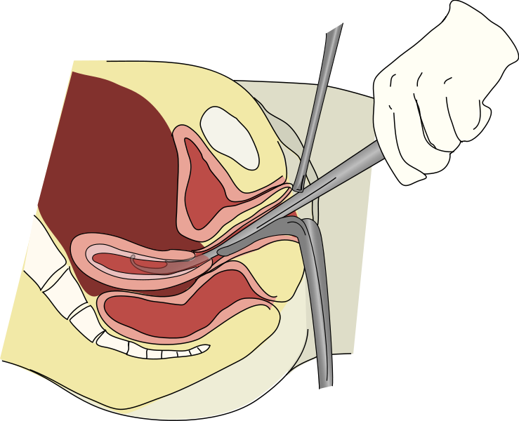
Dilatation and curettage
Presence of villi excludes ectopic pregnancy but not heterotropic pregnancy
Absence of villi and presence of Ariastella reaction suggests ectopic pregnancy.
When floated in saline, chorionic villi are often readily distinguishable as lacy fronds of tissue.
Notes:
It is performed when the pregnancy
is confirmed to be nonviable & location
of pregnancy cannot be confirmed
by USG
Identification of decidua
without chorionic villi is suggestive
of extra uterine pregnancy
Evidence of chronic salpingitis and salpingitis isthmica nodosa (SIN)
Arias-Stella reaction
) Other tests
a)Estradiol: Levels are significantly lower in ectopic pregnancies when compared with viable pregnancies
b)Relaxin: is a protein hormone produced solely by corpus luteum of pregnancy & its levels are significantly lower in ectopic pregnancies.
c)Maternal AFP: levels are elevated in ectopic pregnancies
d)Serum progesterone:
The second most common hormone after hCG in pregnancy is progesterone.
Generally, a progesterone concentration of greater than 25 ng/mL is highly correlated with a normal intrauterine pregnancy while a concentration of less than 5 ng/mL is highly correlated with an abnormal and nonviable pregnancy
.

Slide 51
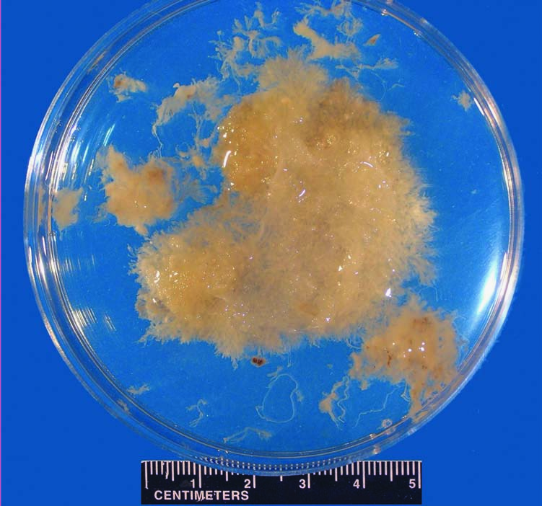
When floated in saline, chorionic villi are often readily distinguishable as lacy fronds of tissue. (From Stovall TG, Ling FW. Extrauterine pregnancy: )

Slide 52
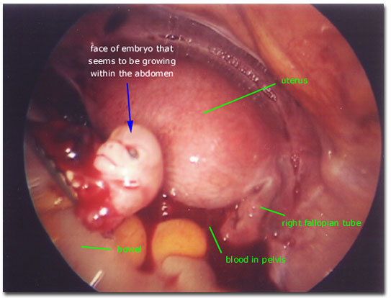
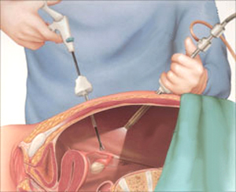
Diagnosis
4- Laparoscopy or Laparotomy
LAPROSCOPY is the gold standard for diagnosis of ectopic pregnancy ,
can also be performed to visually confirm an ectopic pregnancy. Often if a tubal abortion or tubal rupture has occurred.

Slide 53
Other endocrinologic markers
Estradiol
Maternal serum creatinine kinase
Relaxin
Serum inhibin A levels
Maternal Serum alpha feto protein (AFP)level are elevated
A combination of AFP with three other markers—-hCG, progesterone, and estradiol—has 98.5% specificity and 94.5% accuracy for the prediction of ectopic pregnancy.

Slide 54

TREATMENT
Ectopic
Rx

Slide 55
Treatment options
1
2
3
EXPECTANT MANAGEMENT
MEDICAL MANAGEMENT
SURGICAL MANAGEMENT

Slide 56



EXPECTANT
MANAGEMENT

Slide 57
Criteria for selection (RCOG-green top-21-guideline)
Asymptomatic pt
Hemodynamically stable
<100 ml fluid in the pouch of Douglas
Lower beta hcg value<1000 IU/ml
Adnexal mass <3cm without cardiac activity
Pregnancy of unknown location
They must be fully compliant for follow up and must be willing to accept the potential risks of tubal rupture.
Success rate is 60% with decreasing beta hcg titre

Slide 58
MONITORING
Initial follow up
twice weekly with serial beta Hcg measurements
weekly by TVS
By the first week
drop in HCG level by 50%
Adnexal mass size should decrease
Otherwise reassess the options (Medical/Surgical)
If the fall of HCG & reduction in size of adnexal mass satisfatory
weekly hCG & TVS till HCG falls to non pregnant level.

Slide 59
45–70% of pregnancies of unknown location resolve spontaneously with expectant management
Ectopic pregnancy was subsequently diagnosed in 14–28% of cases of pregnancy of unknown location
Intervention has been shown to be required in 23–29% of cases.

Slide 60

MEDICAL
MANAGEMENT
2

Slide 61
CRITERIA FOR MEDICAL MANAGEMENT
Selection criteria
Minimal symptoms & the patient must be hemodynamically stable
no signs or symptoms of active bleeding.
Absence of foetal heart beat
Normal CBC,U&E(urea & electrolytes),LFT(liver function tests)
Exclusion criteria
Difficulty or unwillingness of patient for prolonged follow-up (average follow-up 35days).
Ectopic mass >3.5cm
The presence of cardiac activity in an ectopic pregnancy

Slide 62
Medical
Management
Local
Systemic
salpingocentesis
1.Oral Methotrexate
2. Injectable methotrexate
A) SINGLE DOSE REGIMEN
B) MULTIDOSE REGIMEN
C) TWO DOSE REGIMEN
Methotrexate
- Potassium chloride
- Prostagladin(PGF2α)
- Hypersmolar glucose
Mifepristone
Anti HCG antibody

Slide 63
Local treatment- salphingocentesis
Salpingocentesis is a technique in which agents such as KCl, methotrexate, prostaglandins, and hyperosmolar glucose are injected into the ectopic pregnancy transvaginally using ultrasonographic guidanceby transcervical tubal cannulization, or laparoscopy.
Advantage:
Increased concentration at local site
lesser systemic side effects
Shorter hospital stay
Follow up:
Beta hcg twice wkly till <10iu/l
TVS weekly

Slide 64
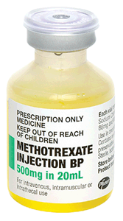
METHOTREXATE
Methotrexate – a drug that destroys actively growing tissues such as the placental tissues ,is used as an injection in selected cases to avoid surgery (in non ruptured ectopic).
Folic acid antagonist inhibits DHFR enzyme thus depleting the stores needed for DNA/RNA synthesis during trophoblast proliferation
First used by Tanaka et al(1982)-
interstitial ectopic pregnancy

Slide 65
Side effects include abdominal pain for 3 – 7 days in 50% of
cases and mild symptoms nausea, mouth dryness and soreness
and diarrhoea,
Methotrexate - Intramuscular(buttock or lateral thigh)
Dose calculated from body surface area
Usual dose ranges between 75-95 mg
The Mosteller formula
BSA (m²) = SQRT( [Height(cm) x Weight(kg) ]/ 3600 )
e.g. BSA = SQRT( (cm*kg)/3600 )

Slide 66
Methotrexate treatment regimens
1.Multidose regimen –
MTX 1mg/kg IM on 1,3,5,7 days
Leucovorin 0.1mg/kg on 2,4,6,8 days
Measure B-hCG levels on days 1,3,5,7 until 15% decrease between 2 measurement
Once B-hCG level drops 15%, stop MTX & monitor B-hCG weekly until non pregnant level

Slide 67
2.Single dose regimen:
3.Two dose regimen:
MTX 50mg/m² BSA on day 0
Measure B-hCG level on days 4 & 7
If level drops by 15%, monitor B-hCG weekly until non pregnant level. If levels do not drop by 15%, repeat dose of MTX & measure B-hCG on days 4 & 7
87% success rate
Advantages:
Increased patient compliance
Simplified administration
Safe & effective
Less expensive
Less monitoring
MTX 50mg/m² BSA on days 0 & 4
Measure B-hCG levels on days 4 & 7
If levels drop by 15%, monitor B-hCG weekly until non pregnant level
If level do not drop by 15%, repeat dose of MTX on days 7 & 11 & measure B-hCG on days 7 & 11. If levels drop 15%, monitor B-hCG level weekly until non pregnant level

Slide 68
UNTOWARD EFFECTS:
Dose & frequency dependent
(30-40%)
Nausea, vomiting
Stomatitis,
Abdominal pain
Bone marrow suppression
Alopecia
Dermatitis & pneumonitis.
Deranged LFT
LEUCOVORIN RESCUE
Notes:
The empty syringe or needle should be placed in a separate Sharp Safe, labelled “Cytotoxic waste forspecial incineration”

Slide 69
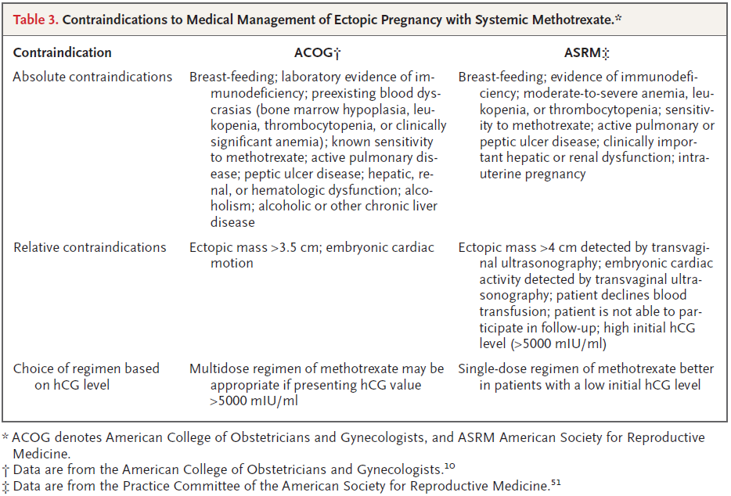

Slide 70
ADVICES
Patient should be given information on(preferably written)
Need for further treatment
Adverse effects
Women should be able to return easily for assessment at any time during follow-up
Advice
avoid sexual intercourse during treatment
to maintain fluid intake
use reliable contraception for three months after methotrexate has been given, (barrier or hormonal)
- Avoid alcohol and vitamin preparations containing folic acid until the hormone level is back to zero.
- Avoid aspirin or drugs such as Ibuprofen for one week after treatment.

Slide 71
Oral methotrexate
The boavailability of oral and parental methotrexate is similar.
Some trials have evaluated oral methotrexate of
15 mg orally on days 1,3 and 5 with folinic acid on days 2,4,6.
This regimen was followed in patients who had
Beta HCg of < 5000 IU/l
Tubal pregnancy without cardiac activity
Mass of < 3.5 cm

Slide 72
Mifepristone With Methotrexate
In single dose regimen addition of 600 mg of mifepristone orally to single dose methotrexate might improve eficacy and speed resolution of unruptured ectopic pregnancies.

Slide 73











3
SURGICAL
MANAGEMENT

Slide 74
Indications for surgical treatment
The patient is not a suitable candidate for medical therapy.
Medical therapy has failed.
The patient has a heterotropic pregnancy with a viable intrauterine pregnancy.
The patient is hemodynamically unstable and needs immediate treatment.

Slide 75
Surgical management
1. Linear salpingostomy:
< 2cm size,
unruptured tubal pregnancy,
in distal third of tube
Antemesenteric border incised –heals by secondary intention
FOLLOW UP
Indications ;
Unruptured ampullary ectopic pregnancy
Wishes to retain potential for future fertility
Affected fallopian tube otherwise normal
Contralateral tube appears damaged
Notes:
ELECTRO CAUTERY,needle tip caytery,lasr, scalper, scissors
Follow up – wkly bhcg to ebsure reslution
If plateau/rises→single dose of mtx

Slide 76
Contraindications
Ruptured tube
Use of extensive cautery to obtain hemostasis
Severely damaged tube
Recurrent ectopic pregnancy in same tube.
The main risk factor of salpingostomy is persistent ectopic pregnancy resulting from failure to remove entire pregnancy.

Slide 77
2. Salpingotomy
Conservative surgical management
Incision – closed with delayed absorbable suture
Ectopic has not ruptured
The tube appears normal
3. Segmental resection and anastomosis: for unruptured isthmic pregnancy
4. Milking /fimbrial expression: infundibular pregnancy, best reserved when products protrude out.

Slide 78
Salpingectomy (partial/total)
Salpingectomy (tubal removal) is the principle treatment especially where there is tubal rupture.
To minimise the recurrance of pregnancy in the tubal stump, complete exicision of the fallopian tube is advised.
Wedge area of outer 3rd of interstitial portion of tube is also resected, known as cornual resection to minimise occurence of pregnancy in tubal stump
Total salpingectomy is the procedure of choice:
Completed childbearing and no longer desires fertility
History of an ectopic pregnancy in the same tube.
Severely damaged tubes

Slide 79







RUPTURED
ECTOPIC
PREGNANCY
Notes:
Along the way we’ve discovered…

Slide 80
Laparascopy OR laparotomy??
Laparoscopy has become the recommended approach in most cases.
Laparotomy is usually reserved for patients:
who are hemodynamically unstable
patients with cornual ectopic pregnancies.
for surgeons inexperienced in laparoscopy and in patients where laparoscopic approach is difficult
An alternative to laparoscopy is the use of minilaparotomy incision.-success rate similar

Slide 81
Laparoscopy
Laparotomy
Less intraoperative blood loss
Shorter hospital stay
Lower analgesic requirement
Future intrauterine pregnancy rate same
Lower repeat ectopic pregnancy rate
Preferable in the haemodynamically unstable patient
Future intrauterine pregnancy rate same

Slide 82
PERSISTENT ECTOPIC PREGNANCY (PEP)
Complication of salpingotomy / salpingostomy(4-15%) when residual trophoblast continues to survive because of incomplete evacuation of ectopic pregnancy.
So serial monitoring of beta hcg.(D1, every 3-7 days thereafter till undetectable)
Risks are small size<2cm, early pregnancy <6wk, preoperative high Bhcg>3000 IU/l
Diagnosis : raised postoperative serum HCG
If untreated, can cause life threatening hemorrhage
TREATMENT -
Methorexate single dose of 50 mg/m2 BSA
Operative intervention for further evacuation / Salpingectomy
Some advocate postoperative administration of “prophylactic “ methotrexate
Of 1 mg/m2 of BSA

Slide 83
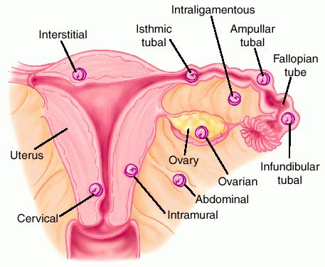
Uncommon Sites of Ectopic Pregnancy
Non tubal pregnancy –types
Cervical(0.1-1%)
Ovarian(0.5-2%)
Abdominal(0.3-0.5%)
Interstitial(2-3%)
Angular
Heterotropic Pregnancy
Ectopic in caesarean scar (<1%)

Slide 84
Ovarian ectopic
MC type of non tubal ectopic
Aetiology:
* Pelvic adhesions.
* Favourable ovarian surface for implantation as in ovarian endometriosis.
Pathogenesis:
* Fertilization of the ovum inside the ovary or,
* implantation of the fertilized ovum in the ovary.

Slide 85
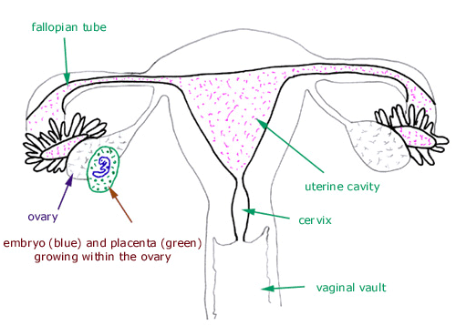
Ovarian pregnancy
Spiegelberg criteria(1878)
* The gestational sac located in the region of the ovary,
* the ectopic is attached to the uterus by the ovarian ligament,
* ovarian tissue in the wall of the gestational sac is proved histologically,
* the tube on the
involved side is intact.

Slide 86
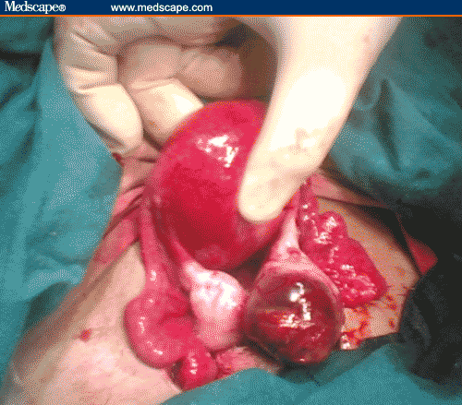
Ovarian pregnancy Treatment:
Misdiagnosis very common(Ruptured corpus luteal cyst75%)
Laparotomy→ ovarian cystectomy/wedge resection for unruptured and oophorectomy for ruptured.
Treatment with MTX and prostaglandin injection has also been reported

Slide 87
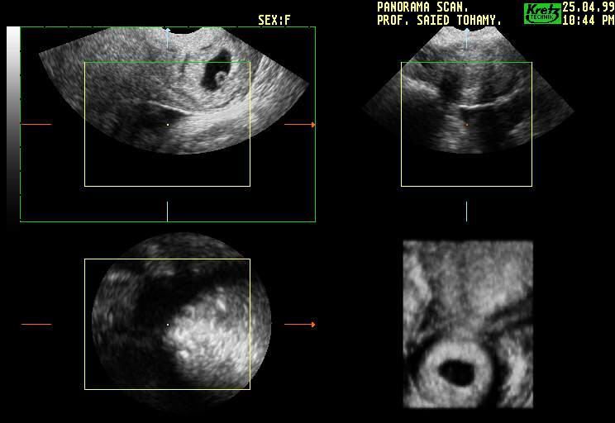
CERVICAL PREGNANCY
Implantation occurs in cervical canal at or below internal Os.
Incidence: In US is 1 in 2,400 to 1 in 50,000 pregnancies.
RISK FACTORS :
History of dilatation and
curretage in the previous
pregnancy is a unique risk factor
Previous caesarean delivery
Asherman’s syndrome
IVF accounting for 3.7 %
DES exposure
Leiomyoma

Slide 88
Diagnosis:
Clinical Criteria : Rubin s criteria
Uterus smaller than the surrounding distended cervix
External os may be open
Visible cervical lesion often blue or purple in colour
Profuse bleeding on manipulation of cervix
CLINICAL CRITERIA: Paulman & McEllin
1. Uterine bleeding, no cramping, following
amenorrhoea
2. Cervix distended, thin walled, soft consistency
3. Enlarged uterine fundus may be palpated.
4. Internal Os is closed
5. External Os is partially opened

Slide 89
USG criteria for cervical pregnancy
Gestatational sac /placental tissue visualizd within cervix
Cardiac motion noted below the level of internal os
No intrauterine pregnancy’
Hourglass uterine shape with ballooned cervial canal
No movement of sac with pressure from transvaginal probe
Closed internal os

Slide 90
HISTOPATHOLOGIC CRITERIA:
1. Cervical glands present opposite to placenta
2. Placental attachment to the cervix must be
below the entrance of uterine vessels .
3. Fetal element absent from corpus uteri.
D/d :
- Carcinoma Cx
- Cervical submucous fibroid
- Trophoblastic tumour
- Placenta previa

Slide 91
MANAGEMENT
Surgical
Medical
Mainstay therapy in past
Recently proposed
Conservative
Radical
surgery
D & C
Single or Combination
regimen along with surgical dilatation and curettage.
Adjunct to surgery
(risk of torrential bleeding)
Hysterectomy
Cerclage procedure
Foley’s catheter as tamponade
Transvaginal ligation of Cx branch of uterine artery
- Angiographic uterine A embolisation
Methotrexate
KCl injection can
also be done
Intracervical vasopressin inj

Slide 92
Abdominal ectopic pregnancy(0.3-0.5%)
Primary abdominal pregnancy
Studifords criteria for diagnosis
Secondary
usually after tubal rupture or abortion
Intraligamentous pregnancy
type of abdominal but extraperitoneal pregnancy. It develops between the anterior and posterior leaves of the broad ligament after rupture of tubal pregnancy in the mesosalpingeal border or lateral rupture of intramural (in the myometrium) pregnancy.
Presence of normal tubes & ovaries with no evidence of recent or past pregnancy
No e/o uteroplacental fistula
presence of a pregnancy related exclusively to the peritoneal surface & early enough to eliminate the possibility of secondary implantation after primary tubal nidation
conceptus escapes out through a rent from primary site – Intraperitoneal or Extraperitoneal broad ligament

Slide 93
Diagnosis:
History: amenorrhoea → an attack of lower abdominal pain & slight vaginal bleeding which subsided spontaneously., painful Fetal movements
Abdominal examination:
Unusual transverse or oblique lie.
Foetal parts are felt very superficial with no uterine muscle wall around.
Vaginal examination:
The uterus is soft, about 8 weeks and separate from the foetus.
Displaced uterine cervix
No presenting part in the pelvis.

Slide 94
Special investigations:
Plain X-ray: shows abnormal lie. In lateral view, the foetus overshadows the maternal spines .
Ultrasound: diagnoses only 40%,shows no uterine wall around the foetus
(MRI): has a particular importance in preoperative detection of placental anatomic relationships.
If pregnancy continues to term→
Perinatal mortality& morbidity is also increased(IUGR, congenital anomalies, fetal pulmonary hypoplasia, pressure deformities)
maternal morbidity& mortality highly increased(7-8 times & 50 times)

Slide 95
Management:
Laparotomy with removal of sac, fetus, placenta, membranes
placenta if attached to vital structures -left in situ
after ligating base
Placental involution→ serial USG, BHCG
MTX treatment contraindicated -high rate of complications due to rapid tissue necrosis
Notes:
Pregnancy terminated surgically through Laparotomy once diagnosed
Haemorrhage can occur– abdominal packing
Angiographic arterial embolisation

Slide 96
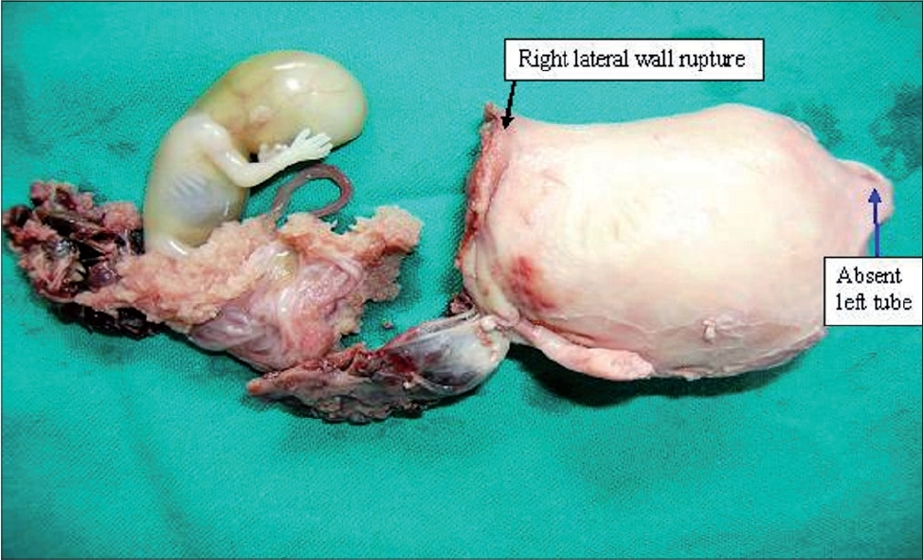
ANGULAR PREGNANCY
Implantation at lateral angle of uterine cavity just medial to uterotubal junction
In true sense not variety of ectopic pregnancy
Confused with interstitial pregnancy
→round ligament lies medial to it.

Slide 97
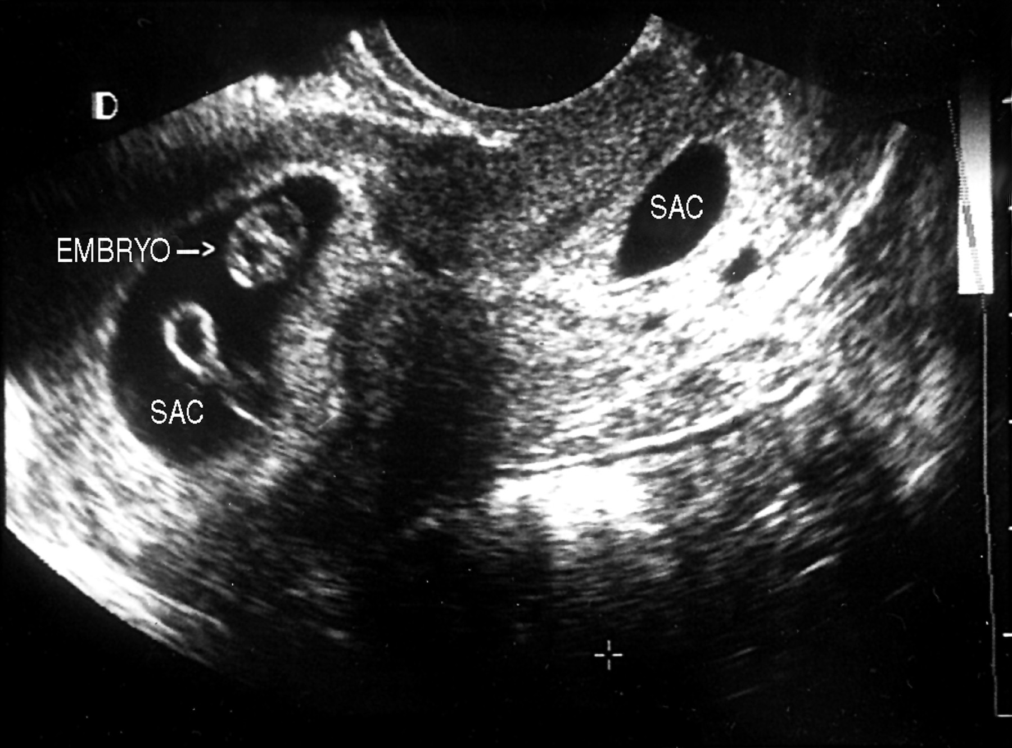
Heterotropic pregnancy
Intrauterine+ extrauterine pregnancy coexist
1:1000→1:30000
ART patients
Delayed diagnosis
Serial B HCG NOT useful
Surgical treatment of ectopic & intrauterine if desired to continue
Spontaneous abortion high
Notes:
Iup at usg and overlooked ep

Slide 98
INTERSTITAL PREGNANCY (2%)
It ruptures late at 3-4 months gestation.
Fatal rupture – severe bleeding as both uterine &
ovarian artery supply.
Early & Unruptured – Local or IM MTX with followup
Cornual resection by Laparotomy may be done.
There is high risk of uterine rupture in
subsequent pregnancy.
Rupture – Hysterectomy is indicated

Slide 99
Caesarean scar pregnancy
Newly highlighted
Prior CS csar, outside normal uterine cavity
Completely surrounded by myometrium
Incidence: 1:800-1:2200
Imaging: sac well perfused
USG criteria:
Trophoblast located between blader and anterior abdominal wall
Fetal pole absent in uterine cavity
Sagittal view through amniotic sac no myometrium between Gestational Sac and bladder
Lack of continuity of anterior uterine wall
Management: no role of expectant management –risk- uterine rupture
MTX, Hysteroscopic resection, uterus preserving wedge resection, hysterectomy

Slide 100
ACOG 2008 recommendations
good and consistent evidence
(Level A):
limited or inconsistent evidence
(Level B):
consensus and expert opinion (Level C):
If the initial hCG level is less than 200 mU/mL, 88% of patients experience spontaneous resolution.
In comparing systemic methotrexate with tube-sparing laparoscopic surgery, randomized trials have shown no difference in overall tubal preservation, tubal patency, repeat ectopic pregnancy, or future pregnancies
An increase in serum hCG of < 53% in 48 hr confirms an abnormal pregnancy.
With an hCG level of > 5,000 mIU/mL, multiple doses MTX may be appropriate.
MTX can be considered in those women with a confirmed, or high clinical suspicion of, ectopic pregnancy who are hemodynamically stable with an unruptured mass.
Failure of the hCG level to decrease by at least 15% from day 4 to day 7 after MTX administration → treatment failure requiring therapy with either additional MTX / surgical intervention.
Post-treatment hCG levels monitored until a nonpregnancy level is reached

Slide 101
RCOG guidelines no:21
Surgical management of tubal pregnancy
laparoscopic approach to the surgical management of tubal pregnancy, in the haemodynamically stable patient, is preferable to an open approach.( A: evidence Ia)
Management of tubal pregnancy in the presence of haemodynamic instability should be by the most expedient method. In most cases this will be laparotomy.( C:evidenceIV)
In the presence of a healthy contralateral tube there is no clear evidence that salpingotomy should be used in preference to salpingectomy(B:EvidenceIIa).
Laparoscopic salpingotomy should be considered as the primary treatment when managing tubal pregnancy in the presence of contralateral tubal disease and the desire for future fertility. (B:EvidenceIIa).

Slide 102
Medical management of tubal pregnancy
Medical therapy should be offered to suitable women, and units should have treatment and follow-up protocols for the use of methotrexate in the treatment of ectopic pregnancy(B:EvidenceIIa)..
If medical therapy is offered, women should be given clear information (preferably written) about the possible need for further treatment and adverse effects following treatment. Women should be able to return easily for assessment at any time during follow-up. (B:EvidenceIIa).
Women most suitable for methotrexate therapy are those with a serum hCG below 3000 iu/l, and minimal symptoms. (B:EvidenceIIa).
Outpatient medical therapy with single-dose methotrexate is associated with a saving in treatment (A: evidenceIb)

Slide 103
Expectant management of pregnancy of unknown location
Expectant management is an option for clinically stable women with minimal symptoms and a pregnancy of unknown location. (C:EvidenceIII)
Expectant management is an option for clinically stable asymptomatic women with an ultrasound diagnosis of ectopic pregnancy and a decreasing serum hCG, initially less than serum 1000 iu/l. (C:EvidenceIII)
Persistent trophoblast
When salpingotomy is used for the management of tubal pregnancy, protocols should be in place for the identification and treatment of women with persistent trophoblast.( EvidenceIV)
Anti-D immunoglobulin
Nonsensitised women who are rhesus negative with a confirmed or suspected ectopic pregnancy should receive anti-D immunoglobulin. .( EvidenceIV)
Patient involvement
Women should be carefully advised, whenever possible, of the advantages and disadvantages associated with each approach used for the treatment of ectopic pregnancy. They should participate fully in the selection of the most appropriate treatment. .( EvidenceIV)

Slide 104
Thank you

