Slide 1

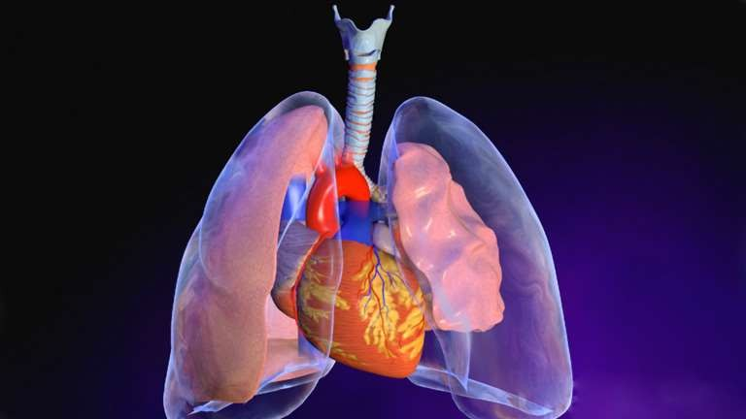
PNEUMOTHORAX

Slide 2
Learning Objectives:
By the end of this lecture, you should be able to :
Define Pneumothorax
Classify Pneumothorax
Discuss the epidemiology of pneumothorax
List the causes of pneumothorax
List the clinical features and signs of pneumothorax
Mention the modalities of investigating pneumothorax and their interpretations
Emergency treatment and definitive treatment of pneumothorax.

Slide 3
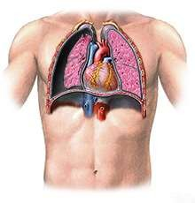
Definition:
Pneumothorax is the presence of air in the pleural space

Slide 4
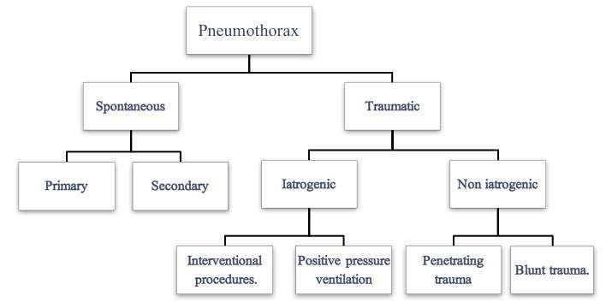
Classification of Pneumothorax

Slide 5



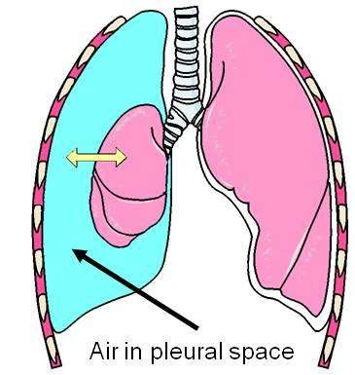
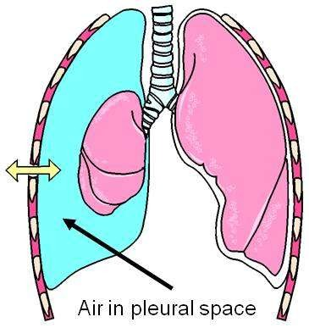
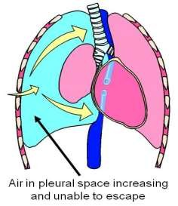
Clinical Types of Pneumothoraces
Pneumothorax
Closed
pneumothorax
Open
pneumothorax
Tension
pneumothorax

Slide 6
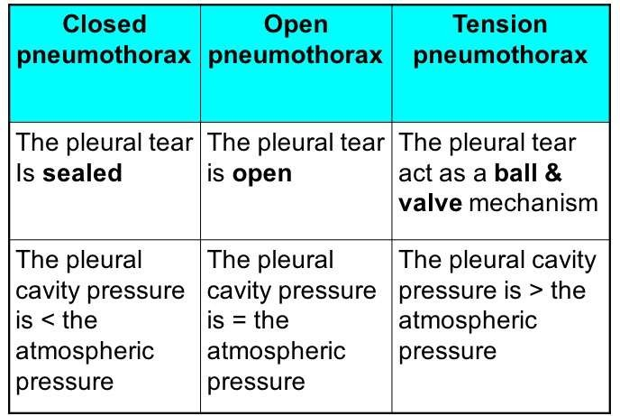
Clinical Types of Pneumothoraces

Slide 7
Epidemiology
Annual incidence of pneumothorax is around 9 per 100,000
Primary pneumothoraces occur most commonly in tall thin men aged between 20 and 40.
They are less common in women (♂:♀ ~5:1) — consider the possibility of underlying lung disease (e.g. LAM, catamenial pneumothorax,marfans syndrome)

Slide 8
Epidemiology
Cigarette or cannabis smoking is a major risk factor for pneumothorax, increasing the risk by a factor of 22 in men and 9 in women.
The mechanism is unclear; a smoking-induced influx of inflammatory cells may both break down elastic lung fibres (causing bulla formation) and cause small airways obstruction (increasing alveolar pressure and the likelihood of interstitial air leak)

Slide 9
Causes and pathophysiology
Primary Spontaneous Pneumothorax
Pathogenesis is poorly understood; pneumothoraces are presumed to occur following an air leak from apical subpleural blebs and bullae, although small airway inflammation is often also present and may contribute by increasing airways resistance, causing ‘emphysema-like changes’ (ELC).

Slide 10
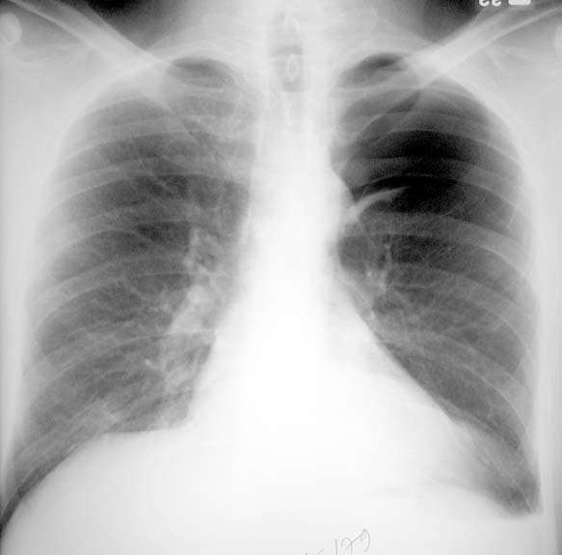

Slide 11
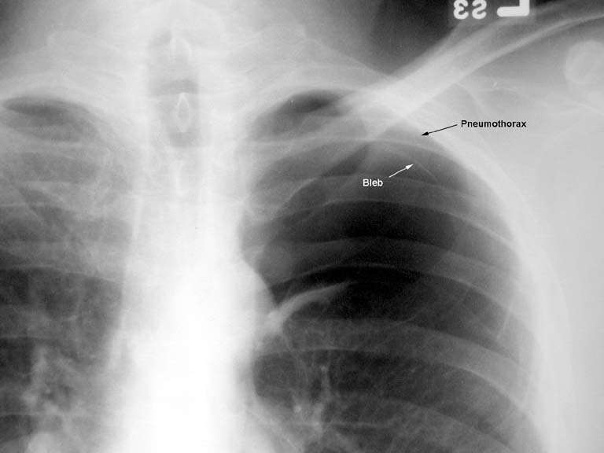

Slide 12
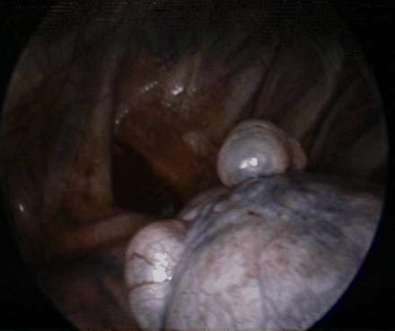
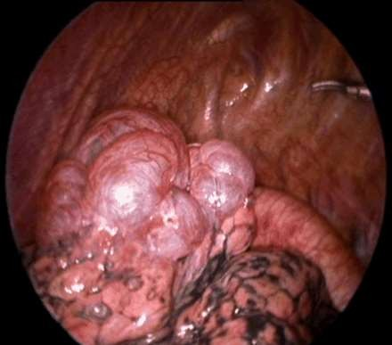
Thoracoscopic image of apical blebs in patient with spontaneous pneumothorax

Slide 13
Traumatic pneumothorax
Accidental trauma:(non-iatrogenic)
Blunt trauma: with fracture ribs.
Penetrating trauma: stab wound or gun shot injury.
Iatrogenic :
Positive pressure ventilation:
Alveolar rupture → interstitial emphysema →pneumothorax.
Interventional procedures:
Biopsy, thoraco-centesis, CVP line,tracheostomy etc..

Slide 14
Tension Pneumothorax
Tension pneumothoraces occur when intrapleural air accumulates progressively in such a way as to exert positive pressure on mediastinal and intrathoracic structures.
It is a life-threatening occurrence requiring rapid recognition and treatment is required if a cardiorespiratory arrest is to be avoided.

Slide 15
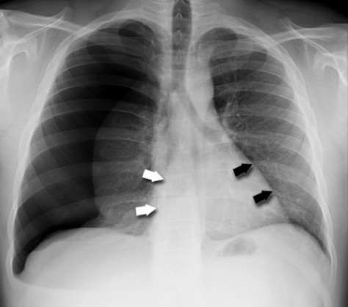
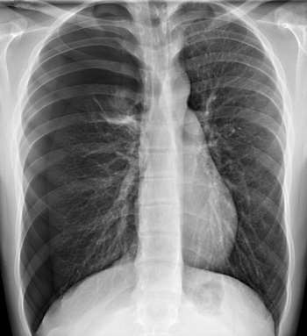
Tension Pneumothorax

Slide 16
Causes and pathophysiology
Secondary Spontaneous Pneumothorax
Underlying diseases include: COPD (60% of cases), asthma, ILD, necrotizing pneumonia, TB, PCP, CF, LCH, LAM, Marfan’s syndrome, oesophageal rupture, lung cancer, catamenial pneumothorax, and pulmonary infarction
Pneumothorax may be the first presentation of the underlying disease.

Slide 17
Clinical features
Classically presents with:
Acute onset of pleuritic chest pain and/or breathlessness.
Breathlessness is often minimal in young patients and is more severe in secondary spontaneous pneumothorax

Slide 18
Clinical features
Uncommon manifestation
Cough
Hemoptysis
Orthopnea
Cyanosis

Slide 19
Clinical features
Signs of pneumothorax include:
Tachycardia
Hyperinflation
Reduced expansion,
Hyperresonant percussion note

Slide 20
Clinical features
Signs of pneumothorax include:
Quiet breath sounds on the pneumothorax side. these are frequently absent in small pneumothoraces.
Hamman’s sign refers to a ‘click’ on auscultation in time with the heart sounds, due to movement of pleural surfaces with a left-sided pneumothorax

Slide 21
Clinical features
Signs of pneumothorax include:
7. May feel ‘bubbles’ and ‘crackles’ under the skin of the torso and neck if there is subcutaneous emphysema.
Presents in ventilated patients with acute clinical deterioration and hypoxia or increasing inflation pressures.

Slide 22
Investigations
Chest X-RAY is the diagnostic test in most cases.
Revealing a visible lung edge and absent lung markings peripherally.
Blunting of the ipsilateral costophrenic angle due to low-volume bleeding into the pleural space.
Pneumothoraces are difficult to visualize on supine films.
Look for a sharply delineated heart border.
Hemidiaphragm and costophrenic angle depression (‘deep sulcus sign’),
Increased lucency on the affected side

Slide 23
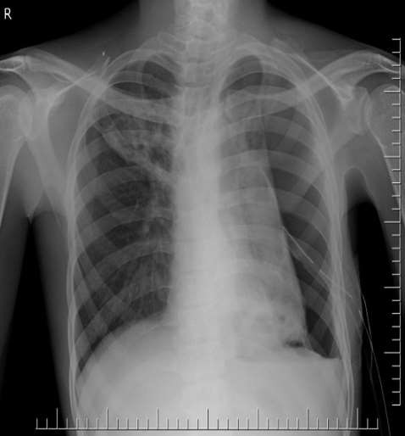
Investigations
Chest X-RAY is the diagnostic test in most cases.

Slide 24
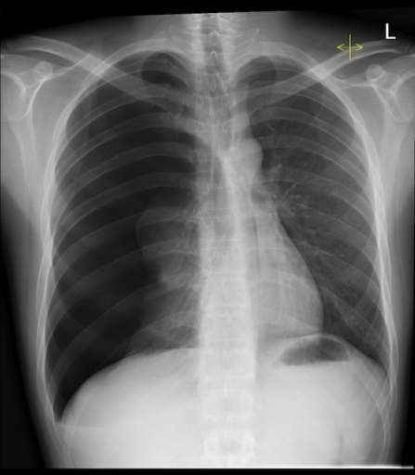
Investigations
Chest X-RAY is the diagnostic test in most cases.

Slide 25
Investigations
Chest X-RAY is the diagnostic test in most cases.

Slide 26
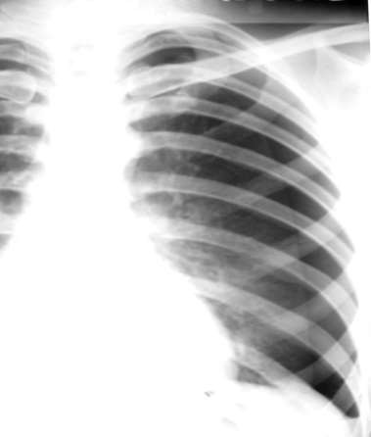
Investigations
Quantification of the size
The simple method to estimate the size
Small, a visible rim of < 2 cm between the lung margin and the chest wall
Large, a visible rim of ≥2 cm between the lung
margin and chest wall
Light index-Measure transverse Diameters of lung and
compare it with diameter
hemithorax
Hemithorax (HT)
Lung (L)
28

Slide 27
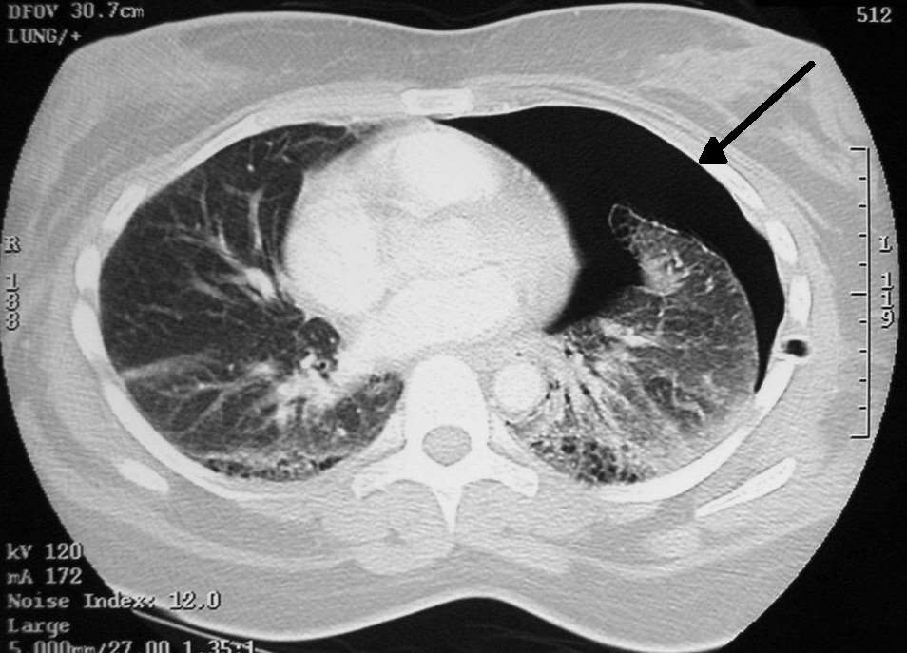
Investigations
CT Chest
CT chest may be
required to
differentiate
pneumothorax from
bullous disease and is
useful in diagnosing
unsuspected
pneumothorax
following trauma and
in looking for evidence
of underlying lung disease

Slide 28
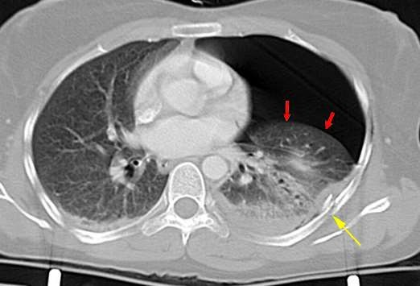
Investigations
CT Chest

Slide 29
Investigations
ABGs frequently show hypoxia and sometimes hypercapnia in secondary pneumothorax.

Slide 30
Initial management
General management points
Determine whether the pneumothorax is primary or secondary (known lung disease/ evidence of lung disease clinically or age >50 with significant smoking history)
Management is determined by degree of breathlessness and hypoxia, evidence of haemodynamic compromise, presence and severity of any underlying lung disease, and, to a lesser extent, CXR pneumothorax size
Severe breathlessness out of proportion to pneumothorax size on a prior CXR may be a feature of impending tension pneumothorax
Secondary pneumothorax has a significant mortality (10%) and should be managed more aggressively.
Treat also the underlying disease.

Slide 31
Oxygen
All hospitalized patients should receive high- flow (10L/min) inspired O₂ (unless CO₂ retention is a problem).
This reduces the partial pressure of nitrogen in blood, encouraging removal of air from the pleural space and speeding up resolution of the pneumothorax.

Slide 32
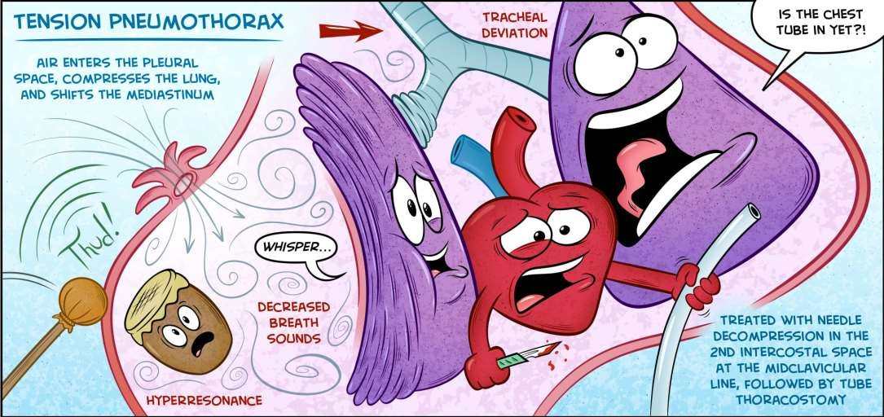
Tension Pneumothorax
Immediate Needle Decompression

Slide 33
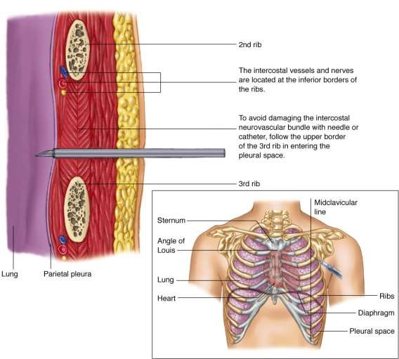
Tension Pneumothorax
Immediate Needle Decompression

Slide 34
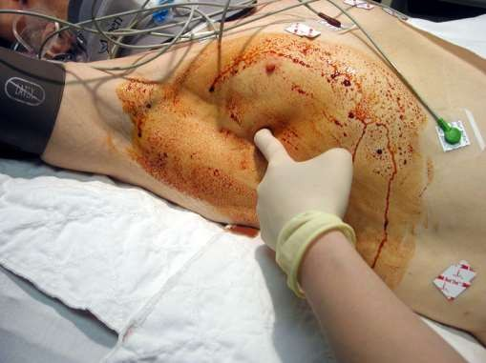
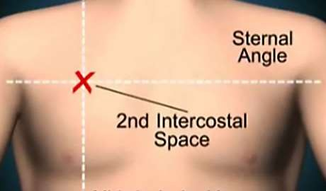
Tension Pneumothorax
Immediate Needle Decompression
Needle Thoracostomy in 2nd I.C.S in M.C.L.
Chest tube insertion in 5th I.C.S in M.A.L.

Slide 35
Aspiration
Halt the procedure if painful or if the patient coughs excessively
Do not aspirate >1.5L of air, as this suggests a large air leak and aspiration is likely to fail
Aspiration is successful if the lung is fully or nearly reexpanded on CXR and patient feels symptomatically better with improved physiology.
If initial aspiration of a primary pneumothorax fails, a chest drain is likely to be required if benefits outweigh risks.

Slide 36
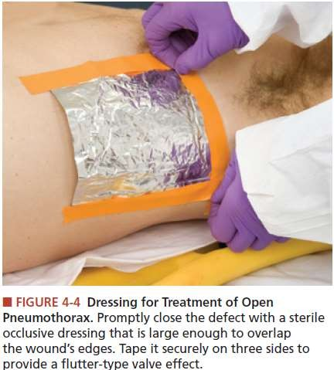
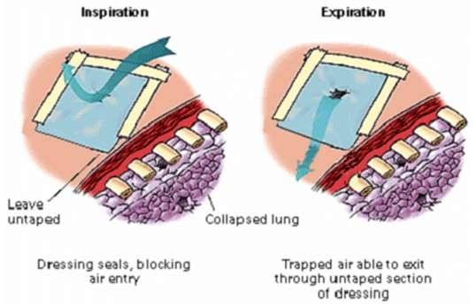
Open Pneumothorax

Slide 37
Chest drainage
Associated with significant morbidity and even mortality
Not required in the majority of patients with primary spontaneous pneumothorax
Small (10–14F) drains are sufficient in most cases; consider large-bore (24–28F) drain in secondary pneumothorax with large air leak, severe subcutaneous emphysema, or in mechanically ventilated patients
Never clamp a bubbling chest drain (risk of tension pneumothorax)

Slide 38
Chest drainage
When air leak appears to have ceased, clamping of the drain for several hours followed by repeat CXR may detect very slow or intermittent air leaks, thereby avoiding inappropriate drain removal; this is controversial, however, and should only be considered on a specialist ward with experienced nursing staff . Addition of washing-up liquid to water in underwater seal bottle aids visualization of bubbling in very slow air leaks

Slide 39
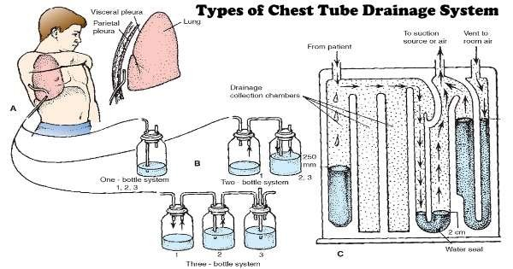
Chest drainage

Slide 40
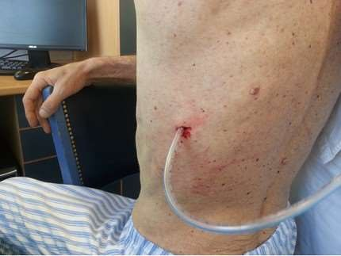
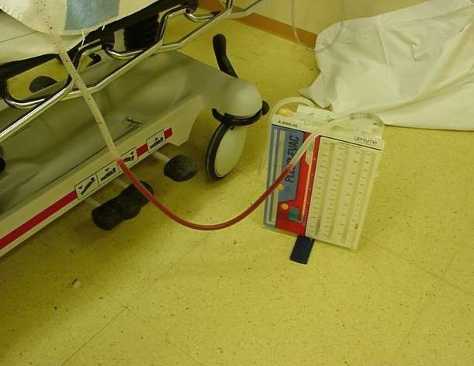
Chest drainage

Slide 41
Chest drainage
If water level in drain does not swing with respiration, the drain is either kinked (check underneath dressing as tube enters skin), blocked, clamped, or incorrectly positioned (drainage holes not in pleural space; check CXR)

Slide 42
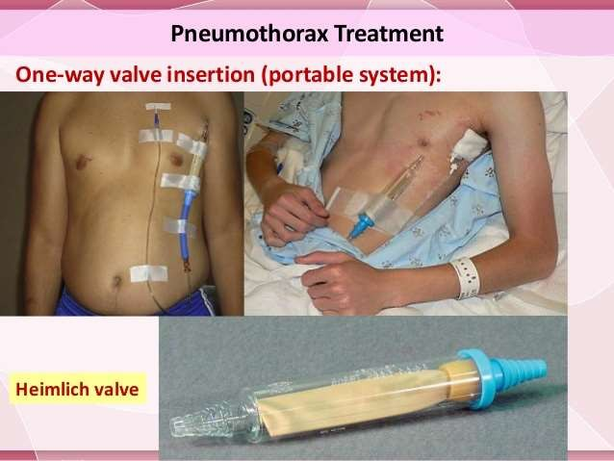
Chest drainage
Heimlich flutter valves (or thoracic vents) are an alternative to underwater bottle drainage and are being used increasingly in some centres. They allow greater patient mobilization and sometimes outpatient management of pneumothorax.

Slide 43
Persistent air leak
Arbitrarily defined as continued bubbling of chest drain 48hrs after insertion
Consider drain suction (–10 to –20cmH₂O), insertion of large- bore drain, and/or thoracic surgical referral
Check that persistent bubbling is not the result of ‘outside’ air being sucked down the drain, e.g. following drain displacement such that a hole lies outside the pleural cavity, or if enlargement of the drain track occurs, allowing outside air to enter and then be aspirated down the drain.

Slide 44
Surgical management
Indications for cardiothoracic surgical referral
Second ipsilateral pneumothorax
First contralateral pneumothorax
Bilateral spontaneous pneumothorax
Persistent air leak or failure of lung to re-expand (3–5 days of drainage)
Spontaneous haemothorax
Professions at risk (e.g. pilots, divers) after first pneumothorax.

Slide 45
Surgical management
Surgical treatments aim to repair the apical hole or bleb and close the pleural space.
1. Video Assisted Thoracic Surgery
Recurrence rates are higher than for open thoracotomy (4% vs 1.5%) although less invasive procedure and shorter hospital stay. Apical blebs/bullae are stapled, and mechanical pleural abrasion and/ or parietal pleurectomy (rather than talc poudrage) is usually favoured for closure of the pleural space. Often the procedure of choice in young patients with primary pneumothorax.

Slide 46
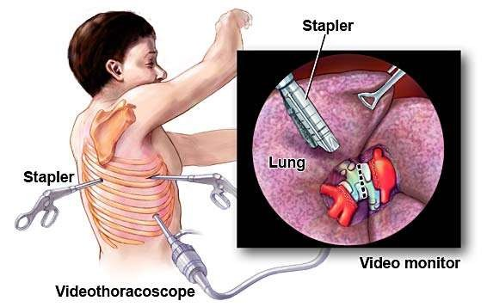
Surgical management
Surgical treatments aim to repair the apical hole or bleb and close the pleural space.
1. Video Assisted Thoracic Surgery

Slide 47
Surgical management
Open Thoracotomy
Same range of operative interventions undertaken as for VATS but associated with longer recovery (albeit with marginally lower recurrence rates)
Transaxillary mini-thoracotomy
Uses a relatively small axillary incision and may be a less invasive alternative to open thoracotomy.

Slide 48
Chemical pleurodesis
Talc or Tetracycline most commonly used.
Can be performed via intercostal drain or at VATS.
Failure rates around 10–20% and some concern about the long-term safety of intrapleural talc; therefore not recommended in younger patients
Consider pleurodesis via intercostal drain only as a last resort in older patients with recurrent pneumothorax in whom surgery would be high risk (e.g. patients with severe COPD)
Likelihood of successful pleurodesis in the setting of an incompletely re-expanded lung with a persistent air leak remains uncertain, although it may be attempted if surgery is not an option.

Slide 49
Further Management
Outpatient follow-up
Repeat CXR to ensure resolution of pneumothorax and normal appearance of underlying lungs
Discuss risk of recurrence, and emphasize smoking cessation, if appropriate
Ascent to altitude with a pneumothorax is potentially hazardous. Guidelines recommend that patients should not fly for at least 1 week from the resolution of spontaneous pneumothorax on CXR. This time interval is arbitrary, however, and patients should understand that there is a high initial risk of recurrence that falls with time, and they may wish to avoid flying for a longer period, e.g. 1 year
Advise never to dive in the future, unless patient has undergone a definitive surgical procedure.

Slide 50
Thank you

