Slide 1
HYDATID CYST
Prof.Dr.A.P.Subburaaj.M.B.,B.S.,M.S.,FIAGES
Professor of surgery

Slide 2
Introduction
Word meaning - ‘tear drop’ / ‘watery vesicle’
Zoonotic disease
Causative agents
  Echinococcus granulosus ( cystic echinococcosis )
    most common
    cDNA encoding calmodulin , a calcium sensor protein,(rEgcaM) plays essential role in the biological function of E,granulosus as a calcium binding protein
  Echinococcus multilocularis (alveolar echinococcosis)- rare , most virulent
  Echinococcus vogeli - most rare

Slide 3
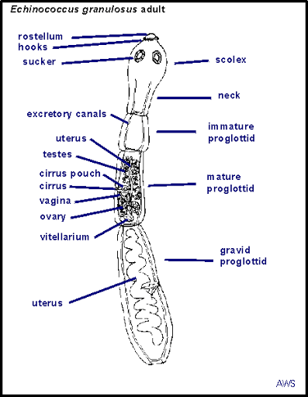
Echinococcus- dog tapeworm
2-8 mm long
Body shape- ribbon like
Comprises of
  Scloex- with four suckers and 2 circular rows of hooks
  Neck
  Immature proglottid
  Mature proglottid
  Gravid proglottid
Three layers
  Outer ectoderm
  Middle mesoderm
  Inner endoderm

Slide 4
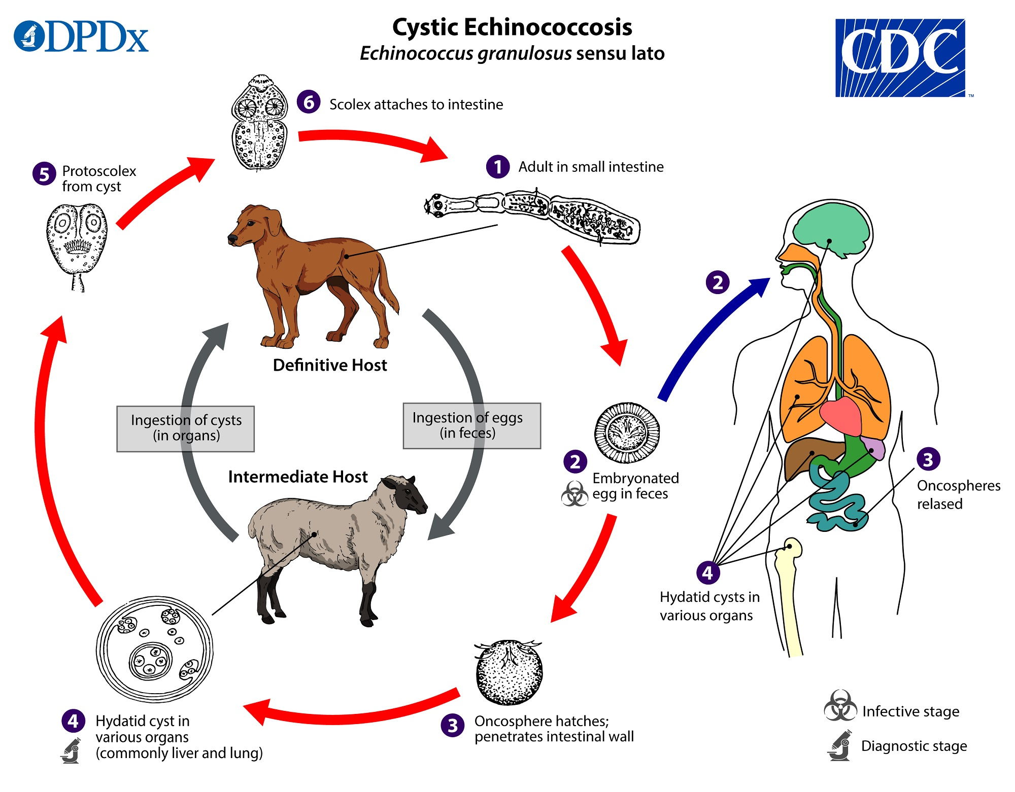
Life cycle
Definitive host - dog
Intermediate host - sheep,cattle,camel
Accidental host - human
Infective stage - egg (gravid proglottid )
MAN IS A DEAD END HOST

Slide 5
LIFE CYCLE
Adult tapeworm attached to ileum villi of the dog (definitive host ) ----------> more than thousand ova are passed daily deposited in the feces
Intermediate host - sheep / accidental host - human
(End stage to parasite)
Human duodenum - embryo releases oncosphere containing hooklets -------> penetrates mucosa
Enter porto- venous circulation which enters into liver /lung
Larvae develop- fluid filled unilocular cyst ‘ HYDATID CYST’

Slide 6
Three weeks after infection , visible hydatid cyst develops slowly develop spherical manner
Pericyst / FIbrous capsule derived from host tissue develops around cyst
Daughter cysts ( brood capsules ) develop from inner germinal layer
Cyst expand slowly over a period of time
Rupture of cyst can die with degeneration of
membrane , develop of cystic vacuoles and calcification of wall

Slide 7
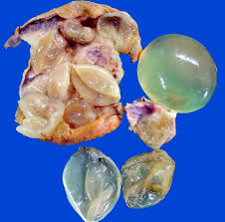
Hydatid cyst
Site of hydatid cyst
Liver (65%)
Lungs ( 25%)
Muscle
Spleen
Kidney
Heart
Bones
Brain
Gross appearance
Resembles bunch of grapes
Slowly growing 2- 3 cm/yr

Slide 8
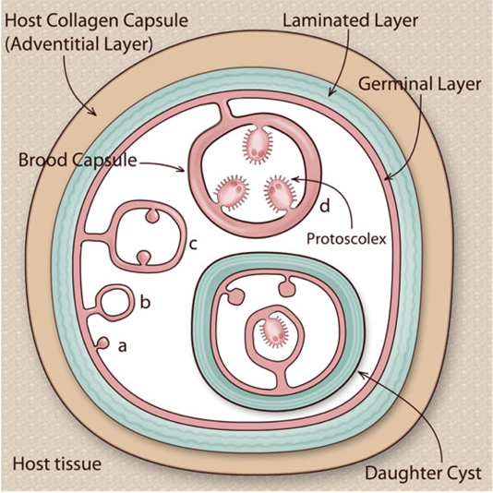
Hydatid cyst
3 layers
Adventitia (pseudocyst) - inseparable fibrous tissue due to reaction of liver to parasite
Laminated membrane (ectocyst ) - elastic , containing hydatid fluid which can be readily peeled off from adventitia
Germinal layer ( endocyst) - only living part , lining the cyst
This layer secretes hydatid fluid, brood capsules with scolices (head of future worms)

Slide 9
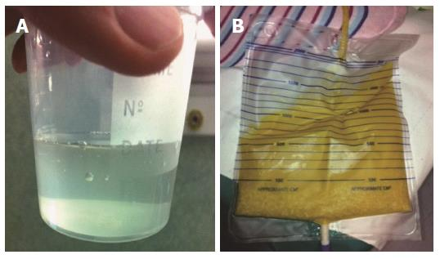
Hydatid fluid
Features
Clear
High specific gravity (1.005-1.009)
Shows hooklets and scolices

Slide 10
Course of disease
Cyst may die and may get calcified
Cyst - enlarged ----> palpable per abdomen
Rupture
  Peritoneal cavity - severe anaphylactic reaction
  Biliary channels - ( most common - 60%)
Secondary infection -------> suppuration and septicaemia
Secondary cyst ------> in lung , spleen , mesentery , retroperitoneum and other organs
Hepatic dysfunction
Disseminated abdominal hydatidosis --------> occur after silent rupture

Slide 11
Symptoms
Mostly asymptomatic
Cyst > 5cm in diameter - pressure symptoms
Common symptoms
  Right upper quadrant pain
  Dyspepsia
  Weight loss
  Fatigue
  Vomiting

Slide 12
Skin
  jaundice ( biliary obstruction )
  Spider angioma ( cirrhosis liver)
  Urticaria (acute allergic reaction due to rupture )
  Erythema (acute allergic reaction due to rupture )

Slide 13
Lungs (pulmonary hydatid cyst )
  Small cyst - remain asymptomatic
  Mediastinal cyst - erode adjacent structures - bone pain/ airflow limitation
  pleural effusion , chronic cough , dyspnoea , pleuritic chest pain , hemoptysis
  Intrabronchial rupture - expectoration of cyst membrane and fluid

Slide 14
Abdomen
  Abdominal tenderness
  Asymptomatic palpable liver with classic thrill ( hydatid thrill ) elicited by three finger test
  Hepatomegaly - if tender, it’s a sign of secondary infection of cyst (fever , chills , rarely ascities )
  Splenomegaly - due to splenic echinococcosis/ portal hypertension
  Palpable mass in the abdomen
  Camellotte sign - following intrabiliary rupture , gas enters into cyst causing partial collapse of cyst wall .
  Rupture into biliary tree ------> obstruction of daughter cyst ----> cholangitis

Slide 15
Cerebral involvement
  Headache
  Dizziness
  Decreased level of consciousness
  Specific neurologic deficit depending in the location of cyst
Extremity pain with or without neurologic deficit is a sign of either bone/ muscle involvement .

Slide 16
Differential diagnosis
Abdominal abscess
Acute liver failure
Biliary cirrhosis
Biliary colic
Biliary obstruction
6. Budd-chiari syndrome
7. Cystic teratoma
8. Cysticercosis
9. Inferior vena caval thrombosis
10. Primary hepatic carcinoma
11. Tuberculosis

Slide 17
WHO classification
Type - CL | Active | Unilocular , no cyst wall , early stage , not fertile
Type CE- 1 | Active | Cyst wall present , hydatid sand present , fertile
Type CE- 2 | active | Multivesicular rosette like cyst wall , fertile
Type CE- 3 | Transitional | Detaching laminated membrane, water lilly sign, beginning of degeneration
Type CE-4 | Inactive | Degenerative content . no daughter cyst , not fertile
Ty[e CE- 5 | Inactive | Thick calcified wall, not fertile

Slide 18
Investigation
Routine blood investigation
  eosinophilia ( 25% of patients )
  leukocytosis ( indicates infection of cyst )
Raised bilirubin , raised alkaline phosphatase
Hypo-gammaglobinemia - present in 30 % patients
Initial screening test - indirect hemagglutination test and enzyme linked immunosorbent assay( ELISA)
Specific confirmation test
  immunodiffusion and immunoelectrophoresis - demonstrates antibodies to antigen 5
Follow up - ELISA test

Slide 19
Casoni test
Intradermal skin test
Sensitivity - -70%
Now largely abandoned- because
  Low sensitivity
  Low accuracy
  Severe local allergic reaction

Slide 20
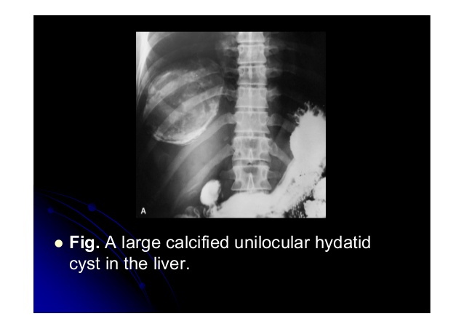
Imaging studies
Plain x-ray
Cystic echinococcosis- non-specific and non revealing
Thin rim of calcification delineating a cyst - echinococcal cyst

Slide 21
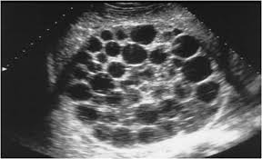
Ultrasound - diagnostic
Solitary cyst
feature suggestive include dependant debris ( hydatid sand) moving freely with change in position
Presence of wall calcification
Multiple cyst -
Multiple cyst with normal intervening parenchyma

Slide 22
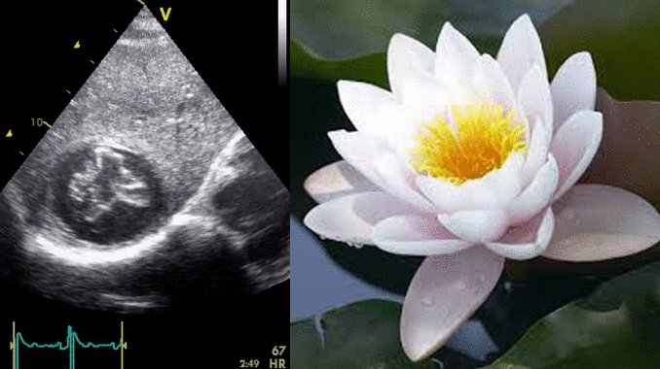
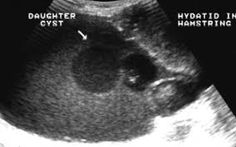
3. Water lilly sign
Separation of membranes due to collapse of germinal layer
4. Daughter cyst
Most characteristic sign
Cyst in a cyst - cart wheel / honeycomb cyst

Slide 23
Hasen Gharbi ultrasound based classification of liver hydatid cyst
Type
1 | Pure fluid collection
2 | Fluid collection with split wall
3 | Fluid collection with septa
4 | Heterogeneous appearance
5 | Reflecting thick walls

Slide 24
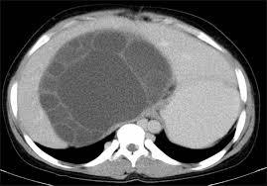
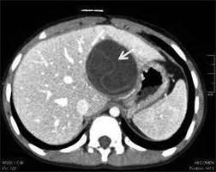
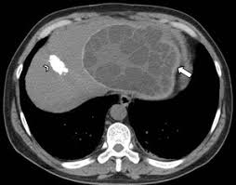
CT - SCAN
Accuracy - 98%
Cart - wheel like - multivesicular rosette like

Slide 25
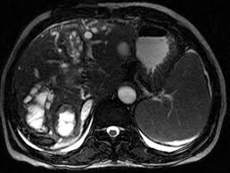
MRI
  Visualize biliary tree and its relation to hydatid cyst
  To find out cysto-biliary communication

Slide 26
Other imaging techniques
Angiography
Direct cholangiography
Immunoscintigraphy
ERCP ( endoscopic retrograde cholangiography )-
  Both diagnostic and therapeutic - In patients with intrabiliary rupture of a hydatid disease in whom a sphincterotomy can be performed .

Slide 27
Treatment
Medical
PAIR
Endoscopic
Surgical - treatment of choice

Slide 28
Approach consideration
Inpatient care for individuals who have had surgical resection of their hydatid cysts is similar to that for any other surgical procedure on the affected organ
SPECIAL CONSIDERATION
  Patients with hepatic cystic echinococcosis with biliary communication .
  These patients observed for symptoms and sign
  If any complications occurs ( biliary obstruction / fistula formation ) - treated by percutaneous or endoscopic stenting of biliary tree with or without sphincteroplasty

Slide 29
Post op - benzimidazoles is continues for 1 month
Antibiotics used prophylactically for surgery as indicated in patients with cysto- biliary fistula for treatment infected infected cyst

Slide 30
Medical management
Indication
Cysts in lungs
Surgically unfit patients
Multiple or multi-organ cyst
Inoperable cyst
Recurrent hydatids
10 days prior to intervention and to continue it for 1 month to 3 months after the intervention
Contraindication
Large cyst
Honeycomb cyst
Infected cyst
Calcified cyst
Pregnancy

Slide 31
Drugs - used
ALBENDAZOLE ( 4 week cycles with 2 weeks drug free interval)
  ovicidal/larvicidal/vermicidal
  3 such cycles are used
  Dose- 400 mg twice daily / 10 mg /kg/day
  Side effects - alter LFT , fever , alopecia , leucopenia,
  Contraindicated in pregnancy
  Less effective in hydatids of bone , brain and eye

Slide 32
2. MEBENDAZOLE
600 mg daily for 4 weeks
3. PRAZIQUANTEL
60 mg/kg along with albendazole for 2 weeks
SCOLICIDAL AGENTS
Cetrimide - can cause acidosis
Alcohol 80 % - can cause cholangitis
Hypertonic saline - cause hypernatremia
Sodium hypocholrite - cause hypernatremia
Hydrogen peroxide

Slide 33
Puncture - Aspiration-Injection-Reaspiration
(PAIR)
INDICATION :
Inoperable patients / patients refusing surgery
Multiple segments in segment I, II and III of liver
Infected cyst / Relapse after surgery or chemotherapy
CL , CE 1 , CE 2 & CE 3 types /Gharbi type 1 & 2
In pregnant women and children less than 3 years
Cyst > 5 cm in different liver segments

Slide 34
CONTRAINDICATION :
Early pregnancy
Lung and brain cyst
Inaccessible cyst
Hyperechogenic cyst
Calcified cyst
Superficially located cyst ( risk of spillage )
Type II honey -comb cyst
Type IV cyst
Cyst communicating with biliary tree ( risk of sclerosing cholangitis from scolecoidal agent)

Slide 35
OUTCOME
Complication rate - 10-40 %
Mortality rate - 0.9 - 2.5 %
Fever - 35% , disappears in 72 hrs
Anaphylaxis
Infection - 10 %
Local recurrences- 4 % repeat PAIR can be done
Reduced cost and shorter hospital stay- desirable

Slide 36
Technique
Preoperative treatment- benzimidazole is mandatory ( 4 d prior to procedure and 1-3 months after )
Done under US/CT guidance
Under LA , cyst punctured using cholangiography 22 gauge needle through thickest route/part of cyst wall
Cyst i s entered through non-dependent wall
50 % fluid is aspirated , all multiple /daughter cyst aspirated ------> injection of scolicidal agents for 15 min -------> re-aspiration of contents .

Slide 37
Repeated until the return is clear
Cyst then filled with isotonic sodium chloride solution
If cyst is > 6 cm or more , drainage catheter is placed for 24 hrs for complete drainage and later alcohol sclerosant is injected
OTHER PROCEDURE
Double - puncture aspiration and injection ( D-PAI ) or modified PAIR/PEVAC( percutaneous EV Acuation of cyst )

Slide 38
Surgery- Gold standard therapy
Abdomen opened , peritoneal cavity packed with mops
Fluid from cyst aspirated and scolicidal agents injected into cyst cavity
Hypertonic saline should be left within the cavity for 15-20 min to have effective scolicidal effect

Slide 39
Laparoscopic pericystectomy
More popular
Main problem is spillage and difficulty n preventing
Contraindication - deeply situated cyst , densely adherent cyst , in-accessible cyst , > 3 cyst , calcified cyst and cyst in other organs .
Liver resection - only occasionally segmental or hemihepatectomy

Slide 40
Choice of surgical technique
CYSTIC ECHINOCOCCOSIS
Radical procedure
  Total pericystectomy
  Partial affected organ resection
Conservative surgery ( open cystectomy )
Simple tube drainage of infected and communicating cyst for surgical options .
MORE RADICAL THE PROCEDURE , LOWER RISK OF RELAPSES BUT HIGHER RISK OF COMPLICATIONS.

Slide 41
ALVEOLAR ECHINOCOCCOSIS
Radical surgery with complete excision of lesion.
Total hepatectomy with transplantation
Reemergence of parasite in transplanted liver
Distant metastasis occur under immunosuppression
Partial resection of unresectable masses - reduce parasite load ---> chemotherapeutic agents .
Ex- VIVO liver resection combined with autotransplantation appears to show potential for curing end stage hepatic alveolar echinococcosis in those with unresectable lesions

Slide 42
CHEMOTHERAPY
CYSTIC - ECHINOCOCCOSIS
INDICATIONS
Primary lung or liver cyst - inoperable
Cysts in 2 or more organs
Peritoneal cyst
Optimal period of treatment time - 3- 6 months

Slide 43
CHEMOTHERAPEUTIC AGENTS
Albendazole ( 10-15 mg/kg/d) -
  1 month oral dose / separated bby 14 day intervals
  Optimal period of treatment- 3-6 months
  Ineffective in treatment of primary liver cyst in patients who are surgical candidates
Mebendazole ( 40- 50 mg /kg/d)
  3-6 months
Praziqunatel - ( 40 mg/kg/wk)
  Isoquinolone derivative

Slide 44
Monitoring
Adverse effects of agents- 2 weeks with CBC
Liver enzyme evaluation for first 3 months and then every 4 weeks
Imaging studies - follow up on the morphologic status of cyst .

Slide 45
ALVEOLAR ECHINOCOCCOSIS
INDICATIONS
Used preoperatively for approx. 2 yrs in patients in whom radical resection is feasible because of possible residual parasite tissue
Pts . who undergo partial resection
Inoperable
Pts who have undergone liver transplant
Long term chemotherapy is required ( 3-10 yrs )

Slide 46
CONTRAINDICATIONS
Early pregnancy
Severe Lekopenia
Chemotherapeutic agents and patient monitoring are the same as with Cystic echinococcosis but the length of treatment is different

Slide 47
Long term monitoring
Postoperative treatment with benzimidazole is continued for 1 month in patients with cystic echinococcosis who have successfully undergone PAIR .
Patients with resected alveolar echinococcois , incompletely resected CE , spillage during surgery or PAIR , metastatic lesions. - treatment continued for 3-6 months
Partially resected AE , unresectable AE , liver transplant for AE - chemotherapy needed for 3-10 yrs .

Slide 48
Laboratory test
Patients on benzimidazole ( monitor for toxicity) - CBC & liver enzyme evaluation performed biweekly interval for 3 months and then every 4 weeks
ELISA or indirect hemagglutination test - performed at 3, 6 , 12 and 24 month interval to assess for recurrence of resected disease or aggravation of existing disease
Imaging - USG / and or CT

Slide 49


