Slide 1
POST MENOPAUSAL BLEEDING

Slide 2

Menopause
Cessation of menstrual periods due to declining estrogen and progesterone production by the ovaries
Refers to the final menstrual period – must be free of periods for one year to be called menopause

Slide 3
Stages of Menopause
Perimenopause – may have erratic cycles, hot flashes, and vaginal dryness; lasts from about 2 years prior to LMP to 2 years after the official “last” LMP. Average age 52 years
Menopause – refers to final last menstrual period
Postmenopausal – from “final” LMP on; women spend about 1/3 of their lives in postmenopausal period

Slide 4
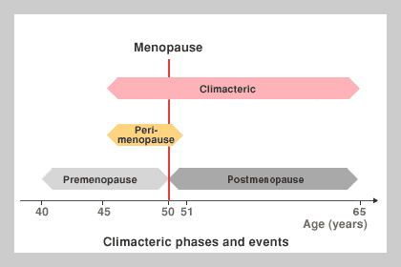

Slide 5
Menopause: Etiology
Natural
Surgical
Premature
Post-chemotherapy/radiation

Slide 6
POST MENOPAUSAL BLEEDING
Bleeding per vagina following established menopause
is called postmenopausal bleeding.
The significance of postmenopausal bleeding,whatever slight it may be, should not be underestimated.
As many as one-third of the cases are due to malignancy. The same importance is also given to
those cases where normal menstruation continues even beyond the age of 55 years.

Slide 7
Causes
The causes of postmenopausal bleeding are :
Senile endometritis
Atrophic endometrium.
Endometrial hyperplasia
Dysfunctional uterine bleeding.
Genital malignancy.
−− Carcinoma of the cervix, endometrium,
vagina, vulva and Fallopian tube.
−− Sarcoma uterus.
−− Granulosa cell tumor of the ovary.

Slide 8
CAUSES
Uterine polyp.
Tubercular endometritis.
Cervical erosion and polyp.
Senile vaginitis.
Decubitus ulcer.
Retained and forgotten foreign body such as pessary or IUCD.
Withdrawal bleeding following estrogen intake.
Urethral caruncle, polyp, prolapse mucosa or carcinoma.
Unknown is about 25 percent. The incidence
however decreases with wider use of hysteroscopy.

Slide 9
Common causes of postmenopausal bleeding
• Genital malignancy
• DUB
• Senile endometritis
• Decubitus ulcer
• Urethral caruncle
• Retained pessary or IUCD

Slide 10
Investigations
Investigations
Initial step is to establish the fact that it is vaginal
bleeding and not bleeding per rectum or hematuria.
560 Textbook of Gynecology
Detailed history regarding
hh Age of menopause.
hh Menstrual pattern prior to menopause.
hh Amount of bleeding, number of episodes.
hh Sensation of something coming out of the introitus.
hh Urinary problems like dysuria or frequency of
urination.
hh Intake of estrogen—Even if the history of intake
is present, full investigations should be carried out
to exclude malignancy.
hh Family history of endometrial and/or ovarian
carcinoma (first degree relative).
General examination
Obesity and hypertension are often related to
endometrial carcinoma.
Enlarged groin or supraclavicular lymph nodes
may be palpated. Metastatic nodules in the anterior
vaginal wall may be present. Breasts should be
palpated because gynecological symptoms may be
related to breast cancer (p. 387, 388).
Per abdomen: A lump in the lower abdomen may be
due to pyometra or uterine sarcoma or adnexal mass.
Inspection of the perineum
. If the uterus is outside the introitus, a decubitus
ulcer may be detected (see p. 206).
. Careful inspection of vulva may reveal a growth.
If it is present, biopsy is to be taken.
Initial step is to establish the fact that it is vaginal bleeding and not bleeding per rectum or hematuria.

Slide 11
Palpation: To separate the labia for better inspection
of the urethral meatus to find out any caruncle, polyp or mucosal prolapse.
Speculum examination: To note the condition of
the cervix and the vault of the vagina.
Any visible cervical growth → biopsy is to be taken for histology.
Cervix apparently looking normal → cervical and endocervical smear to exclude dysplasia or CIN
Aspiration cytology — for endometrial carcinoma.

Slide 12
Pipelle endometrial sampling can be done with a long and narrow plastic cannula
This is done as an OPD procedure during speculum examination. Adequate sample is obtained with this procedure and the tissue is subjected for histological examination.
Bimanual examination
the Uterus may be normal, atrophic or enlarged due to pyometra or sarcoma.
Adnexal mass (infective or ovarian) may be palpable.

Slide 13
Ultrasonography transvaginal probe (TVS) is more accurate because of its proximity to the target tissue (endometrium). Endometrial thickness less than 4 mm indicates atrophy. On the other hand, thick polypoid endometrium (9–10 mm), irregular texture, fluid within the uterus require further evaluation (to exclude malignancy).
 Saline infusion sonography (SIS) is more accurate compared to sonography alone and biopsy is taken

Slide 14
 Hysteroscopic evaluation and directed biopsy.
 Endometrial biopsy may be done using the Sharman curette as an outpatient basis.
 Fractional curettage, if the cervical cytology becomes negative .
 Endometrial biopsy for diagnosis of endometrial carcinoma under guidance of sonohysterography or hysteroscopy has got the similar diagnostic accuracy.

Slide 15
 Laparoscopy in suspected cases of ovarian or adnexal mass.
 CT and MRI may be useful in selected cases of postmenopausal bleeding.
Detection of a benign lesion should not prevent further detailed investigations to rule out malignancy

Slide 16


DIAGNOSIS
Pap smear
TVS
Endometrial biopsy
VABRA or Pipelle

Slide 17
Tissue Diagnosis
Methods of Endometrial Sampling:
Pipelle / Endocell
Outpatient hysteroscopy
Curettage under general anesthesia

Slide 18
Diagnostic evaluation
Outpatient endometrial biopsy with the Pipelle catheter is reliable and accurate for the detection of disease in most cases of endometrial cancer (level of evidence: A).
Detection rates by pipelle was :
91 and 99% for endometrial ca.
81% for hyperplasia
Hysteroscopic-guided endometrial biopsy remains the gold standard for endometrial cancer diagnosis (level of evidence: A ).

Slide 19
Diagnosis
Hysteroscopy with endometrial curettage or endometrial sampling, curettage alone，or outpatient endometrial sampling alone，are essential．
Hysteroscopy，cervical smear（>1％risk of concurrent cervical malignancy）and
vaginal or abdominal ultrasound for ovarian pathology are advised，when endometrial malignancy is found．

Slide 20
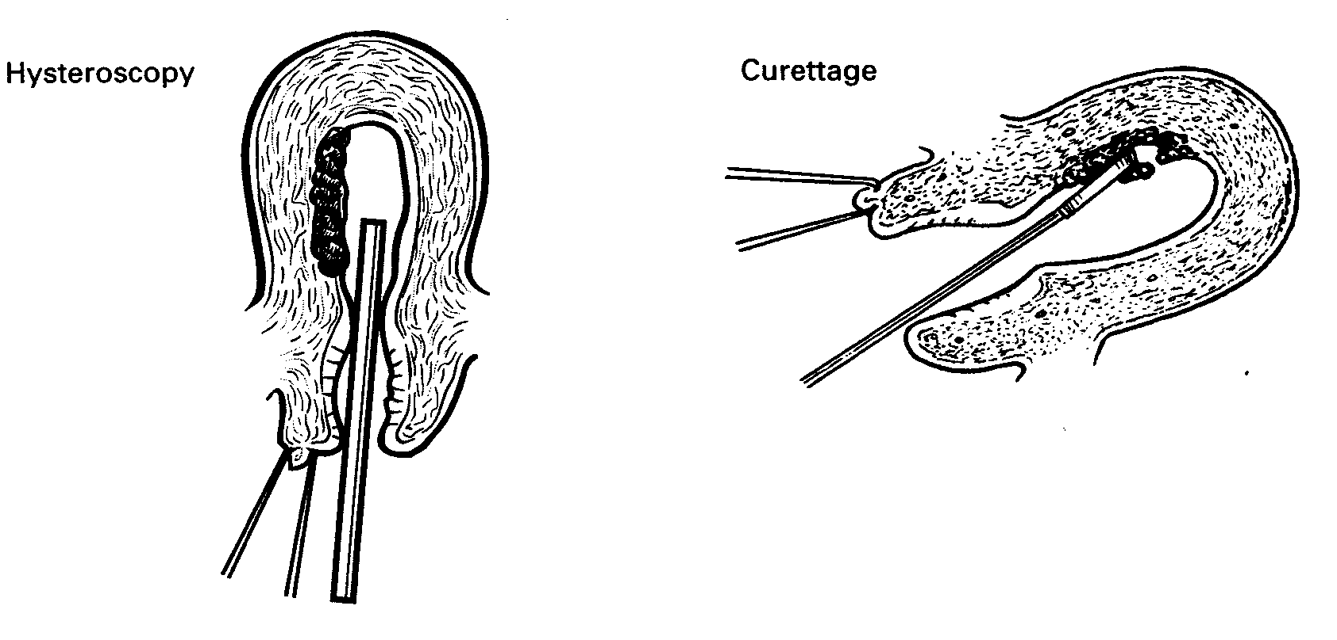

Slide 21
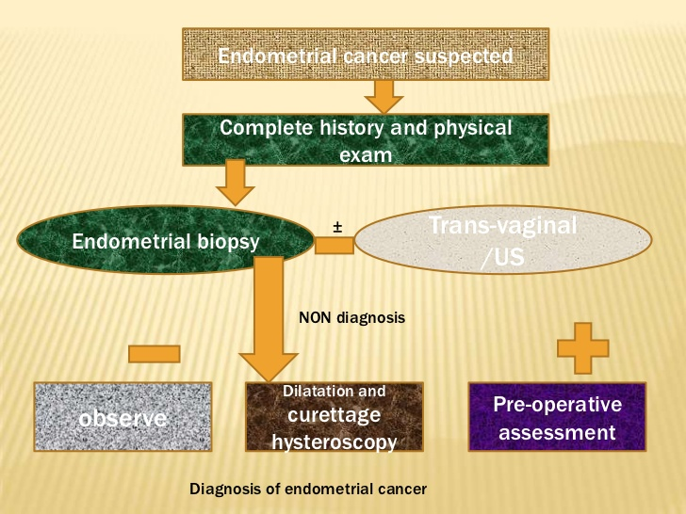

Slide 22
Diagnostic evaluation
Transvaginal ultrasonography is highly sensitive and specific in predicting the presence of endometrial cancer and can be used to select patients for endometrial biopsy (level of evidence: B).
If symptomatology persists despite negative findings from the previously cited tests, further evaluation is justified because none of these tests have 100% sensitivity (level of evidence: B).

Slide 23
TREATMENT
. If the cause is found, the treatment is directed to it.
. If no cause is detected and there is only minimal bleeding once or twice, careful observation is mandatory, if conservatism is desired.
. In cases of recurrences or continued bleeding whatever may be the amount, it is better to proceed for laparotomy and to perform hysterectomy with bilateral salpingo-oophorectomy.
Unexpectedly, one may find a pathology either in the ovary or Fallopian tube or else, an uterine polyp — benign
or malignant may be evident in the removed uterus.

Slide 24
Thank you

