Slide 1
CAUSES AND ONSET OF LABOUR

Slide 2
NORMAL LABOUR
Series of events that takes place in the genital organs in an effort to expel the viable products of conception(fetus,placenta and the membranes)out of the womb through the vagina into the outer world is called labour

Slide 3
Onset of labour
I. Characterized by
➢ The show
➢True labour pains
➢Dilatation and effacement of cervix
➢Formation of bag of forewaters

Slide 4
The show
➢ Show (bloody show)
sign of the impending onset of active labour
extrusion of mucus plug of the cervical canal
➢ Discharge of small amount of blood-tinged
mucus from vagina
5/34

Slide 5
True labour pains
➢ These Uterine Contractions are Characteristic of Labour-painful
➢ cause of pain (not known definitely)
➢ ① hypoxia of contracted myometrium
➢ ② compression of nerve ganglia in cervix & lower
uterus by the tightly interlocking muscle bundles
➢ ③ stretching of cervix during dilatation
➢ ④ stretching of peritoneum overlying the fundus

Slide 6
➢ Interval between contractions
10 minutes at the onset of the first stage
→ diminishes gradually
→ 1 minute or less in the second stage
➢ Periods of relaxation between contractions
- essential to welfare of the fetus
- unremitting contraction of uterus compromises
uteroplacental blood flow, cause fetal hypoxia ➢ Duration of contraction in active phase
Duration 30-90 seconds (average 60 sec)
Pressure 20-60 mmHg (average 40 mmHg)

Slide 7
DILATATION AND EFFACEMENT OF CERVIX
•
• Effective force of the 1st stage of labor is uterine
contraction
• As the result of the action of these forces, two
fundamental changes take place in the already
ripened cervix
“effacement & dilatation”
• The cervix is said to be completely (fully)dilated : 10 cm
•

Slide 8
Cervical Effacement
➢ obliteration or taking up of the cervix
➢ shortening of the cervical canal
➢ muscular fibers at above the level of the
internal os are pulled upward or “taken up”
into the lower uterine segment

Slide 9
FORMATION OF BAG OF FOREWATERS
➢The process of cervical effacement
and dilatation causes the formation
of the forebag of amniotic fluid
which is the leading portion of
amniotic sac and fluid located in
front of the presenting part

Slide 10
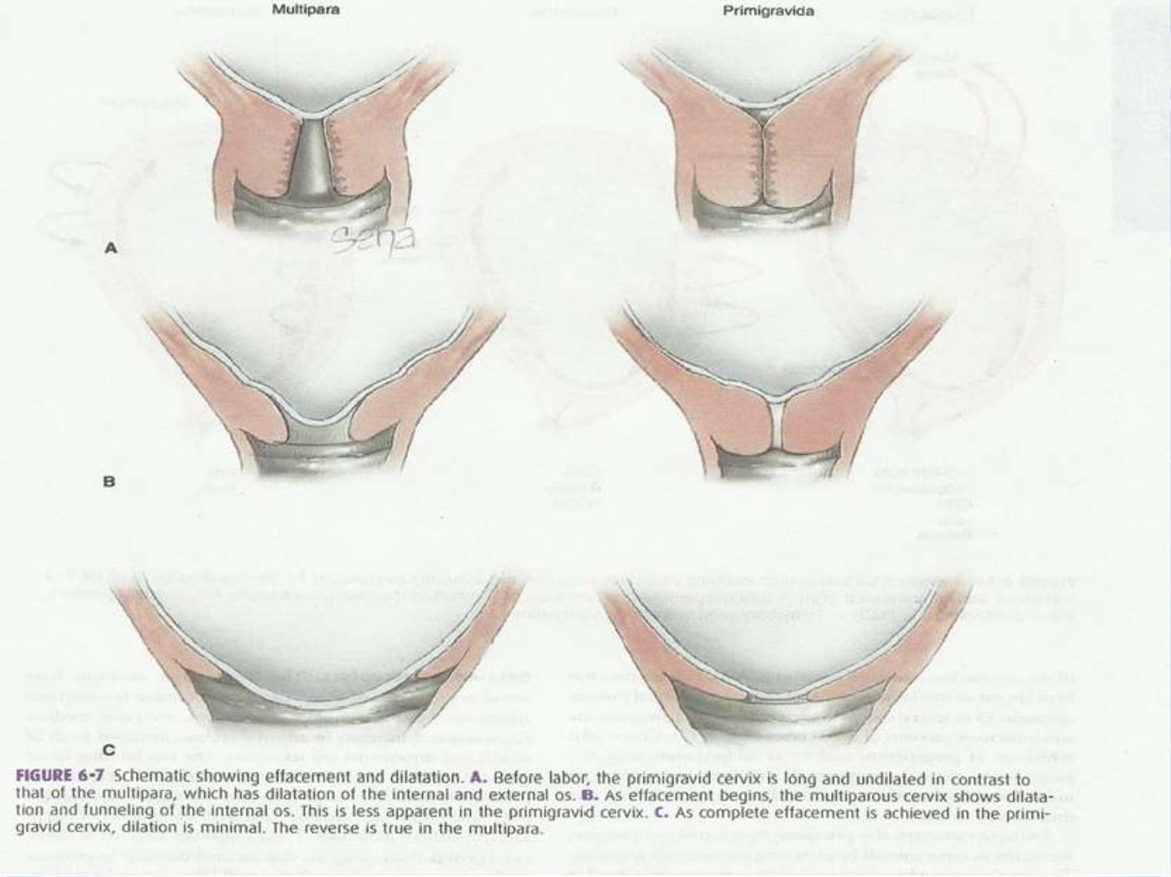

Slide 11
Phase 1
Quiescence
Phase 2
Activation
Phase 3
Stimulation
Phase 4
Involution
Prelude to
parturition
Preparation
for labor
Processes
of labor
Parturient
recovery
Uterine
contraction,
Contractile
Unresponsiveness, preparedness
Uterine
Uterine
involution
cervical softening
for labor,
cervical
ripening
cervical dilation,repair,
fetal,placenta expulsion,breast feeding
Conception
Initiation of
parturition
onset of
labor
Delivery of
conceptus
Fertility
restored
THE PHASES OF PARTURITION

Slide 12
Phase I :uterine quiescence and
cervical softening
➢ In this phase the inherent propensity of
myometrium to contract is held unresponsive to
natural stimuli.
➢ Although some myometrial contraction of low
intensity and brief duration that do not cause
cervical dilatation are noted during this phase.
➢ Near the end of pregnancy ,contractions of this
type become more common, especially in
multiparous women reffered to as Braxton Hicks
contractions or false labour

Slide 13
Cervical softening
➢Cervical softening results from increased
vascularity,glandular hypertrophy and
hyperplasia,and compositional or structural
changes of the extracellular matrix.

Slide 14
Phase I : biochemical and
physiological changes
➢ Progesterone and oestrogen:
administration of progesterone
receptor antagonist will promote
all key features of onset of labour
like cervical ripening,increased cervical distensibility and increased uterine sensitivity
to uterotonins.

Slide 15
➢Steroid hormone regulation of myometrial cell to cell
communication ; progesterone causes
decreased expression of contraction
associated proteins and is also
known to inhibit expression of gap
junctional proteins and thus
increases uterine quiescence.

Slide 16
G-protein coupled receptor that
promote myometrial relaxation
➢ Beta –Adrenoreceptors:β –adrenergic receptors mediates
Gαs-stimulated increases in adenylyl cyclase,increased levels of
cAMP and myometrial cell relaxation
➢ Relaxin ;relaxin family peptide receptor-1-mediates
activation of adenylyl cyclase and thus may promote
uterine relaxation

Slide 17
➢CRH ;synthesized in placenta and
hypothalamus ,found to have dual role during
pregnancy and labour,
➢During pregnancy it binds the receptor CRH-
R1
production of cAMP and
subsequent inhibition of myometrial activity
➢At term CRH can activate the Gqα protein
pathway which favours myometrial
contraction

Slide 18
➢Prostaglandins ;most commonly considered as
uterotonins however they have diverse effects
and some acts as smooth muscle relaxants
➢Both PGE2 and PGI2 could potentially act to
maintain uterine quiscence by increasing
cAMP signaling yet PGE2 can promote uterine
contractility through binding to EP1 and EP2
receptors

Slide 19
➢Thus either the generation of specific
prostaglandins or relative expression of the
various prostaglandins receptors may
determine myometrial response to
prostaglandins
➢Atrial and brain natriuretic peptide and
cGMP:cGMP levels can be stimulated by either
ANP and BNP and promotes smooth muscle
relaxation .BNP is secreted by amnion in large
amounts and ANP is expressed in placenta

Slide 20
Accelerated uterotonin degradation
➢In addition to pregnancy induced compounds
that stimulates myometrial cell refractoriness
there are striking increases in enzymes that
degrade or inactivates endogenously produced
uterotonins which includes:
➢PGDH and prostaglandins
➢Oxytocinase and oxytocin
➢Diamine oxidase and histamine
➢Angiotensinases and angiotensin II
➢PAF acetylhydrolase and PAF

Slide 21
PHASE II:uterine activation &
cervical ripening
➢ Myometrial changes include marked increase in
oxytocin receptors ,prostglandin receptors and increase
in number and surface area of gap junction proteins
such as connexin43 .together these leads to increased
uterine irritability and responsiveness to uterotonins.
➢ Another critical change in phase 2 is formation of lower
uterine segment from the isthmus .with this
development lightening occurs.
And there is higher expression of oxytocin receptors
in fundal myometrium.

Slide 22
Cervical ripening in phase2
➢The transition from softening to ripening
begins weeks or days before onset of
contractions.
➢The cervix is made up of only 10 to 15 percent
smooth muscle and remaining is connective
tissue which includes type 1,3 and 4
collagen,glycosaminoglycans, proteoglycans
and elastin

Slide 23
Phase II: physiological and
biochemical processes
➢Progesterone functional withdrawal:this can be
mediated through several mechanisms
➢Local inactivation of progesterone by steroid-
metabolizing enzymes or synthesis of a natural
antagonist.

Slide 24
Oxytocin receptors
➢ There is an increase in myometrial
oxytocin receptors and there
activation results in increased
phospholipase C activity and
subsequent increase in cytosolic
calcium and uterine contractility

Slide 25
Relaxin
➢Causes remodeling of extracellular
matrix of uterus,cervix,vagina, breast
and pubic symphysis

Slide 26
Fetal contribution to initiation of
labour
➢Uterine stretch and parturition is
required for induction of contraction
associated proteins.
➢Stretch increases expression of gap
junction protein-connexin 43,as well
as oxytocin receptors.

Slide 27
Fetal endocrine cascade
➢At term the fetal adrenal glands weigh same as
those in the adults and similar in size
➢The daily production of steroid by adrenal glands near term is 100 to 200mg/day higher than 30 to 40mg/day seen in adult glands at rest
➢Fetal cortisol levels increase during the last weeks of gestation during the same period levels of DHEA-S also increases significantly leading to increase in maternal oestrogens particularly estriol.

Slide 28
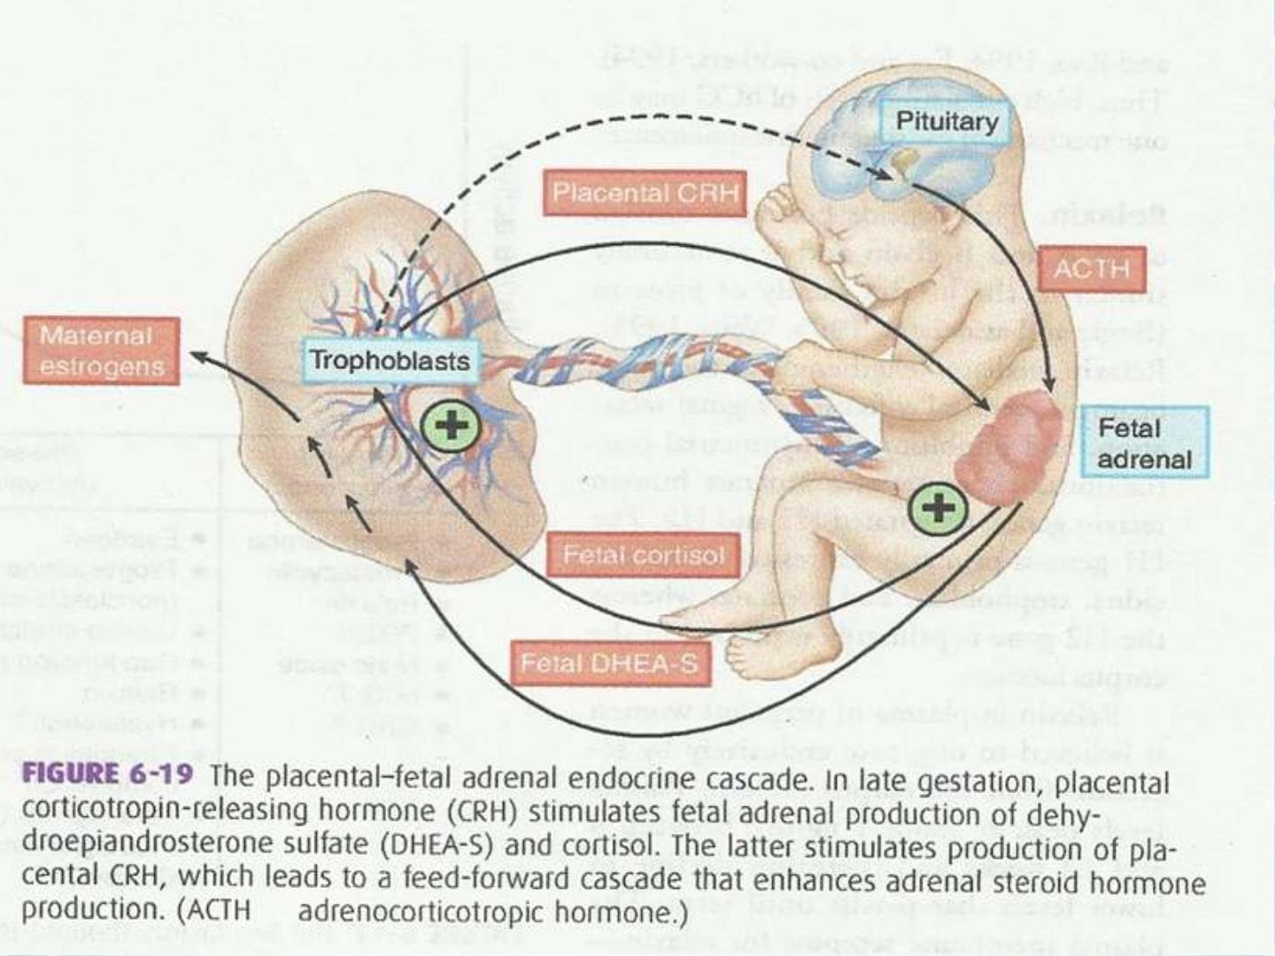

Slide 29
Placental CRH production
➢A CRH hormone identical to maternal and
fetal hypothalamic CRH is synthesized by
placenta in relatively large amounts.
➢One important difference is that,unlike
hypothalamic CRH which is under
glucocorticoid negative feedback , cortisol has
been shown to stimulate placental CRH
production.

Slide 30
➢This ability makes it possible to create a feed forward endocrine cascade that does not end until separation of fetus from placenta at delivery.
➢Resulting high levels of CRH may modulate
myometrial contractility via interaction with the
CRH receptor

Slide 31
➢It has also been proposed that cortisol affects
the myometrium indirectly by stimulating the
fetal membranes to increase PG synthesis
➢Finally CRH has been shown to stimulate fetal
adrenal steroid synthesis thereby
increasing substrate placental
aromatization and increased levels of
oestrogen

Slide 32
Fetal lung surfactant
➢ Pulmonary surfactant and its
components such as PAF when secreted
into amniotic fluid have been reported to stimulate PG synthesis and uterine contractility

Slide 33
CAUSES OF ONSET OF LABOUR
Mechanical
➢ Uterine distension
theory
Biochemical
Oxytocin
Prostaglandins
PAF
➢ Stretch of the lower
Uterine segment by
presenting pact
Angiotensin II
Histamine
Serotonin & Others
➢ Mechanical stretching of cervix
(Ferguson’s Reflex) & stripping
of fetal membranes

Slide 34
Uterine distension theory
➢This theory is supported by the observation
that multifetal pregnancy and pregnancies
associated with polyhydramnios are at much
greater risk for preterm labour than singletons.

Slide 35
Fergusons reflex
➢ mechanical stretching of cervix enhances
uterine activity ,release of oxytocin has
been suggested but not proven.
➢manipulation of the cervix and stripping the
fetal membranes is associated with an
increase in PGF metabolite in blood.
2α
➢ exact mechanism : not clear

Slide 36
Biochemical and Physiological
processes
➢Current data favour uterotonins theory of
labour initiation
➢Increased number of uterotonin production
would follow once phase 1 is ended and
uterine phase 2 processes are implemented

Slide 37
Oxytocin
➢It was first uterotonin to be implicated in
parturition initiation
➢The number of oxytocin receptors strikingly
increases in myometrial and decidual tissues near
end of gestation
➢Oxytocin acts on decidual tissue to promote
prostaglandin release
➢Oxytocin is synthesized directly in decidual
and
in the placenta.

Slide 38
Platelet activating factor
➢The PAF receptor is a member of the G-
protein- coupled receptor family.
- stimulation of PAF increases myometrial
cell calcium levels and promotes uterine
contractions.
➢Levels of PAF in amnionic fluid are increased during labor which promotes contraction.

Slide 39
Prostaglandins
➢Evidence supportive of this theory includes;
➢Levels of prostaglandins or their metabolites in
amniotic fluid ,maternal plasma and maternal
urine are increased during labour
➢Treatment of pregnant women with PGs by any of
several routes of administration,causes abortion
or labour at all stages of gestation

Slide 40
Endothelin-1
➢The endothelins are a family of 21-amino acid
peptides that powerfully induce myometrial
contraction.
➢It is produced in myometrium and its potential
contribution to phase 3 of parturition is not
defined.

Slide 41
Angiotensin-II
➢There are two G-protein-linked angioteneism
II receptors in the uterus - AT1 and AT2.
➢In non pregnant women the AT2 receptors is
predominant, but the AT1 receptor is
preferentially expressed in pregnant.
➢Angiotenism II is binding to the plasm-
membrane receptor evokes contraction.

Slide 42
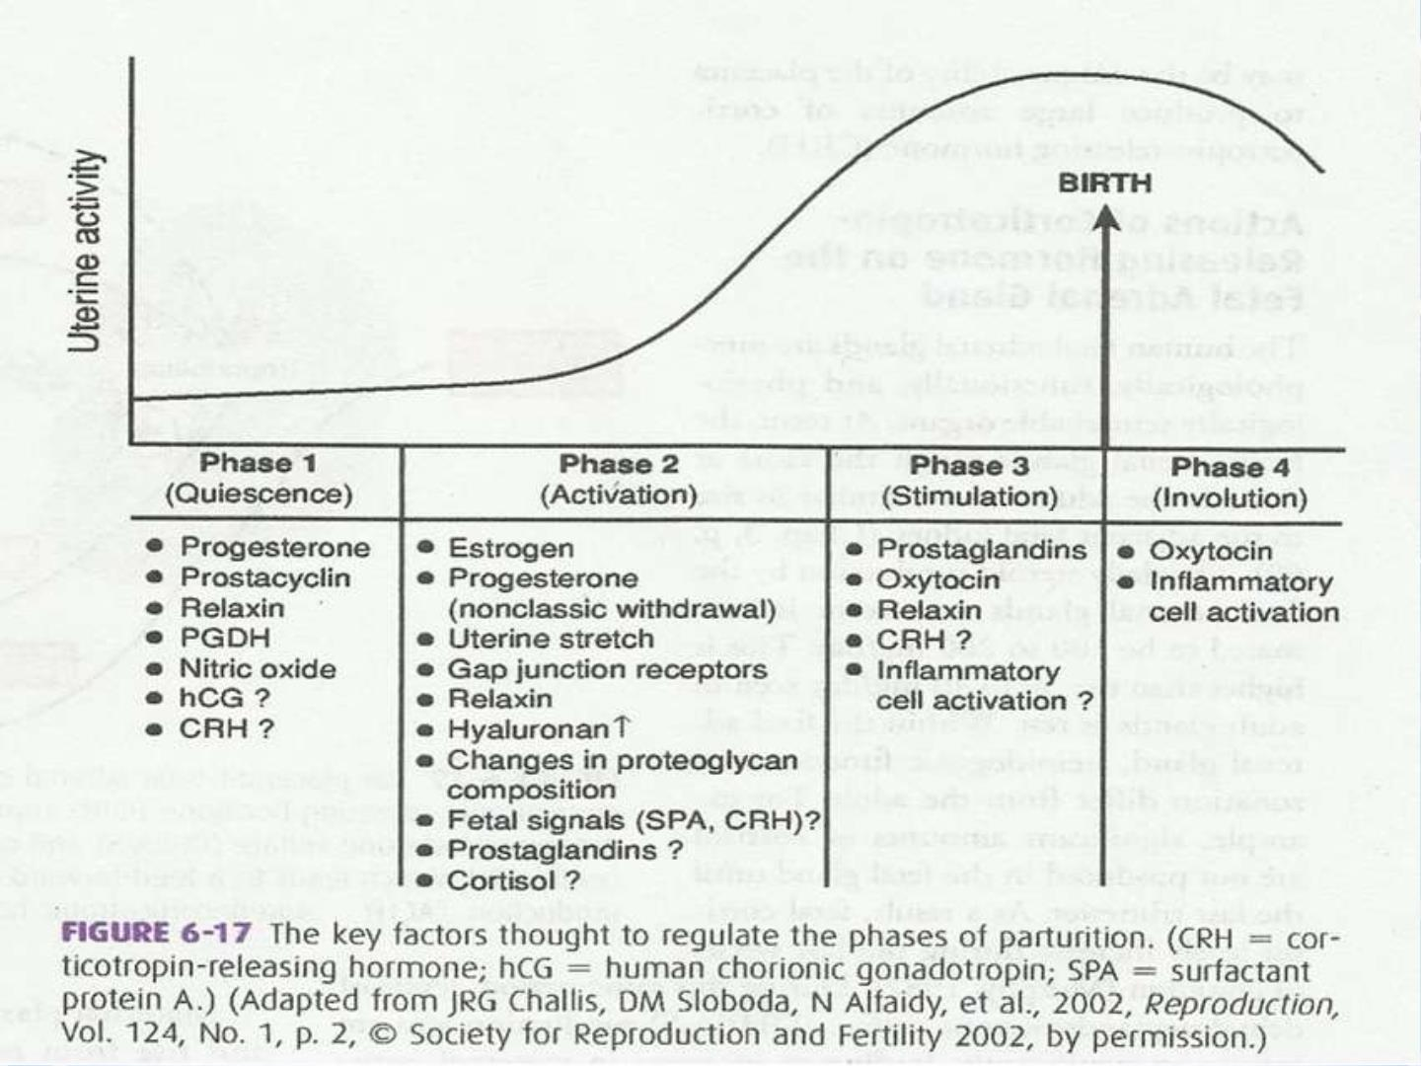

Slide 43
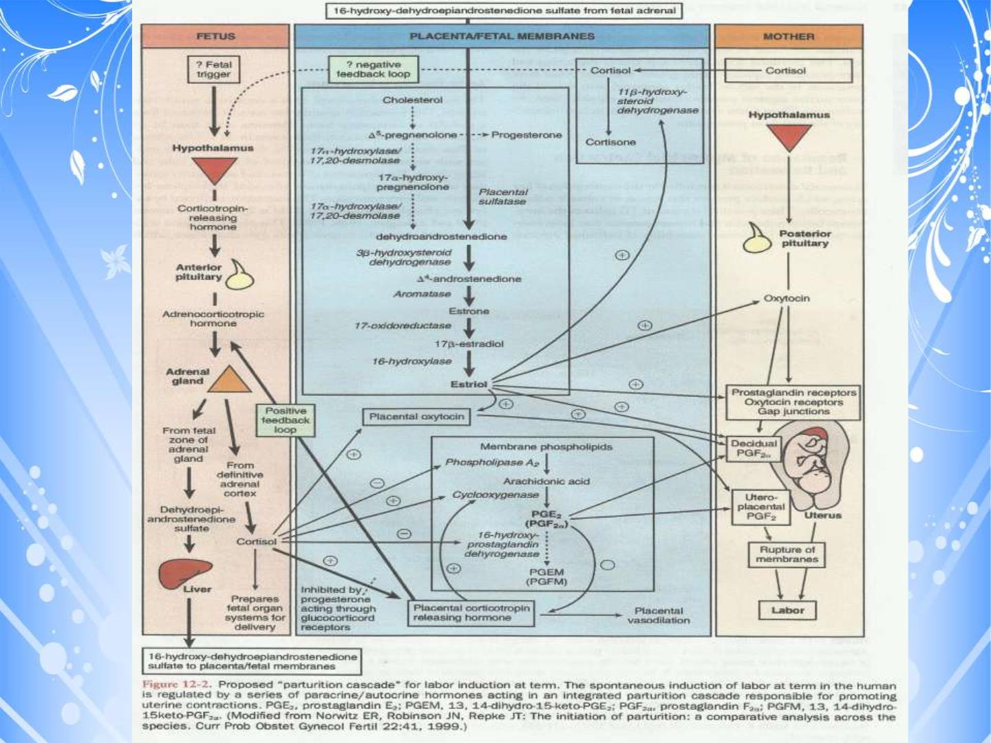

Slide 44
THANK YOU

