Slide 1
NON NEOPLASTIC ENLARGEMENT OF OVARY
Professor Dr. B.JEYAMANI MD.,DGO., Department of OBG,
VMKVMCH, Salem

Slide 2
Non Neoplastic :
●Follicular cyst
●Follicular haematomas
●Luteal cyst of ovary
●Multiple functional cysts
●Polycystic ovarian disease

Slide 3
Follicular cysts
●Most common
●Maybe single or multiple
●Maybe bilateral
●Vary in size: Small plebs to cysts of large size ●Generally do not exceed 5cm in diameter

Slide 4
Cause
●Failiure of absorption of the fluid in an incompletely developed follicule in anovulation.

Slide 5
Symptoms
Usually Asymptomatic
●Acute abdomen: symptoms and signs of acute abdomen (Due to Hgc, Rupture or torsion)
●Pelvic pain
●Dyspareunia incase of large and multiple cysts
●Irregular bleeding

Slide 6
Differential diagnosis
CA ovary
PID
Endometriosis

Slide 7
Treatment
●Self limiting: disappears spontaneously within a few weeks to months.
●If the cysts persists for more than 3 months or the size increases more than 7cm, evaluation should be done to rule out malignancy

Slide 8
Follicular haematomas
Small follicular haematomas, common and insignificant.
Asymptomatic old cysts: appears to contain tarry material mistaken for endometriosis

Slide 9
Lutein cysts of the ovary
●Two types: –
Granulosa lutein cysts (corpus luteal cysts)
Theca luteal cysts

Slide 10
Granulosa lutein cysts (CL cysts)
●Functional
●Non neoplastic enlargement
●Persistent corpus luteal cysts may cause local pain and tenderness in delayed menstruation ●DD: unruputured ectopic pregnancy
●Diagnosis: USG, Serum Beta-HCG(Quantitative estimate)
●Treatment: Self limiting, resolves in due course of time Theca lutei

Slide 11
Theca lutein cysts
●Bilateral
●Filled with straw colored fluid
●Conditions:
– Hydatidiform mole
– Choriocarcinoma
– ART: Gonadotrophin(HcG) or induction of ovulation

Slide 12
Multiple functional cysts
Caused by:
– OHSS- Ovarian hyperstimulation syndrome
– PCOS- polycystic ovarian syndrome
– FSH secreting pitutary adenoma

Slide 13
Functional cysts
●Size never more than 7cm
●Unilocular with clear fluids
●Regresses after some time
If persists 3-6 cycles of ocp – cause regression.

Slide 14
POLYCYSTIC OVARIAN SYNDROME
Professor Dr. B.JEYAMANI MD.,DGO., Department of OBG,
VMKVMCH, Salem

Slide 15
PCOS originally was described by Stein and Leventhal as the association of amenorrhea with polycystic ovaries; five of the original seven cases had hirsutism or acne and four had obesity .

Slide 16
The syndrome has been defined by international consensus in adults .
The essential components of the syndrome are the various combinations :
unexplained hyperandrogenism,
anovulationa
polycystic ovary
While obesity and insulin resistance are strongly associated with the syndrome, they are not essential to the diagnosis; indeed about half of patients are non-obese

Slide 17
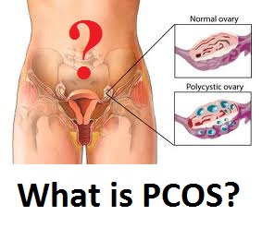

Slide 18
It is important to appreciate that PCOS is a syndrome, not a disease, reflecting multiple potential etiology

Slide 19
Epidemiology

Slide 20
Polycystic ovary syndrome (PCOS) is recognized as one of the most common endocrine/metabolic disorders of women.
PCOS affects premenopausal women, and the age of onset is most often perimenarchal (before bone age reaches 16 y).

Slide 21
High-risk groups — A number of conditions are associated with an increased prevalence of PCOS:
Women with oligoovulatory infertility
Obesity and/or insulin resistance
Type 1 , type 2 or gestational diabetes mellitus
A history of premature adrenarche
First-degree relatives with PCOS
Mexican-American women compared with Caucasian or African-American women
Women using antiepileptic drugs

Slide 22
Pathophysiology

Slide 23
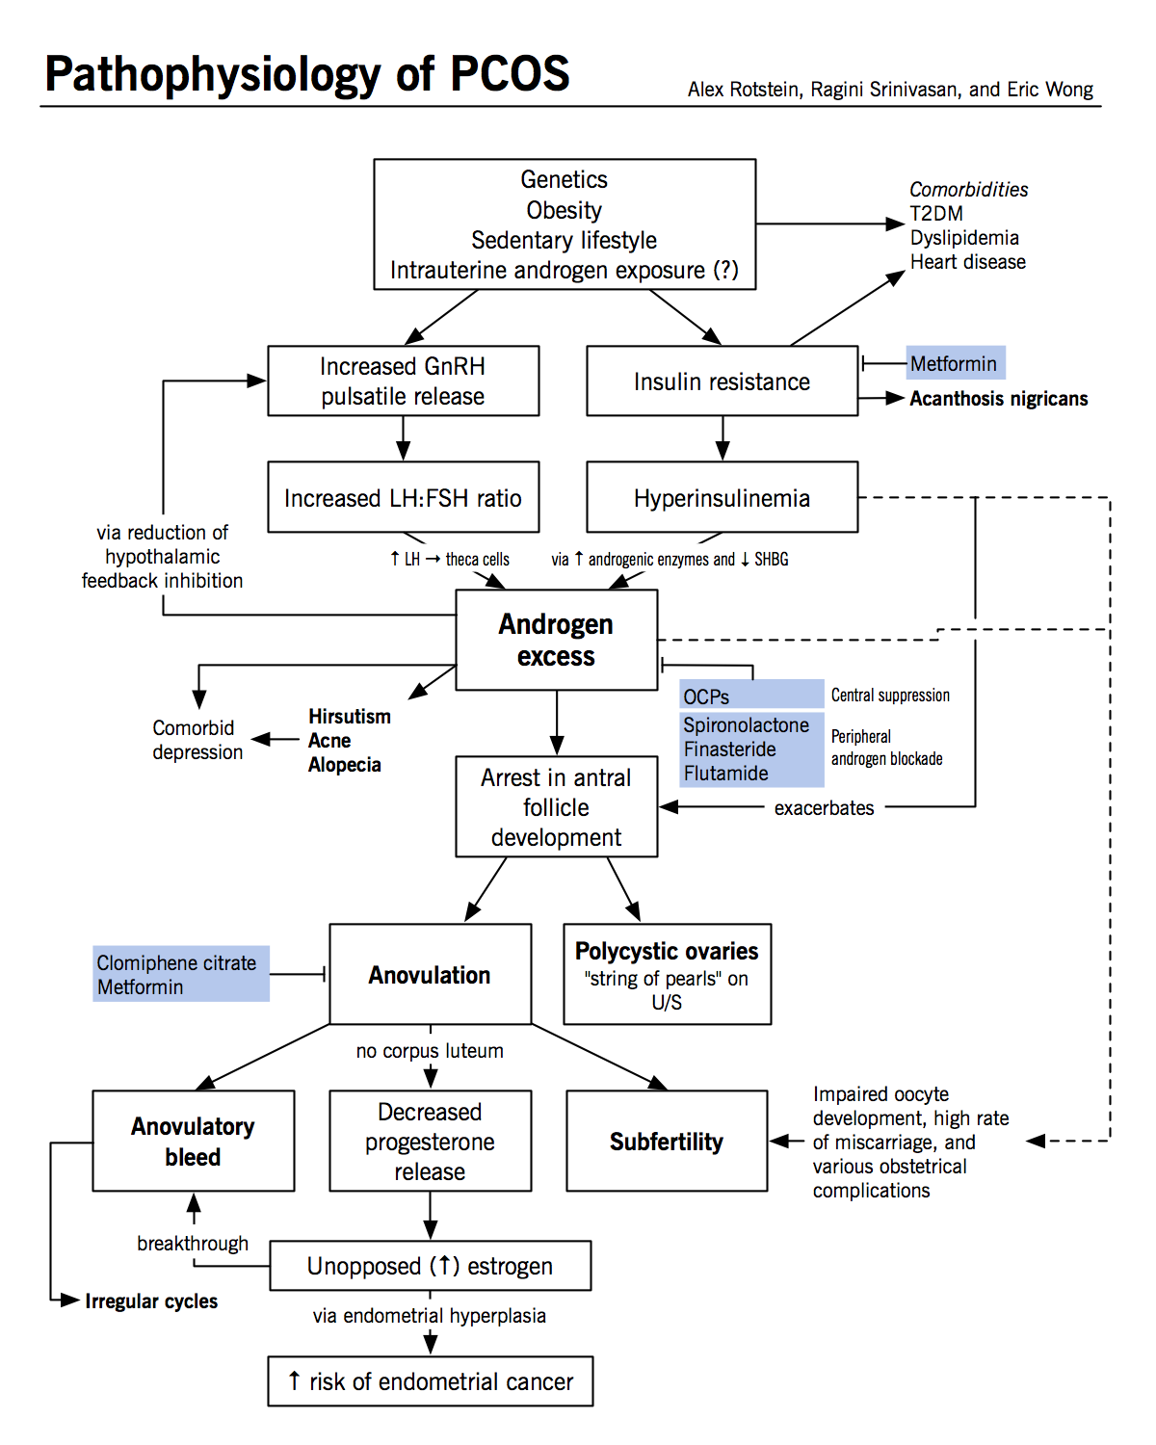

Slide 24
Diagnostic Criteria

Slide 25
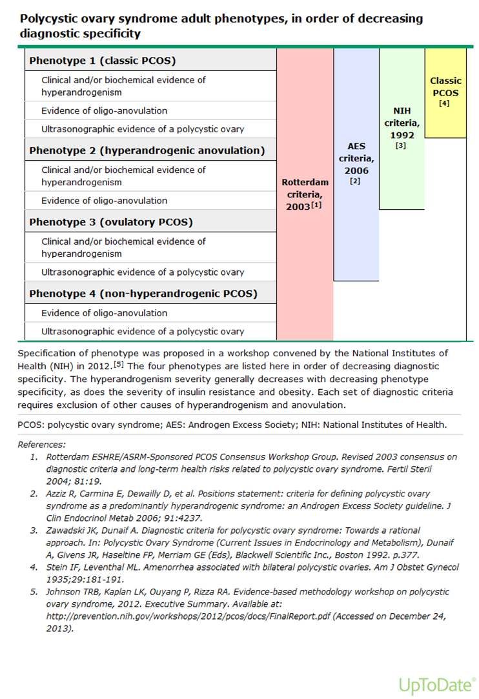

Slide 26
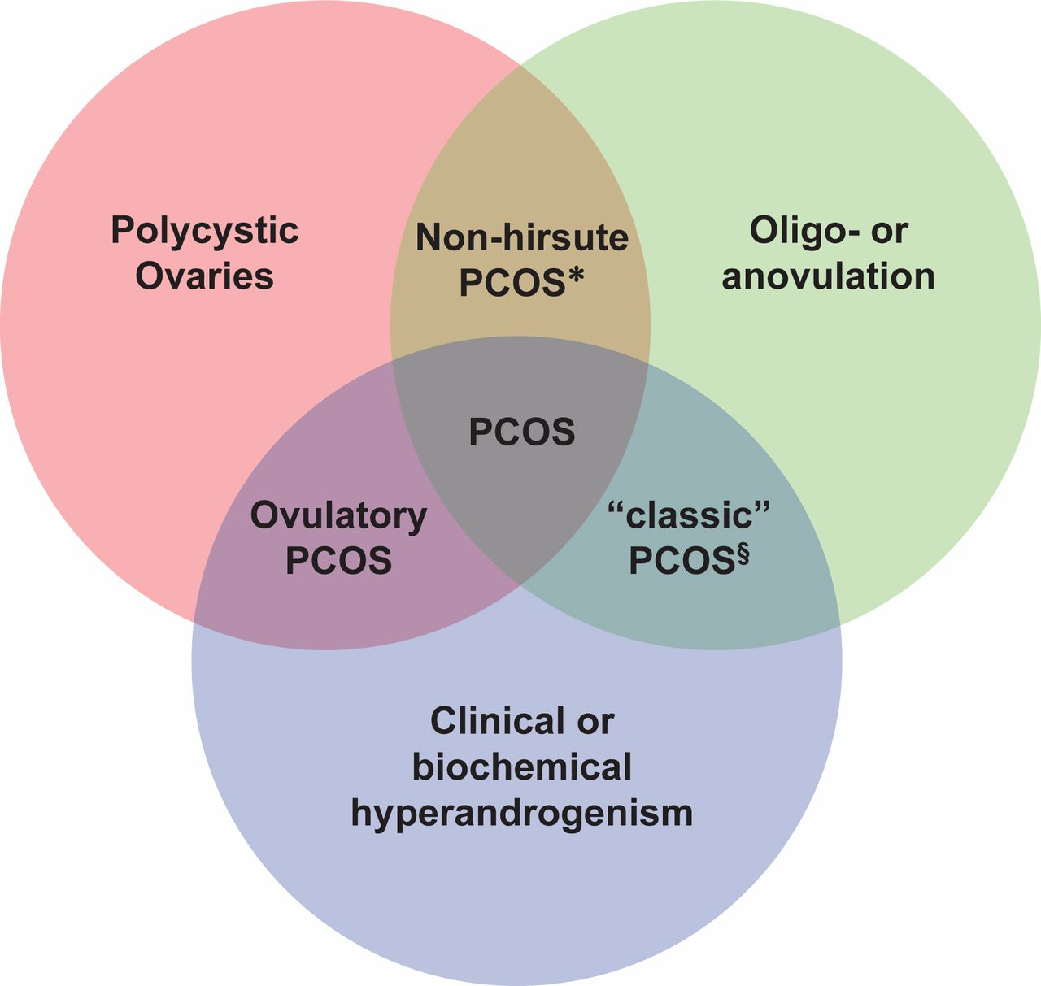

Slide 27
Clinical Features

Slide 28
Cutaneous manifestations
ovarian findings
Associated metabolic features

Slide 29
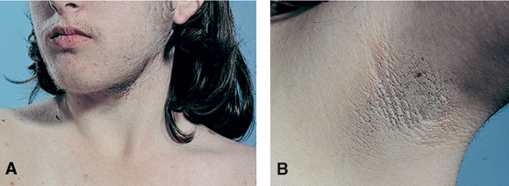

Slide 30
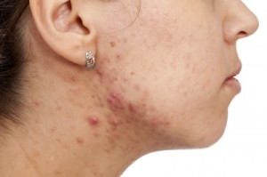

Slide 31
Ferriman and Gallwey (1961) scoring system
They scored the density of hair at 11 different body sites; namely the upper lip, chin, chest, upper back, lower back, upper abdomen, lower abdomen, arm, forearm, thigh, and lower leg
0: absence of terminal hair,4: extensive terminal hair growth,Scores > 6 were deemed significant
Hatch et al 1981 modified scheme (9 sites) excluding lower legs and forearms as these are less sensitive to androgens

Slide 32
These schemes are typically used for research rather than clinical setting ( limitations include : most women have been using cosmetic measures by the time they see a clinician , the expression of hair growth varies betweenracial/ethnic groups , there is inly modest correlation betweenthe quantity of hair growth and serum androgen level )

Slide 33
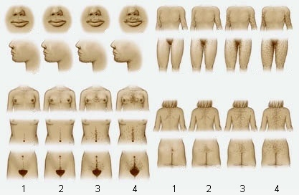
Ferriman and Gallwey scoring system

Slide 34
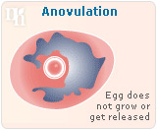

Slide 35
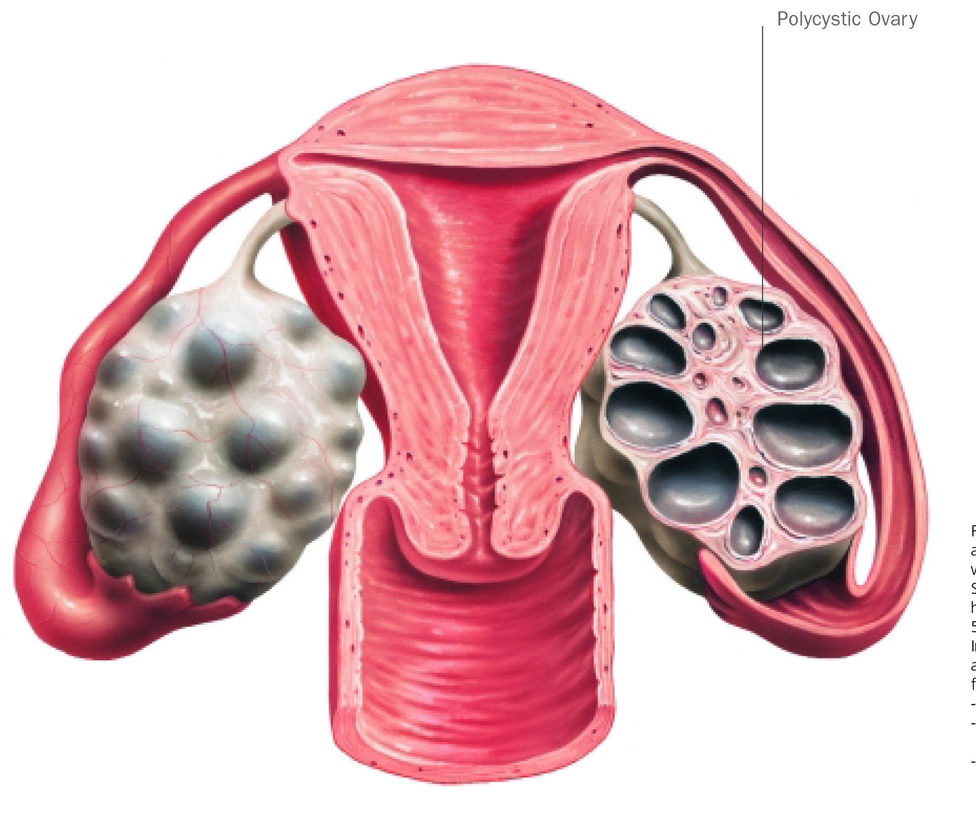

Slide 36
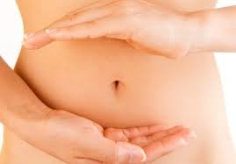
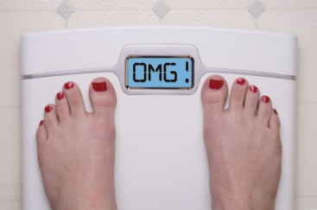

Slide 37
Diagnosis

Slide 38
Rotterdam criteria — Using these criteria, two out of three of the following are required to make the diagnosis of PCOS:
Oligo- and/or anovulation
Clinical and/or biochemical signs of hyperandrogenism
Polycystic ovaries (by ultrasound)

Slide 39
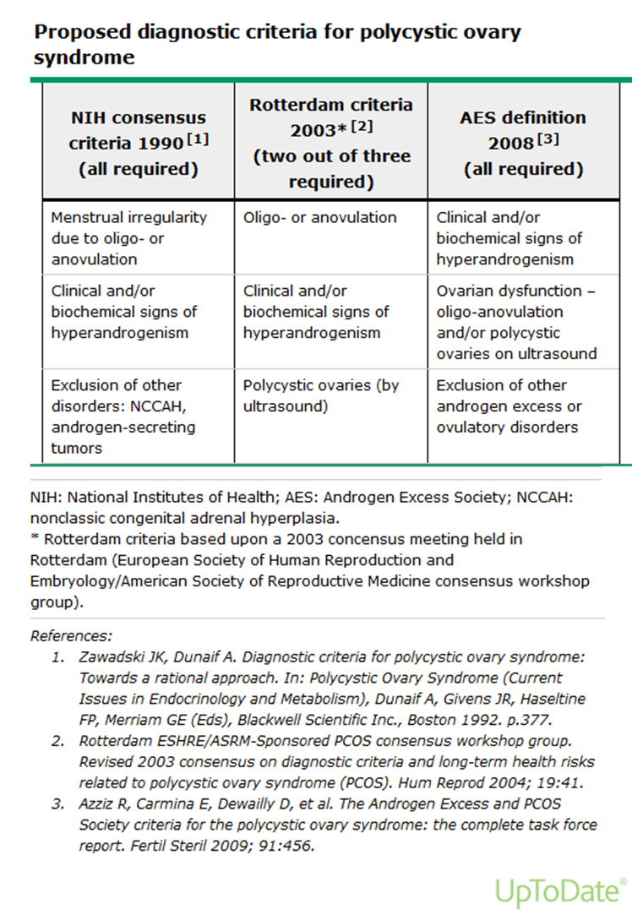

Slide 40
Ultrasound —The 2003 Rotterdam criteria, considered to have sufficient specificity and sensitivity to define PCOM, include the presence of 12 or more follicles in each ovary measuring 2 to 9 mm in diameter and/or increased ovarian volume (>10 mL; calculated using the formula 0.5 x length x width x thickness). One ovary fitting this definition is sufficient to define PCOM.

Slide 41
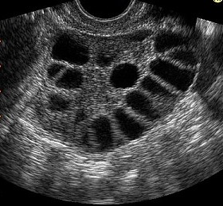

Slide 42
Initial evaluation by : 1- History and physical exam 2- Laboratory investigations

Slide 43
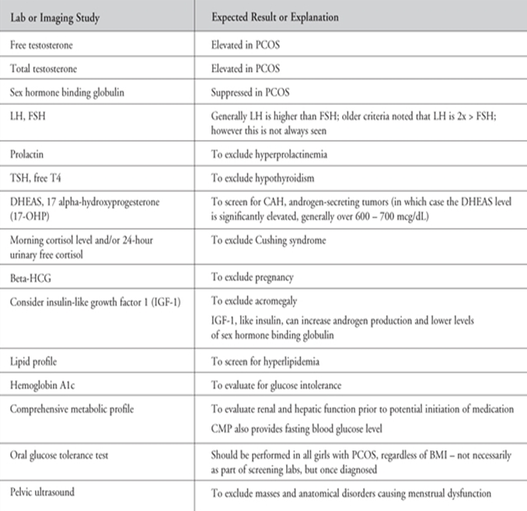

Slide 44
DDx
Acromegaly
Adrenal Carcinoma
Amenorrhea
Congenital Adrenal Hyperplasia
Cushing Syndrome
Hyperprolactinemia
Hyperthyroidism /Hypothyroidism
Ovarian Tumors
Exogenous drugs ( danazole , androgenic steroids)

Slide 45
SEQULAE OF PCOS
Obesity
Menstrual abnormality
Anovulation,infertility
Miscarriage
Abnormal lipid profile
Androgen excess
like acne,hirsutism
Alopecia
Insulin resistance : glucose intolerance acanthosis nigrans.
Diabetes mellitus
Endometrial cancer
Persistently elevated estrogen effect
Dyslipidaemia ↓HDL,↑LDL,↑triglycerides
Hypertension
Cardiovascular disease
Atherosclerosis
Obstructive sleep apnoea

Slide 46
Metabolic syndrome
Diagnostic criteria
Abdominal Obesity
(waist circumference ) > 88cm
Triglycerides level >150mg/dl
HDL-cholesterol <50mg/dl
Blood pressure ≥130/80mmhg
Fasting blood glucose ≥ 100mg

Slide 47
Treatment

Slide 48
Management
Treatment is primarily to correct the biochemical abnormalites.
Life style changes :
Weight reduction
Exercise
Drugs

Slide 49
Certain lifestyle changes, such as diet and exercise, are considered first-line treatment for women with polycystic ovarian syndrome (PCOS).
Pharmacologic treatments are reserved for so-called metabolic derangements, such as anovulation, hirsutism, and menstrual irregularities.
Medications for such conditions include oral contraceptives, metformin, prednisone, leuprolide, clomiphene, and spironolactone.

Slide 50
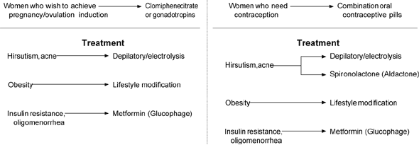

Slide 51
Lifestyle changes, cosmetic , physical and hormonal therapies
Cosmetic and hormonal therapies are effective as long as they are in place, more permanent reductions cab be achieved using physical methods

Slide 52
Fertility not desired
Combined ocp
Antiandrogens – hirsutism
Metabolic syndrome – Insulin resistance is the major abnormality to cause metabolic syndrome.
Hyperinsulinaemia - ↑ses the risk of dyslipidaemia,type 2 DM,cardiovascular disease. Treatment – Metformin

Slide 53
Desires pregnancy
Chronic Anovulation is the common cause of infertility
Ovulation induction.
Insulin sensitizers
metformin

Slide 54
Life style changes and weight reduction
Weight loss reduce hyperandrogenism and insulin resistance , esp. in overweight women with PCOS
Weight reduction of 5-10% can improve hirsutism by 40-55% within 6 months of weight loss
In obese women with PCOS, weight loss programmes should be first line of intervention, to include low calorie diet and exercise over 6 months

Slide 55
Cosmetic methods
Plucking, waxing, bleaching, the use of depilatory creams.
shaving should be avoided as it leads to blunt hairs that may feel like stubble- although no increase in hair growth which is a misconception.
Depilatory and creams decrease local hair but chronic use can cause skin irritation
plucking and waxing can cause folliculitis and ingrown hairs in androgenic areas

Slide 56
Physical
Electrolysis: expensive, time consuming (18 months to 4 years), painful and really practical for a limited area. It may cause depigmentation and scarring.
Laser photothermolysis: used to destroy hair follicles without damaging nearby tissue. It can cover a wider area than electrolysis. It is best for fair skin women. It reduces hair density by 30% after 3-4 sessions

Slide 57
Hormonal therapy
The basis of action is either the suppression of androgen production or blocking of the action of androgens on the skin.
This results in the hairs reverting back to vellous-type hair.
oral contraceptives are considered the first line for management of hirsutism ,an anti-androgen is added if the clinical response is suboptimal after 6 months of therapy.
Insulin lowering agent are not considered to be an effective therapy for hirsutism .

Slide 58
OCPs
The use of estrogen-progestin contraceptives as initial therapy
Efficacy data come primarily from OC studies ,but transdermal and vaginal estrogen-progestin contracetives are considered to be effective .
The mechanism :
1-inhibition of LH and therefore LH-dependent androgen production .
2-increased hepatic synthesis of SHBG by estrogen ,resulting in decreased concentration of serum free testosterone .
3- inhibition of adrenal androgen production .

Slide 59
OCPs
It is estimated that 60 to 100 percent of hyperandrogenic women experience a significant reduction in hair growth with OC .
The best evidence comes from a pooled analysis of 2 trials in34 women comparing Ocs with either placebo or notherapy , OC therapy was associated with a greater reduction in Ferriman-Gallway hirsutism scores .
OC therapy usually begun with a formulation that contains 30 to 35 mcg ethinylestradiol. The lower dose ethinylestardiol suppress serum androgen to somewhat lessser degree unless admiistered continuously .
In women over 40 years age 20 mcg typically use .

Slide 60
OCPs
We typically choose OCPs that contains a progestin with low-adrogenicity ( or a progestin that has antiandrogenic properties such as cyproterone acetate or drospirenone ).

Slide 61
Antiandrogen therapy
Don’t use them as amonotherapy because there effect in the developing male fetus in utero .
In women who can’t conceive or who use a reliable contracepive method , antiandrogen may be considered as a monotherapy .
Add it to women on oral contraceptive who feel that theier response to treatment is suboptimal .

Slide 62
Available anti-androgens
In an analysis of four trials , the addition of an anti-androgen to an oral contraceptive was slightly more effective than an oral contraceptives alone

Slide 63
Choice of antiandrogen
Spironolactone ifs the preferable one , because many clinical trials have shown onsistent benefit and it is considered to be safe .
We start with 50 mg twice daily , and increase to 100 mg twice daily as needed
The side effects of spironolactone include : hyperkalemia , GI discomfort , and irregular menstrual bleeding

Slide 64
Finasteride : (5 mg /day ) , when used In early pregnancy is assocuiateed with musculinization of the male fetus .
Flutamide : is equally or even more effective than spironolactone and finasteride , but ACOG suggests against its use since it is associated with hepatoxicity .
Cyproterone acetate .

Slide 65
Insulin lowering agent
The 2008 Endocrine society guidelines and suggest against their use in hirsutism as metformin has minimal or no benefit , and rosiglitazone whilst modestly effective for hirsutism is associated with weight gain and possible adverse cardiovascular effects.

Slide 66
Topical therapy
Vaniqa ( eflornithine hydrochloride cream 13.9% ) is a topical that is available for the treatment of uwanted facial hair in women .
It is an inhibitor of hair growth , not a depilatory , and must used indefinitely to prevent regrowth .
In two clinical trials of combined eflornithine and laser therapy , a more rapid response was observed when compared with laser alone

Slide 67
Other therapies
GnRH agonist :
Glucocorticoids :.

Slide 68


Slide 69


