Slide 1
DEVELOPMENT OF UTERUS AND CONGENITAL ANOMALIES

Slide 2
MULLERIAN DUCTS
Paired ducts derived from intermediate mesoderm.
Known as paramesonephric duct.
Appear between 5-6 wks.
Derived from intermediate mesoderm lateral to wolffian duct as invagination of dorsal coelomic epithelium.
Depends on absence of male determining factor which is present in Y-chromosome.

Slide 3
Development of Genital Ducts
• Both male and female embryos have two pairs of genital ducts
• The mesonephric ducts (wolffian ducts) play an important role in the development of the male reproductive system
• The paramesonephric ducts (mullerian ducts) have a leading role in the development of the female reproductive system
• Till the end of sixth week, the genital system is in an indifferent state, when both pairs of genital ducts are present

Slide 4
Mullerian ducts form as buds of coelomic epithelium .
Grows downward & lateral to corresponding wolffian ducts.
Turn inwards & crosses anterior to it joining its fellow from opposite side.

Slide 5
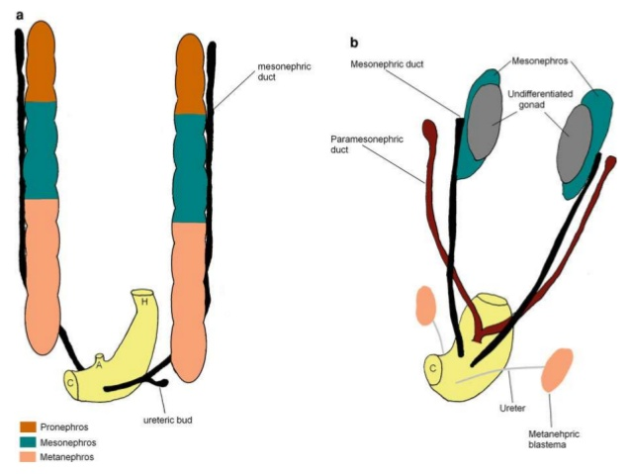

Slide 6
Upper vertical part lateral to wolffian duct → fallopian tube.
Middle horizontal part crossing wolffian duct → remaining part of fallopian tube.
Lower vertical part fusing to opposite part → uterus, cervix, upper 1/3rd of vagina.
In forming the uterus, the mullerian ducts fuses from below upwards

Slide 7
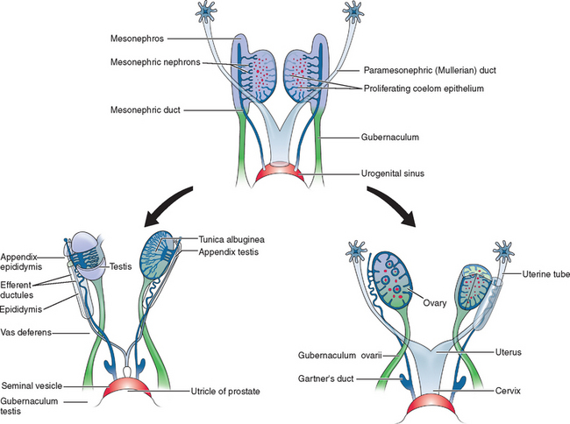

Slide 8
Development of VAGINA
Develops in 3rd month of embryonic life.
From lower end of uterovaginal canal (mullarian duct) & urogenital sinus.
Uterovaginal canal fuses with sinovaginal bulb (develops from posterior aspect of urogenital sinus)forming vaginal plate.
Later canalizes to form vaginal canal.

Slide 9
Upper 1/3rd develops from mullerian duct – mesodermal.
Lower 2/3rd develops from vaginal plate – endodermal.
Incomplete breakdown of the junction between the bulbs and the urogenital sinus proper leaves the hymeneal membrane

Slide 10
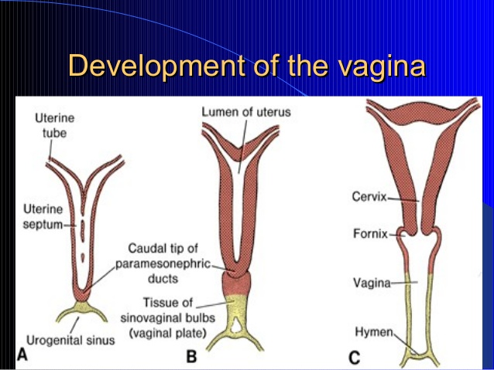

Slide 11
The Development of the Gonads
The germ cells (primordial germ cells) migrate to the genital ridge by the 6th week.
The germ cells influence development of the gonad into ovary or testes.
Differentiation into testis or ovaries depends on the presence or absence of the Y chromosome in the germ cells.
Ovarian Differentiation Occur in the the absence of Y chromosome and SRY protein. It occurs two weeks later (about the 8th week)

Slide 12
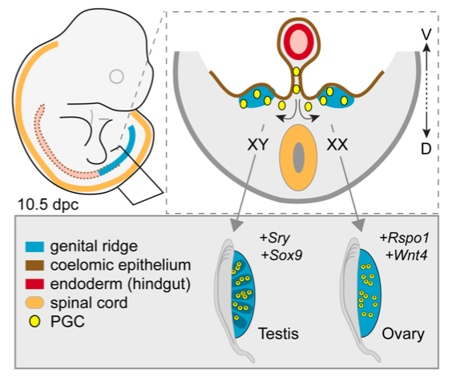

Slide 13
By the fourth month:each germ cell, now become known as Oogonia, is surrounded by a single layer of epithelial cells.
The oogonia are transformed into primary oocytes as they enter the 1st meiotic division and arrest in prophase until puberty and beginning of ovulation.
Around the 20th week of gestation the ovary contains about 7 million germ cells.
Degeneration and atresia begins around 20 weeks and by birth approximately 2 million germ cells remain.

Slide 14
CLASSIFICATION OF CONGENITAL ANOMALIES 7 classes according to the American Fertility Society (AFS) (1988):

Slide 15
Class I (hypoplasia/agenesis):
The most common form is the Mayer- Rokitansky-Kuster-Hauser syndrome: Combined agenesis of the uterus, cervix, and upper portion of the vagina.
Patients have no reproductive potential aside from medical intervention in the form of IVF of harvested ova and implantation in a host uterus.
DD: Testicular fiminization syndrome

Slide 16
2. Class II (unicornuate uterus):
• result from complete, or almost complete, arrest of development of 1 mullerian duct.
•If the arrest is incomplete, as in 90% of patients, a rudimentary horn with or without functioning endometrium is present.
•If the rudimentary horn is obstructed, it may come to surgical attention when presenting as an enlarging pelvic mass.
•If the contralateral healthy horn is almost fully developed, a full-term pregnancy is believed to be possible.

Slide 17
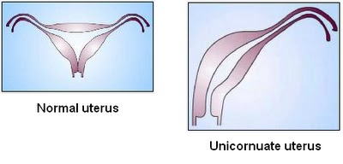
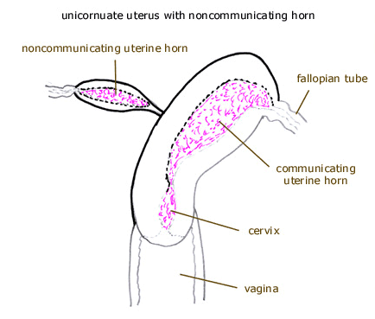

Slide 18
3.Class III (didelphys uterus):
•results from complete nonfusion of both mullerian ducts.
•The individual horns are fully developed and almost normal in size.
Two cervices are inevitably present.
•Didelphys uteri have the highest association with transverse vaginal septa.
•treatment : metroplasty; however, since each horn is almost a fully developed uterus, patients have been known to carry pregnancies to full term.

Slide 19
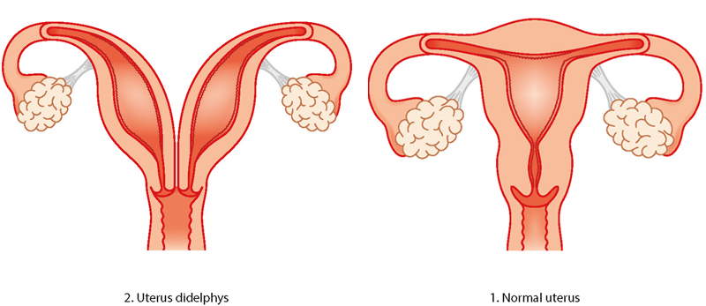
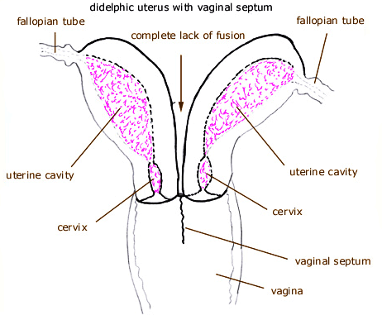
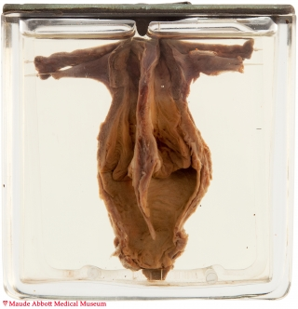

Slide 20
4.Class IV (bicornuate uterus):
• Results from: partial nonfusion of the müllerian ducts.
• Subtypes:
Bicornuate unicollis: The central myometrium extend to the level of the internal cervical os
Bicornuate bicollis: The central myometrium extend to the level of external cervical os

Slide 21
DD of bicornuate bicollis from didelphys uterus
1.it demonstrates some degree of fusion between the two horns, while in classic didelphys uterus, the two horns and cervices are separated completely.
2.the horns of the bicornuate uteri are not fully developed; typically, they are smaller than those of didelphys uteri.
• Some patients are surgical candidates for metroplasty

Slide 22
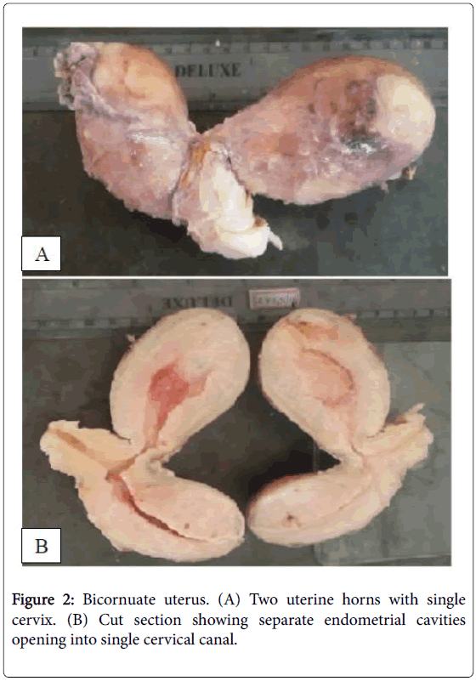

Slide 23
5.Class V (septate uterus):
•results from failure of resorption of the septum between the two uterine horns.
•The septum can be partial or complete, in which case it extends to the internal cervical os •Histologically composed of: myometrium or fibrous tissue.
•The uterine fundus is typically convex but may be flat or slightly concave .
•Women with septate uterus have the highest incidence of reproductive complications.

Slide 24
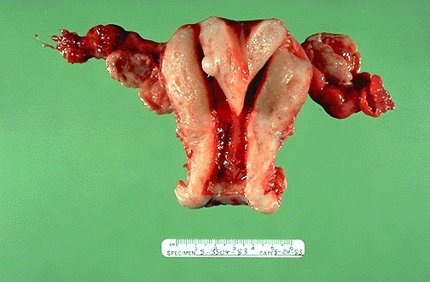
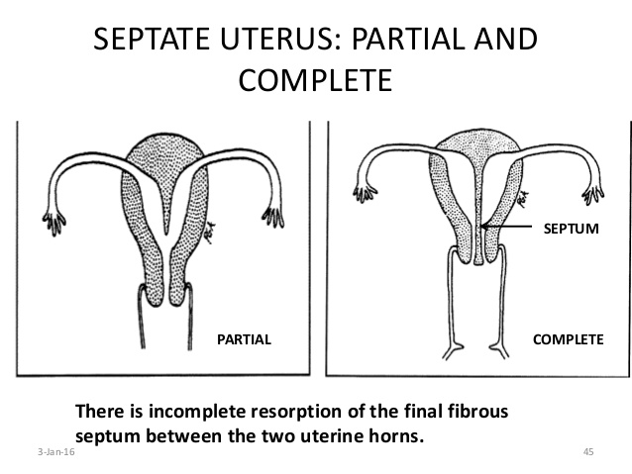

Slide 25
6.Class VI (arcuate uterus):
•The endometrial cavity demonstrates a small fundal cleft or impression (>1.5 cm).
•The outer contour of the uterus is convex or flat.
•This form is a normal variant
it is not significantly associated with the increased risks of pregnancy loss and the other complications found in other subtypes.

Slide 26

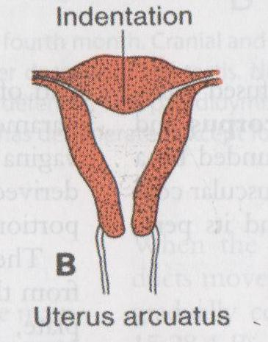

Slide 27
7.Class VII (diethylstilbestrol-related anomaly): The uterine anomaly is seen in the female offspring of as many as 15% of women exposed to DES during pregnancy.
Uterus: hypoplasia and a T-shaped uterine cavity.
Cervix: abnormal transverse ridges, hoods, stenoses
Vagina: adenosis with increased risk of vaginal clear cell carcinoma.

Slide 28
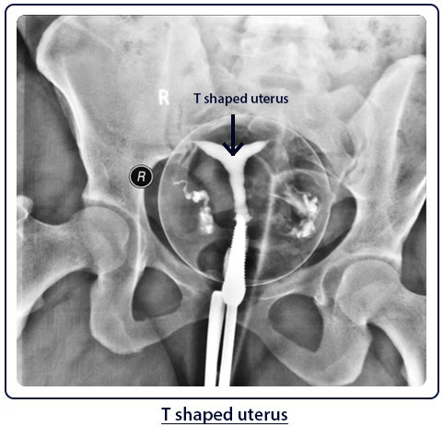

Slide 29
TeLinde's Modification of the American Fertility Society Classification of Uterovaginal Anomalies
Class I. Dysgenesis of the Mullerian Ducts
Class II. Disorders of Vertical Fusion of the Mullerian Ducts
Class III. Disorders of Lateral Fusion of the Mullerian Ducts
Class IV. Septate uterus

Slide 30
VERTICAL FUSION DEFECTS
VAGINAL ATRESIA :the lower portion of vagina is replaced by fibrous tissue.The superior structures (uterus) are well defined.
TRANSVERSE VAGINAL SEPTUM
IMPERFORATE HYMEN : failure of canalisation of vagina
Complete absence of vagina : mullerian agenesis

Slide 31
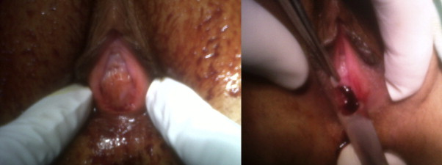
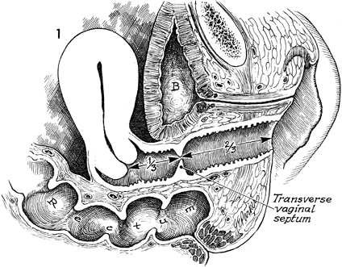

Slide 32
THANK YOU

