Slide 3
MENSTRUAL AGE
Also known → GESTATIONAL AGE
From the first day of the last menstrual
9 MONTHS AND 7 DAYS
280 DAYS
40 WEEKS

Slide 4
FIRST TRIMESTER ( FIRST 12 WEEKS)
SUBJECTIVE SYMPTOMS :
AMENORRHOEA
MORNING SICKNESS
FRQUENCYOF MICTURITION
BREAST DISCOMFORT
FATIGUE

Slide 5
Morning sickness: 70% cases
- usually appears soon following the missed
period.
- Nausea , vomiting especially in the morning on rising from the bed.
Rarely lasts beyond 16 weeks

Slide 6
3- Freguency of micturition
by 8 to 12 th week
- Due to congestion of bladder mucosa. Irritation of
the bladder by the pregnant uterus.
- resting of bulky uterus on the bladder (exaggerated anteverted position of the uterus).
- change in maternal osmoregulation → leads to increased thirst and polyuria.
- Usually disappears after the third month

Slide 7
4. BREAST DISCOMFORT :
Fullness and pricking sensation , 6-8th week
5. FATIGUE

Slide 8
OBJECTIVE SIGNS
Breast signs : ( evident in a primigravida).
6 - 8 weeks
Increased size and vascularity→Dilated
visible veins.
Increased pigmentation of the nipple and areola
Appearance of Montgomery tubercles in the areola ( dilated sebaceous glands)
Thick yellow secretion (colostrum) – as early as 12th week

Slide 9
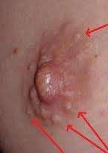
Appearance of Montgomery tubercles in
the areola ( dilated sebaceous glands)

Slide 10
PER ABDOMEN:
Uterus remains a pelvic organ until 12 th week
PELVIC CHANGES:
JACQUEMIER’S OR CHADWICK’S SIGN
OSIANDER’S SIGN
GOODELL’S SIGN

Slide 11
JACQUEMIER’S SIGN
Also known as Chadwick’s sign
Dusky hue of the vestibule and anterior vaginal wall
, 8th week of pregnancy

Slide 12
OSIANDER’S SIGN
Increased pulsation , felt through the lateral fornices

Slide 13
GOODELL’S SIGN
Cervix becomes soft as early as 6th week
Softening is more surrounding the external os and also in the upper part.
The pregnant cervix feels like the lips of the mouth.
On speculum examination. The bluish discolouration of the cervix is visible → due to the increased vascularity

Slide 14
UTERINE SIGNS:
SIZE SHAPE AND CONSISTENCY :
HEN EGG -6TH WEEK
CRICKET BALL 8TH WEEK
FETAL HEAD 12TH WEEK
NPN PREGNANT PYRIFORM TO GLOBULAR SHAPE BY 12 WEEKS
PISKACEK’S SIGN- ASYMMETRICAL ENLARGEMENT OF UTERUS IN LATERAL IMPLANTATION

Slide 15
Hegar sign : ( elicited between 6-10 weeks).
Two fingers in the anterior fornix, the fingers of the other hand over the abdomen behind the uterus . The fingers of both hands can be approximated as the lower part of the uterine body is soft and empty.
Palmer sign:
Uterine contractions felt on bimanual examination.

Slide 17
ULTRASOUND
Intra decidual gestational sac is identified
as early as 29 – 35 days of gestation
Gestational sac & yolk sac -5 menstrual
weeks
Fetal pole and cardiac activity – 6 weeks
Embryonic movements -7 weeks
Doppler effect of US can pick heart rate by 10th week

Slide 18

Diagnosis in the
( 13-28 weeks)
Symptoms:
second
trimester
1.
2.
Amenorrhea.
Morning sickness and
decrease .
urinary symptoms gradually
3.
“Quickening “ : perception of fetal movements by
the pregnant woman:
a.
b.
18-20 weeks in primigravida.
16-18 week s in multipara.
4.
Abdominal enlargement.

Slide 19
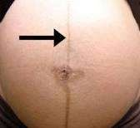
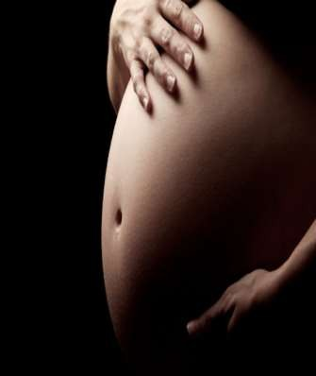
ABDOMINAL EXAMINATION…
INSPECTION:
– Linea nigra extending from symphysis pubis to ensiform cartilage
•
→
20th
week…

Slide 20
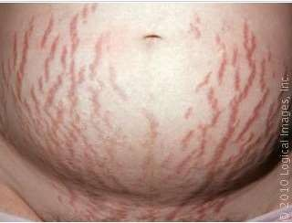
– STRIAE ( both pink and white) visible in the
lower abdomen more towards the flanks…

Slide 21
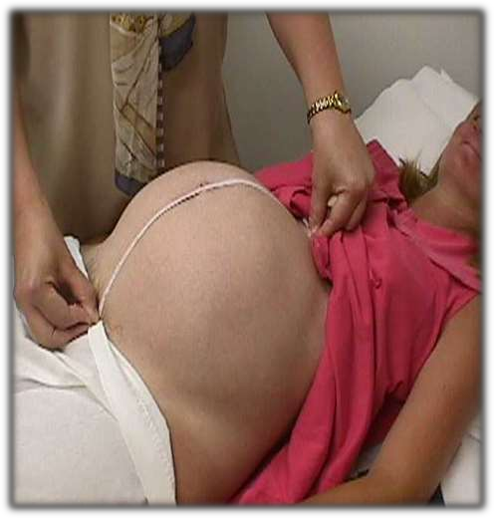
•
PALPATION:
– Fundal height – increased with progressive enlargement of the uterus.

Slide 22
Height of the uterus midway between symphysis pubis and umblicus – 16 weeks
Umblicus – 24 weeks

Slide 23
Uterus – soft and elastic
Braxton Hicks contraction
Palpation of fetal parts
Active fetal movements
External ballotment

Slide 24
AUSCULTATION
FETAL HEART SOUND
18 – 20 Weeks by stethoscope
DD
UTERINE SOUFFLE
FETAL OR FUNIUC SOUFFLE

Slide 25
VAGINAL EXAMINATION
Bluish discolouration of vulva , vagina , cervix
Internal ballotment – 16-28th week

Slide 26
INVESTIGATIONS
SONOGRAPHY:
1. Routine sonography at 18 – 20 weeks permits a detailed survey of fetal anatomy, placental localisation and integrity of cervical canal and fetal viability
MRI
RADILOGICAL EXAMINATION

Slide 27
Diagnosis in the third trimester
(29 - 40weeks)
SYMPTOMS:
•
–
–
Amenorrhoea persists
Enlargement of the abdomen → leading to discomfort to the patient (palpitaion or dyspnoea following exertion)
–
LIGHTENING:
38th
week → sense of relief of the
pressure symptoms due to engagement of the
presenting part.

Slide 28
– Frequency of micturition reappears
– Fetal movements are more pronounced.

Slide 29
•
SIGNS:
–
Cutaneous changes are more prominent with
increased pigmentation and striae.
Uterine shape – from cylindrical to spherical
–
beyond
36th
week
–
FUNDAL HEIGHT (distance between the umbilicus
and ensiform cartilage)
•
•
•
Junction of the upper and middle third at 32 weeks.
Level of ensiform cartilage at
36th
week
Comes down to 32 weel level at
40th
week because of
the engagement of the presenting part.

Slide 30
•
SIGNS:
–
Cutaneous changes are more prominent with
increased pigmentation and striae.
Uterine shape – from cylindrical to spherical
–
beyond
36th
week
–
FUNDAL HEIGHT (distance between the umbilicus
and ensiform cartilage)
•
•
•
Junction of the upper and middle third at 32 weeks.
Level of ensiform cartilage at
36th
week
Comes down to 32 weel level at
40th
week because of
the engagement of the presenting part.

Slide 31
•
SYMPHYSIS FUNDAL HEIGHT:
–
Upper border of the fundus located by ulnar
border of the left hand and point is marked.
Distance between the upper border of the symphysis pubis upto the point marked is measured in centemetre
–
–
After 24 weeks, the SFH in cm corresponds
number of weeks upto 36 weeks.
to
the
•
•
Braxon-Hicks contraction – more evident
Fetal movements – easily felt

Slide 32
•
Palpation of the fetal parts and their identification
become much easier.
F.H.S – heard distinctly
SONOGRAPHY:
•
•
– Fetal growth assessment
accurate.
Amniotic fluid volume assessment – for oligo / poly.
can be made more
•

Slide 33
DIFFERENTIAL DIAGNOSIS

Slide 34
•
•
UTERINE FIBROID
CYSTIC OVARIAN TUMOUR (Amenorrhoea absent firm, hard, positive sign absent, USG)
ENCYSTED TUBERCULAR PERITONITIS (H/O Koch’s infection, swelling ill defined, positive signs absent, USG)
HAEMATOMETRA
•
•
•
DISTENDED URINARY
solves the problem)
PSEUDOCYESIS
BLADDER (Catheterisation
•

Slide 35
SUMMARY OF DIAGNOSIS OF PREGNANCY
POSITIVE SIGNS OR ABSOLUTE SIGNS:

