Slide 1
ABORTION

Slide 2
DEFINITION
Abortion is the expulsion or extraction of an embryo or fetus weighing 500 gms or less which is not capable of independent survival or before the period of viability( 28 weeks ).

Slide 3
TYPES OF ABORTION
Complete abortion
Threatened abortion
Inevitable abortion
Incomplete abortion
Missed abortion
Recurrent abortion

Slide 4
THREATENED ABORTION

Slide 5
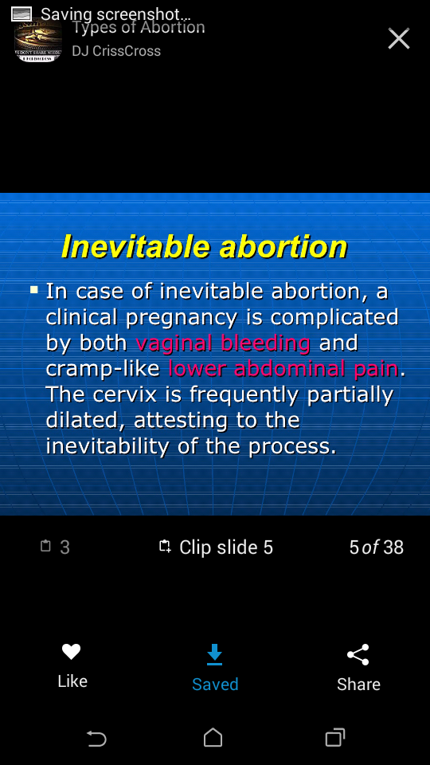

Slide 6
Incomplete abortion
Incomplete abortion involves the passage of products of conception .
Comes with vaginal bleeding , cramp like pain and cervical dilatation.

Slide 7
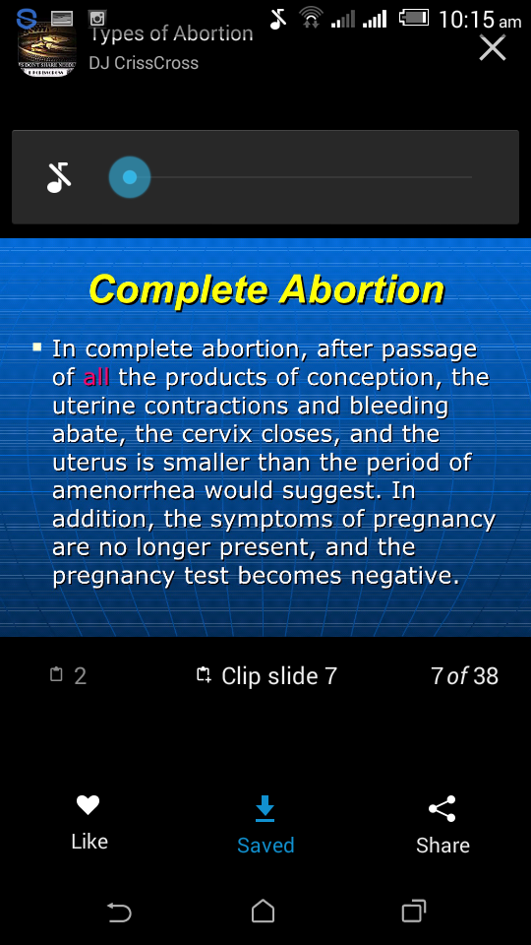

Slide 8
Missed abortion
Fetus has died but retained in the uterus
After 16 weeks of gestation D&C may become a problem
Fibrinogen levels should be checked until placenta and fetus are expelled.

Slide 9
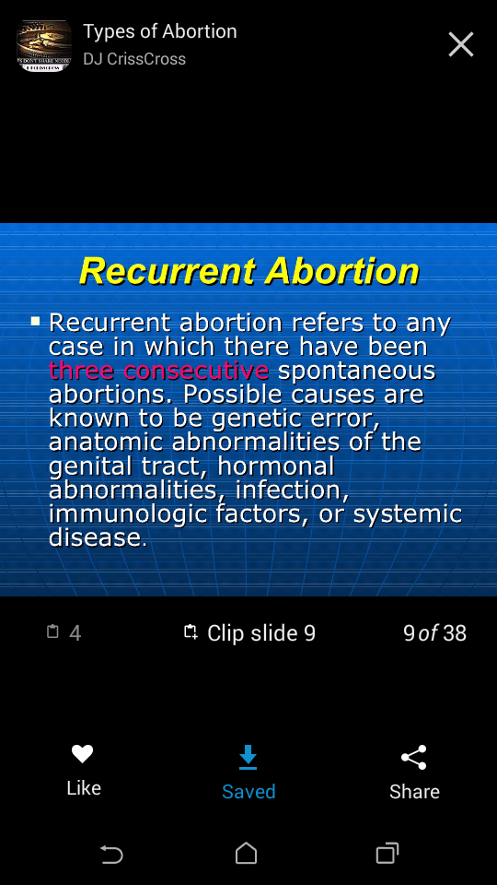

Slide 10
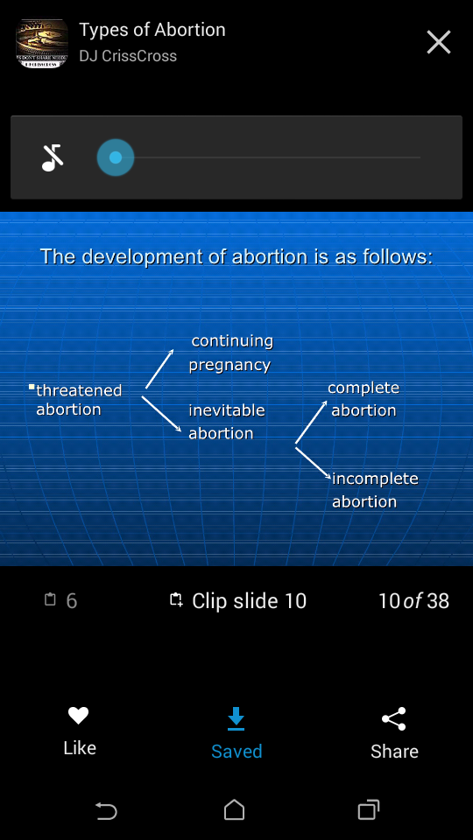

Slide 11
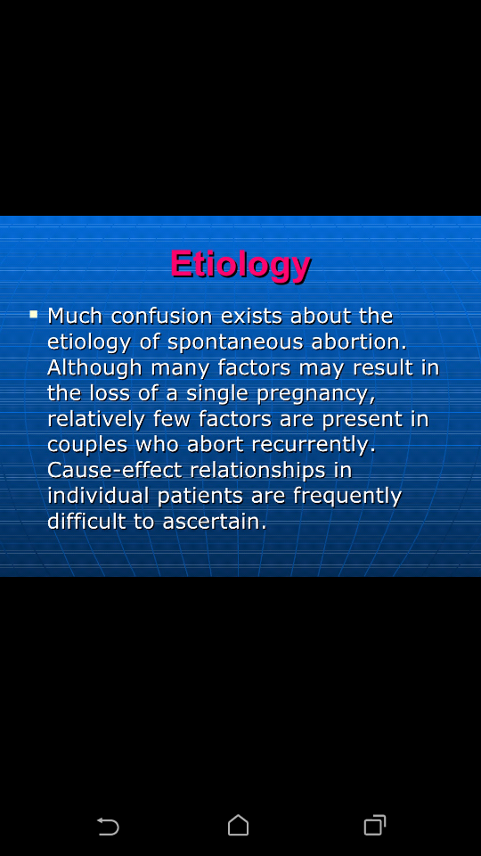

Slide 12
General maternal factors
Infections
Environmental exposure
Systemic disorders
Psychological factors

Slide 13
INFECTIONS

Slide 14
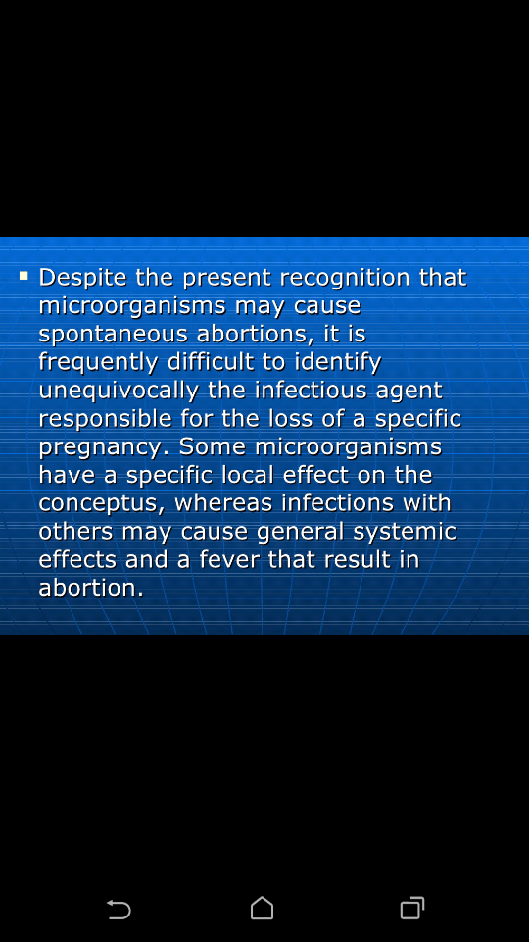

Slide 15
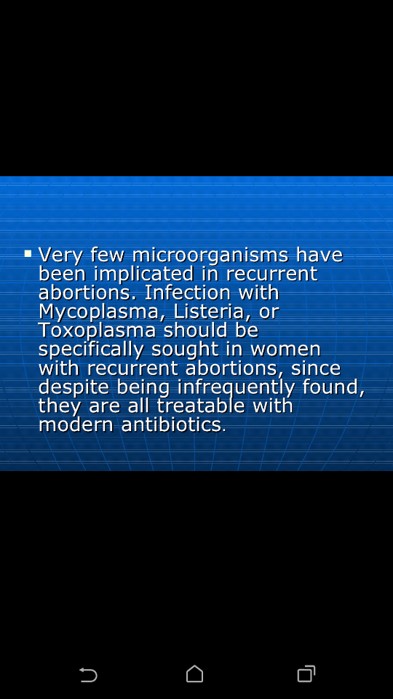

Slide 16
ENVIRONMENTAL EXPOSURE

Slide 17
Maternal smoking
Alcohol consumption

Slide 18
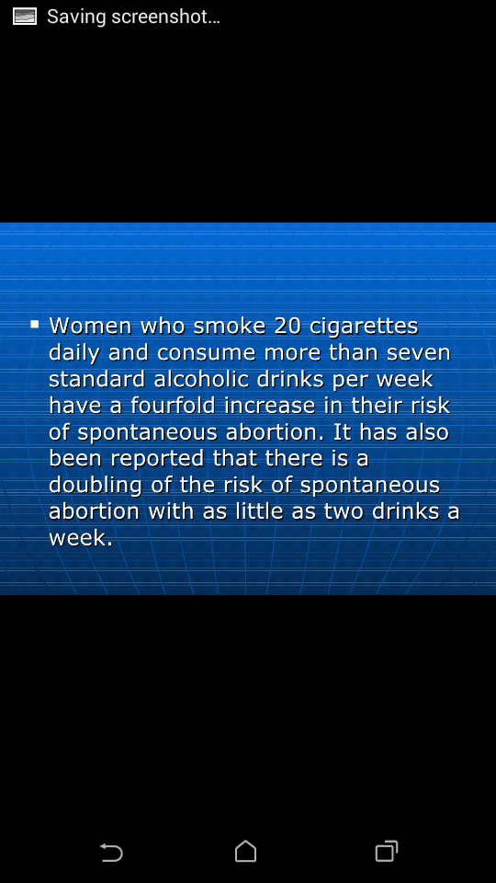

Slide 19
SYSTEMIC DISORDERS
Diabetes mellitus
Hypothyroidism
Systemic lupus erythematosus

Slide 20
Local maternal factors
Endocrine factors
Uterine abnormalities
Trauma

Slide 21
Endocrine factors
Insufficient production of progesterone by corpus luteum Before the placenta is fully formed Inadequate development of decidua and abortion

Slide 22
Uterine abnormalities
Incidence of abortion is increased in Septate uterus.
Retroversion of uterus is not a cause for miscarriage
Fibromyoma of uterus which is closely related to uterine cavity may cause abortion.

Slide 23
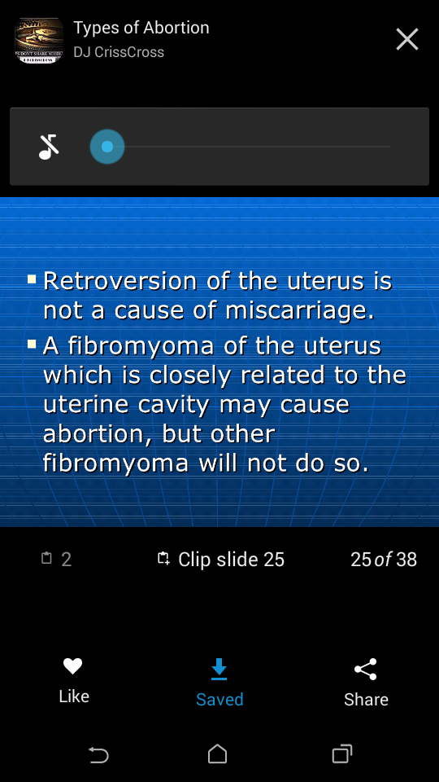

Slide 24
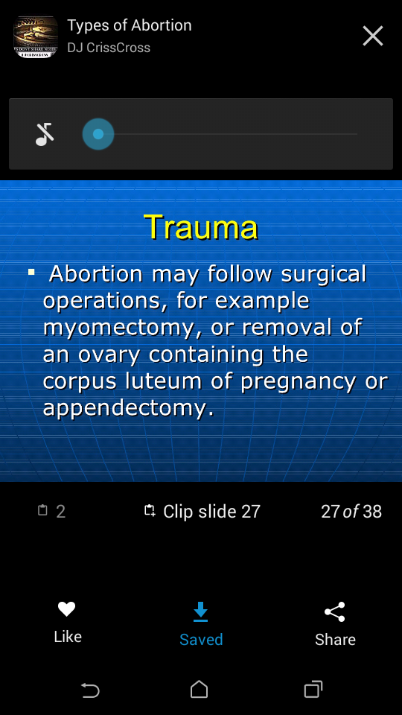

Slide 25
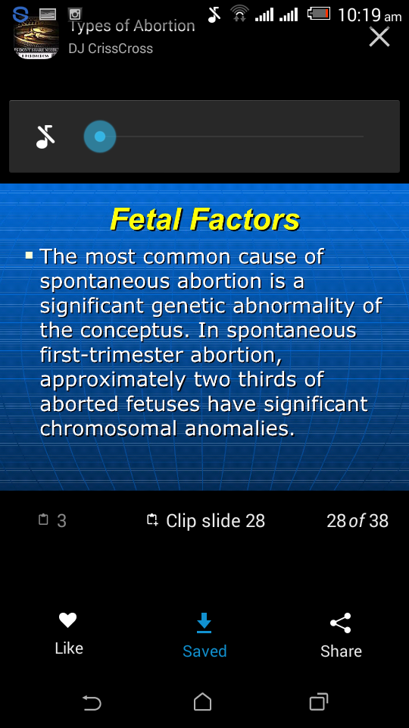

Slide 26
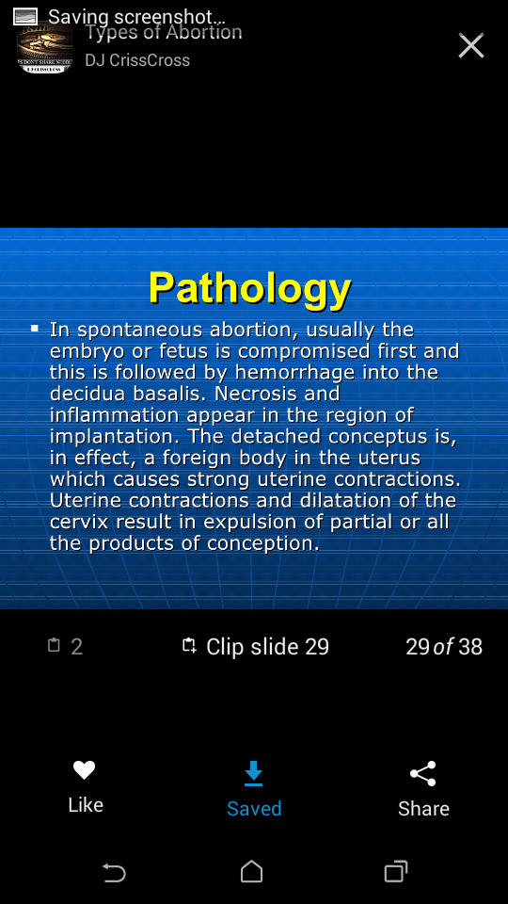

Slide 27
MANAGEMENT

Slide 28
Threatened abortion
Patient kept un bed rest for two days
As soon as initial bleeding has stopped USG is taken
USG shows whether the fetus is viable or not
Prognosis is good when all abnormla signs and symptoms disappear

Slide 29
Ineveitable abortion
Examination should be done instrict aseptic conditions because uterus expels its content unaided
If abortioin is not completed or hemorrhage becomes severe content of uterus are removed with suction curettage

Slide 30
Incomplete abortion
Admission -To prevent infection, to control bleeding and to obtain an empty and involuting.
Risk associated with retained productsare hemorrhage and sepsis.

Slide 31
Misssed abortion
Once diagnosed uterus must be emptied.
In early pregnancy it can be done by suction curettage.
Prognosis for the mother is good .

Slide 32
Recurrent abortion
Paternal and maternal chromosomes should be evaluated .
Systemic disorders hpuld be ruled out in the mother such SLE ,DM and thyroid disorders.
Rule out the presence of infections such as mycoplasma, listeria, toxoplasma,etc.
Pelvic examination

Slide 33
Causes of recurrent abortion
Cervical incompetence
Infection
Chromosome aberration
Septate uterus

