Slide 1
ENDOSCOPY IN GYNAECOLOGY

Slide 2
Gynecological Endoscopy
Endoscopy in gynaecology has
Laparoscopy
Hysteroscopy.

Slide 3
LAPAROSCOPY
Outline:
Definition
Instruments
The Procedures
Indications and contraindications
Complications

Slide 4
LAPAROSCOPY
Definition:
It is a technique which allows viewing (Diagnostic) and surgical maneuvers (Therapeutic) to be performed in abdominal organs through a surgical incision of < 1cm with help of pneumoperitoneum.

Slide 5
EQUIPMENT AND TECHNIQUE
1.Patient positioning
2.Operating room organisation
3.Peritoneal access
4.Visualisation
5.Manipulationof tissue and fluid
6.cutting, hemostasis and tissue fastening
7.Tissue extraction
8.Incision management.

Slide 6
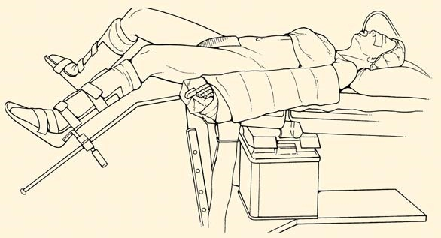
Patient positioning
It is essential for patient safety,comfort of operator and optimal visualisation of pelvic organs.

Slide 7
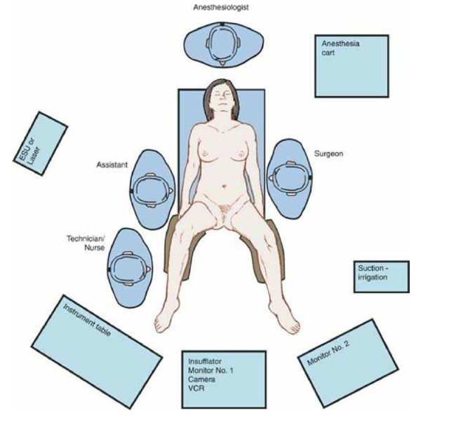
Operating room

Slide 8
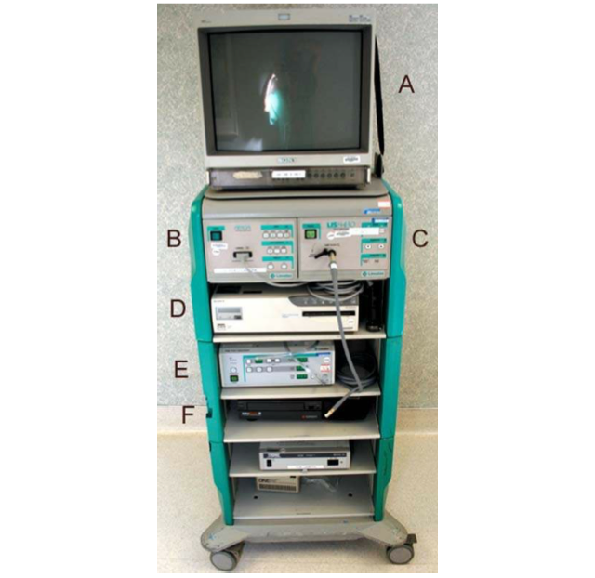

Laparoscopic tower

Slide 9
Peritoneal access
Closed technique:
Blind approach in which the cannula is introduced with an obturator designed to penetrate the abdominal layers.
In open,initial entry into peritoneal cavity is achieved with minilaparotomy .

Slide 10
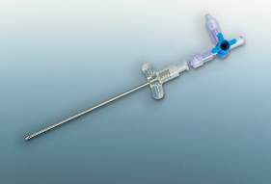
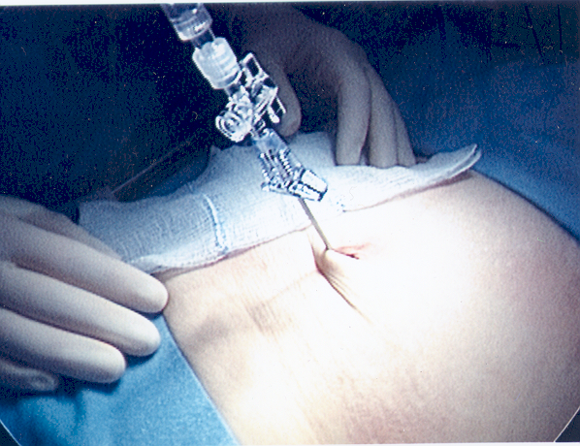
Instruments
1. Verres needle:
used to inflate air to the peritoneal cavity (pneumoperitoneum) through the umbilicus where there is the thinnest abdominal wall.
when pressed against tissue such as fascia or peritoneum,spring loaded blunt obturator is pushed back into hollow needle,revealing its sharp end.
When the needle enters the peritoneal cavity ,obturator springs back into position ,protecting theintraabdominal contents from injury.

Slide 11
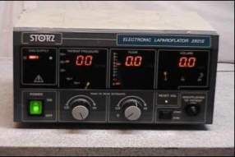
2. Electronic laparoflator: INSUFFLATOR
Used to insufflate through the verres needle.
Maintains constant intra-abdominal pressure without exceeding the safety limit.(25-30 mm Hg)

Slide 12
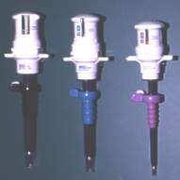
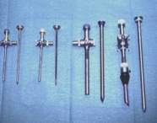
3. Trocars:
Permit access to the intraperitoneal cavity in which other instruments can pass.
The trocar used should be adapted to the diameter of the telescope selected.
Disposable or reusable.

Slide 13

4. Telescope:
There are different sizes and angels, each with a different use.
They are used to visualize the peritoneal cavity.

Slide 14
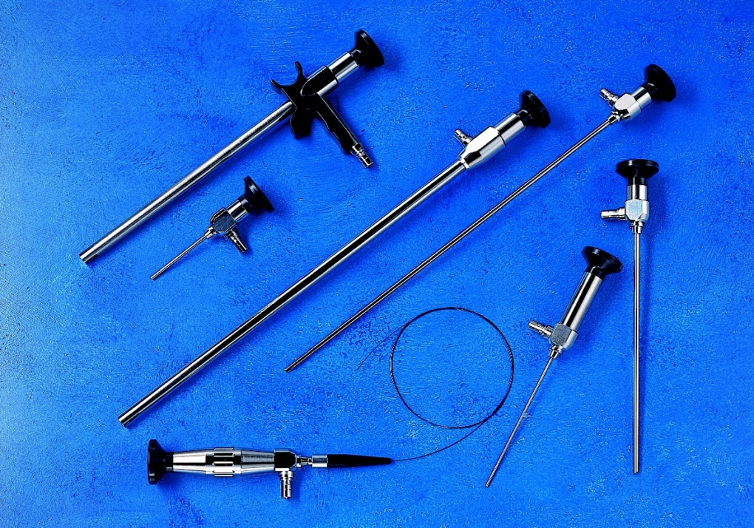
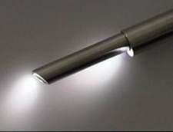
5. Camera
equipment.
6. Light source.

Slide 15
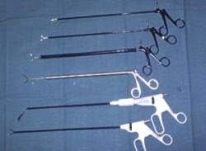
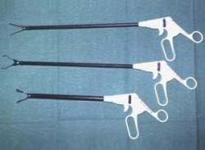
7. Forceps and scissors:
There are two types:
- Disposable
- Reusable
They can be either atraumatic or grasping forceps.

Slide 16
Instruments
8. Bipolar elecrtosurgey.
9. Unipolar electrosurgery.
10. Laser.
11. Suction and irrigation system.
12. Suture.
13. Laparoscopic bag.
14. Tissue morcellator: used to remove large specimens like myomas or an entire uterus in small pieces.
15. Uterine manipulator: used to mobilize or stabilize the uterus and adnexa.

Slide 17
Procedure
Preparation of the patient:
Inform the patient about the therapeutic benefits and potential risks (informed consent).
Intestinal preparation: Simple intestinal emptying, for better viewing and preventing injuries.
Place the patient in the lowlithotomy position.

Slide 18
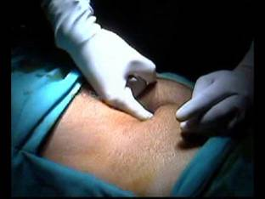
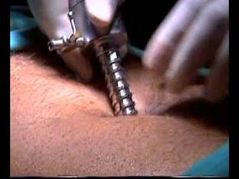
2. Creation of pneumoperitoneum:
The abdominal wall is lifted by hand or by grasping forceps
Pnemoperitoneum is created by verres needle introduced to the umbilical area (less subcutaneous and preperitoneul tissue).
The needle is inserted in an oblique angle toward the uterine fundus
The negative pressure will allow the underlying structures to fall away.
After making sure that the needle is in correct position, air flow can be increased to 2.5 liters per minute till a pressure of 15mmHg

Slide 19
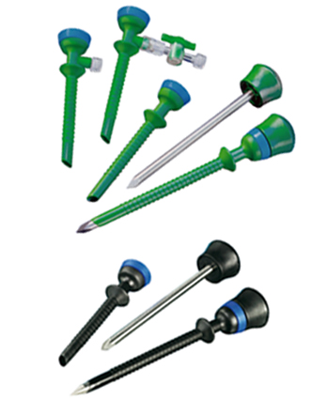
3. Trocar introduction
Once the intra-abdominal pressure reaches 15 mmHg the main trocar is introduced after removal of veress needle.
b. The position of the trocar must be verified by inserting the laparoscope and viewing the pelvic cavity.

Slide 20
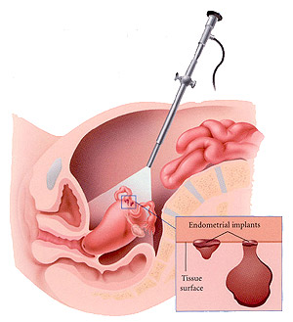
4. Viewing the peritoneal cavity:
A. The omentum, bowel and bifurcation of pelvic vessels should be evaluated to avoid injuries caused during the introduction of Verres needle or trocar.
The site of introduction of other
trocars should be verified by finger
palpation and transillumination of
abdominal wall to avoid injury to
epigastric vessels.
C. Identify if there is any bleeding

Slide 21
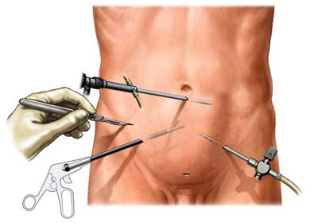
After the procedure
CO2 gas must be
evacuated completely
to reduce post-operative
pain
In operative procedures:
- 1 or 2 bottles of Ringer’s lactate are used to wash the peritoneal cavity after laparoscopy.
-

Slide 22
Indications
Used as a diagnostic tool
Infertility: status of the fallopian tube (morphology and functionality) and any pathological condition e.g. adhesions.
Ovarian cysts or tumors.
Ectopic pregnancy.
PID: tubal abscess or adhesions.
Endometriosis: define the sites of implants and endometrial cysts.

Slide 23



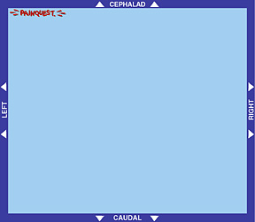
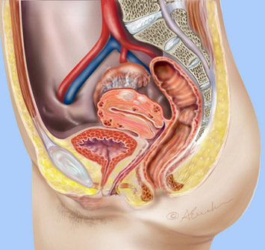
Diagnostic Laparoscopy for Gynecological Pelvic Disorders

Slide 24
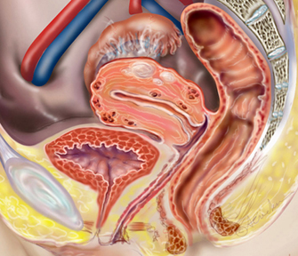
Gynecologic Disorders:
Chronic pelvic pain
Ectopic pregnancy
Pelvic inflammatory disease
Endometriosis
Adhesions
Ovary: cysts, torsion
Fallopian tube: torsion,
salpingitis
Uterus: fibroid, leiomyomata
Pelvic congestion syndrome
Infertility

Slide 25
Chronic Pelvic Pain
> 40% of gynaecological diagnostic laparoscopies
are done for CPP
A negative laparoscopy is not synonymous with no diagnosis or no disease
A meticulously performed negative laparoscopy means that a woman does not have endometriosis-associated or adhesion-associated pain

Slide 26
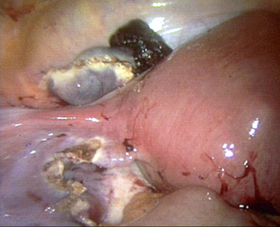
Ectopic pregnancy
Laparoscopy should be regarded as a therapeutic rather than diagnostic tool for suspected ectopic pregnancy.
Transvaginal ultrasound has replaced laparoscopy for diagnosis of ectopic pregnancy.
Laparoscopy has diagnostic role if probable tubal pregnancy or diagnosis in doubt.
Large randomisd controlled studies have demonstrated that > 80% of ectopic pregnancies can be managed laparoscopically
The most commonly used procedures at laparoscopy are salpingectomy and salpingotomy.

Slide 27
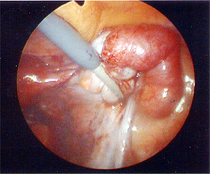
Pelvic Inflammatory Disease
Clinical diagnosis of PID is often difficult especially when symptoms are mild, as frequently when the primary organism is C. trachomatis.
Laparoscopy is the gold standard for the diagnosis of PID – should be used when diagnosis is uncertain, especially in young women for whom the preservation of fertility is important.
Laparoscopy should be considered for patients who have not responded to antibiotic therapy within 48 to 72 hours.

Slide 28
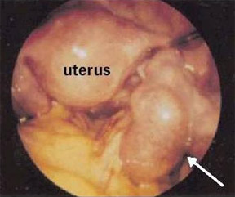
Tubo-ovarian Abscess
Most commonly isolated pathogens from a tubo-ovarian abscess are C. trachomatis and peptostreptococci.
At laparoscopy the peritoneal cavity (pelvis and abdomen) is inspected carefully.
The surgical steps include adhesiolysis, aspiration of the abscess cavity, dissection and excision of necrotic tissue, tubal lavage, and irrigation of the peritoneal cavity before completion of the procedure.
Laparoscopic surgery combined with adequate broad-spectrum antibiotic therapy has proven successful in the treatment of more than 95% of patients.

Slide 29
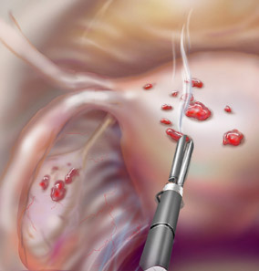
Endometriosis
Endometriosis is a histologically-defined disease :“the presence of ectopic tissue which possesses the histological structure and function of the uterine mucosa”. ( Sampson 1921)
Laparoscopy has largely replaced laparotomy as the diagnostic procedure for any patient suspected of having endometriosis.
Based on visual appearance endometriosis are classified as atypical (red, yellow, white or clear) or typical (black-brown, black or puckered black stellate) lesions.

Slide 30
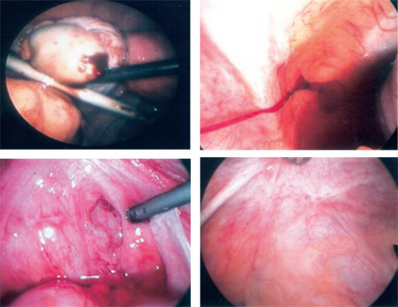
Endometriosis presents with a variety of appearances that may make visual diagnosis difficult and inaccurate.
White fibrotic lesion on the uterosacral ligament
Brownish lesion on the ovary
Peritoneal pocket of endometriosis
Red stellate lesions in the cul-de-sac

Slide 31
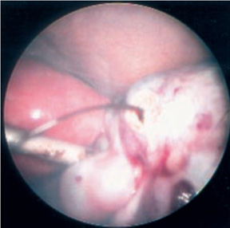
Endometriosis
Laparoscopic evaluation requires detailed visualization of all sites of endometriosis:
A study of 716 women with endometriosis found these anatomical distributions:
cul-de-sac and uterosacrals ( 69%)
ovaries ( 45%) ovarian fossae ( 33%)
and uterovesical fold ( 24% )
ovaries (all surfaces)
ovarian fossae
pelvic peritoneum (cul-de-sac, periureteral, bladder peritoneum)
uterine ligaments
sigmoid colon appendix
fallopian tubes rectovaginal septum
Chocolate fluid from needle puncture of a suspected occult endometrioma.

Slide 32
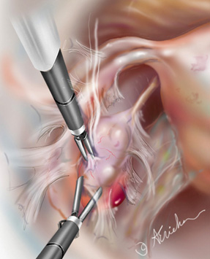
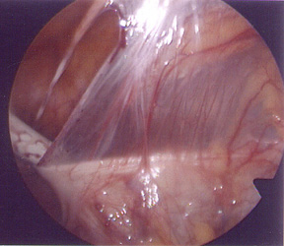
Adhesions
Pre-operative history of PID, endometriosis, perforated appendix, prior surgery or inflammatory bowel disease.
Presently the only definitive way to diagnose adhesions is by surgical visualization usually via laparoscopy instead of laparotomy.
Laparoscopic studies reveal adhesions on average in 24% of CPP patients and 17% of non-CPP patients.

Slide 33
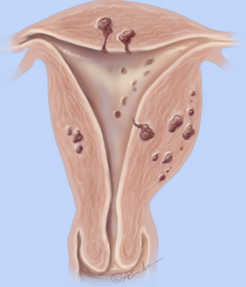
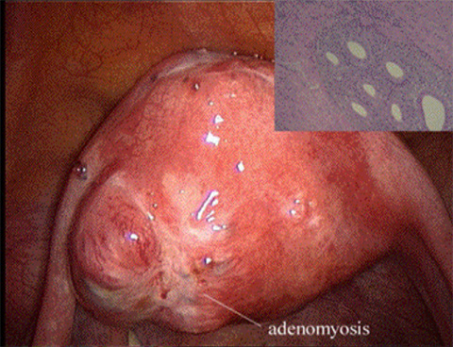
Adenomyosis
Endometrial cells penetrate the myometrium causing either localized (adenomyoma) or diffuse overgrowth.
Adenomyomas that penetrate the uterine cavity become submucosal tumors.
An enlarged uterus from adenomyosis is often misdiagnosed as being from fibroids

Slide 34
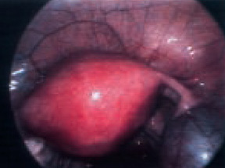
Ovarian Cysts
Most ovarian cysts are haemorrhagic corpora lutea or follicle cysts.
They are usually asymptomatic and when they cause pain it is almost always acute.
Laparoscopic evaluations of patients with CPP reveal ovarian cysts on average in only 3% of all cases.
Paratubal cyst

Slide 35
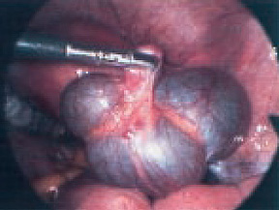
Ovarian Cysts
Even when the surgeon is ‘certain’ that the ovary is benign, it is essential that tissue be sent for histological evaluation.
Open the cyst and inspect the lining for papillary structures or excrescences.
If these are noted, then a laparotomy should be done .

Slide 36
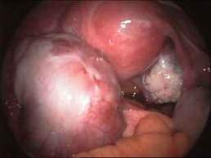
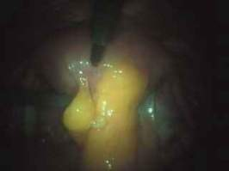
Ovarian Cyst
Adhesions between the omentum and uterus

Slide 37
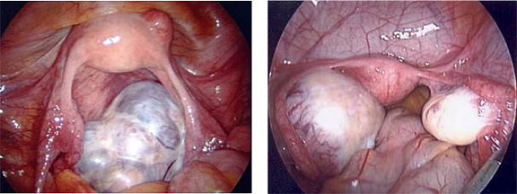
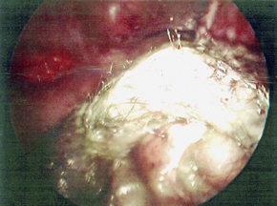
Ovarian Cysts
The nature of the fluid is characteristically diagnostic :
chocolate (usually endometrioma or haemorrhagic corpus luteum) sebaceous (teratoma), or mucinous (mucinous cystoma).
Mucinous cyst
Teratoma
Dermoid cyst

Slide 38
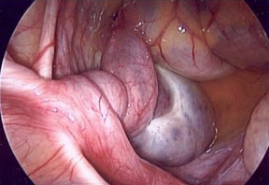
Adnexal Torsion
A rare gynecologic emergency that nearly always occurs unilaterally.
Common causes are benign ovarian tumors and cysts; malignant processes are rare.
Relapse or bilateral adnexal torsion can cause sterility interfering with fertility.
In 30% of the patients, there is torsion of a normal adnexa, while the majority of the cases are associated with ovarian pathology.

Slide 39
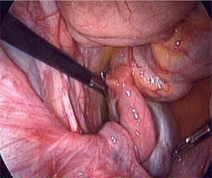
Adnexal Torsion
Conservative management by laparoscopy is the best approach when tissues are viable and should be carried out promptly to preserve the adnexa
(basic principles of conservative management are to untwist the structure and treat the underlying cause ‘ie - ovarian cyst’).
Once untwisted, the organ must be observed to ensure color change to normal, confirming viability and blood supply.

Slide 40
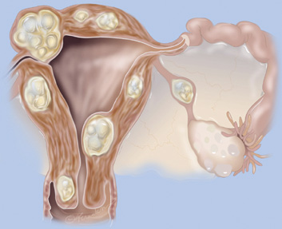
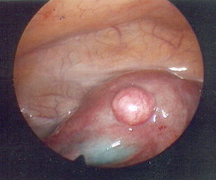
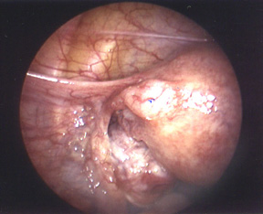
Leiomyoma (fibroids)

Slide 41
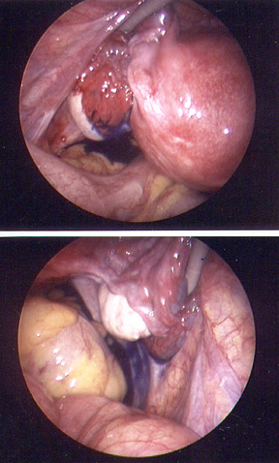
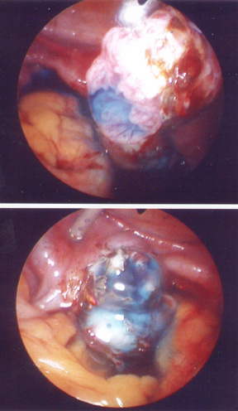
Infertility

Slide 42
As a therapeutic tool
- Management of ovarian cyst by:
Drainage.
Ovarian cystectomy.
Ovarian drilling of the cortex and stroma to decrease androgens in the ovaries
Correcting ovarian torsion.
As a treatment of endometriosis By removal of the endometrial cyst, cauterization of endometrial spots and adhesiolysis
- Management of infertility:
Adhesiolysis
Treat the cause (endometriosis, PCOS)
- Myomectomy for fibroids: used for subserosal and intramural fibroids only, not used for submucosal fibroids.
- Management of PID: by draining tubal abscess and adhesiolysis.

Slide 43
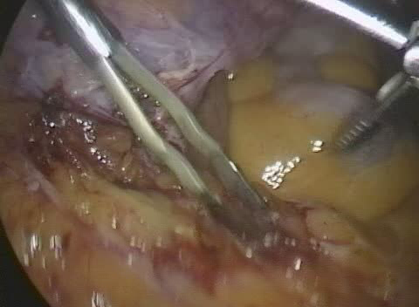
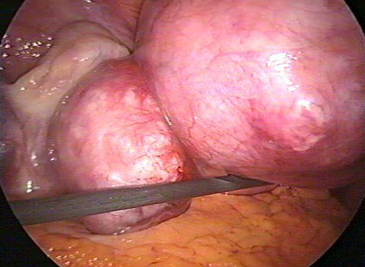
Adhesiolysis
Myomectomy

Slide 44
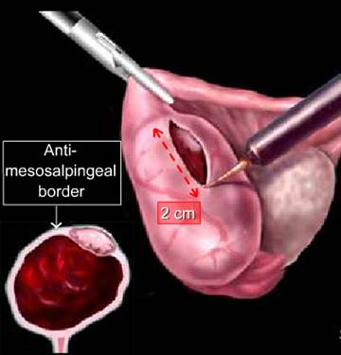
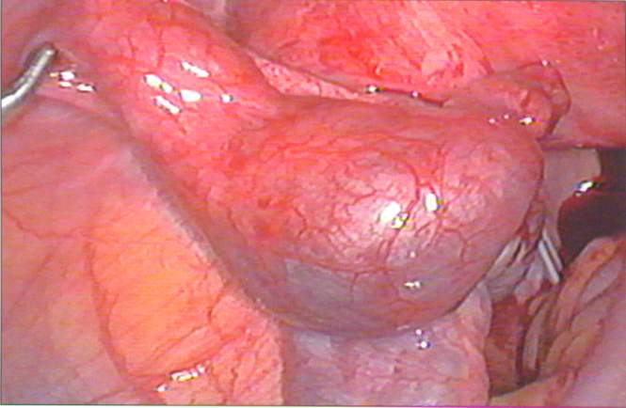
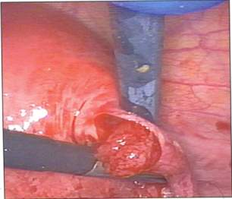
Management of Ectopic Pregnancy:
Salpingotomy
Used to preserve the tubes for desired reproductivity.
Done if the patient is hemodynamicaly stable
If size < 5 cm
Location must be ampullary, infundibular or isthmic.
Contralateral tube either normal or absent.

Slide 45
Salpingectomy
(it is the standard for ectopic pregnancy)
- Ruptured tube
- Multiple recurrence of ectopic pregnancy.
- Size of ectopic > 5 cm

Slide 46
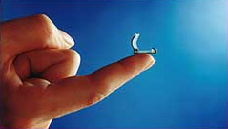
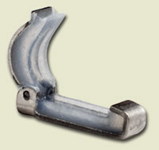



Tubal sterilization by:
- Bipolar coagulation.
- Clips (filshie clips) and rings
- Before doing this you should consult the patient about 3 things
- Chance of irreversibility
- Failure rate 1/200
- Bleeding may occur and we may shift to laparatomy.
Ring sterilization

Slide 47
Contraindications
Generalized peritonitis
Hypovolemic shock
Severe cardiac disease
Hemoglobin less than 7 g/dL
Uterine size > 12 wks.
Multiple previous abdominal procedures
Extreme body weight

Slide 48
Complications:-
Anesthetic and cardiopulmonary complications:
Risks of GA- hypoventilation,oesophageal intubation,GE reflux,bronchospasm,narcotic overdose,cardiac arrythmias and cardiac arrest.

Slide 49
Co2 embolus:
if large amount of CO2 enters central venous circulation leads to severe cardiopulmonary compromise.
Signs: sudden and otherwise unexplained hypotension ,cardiac arrythmia,cyanosis and heart murmurs.
If it is suspected or diagnosed- surgeon must evacuate the CO2 from peritoneal cavity and place the patient in left lateral position with the head below the level of rt atrium.

Slide 50
Cardiovascular complications:
Cardiac arrythmias occur frequently and is commonly due to hypercabia and acidemia.
Hypotension can occur because of very high intraperitoneal pressure leads to decreased venous return.
Gastric reflux:
Gastric regurgitation and aspiration can occur especially in obesity,gastroparesis,hiatal hernia .
In these patients airway must be maintained with cuffed ET tube.

Slide 51
Extraperitoneal insufflation
Most common cause are preperitoneal placement of the insufflating needle and leakage of CO2 around the cannula sites.
Leads to subcutaneous edema sometimes becomes extensive involving extremities,neck and mediastinum.
It is identified by palpation of crepitus usually in the abdominal wall.
In mild cases,findings usually resolve after evacuation of pneumoperitoneum,no specific therapy is noted.

Slide 52
Electrosurgical complications:
Complications of electrosurgery occur secondary to thermal injury from unintended or inappropriate use of active electrode, current diversion to an undesirable path or injury at the site of dispersive electrode.

Slide 53
Haemorrhagic complications:
Great vessel injury:
Most dangerous are injuries to great vessels like aorta and the inferior vena cava,common iliac vessels and their branches.
The most catastrophic injuries occur secondary to insertion of an insufflation needle or the tip of the obturator.
After vascular injury patient may develop profund hypotension with or without hemoperitoneum.

Slide 54
Abdominal wall vessel injury
The abdominal wall vessels most commonly injured during laparoscopy are superficial inferior epigastric artery as they branch from femoral artery course cephalad in each lower quadrant.
The more serious injuries are those to the dep inferior epigastric vessels which are branches of external iliac artery and vein that course cephalad but are deep to rectus fascia and often deep to the muscles.

Slide 55
Contd..
Signs:
Blood dripping down the cannula,postoperative appearance of shock and abdominal wall discolorization or hematoma located near the incision.

Slide 56
Complications
- Injury to abdominal organs
GI: if the intestine is distended or adherent to the abdominal wall (prevented by good intestinal preparation) and putting the patient on the telendelenburg position.
Bladder injury: prevented by emptying the bladder.

Slide 57
Complications
.
Incisional hernia and wound dehiscence

Slide 58
Conclusion:
Laparoscopy provides a vital tool for diagnosing pelvic pain – it provides first hand visual comprehension of the problem as well as an immediate opportunity to continue with therapeutic surgical correction.

Slide 59


