Slide 1
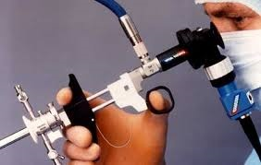
ENDOSCOPY IN GYNAECOLOGY.

Slide 2
ENDOSCOPY.
Visualisation of the Pelvic Organs by way of endoscopes has been employed sporadically since the beginning of the 20th century.
Endoscopy is now simple and efficient .
It is popular ensures adequate lighting without dangerous heating of the peritoneal cavity.
HYSTEROSCOPY,
LAPAROSCOPY.

Slide 3
HYSTEROSCOPY.
Visualisation of the endocervical canal and uterine cavity through an endoscope (incorporating fibre optics) is known as Hysteroscopy.
Hysteroscopy can be used for
Diagnostic procedures &
Therapeutic Procedures.

Slide 4
INDICATIONS.
DIAGNOSTIC:
Endometrial Polyp,
Abnormal Uterine Bleeding,
Submucous myoma,
Postmenopausal Bleeding,
Uterine anomalies,
Missing IUCD(Foreign bodies),
Endometrial Cancer,
Intrauterine Adhesions,
Atrophic endometrium/
Chronic endometritis ( Oligo /Amenorrhoea)

Slide 5
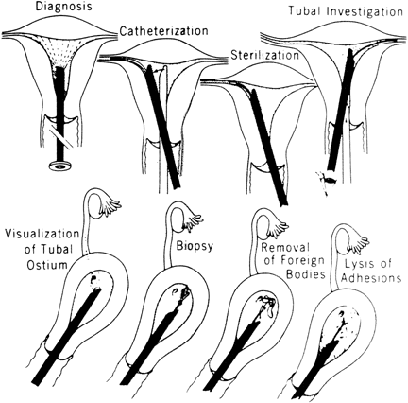

Slide 6
OPERATIVE INDICATIONS.
Polypectomy,
Lysis of Intrauterine Adhesions,
Removal of IUCD,
Resection of Uterine septum,
Removal of Submucous myoma,
Endometrial resection/ablation,
Tubal cannulation,
Hysteroscopic sterilisation:
Using Sclerosing chemicals
Quinacrine,Methyl cyanoacrylate,Silver nitrate
Injecting chemicals:Silicone Rubber.
Hysterosopic guided biopsy (Endometrial Ca),

Slide 7
INSTRUMENTS.
Instrumets used for Dilatation & Curettage,
Diagnostic Sheath(4-5mm in diameter),
Operating Sheath(8-10mm in diameter),
Hysteroscope,
Rectoscope,
Loop,
Roller ball,
Needle electrodes,
Uterine insufflation unit,
Distension medium :
1.5% glycine,
32% dextran,
Normal Saline and CO2.

Slide 8
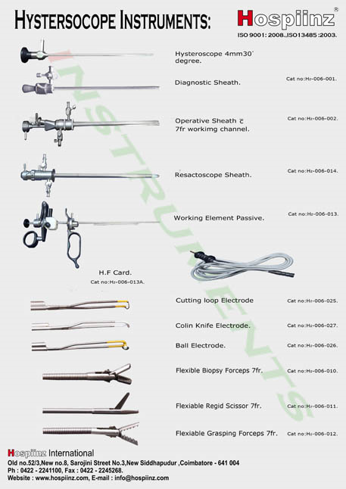

Slide 9
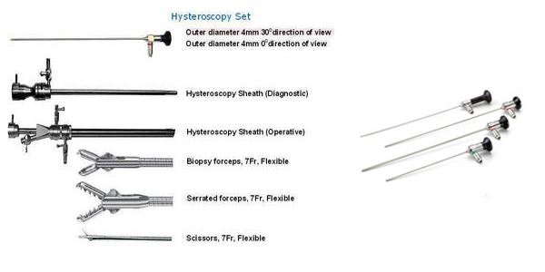

Slide 10
HYSTEROCOPE.
HYSTEROSCOPE vary in diameter from 3mm to 4mm.
The angle of view may be 0 to 30 degree.
The diagnostic sheath allows insufflation medium to enter the uterus.
DISTENSION MEDIUM:
Saline is used as hysteroflation medium for diagnostic hysteroscopy, but it is a good conductor of electrons,it cannot be used with diathermy.
High viscosity media like Hyskon
Low viscosity media like glycine or sorbitol are used for operative procedures.(non-electrolyte solution)
Carbon di oxide can be used as gaseous distension medium.

Slide 11
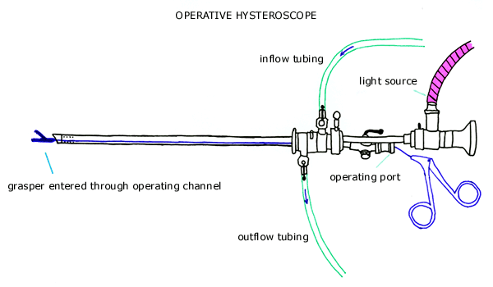

Slide 12
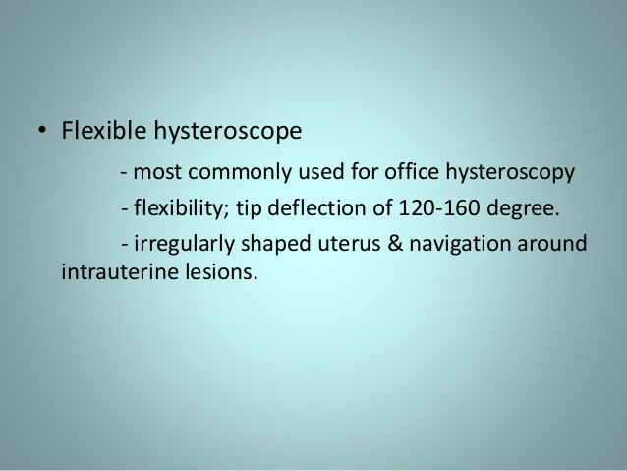

Slide 13
ANAESTHESIA & POSITION.
Hysteroscpy can be performed as an office procedure since diagnostic sheath is only 5mm in diameter and doesnot require cervical dilatation.
Operative Hysteroscopy requires admission & General Anaesthesia.
Patient is placed in dorsal lithotomy position.

Slide 14
PROCEDURE.
Vaginal wall is retracted with speculum,cervix is held with vulsellam and uterocervical length is measured with uterine sound.
Diagnostic sheath and telescope are assembled, and saline and optic cable are connected. The scope with sheath is introduced into the uterus.
With uterine distension,the cervix,fundus and tubal ostia can be visualised.
Cervical canal is visualised while introducing and withdrawing the scope.

Slide 15
If operative hysteroscopy is planned,cervix is dilated to 8-10 hegar’s.
Glycine is connected to the operating sheath.
Scope and operating attachements are assembled and introduced into the cavity.
Uterine cavity is visualised and opeerative procedures are performed.
The hysteroscope has a side channel which permits the passage of the distension medium.

Slide 16
For operative hysteroscopy,an additional channel permits the introduction of resectoscope,roller ball or laser fibre.
An Outflow tract allows the fluid passinq out to be collected in a bottle.
Special collecting bags paced under the patient’s buttocks to collect any fluid leaking out of vagina to allow as accurate estimation as possible of fluid deficit and prevent fluid overload.

Slide 17
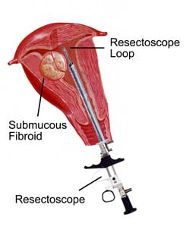

Slide 18
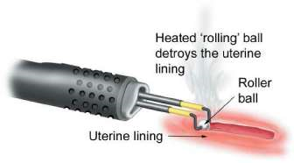

Slide 19
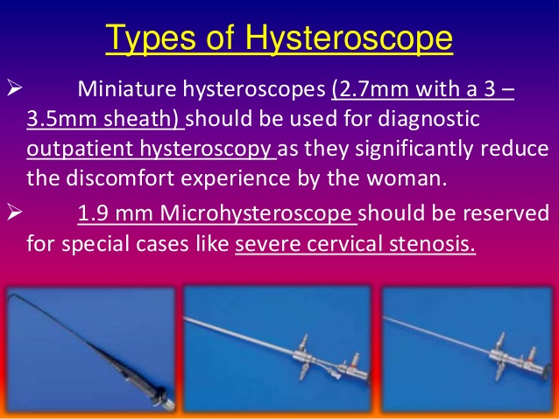

Slide 20
COMPLICATIONS.
Haemorrhage:
Intraoperative,
Postoperative.
Uterine Perforation,
Mechanical or Burn injury to intra-abdominal viscera & Vessels,
Electrolyte disturbances due to the distension media,
Fluid Overload especially with the use of non-electrolyte solutions.

Slide 21
DELAYED COMPLICATIONS:
Infection,
Secondary Haemorrhage,
Haematometra,
Cyclical Pain ,
Treatment Failure with recurrence of symptoms.

Slide 22
CONTRAINDICATIONS.
Hysteroscopy is contraindicated in the
Presence of Infection ,
(except in the case of a Misplaced IUCD),
Pregnancy,
Cervical Malignancy.
In presence of bleeding ,it may pose some difficulty.

Slide 23
Endometrial ablation.
It is the elimination of the endometrium by resection or thermal energy.
Procedure is done in immediate postmenstrual period.
Preoperative treatment with GnRH analogues or danazol
Easier to resect a thin endometrium.
Two Generation Technique;
1st Generation Techniques,
2nd Generation Techniques.

Slide 24
First generation techniques.
Glycine –Distending Medium,
A Roller Ball cautery used to cauterise the entire endometrium,
Endometrium may be resected using a wire-loop cautery.
Entire endometrium can also be destroyed by laser.
DISADVANTAGES:
Require a skilled operator,
Have a long learning curve,
Require General Anaesthesia,
COMPLICATIONS:
Perforation,
Fluid overload.

Slide 25
SECOND GENERATION TECHNIQUES
Thermal ballon ablation is the most popular technique used.
Saline is infused through a balloon;warmed to 87 degree C
Pressure:160-180 mm Hg
Kept in contact with the endometrium for 8 minutes.
Followup:
30%-Amenorrhoeic,
40-50%-Reduced Bleeding,
10-20%-Hysterectomy for continued symptoms.
ADVANTAGES:
Easy to learn,
Performed under mild sedation,
Outpatient procedure,
Fewer Complications.

Slide 26


