Slide 1
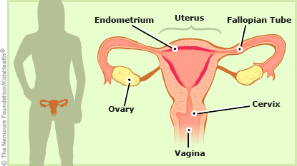
FEMALE FACTORS CAUSING INFERTILITY

Slide 2
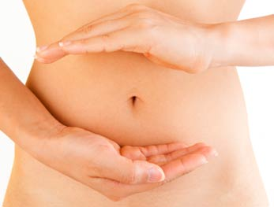
Etiology
Dyspareunia and vaginal causes
Congenital defects in the genital tract
Infection in the lower genital tract
Cervical factors (5%)
Uterine causes (10%)
Tubal factors (25-30%)
Ovarian factors (30-40%)
Pelvic/Peritoneal causes (5%)
Chronic ill health
Hormonal causes
Unexplained infertility (15%)

Slide 3
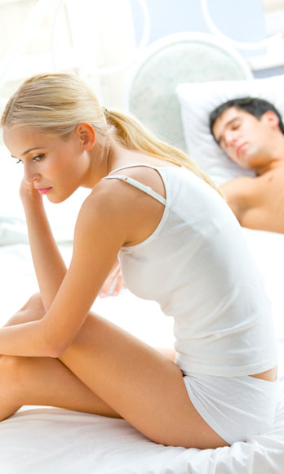
Dyspareunia
Reduce the COITAL FREQUENCY.
Fixed retroversion with prolapsed ovaries
Inflamed adnexal disease
Pelvic endometriosis

Slide 4
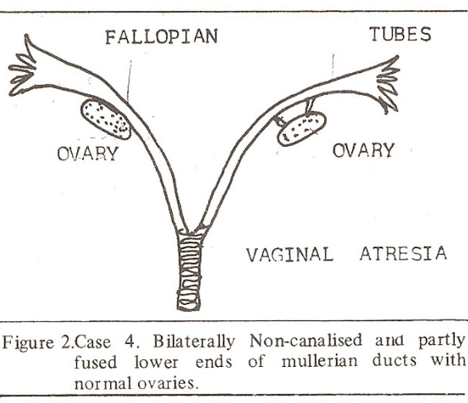
Congenital defects in the genital tract
Absent or septate vagina
Hypoplasia, absent uterus
Bicornuate uterus and septate uterus cause recurrent miscarriage
Impairs spermal functions.
Ex: Chlamydial cervicitis
Infection in the lower genital tract

Slide 5
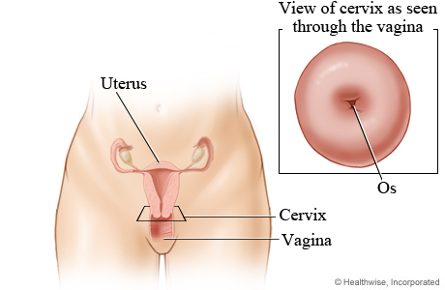
Cervical factors
Agglutinating antisperm antibodies in the cervical mucous
Cervical fibroid (distorting the passage of sperms)
Cervical stenosis and scarring. Causes:
Congenital
post-surgical: LEEP
conisation
amputation
fothergills operation

Slide 6
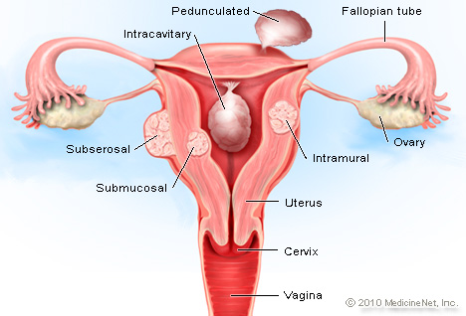
Uterine factors
Congenital abnormalities
Submucous myomas
Cornual fibroid
Adenomyosis
Endometrial polyps
Endometrial hyperplasia
Endometrial tuberculosis (Asherman’s syndrome)

Slide 7
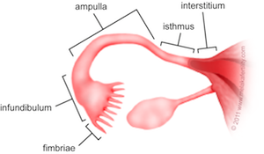
Tubal factors
Tubal tuberculosis
Tubal endometriosis
Salpingitis isthmica nodosa
Tubal polyps
Tubal spasm
Peri tubal adhesions
Intratubal mucous debris/ tubal blockage
Fimbrial end blockage
PID - Incidence: 1episode-12%, 2episodes-23%, 3episodes-54%. Chlamydia and gonorrhoea are common pathogens associated with PID and infertility.

Slide 8
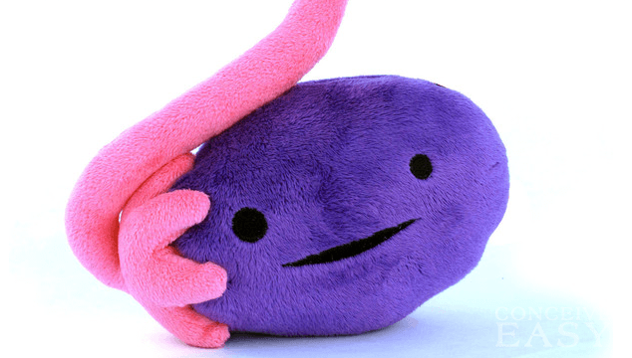
Ovarian factors
Decreased ovarian reserve
PCOS
Anovulation
Oligo-ovulation
LPD (4%)
Periovarian adhesions
Luteinized unruptured follicular syndrome (9%)

Slide 9
OVARIAN RESERVE:
No. of resting or non growing primordial follicles in the ovaries.
DECREASED OVARIAN RESERVE:
Causes: Advanced maternal age
Premature ovarian failure
Resistant ovary

Slide 10
WHO classification of disorders of ovulation:
Type I: Hypogonadotrophic Hypogonadism
Ex: Sheehan’s syndrome
Type II: Normogonadotrophic Hypogonadism
Ex: PCOS
Type III: Hypergonadotrophic Hypogonadism
Ex: ovarian failure, Turners syndrome, radiation, chemotherapy, autoimmune diseases

Slide 11
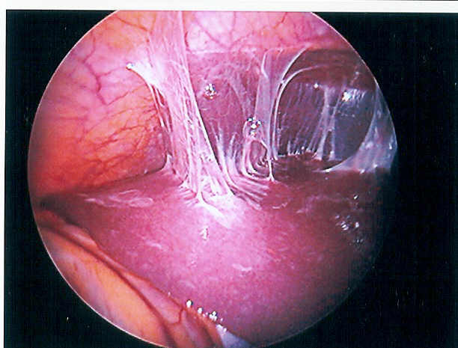
Pelvic/Peritoneal causes
Adhesions:
Impairs the peristaltic movements of the fallopian tubes.
Endometriosis:
In pelvic endometriosis - macrophages in the peritoneal fluid may engulf the ovum and sperms preventing fertilization.

Slide 12
Chronic ill health
Diabetes
Tuberculosis
Thyroid dysfunction
Hyperprolactinaemia
Pituitary gland dysfunction
Hypothalamic disorders
Hormonal causes

Slide 13
Investigations Tests For OVULATION
Basal body temperature
Midluteal serum progesterone
Urinary LH
TVS
Endometrial biopsy
Fern test

Slide 14
Tests for TUBAL PATENCY
Insufflation test ( Rubin’s test )
HysteroSalpingoGraphy ( HSG )
Laproscopic chromopertubation
SonosalpingoGraphy (SSG)
Some newer modalities ( Endoscopy ) also available….
1.Laparoscopy 2.Hysteroscopy 3.Transvaginal falloscopy 4.Ampullary & fimbrial Salpingoscopy

Slide 15
Insufflation test ( Rubin’s test)
Principle :
Cervical canal is continuous with peritoneal cavity through tubes so, when air or Co2 pushed transcervicaly it reach to peritoneal cavity & gives evidence of normal patency.
Time :
Postmenstrual phase at least 2 days after
stoppage of bleeding.

Slide 16
Limitation : PID & Post ovulatory period
Observation : Hissing sound on auscultation at Iliac fossa Shoulder pain
Drawback :
In 1/3 it’s false negative due to cornual spasm Can’t identify the SITE & SIDE of blockage

Slide 17
HysteroSalpingoGraphy ( HSG )
Principal :
Same as Insufflation test but instead of air & Co2, DYE is instilled trans cervicaly
Time: Day 6-11
Limitation:
Post ovulatory period
PID, endometriosis, tuberculosis
There may be a risk of radiation..!!
Dye :
Water soluble (preferable)
Oil Soluble

Slide 18
Water soluble:
50% Iodine with 6% polyvinyl Alcohol in water
Rapid absorption
Less tissue reaction & less adhesion
Harmless if intravasated in venous system
Oil soluble:
Lipiodol & Ethiodol
It gives more clear & Sharper image
Slow – delayed
More
May cause oil granuloma & embolism

Slide 19
Method : Foley’s catheter or Leech-wilkinson cannula is used for insufflation. With aseptic precaution DYE is injected by cannula into uterine cavity under vision with Fluoroscopic screen.. 15 ml is adequate The dye flows through the uterus and tubes and spills into the peritoneal cavity & the dye can be visualised.

Slide 20
Tube patent
Observation
Medium spill out abd. Ostia & smear the bowl
Flow stopped in between
Large confined mass without peri. spill
May be hydrosalpinx
Tube Block &
site will seen
Other things can identify..!!!!
such as..Uterine abnormality - septate, bicornuate etc…
Bilateral cornual block with extravasation suggest TUBERCULAR salpingitis

Slide 21
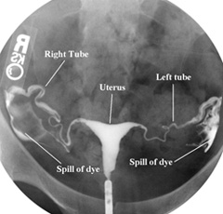
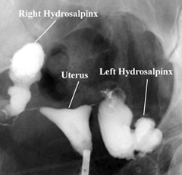
Normal HSG/ Hydrosalpinx

Slide 22
Complications:
vascular intravasation, cervical laceration, uterine perforation, hemorrhage, vasovagal reactions, severe pain, allergic response to dye.
Prophylactic Doxycycline 100mg twice daily for 5days is advisable

Slide 23
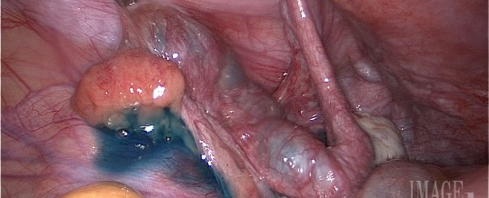
Laproscopic chromopertubation
It’s invasive procedure…
Lap. visualization of pelvic organs & injection of METHYLENE BLUE dye through Cx & it’s spill is visualized.

Slide 24
Indication : - Abnormal HSG finding
- Failure to conceive after 6 month of Rx
- Unexplained infertility & age above 35 yr
- Prior to tubal microsurgery
- Also used as Therapeutic in adhesion & fimbrial block, ovarian drilling
Time :
Day 6-11

Slide 25
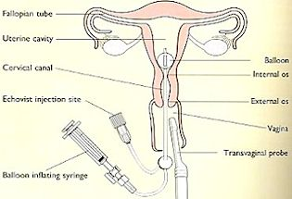
SonosalpingoGraphy
Principle : Normal saline pushed in uterine cavity with pediatric foley’s catheter & bulb inflated above internal os which prevents leakage.
Nearly 200 ml saline needed.
inj. of small amount air help in visualization of air bubble movement

Slide 26
Advantage :
Non-invasive, no radiation exposure
Tubal pathology can be detected
Uterine malformation,
synechiae or polyp can be detected
Fluid in Pouch of Douglas can be detected

Slide 27
Laparoscopy
Advantages
Minimally invasive
Less adhesions
less pain
Early recovery
Less infection
Better visualisation
All factors evaluated & treated simultaneously
Used as Diagnostic & therapeutic
Diagnostic : Uterus
Ovaries
Tubes
Peritoneal factors
Therapeutic : Adhesoilysis
Ovarian Drilling & IVF
Fulgration of endometriosis
Tubal reconstructive surgery
Ovarian cystectomy
Biopsy from suspicious lesions
Resection of Gross Hydrosalpinx

Slide 28
Hysteroscopy
Diagnostic : Cervical canal, uterine cavity, Endometrium, Tubal ostia
Therapeutic : Polyp excision & Biopsy
Septal resection
Proximal tubal cannulation
sub mucous myomectomy..

Slide 29
Transvaginal falloposcopy
Visualize lumen of tubes.
Therapeutic for Medial end blockage due to adhesion or mucous plug.
Ampullary & fimbrial Salpingoscopy
To Study mucosa of F. tube in deciding between tubal microsurgery & IVF.
Colour Doppler Ultrasound – Under study

Slide 30
Tests for UTERINE factors
HSG
TVS
SIS
Hysteroscopy
Post coital test
Tests for CERVICAL factor

Slide 31

Other Investigations:
Hirsutism/virilisation: testosterone, DHEA, 17(OH)P
Galactorrhoea: prolactin, TSH
Obesity: blood sugar, lipid profile
History s/o infection: cervical swab
Women> 35yrs: Day3 FSH/oestradiol

Slide 32

Treatment
Counselling regarding Fertile Period
For ovulatory dysfunction:
OVULATION INDUCTION
OVARIAN DRILLING

Slide 33
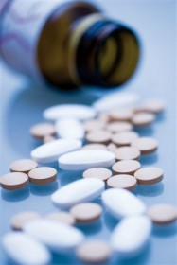
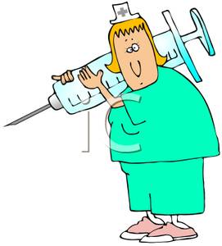
Ovulation inducing agents:
Clomiphene Citrate
Gonadotrophins- hMG, hCG, R.FSH
Aromatase inhibitors- Letrozole
Tamoxifene
Drugs used to facilitate ovulation induction:
Insulin sensitisers- Metformin, Pioglitazone
Complications of OI:
OHSS, multifetal gestation

Slide 34
Treatment for tubal factors:
Proximal tubal occlusion(intramural portion, isthmus/ampulla of the tube):
Selective salpingography
Radiologically guided tubal cannulation
Hysteroscopic cannulation
Microsurgery- resection and anastomosis, tubocornual anastomosis
2. Distal tubal occlusion:
Fimbrioplasty
Neosalpingostomy
Salpingectomy and in vitro fertilisation

Slide 35
Treatment of uterine factors:
Endometrial polyp - Hysteroscopic Polypectomy
Myoma – Myomectomy
Intrauterine adhesions – Hysteroscopic Adhesiolysis
Congenital anomalies – Surgical correction

Slide 36
Treatment of CERVICAL & PERITONEAL factors:
Active infection should be treated.
Adhesions caused by PID/ endometriosis can be released by lap.adhesiolysis. But adhesions can recur. IVF is the best option in many of these women.
In women with abnormal Post Coital Test or UNEXPLAINED INFERTILITY – IUI is the treatment of choice.

Slide 37
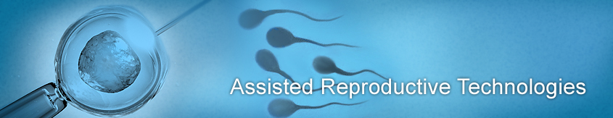
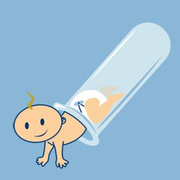
IVF
ICSI
GIFT
ZIFT
PGD
Sperm retrieval techniques:
(TESE, MESA, PESA, TESA)
Alternatives- donor oocyte, donor sperm, donor embryo, gestational surrogacy

Slide 38
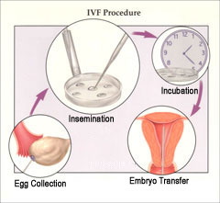
IVF
Controlled ovarian hyperstimulation by downregulation with GnRH analogue and ovulation induction with gonadotrophins.
Ultrasound guided oocyte retrieval is done on the day when the follicle is 17-18mm in size.

Slide 39
Processing of the sperm.
Lab. Fertilisation of the oocytes
Embryos are then cultured for 3-5days
Transcervical transfer of embryo into the uterine cavity under ultrasound guidance.
Luteal support is provided with vaginal progesterone.

Slide 40
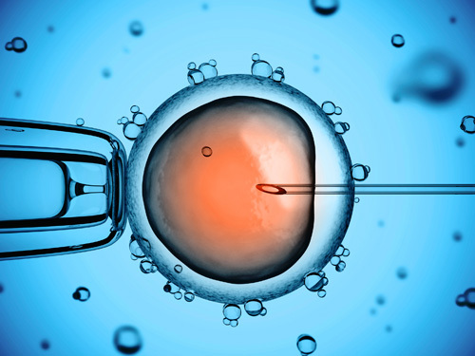
ICSI
Used in couples with male factor infertility.
Cumulus cells surrounding the ovum are removed and single sperm is injected through the zona pellucida into the cytoplasm.
This method yields 50-70% successful fertilization rates

Slide 41
Indications of ICSI:
Sperm count<5mil/ml
Decreased/absent motility of sperms
Failed IVF
Unexplained infertility
Sperms are obtained by semen washing/ TESA/PESA/MESA

Slide 42
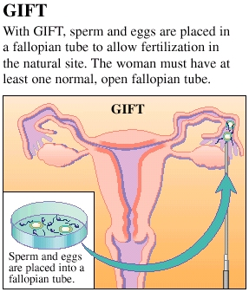
GIFT
Involves ovarian stimulation and egg retrieval, followed by laparoscopically guided transfer of a mixture of unfertilized eggs and prepared sperms into the fallopian tube.
Not suitable for tubal factor infertility.
Used in unexplained infertility and mild male factor infertility.

Slide 43
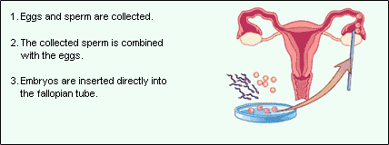
ZIFT
The egg is fertilized as for IVF, but transferred into the fallopian tube laparoscopically on Day1.

Slide 44

Preimplantation Genetic Diagnosis PGD
Performed by removing a sinle cell from the embryo at 6-8 cell stage for the diagnosis of single-gene defects, aneuploidy and translocations.
Perfomed when there is a family history of inherited disorders.

Slide 45
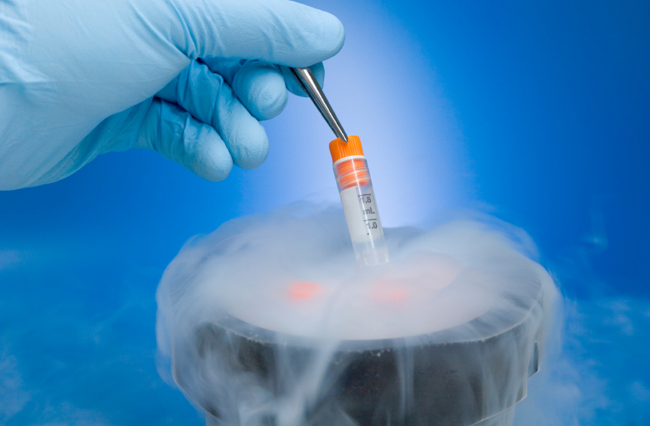
Embryo cryopreservation
Several eggs can be retrieved in a single cycle and fertilized, but only 2 or 3 are usually transferred to the uterus. The remaining embryos can be cryopreserved and used in subsequent cycles.

Slide 46
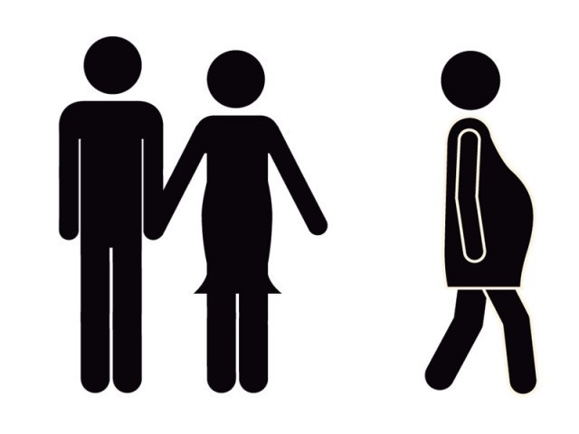
Surrogacy
It is an agreement of carrying
of a pregnancy for intended
parents.
Types:
Gestational surrogacy (transfer of embryo created in IVF)
Traditional surrogacy (the surrogate is impregnated naturally or artificially)

Slide 47


