Slide 1
Vulval Dystrophies
Vulval Cysts
Benign vulval neoplasms
Anatomy of the Vagina
Biology of the Vagina

Slide 2
Vulval dystrophies
Non neoplastic epithelial disorders
Represent a spectrum of atropic and hypertrophic lesions caused by a variety of stimuli resulting in circumscribed or diffuse white lesions.
Causes :
Trauma, excessive straching, allergy
Folic acid, B12 deficiency, achlorhydria
Chronic infection
Metabolic disorders-diabetes, thyroid
Immunosuppresion
Autoimmune disease-SLE

Slide 3
Microscopically these white lesions show patterns varying from mild dysplasia to frank malignancy in different parts of same lesion.
The present day histological classification of vulvar dystrophies is based on International Society for the study of Vulvar Diseases.
Hyperplastic dystrophy
Lichen sclerosus
Mixed

Slide 4
Hyperplastic dystrophy
(squamous cell hyperplasia)
Chronic irritation or chronic vulvovaginal infection leads to benign epithelial thickening and hyperkeratosis.
It may involve any part of the vulva, perianal area, perineum and the adjacent thighs.
Patient suffers with pruritus, soreness, discharge and dyspareunia
The lesions begins as white polygonal papules which coalesce to form plaques giving the appearance of “splashed with white wash”
In acute phase-lesions may appear red and moist due to secondary infection
As epithelial thickening develops, the vulva causes maceration and a raised circumscribed or diffuse white lesion occurs giving a rubbery look

Slide 5
Histology:
- Hyperkeratosis,
- Downgrowth of rete pegs deep into the dermis,
- Inflammatory infiltrate in dermis,
- Prickle cell layer increased in thickness,
- Cells of basal layer shows active mitosis.
10-30% of cases develop malignant change

Slide 6
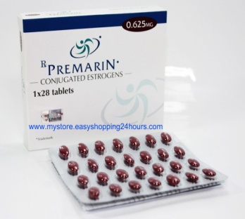
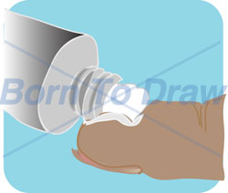
Rx:
Initial treatment with oestrogens is worthwhile.
oral administration of premarin-0.625mg of conjugated equine oestrogen helps to control vulval pruritis.
Bland local medicaments like calamine lotion, crotamine or zinc oxide paste are soothing.
In case of superadded inflammation steroid ointment containing 1% hydrocortisone, betamethasone, fluocinolone with or without antimicrobial agents like neomycin, antibiotic-soframycin, antifungal-miconazole or chiniofon are useful.
Mild sedative at bed time-2% lignocaine ointment relieves pain, prevents patient from scratching.
Surgical excision is indicated in case of advanced lesions.

Slide 7
Lichen sclerosus
(atrophic dystrophy)
Disease of elderly women over the age of 65yrs.
With aging, endogenous oestrogen decreases and atrophic changes in the vulvar skin and subdermal tissues appear, followed by atrophy of vaginal mucous membrane, contracture of vaginal introitus.
Genetic and familial tendency is also noted.

Slide 8
Symptoms- pruritus, dysuria, dyspareunia, local discomfort.
In acute phase-lesion may appear dusky involving vulva, perineum and perineal area in hour glass pattern. Skin is papery thin and wrinkled.
As the disease progresses the labia minora blend into labia majora and causes narrow introitus

Slide 9
Histology :
Hyperkeratosis
Thinning of epidermal epithelium
Flattening of rete pegs
Hyalinization of collagen
Inflammatory infiltrate in the subepidermis
5-10% of cases may develop malignancy

Slide 10

Rx:
Local application of steroids- oestrogen cream and testosterone propionate.
2% testosterone ointment in white petroleum resolves pruritus in 6-8wks.
In young women topical progesterone is preferred. Vitamin A, retinoid analogues have been administrated
LS is now treated with 0.05% clobetasol ointment for 8-12wks followed by trimovate (clobetasone+nystatin) to maintain symptomatic relief.
Surgery is rarely employed and not curable. Skinning vulvectomy, cryo and laser ablasion have been employed

Slide 11
Vulval Cysts
Sebaceous cysts
Bartholin’s cysts
Cyst of the canal of Nuck

Slide 12
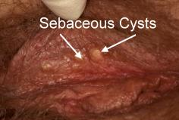
Sebaceous cysts :
- Commonly seen between the labia majora and minora.
- Blockage of duct of sebaceous gland
- Contains cheesy material

Slide 13
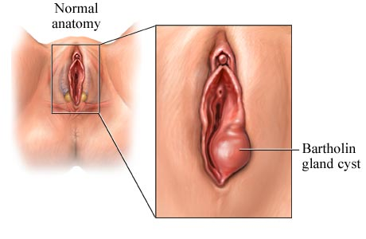
Bartholin’s cyst :
Commonly seen on the
inner side of the junction of
ant2/3rd with the post1/3rd
of the labia majus.
Formed when the duct is blocked either by inflammation or by inspissated secretion.
Small cyst-asymptomatic
Large cyst-bulges across the vaginal introitus and causes dyspareunia, discomfort and may get infected.

Slide 14
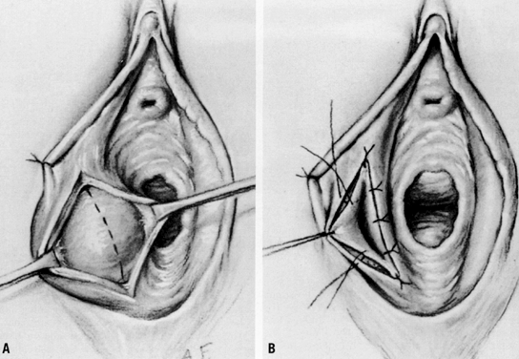
Excision/ Marsupialization :
Incision runs along the long axis of labia majora, away from the introitus to avoid a painful scar and dyspareunia.
The cavity is scraped, hemostasis secured and the edge sutured to the skin.
The cavity shrinks and heals by granulation tissue

Slide 15
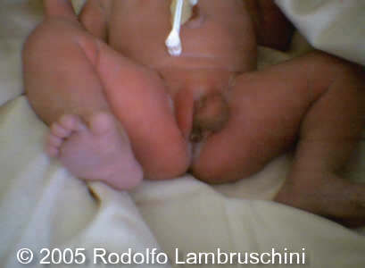
Cyst of the canal of Nuck :
It is a remnant of the processus vaginalis beneath the anterior part of the labia minora
In rare cases, it may give rise to a cyst or a hydrocele in women

Slide 16
Benign vulval neoplasms
Lipoma, Fibroma, Neurofibroma:
Rare pedunculated benign growths.
Needs excision.
Hidradenoma :
Tumors of apocrine sweat glands, occur on medial aspect of labia majora.
Usually less than 1cm in diameter, firm and freely movable. Ulceration and pain may develop if the lesion connects with epithelial surface.
Rarely it may undergo malignant change and requires excision.

Slide 17
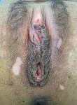
Pigmented vulvar tumors :
Classified as lentigo, vulvar melanosis and naevi.
A growing mole may develop into melanoma. It should be excised and subjected to histology.
Endometriosis :
Purplish swelling seen over the labia majora or episiotomy scar over the perineum.
Grows during menstruation, becomes painfull. But recedes in between menstruation.
Requires excision

Slide 18
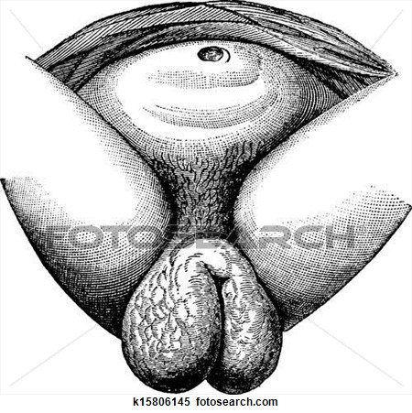
Elephantiasis vulva :
Caused by W.bancrofti, filariasis disease of the tropic.
Causes elephantiasis vulva and inguinal lymphadenitis
If DEC fails to cure the condition, surgical excision is needed

Slide 19
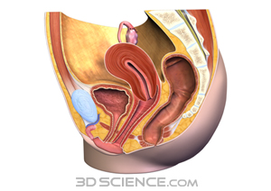
Anatomy of the Vagina
The vagina is a fibromuscular
passage that connects the
uterus to the introitus.
Synonym-Kolpos
Situation-behind the bladder
and urethra, and infront of
rectum and anal canal.

Slide 20
Direction:
- In erect posture-the vagina is directed upwards,backwards with a forward convexity, making an angle of about 45degrees with uterus.
- In supine position it makes an angle of 75degrees with the horizontal plane
- These angulations vary with the conditon of bladder and rectum
Length:
  anterior wall is 8-9 cm
  posterior wall is 10 -11 cm

Slide 21
The diameter of vagina gradually increases from below upwards. The lower end (introitus vaginae) is about 2.5cm, and the upper end (vault) is roughly 5cm.
In the anterior vaginal wall 3 sulci can be distinguished.
Submeatal sulcus- immediately above the meatus
Transverse vaginal sulcus-junction of urethra and bladder
Bladder sulcus-junction of bladder and anterior vaginal wall

Slide 22
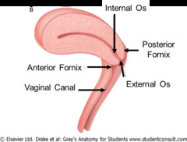
Fornices of vagina:
The vaginal vault is in the form of circular groove which is divided into 4 parts by the protruding cervix.
Anterior fornix- shallowest fornix that lies infront of the cervix
Posterior fornix-deepest fornix that lies behind the cervix
2 lateral fornices that lie one on each side of the cervix

Slide 23
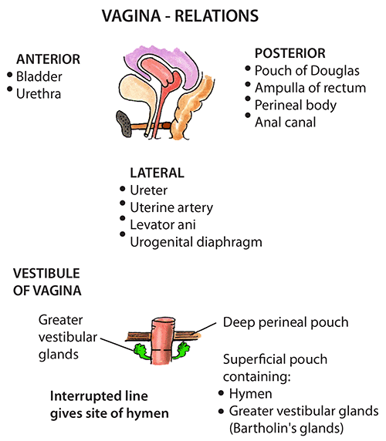
Relations:
Anterior wall- upper half : base of bladder,
lower half : urethra
Posterior wall- upper 1/3rd : ant.wall of POD,
middle 1/3rd : ampulla of rectum,
lower 1/3rd: perineal body
Lateral walls-
upper 1/3rd : transverse cervical ligament of
pelvic fascia in which vaginal veins,
ureter, uterine artery are embedded.
middle 1/3rd: pubococcygeus of levator ani,
lower 1/3rd: pierces the urogenital diaphragm and
related to bulb of vestibule,
bulbospongiosus,
greater vestibular gland of bartholin

Slide 24
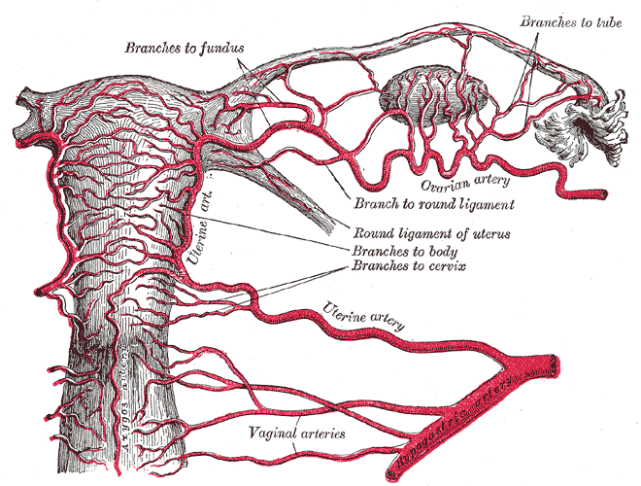
Arterial supply:
Vaginal branch of internal iliac artery
Cervicovaginal branch of uterine artery
Middle rectal and internal pudendal arteries
Branches of these arteries anastomose to form anterior and posterior midline vessels called vaginal azygos arteries

Slide 25
Venous drainage :
The vaginal venous plexus drains into the internal iliac veins through the vaginal veins
Lymphatic drainage :
upper 1/3rd-external iliac nodes
middle 1/3rd-internal iliac nodes
lower 1/3rd-superficial inguinal nodes

Slide 26
Nerve supply :
Upper 2/3rd-pain insensitive
supplied by sympathetic L1,L2, parasympathetic S2,S3 nerves derived from inferior hypogastric and utero vaginal plexus.
Lower 1/3rd-pain sensitive
inferior rectal branch of pudendal nerve
posterior labial branches of perineal nerve

Slide 27
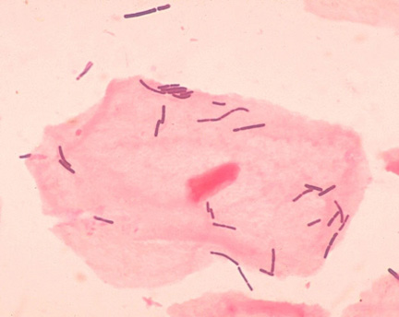
Biology of the Vagina
Vaginal flora: Doderlein’s bacillus is the only organism found in the upper 2/3rd of the vagina.
Doderlein’s bacilli are large gram positive rod shaped organisms, which are sugar fermenting. They convert glycogen into lactic acid which is responsible for high acidity of normal healthy vagina.
pH – 4.5

Slide 28
In a healthy adult women, the vaginal contents consists of white coagulated material.
The components of vaginal secretion are:
Sweat and sebaceous glands of vulva, specialised racemose glands of bartholin’s. The odour of the vaginal secretion is provided by the apocrine glands of vulva.
Transudate of vaginal epithelium, desquamated cells of cornified layer.
Mucous secretion of endocervical glands
Endometrial glandular secretion

Slide 29
Thank You

