Slide 1
FETAL CIRCULATION

Slide 2
Fetal circulation is the circulatory system of the human fetus,often encompassing the entire fetoplacental circulation that also includes the umbilical cord and the blood vessels within the placenta that carry the fetal blood

Slide 3
DEVELOPMENT OF THE FETAL CIRCULATORY SYSTEM
Begins to develop towards the end of the THIRD WEEK and the four chambered heart is completely formed by the end of 6 weeks
Heart starts to beat at beginning of the FOURTH WEEK

Slide 4
PLACENTAL ROLE
Fetal haemoglobin has greater affinity for oxygen than adult haemoglobin ,which allows a diffusion of oxygen from the mother circulatory system to fetus.
The circulatory system of the mother is not directly connected to the fetus .the placenta functions as the respiratory centre for the fetus as well as a site of filteration for plasma nutrients and wastes

Slide 5
 | FETAL | NEWBORN
GAS EXCHANGE | PLACENTA | LUNGS
PULMONARY CIRCULATION | VASOCONSTRICTED | DILATED
MYOCARDIUM COMPLIANCE,CONTRACTILITY | LESS | GOOD
DOMINANT VENTRICLE | RIGHT | LEFT

Slide 6
- Fetal blood flows from the placenta to the fetus through the umbilical cord
- fetal deoxygenated blood flows to the placenta through two umbilical arteries
Blood with high oxygen content moves from the placenta to the fetus through a single umbilical vein.

Slide 7
DIFFERENCES FROM ADULT CIRCULATION
Fetal blood is not oxygenated in the lungs so the major portion of right ventricular output bypasses the lungs..
Well oxygenated blood enters the left ventricle which supplies the heart and the brain and less oxygenated blood enters the right ventricle ,which supplies the rest of the body.

Slide 8
BLOOD FLOW

Slide 9
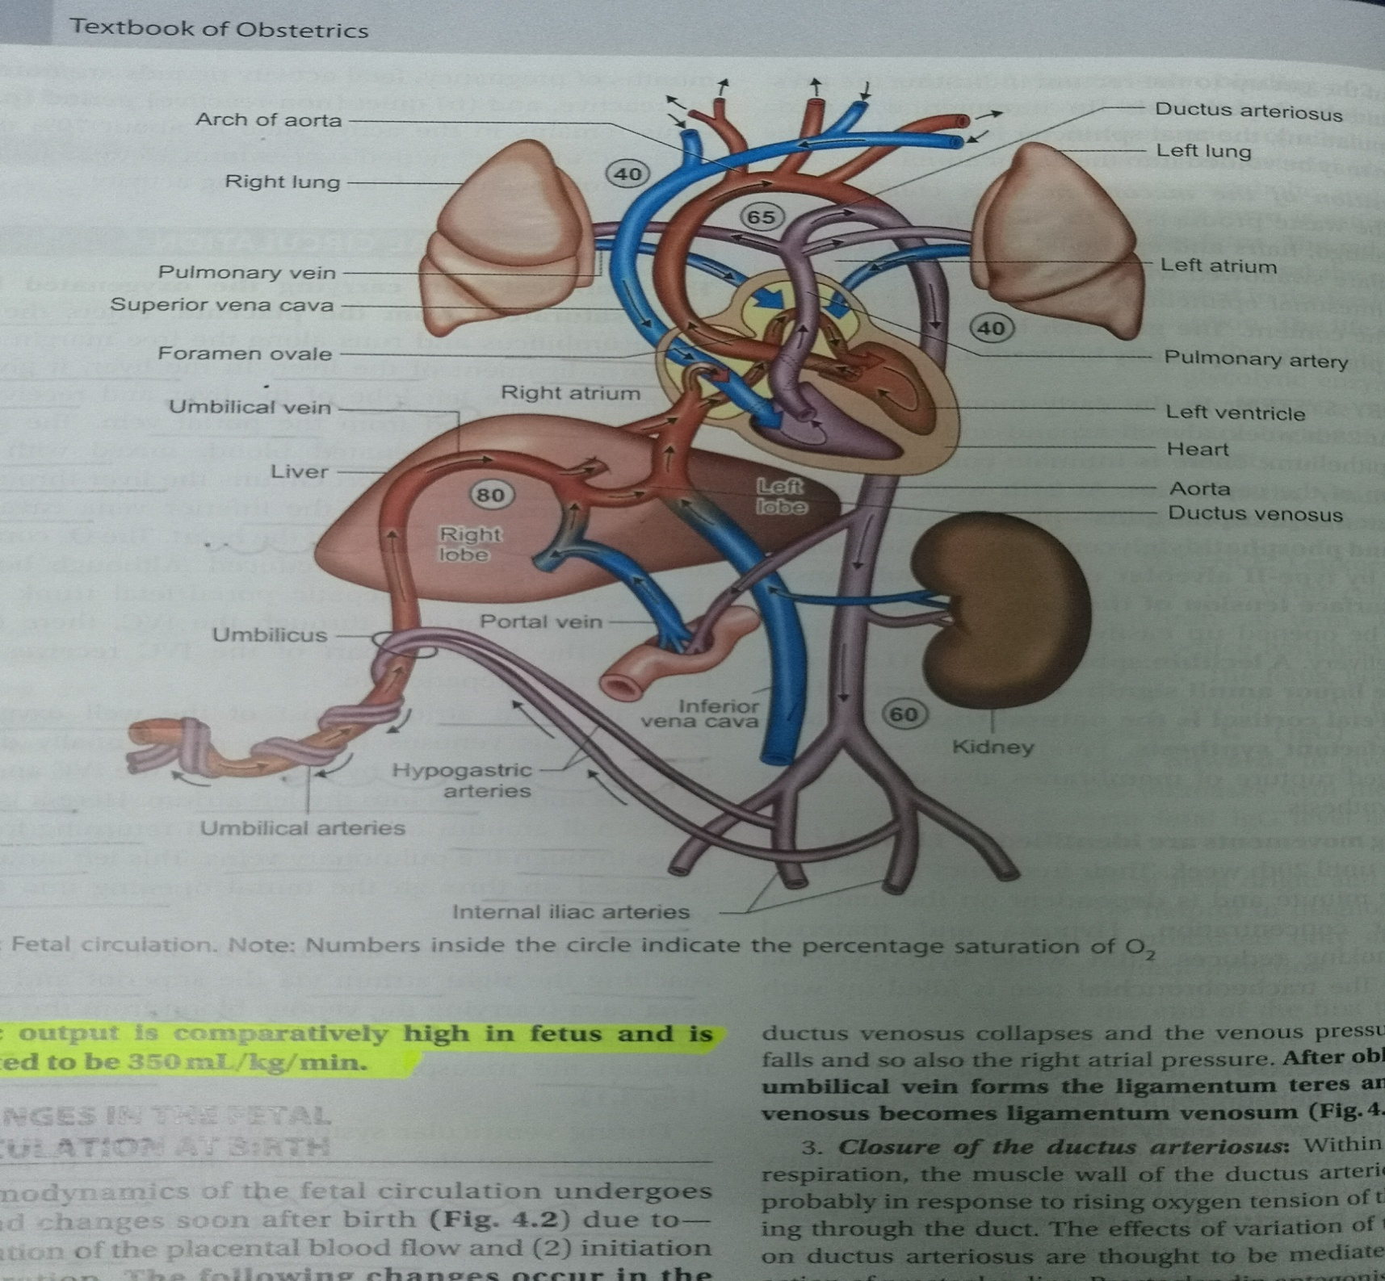

Slide 10
Blood vessels traverse the umbilical cord (two umbilical arteries and one umbilical vein),which connects the placenta and the fetus.
Umbilical vein carries oxygenated blood from the placenta(sat-80%,po2:32-35mmg)and passes directly to the liver, but before doing so it gives a branch the DUCTUS VENOSUS and the PORTAL SINUS
The DUCTUS VENOSUS traverses the liver to enter the inferior vena cava directly , because it doesn’t supply oxygen to the intervening tissues it carries well oxygenated blood directly to the heart.

Slide 11
In contrast the PORTAL SINUS carries blood to the hepatic veins primarily on the left side of the liver where oxygen is extracted.
So the deoxygenated blood from the liver then flows back into the inferior vena cava, which also receives less oxygenated blood returning from the lower body(sat-70%)
#Therefore blood flowing to the fetal heart from the inferior vena cava to the right atrium consists of
- oxygenated blood that passes directly through the ductus venosus
- Less well oxygenated that that returns from most of the veins below the level of the diaphragm.

Slide 12
In the RIGHT ATRIUM the blood enters the left atrium and the right ventricle depending on oxygen content .This separation of blood according to the oxygen content is aided by the pattern of blood flow in the inferior vena cava.
Well oxygenated blood - medial aspect of inferior vena cava
Less oxygenated blood -lateral vessel wall.

Slide 13
Once the blood enter the RIGHT ATRIUM
The CRISTA DIVIDENS shunts the well oxygenated blood from the medial side of inferior vena cava and the ductus venosus
Through the FORAMEN OVALE and into the left ventricle(sat-65%,po2:26-28mm)
to the heart and brain
Tissues extract oxygen ,resulting in less oxygenated blood returning to the right heart through the superior vena cava

Slide 14
The less oxygenated blood along the lateral wall of the inferior vena cava enters the right atrium and is deflected through the tricuspid valve to the right ventricle .
SUPERIOR VENA CAVA carries the less well oxygenated blood .(sat-40%,po2:12-14mm) returning from brain and upper body is shunted directly to the right ventricle .
* The ostium of the coronary sinus lies superior to the tricuspid valve so that the less oxygenated blood also returns to the right ventricle.
AS A RESULT ,BLOOD IN THE RIGHT VENTRICLE IS 15 – 20 % LESS SATURATED THAN THE BLOOD IN THE LEFT VENTRICLE.

Slide 15
90% of the blood exiting the right ventricle (only about 10% of right ventriclar outflow enters the lungs) passes through the pulmonary artery(sat-50-55% po2:16-18mm) is
shunted through the DUCTUS ARTERIOSUS –a connection btw the pulmonary artery and aorta
(sat 55-60%,po2:20-22mm)
-protects the lungs from the circulatory overload
-allows the right ventricle to strengthen
-high pulmonary vascular resistence, low pulmonary blood flow
Arch of aorta > descending aorta

Slide 16
Common iliac arteries:internal and external
Internal illiacs further into hypogastric arteries
Distally become the umbilical arteries
In the placenta the blood picks up the oxygen and other nutrients and is recirculated through the umbilical vein.

Slide 17
The total fetal cardiac output –the combined output of both left nd right ventricles:350ml/kg/min
Descending aortic blood flow-65% returns to the placenta remaining 35% perfuses to the fetal organs and tissues.

Slide 18
CHANGES IN FETAL CIRCULATION AT BIRTH
loss of placental circulation and clamping of the umbilical cord after birth
Sudden increase in systemic vascular resistence (d/t loss in low resistence placental circulation)
Increase in aortic blood pressure
increase in left atrial pressure>rt atrial pressure

Slide 19
Septum primum approx with septum seccundum
Closure of foramen ovale
-sudden fall in flow through ductus venosus with complete disapperance by postnatal day 7>ductus venosus closes

Slide 20
PATENCY OF THESE PATHWAYS MAY EITHER
Provide a life saving pathway for blood to bypass a congenital defect
Eg :Patent ductus in pulmonary atresia or COA
Foramen ovale in transposition of great vessels
Present an additional stress to the circulation
Eg: patent ductus arteriosus in preterm infant

Slide 21
Ductus arteriosus
Sudden expansion of lungs with first few breaths
Fall in pulmonary vascular resistence
Increase flow in pulmonary arteries
Increase in systemic vascular resistence
Increase in aortic pressure
Reversal of shunt in ductus arteriosus to left to right(from aorta to pulmonary artery)

Slide 22
Increase in po2(upto 50mmg)
Muscles of ductus arteriosus to constrict (its patency is maintained by combined effects of oxygen tension and endogenous PG
Closure of ductus arteriosus

Slide 23
Threapeutic agents may either:
Maintain fetal pathways open:PGE1
Promote theirclosure:INDOMETHACIN

Slide 24
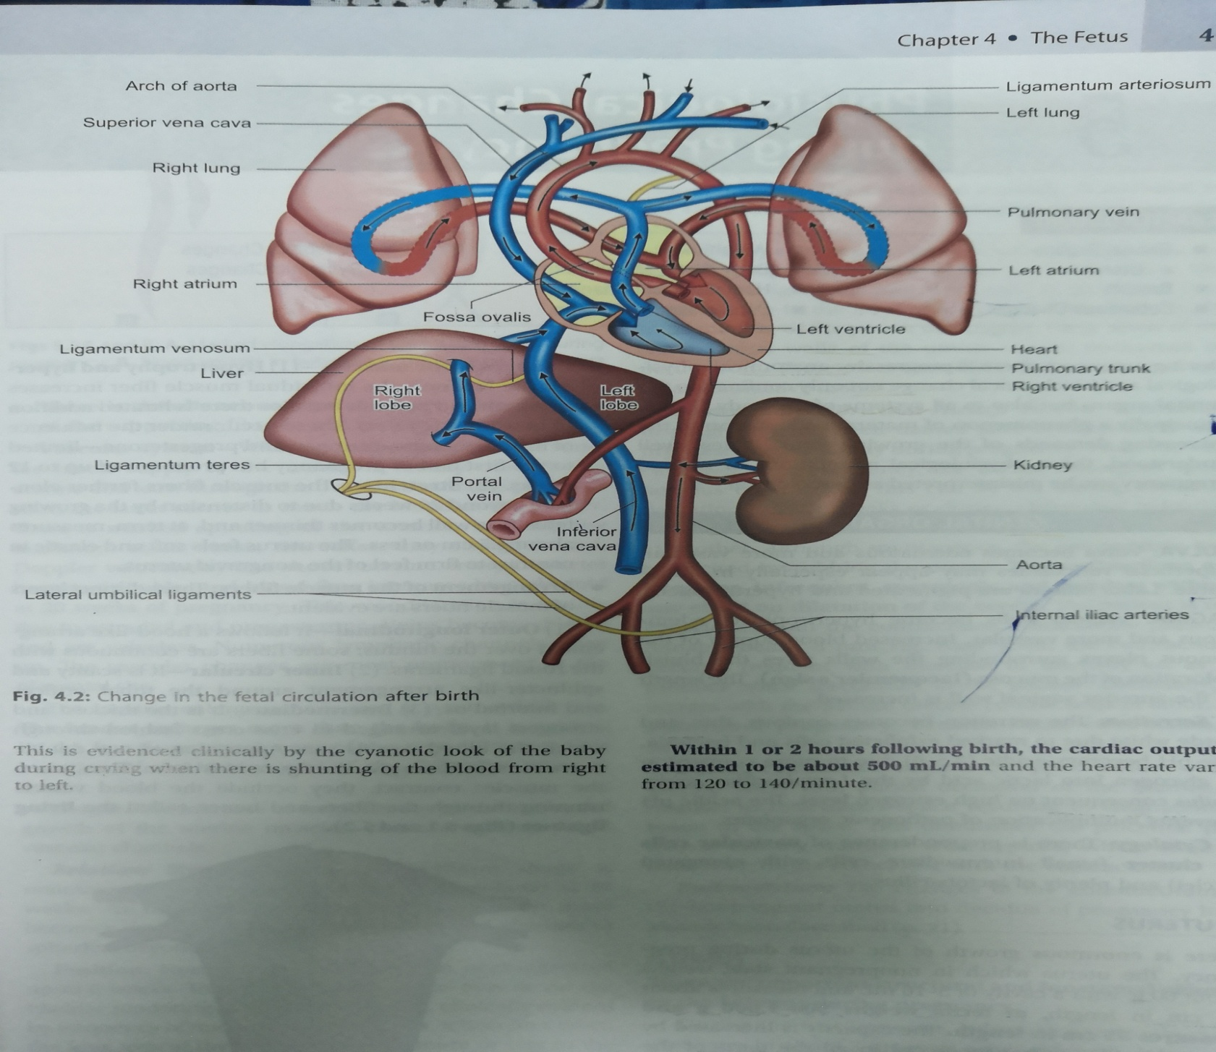

Slide 25
CLOSURE OF THE UMBILICAL ARTERIES
- distal part – lateral umbilical ligaments
- proximal part – remains open as superior vesical arteries
2)CLOSURE OF THE UMBILICAL VEINS
- obliteration occurs later than the arteries
- umbilical vein forms ligamentum teres
- ducgtus venosus forms ligamentum venosum

Slide 26
3) CLOSURE OF THE DUCTUS ARTERIOSUS
- functional closure of the ductus may occur soon after establishment of pulmonary circulation.
- Anatomical closure- about 1-3 months
- forms ligamentum arteriosum
4)CLOSURE OF THE FORAMEN OVALE
- functional closure soon after birth
- anatomical closure around one year
-forms the fossa ovalis

Slide 27
WITHIN ONE OR TWO HOURS FOLLOWING BIRTH ,THE CARDIAC OUTPUT IS ESTIMATED TO BE ABOUT 500ML /MIN , HEART RATE – 120-140/MIN

