Slide 1
MALFORMATIONS OF GENITAL TRACT

Slide 2
INTRODUCTION
EMBRYOGENESIS
VAGINAL ABNORMALITIES
VAGINAL MALDEVELOPMENTS
UTERINE ABNORMALITIES
FALLOPIAN TUBE ABNORMALITIES
OVARIAN ANOMALIES
WOLFIAN REMNANT ABNORMALITIES

Slide 3
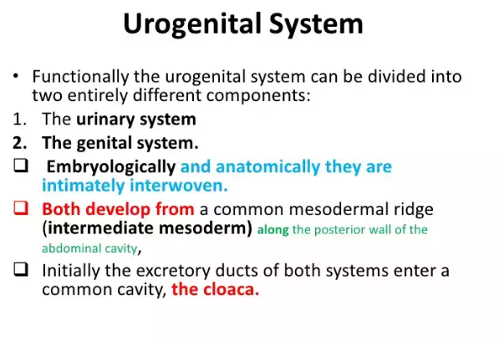
EMBRYOGENESIS.

Slide 4
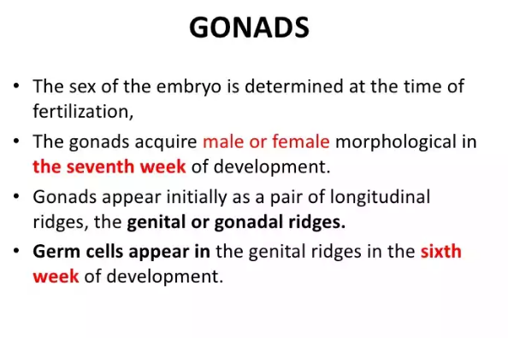

Slide 5
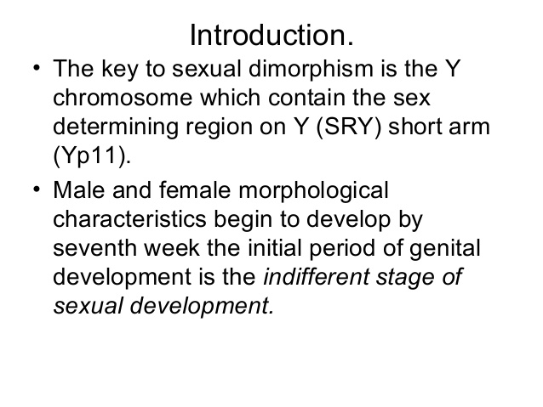

Slide 6
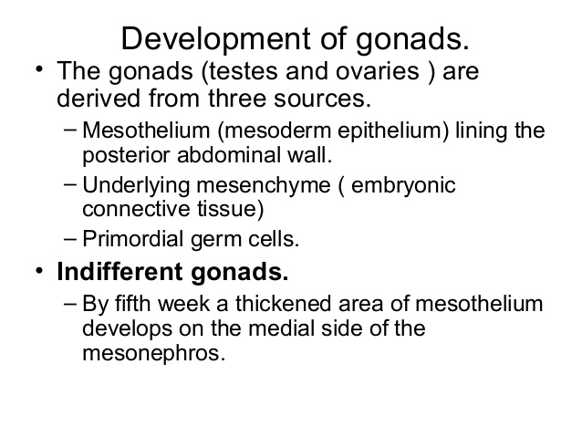

Slide 7
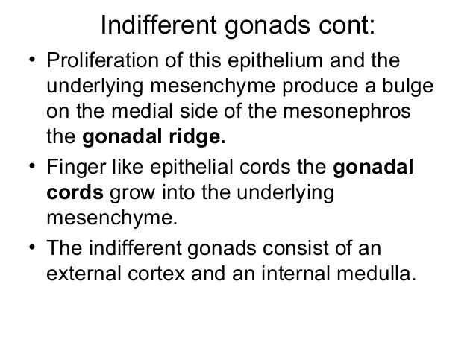

Slide 8
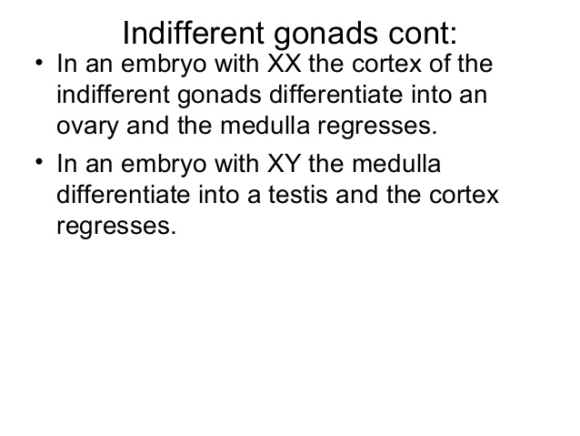

Slide 9
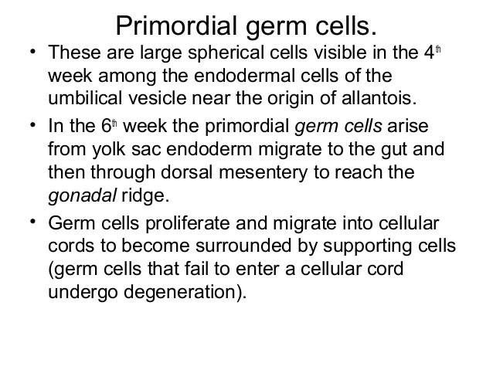

Slide 10
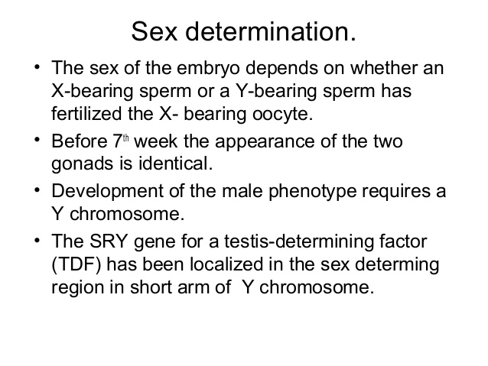

Slide 11
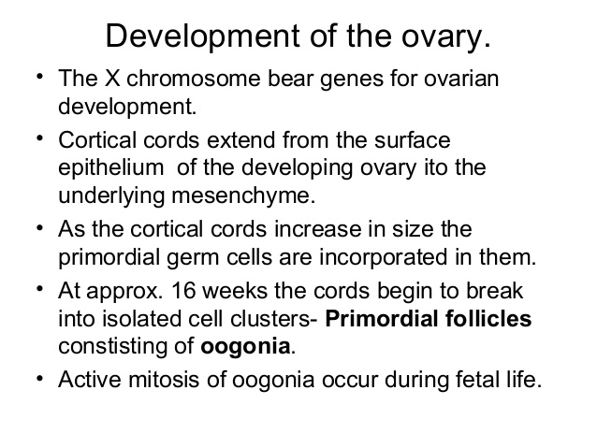

Slide 12
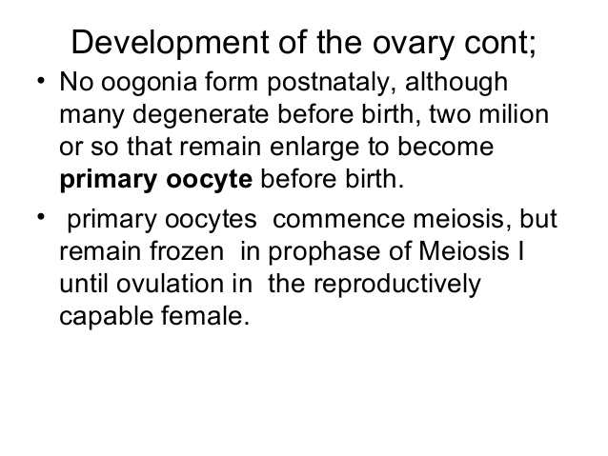

Slide 13
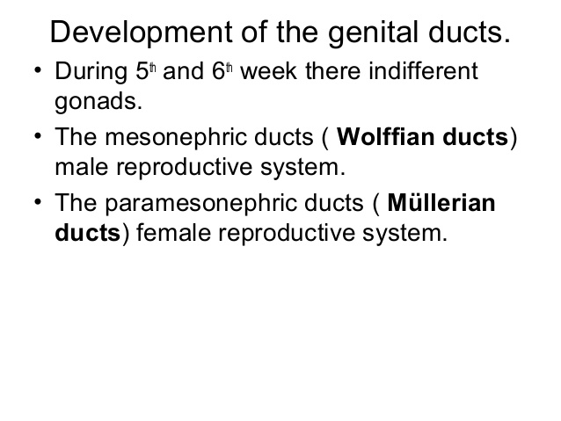

Slide 14
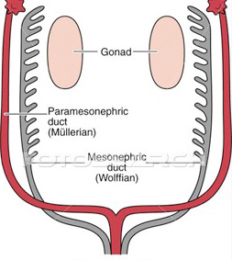

Slide 15
Paramesonephric ducts.
Paramesonephric ducts are present in intermediate mesoderm.
They are formed by invagination of coelemic epithelium,
They lie lateral to mesonephric ducts.here the ducts of the two sides meet and fuse in the middle line to form utero-vaginal canal(uterine canal).
The caudal end of this canal comes in contact with the dorsal wall of definitive urogenital sinus.
It give origin to uterine tubes, uterus ,part of vagina.

Slide 16
Female sexual development does not depend on presence of ovaries or Hormones.
Uterine tubes develop from unfused cranial parts of mullerian ducts.
Original points of invagination of ducts into coelomic epithelium remains as the abdominal openings of tubes.
Caudal fused portion of these ducts form the uterus and vagina(upper part).
Fusion of mullerian ducts also brings together a peritoneal fold that forms broad ligament and two peritoneal compartments(Rectouterine pouch,Vesico-uterine pouch).

Slide 17
Development of Uterus
Epithelium of uterus develops from fused paramesonephric ducts.
Myometrium is derived from surrounding mesoderm.
As thickness of myometrium increases,unfused horizontal parts of two paramesonephric ducts come to be partially embedded within its substance and help to form the fundus of uterus.
The cervix can soon be recognized as a seperate region.
In fetus , cervical part is larger than body of uterus.

Slide 18
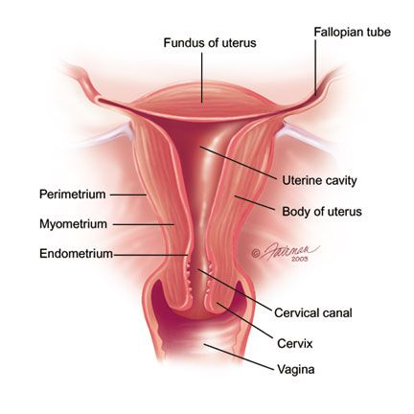

Slide 19
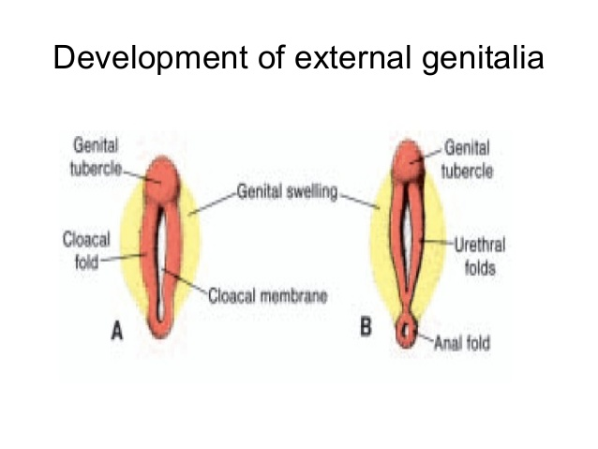

Slide 20
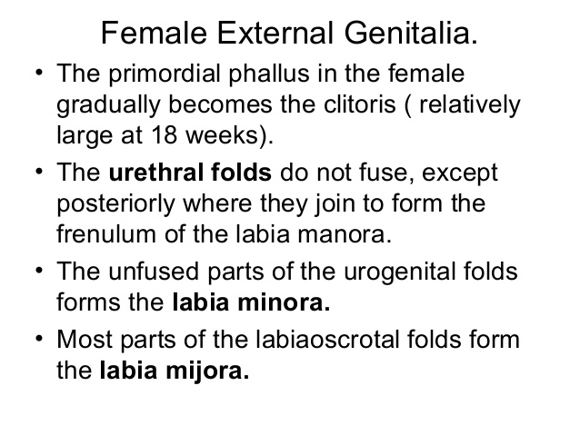

Slide 21
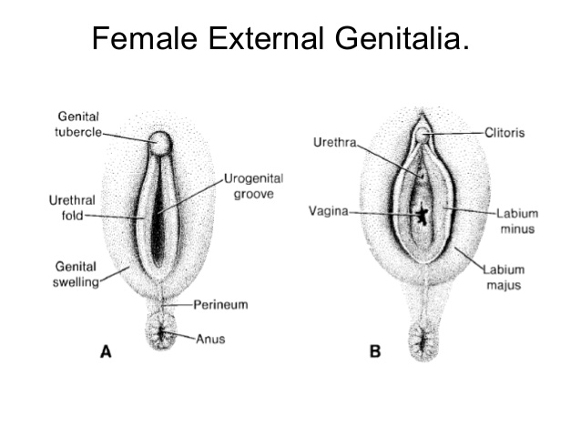

Slide 22
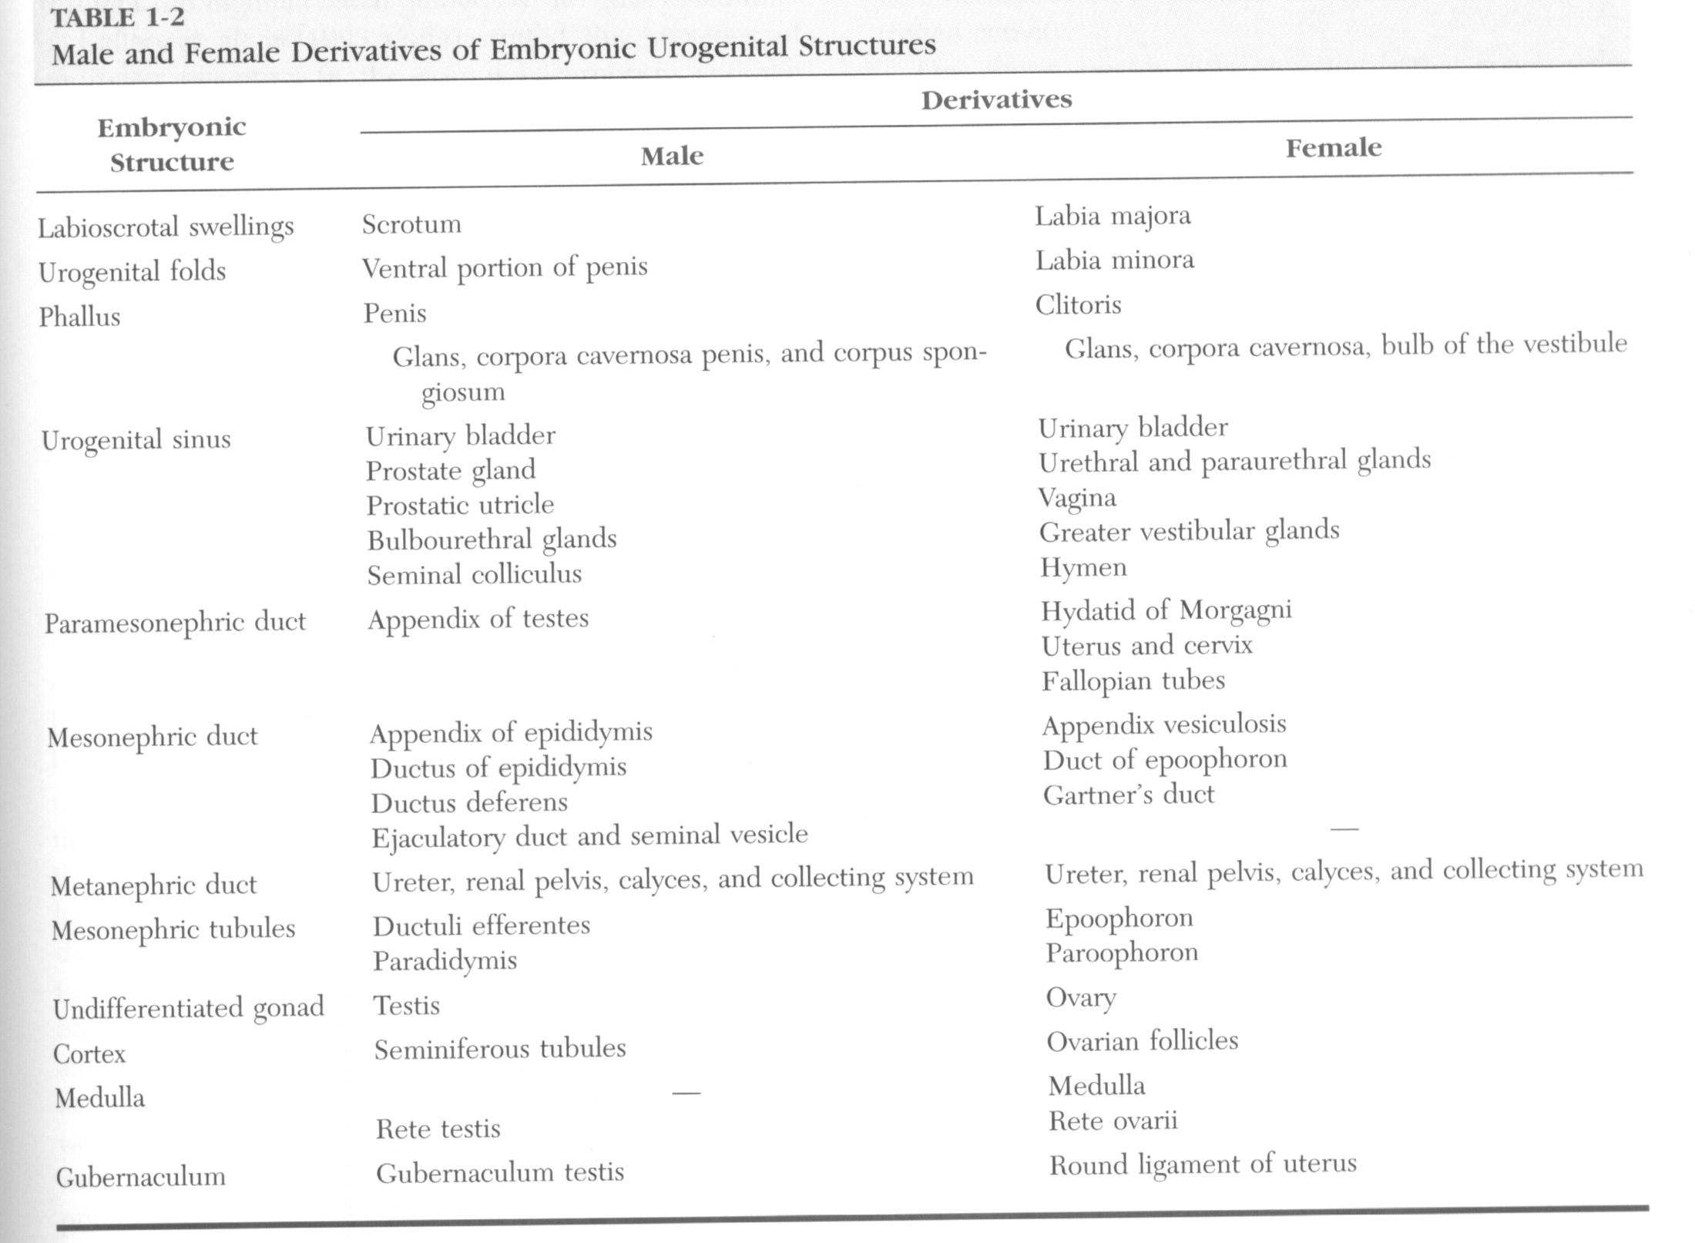

Slide 23
Development of vagina.
Fibromuscular wall of vagina is derived from surrounding mesenchyme.
Uterovaginal primodium with urogenital sinus form sinus tubercle induce formation of paired endodermal growth of sinovaginal bulb.
Sinovaginal bulbs fuse to form the lumen of the vagina.
Until late fetal life,lumen of vagina is seperated from the cavity of urogenital sinus by a membrane, the Hymen.(derived from invagination of the posterior wall of the urogenital sinus)
Upper 2/3rd from mullerian duct.
Lower 1/3rd from Urogenital sinus.

Slide 24
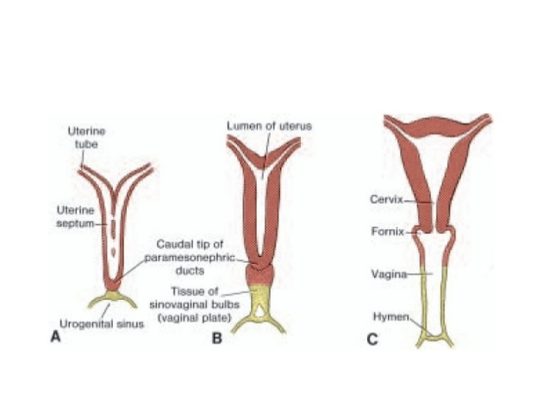

Slide 25
VAGINAL ABNORMALITIES
NARROW INTROITUS
The existence is revealed after marriage
Dyspareunia may be the first complaint
Treatment is effective by manual streching under GA or surgical management[perineoplasty/fentons operation]

Slide 26
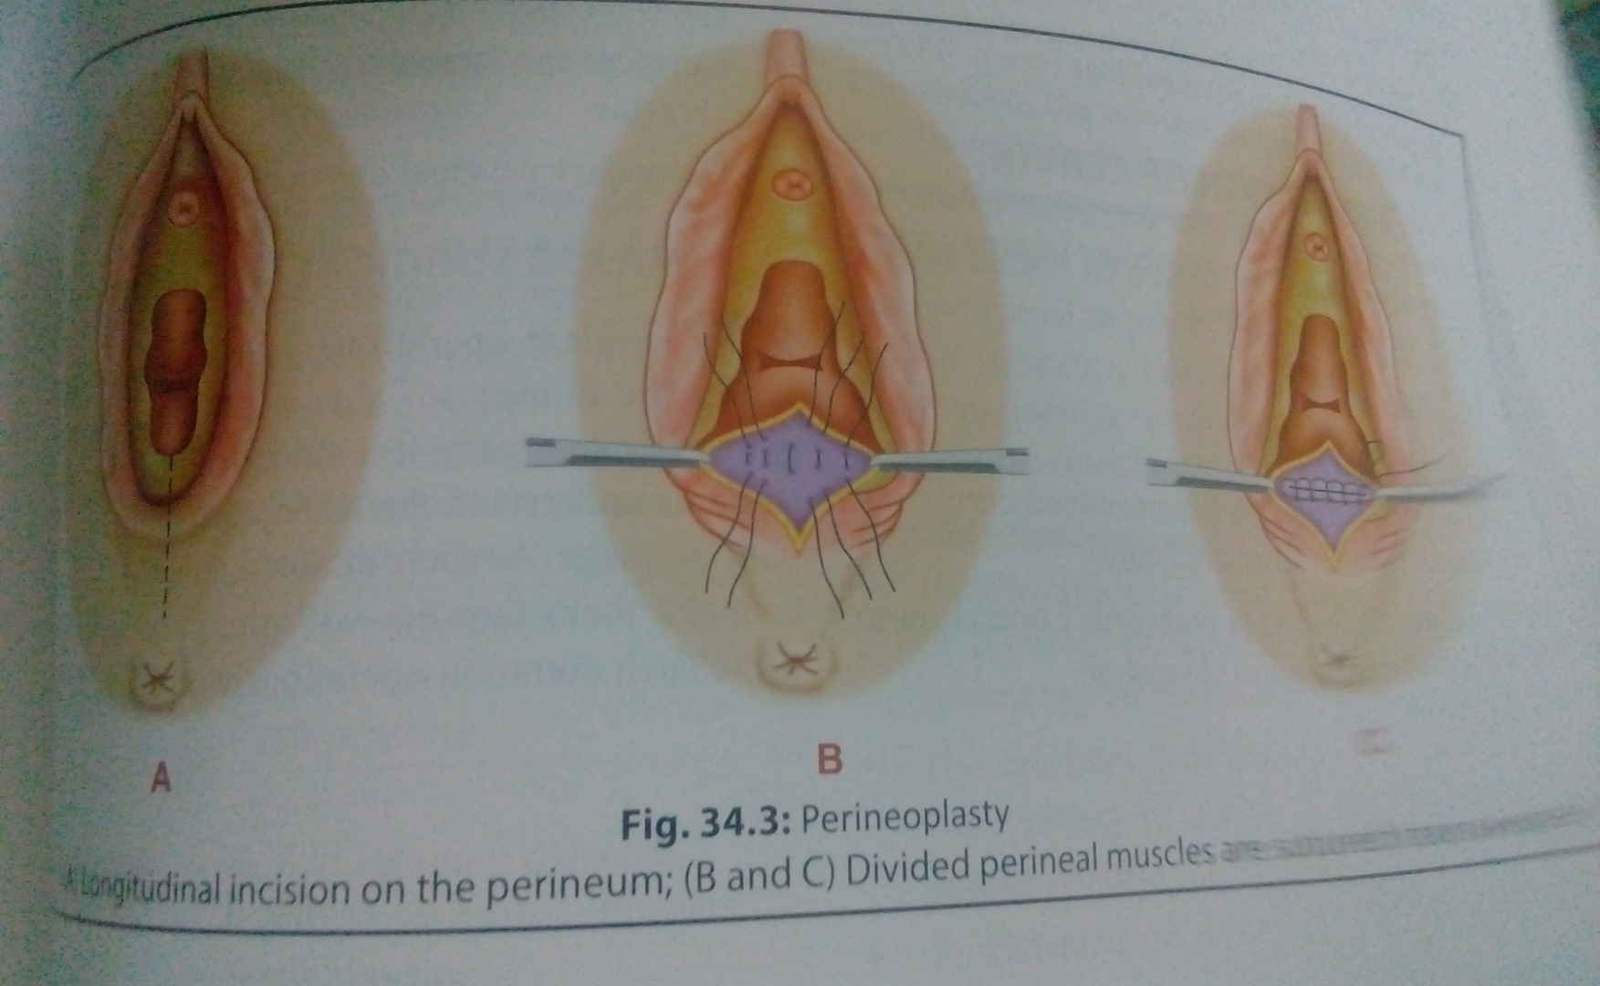

Slide 27
PERINEOPLASTY
It is the reconstriction of narrow vaginal introitus to make it adequate for sexual function
A longitudinal incision is made in the midline above(2cm) the fouchette to the skin of perineum below (2cm)
The incision is deepened through the vaginal mucosa, skin, and the perineal body
Mobilization of vaginal mucosa and the perineal skin is done
Two gloves in worn in left hand .left index finger is introduced into the rectum and it is hooked upwards and ourwards,while superficial perineal muscles are divided
Finally wound is sutured in layers transversaly by using interrupted sutures

Slide 28
HYMEN ABNORMALITIES
Gross hymen abnormality of significance is IMPERFORATE HYMEN
It is due to failure of disintegration of central cells of the mullerian eminence that projects into urogenital sinus
The exsistance is almost always unnoticed until the girl attains her 14-16 yrs of age
As the uterus is functioning normally the menstrual blood pent up inside the vagina behind the hymen [CRYPTOMENORRHEA]

Slide 29
Depending upon the amount of blood so accumulated it first desends the vagina[HEMATOCOLPOS]
The uterus is next involved the cavity is dilated [HEMATOMETRA]
In the late and neglected cases tubes may also be distended after the fimbrial ends are closed by adhesions [HEMATOSALPHINX]

Slide 30
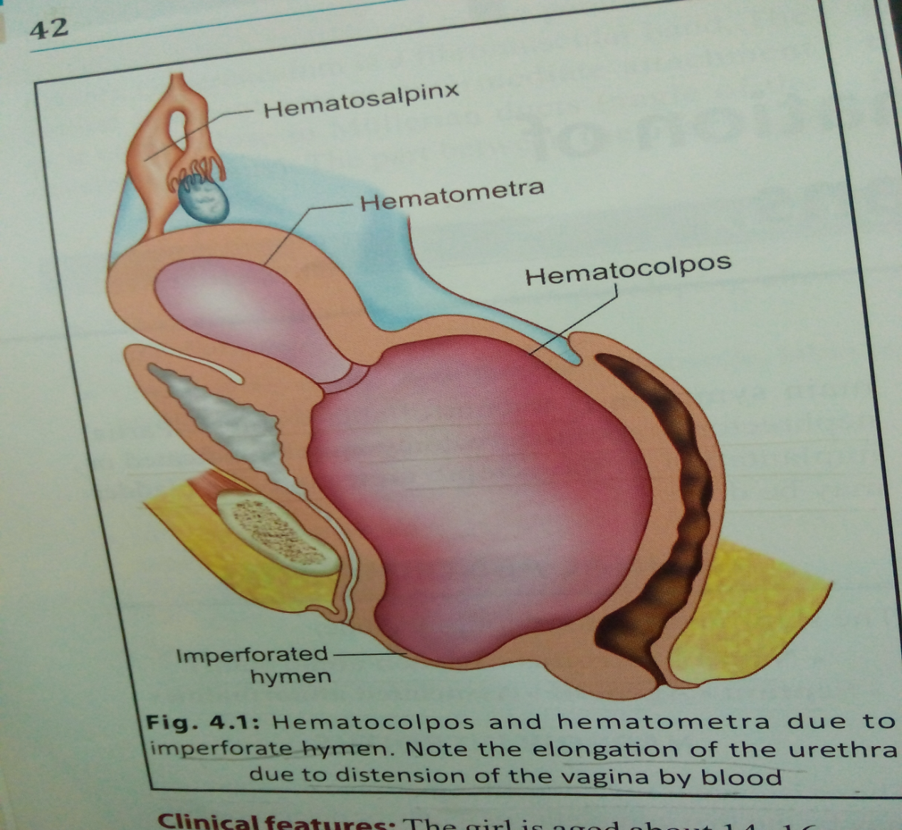

Slide 31
CLINICAL FEATURES OF IMPERFORATE HYMEN
The girl 14—16 yrs
Severe lower abdominal pain
Continous
Urinary symptoms like frequency,dysuria or retention of urine
The cause of retention is due to elongation of the urethra

Slide 32
Abdominal examination reveals supra pubic swelling which may be uterine or full bladder
Prior catheterization reveals the true state
Vulval inspection reveals a tense bulging membrane of bluish discoloration
In majority however it is not a true hymen, but obustructing membrane is a transverse vaginal septum close to the inner aspect of the hymen
Rectal examination reveals bulged vagina
USG—can make diagnosis of hematometra and hematocolpos

Slide 33
Treatment
Cruciate incision is made in the hymen
The quadrants of the hymen are partially excised not too close to the vaginal mucosa
Spontaneous escape of dark tarry coloured blood is allowed
Pressure from above should not be given. Internal examination should not be done
The patient is put in bed with head end raised
Antibiotics given
The residual pathology if any may be detected by internal examination only after her next period is over

Slide 34
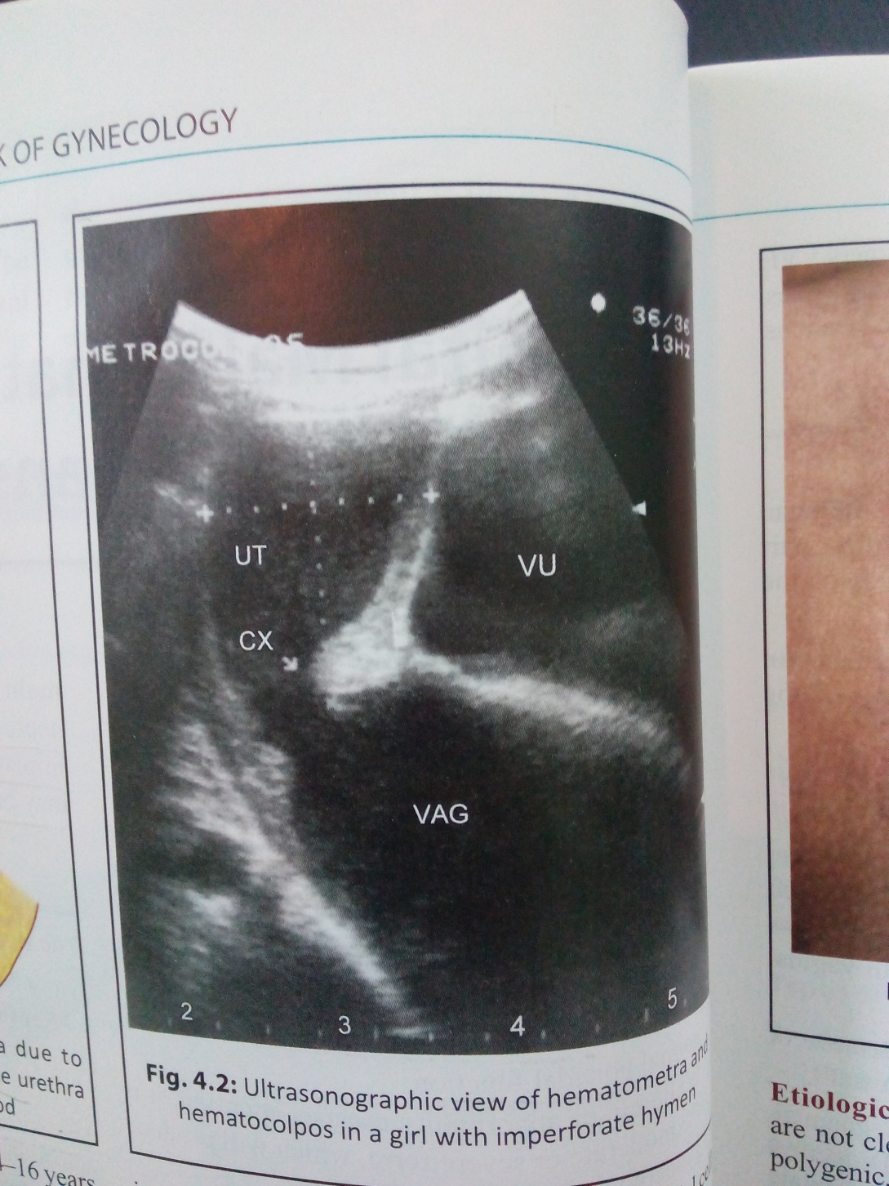

Slide 35
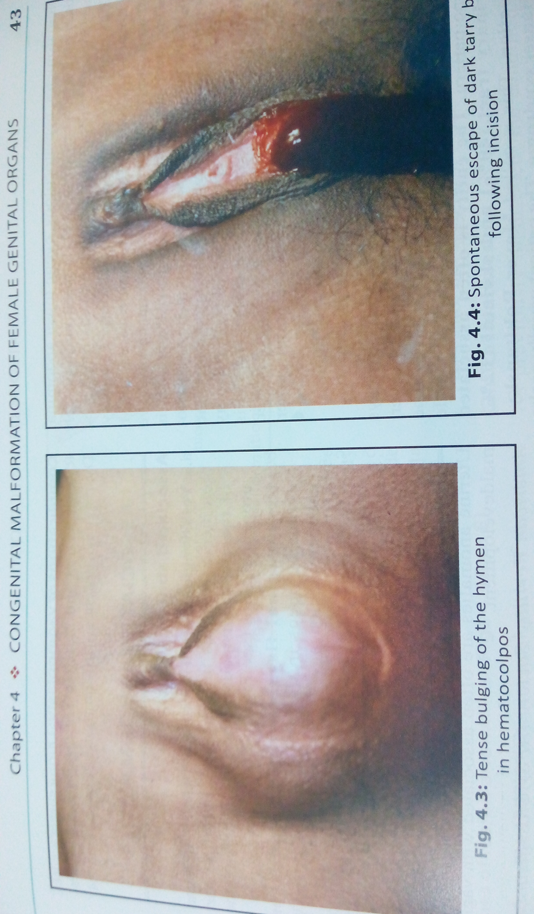

Slide 36
VAGINAL MALDEVELOPMENTS
Agenesis of vagina
Failure of vertical fusion
Failure of lateral fusion

Slide 37
Complete agenesis
Failure of canalization of vagina result in vaginal agenesis
However there is presence of healthy gonads and fallopian tubes
The patient is phenotypically female with normal female karyotype pattern
The entity is often associated with urinary tract 40% and skeletal 12% malformation
This is called mayer rokitansky kuster hauser syndrome
The patient usually seeks advice for primary amenorrhea and dyspareunia
Vagina is totally non canalized
A small dimple or very short vagina can be identified

Slide 38
Partial agenesis
Failure of canalization of lower part of the vagina , distal to the normal uterus ,cervix and upper vagina leads to this anomaly
Menstrual blood distends the uterus and upper vagina and therefore these girls present with abdominal pain and the pelvic mass at puberty (cryptomenorrhea)
Vaginal dimple may be visuvalized

Slide 39
Anomalies of vertical fusion
Transverse vaginal septum
It is due to non-canalization at the junction between the two developmental parts of the vagina : mullerian tubercle and sinovaginal bulbs
The septum located in lower vagina is often in the upper or middle third of vagina
The septae is <1cm thick
The pt present with abdominal pain , pubic mass at puberty
A short vagina is present below the septum

Slide 40
Anomalies of vertical fusion
Imperforate hymen
Hymen is situated at the junction between the sinovaginal bulb and urogenital sinus
Non canalization of these leads to mucocolpos in the neonatal period or haematocolpos at puberty
Girls with imperforate hymen present with primary amenorrhea , abdominal pain, pelvic mass (cryptomenorrhoea)
A bluish bulging membrane seen above the introitus

Slide 41
ANOMALIES OF LATERAL FUSION
Longitudinal vaginal septum
The septum may be complete or partial
It may be present when the distal parts of the mullerian ducts fail to fuse
It may be associated with double uterus and double cervix
It is asymptomatic but it may cause dyspareunia or may obstruct delivery
In such conditions septum is to be excised.Result of surgery is good in achieving pregnancy

Slide 42
EVALUATION OF VAGINAL ANOMALIES
Clinical evaluation
Examination of external genitalia
PR examination to look for haematopcolpos of uterus
Investigations
USG
MRI

Slide 43
SURGICAL MANAGEMENT OF VAGINAL ABNORMALITIES
IMPERFORATE HYMEN | CRUCIATE INCISION
TRANSVERSE AND LONGITUDINAL VAGINAL SEPTUM | Excision of the septum
VAGINAL AGENESIS WITH HAEMATOCOLPOS | Drainage of haematocolpos Vaginal reconstriction
TOTAL VAGINAL ATRESIA(MRKH) | Gradual dilatation Mcindoes vaginoplasty Williams vulvovaginoplasty Vaginal reconstriction

Slide 44
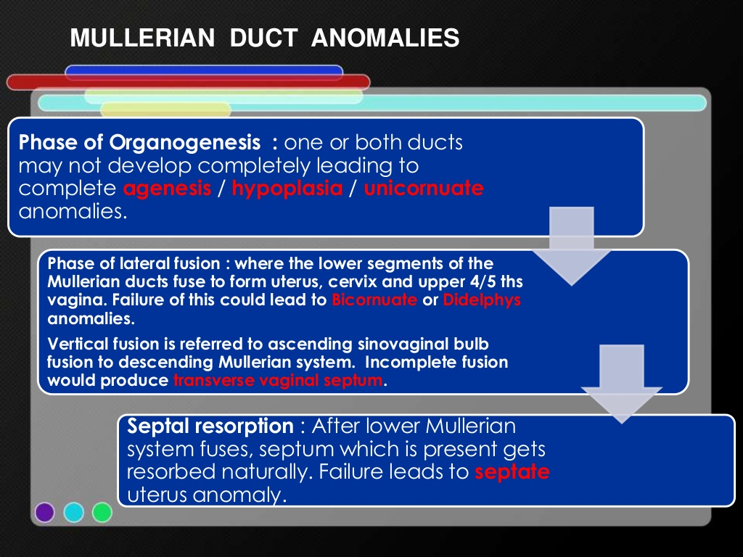

Slide 45
CLASSIFICATION | ANOMALY
Class-1(Agenesis/Hypoplasia) Segmental/complete mullerian agenesis/aplasia) | Vaginal Cervical Fundal Tubal Combined.
Class -2(Unicornuate) | Communicating Non-communicating No cavity With/without rudimentary horn.
Class-3(Didelphys) | Uterus didelphys
Class-4(Bicornuate) | Complete Partial.
Class-5(Septate) | Complete Partial.
Class-6(Arcuate) | arcuate
Class-7(DES-related) | DES-related T-shaped uterus with or without dilated horns.

Slide 46
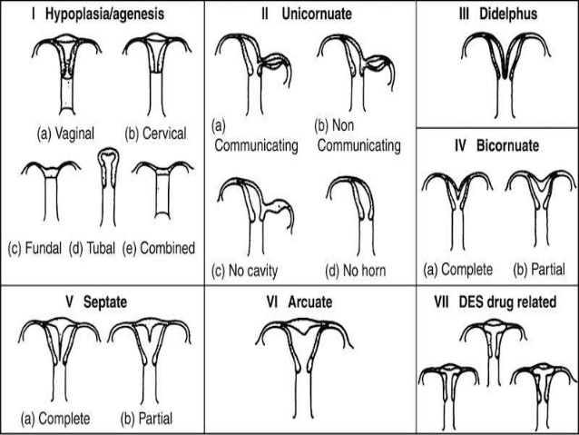

Slide 47
Absence/incomplete development of Both Mullerian ducts(Class-1)
Pathology:
Complete failure in development of the mullerian ducts results in abscence of the fallopian tube,uterus and most of the vagina(Mayer-Rokitansky-kuster-Hauser(MRKH)syndrome)
In such cases vulva is likely to be normal and there may be depression of variable depth representing the lower( urogenital sinus) part of the vagina.
It is usual to find such a depression covered with a normal hymen.

Slide 48
The patients have a normal female karotype.
Renal ectopy/agenesis,skeletal abnormalities,as well as cardiac anomalies are associated.
Mutifactorial mode of inheritance.
MRKH Syndrome has been linked with decreased galactose-1-phosphate uridyl transferase activity leading to increased intrauterine galactose exposure.
An association with MHC Ag has also been reported.
Poorly formed ducts of full length resulti in hypoplasia of the whole genital tract.
Incomplete development sometimes affects the lower parts of the ducts only.

Slide 49
Clinical aspects:
Primary Amenorrhoea(age:15-18 years)
Growth & secondary sexual characteristics are normal.
L/E: small vagina pouch .
On Rectoabdominal examination:Uterus cannot be palpated.
Ultrasound:Confirms the absence of the uterus and demonstrates the ovaries.ocassionally,the rudimentary horns can be seen.
If ultrasound is inconclusive MRI or laproscopy is required.
MRI is the IDEAL method for demonstrating uterine malformation.

Slide 50

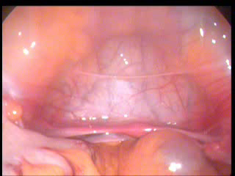

Slide 51
Chromosomal analysis is not usually required in these patients.
Renal anomalies are the most common associated features seen in 40%of cases,ranging from complete agenesis to malposition(usually a pelvic kidney),to substle architectural alteration.
Skeletal abnormalities can involve the spine,limbs or ribs.
These are seen in 10-15% of patients.
Subclinical auditory defects.

Slide 52
ABSENCE/INCOMPLETE DEVELOPMENT OF ONE MULLERIAN DUCT(CLASS 2)
PATHOLOGY:
Absence of one mullerian duct results in a unicornuate uterus with only one fallopian tube.
The cervix & vagina may be normal in appearence and function but they represent strictly only one half of the fully developed organs.
A true unicornuate uterus is rare and is usually with absence or gross malformation of the renal tract on the side of the missing mullerian ducts.

Slide 53
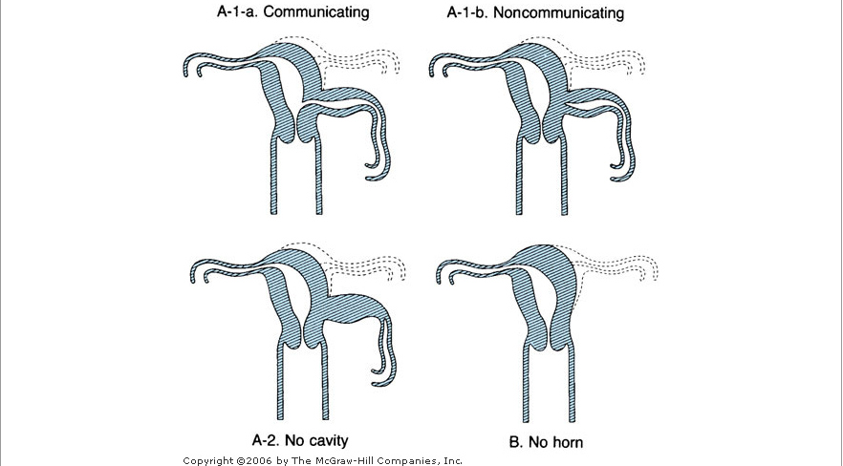
Unicornuate Uterus.

Slide 54
Symptoms:
Incidental finding discovered by chance/as a result of pregnancy complications.
Dysmenorrhoea (pain is limited to the side on which the horn is present)
Favours abortion, Premature labour.
Breech presentation of the foetus.
Fundal insertion of the placenta.
But uterus usually contracts efficently in all stages of labour.

Slide 55
Signs.
Uterus which leans well to one side of the pelvis and which cannot be straightened should always be suspected as being cornuate.
Hysterosalpingographs
  Cannot distinguish between true and apparent unicornuate deformity.

Slide 56
Treatment.
No treatment needed.
The rudimentary horn of an apparent unicornuate uterus have to be excised if it causes symptoms.

Slide 57
Uterus Unicornis:
Body and cervix of the uterus have been developed from one mullerian duct only and there is a rudimentary horn to one side of it,the cavity of which usually fails to communicate with either the developed horn or the vagina.
Ocassionally,the uterus may be itself may be a rudimentary organ or it may be infantile and very underdeveloped.
More rarely still,there may be a complete absence of the uterus in some cases.

Slide 58
Uterus Unicollis:
Pregnancy is extremely rare in this type of deformity.
Pregnancy in the rudimentary horn is attended with grave risks.

Slide 59
Imperfect fusion of the mullerian ducts
Pathology:
Failure of fusion of the mullerian ducts occurs in varying degrees.
Demonstrated 10-15% fertile women are affected.
Uterus didelphys(class-3)
Bicornuate uterus(class-4)
Septate and subseptate uterus(class-5)
Arcuate uterus(class-6)
DES-related Anomalies(class-7)

Slide 60
Uterus Didelphys.(Class-3)
If the two mullerian ducts remains seperate, the two halves of the uterus remain distinct and each has own cervix.
Patients have no difficulties with menstruation and coitus.
One sided is obstructed and symptomatic
Increased risk of
    miscarriage,
    malpresentations(Breech) and
    premature labour.
Majority have no reproductive difficulties.

Slide 61
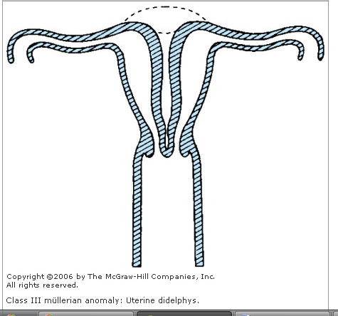
Uterus Didelphys

Slide 62
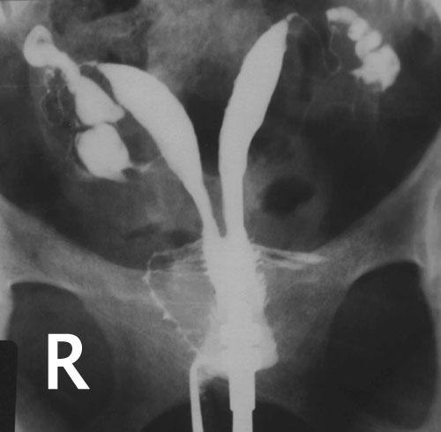
HSG in Uterus didelphys

Slide 63
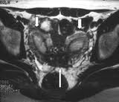
MRI in Uterus Didelphys.

Slide 64
Complications:
Non-gravid uterus –fibroid.
Seperately palpable-ovarian mass.
Mistaken diagnosis of extrauterine gestation.
Menstruation can occur even during pregnancy.
IUGR,
PRETERM DELIVERY,
MALPRESENTATIONS.

Slide 65
BICORNUATE UTERUS (Class -4)
Upper parts of the uterine portions of the mullerian ducts remain distinct,while the lower parts undergo imperfect fusion.
Cervix is single,but divided by a median septum and this sepum continue into the vagina and divides it too.
Deep depression at the fundus.
Repeated poor pregnancy outcome

Slide 66
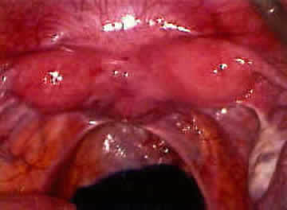
Laparoscopic appearence of Bicornuate Uterus.

Slide 67
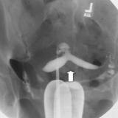
HSG in Bicornuate Uterus.

Slide 68
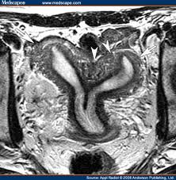
MRI in Bicornuate Uterus.

Slide 69
Septate and subseptate uterus(Class-5)
Uterus septus:
Uterus presents the normal shape externally with no depression at the fundus ,but a septum streches right upto
external os dividing the body of uterus and cervical canal into two halves.
The vagina is single.
Uterus subseptus:
Septum doesnot extend to the entire length of the uterine cavity , being confined to the upper portion for a variable distance.

Slide 70
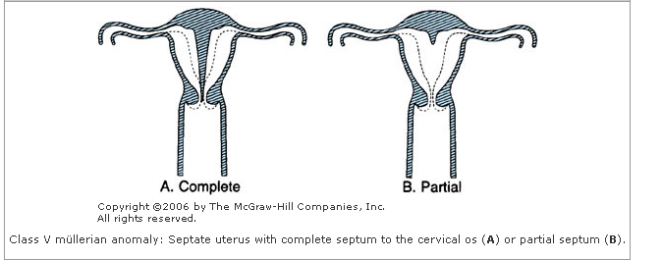

Slide 71
UTERUS SEPTUS AND SUBSEPTUS..
In some, pregnancy and labour proceed normally.
Sometimes,Repeated abortions may occur.
Malpresentations especially Breeech, may be more frequent.
Placenta may be retained or adherent and it is during the manual removal of the placenta that the condition is generally diagnosed.

Slide 72
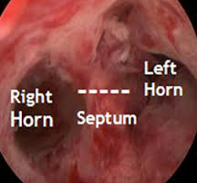
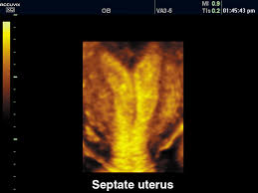
Septae uterus.

Slide 73
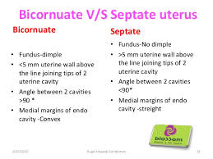

Slide 74
Arcuate uterus(Class -6)
This is the low grade of abnormality.
Uterus is normal,except for a slight depression in the midline over the fundus giving it a saddle shaped or arcuate appearence.

Slide 75
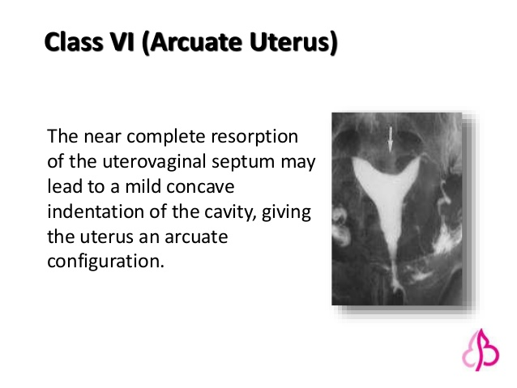

Slide 76
Deformities in combination.
Uterus bicornis unicollis:
  Same as Uterus bicornis bicollis,except that there is one cervical and vaginal canal.
  Duplication and Diverticula of Mullerian Ducts:
  If mullerian ducts are duplicated, a true double uterus with 4 fallopian tubes can result but extremely rare.
  More common:Diverticula of the ducts which give rise to
  Accesory abdominal ostia of the tube,
  Acessory tubes,
  Diverticula of the tube,
  Uterine diverticulum/Acessory horn(MULLEROMA)third horn is not a supplied with a fallopian tube or round ligament.If functional it can cause severe dysmenoorhoea.

Slide 77
DES-related Anomalies(Class-6)
Women who are exposed to Diethylstilboestrol(DBS) in utero.
Benign vaginal adenosis,
Cervical hoods,
septae,
Collars.
T-shaped uteri,wide lower segments & constriction bands.
High incidence of perifimbrial paratubal cysts.
Vaginal clear cell carcinoma is very rare.

Slide 78
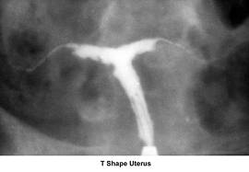
T-Shaped Uterus.
Management:
Lateral Metroplasty.
Encerclage is mandatory in event of Pregnancy.

Slide 79
Causes:
Mullerian ducts are ordinarilly pulled together by subperitoneal fibromuscular tissue and defect in this process is a cause of these malformations.
Uterus didelphys and bicornuate uterus often unusally thick and strong round ligaments and a tough vesicorectal fold running between each horn,may be that these prevent the mullerian ducts coming together.

Slide 80
Symptoms:
Menstrual:
Menstrual cycle is usually normal.
  Primary amenorrhoea
  Outflow obstruction
Menorrhagia:
  Because of larger bleeding surface offered by two well-developed uterine horns.
  SpasmodicDysmenorrhoea:
  Unusual arrangement of the musculature and by abnormal contractions.
  Un equal development of the two horns can be manifested by one sided dysmenorrhoea.
  Failure to contain flow:
  Failure to control menstrul outflowby means of a single intravaginal tamponade(Septae vagina &Uterus didelphys)

Slide 81
Coital
Dyspareunia:
    Vaginal septum cause difficulty in coitus
    One half of the vagina is then usually dilated and the septum is pushed to the side.
    Bleeding:
    attempts at coitus or at insertion of a tampon sometimes cause bleeding from a vessel in the lower edge of the septum.

Slide 82
Obstetrical causes
Infertilty :
  Only form of malfusion that lower the infertility is a fully septate vagina.
  coitus may happen in half which doesnot communicate with cervix/uterus(Developed)/doesnot serve the ovary which has ovulated in that particular cycle.
  Cornual pregnancy/Ectopic pregnancy
  Site of the conceptus:if both horns are well developed successive pregnancy not necessarily from same cavity.
  Sacculation of the Uterus:
  Either organic/functional abnormality during pregnancy.
  Saccule is sited on the line of the mullerian ducts it may be a manifestation of a fusion defect.

Slide 83
Abortion and Premature Labour:
Uterus is malformed.
Inadequate streching and hypertrophy to accomodate the pregnancy,poor implantation,placentation on a septum.
Uterine malformation cause late than early abortions,because of associated incompetent os.
Malpresentation:
Fundal /cornual insertion of the placenta, are often explained by an abnormality of uterus.
Subseptate/bicornuate deformity: Transverse lie.
Uterus Didelphys/Unicornuate uterus: Breech prsentation.
Transverse lie resists version.
H/o malpresentations in several Pregnancy raise suspicion of uterine malformations.

Slide 84
Inefficent uterine action:
More common in 3rd trimester.
Manual removal of placenta (bicornuate/septae/subseptae uterus)
Incidence of postpartrum haemorrhage increased.
If horns completely seperate expulsive action is good.
High vaginal septum can prevent cervix from dilating.
Obstructed Labour:
Non pregnant horn of uterus didelphys enlarges during pregnancy due to hormonal influences as the pregnant horn.
It remains low in pelvis which obstructs the delivery of the foetus

Slide 85
Ruptured uterus.
Dystocia .
Foetal growth restriction
Evaluvation of mullerian anamolies:
Clinical evaluvation
  History,
  Examination of secondary sexual characteristics.
  External genitalia
  Per vaginal & Per rectal examination.

Slide 86
Investigations:
Ultrasound –Pelvic and Renal.
Magnetic Resonance Imaging.
Laproscopy,
Hysteroscopy,
Hysterosalpingogram

Slide 87
Management
Mangement depends on type of anomaly.
Rudimentary horn with signs of obstruction should be excised
Uterine septum can be excised hysteroscopically.
Strassman meteroplasty consists of wedge resection of the septum and reconstruction ot uterus(Bicornuate uterus)

Slide 88
SURGICAL MANGEMENT of UTERINE ANOMALIES.
CLASS | MANAGEMENT
CLASS-1 | RECONSTRUCTION OF VAGINA EXCISION OF SEPTUM
CLASS-2 | EXCISION OF RUDIMENTARY HORN
CLASS-3 | EXCISION OF VAGINAL SEPTUM OCASSIONALLY METROPLASTY
CLASS-4 | STRASSMAN METROPLASTY
CLASS-5 | HYSTEROSCOPIC SEPTAL RESECTION
CLASS-6 | NO SURGERY REQUUIRED
CLASS-7 | DEPENDS ON ANAMOLY MAY NOT REQUIRE SURGERY

Slide 89
ABNORMLITIES OF OVARIES
There may be streak gonad or gonadal dysgenesis
Which associated with errors of sex chromosomal patterns
No treatment is of any help
Accesory ovary (division of original ovary inti two)may rarely be present
Supernumerary ovary may be found in broadligament or elesewhere
This can explain a rare event where menstruation occurs even after removal of two ovaries

Slide 90
WOLFFIAN REMNANT ABNORMALITIES
The outer end of the wolffian duct may be cystic , size of pea , often pedunculated(hydatid of morgagni) and attached near the outer end of the tube
The tubules of the gartners duct may be cystic the outer ones are koblets tubules , the middle set , epoophoron and the proximal set paroophoron
Small cyst may arise from any tubules
A cystic swelling from the garterns cyst may appear on the anterolateral wall of the vagina

Slide 91
PARAOVARIAN CYST
It arises from the vestigial remnants of wolffian tissue situated in the mesosalphinx between the tube and ovary
This can attain the big size
The cyst is unilocular
Wall is thin and contains clear translucent fluid
The ovarian fimbria with the ovary is streached over the cyst
The wall consists of connective tissue lined by single layer of low columnar epithelium.

Slide 92
ABNORMALITIES OF FALLOPIAN TUBES
The tubes may be abnormally elongated ; may have accessory ostia or diverticula. Rarely, the tube may be absent on one side
These conditions may lower the fertility or favour ectopic pregnancy

Slide 93
Other abnormalities
LABIA MINORA
Labial fusion : true due to developmental defect or inflammatory
LABIA MAJORA
Hyperplastic or hypoplastic labia
Abnormal fusion in adrenogenital syndrome

