Slide 1
GESTATIONAL TROPHOBLASTIC DISEASES

Slide 2
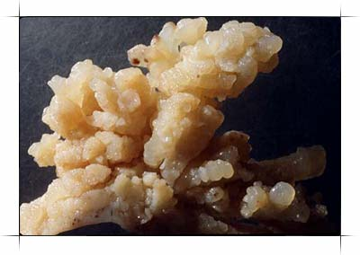
DEFINITION
Spectrum of proliferative abnormalities of trophoblasts associated with pregnancy

Slide 3
CLASSIFICATION [modified WHO1998]
Hydatidiform mole: Complete
Partial
Invasive mole
Placental site trophoblastic tumour
Choriocarcinoma: Non metastatic disease
Metastatic disease

Slide 4
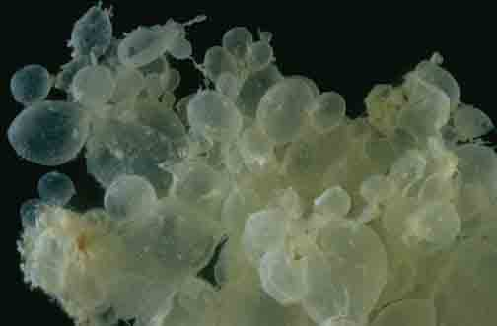
HYDATIDIFORM MOLE(vesicular mole) DEFINITION
Abnormal condition of the placenta where there are PARTLY DEGENERATIVE and PARTLY PROLIFERATIVE changes in the chorionic villi resulting in the formation of clusters of small cysts of varying sizes.

Slide 5
INCIDENCE
U.S. and Europe 1/1500
South East Asia 1/150
Highest incidence is in PHILIPPINES 1/80
INDIA: 1/400

Slide 6
ETIOLOGY
Teenage pregnancy
Women over 35yrs of age
Inadequate intake of: carotene,
protein,
animal fat.
Disturbed maternal immune mechanism- rise in gammaglobulin level in absence of hepatic disease

Slide 7
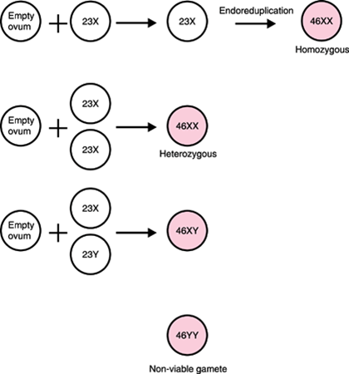
Cytogenetic abnormalities:
enucleate egg fertilization (ovum nucleus may be either absent or inactivated, that has been fertilized by a haploid sperm, which then duplicates its own chromosomes)
chromosome karyotype of COMPLETE MOLE is DIPLOID. (90% is 46XX,10% is 46XY)

Slide 8
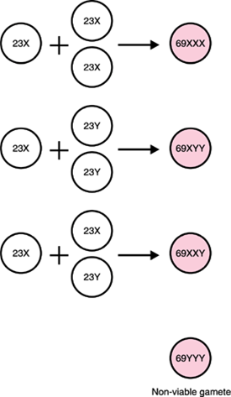
chromosome karyotype of 90% INCOMPLETE MOLE is TRIPLOID with the extra haploid set of chromosomes derived from the father. The most common chromosome karyotype is 69XXY, and then is 69XXX or 69XYY.

Slide 9
PATHOLOGY
Complete mole incomplete mole
Embryotic or fetal tissue - +
Villus stromal edema diffused localized
Trophoblastic hyperplasia diffused localized
Villus outline regular irregular
Villus stromal blood vessel - +
Karyotype diploid triploid/
tetraploid

Slide 10
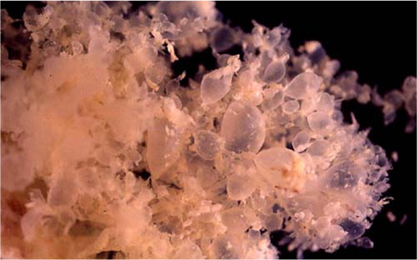
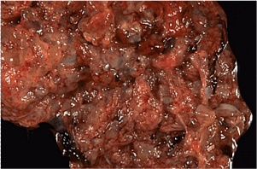
PARTIAL MOLE - Shows a less clear -cut picture ,with the formation of vesicles usually focal. - Fetus and membranes may present.
COMPLETE MOLE
- Numerous edematous vesicles, which looks like a bunch of small clear grapes.
- Usually no fetus, or membranes.

Slide 11
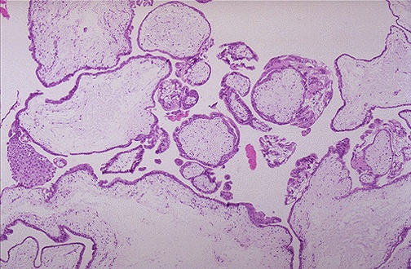
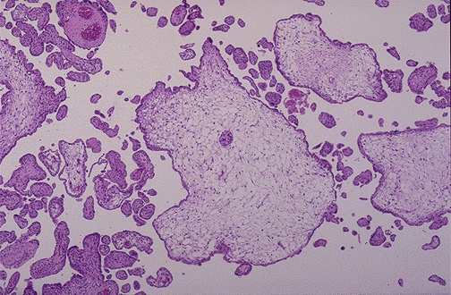
PARTIAL MOLE - Some villi show odematous change, while others are normal or fibrotic. - Vesicles have degree of vascularity. - trophoblastic proliferation is usually slight and focal
COMPLETE MOLE
- Large oedematous enlarged villi.
- Avascular.
- Variable degree of trophoblastic hyperplasia.

Slide 12
CLINICAL FEATURES
C0MPLETE MOLE:
H/O AMENORRHOEA
2. VAGINAL BLEEDING (90%) after a period of amenorrhea (average 12 weeks) may continue intermittently for several weeks.
Mimic an incomplete or threatened abortion.
The blood may be mixed with gelatinous fluid from ruptured cysts giving the appreance of WHITE CURRANT IN RED CURRANT JUICE.

Slide 13
Expulsion of GRAPE LIKE VESICLES p/v.
4. Varying degree of LOWER ABDOMINAL PAIN
Over stretching of the uterus
Concealed haemorrhage
Infection
Uterine contractions to expel out the contents

Slide 14
5. UTERINE ENLARGEMENT:
The uterus is commonly “large for date”in 50% of cases.
Although, in a small proportion of cases the uterus corresponds to the gestational age or smaller than date.
The uterus is soft/doughy in consistency.
The fetal parts are not palpable, and fetal heart is absent.

Slide 15
6. LARGE THECA LUTEIN CYSTS of the ovary are present in 20-25% of cases.
7. HYPEREMESIS GRAVIDARUM occurs into 25% of cases.
8. PRE-ECLAMPSIA occur in association with the moles with range widely from 12-54%.
9.TROPHOBLASTIC EMBOLI in 2% of cases.

Slide 16
10. HYPERTHYROIDISM: Develop in small proportion of women (5%) ,and this may be due to thyrotrophic effects of the human chorionic thyrotrophin. which may lead to:
Goitre
fine tremor
supra-ventricular tachycardia
weight loss

Slide 17
PARTIAL MOLE:
Have the major clinical features of complete mole but it is slightly manifested.
Usually as a regular incomplete or missed abortion
Uterine enlargement(less than the date)
No Hyperemesis
No Hyperthyroidism
No Theca-lutein cysts

Slide 18
INVESTIGATIONS
CBP
LFT
RFT
TFT
USG
Quantitative estimation of hCG
Chest X-ray
Plain X-ray abdomen
CT
MRI

Slide 19
DIFFERENTIAL DIAGNOSIS
Threatened abortion
Fibroid or ovarian tumour with pregnancy
Multiple pregnancy
Hydramnios

Slide 20
MANAGEMENT
Suction evacuation
Supportive therapy
Counselling for regular followup
Patients are grouped into:
Group A: mole in the process of expulsion.
(cervix is favourable)
Group B: uterus remain inert.
(cervix is tubular and closed)

Slide 21
Group A:
Preferred method is SUCTION EVACUATION.
Performed under iv sedation/ general anaesthesia.
A negative pressure of 200-250 mm Hg is applied.
Use of oxytocin helps the expulsion of moles and reduces blood loss but its routine use is not recommended.

Slide 22
Group A:
Digital exploriation and removal of mole by ovum forceps under GA is an alternative procedure.
After the evacuation is completed, methergin 0.2mg is given IM

Slide 23
Group B:
Prior slow dilatation of cervix followed by suction and evacuation
Alternatively, vaginal misoprostol PGE1 400mcg 3hrs before the procedure may be used.

Slide 24
Complications of vaginal evacuation:
Uterine injury
Haemorrhage
Shock
Acute pulmonary insufficiency
acute chest pain, tachycardia, tachypnoea, dyspnoea develop about 4-6hrs following evacuation.
Thyroid storm
In presence of hyperthyroid state, when evacuation is done under GA acute features such as hyperthermia, delerium, convulsions, coma and cardiovascular collapse develop

Slide 25
Place of curettage following vaginal evacuation
Done in cases with persistent vaginal bleeding.
Objective of the curettage is to remove the necrosed decidua and the attached vesicles so as to accelerate involution and to reduce the irregular bleeding.
Curettage may be done 5-7 days following evacuation. At this time, uterine wall gets thicker, firmer and the cavity becomes smaller- so that effective curettage can be done without risk of damaging the uterus.
Materials should be sent for the histology

Slide 26
HYSTEROTOMY:
Rarely done these days.
Cervix is unfavourable for immediate vaginal evacuation
Accidental perforation during evacuation
Profuse vaginal bleeding

Slide 27
HYSTERECTOMY:
Pts with age over 35
Pt completed her family irrespective of age
Uncontrolled haemorrhage
Perfortion during evacuation

Slide 28
Follow Up
Mandatory for all cases for 2yrs (occurrence of choriocarcinoma is mostly confined to this period)
Objective is to diagnose persistent trophoblastic disease.
Contraception: Pt is adviced not to be pregnant for atleast 1yr

Slide 29
hCG levels following evacuation should regress to normal within 3months time.
INTERVALS:
HCG weekly till normal
QM/3monthly in the 1st yr
Q6M in the 2nd yr

Slide 30
PROTOCOLS:
Enquire about symptoms:
abnormal vaginal bleeding, cough, haemoptysis, breathlessness
Abdominal & pelvic examination
hCG evaluation
chest X-ray film

Slide 31
PROPHYLACTIC CHEMOTHERAPY:
hCG level fails to become normal by 10-12wks
Re-elevation at 4-8wks
Rising beta hCG level after reaching normal levels
Post evacuation haemorrhage
Evidence of metastasis
Where followup facilities are not adequate

Slide 32
REGIMENS:
METHOTREXATE 1mg/kg/day IV/IM on days 1,3,5,7 with FOLINIC ACID 0.1mg/kg IM on days 2,4,6,8.
It is to be repeated every 7days
Total 3 courses are given
Beta hCG level should decrease by 15%, 4-7 days after methotrexate

Slide 33
Alternatively, ACTINOMYCIN D 12mcg/kg/day for 5days

Slide 34


