Slide 1
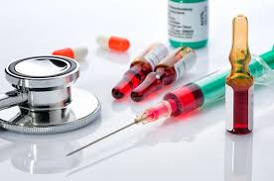
HORMONAL CONTRACEPTIVES.

Slide 2
Non-Oral Hormonal Contraceptives
Hormone releasing IUCDS.
Injectables Contraceptives.
Contraceptive Implants.
Hormonal Contraceptive Vaginal Rings.
Transdermal Contraceptive Patch.

Slide 3
Hormone Releasing IUCDs.
Progestasert,(Progesterone IUCD).
Levonova or Mirena. Levonorgestrel(LNG) IUCD 20

Slide 4
Hormone releasing IUDs.
T-shaped devices,slightly thicker than than Cu-Ts.
Containing hormonal capsules in the vertical rods from where hormones are released slowly.
IUCDs acts mostly by the local effects,maintaining a high local level of progesterone and a relatively low level of oestrogen.
MOA: keeping the endometrium in an advanced progestational phase.,this hinders implantation of the blastocyst.
Ovulation is not affected.

Slide 5
Progestasert.
This device contains 65 mcg of progesterone perday and is effective as CuT 380-A.
It is effective life of only 1 year,thereby needing replacement every year.
It reduces menstrual loss.
Insertions are sometimes difficult and painful,needing local anaesthesia or analgesia

Slide 6
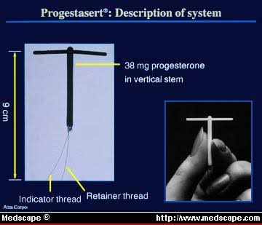
Progestasert IUCD.

Slide 7
Levonorgestrel IUCD 20.
Long acting IUCD is T-shaped and has a capsule on the stem,containing a mixture of 40-60mg of LNG,
52mg in MIRENA.
Releasing 20mcg of the hormone per day.
Failure rate of 0.1-0.4 per 100 women in the 1st year.
Effective for 5 years.
LNG reduces menstrual blood loss(Sometimes resulting in amenorrhoea)& cramping.
It reduces menorrhagia from uterine fibroids,benfit may be diminished with distorting submucosal fibroids
Protective effect against ectopic pregnancy.
Insertion is somewhat difficult and painful.

Slide 8
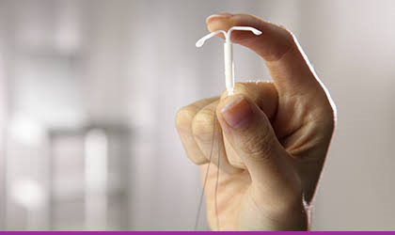
LNG IUCD.

Slide 9
Non contraceptive benefits.
Effective way to deliver the necessary progestin therapy in postmenopausal women on estrogen therapy.
Reduced risk of endometrial cancer and improvement in symptoms of endometriosis and adenomyosis.

Slide 10
Mechanism of Action.
Blood hormones levels are significantly lower than with other progesterone-only contraception and remain stable at approximately 150-200pg/ml.
About 85% cycles are ovulatory.
Is a result of thickened and scant cervical mucus,
Endometrial atrophy,
Intrauterine inflammatory response.

Slide 11

Injectable Contraceptives.
Many women cannot take oral contraceptives regularly;leading to a failure rate of 1-8 per 100 women years or even more in actual use,though the pills are more effective.
2 types of injectable steroid contraceptives,some contains,
Progesterone only,
Combined Progesterones and Oestrogens.

Slide 12
Progestogen only injectables
Two types:
Depot-Medroxyprogesterone acetate.
Nor ethisterone acetate.

Slide 13
Mechanism of action.
Inhibits ovulation in most women.
Levels of FSH and LH are lowered.
LH surges donot occur.
Making cervical mucus thick and scanty,
Thus creating barrier to sperm penetration
Making endometrium less suitable for implantation.

Slide 14
Depot-Medroxyprogesterone acetate.
Trade name:Depo-Provera,Megestron,Contracep.
DMPA is a progestogen derived from the natural hormone progesterone.
It is prepared in a microcrystalline suspension that delays absorption of the hormone after an injection.
DOSAGE:
One injection of Depo-Provera remains effective for 3 months.
It is administered in the form of a 150mg injection once every 3months plus or minus 14 days.

Slide 15
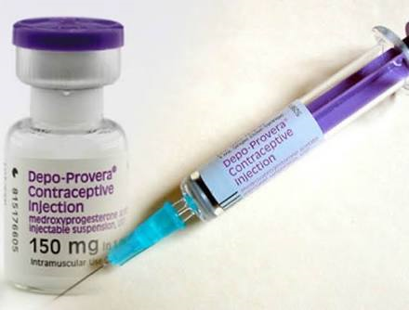
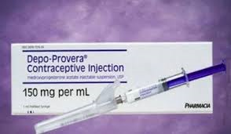
DMPA.

Slide 16
Preparations.
Monthly injection of DMPA with 5 mg of oestradiol.
DMPA 150mg 3monthly,
DMPA 300mg 6 monthly.
Cyclofem and Lunelle:
½ ml contains 25 mg DMPA and oestradiol cypionate 5mg.
The failure rate:0.2% at the end of 1 year.
The menstrual irregularity is less than with progesterone –alone injections.
It should be remembered that the first menstrual period comes 10-15 days after the first ijection but thereafter every 30 days and lasts for 5 days.
Failure rate of 0.1-0.4%
Ovulation returns in 6 months.

Slide 17
Norethisterone enanthate.
NET EN Is a progesteronederived from 19-nortestosterone and is used in acastor oil solution.
It is converted in the body to a biologically active from,NET norethindrone before it can produce contraceptive effect.
Most effective regimen:
200mg NET EN injection every 2 months

Slide 18
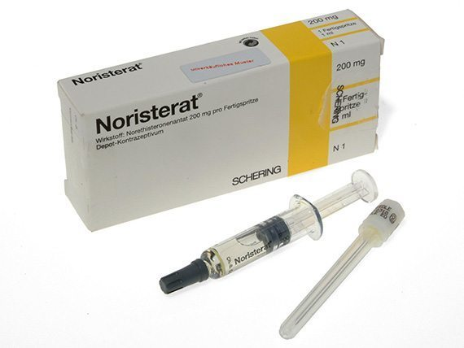
NORETHISTERONE ENANTHATE.

Slide 19
Other preparations.
Mesigyna (1/2ml containing NET 50 mg with oestradiol valerate 5mg) is given by deep im injection once a month with +/3 days.
The low failure rate of 0.4% at the end of 1 year is encouraging.

Slide 20
Timing of the injection.
The injection should be administered within 7 days of menstruation with
Grace period of
1 week for NETO(8-9 weeks).
2 weeks for DMPA(12-14 weeks of first injection for DMPA).
Injections are more effective when given in the first 5-7 days of the menstrual cycle,so that to prevent ovulation in that cycle.

Slide 21
Injection technique.
No medicine should be left in the vial.
NET EN vials needed to be warmed up before the drug can be drawn into a syringe.
The injections should be given deep into the muscle in the buttock,
Although DMPA may be given in the arm.
Imperfect injection technique impairs effectiveness.
Regularity of injections at proper intervals.

Slide 22
WHO Medical Eligibility Criteria.
Are Breast feeding(Starting 6 weeks after delivery).
Have no children.
Are Adolescents(Preferably at or after 16 years of age)
Are fat or thin.
Just had abortion(First or second trimester)

Slide 23
Absolute contraindication
Current or Past breast cancer.

Slide 24
Advantages.
Injections are easy to administer and there is no worry over ‘missing pill’.
Long acting reversible.
The compliance is good and the woman remains under regular medical supervision.
The side effectsof lipid and carbohydrate metabolism are avoided.
DMPA is least androgenic.
It is situated to lactating women.

Slide 25
Return to fertility is slightly delayed in DMPA group compared to NET,but 80% conceive in 1 year.
5 months for DMPA and 3-4months for NETO.
Coital independent.
The incidence of PID,ectopic pregnancy and functional ovarian cysts is low,so also endometrial cancer.
Avoids oestrogenic side effects.(Heart attack/thromboembolism)
Can be given to a woman with sickle cell anaemia.
It cures or ameliorates menstrual troubles like menorrhagia and dysmenorrhoea as well as endometriosis.
Reduce the risk of vaginal candidiasis.
DMPA prevents sickling & the development of abnormal shaped red cells,lessens episodic bone pain in women.
Best contraceptive for these patients.

Slide 26
Side effects.
Change of menstrual pattern.
Weight gain.
Possible affection of glucose metabolism.
Possible affection of fertility.
Possible cardiogenic effets.
Bone density changes.
Teratogenicity concerns.
Possible cardiovascular disease.
Other side effects.

Slide 27
Change of Menstrual pattern.
Irregular menstrual bleeding and spotting as well as temporary absence of meses are the most common side effects in first few months of use.
With continued use,irregular bleeding beomes less but the absence of menses increases even leading to total amenorrhoea.
Menstrual irregularities are less with NET EN than with DMPA
Proper counselling before use of these injections leads to dissatisifaction and fear.

Slide 28
Weight gain.
The average weight gain is 1-3kg is due to increased appetite

Slide 29
Possible affection of glucose metabolism.
Impaired glucose tolerance is noted.
Overt glucose intolerance is caused by DMPA or NET EN

Slide 30
Possible affection of fertility.
Injectable contraceptives donot produce sterility.
The average return to ovulation following NET EN use was found to be 2.6 months than after DMPA Use 5.5 months.
There is a delay in return of fertility but 80% are expected to conceive by end of 1 year.

Slide 31
Possible carcinogenic effects.
Among women with HIV infection,long term DMPA use(>5years) may increase the risk of carcinoma in situ and invasive cervical carcinoma.
Donot prevent STD and HIV

Slide 32
Teratogenicity concerns.
DMPA exposure during pregnacy or breast feeding doesnot adversely affect the long term growth and development of children nor does it increase the chance of congential anomaly.

Slide 33
Possible cardiovascular disease.
WHO Study says there is little or no increased risk of cardiovascular complications associated with use of progesterone only injectables.
Although further investigation is needed for possible risk of stroke among women with hypertension.
Most studies show no significant change of blood pressure among POI users.

Slide 34
Other side effects.
Headache,
Dizziness,
bloating of the abdomen,
Breast and mood changes

Slide 35
In lactating women.
Menstrual irregularity is accepted by puerperal women as physioogical.
The injection should be started within a month of delivery in a non-lactating woman because ovulation is delayed upto atleast 10 weeks in lactating women .
Pregnancy rate is 0.4 per 100 woma years for DMPA.
It doesnot reduce milk volume.
Doesnot cause any major shift in milk composition as are found in COC users
Some studies,shown that milk volume and duration of lactation may improve in users of DMPA.

Slide 36
Combined injectable contraceptives.
Cyclofem containing DMPA 25 mg plus oestradiol cypionat 5mg.
Trade name:Cycloprovera,Feminema and Lunelle.
Mesigna containing NET EN 50mg plus oestradiol valerate 5mg also known as Norigynon.
Marvelon :
Desogestrel 150mcg with EE2 30mcg.
Femovan:
Gestodene 75mcg with EE2 35mcg.
Anafertin-Dihydroprogesterone+150mg testosterone enanthate 5mg.

Slide 37
The injections are given once a month every 30+/-3 days irrespective of menstruation.
The first injection should be given within 5-7 days of the cycle to avoid the chance of pregnancy in the first menstrual cycle.
Can be administered on other days provided pregnancy is excluded.
Average weight gain was found to be 0.84kg after 1year.
Ovulation is restored within few months after discontinuation

Slide 38
Mode of action.
Like COCs,combined injectable contraceptives produce their effect by
Inhibiting Ovulation,
Thickening cervical mucus which prevents sperm penetration,
Causing changes in the endometrium,which prevents implantation of the blastocyst.
Failure rate is 0.2-0.4%

Slide 39
WHO medical eligibility criteria.
Absolute contraindications:
Breast feeding within 6 weeks postpartrum,confirmed or suspected pregnancy,
Cancer of the breast or liver,
Past or present thromboembolic disorders
Heart disease,stroke,
Hypertension (BP>160/100mmHg),
Migraine with aura,
Complicated diabetes.

Slide 40
Drawbacks.
Increased cost factor,
Availability,
Cyclofem & Mesigyna are not available in India.

Slide 41
Newly approved drugs.
DMPA-Sc.
LNG butanoate injectable.

Slide 42
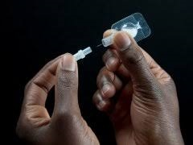
DMPA-Sc
New low dose sc DMPA
Contains 104mg of progesterone
Provides slower and more sustained absorption of progesterone while consistently preventing ovulation.

Slide 43
LNG butanoate injectable
5-10mg of LNG butanoate would give contraceptive effect for 3 months.
It have potential benefits of less ovarian supression than DMPA.
Produces less amenorrhoea and quick return to fertility.
Costly.
Contraceptive effect for 6 months.

Slide 44
Contraceptive Implants
Progestogen –only implants in which release of progestogen at a controlled rate,providing small doses to achieve good contraceptive effect.

Slide 45
Types of Implants.
Norplant I,
Implanon,
Jadelle or LNG rod or Norplant II

Slide 46
Norplant I
It was developed by the Population Council and is manufactured by Leiras in Finland .
Consists of six silastic capsules with a diameter of 2.4mm and a length of 3.4cm,each containing 36mg of LNG
These are inserted under the skin in the inside of the upper arm or forearm in most cases,
In a fan shaped manner under local anaesthesia by means of special trocar through a small incision which doesnot need suturing.
It becomes effective within 24 hours and remains effective for 5 years.
It should better be inserted in cycle days 1-7.

Slide 47
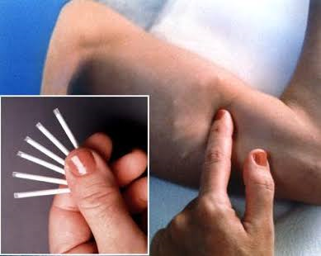
NORPLANT-1

Slide 48
Insertions can be done immediately agter sbortion or 6 weeks after delivery.
LNG diffuses through silastic membrane of the capsule at a slow steady rate.
The daily release rate averages 50-80mcg in the 1st year
30-35mcg over the next 5 years.
The capsule should be removed after 7 years
Subsequently reinsertion should be carried out at a different site or some other contraceptive measure should be advised.

Slide 49
The removal is performed under local anaesthesia,through a tiny insertion made just below the lower ends of the implants.
Removal is difficult than insertion and may need second insertion or second attempt.
The hormonal effect passess off soon after the Norplant is removed.
It is less effective in women weighing over 70kg.

Slide 50
Mode of action
It makes cervical mucus thicker and scantier preventing sperm penetration.
LNG suppresses ovulation in atleast half the cases by affecting the hypothalamus & pituitary,suppressing LH surge responsible for ovulation.
It depresses the endometrial growth,necessary for implantation of the ovum.
Failure rate is 0.05%

Slide 51
Implanon
Developed by Organon international.
It is a single rod device containing 67mg of the progestogen 3 keo desogestrel also called etonogestrel,the active metabolite of desogestrel in a matrix of ethinyl vinyl acetate(EVA) and covered by a 0.006mm EVA membrane.
It is a single 40mm rod,which is 2mm in diameter.
It is easily inserted straight from a sterile preloaded applicator with a cleverly shaped wide –bore needle by a simpke injection/withdrawal technique.
It is placed subcutaneously on the innerside of the upper arm under local anaesthesias

Slide 52
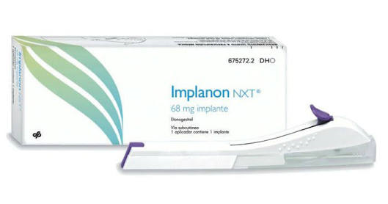
IMPLANON.

Slide 53
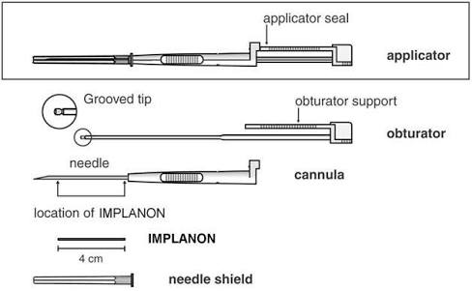

Slide 54
Though insertion is not difficult,specific training is essentia to acquire the technique.
The implant is designed to release3-keto-desogestrel for a period of 3 years at alevel above the presumed critical level of 30mcg/day needed for complete inhibition of ovulation.
Implanon is effective for 3 years.
Implanon has a low androgenic effect.
It is a good choice for adolescents as well as for women with hypertension,diabetes,anaemia and endometriosis ,breast feeding mothers.

Slide 55
Irregular vaginal bleeding & amenorrhoea are the most common side effects.
Methods allows easy insertion and removal.
Further long term studies are needed before Implanon can be accepted more widely & internationally.

Slide 56
Jadelle or LNG Rod.
It is manufactured bu Leiras in Finland.
LNG rod consists of two sialastic rods,each measuring 44mm long
A total of 70mg LNG is dispersed in the matrix of each rod.
They are inserted and removed in the same way as the original Norplant although insertion and removal is easier.
The daily release of hormone is almost same as norplant.
Failure rate is 0.05%

Slide 57
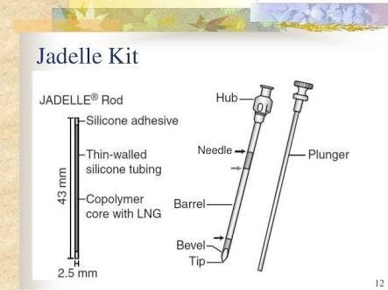

Slide 58
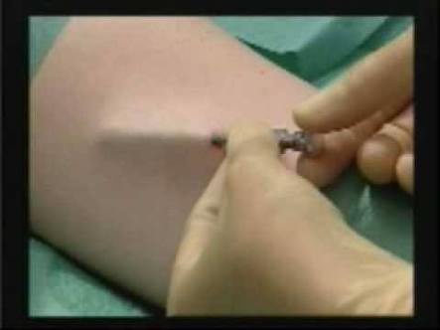

Slide 59
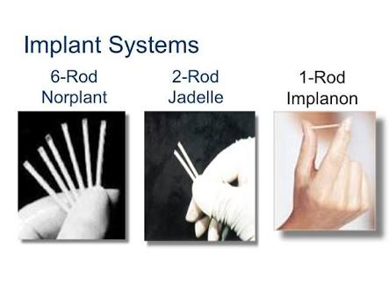

Slide 60
Main points about LNG rod.
It has approved effective life of 5 years rather than 3 years.
The device is easier to insert and remove than old Norplant system
Becomes fragile through prolonged stay in a woman’s arm.

Slide 61
ST-1435 Single –rod implant or Nesterone implant.
Single modified silastic implant using a new progestogen ST-1435 which has contraceptive and side effects similar to thse of LNG.
The implant contains ST-1435 crystals encased in a silastic capsules which releases the hormone at the rate of 100mcg/day.
Chinese No.2 Implant:
This system –also called sino implant is nearly identical to Jadelle but contains more LNG
150mg instead of 140mg.

Slide 62
Advantages.
Compliance is good.
Coital independent with ‘no nuisance’ of daily oral or frequent complications.
Pregnancy rate varies between 0.2 and 1.3 per 100 woman years.
Systemic side effects are few and first pass effect on the liver avoided.
Can be used by lactating mothers and over the age 40.
Return of fertility has been mentioned.

Slide 63
Disadvantages.
Breakthrough bleeding,
Irregular cycles,amenorrhoea,
Ectopic pregnancy is reported in 1.3%
Local infection may occur.
Invasive micro-Surgical procedure.
Implants are expensive and cost Rs.10,000.
Infertility is seen in few cases.

Slide 64
Hormonal contraceptive vaginal rings.
Vaginal rings are a new method of steroid contraceptives.
Good cycle control
Deliver hormones more steadily than COCs.
A woman inserts the vaginal ring with her fingers in the higher part of vagina.
The vaginal ring currently available for contraception is Nuva Ring.

Slide 65
Nuva ring
It is a soft vaginal ring that releases 15mcg EE and 120mcg ENG,the active metabolite of desogestrel,perday as a controlled delivery system.
Women keep the Nuva ring in the vagina for 3 weeks.
Remove it for 1 week during which they will havewithdrawal bleeding.
A new vaginal ring is needed for each 4 week cycle.
If necessary the ring can be removed for intercourse,but it shouldnot be outside the vagina for longer than 3 hours.
at atime during scheduled 3 weeks use.
When the period of non-use exceeds 3 hours,additional method of contraception for next 7 days.

Slide 66
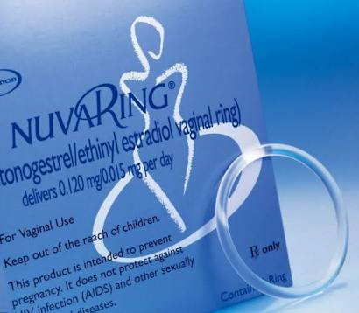
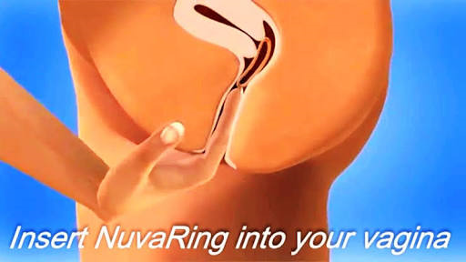
NUVA RING.

Slide 67
The contraceptive effect of Nuva ring is achieved through inhibition of ovulation.
Concomitant use of vaginal antimycosis,spermicides or tampons doesnot appear to affect efficacy.
The metabolic effects of Nuva ring are similar to those of low doses COCs.
Failure rate is 0.3% within the 1st year of use and 8% after typical use.

Slide 68
Ring is 50-75mm in diameter and 5-9mm thick.
The hormone is safe as it get absorbed through the vaginal mucosa and bypasses the liver.
Other Rings:
Nestorone Ring.

Slide 69
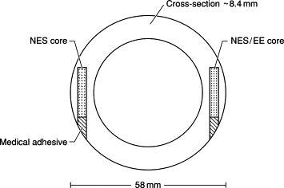
Nestorone rings
150mcg progesterone +15mcg EE2 effective for 1 year.
Failure rate is 1.4 per 100 woman years.

Slide 70
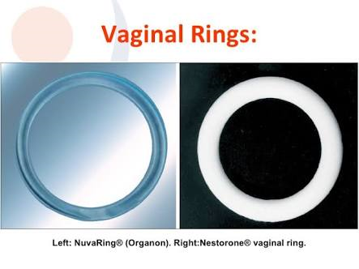

Slide 71
Progestogen vaginal ring
Vaginal progestogen only ring called ‘Progering’
Natural hormone .
Less effective than combined rings.
They are effective in lactating women because breastfeeding itself provides some protection against pregnancy.
They donot contain oestrogen which can reduce milk secretion.
Each ring releases 10mg of progesterone daily and lasts for 3 months.
Can be used upto 1year.
Bleeding disturbances are common.

Slide 72
Advantages.
Self insertion and removal,
Good compliance,
Quick reversible,
Same advantages as other progestogens.

Slide 73
Disadvantages.
Ring expulsion without the knowledge of the woman-sometimes resulting in pregnancy.
Factors are associated with expulsion are prolapse of the uterus,cystocele,rectocele and severe or chronic constipation.
Expensive rupees 700 per ring per cycle.
Local irritation is felt by few,vaginitis 5%.
Systemic side effects:
Headache,
Leucorrhoea,
Vaginitis,
Nausea
Breast tenderness.

Slide 74
Transdermal patches
Only contraceptive patch is ‘Ortho-EVRA’.
Elutes 150mcg of norelgestromin and 20 mcg EE2.
A women wears a patch for 1 week
Replaced it by another one placed at a different site for a total of 3 weeks,followed by 1 week with no patch.
The patches work by preventing ovulation,thickening the cervical mucus and suppressing endometrial growth.

Slide 75
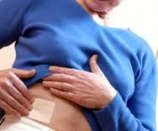

TRANSDERMAL PATCH

Slide 76
Ortho-EVRA is a square patch resembling a light brown bandage.
Each side is about 4.45cm long.
Patch is applied over dry skin on the buttocks,lower abdomen,upper outer arm or the upper body,but not on breasts.
Patch adheres well to the skin,allowing women to perform daily regular activities such as bathing,swimming,working and exercising without interruption even in warm,humid , climates.
It falls off in about 2% cases.
Failure rate is 0.3 per 100 women.

Slide 77
First patch should be applied within first 5 days of menstruation.
It should then be changed each week for 3 weeks applying it each time to a new location.
For the 4th week,no patch is worn,to allow for withdrawal bleeding.
It is contraindicated in obese women.
Side effects:
Skin irritation,
Breast discomfort,
Breakthrough bleeding(1%),
Headache ,
Nausea.

Slide 78
Percutaneous gel/Spray.
3 gms daily of percutaneous gel of oestradiol with cyclical progestogen is easy to apply.
One should wait for 1 hour for the gel to get dry up and not to be in contact with any other members.
It should not be applied over the breast.
Nestorone is also being clinically tried as a gel applied to the skin daily for 3 months.

Slide 79
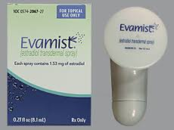

Percutaneous Spray.

Slide 80
Centchroman (ORMELOXIFEN)
Is a synthetic nonsteroidal contraceptive taken as a 30mg tablet, started on the first day of menses and taken twice weekly for 12 weeks and weekly thereafter.
Half life is 170 hours.
It doesnot prevent ovulation.
It prevents implantation through endometrial changes.
It exhibits a strong anti-oestrogenic .
Weak oestrogenic action peripherally at the receptor level.
The return of fertility occurs soon after stoppage of the drug within 6 months.
Centchroman is not teratogenic or carcinogenic.
Exerts no pharmacological effect on other organs.

Slide 81
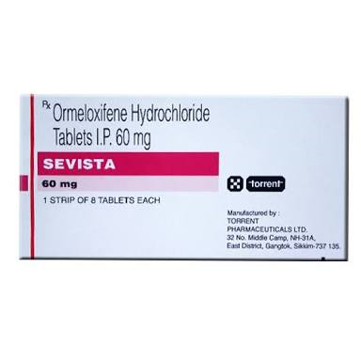
CENTCHROMAN

Slide 82
It cause:
Prolonged cycles,
Oligomenorrhoea in 8 % of cases.
This is due to prolonged proliferative phase.
Pregnancy rate is 1.83 per 100 woman years.
The drug can be used as a postcoial pill.
It has been developed by Central Drug Research Institute, Lucknow.
Released in India under the name of saheli.

Slide 83
Side effects of Ormeloxifen.
Headache,
Nausea,
Vomiting,
Weight gain,
Doesnot protect against HIV and STD.
Some delay in return of fertility(upto 6 months).
Prolonged use-Hyperplasia and Atypical endometrium.

Slide 84
Contraindications
During 6 months of lactation.
PCOD,
Hepatic dysfunction,
Cervical dysplasia,
Allergy to the drug.

Slide 85
Immunological methods.
Antigens which are experimented upon are:
Beta HCG subunit(300mcg)IM six-weekly x 3 doses evokes specific antibodies and thereby produces sterility for 1 year.
Zona pellucida plays a important role in fertility.
The Zona pellucida antibodies can either prevent penetration of ovum by the sperm or prevent shedding of zona after fertilisation so that implantation is impossible.
Antibodies to sperm antigens,these trials have not yet proved successful in human beings.
AntiFSH vaccine(Inhibin is also under trial).

Slide 86
Emergency Contraceptives.
Is a method of contraception used as an emergency procedure before menstruation is missed,to prevent pregnancy following unprotected intercourse or expected failure of contraception.
Alternative terms are Postcoital or morning after contraception.
It interferes with post ovulatory events leading to pregnancy and is therefore known as interceptive.

Slide 87
MOA.
Agents donot interfere with fertilization but act on the blastocyst before or soon after implantation are called Interceptive.
Those that interfere with early gestation before or soon after missing periods are called ’Contragestives’.
Delay ovulation if taken soon after intercourse, cause corpus luteolysis & bring about cervical mucus changes and endometrial atrophy.
When Contragestives are used postcoitally before the period is missed,they donot fall in category of ‘abortifiacients’

Slide 88
Indications.
Following
Unprotected sexual intercourse,
Rape,
Accidental rupture of a condom during coitus taking place around ovulation.
It is used in misplace IUCD and missed Pill.
These postcoital methods should be used mainly as ‘back up’ methods.
Adolescent girls can be saved from illegal abortions- moral, physical & social.
Not as a regular contraceptive due to high failure rates and high incidence of irregular bleeding.

Slide 89
Methods
Two methods of emergency contraception
Hormonal
Mechanical.

Slide 90
Hormonal emergency contraception
Levonorgestrel (LNG)-only pills.
Combine d Oestrogens and progestogen pills also known as Yuzpe regimen.
The Yuzpe regimen has been studied and widely practised since 1970.
However ,since 1993, LNG only pills are preferred,mostly because of side effects.

Slide 91
LNG.
PROSTINAR TABLET:
One dose of 0.75mg LNG pill should be taken as soon as possible after unprotected intercourse, followed by a same dose taken 12 hours later.
Both doses must be taken within 72 hours of intercourse.
The failure rate is 1.1%
Other dose regimens:
Single 1.5mg dose of LNG is as effective for emergency contraception.
Two 0.75mg doses of LNG taken 12 hours apart.
No significant difference was found among two types of treatments regarding effectiveness & side effects

Slide 92
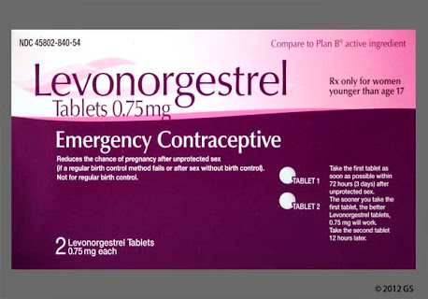
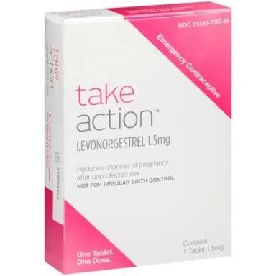
LNG TABLET.

Slide 93
Brand names:
EC pill,
Pill 72
ECEE2
The period may come earlier or delayed.
MECHANISM OF ACTION:
LNG prevents ovulation
Causes desynchronization of endometrium through its receptors (luteal phase deficiency).
The period may come earlier or delayed.

Slide 94
SIDE EFFECTS.
RISK OF ECTOPIC PREGNANCY REMAINS.
CONTRAINDICATIONS:
Liver Disease,contains lactose, so allergy to galactose.
Contraindicated in a woman with history of thrombophlebitis and migraine.

Slide 95
Advantages .
It has no oestrogen and its associated side effects.
It can be offered to hypertension,cardiac and diabetic woman.
It can be offered to a lactating woman.
It can be given as late as 120 hours after the unprotected intercourse.
Single dose therapy is an advantage.

Slide 96
Combined oestrogens & progesterone pills.
Also known as Yuzpe regimen.
It consists of oral dose of ethinyl estradiol(EE) 0.1 mg with 1.0mg of dinorgestrel repeated after 12 hours starting within 72 hours of unprotected intercourse.
Trade names: Norigynon,Noral,Ovidon.
High dose pill contains 50mcg of EE and 250mcg LNG(or 500mcg dl-norgestrel)such as Ovral are available.
2 pills should be taken as soon as possible, but not later than 72 hours of unprotected coitus, followed by 2 other pills 12 hours later.

Slide 97
Mode of action.
Mechanism is not been clearly established.
They may act through:
Inhibition or delay of Ovulation.
Prevention of implantation in the altered endometrium.
Prevention of fertilization due to quick transport of sperms or ova.

Slide 98
Risk.
Development of vaginal adenosis and adenocarcinoma of the children owing to the effect of prenatal oestrogen therapy.
Development of limb defect and cardiovascular defect.
But the chances of these disorders are very remote or nil because:
The drug is given before organogenesis starts, and that too for a short time.
The blastocyst is resistant to drugs before or soon after implantation.
Combined pills have a teratogenic effect,
Increase the chances of ectopic pregnancy.

Slide 99
Side effects.
Nausea:
50% women using Yuzpe regimen.
20% using LNG only pills.
But doesnot usually last for more than 24 hours.
Nausea is less are taken at bedtime or with food or milk,or with antiemetic drugs.
Vomiting:
20% women using Yuzpe regimen
5% using LNG only pills.
If vomiting occurs within 2 hours of taking the pills , the dose should be repeated.
In severe vomiting,repeat dose of the pills may be administered vaginally.

Slide 100
Irregular uterine bleeding:
Experience spotting after taking the pills.
Majority of women have their period on time or early,may be delayed for 3-7days.
Other side effects:
Headache,
Dizziness,
Fatigue,
Breast tenderness.
Aspirin or other pain-relieving drugs to relieve headache & breast tenderness.

Slide 101
RU 486(Mifepristone)
RU 486 is a steroid with an affinity for progesterone receptors.
It doesnot prevent fertilization but by blcking the action of progesterone on the endometrium.
It causes sloughing and shedding of decidua and prevents implantation.
It is not teratogenic.

Slide 102
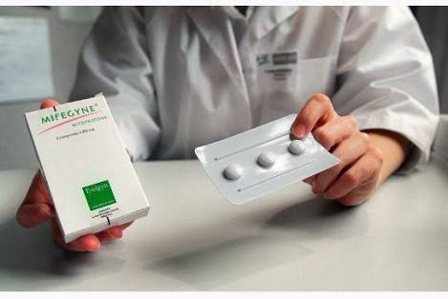
RU 486 (MIFEPRISTONE)

Slide 103
Dosage.
25-50mg is effective in preventing pregnancy.
Failure rate is 0.9%.
It causes delayed menstruation.
Ectopic pregnancy is not avoided.
The drug is expensive as compare to LNG.

Slide 104
Ulipristal
Ulipristal is a synthetic progesterone hormone receptor modulator.
Attaches to progesterone receptor and prevents/delays ovulation and suppresses endometrium prevents implantation.
A 30 mg tablet should be taken within 5 days.
2% pregnancy rate is reported.
S/E:
Headache,
Mood Changes.

Slide 105
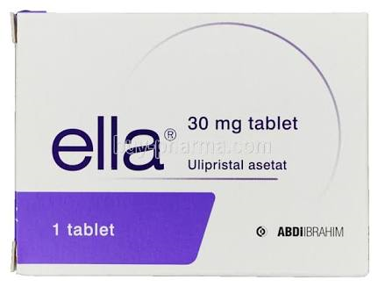
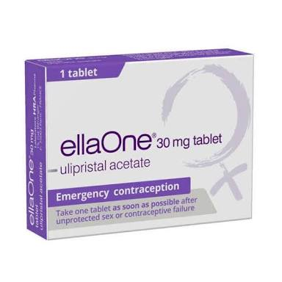
ULIPRISTAL

Slide 106
Centchroman
Two tablets 60 mg taken twice in 24 hours within 24 hours of intercourse can prevent implantatio in 99% women.

Slide 107
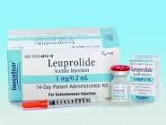
GnRH Agonists
Daily administration of GnRH agonist (buserelin) prevents ovulation.
The drug is on trial for its contraceptive effect.
Very expensive – has to be given by subcutaneous injection.

Slide 108
Prostaglandins
Self administered vaginal supposirory containing prostaglandin following an unprotected intercourse,
By virtue of its luteolytic effect on the ovary and its increased motility effect on fallopian tubes and the uterus
Prevents implantation and brings about menstruation.

Slide 109
Mechanical Emergency contraception.
IUCDS can be used inserted within 5 days of intercourse can prevent implantation of a fertilized ovum.
For rape cases & those who are high risk of STDs,
IUDs can be introduced after proper counselling under cover of antibiotics if the woman come after3 days and before 5days of unprotected sex act.
IUD should be removed after the next menstruation.
If they come less than 72 hours after sex,hormonal pills should be used.

Slide 110
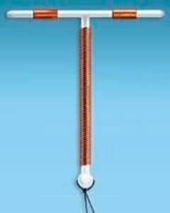
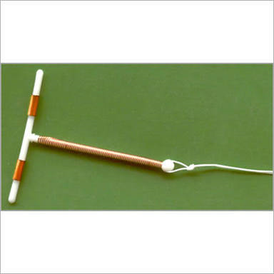
CU-T.

Slide 111
ADVANTAGES:
It can be inserted as late as 5 days after the unprotected intercourse.
It is cheap.
Failure rate is 0.1%
It can remain as ongoing contraceptive method for 3-5 years.

Slide 112
Disadvantages.
Increase the chance of Severe Pelvic Infection if the woman has vaginal infection including STD
IUCDS Donot prevent HIV/AIDS.
MOA:
IUCDs act in the usual way by causing giant cell and lymphocytic infiltration and enzymatic and other cellular changes in the endometrium,
Damaging the blastocyst directly around the time of implantatio.

Slide 113


