Slide 1
Hyperprolactinemia
.

Slide 2
PROLACTIN
Prolactin(PRL) is a polypeptide hormone resembling growth hormone and human placental lactogen.
It contains 198 aminoacids and secreted by pituitary lactotrophs in a pulsatile manner.
Molecular weight:23,000D.
Extrapituitary sites for prolactin production:
Endometrium,
Decidua,
Hypothalamic neurons,
Instestines,
Lungs and renal cancer.

Slide 3
In human genome, a single gene on chromosome on 6 encodes Prolactin.
In the basal state three forms are released:
A monomer called little/naive Prolactin: Biologically active.
A dimer, called as big prolactin :Elevated in Pregnancy.
Multimeric species called as big-big prolactin: which is inactive.
Clinical assays for prolactin measures the little prolactin and they are sufficient to assess disease of abnormal pituitary production of the hormone.

Slide 4
Functions of Prolactin.
Associated with reproduction:
Lactation,
Luteal function,
Reproductive behaviour.
Homeostasis:
Immune responsivity,
Osmoregulation,
Angiogenesis.

Slide 5
In contrast to the other anterior pituitary hormones, which are controlled by hypothalamic-releasing factors,
Prolactin secretion is primarily under inhibiting control mediated by dopamine.
Dopamine is secreted by the tuberoinfundibular dopaminergic neurons into the portal hypophyseal vessels is the primary Prolactin Inhibiting Factor(PIF).

Slide 6
Dopamine receptors were found on pituitary lactotrophs & treated with dopamine or dopamine agonists suppresses prolactin secretion.
Dopamine antagonists metoclopramide abolishes the pulsatility of prolactin release and increase S.prolactin levels.

Slide 7
Definition:
Hyperprolactinemia is defined as persistent high level of prolactin in a non-pregnant and non lactating women.

Slide 8
Stimulating factors:
Beta endorphin.
17 Beta estradiol,
Enkephalins
Gonadotropin-releasing hormone,
Histamine,
Serotonin,
Substance P,
Thyrotropin releasing hormone,
Vasoactive Intestinal Peptide.

Slide 9
Inhibitory factors.
Dopamine,
Gamma-aminobutyric acid,
Pyroglutamic acid,
Somatostatin,
Histidyl-proline diketopiperazine

Slide 10
Physiologic conditions
Anesthesia,
Empty sella syndrome,
Idiopathic,
Intercourse,
Major surgery and disorders of chest wall :
  Burns,
  Herpes,
  Chest Percussion.
Newborns,
Nipple stimulation,
Pregnancy,
Sleep,
Stress,
Postpartrum (nonnursing:days1-7;nursing with suckling)

Slide 11
Hypothalamic conditions:
Arachnoid cyst,
Craniopharyngioma,
Cystic glioma,
Cysticercosis,
Dermoid cyst,
Epidermoid cyst,
Histiocytosis,neurotuberculosis,
Pineal tumours,
Pseudotumour cerebri,
Sarcoidosis,
Suprasellar cysts
Tuberculosis.

Slide 12
Pituitary conditions.
Acromegaly,
Addison disease,
Craniopharyngioma,
Cushing syndrome,
Hypothyoidism,
Histiocytosis,
Lymphoid hypophysitis,
Metastatic tumours(especially of the lungs & breasts),
Multiple Endocrine Neoplasia,

Slide 13
Thyrotropin releasing hormone administration,
Trauma to stalk,
Tuberculosis,
Nelson syndrome,
Pituitary adenoma(Micro or Macroadenoma),
Post-Oral Contraception,
Sarcoidosis.

Slide 14
Metabolic dysfunction.
Ectopic production:
  Hypernephroma,
  Bronchogenic sarcoma.
Hepatic cirrhosis,
Renal failure,
Starvation refeeding

Slide 15
Metabolic dyfunction
HP occurs in chronic renal failure (20-75%).
Women with hyperandrogenemia also have hyperprolactinemia.
Hypothyroidism.

Slide 16
HYPOTHYROID.
Patients with hypothyroidism exhibit hyperprolactinemia with remarkable pituitary enlargement caused by thyrotroph hyperplasia.
These pts respond to thyroid replacement therapy with reduction in pituitary enlargement and normalization of prolactin levels.

Slide 17
Hyperandrogenemia.
Elevated prolactin levels may alter adrenal function by enhancing the release of adrenal androgens such as DHEAS.

Slide 18
Drugs
Antidepressants:
  Amoxapine,
  Imipramine,
  Amitriptyline.
Alpha Methyl dopa,
Cimetidine,
Estrogen therapy,
Opiates,
Reserpine,
Sulpride,
Verapamil,
Amphetamine,
Haloperidol,
Cocaine abuse

Slide 19
Dopamine antagonists.
Phenothiazines,
Thioxanthenes,
Butyrophenone (HALOPERIDOL)
Diphenylbutylpiperidine,
Dibenzoxazepine,
Dihydroindolone,
Procainamide,
metoclopromide

Slide 20
Drug induced hyperprolactinemia.
If medicaions can be discontinued, resolution of hyperprolactinemia is uniformly prompt.
Estrogen replacement = Normalisation of menses for those with disturbed or absent ovulation.
Treatment with dopamine agonists may be utilised if ovulation is desired and the drug induced hyperprolactinemia cannot be discontinuedss.

Slide 21
Thyroid.
Thyrotropin releasing hormone(TRH) causes prolactin release when present at supraphysiologic levels (as in Primary Hypothyroidism).
It doesnot appear to play an immunomodulatory role in the normal physiologic regulation of prolactin secretion.
Hypothyroidism causes hyperprolactinemia because of stimulating effect of raised thyroid stimulating hormone(TSH).

Slide 22
Evaluation.
Plasma levels of immunoreactive prolactin :5 to 27 ng/mL
through the normal menstrual cycle.
Prolactin is secreted in a pulsatile fashion with pulse frequency ranging from about
14 pulses per 24 hours in the late follicular phase ,
9 pulses per 24 hours in the late luteal phase.
There is diurnal variation with lowest level occuring in the mid morning.

Slide 23
When should we measure Prolactin??
Sample is preferrably is drawn midmorning
not after stress,
previous venipuncture,
breast stimulation, or
physical examination ,
all of which transiently increase prolactin levels.

Slide 24
When we shouldnot measure prolactin??
Samples should not be drawn soon after the patient awakes or after procedures.
Levels rise 1 hour after the onset of sleep and continue to rise until peak values are reached between 5 and 7am.
The pulse amplitude of prolactin appears to increase from early to late follicular and luteal phases.
Because of variability of secretion and inherent limitations of radioimmunoassay. An elevated level always be rechecked.

Slide 25
Prolactin levels are found to be elevated,hypothyroidism and medications should be ruled out as a cause.
Prolactin and TSH determination are basic evaluation in infertile women.
The level up to 100ng/ml suggests hyperprolactinemia
Levels more than 100ng/ml occurs in presence of tumour.
Twenty percent cases of PCOD,
endometriosis

Slide 26
Mechanism
Hyperprolactinaemia is associated with reduction in GnRH and gondotrophin production through direct effect on the hypothalamus & pituitary.
Secondary to gonadotropin deficency,oestrogen levels are low and patients generally donot have withdrawal bleeding with progesterone.

Slide 27
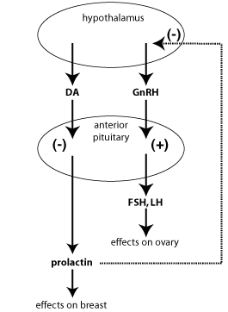

Slide 28
Clinical manifestations in women
GALACTORRHEA:(Non-Puerperal Lactation)
  Unilateral/Bilateral,
  Continuous/Intermittent.
OVULATORY DYSFUNCTION:
  Oligo-ovulation,
  Anovulation.
  Infertility.
MENSTRUAL TROUBLES:
  Oligomennorhoea,
  Amenorrhoea.
  Delayed puberty,

Slide 29
REGARDING FERTILITY:
  Infertility,
  Abortions(Corpus Luteal defect).
SYMPTOMS DUE TO TUMOUR:
  Headache ,
  Visual disturbances(tumour presses upon optic nerve)

Slide 30
Clinical manifestations in male.
Loss of libido,
Impotency,
Oligospermia=>Infertility,
Gynaecomastia.

Slide 31
Physical signs.
Amenorrhoea without Galactorrhoea is assoiated with hyperprolactinemia in 15% of women.
Cessation of normal ovulatory processes resulting from elevated prolactin levels is primarily caused by the suppressive effects of prolactin, via hypothalamic mediation ,on GnRH pulsatile release.

Slide 32
S.prolactin levels may secondarily impair the mechanism of ovulation by causing :
A reduction in granulosa cell number and FSH binding,
Inhibition of granulosa cell 17Beta estradiol production by interferring with FSH secretion,
Causing inadequate lutenization,
Reduced luteal secretion of Progesterone.

Slide 33
Isolated galactorrhoea is considered indicative of hyperprolactinemia, prolactin levels are within the normal range in nearly 50% of patients.
Sensitivity of breast to the lactotrophic stimulus endangered by normal prolactin levels is sufficient to result in galactorrhoea.
Approximately 1/3 rd of patients having galactorrhoea have normal menses.

Slide 34
Conversely,hyperprolactiemia commonly occurs in the absence of galactorrhoea(66%) which may result from inadequate estrogenic or Progestational priming of the breast
Pts with both galactorrhoe & amenorrhoea 2/3 rd will have hyperprolactinemia.
1/3rd will have pituitary adenoma.
3-10% women diagnosed as PCOS will have hyperprolactinemia.

Slide 35
Investigations.
MRI with gadolinium enhancement of the sella & pituitary gland appears to provide the best anatomic detail.
The cumulative radiation dose from multiple CT scans may cause cataracts and the “Coned down” views or tomograms of the sella are very insensitive and expose the patient to radiation.
MRI is to differentiate a pituitary microadenoma from a macroadenoma and to idenify other potential sellar-suprasellar masses.
Untreated microadenomas donot enlarge over 4 to 6 year period

Slide 36
Pituitary microadenoma.
Radiologic abnormality consistent with a microadenoma (<1cm) is found.
Pts with microadenomas can be reassured of a probable course, and many of the lesions exhibit gradual spontaneous regression.
Adenomas are monoclonal in origin.

Slide 37
HOW MICROADENOMA DEVELOPS??
Release of pituitary stem cell growth inhibitors via activation or loss of function mutation results in cell cycle dysregulation and is critical to the development of pituitary microadenomas & macroadenomas.
Genetic mutations are thought to release stem cell growth inhibitors and results in autonomous anterior pituitary hormone production, secretion and cell proliferation.

Slide 38
Additional anatomic factors that may contribute to adenoma formation include reduced dopamine concentrations in the hypophyseal portal system and vascular isolation of the tumour or both.
Recently,heparin-binding secretory-transforming (HST) gene was noted in a variety of cancers & in prolactinomas.

Slide 39
Microadenoma.
Calcification of the tumors may take the form of psammoma body or a pituitary stone.
Are acidophilic tumours .
Symptoms:
Headache,
Visual defects
(Bitemporal hemianopia)tumour compressing optic chiasma.s

Slide 40
Treatment.
Expectant management,
Medical treatment.

Slide 41
Expectant management.
In women who donot desire fertility,expectant management can be used for both
microadenoma
Hyperprolactinemia without an adenoma while menstrual function remains intact.
Hyperprolactinemia induced estrogen deficiency, rather than prolactin itslef, is the major factor in the development of osetopenia.
HRT or OCPs for pts with amenorrhoea or irregular menses.
Pts with drug induced hyperprolactinemia can be managed expectantly. Imaging may be repeated in 12 months if prolactin remains stable.

Slide 42
Medical treatment.
Ergot alkaloids are the mainstay of therapy.
Agents act as strong dopamine agonists, thus directing prolactin levels.
Effects on prolactin levels occurs within hours and lesion may decrease within 1 or 2 weeks.
Bromocriptine(commonest used Ergot alkaloid)
Decreases prolactin synthesis,
DNA synthesis,
Cell Multiplication,
Overall size of prolactinomas,
Return of ovulatory menses in 80% to 90% of patients.

Slide 43
Dopamine Agonists.
AGONIST | NATURE | DOSE | MAINTENANCE
BROMOCRIPTINE (Parlodel) | ERGOT | 2.5-10MG/DAY | 7.5mg/d
Quinagolide (Norprolac) | Ergot | 25-300ug/day | 75ug/day.
Lisuride (Dopergine) | Ergot | 0.-0.2mg/day | 0.1mg/day
Cabergoline | Ergot | 0.25-1mg/TWW | 1mg/week

Slide 44
Bromocriptine:
Semi-Synthetic ergot derivative (lysergic acid derivative of ergoline)
a powerful dopamine agonist.
Short half life: 3.3 hours
It may need multiple dosing throughout the day.
Approximately 12% pts unable to tolerate this medication at therapeutic levels.

Slide 45
Mechanism of Action.
It supresses prolactin while promoting the secretion of gonadotropins.
It thus induces menstruation ,ovulation and promotes pregnancy.
It also supresses lactation

Slide 46
Adverse effects:
Nausea,
Headache,
Hypotension,
Dizziness,
Fatigue,
Drowsiness,
Vomiting,
Nasal congestion,
Constipation.
Rarest side effect: Psycotic reaction.
Auditory hallucinations, delusional ideas, changes in the mood that quickly resolves after dicontinuation of drugs.

Slide 47
Route of excretion.
Bromocriptine is excreted via the biliary tree, caution is required when using it in the presence of liver disease.

Slide 48
Contraindications:
Hypertension,
Cardiovascular disease,
Thromboangitis obliterans.

Slide 49
Therapeutic Applications.
Suppresion of lactation,
Cyclical mastalgia,
Anovulatory infertility caused by hyperprolactinemia.
Treatment of microadenoma and preoperatively in macroadenoma to shrink the tumour prior to surgery.

Slide 50
Dosage:
Bromocriptine 1.25mg HS at bed time for 1st week,
1.25 mg bd for 2nd week,
1.25mg at morning and 2.5mg at evenig for 3rd week,
2.5mg bd for 4th week.
To minimize the side effects, bromocriptine usually is started at a low dosage and increased gradually.

Slide 51
Cabergoline.
Another ergot alkaloid, has a very long half life can be given orally twice per week.
Long duration of action is attributable to slow elimination by pituitary tumour tissue, high affinity, binding to pituitary dopamine receptors and extensive enterohepatic circulation.

Slide 52
Dosage:
Dosage: 0.25mg twice perweek is usually adequate for hyperprolactinemia with values less than 100ng/ml.
To normalise prolactin levels the dosage can be increased by 0.25mg per dose on a weekly basis to a maximum of 1mg twice weekly.
Half life of drug: 65 hours.

Slide 53
Side effects.
Increased risk of cardiac valve regurgitation.
Higher doses and a longer duration of therapy were associated with a higher risk of valvulopathy.
It is postulated that 5HT2b receptor stimulation leads to fibromyoblast proliferation.
Asymptomic tricuspid regurgitation

Slide 54
Macroadenomas.
Macroadenomas are pituitary tumours are larger than 1cm in size.
Evaluation for pituitary hormone deficiencies may be indicated.
Symptoms of macroadenoma enlargement:
Severe headache,
Visual field changes,
Rarely diabetes insipidus and blindness.

Slide 55
Repeat MRI is indicated within 6 months to document shrinkage or stabilisation of the size of macroadenoma.
The examination may be performed earier if new symptoms develop or if there is no improvement in previously noted symptoms.

Slide 56
Medical treatment.
Tumour regrowth occurs in more than 60% of cases after discontinuation of bromocriptine therapy, long term therapy is required.
After stablisation of tumour size is documented, MRI scan is repeated 6 months later and is stable.yearly for several years.
Examiation is repeated if new symptoms develop or if there is no improvement in symptoms.

Slide 57
Serum prolactin levels are measured every 6 months.
Normalized prolactin levels or resumption of menses shouldnot be taken as absolute proof of tumour response to treatment

Slide 58
Indications for surgery:
Patient drug intolerance,
Tumour resistant to medical therpay,
Persistent visual field defects n spite of medical treatment.
Patients with large cystic or haemorrhagic tumours.

Slide 59
Surgical Intervention.
Neurosurgeons (2-6weeks) preoperative course of bromocriptine increases the efficacy of surgeons in patients with larger adenomas.
Despite surgical resection, recurrence of hyperprolactinemia and tumour growth is common.
Surgery of choice: TRANSPHENOIDAL ADENECTOMY.

Slide 60
COMPLICATIONS OF SURGERY.
Cereberal carotid artery injury,
Diabetes insipidus,
Meningitis,
Nasal septal perforation,
Partial or panhypopituitarism,
Spinal fluid rhinorrhoea,
Third nerve palsy.
Periodic MRI scanning after surgery is indicated, particularly in patients with recurrent hyperprolactinemia.

Slide 61
Use of estrogen in hyperprolacinemia.
Elevated levels of estrogen as found in pregnancy are responsible for hypertrophy and hyperplasia of lactotrophic cells and account for the progressive increase in prolactin levels in normal pregnancy.
Pregnancy may have a favourable influence on preexisting prolactinomas.
Estrogen replacement or OCP use is appropriate for hypoestrogenic pts with hyperprolactinemia secondary to microadenoma or hyperplasia.

Slide 62
Monitoring pituitary adenomas during Pregnancy.
Prolactin secreting microadenomas rarely create complications during pregnancy.
Monitoring of patients with serial gross visual field examination and fundoscopic examination is recommended.
If Persistent headaches,visual field deficits, or visual or fundoscopic changes occur.
MRI scanning is advisible.

Slide 63
Because S.Prolactin levels Progressively rise throughout pregnancy, Prolactin measurements are rarely of value.
Women who become pregnant while taking brmocriptine to treat a return of spontaneous ovulations, discontinuation of bromocriptine is recommended.
This doesnot preclude subsequent use of bromocriptine during the pregnancy to treat symptoms.
(Visual defect,Headache) due to the further enlargement of the microadenoma.

Slide 64
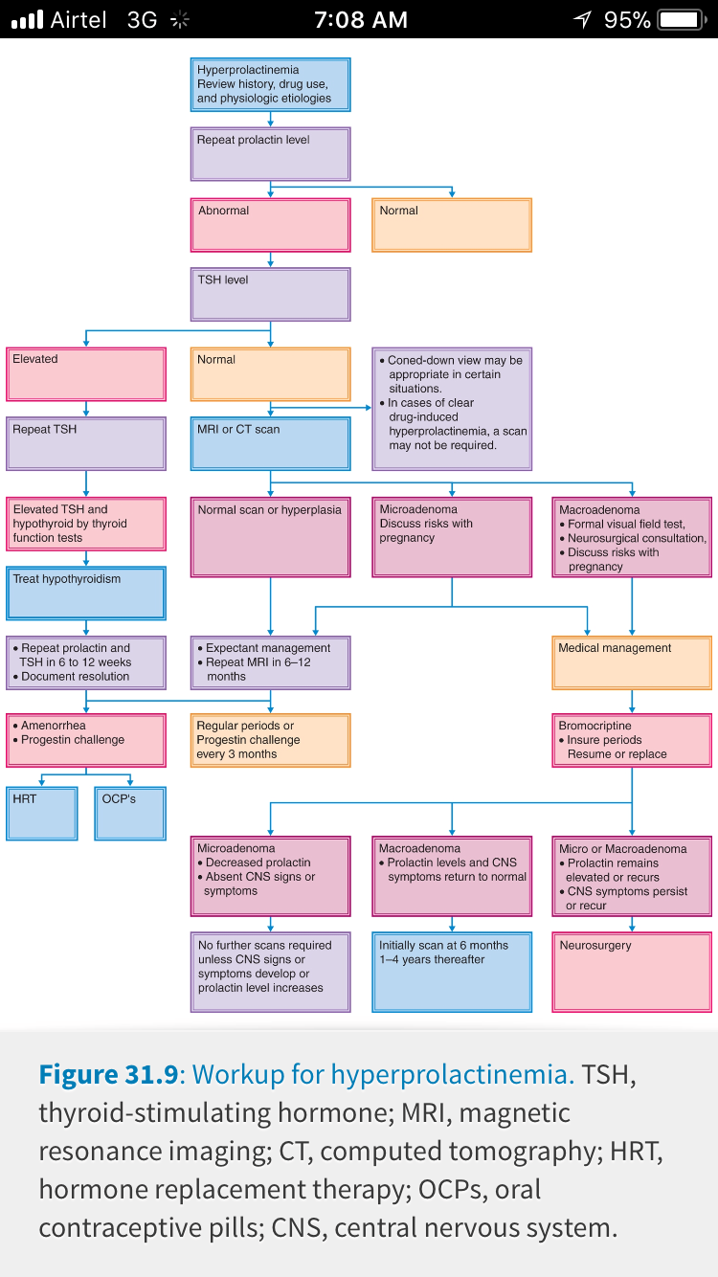

Slide 65

s

