Slide 1
Amniotic fluid and abnormalties

Slide 2
introduction
Amniotic fluid is contained in an amniotic sac lined internally by amnion and externally by chorion.
It is the fluid milieu of the fetus
Amniotic fluid environment is best suited for fetal development
It plays a dynamic role in fetal physiology and is an important component of fetal-maternal communication system
Disruption of the fine balance may result in overproduction or underproduction of fluid.

Slide 3
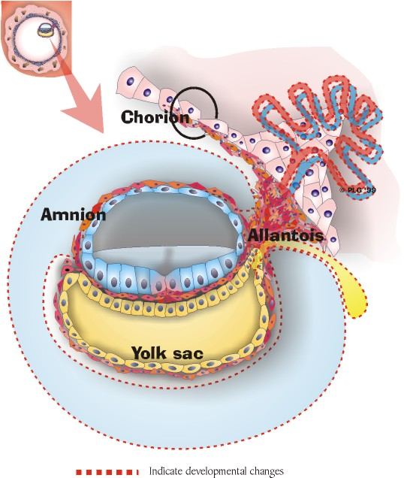
Development
Amniogenic cells line the inner surface of trophoblast
Derived from fetal ectoderm of the embryonic disc

Slide 4
Amniotic Fluid
Before 20 weeks gestation –
  Amniotic fluid is an ultrafiltrate of maternal serum
  Maternal & Amniotic fluid osmolality, sodium, urea, and creatinine are roughly equal.
At term
  Volume = 900cc
  Reflective of fetal renal function.
  Progressively hypotonic.
  Contains fetal debris: squamous cells, mucin, lanugo.

Slide 5
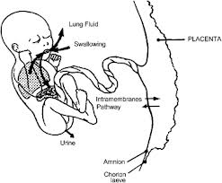
Sources of amniotic fluid
The two primary sources of amniotic fluid are fetal urine and lung liquid, with an additional small contribution due to secretions from the fetal oral-nasal cavities.
Fetal urine is a major source of amniotic fluid in the second half of pregnancy.

Slide 6
Sources of amniotic fluid
Urine production Approximately 110/ml/kg every 24 hours at 25 weeks to approximately 190 ml/kg every 24 hours at 39 weeks
At term, the current best estimate of fetal urine flow rate may average 700-900 ml/day.

Slide 7
Sources of amniotic fluid
The fetal lungs are the second major source of amniotic fluid during the second half of gestation.
Studies in near-term fetal sheep have shown that there is an outflow from the lungs of 200-400 ml/day

Slide 8
Sources of amniotic fluid
The inward transfer of solute across the amnion with water following passively is the most likely source of amniotic fluid very early in gestation
Part of AFV may be derived from water transport across the highly permeable skin of the fetus during the first half of gestation, at least until keratinization of the skin occurs around 22-25 weeks.

Slide 9
Routes of amniotic fluid removal
The two primary routes of amniotic fluid removal are fetal swallowing and absorption into fetal blood perfusing the fetal surface of the placenta.
Fetal swallowing plays an important role in determining AFV during the last half of gestation.

Slide 10
Routes of amniotic fluid removal
The fetus begins swallowing at the same gestational age when urine first enters the amniotic space, that is around 8-11 weeks.
It is estimated that the volume of amniotic fluid swallowed in late gestation averages 210-760 ml/day

Slide 11
Intermembranous & transmembranous pathways
As a further pathway, rapid movements of both water and solute occur between amniotic fluid and fetal blood within the placenta and membranes; this is referred to as the intramembranous pathway.
Movement of water and solute between amniotic fluid and maternal blood within the wall of the uterus is an exchange through the transmembranous pathway

Slide 12
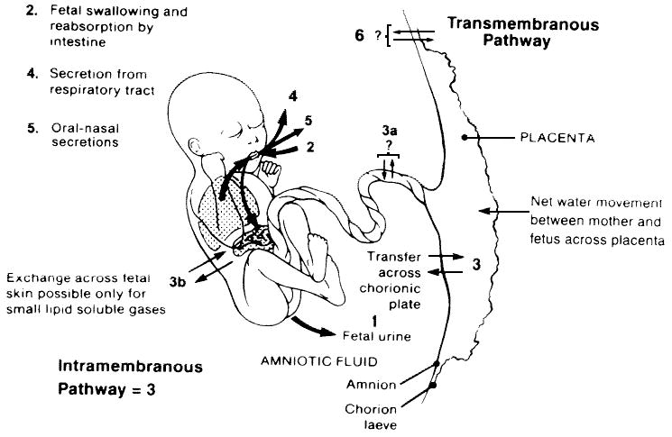
Amniotic fluid volume

Slide 13
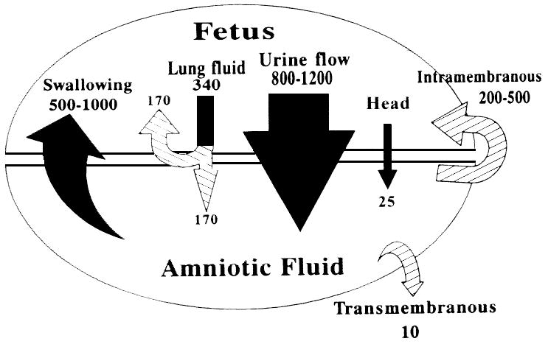
Amniotic fluid volume

Slide 14
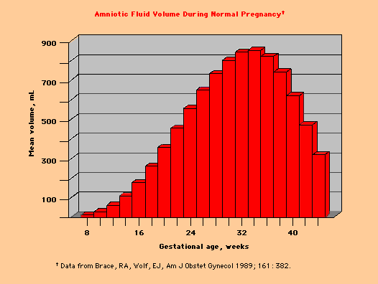
Amniotic fluid dynamics

Slide 15
Physical properties
Ph- >7
specific gravity:1.010
highly hypotonic to maternal serum at term
osmalality -250m osmol/litre- fetal maturity

Slide 16
Chemical composition:
Water -98%
Solids -2%
Organic: glucose: 20 mg%
proteins:300 mg%
urea: 30 mg%
creatinine: 2 mg%
uric acid: 4 mg%
total lipids: 50 mg%
hormones(prolactin, insulin, renin)
Inorganic : sodium, potassium, chloride
Suspended particles: lanugo, exfoliated squamous epithelial cells from fetal skin, vernix caseosa,cast off amniotic cells, cells from respiratory tract,urinary bladder and vagina of the fetus

Slide 17
functions
In pregnancy
It is essential for fetal growth and development (integral part of normal respiratory system development)
It allows fetal movements by reducing contact the fetus and the membranes and also prevents adhesions (development of musculoskeletal system)
It protects fetus from forces exerted secondary to maternal trauma (shock absorber) and minimizes umbilical cord compression

Slide 18
functions
4) It maintains temperature
5) It prevents placental retraction and thus prevents fetal asphyxia
6) It bacteriostatic properties reduce the potential for infection
7)Swallowed liquor provide gamma globulin and antibodies:passive immunity

Slide 19
functions
In labour
The fore bag of water , acts as hydrostatic wedge ,helps the dilatation of the cervix during labour
Rupture of membranes helps in augmentation of labour (mesenchymal cells in the amnion are rich in glycerophosholipids which are Prostaglandin precussors)
It flushes the birth canal at the end of first stage of labour and by its aseptic and bactericidal action protects the fetus and prevents ascending infection to uterine cavity

Slide 20
AMNIOTIC FLUID as an indicator of fetal health
Pale,straw coloured : normal
green : meconium stained
bright red: abruptio placentae
dark red: intrauterine death
pus like: chorioamniotis

Slide 21
oligohydramnios
DEFINITION:
Decrease in the volume of amniotic fluid relative to the gestational age
Other definitions:
AMNIOTIC FLUID VOLUME < 5 th percentile for gestational age
AMNIOTIC FLUID INDEX < 5
SINGLE VERTICAL POCKET < 2 cms
Amniotic fluid volume of less than 500 mL at 32-36 weeks' gestation

Slide 22
INCIDENCE: 0.5-5%
1:750

Slide 23
etiology
FETAL
PROM (50%)
CHROMOSOMAL ANOMALIES
CONGENITAL ANOMALIES
IUGR
IUFD
POSTTERM PREGNANCY
MATERNAL
PREECLAMPSIA
APLA SYNDROME
CHRONIC HYPERTENSION
DRUGS
PG SYNTHETASE INHIBITORS
ACE INHIBITORS
IDIOPATHIC
PLACENTAL
CHRONIC ABRUPTION
TTTS
CVS

Slide 24
Congenital anomalies associated with oligohydramnios
Amniotic band syndrome
cardiac: fallots tetralogy,septal defects
CNS:holoprosencephaly,meningocoele, microcepaly
chromosomal: triploidy, trisomy 18, turner syndrome
cloacal dysgenesis
cystic hygroma
diaphragmatic hernia

Slide 25
CONGENITAL ANOMALIES
Genitourinary :renal agenesis,renal dysplasia,urethral obstruction, bladder extrophy, meckel –gruber syndrome, ureteropelvic junction obstruction,
skeletal: sirenomyelia, sacral agenesis,absent radius, facial clefting
TRAP
twin- twin transfusion syndrome
VACTERAL(vertebral, anal , cardiac, tracheo –esophageal, renal, limb)association

Slide 26
Amniotic band syndrome
Is a group of congenital birth defects caused by entrapment of fetal parts in fibrous amniotic bands in utero
Incidence: 1 in 1,200 to 1 in 15,000 live births
Cause of about 178 in 10,000 miscarraiges
Upto 50% of cases--- cleft lip, cleft palate, club foot deformity
hand and finger anomalies -80%

Slide 27
pathophysiology
Amniotic band theory
Rupture of amniotic membranes – detachment from the chorion --- amniotic fluid leaking through the tear ---fetal can move digits or limbs through tear and exit the amniotic cavity---- the outer surface of the amnion produce mesodermic fibrous strings which may entangle and entrap different organs----constriction and amputation anomalies

Slide 28
stages
Constriction of the appendages by amniotic bands result in:
Restriction of growth around the digits , arms and legs
Constriction rings around the digits , arms, and legs –the bands will partly constrict the blood flow causing deep groove in the baby’s skin
Swelling of the extremities distal to the point of contriction
Amputation of digits , arms and legs

Slide 29
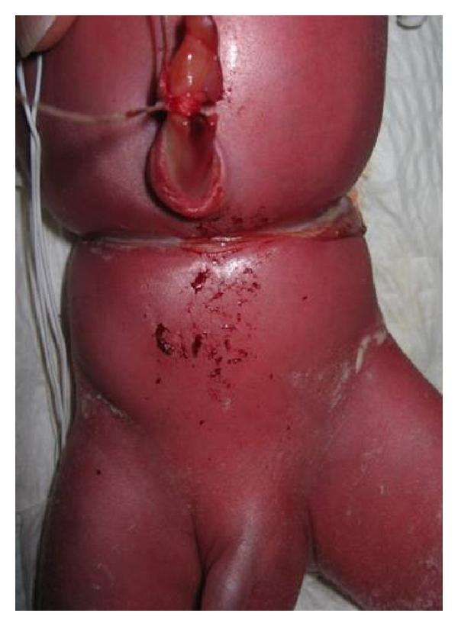
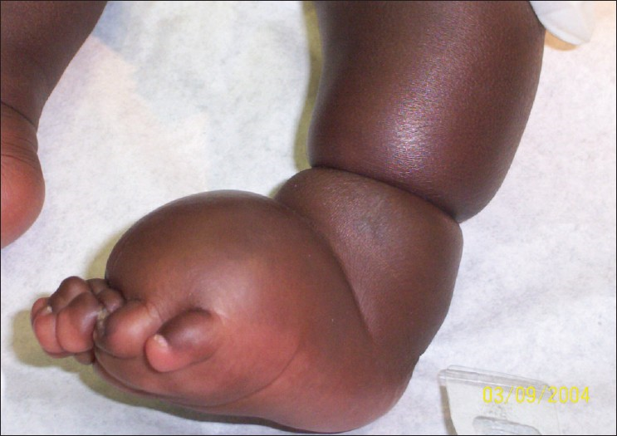

Slide 30
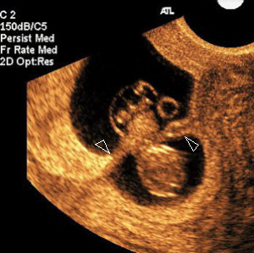
Diagnosis
Ultrasound: visualization of abberent sheet or band of amnion attached to the fetus with resultant deformity and restriction of motion

Slide 31
Amniotic band syndrome
Treatment
Bands that only cosmetically affect superficial skin –no intervention
Tight constriction bands ,resulting in gross lymphedema, vascular compromise- surgical release

Slide 32
Diagnosis: oligohydramnios
SYMPTOMS
NO SPECIFIC SYMPTOMS
H/O leaking p/v
Postterm
s/o preeclampsia
Drugs
Less fetal movements
SIGNS
Uterus – inadequate fundal height growth
Feels full of fetus
Malpresentation
IUGR

Slide 33
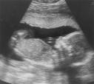
ultrasound
METHODS
MVP <2 cms
(<1 severe)
AFI <5 cms
(5-8 borderline)
2D pocket <15 sq cms

Slide 34
Technique of afi
Supine position
a linear, curvilinear or sector transducer can be used
Divide the uterus into 4 quadrants using the maternal sagittal midline vertically and an arbitary transverse line approximately halfway between symphysis pubis and upper edge of the fundus
Transducer must be kept parallel to the maternal sagittal plane and perpendicular to the maternal coronal plane throughout

Slide 35
The deepest unobstructed (free of umbilical cord or fetal parts) and clear pocket of amniotic fluid is visualized and the image frozen
ultrasound calipers are manipulated to measure the pocket in a strictly vertical direction
the process is repeated in each four quadrants and pockets summed , which gives AFI
If AFI <8 , perform the four quadrant evaluation 3 times and average the values

Slide 36
complications
FETAL
Abortion
Prematurity
IUFD
Deformities -CTEV,contractures,
amputation
Potters syndrome- pulmonary
hypoplasia
Malpresentations
Fetal distress
MAS
Low APGAR
MATERNAL
Increased
morbidity
Prolonged labour: uterine inertia
Increased operative intervention
(malformations,
distress)

Slide 37
management
DEPENDS UPON
AETIOLOGY
GESTATIONAL AGE
SEVERITY
FETAL STATUS & WELL BEING

Slide 38
Determine etiology
R/O PROM, h/o medical illness
TARGETED USG FOR ANOMALIES
R/O IUGR ,IUFD when suspected
Amniocentesis if chromosomal anomalies
suspected – early symmetric IUGR
Tests for APLA Syndrome , if suspected

Slide 40
treatment
ADEQUATE REST – decreases dehydration
HYDRATION – Oral/IV Hypotonic fluids(2 Lit/d)
temporary increase
SERIAL USG – Monitor growth,AFI,BPP
INDUCTION OF LABOUR/ LSCS
Lung maturity attained
Lethal malformation
Fetal jeopardy
Severe IUGR
Severe oligohydramnios

Slide 41
Role of l- arginine in oligohydramnios
L-arginine is a versatile amino acid with a wide range of biological functions.
It serves as a precursor not only to proteins but also nitric oxide which has been identified as endothelium-derived relaxing factor.
L-arginine increases uteroplacental blood flow through nitric oxide mediated dilatation of vessels thereby increasing the supply of nutrients to the fetus aiding its growth.

Slide 42
Amnio infusion
Is a procedure in which a physiologic solution( such as normal saline , ringer lactate or 5%glucose) is infused into the uterine cavity to replace the amniotic fluid
It can be diagnostic or therapeutic

Slide 43
AMNIO INFUSION
Indications:
Antenatal:
Severe oligohydramnios to prevent pulmonary hypoplasia
As an aid to ultrasonography imaging in patients with severe oligohydramnios
administration of antibiotic therapy in chorioamniotis

Slide 44
AMNIO INFUSION
Intranatal:
Correcting variable deceleartions because of cord compression
reduce fetal distress caused by meconium staining of fluid
Route
Transcervical
transabdominal

Slide 45
amnioinfusion
Catheter :
Double lumen catheter or 20 -22 guage spinal needle
infusate:
Normal saline, ringer lactate or 5% glucose
Temperature:room temperature can cause bradycardia
body temperature
Dose
For AFI < 5 : 500 ml; AFI 5-10 : 250 ml

Slide 46
amnioinfusion
Method: under aseptic precautions and local anesthesia
USG done to identify a pool of amniotic fluid devoid of cord
the catheter or needle is guided under ultrasonography control
position is confirmed
continous or intermittent infusion can be done by 50 ml syringe or infusion pump at rate of 20-30 ml/min
Repeat infusion weekly to maintain AFI>10
Infusion of 250 ml of saline increases AFI by 4.3 +_ 1.5 cms

Slide 47
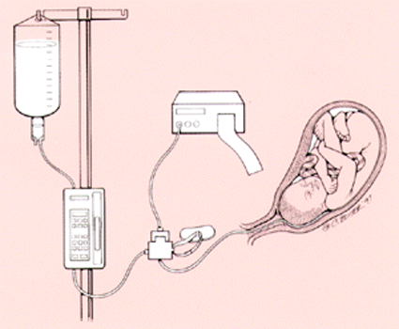

Slide 48
Complications:
umbilical cord prolapse
uterine overdistention
Uterine rupture
fetal bradycardia
amniotic fluid embolism

Slide 49
polyhydramnios
DEFINITION:
Defined as an excessive volume of amniotic fluid relative to gestational age
Metric: refers to an excess of amniotic fluid usually greater than 2 liters
Clinical: It is a clinical condition where amniotic fluid is excessive as compared to fetal size, causing pressure symptoms

Slide 50
It is generally defined as :
amniotic fluid index(AFI) > 20 - 25
largest fluid pocket depth (maximal vertical pocket) greater than 8 cm
overall amniotic fluid volume larger than 1500 - 2000 cc ³
two diameter pocket (TDP) > 50 cm ²

Slide 51
incidence
0.4-3.5% of all pregnancies
minor degrees of hydramnios are common
hydramnios which causes symptoms 1:1000 pregnancies

Slide 52
pathophysiology
Polyhydramnios occurs as a result of either increased production or decreased removal of amniotic fluid.
The aetiology of polyhydramnios can be due to a vast variety of maternal and fetal disorders.

Slide 53
etiology
Fetal :(10-20%)
CONGENITAL FETAL MALFORMATIONS
CNS lesions:
1)Anencephaly:
2) Hydrocephaly
3)Iniencephaly
4)Hydranencephaly
5)Encephalocele
6)microcephaly

Slide 54
Gastrointestinal abnormalities:
  oesophageal atresia
  Duodenal stenosis
  Diaphragatic hernia
  jejuno-ileal atresia
  gastroschisis
  omphalocoele
Respiratory tract
Cystic adenomatoid malformation of lung
Chylothorax
fetal cervical masses
thoracic masses
CVS
Valvular incompetence
Valvular stenosis
Ebstein’s anomaly

Slide 55
Multiple gestation(7.5%)
MATERNAL
Diabetes mellitus(25%)
Heart disease
Renal disease
Rhesus sensitization
PLACENTAL CAUSES:
Chorioangioma of placenta
Obstructionof umbilical vein due to true knots or thrombosis

Slide 56
Idiopathic (50%)
Overproduction of decidual prolactin impair diffusional flow of water away from the amniotic compartment

Slide 57
Types :
Acute
chronic

Slide 58
Acute polyhydramnios:
Very severe
Rare condition
Rapid accumulation of liquor over few days
Occurs before 24 weeks
Commonly seen in twin –to –transfusion syndome

Slide 59
Chronic polyhydramnios:
More common
accumulation of liquor is gradual over few weeks
It occurs in late pregnancy
it may result in preterm labour
has a better prognosis

Slide 60
Clinical features:
Pressure symptoms:
Abdominal discomfort
dyspnoea
orthopnea
palpitations
edema of legs
varicosities

Slide 61
Signs :
Patient may be dyspneic at rest
Pedal edema
Evidence of PIH
Per abdomen:
Skin over abdomen is tense, shiny
umbilicus is everted
SFH and AG are increased
Difficulty in palpating fetal parts
malpresentation and non engagement-common
FHS heard faintly
Per vaginal:
Cervix is pulled high up
it may be dilated with bulging membranes

Slide 62
COMPLICATIONS
MATERNAL:
During pregnancy:
Gestational hypertension
Malpresentation
Premature rupture of mambranes
Preterm labour
During labour:
Early rupture of membranes
Cord prolapse
Uterine inertia
Abruptio placenta

Slide 63
Puerperium :
Post partum haemorrhage
sub involution
Fetal :
Perinatal mortality is 50%
Prematurity
Congenital anomalies
Hydrops fetalis
Cord prolapse

Slide 64
investigations
Ultrasonography:
Maximal (deepest) vertical pocket:
The largest ,cord free vertical pocket of amniotic fluid is measured with the transducer held at right angles to the maternal abdominal contour
A single measurement of 8 cms or more is suspicious or polyhydramnios
Mild-8-12 cms
moderate-12-16 cms
severe->16 cms

Slide 65
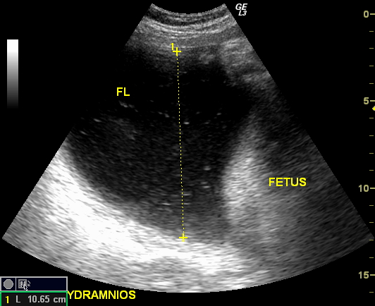

Slide 66
Amniotic fluid index: divide abdomen in 4 quadrants using umbilicus and linea nigra as reference points
Calculate the AFI by adding up the MVP measurements for each quadrants
AFI >24 cms ( or >2 SD or above 95TH percentilefor gestational age) is diagnostic

Slide 67
Two –diameter amniotic fluid pocket:
This method assesses the AFV as the product of the vertical and the horizontal dimensions of the largest vertical pocket
Values below 15 cm2-oligohydramnios
more than 50 cm2-hydramnios

Slide 68
treatment
Treatment of underlying etiology:
correcting poorly controlled maternal diabetes
correcting fetal anemia
TTTS: serial amnioreduction or coagulation of anastomotic vessels

Slide 69
treatment of polyhydramnios
Hospitalization,bed rest ,investigations to find out the cause
If fetal malformations present
Termination of pregnancy
If no fetal malformations
If no pressure symptoms
Continue pregnancy
Treatment of complicating factors
If pressure symptoms present
If gestational age>37
If gestational age<37
Therapeutic amnioreduction
Induction of labour with oxytocin or ARM

Slide 70
Amnio -reduction
Refers to removal of one to several liters of amniotic fluid through insertion of either a 19 guage needle or catheter into the amniotic cavity close to the midline and below the umbilicus
criteria :
USG- AFI greater than 40 cms or deepest single pool greater than 12 cms
Clinical: maternal discomfort (orthopnea, dyspnea)
Fetal condition:twin to twin tramsfusion syndrome

Slide 71
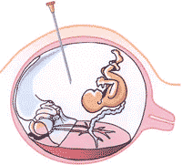
O.5-2 litres –aspirated (rate not exceeding 500 ml/hr) under sonographic guidance
each 100ml of amniotic fluid removed- decreases AFI by 1 cms
Amniotic fluid re-accumulates quickly ,procedure is repeated initially 2-3 times in the first week , followed by weekly amnioreduction or as clinically indicated

Slide 72
Complications:
Placental abruption
chorioamniotis
pretrm labour
PPROM
Injury to the fetus or umbilical cord vessels

Slide 73
Medical management
Indometacin:
PG E inhibitor
Reduce the amount of amniotic fluid produced and relieve the symptoms of polyhydramnios
Mechanism:
Enhanced fluid resorption by Lungs secondary to increased fluid breathing
increased fluid movement across the fetal membranes
decreased fetal urine production –impaired normal PG mediated response of renal vasculature
Dose:25 mg orally for 6 hrs
If significant decrease ,reduce the dose 25 mg every 12 hrs

Slide 74
Complications:
Maternal: GI(ulceration, bleeding)
Renal insufficiency
pulmonary edema
cholestatic jaundice
Fetal: ductal constriction
Prolonged exposure lead to hypertrophy of pulmonary artery , cardiac failure, hydrops
necrotizing enterocolits
Ileal perforation
IVH

Slide 75
INTRANATAL MANAGEMENT
Malpresentation, cord presentation and / or cord prolapse should be detected and the labour is managed according to the condition.
Controlled ARM should be performed
Active management of third stage is carried out to guard against PPH

Slide 76
AMNIOCENTESIS
Is performed under ultrasound guidance after 15 weeks of gestation
INDICATIONS:
1)CHROMOSOME ANALYSIS(for karyotype, florescent in situ hybridization,PCR)
2)DNA DIAGNOSIS(single gene disorders,X linked disorders)
3)BIOCHEMISTRY (Alpha feto protein , acetylcholinesterase)
4)FETAL INFECTIONS (toxoplasmosis,cytomegalovirus)
5)CHORIOAMNIOTIS
6)LUNG MATURITY
7)ASSESSMENT OF RHESUS DISEASE

Slide 77
PROCEDURE:
Skin is cleaned with antiseptic solution
A 22 gauge needle is used
Under continuous USG visualization using linear transducers placed in sterile bag ,the needle is inserted in two rapid ,successive steps
The first step –tip of the needle into subcutaneous tissue
Second step-place the needle inside the amniotic cavity

Slide 78
When the needle is inside the amniotic cavity ,the stylet is removed and fluid should come out freely from the needle
The fluid is aspirated with the sterile syringe
Two 10 ml aliquots of fluid are withdrawn,placed into two separate sterile plastic tubes and transported to laboratory
After the fluid is removed ,the needle is withdrawn and fetal heart motion is observed

Slide 79
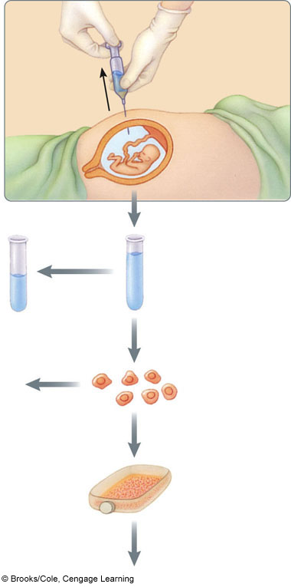
Removal of about 20 ml of amniotic ﬂuid containing suspended cells that were sloughed off from the fetus
Biochemical analysis of the amniotic ﬂuid after the fetal cells are separated out
Centrifugation
Fetal cells are removed from the solution
Analysis of fetal cells to determine sex
Cells are grown in an incubator
Karyotype analysis
p. 46

Slide 80
COMPLICATIONS
Pregnancy loss(0.3-1%)
increase risk
Needle larger than 18 G
Multiple needle insertion
Discolouration of amniotic fluid
Amnionitis
vaginal bleeding
Leakage of amniotic fluid
fetal trauma with needle

Slide 81
Alpha fetoprotein
Measurement of AFP in maternal serum and amniotic fluid is used extensively for the prenatal detection of some serious fetal anomalies.

Slide 82
AFP Biochemistry
AFP is produced initially by the fetal yolk sac in small quantities and then in larger quantities by fetal liver as the yolk sac degenerates.
Trace amounts are also produced in the fetal gut and kidneys.

Slide 83
AFP Biochemistry
Concentrations of AFP in fetal serum
  Early in embryonic life:1/10 the concentration of albumin in fetal serum
  16 weeks gestation:3,000,000 ng/ml
  At term:declines steadily to 5000 to 120,000 ng/ml

Slide 84
Clinical significance of AFP
Maternal serum and amniotic fluid AFP are useful tests for detecting some serious fetal anomalies
Maternal serum AFP is elevated in 85% to 95% of cases of fetal open neural tube defect and is low in about 30% of cases of fetal Down’s syndrome.

Slide 85
Acetyl cholinesterase
A useful adjunct in the diagnosis of neural tube defects is the measurment of acetylcholinesteras in amniotic fluid
The usual technique for identification of AChE is polyacrylamide gel electrophoresis.

Slide 86
Acetyl cholinesterase test sensitivity
A study of more than 5000 patients reported that determination of AChE by electrophoresis had specificity of 99.76% and following sensitivities:

Slide 87

Anencephaly,97%

Slide 88
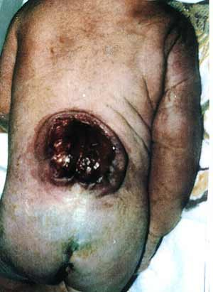
Open spina bifida,99%

Slide 89
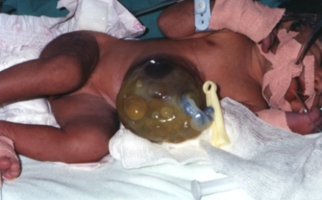
Abdominal wall defects,94%

Slide 90
Amniotic fluid testing
Testing amniotic fluid for AFP and AChE can predict open neural tube defects more accurately than maternal serum screening.
Patient with unexplained high maternal serum AFP levels and normal ultrasonography findings should be offered amniotic fluid testing.
Any patient who has had a child with a neural tube defect has 3% to5% risk for recurrence and also should be offered amniotic fluid AFP testing
Any elevation of AFP in amniotic fluid should lead to AChE analysis

Slide 91
AF and Respiratory distress syndrome (RDS)
all of the available biochemical tests for fetal lung maturity rely on the amniotic fluid content of surfactant
adult mature surfactant is approximately 80% phospholipids, about 10% protein, and about 10% neutral lipids (primarily cholesterol).
The major species of phospholipid in surfactant is phosphatidylcholine (also referred to as lecithin), which accounts for 80% of the total phospholipid

Slide 92
AF and Respiratory distress syndrome (RDS)
Respiratory distress syndrome (RDS) was associated with a significant mortality rate approaching approximately 30%.
In the 1950s, it was discovered that the resistance of pulmonary alveoli to collapse during expiration was mainly caused by the presence of a surface tension-lowering material lining the alveolus (surfactant).
As the lungs develop, significant quantities of surfactant are washed out of the fetal lung and accumulate in the amniotic fluid.

Slide 93
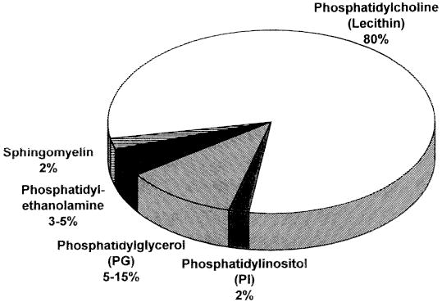
Surfactant lipid Composition

Slide 94
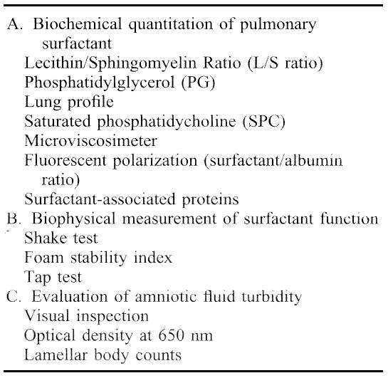

Slide 95
L/S ratio test
The L/S ratio test remains one of the most commonly used tests, and one of the standardized tests against which all other tests are compared.
With a L/S ratio of 1.5-1.9, approximately 50% of infants will develop RDS. Below a ratio of 1.5, the risk of subsequent RDS increases to 73%.
One of the major disadvantages of the L/S ratio is the inability to use this test in the setting of contaminated amniotic fluid. Both blood and meconium staining of amniotic fluid have been found to interfere with L/S ratio determinations.

Slide 96
PG determinations:
It is found that the false-positive rate for PG determination was 1.8%. This rate is significantly lower than the false-positive rate they found for the L/S ratio(5%)
PG performs much better than the L/S ratio in predicting babies who will develop RDS. Finally, PG determinations accurately predict pulmonary maturity and give a better indication of pulmonary immaturity than does the L/S ratio

Slide 97
Saturated Phosphatidylcholine
Saturated Phosphatidylcholine has been found to predict pulmonary maturity
Respiratory distress syndrome was correctly predicted 55.5% of the time by L/S ratio and 82% of the time by SPC.
Pulmonary immaturity = an SPC <500 μg/dl
In addition, the SPC was found to be valid in the presence of blood and meconium, whereas the L/S ratio was not.

Slide 98
Microviscosimeter
Microviscosimeter testing measures surfactant associated with a phospholipid membrane using fluorescent dye techniques.
The microviscosimeter commonly used in the fetal lung maturity analyzer or FELMA machine.

Slide 99
Surfactant/Albumin Ratio
A recently introduced TDx FLM assay is an automated fetal lung maturity test based on the principle of fluorescent polarization used previously with the microviscosimeter.
A surfactant albumin ratio of 50-70 mg surfactant/g of albumin has been considered mature in most studies
The TDx test correlates well with the L/S ratio and has few false-immature results, making it an excellent screening test
It only requires approximately 1 ml of amniotic fluid and the test can be performed in less than an hour,

Slide 100
Shake test
this test use the principle that when ethanol is added to amniotic fluid, the nonsurfactant foam causing substances in amniotic fluid are removed.
any stable foam layer that persists after shaking is due to the presence of surfactant in a critical concentration.
when serial dilutions of ethanol are used, the surfactant can be quantified.
it is found that the shake test was comparable to the L/S ratio and had a high predictive value for RDS when applied to uncontaminated amniotic fluid.

Slide 101
Tap Test
the tap test examines the ability of surfactant within amniotic fluid to break down bubbles within an ether layer.
the test is performed on 1 ml of amniotic fluid mixed with a drop of 6N hydrochloric acid and 1.5 ml of diethylether
the tube is tapped 4 times and examined for the presence of bubbles within the ether layer.
in mature samples, the bubbles quickly breakdown, whereas in immature amniotic fluid specimens more than 5 bubbles persist in the ether layer.
this rapid test was comparable with the phospholipid profile

Slide 102
Visual Inspection
The basis is whether or not newspaper could be read through the amniotic fluid sample, that is, was the fluid too turbid to read text through.
with clear fluid (readable newsprint) the sensitivity of an immature result is 98%.

Slide 103

Optical Density at 650 nm
with a OD 650 value of 0.15 or greater, the L/S ratio was always greater than 2.0
when the OD 650 was less than 0.15, only 6% of L/S ratios were greater than 2

Slide 104
Amniotic fluid assesment and Renal maturity
The fetal kidneys start to develop during the 4th and 5th weeks of gestation and begin to excrete urine into the amniotic fluid at the 8th to 11th week
At the 20th week the fetal kidneys produce most of the amniotic fluid
Renal maturity is defined by the increase in glomerular filtration and by the maturity of renal tubular cells that begin to express various tubular transporters over the months of gestation

Slide 105
AF assesment and Renal maturity
Glomerular filtration in the fetal kidney can be assessed by the concentrations of creatinine and urea in the amniotic fluid
Creatinine concentrations of 2 mg/dl represent an age of at least 37 weeks of gestation
The function of the renal tubule system, specifically proximal tubules, can also be assessed by the concentrations of ß2-microglobulin
in the third trimester of gestation

Slide 106
AF assesment and Renal maturity
ß2-Microglobulin produced by the fetus is filtered and reabsorbed by proximal tubules, with an expected reduction in its concentrations at week 36 in normal pregnancies.
This reduction can be considered as an index of renal tubular maturation

Slide 107
AF assesment and Renal maturity
Analysis of creatinine and urea in amniotic fluid permits an evaluation of renal maturation.
Creatinine values in the amniotic fluid that best represent fetal maturity are 1.5 to 2.0 mg/dl

Slide 108
Amniotic fluid and Bone Healing
Hyaluronic acid (HA) is a linear polysaccharide with a high molecular weight.
It is found in all extracellular matrices and has the same structure in all species.
If HA is administered during surgery, scar formation is prevented.
HA is known to reduce scar formation by inhibiting lymphocyte migration, proliferation and chemotaxis, granulocyte phagocytosis , degranulation, and macrophage motility

Slide 109
AF and Bone Healing
HA influences and enhances tissue regeneration through its ability to retain large amounts of water.
HA has been reported to increase osteoblastic bone formation in vitro through increased mesenchymal cell differentiation and migration.

Slide 110
AF and Bone Healing
Human amniotic fluid (HAF), obtained by amniocentesis during the second trimester of gestation, contains high molecular weight HA in high concentrations.
It has been showed that HASA (HA-stimulating activator) which is present in HAF, stimulates the wound to increase the production of endogenous HA
HAF may increase both endogenous and exogenous HA in the application region.
HAF has been reported to enhance new cartilage formation.

Slide 111
Amniotic fluid –derived stem cells
Stem cells found in amniotic fluid –new treatment for disease and injury
when they are grown in right environment –fat cells,bone cells ,brain cells , muscle cells , blood vessel cells or liver cells
It can be grown in large quantities –double every 36 hrs
They do not require guidance from other cells and do not produce tumours

Slide 112
conclusion
Amniotic fluid plays a dynamic role in fetal physiology and is an important component of fetal-maternal communication system
FETAL URINE AND LUNG SECRETIONS ARE THE MAJOR source of amniotic fluid
Normal AFI=8-24 CMS
Identifying the cause is main goal in the treatment in the treatment of oligohydramnios and polyhydramnios

Slide 113
If amniotomy is required but the presenting part is not well engaged, an assistant can apply external fundal or suprapubic pressure to keep the fetus in place while the amniotic fluid is slowly released. Before amniotomy, this pressure should be determined to be adequate to ensure that the fetal head is applied to the cervix.
When this technique is not feasible or has been attempted without success, a controlled amniotomy can be performed. In this instance, the patient should be taken to the cesarean suite and placed in the lithotomy position. A speculum is placed in the vagina, and the amniotic sac is visualized. A spinal needle is then used to make 1 or more small holes in the sac, thereby very slowly releasing amniotic fluid under direct visualization and allowing the presenting part to descend safely into the pelvis.

