Slide 1
Place of forceps in modern obstetrics

Slide 2
In last few decades obstetrics as a science has undergone a phenomenal development such as in fields of fetal monitoring, surgical aids and techniques ,anesthesia
There have been also a change in the legal system even, that even a small mishap is viewed seriously
In such a scenario ,instrumental deliveries have become obsolete due to concerns over neonatal and maternal safety, medico-legal issues , fewer clinicians skilled in forceps use and perception of the practitioner that caesarean section has less morbidity.
However in present day concept of active management of labour forceps still have their own place and should be considered in suitable cases

Slide 3
Recent trends
In 1960’s 29.7% of births were forceps assisted, but by 1970’s the incidence was down to 12.2%. At the same time, cesarean birth rates rose from 5.5% in 1970 to 15.2% in 1980 and now is as high as 20–25%.
forceps assisted vaginal delivery account for a fairly constant rate of 11% of deliveries (1990-2009) Rates have been reported to vary from 7.4-16% all over the world in different countries.
ACOG 2011 guidelines-2011 ,is 0.8% .
3.3 percent of all deliveries in 2013 were accomplished via an operative vaginal approach . Forceps deliveries accounted for 0.6 percent of vaginal births and vacuum deliveries accounted for 2.7 percent of vaginal births.

Slide 4
History
The credit for the invention of obstetrical forceps goes to the Chamberlain family(1569)
The Chamberlain family used four pairs of forceps of different sizes with only cephalic curve
Levret(1747) introduced the pelvic curve to the forceps
Smellie(1751) reinforced pelvic curve and introduced English lock and is used in after coming head
Tarnier(1877) introduced the axis traction
Barton and Keilland introduced the two specialised forceps

Slide 5
Forceps delivery
Obstetric forceps is a double-bladed metal instrument used for extraction of the fetal head
The rate of operative vaginal delivery is 10 – 13% out of which 4% is forceps delivery
Recent prevalance shows ,rate of operative vaginal delivery is 3.3% with forceps accounting for 0.8%.

Slide 6
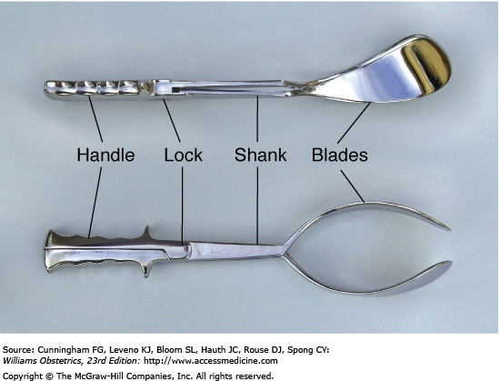
Parts of a forceps
Blade
Shank
Lock
Handle

Slide 7
Blade
There are 2 blades which are named right or left in relation to the maternal pelvis
It has 2 curves :
Cephalic curve which conforms to the fetal head and reduces the danger of compression
Pelvic curve which fits the curve of maternal pelvis
called the curve of Carus
The tip of the blade is known as toe
The heel of the blade refers to the end of the blade attached to the shank

Slide 8
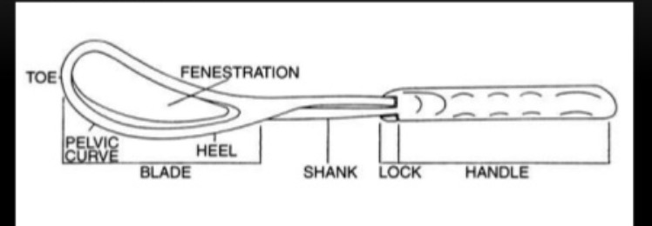
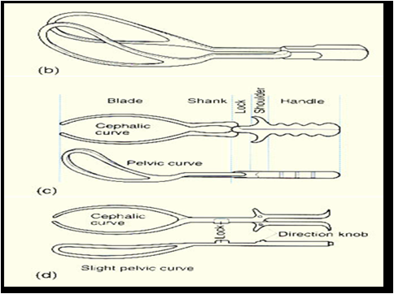

Slide 9
The blade can be :
Solid – eg. Tucker - Mclane
Fenestrated – eg. Simpson
Pseudofenestrated – eg. Luikart Simpson
The blade is fenestrated to:
  Prevent compression of the head.
  Prevent its slippage as the parietal eminences
  are protruding through the fenestration.
  Make its weight lighter.

Slide 10
Shank
It is the part between the blade proper and the lock
It increases the length of the forceps and facilitates locking of the blade outside the vulva
Simpsons forceps have parallel separated shanks results in long tapering curve for long moulded head
Elliot forceps have overlapping shanks for rounded moulded head
Wrigleys forceps have short shank-only used when head(not caput) is at +3
Pipers have long shank for ventral application to the after coming head

Slide 11
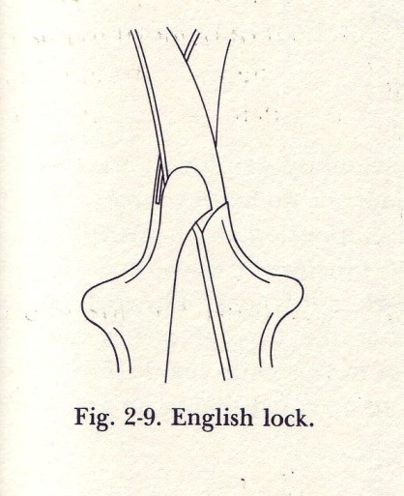
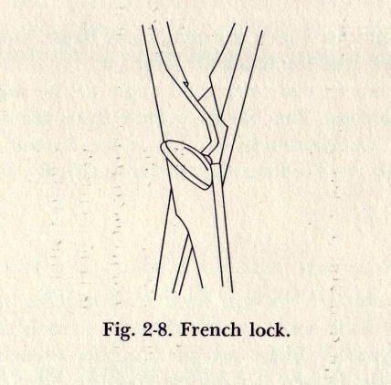
Lock
The lock holds the 2 branches together.It is constructed such that right one fits over left
The various types of lock are : ;
  English type: double slot lock.
  introduced by Smellie
  eg. Simpson’s forceps
  ii. French type: screw lock.
  eg. Tarnier’s & DeWees forceps
  iii. German type: combination of both English
  & French lock

Slide 12
  iv. Sliding lock: the right blade slides over the left
  blade which bears a L shaped clamp
  eg. Kielland & Barton forceps
  Pivot lock : it allows the blade to open & close in
  an arc
  eg. Laufe’s modification of Piper’s
  forceps
  vi. Heister’s lock
  vii. Chamberlain’s lock

Slide 13
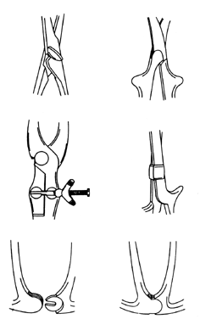
French lock
English lock
German lock
Sliding lock
Pivot lock

Slide 14
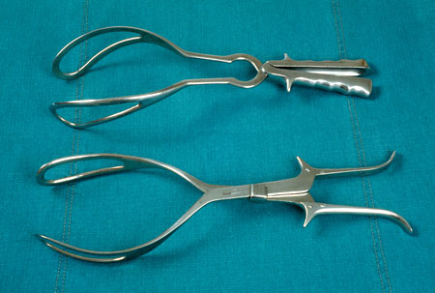
Handle
They are apposed when the blades are articulated
The handles are held by the operator & applies traction to the fetal head
They may have a shoulder guard to facilitate traction
It can be serrated or smooth

Slide 15
Axis traction piece
A separate piece is attached to the forceps to direct the traction in the direction of pelvic axis
The 3 types of axis traction device are :
Neville - Simpson – Barnes
A single bar attached to the handle just behind
the lock
Milne - Murray’s
2 bars and a handle to be attached to the blade
proper
Bills axis traction bar

Slide 16
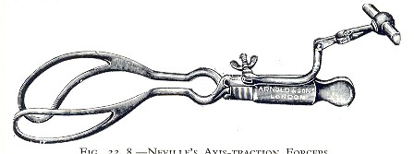
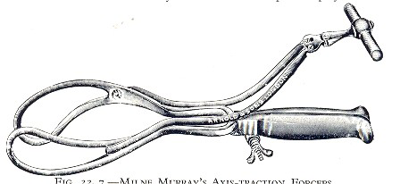
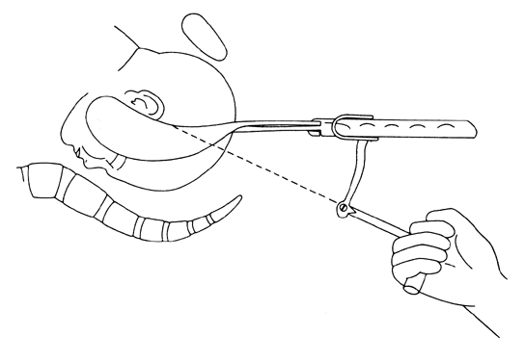

Slide 17
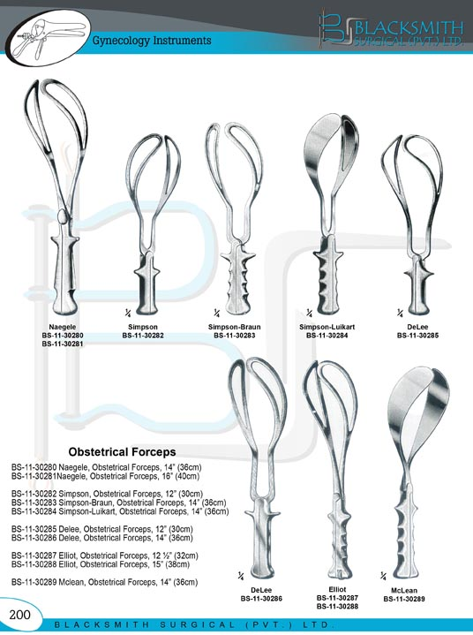
Types of forceps
Classical
Simpson type
Elliot type
Modified classical
instruments

Slide 18
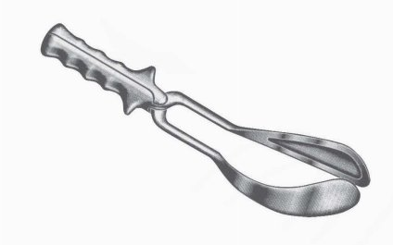
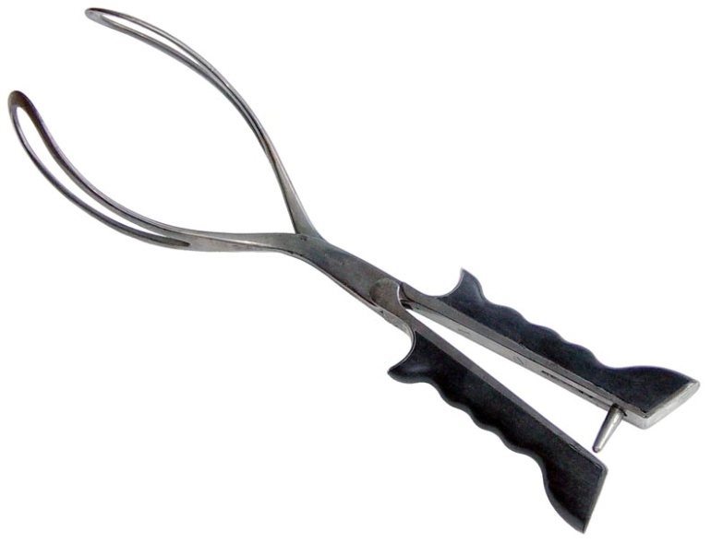
Simpson type
Longer cephalic curve
Parallel shank
English lock
Excellent for moulded head
Elliot type
Shorter cephalic curve
Overlapping shank
Has adjustable pin for regulating lateral pressure on handles
Used in cases of minimal moulding
Eg.
Elliot forceps
Tucker – Mclane
Tucker Mclane Luikart
Bailey Williamson
Simpson forceps
Luikart Simpson
Simpson Braun
DeLee
Hawks Dennen
Neville Barnes
Wrigley
De Wees

Slide 19
Modified classical
Simpson type
Elliot type
Luikart Simpson
Simpson Braun
DeLee
Hawks Dennen
Neville Barnes
Wrigley
De Wees
Tucker – Mclane
Tucker Mclane Luikart
Bailey Williamson

Slide 20
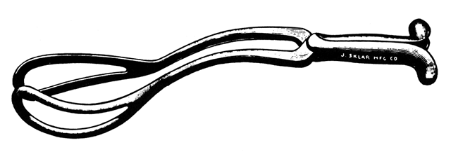
Divergent or parallel blades instrument designed to limit fetal cranial compression. Examples -Laufe, Shute & Moolgaoker.

Slide 21
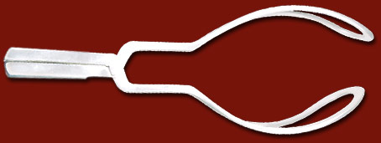
Wrigley’s forceps
11 inches in length
Short curves
Short shanks –inability to reach high up in pelvis,prevents uterine rupture
Used as outlet forceps

Slide 22
Specialized instruments : -Designed for specific indications like-
Barton's for transverse arrest in platypeloid pelvis
Keilland's for mid pelvic rotation & correction of asynclitism
Piper's for delivery of aftercoming head in breech.

Slide 23
Piper’s forceps
It is a specialised forceps for the aftercoming head of breech.
It is characterised by : cephalic curve
reverse pelvic curve
long parallel shanks
English lock
It stabilises & protects the head & neck.
The body of breech can rest on the long shanks.

Slide 24
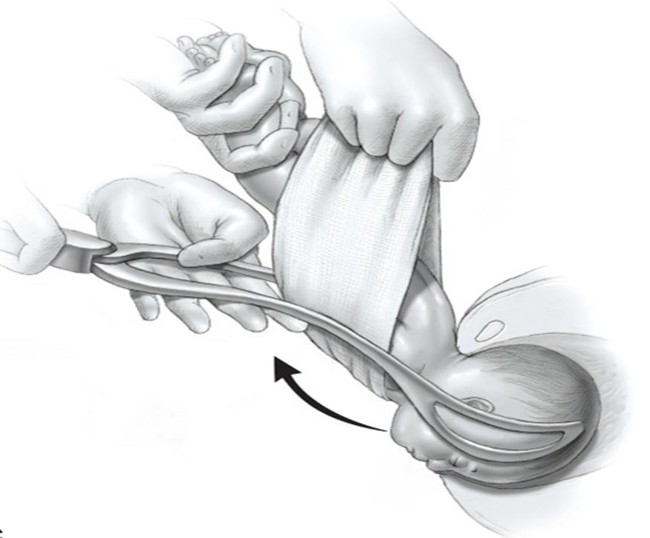

Slide 25
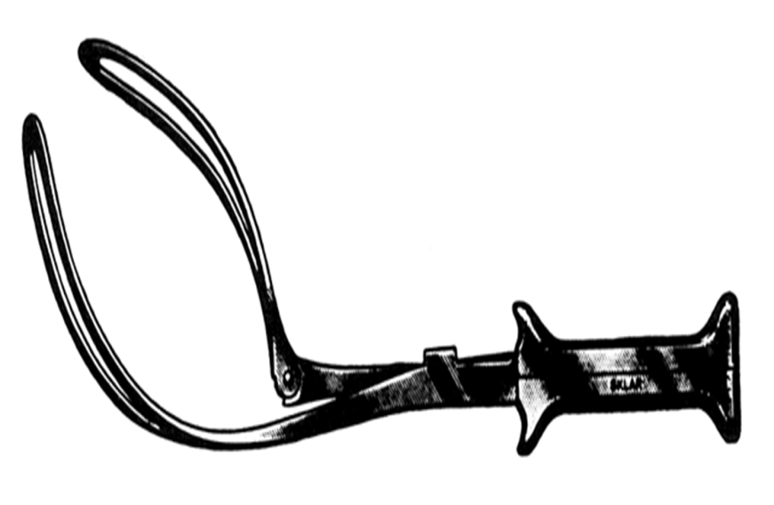
Barton’s forceps
The blade of the posterior branch joins the shank at an obtuse angle corresponding to that between the inlet and outlet pelvic planes
A 90 degrees hinge joint is between the blade and the shank of the anterior branch
A sliding lock allowing application to asynclitic head
Indication : transverse arrest especially in a platypeloid pelvis with a flat sacrum

Slide 26
Kielland rotational forceps
It has a slight pelvic curve which is again nullified by a slight bend between the blade proper and the shank so it is nearly a straight forceps allowing atraumatic rotation and extraction of the head by a single application
A sliding lock which allows application on asynclitic head
It offers a single accurate application for correction of asynclitism and rotation
Applied by 3 methods
  Wandering method
  Classical method
  Direct method

Slide 27
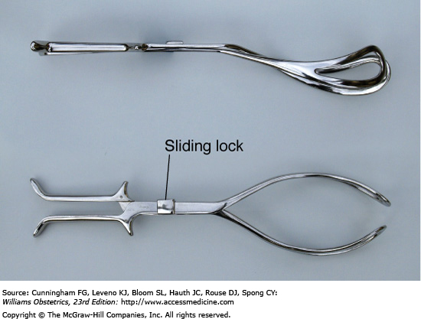
Advantages
It allows the forceps to travel through a small arch due to its straight design
It accomodates heads of various sizes due to its long shanks
Slight pelvic curve allows slight degree of axis traction
The sliding lock accomodates the asynclitic head

Slide 28
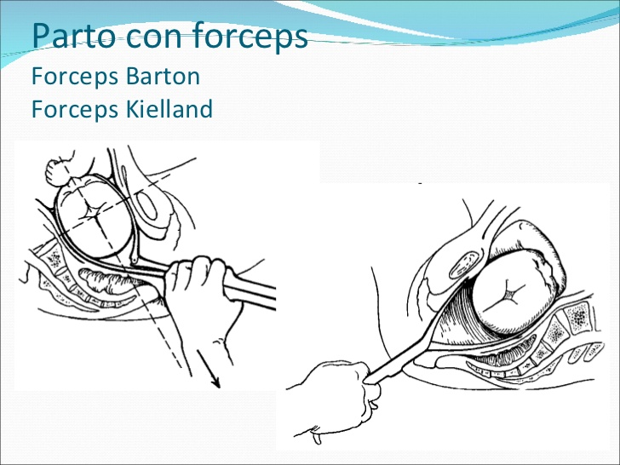

Slide 29
Functions of forceps
Traction:-
  This is the ultimate & dominant function
  The pelvic curve is effective with the occipitoanterior position , so correctional rotation of head to OA done before or with onset of traction
  It should be timed to coincide with uterine contractions & voluntary expulsive efforts
  Delivery should be effected by traction with no > 3 contractions with moderate force

Slide 30
There are 2 components of traction – direction and amount
The direction must be in the axis of pelvic curvature
The amount of traction force should always be least possible
The maximum possible force is 18 kg in a primigravida & 13 kg in a multigravida

Slide 31
Compression effect:-
  This is minimal when properly applied & should not be more than necessary to grasp the head.
  However it has some pressure effect on the well-ossified base of the skull
Rotation of head:-
  This occurs with the use of Kielland's forceps and also in low forceps cephalic application with the occiput in the 2 or 10 'o' clock position

Slide 32
.
Protective cage: -
  When applied on a premature baby it protects from the pressure of the birth canal.
  When applied on the after-coming head it lessens the sudden decompression effect.
As a vectis:-
  By applying one blade to deliver the head in caesarean section

Slide 33
CLASSIFICATION OF FORCEPS
I) DENNEN CLASSIFICATION (1952)
Dr.E.H.Dennen, classified forceps based on 4 major obstetric planes of the pelvis.
1) High forceps
2) Mid forceps
3) Low mid forceps
4) Outlet forceps

Slide 34
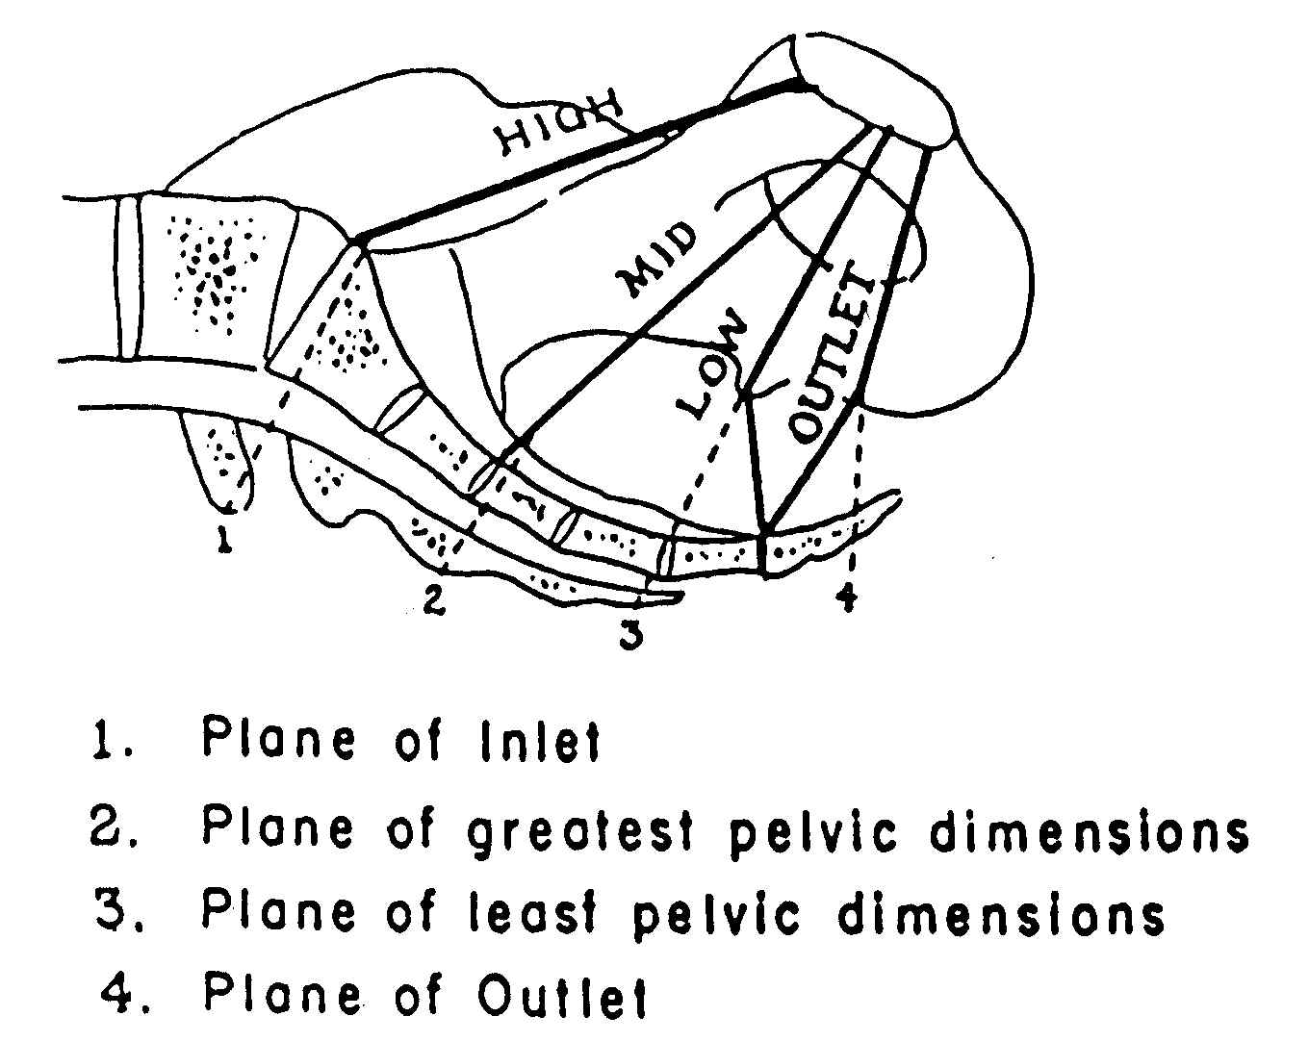

Slide 35
Classification of forceps application
NEWER CLASSIFICATION AS PER A.C.O.G.1981(REVISED IN 2007):-
Outlet forceps | Fetal scalp is visible at introitus without separating the vulva. Fetal skull(not caput) has reached the pelvic floor. Saggital suture is in the A.P.diameter or in the Lt./Rt. Occiputo anterior/posterior position. Fetal head is at or on perineum. Rotation does not exceed 45 degrees.
Low forceps | The leading point of the fetal skull is at a station greater than or equal to +2 and is not on the pelvic floor Any degree of rotation may be present
Mid forceps | Head is engaged and The leading point of the skull is >+2 Rotation not considered.
High forceps | EXCLUDED

Slide 36
Indications
Maternal
Prolonged 2nd stage:
      Nullipara-
        >3 hrs with regional anaesthesia
        >2 hrs without regional anaesthesia
      Multipara-
        >2 hrs with regional anaesthesia
        >1hr without regional anaesthesia
Maternal distress manifested by :
  Exhaustion.
  Pulse >100 beats / min.
  Temperature >38 degreesC .
  Signs of dehydration.

Slide 37
Maternal diseases as:to shorten 2nd stage of labour
  Heart disease
  Pulmonary disease
  Pre-eclampsia and eclampsia
  Post caesarian pregnancy
  Cerebrovascular abnormalities
  Neurological disorders where voluntary efforts are contraindicated or impossible

Slide 38
Fetal indications
  Fetal distress in second stage
      Abnormal heart rate pattern.
      Passage of meconium.
      Abnormal scalp blood pH.
  Cord prolapse in second stage
  After-coming head of breech
  Low birth weight baby
  Fetal malpositions such as direct occipitoposterior ,occipito transverse,or persistant occipitiposterior

Slide 39
During caesarean section
Wrigley or short Simpson forceps is used
It is used to decrease traumatic extension
Single vectis blade can be used to turn and elevate the occiput through the uterine incision

Slide 40
Contraindications
Incompletely dilated cervix
Fetopelvic disproportion
Unengaged head
Non vertex or brow presentation
Dead fetus with postmortem changes
Inability to diagnose fetal head position or pelvic adequacy
Macrosomia
Fetal coagulopathy
Operator inexperience
Refusal of the patient

Slide 41
Prerequisites
Maternal criteria
Adequate analgesia such as epidural or pudendal block or labio perineal infiltration can be used
Lithotomy position
Bladder empty
Clinical pelvimetry must be adequate in
dimension and size to facilitate an atraumatic
delivery
informed consent to be taken
Epsiotomy can be given after application of forceps during traction

Slide 42
Fetal criteria
Vertex presentation or face with mento anterior
The fetal head must be deeply engaged in the pelvis (vault bone >1cm below ischial spines and per abdomen <1/5th palpable
The exact position of the fetal head must be known with
certainty, malposition and asynctilism to be determined
The station of the fetal head must be +2
The attitude of the fetal head and the presence of
caput succedaneum and/or moulding should be
noted

Slide 43
Uteroplacental criteria
Cervix fully dilated
Membranes ruptured
No placenta previa
Other criteria
Experienced operator who is fully acquainted with the use of the instrument
The capability to perform an emergency cesarean delivery if required

Slide 44
Dr. Bachman’s checklist
Anesthesia.
Bladder empty.
Cervix dilated.
Determine the position of the head.
Equipment ready.
Forceps ready.
Gentle traction.
Handle elevated to follow j-shaped curve.
Incision for episiotomy.
.

Slide 45
F – Fully dilated cervix
O – rOtation should be complete
R – Rupture of membranes
C – CPD should be ruled out
E – Engagement should have occurred
P – Position & presentation should be known
S – Station of the head should be >+2

Slide 46
Application of forceps
Cephalic application
It was first described by William Smellie
Blades are applied along the sides of the head, grasping the biparietal diameter in between the widest part of the blades and the long axis of the blades correspond to the occipito-mental plane
Biparietal bimalar application is the correct cephalic application
This causes least damage on the head

Slide 47
Pelvic application
  Blades are applied along the maternal pelvic wall irrespective of the position of the head
  Serious compression effect on the cranium can occur, so it should be avoided
  When the head is sufficiently rotated, pelvic & cephalic applications naturally coincide and so pelvic application is only justified in low forceps operations

Slide 48
Cephalopelvic application
If both the branches are oriented correctly on the head & are along the pelvic axis
It is the ideal application & possible when the occiput is directly anterior or posterior or in mentoanterior position

Slide 49
Application of blades
Two or more fingers of the right hand are introduced inside the left posterior portion of the vulva and into the vagina beside the fetal head
The handle of the left branch is grasped between the thumb and fingers of the left hand
The tip of the blade is then gently passed into the vagina between the fetal head and the palmar surface of the fingers of the right hand
The right blade is held in the right hand and introduced into the vagina as described for the left blade
After positioning, the branches are articulated ,never be forced together
If not locked it is a bad application,remove and reposition again

Slide 50
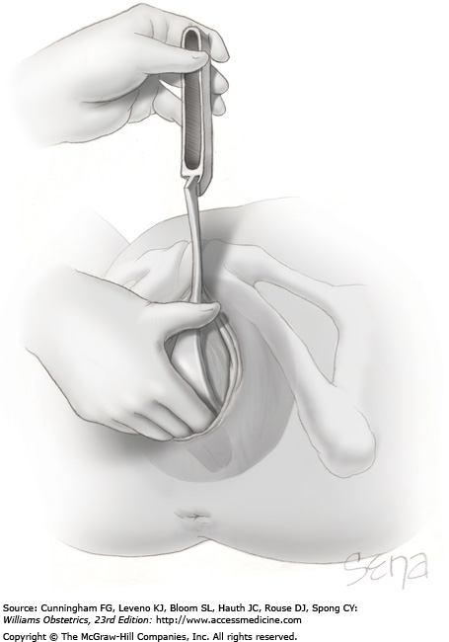
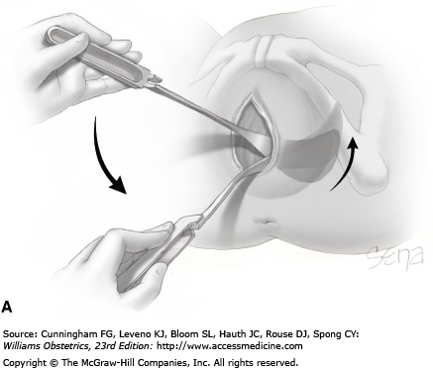

Slide 51
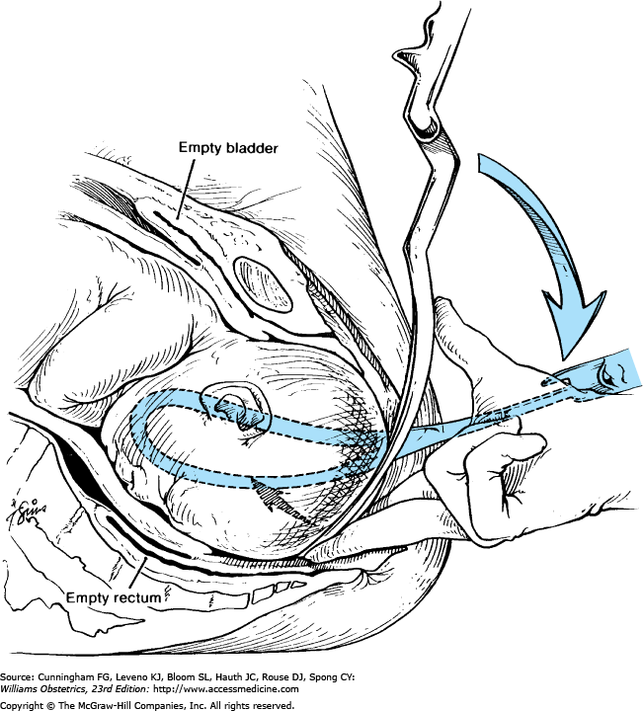

Slide 52
If the fetus is in an occiput anterior position, then the concave margins of the blades are directed toward the sagittal suture
If the fetus is in an occiput posterior position, then the concave margins are directed toward the fetal face
The forceps should not slip, and traction may be applied most advantageously
If one blade is applied over the brow and the other over the occiput, the instrument cannot be locked,
or if locked, the blades will slip off when traction is
applied

Slide 53
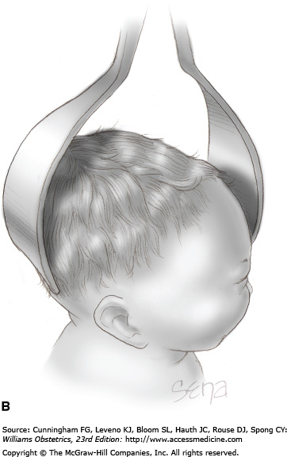
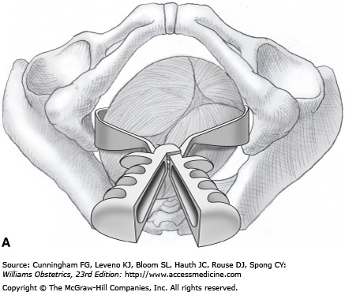

Slide 54
Dennen’s 3 checks of position.
Posterior fontanelle
Midway between the sides of the blade
lambdoid sutures should be one finger breadth above the plane of the shank
If >1 finger breadth – deflexion of head to be suspected
Saggital suture lies perpendicular to the plane of shanks of forceps, blades should be equidistant from sagittal suture
Fenestration of blades should be barely felt and is equal

Slide 55
Position of forceps in relation to maternal pelvis and the fetal skull

Slide 56
Application of traction
Gentle, intermittent, horizontal traction is exerted until the perineum begins to bulge.
Traction should be intermittent (given at each uterine contraction) and the head should be allowed to recede in intervals.
With traction, as the vulva is distended by the occiput, an episiotomy may be performed if indicated.
The direction of traction should be along pelvic curvature as backward tilted L shaped manner.
The handles are gradually elevated, eventually pointing almost directly upward as the parietal bones emerge .

Slide 57
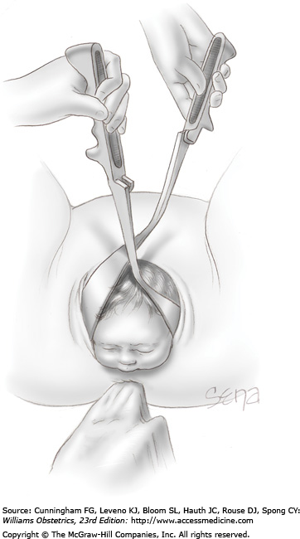
The head borns by extension
If urgently indicated, as in severe fetal bradycardia, delivery should be sufficiently slow, deliberate, and gentle to prevent undue head compression and maternal tissue trauma
Removal of forceps should be in reverse of application .Handle of right blade raised towards mothers left groin and the blade slides around the head and so on the left

Slide 58
Other hand on the shanks of the forceps to apply downward traction – “Pajots Saxtorph manoeuvre”
This ensures that traction is along the curve of the pelvis i.e downwards , forwards & upwards
Once occiput passes under the symphysis , direction changed to forward & upwards
As the head extends over the perineum – handles are elevated 75º above horizontal

Slide 59
Pajot’s maneuver

Slide 60
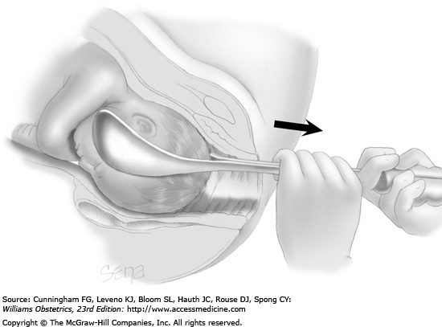
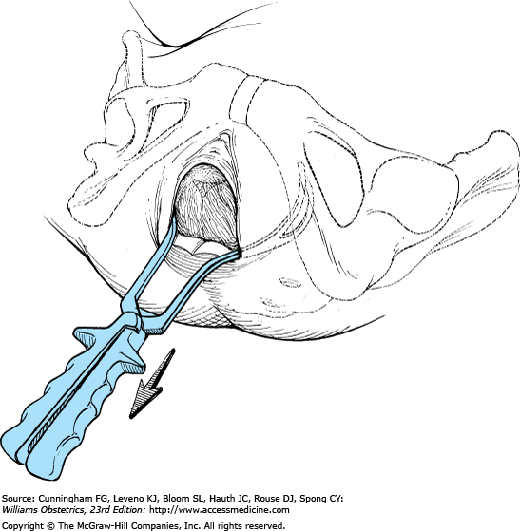

Slide 61
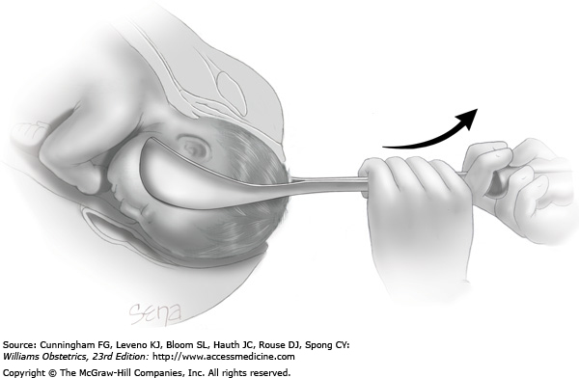

Slide 62
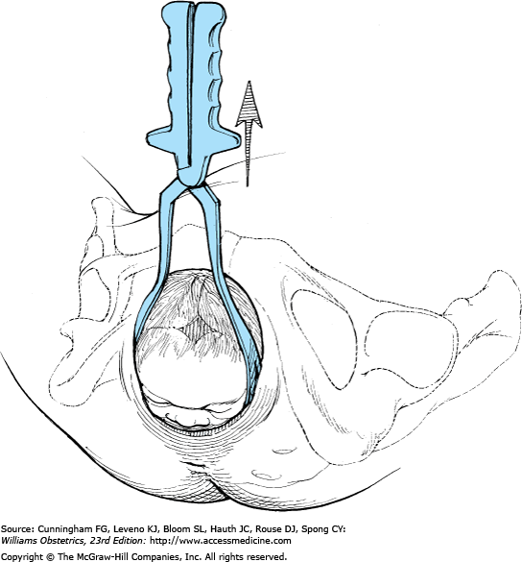

Slide 63
the thickness of the blades adds to the distension of the vulva, thus increasing the likelihood of laceration or necessitating a large episiotomy
To prevent this, the forceps may be removed and delivery completed by the modified Ritgen maneuver

Slide 64
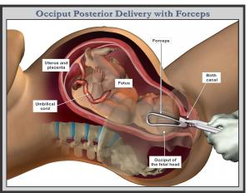
In Occipito-posterior position –
Blades are to be applied as usual but they should be equidistant from sinciput & occiput, convex edges pointing to the occiput ,concave edges point to the face
Traction - Horizontal till the root of the nose is under the pubic symphysis, then upward till the occiput emerges over the perineum & finally downwards.
Therefore head borns by extension.

Slide 65
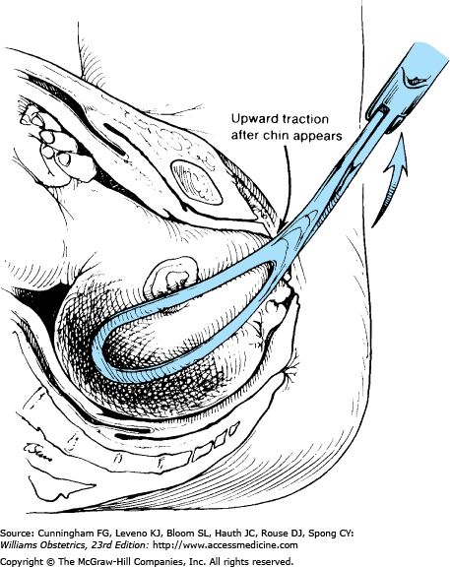
In face presentation
Blades are to be introduced along the Occiputo-mental diameter with pelvic curve directed towards neck
Traction is applied downwards till the chin appears under the symphysis pubis till head deflexes & then upwards delivering the nose, eyes, brow & occiput

Slide 66
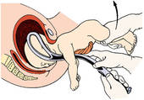
Forceps for aftercoming head of breech
Piper's forceps are specially designed for this purpose.
Forceps to be applied when the occiput lies against the back of the symphysis in mento occiput direction
Blades to be applied from below after raising the legs and locked underneath the fetal chest
Traction to be maintained in an arc, which follows the axis of the birth canal,outward and upward to deliver the head in flexion

Slide 67
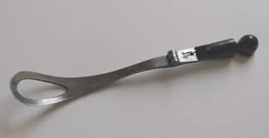
Vectis
One blade of the forceps or a special instrument is used to assist the delivery of the head through the uterine incision during LSCS
It helps in rotation & elevation of the head by extension
It has only the fenestrated cephalic curve

Slide 68
Prophylactic forceps
Introduced by De Lee (1920), refers to outlet forceps delivery, only to shorten the second stage of labour to prevent anticipated maternal or fetal complications in
Eclampsia
Heart disease
Previous caesarean section
Post maturity
Low birth wt babies
During epidural anaesthesia

Slide 69
TRIAL OF FORCEPS- a place in modern obstetrics
The concept of trial of instrumental vaginal delivery in theatre was first described in 1953 by Jeffcoate.
This has been promoted recently to try to reduce any delay that might follow an unsuccessful attempt at instrumental delivery requiring transfer of the patient to the operating theatre.
It should be performed in a double setup with everything ready for a caesarean section
It is indicated in case of labour arrests with the vertex at the low- mid pelvic level
Should be terminated when moderate traction fails to deliver the baby or when rapid delivery by ceaserean section is needed in case of fetal distress

Slide 70
Most of the women have spontaneous vaginal birth, but some ( 5-20%) women need assistance in the second stage for the delivery of the baby, using either forceps or vacuum extraction The majority of the instrumental delivery are conducted in the delivery room, but in a small proportion 2% -5%, a trial of instrumental delivery is conducted in theatre.
“The tentative application of the forceps
with the anticipation of failure &
the willingness to abandon the procedure
in favor of CS whose preparations are
simultaneously made if that prove necessary”

Slide 71
Failed forceps
It is failure to extract the fetus by the forceps which may be due to the failure to apply the forceps or to deliver the head with it
Forceps fail when :
Cannot apply the branches
Branches do not lock
Branches slip after application
While effecting rotation only blades rotate
Extraction is not possible
Morbidity or mortality to fetus & mother

Slide 72
Causes of failed forceps are :
Application before full dilatation of cervix
Gross CPD
Unrecognized malposition
Undiagnosed malpresentation
Contraction ring
fetal congenital anomalies as hydrocephalus, ascitis and conjoined twins
Soft tissue dystocia as fibroid , ovarian tumour , bladder stone

Slide 73
Management of failed forceps :
Reassessment to detect the cause
Caesarean section in uncorrectable causes
Exploration of birth canal for injuries

Slide 74
TRIAL FORCEPS
FAILED FORCEPS
Knowing that a certain degree of disproportion at mid pelvis may make the procedure incompatible,low or mid forceps is applied abandoning it at the earliest in favour of ceaserean section
Should be done in O.T with everything kept ready for CS
When a vigourous but unsuccessful attempt is made with forceps anticipating a successful forceps delivery
Due to lack of obstetric skill,and other factors disproportion

Slide 75
Complications
Maternal
    Extension of the episiotomy involving anus & rectum or vaginal vault
    Vaginal lacerations
    Cervical tear if cervix was not fully dilated
    Bladder injury
    Ureteric injury
    Rupture uterus
    Bone injuries
    Pelvic nerve injuries

Slide 76
  Post partum haemorrhage due to trauma, atonic uterus or anaesthesia.
  Shock
  Due to blood loss, dehydration or prolonged
  labour
  Delayed or long-term sequel
    Chronic low backache
    Genital prolapse
    Stress incontinence
    Genito-urinary fistulas.

Slide 77
Fetal
Transient facial marks
Facial palsies
Fracture of facial bones & skull
Cervical cord damage
Injury to scalp : bruise , abrasion , laceration
cephalhematoma
subgaleal hematoma
intracranial hemorrhage
Tentorial tears

Slide 78
Late complications
delayed milestones
cerebral palsy
mental retardation
behavioural problems

Slide 79
ACOG OCT 2015
According to a newly revised Practice Bulletin, operative vaginal delivery remains an important part of modern obstetric care and in the appropriate circumstances should be used to safely avoid cesarean delivery.
Though operative vaginal delivery with the use of tools is not without risk, the overall chance of newborn injury is low.
For a mother and/or fetus showing signs of possible compromise, successful operative vaginal delivery can shorten the exposure to additional labor or a cesarean delivery, which poses risks including hemorrhage, infection, prolonged healing time, increased cost, higher likelihood of repeat cesarean delivery and risks of future placental abnormalities such as placenta accreta
It recommends against routine episiotomies for all operative vaginal deliveries because of heightened risk of additional tearing.

Slide 80
RCOG -guidelines
All women should be encouraged to have continuous support during labor as this can reduce the need for operative vaginal delivery.
Use of upright or lateral positions and avoiding epidural analgesia can reduce the need for operative vaginal delivery.
A standard classification of operative vaginal delivery should be used.
Operators should be aware that no indication is absolute and should be able to distinguish ‘standard’ from ‘special’ indications.
Safe operative vaginal delivery requires a careful assessment of the clinical situation, clear communication with the mother and healthcare personnel and expertise in the chosen procedure.

Slide 81
Informed consent
Women should be informed in the antenatal period about operative vaginal delivery, especially during
their first pregnancy.
For deliveries in the delivery room, verbal consent should be obtained before an operative vaginal delivery and the discussion documented in the notes. If circumstances allow, written consent may also be obtained.
Written consent should be obtained for trial of operative vaginal delivery in theatre.

Slide 82
An operative vaginal delivery should be performed by an operator who has the knowledge, experience and skills necessary to assess and to use the instruments and manage complications that may arise.
Operative vaginal births that have a higher risk of failure should be considered a trial and conducted in a place where immediate recourse to caesarean section can be undertaken
Operative vaginal delivery should be abandoned where there is no evidence of progressive descent with moderate traction during each contraction or where delivery is not imminent following three contractions of a correctly applied instrument by an experienced operator.

Slide 83
Obstetricians should be aware of increased neonatal morbidity with failed operative vaginal delivery
and/or sequential use of instruments and should inform the neonatologist when this occurs to ensure appropriate management of the baby.

