Slide 1
Intrauterine Growth Restriction

Slide 2
DEFINITION
It is a condition wherein which the foetus fail to reach its genetic growth potential and at increased risk of perinatal morbidity and mortality
It is defined as a condition wherein the foetal weight is below the 10th percentile or 2 SD for gestational age.
INCEDENCE 3 _ 10% of infants are growth restricted.

Slide 3


Slide 4
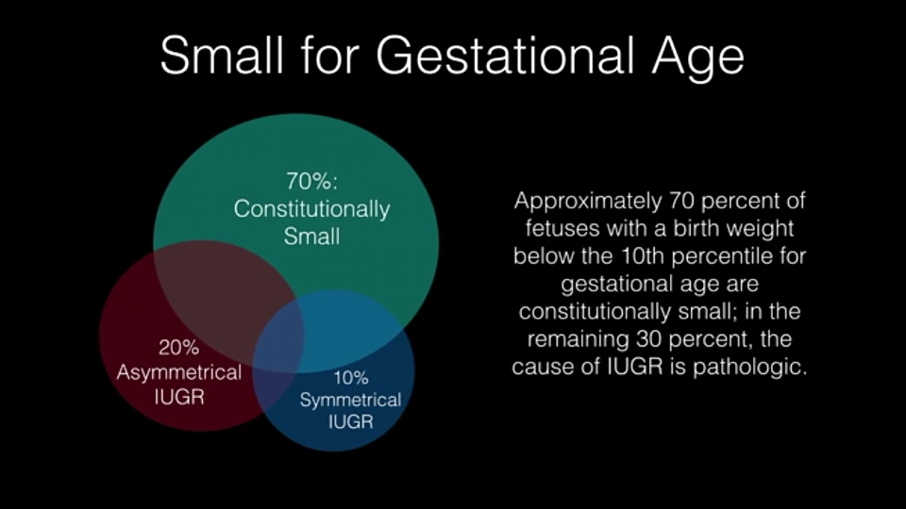

Slide 5
SMALL FOR GESTATIONAL AGE
Small foetus is not necessarily growth restricted
The baby may be constitutionally small, these neonates are not at increased risk
Late onset of pathological cessation of growth may produce a baby with typical features of IUGR
May or may not have pathological restriction in its growth.

Slide 6
Small for gestational age cntd........
It includes foetus with
Incorrect dated pregnancy
Genetic/chromosomal defect
Intrauterine infection
IUGR

Slide 7
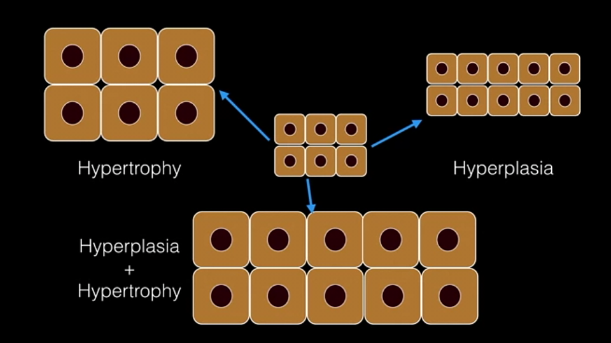

Slide 8
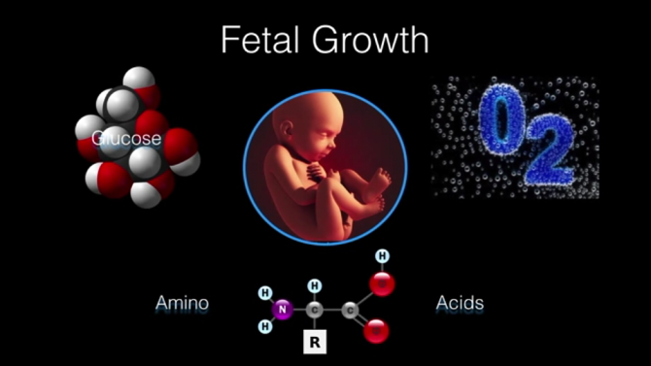
NORMAL GROWTH
Foetal growth occur in three phases
Cellular hyperplasia phase __last for 1st 16 weeks.
Phase of concomitant hyperplasia and hypertrophy __occurs between 16 & 32 weeks.
Cellular hypertrophy __occurs between 32 weeks & term , during this phase only more fat glycogen & fat deposition takes place.

Slide 9


Slide 10
Normal growth cntu....
The control of foetal growth is a complex process confined by multiple variables like
maternal height
Race
Socio economic status
At biological level it depends on growth potential & substrate supply
Growth potential __from parents & through growth factors like insulin growth factors.
Substrate supply _ from placenta which is dependent on uterine & placenta vascularity.

Slide 11
GROWTH RATES
5 gram/day at 15 weeks
15 -20 gram/day at 24 weeks
30-35 gram/day at 34 weeks
Symphysiofundal height increases by 1cm /week between 14 _32 weeks
Abdominal growth increases by 1 inch/week after 30 weeks.

Slide 12
PATHOPHYSIOLOGY
It related to placental insufficiency
The number of spiral arteries supplying the placental bed is fixed relatively in early preganacy.
To accomodate necessary blood flow the spiral arteries undergo certain changes mediated by tropboblastic invasion.
In 1 st trimester the decidual segments of the arteries undergo degeneration of internal elastic lamina, denudation of smooth muscle & elastic in the inner and outer media , which are replaced by fibrin & hyaline.
In 2nd phase 16_18 weeks there is extension of trophoblastic invasion into myometrial segment of spiral arteries .

Slide 13
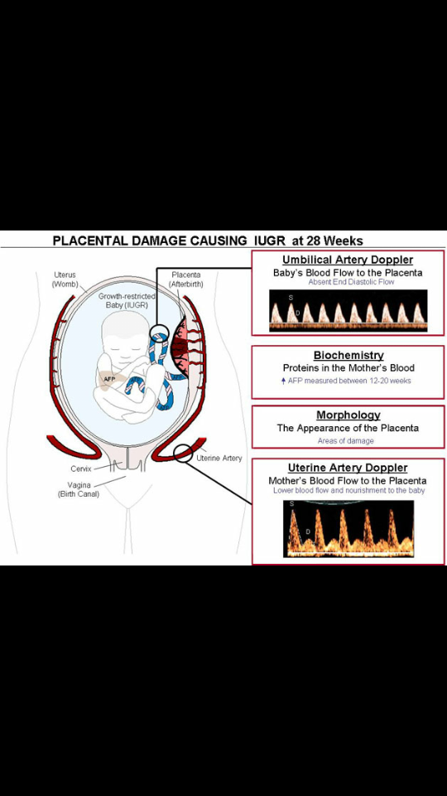

Slide 14
In woman with placental insufficiency , the trophoblastic invasion is confined to the decidua and the spiral & radial arteries do not transform into low resistance vessels.

Slide 15
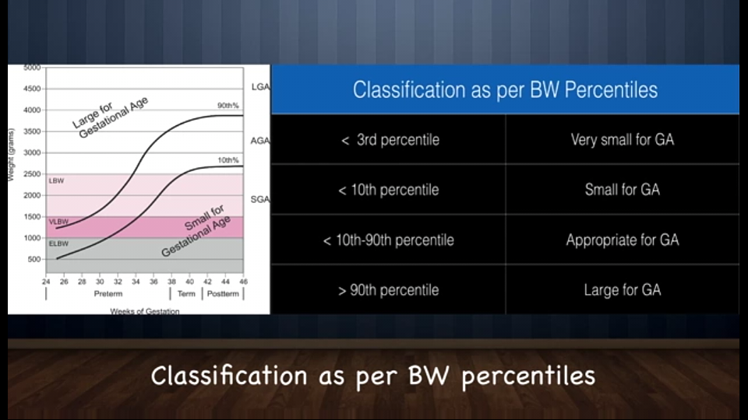

Slide 16
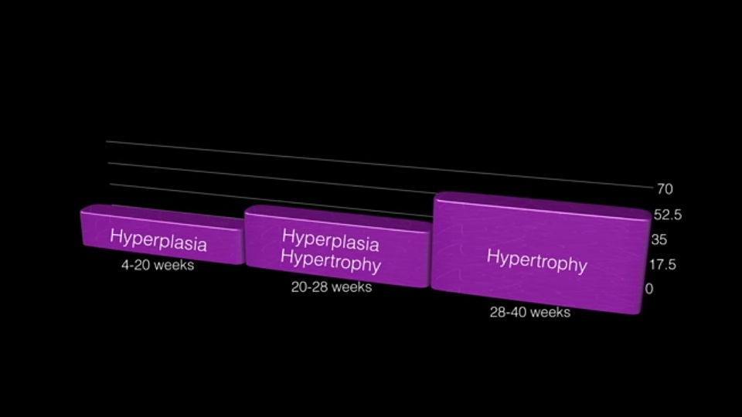
CLASSIFICATION
TYPE 1 / SYMMETRICAL / EARLY ONSET IUGR
TYPE 2 / ASYMMETRIACL / LATE ONSET IUGR
INTERMEDIATE IUGR

Slide 17
SYMMETRICAL IUGR
Incidence 20 _30%
As a result of growth inhibition early in pregnancy
The early phase of embryonic & foetal development from 4 to 20 weeks is characterized by active mitosis _ hyperplastic stage.
Any pathological insult at this stage leads to reduced in number of cells in the foetus & decrease in growth potential.

Slide 18
causes
Intrauterine infections
Chromosomal disorders
Congenital malformations
In absence of identifiable cause & sonographically abnormality , 25% foetus with severe onset IUGR have aneuploidy.

Slide 19
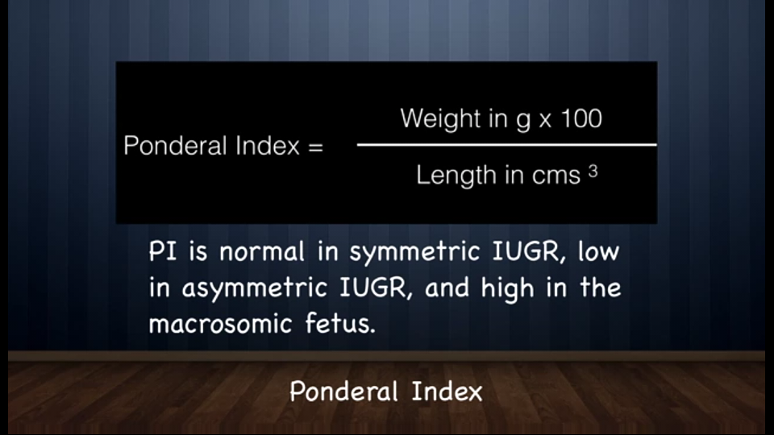
All parameters i.e. Head and abdominal circumference , length & weight , are below 10% percentile for gestational age , hence these infants have a normal ponderal index.

Slide 20
PROGNOSIS
Depends on underlying pathology
Severity of IUGR
Medical interventions to improve fetal growth are rarely effective.

Slide 21
ASYMMETRICAL IUGR
Incidence 70_80 %
It occurs as a result of restriction of nutrient supply in utero i.e uteroplacental insufficiency.
It usually associated with maternal diseases such as chronic hypertension , renal diseases , & vasculopathy.
It accounts for 40 _80 % of growth restricted fetus
The onset occurs later than type 1 after 32 weeks of gestation.

Slide 22
Normal fetal growth in 2nd trimester is characterized by hypertrophy
In type 2 IUGR foetus is near total number of cells but the cell size is reduced.
There is brain sparing effect so that the head growth remains normal but abdominal growth slows down.
Ponderal index is low
Abdominal circumference is low
Normal head circumference & foetal length

Slide 23
BRAIN SPARING EFFECT
Foetal adaptive response to chronic hypoxia , in which foetus redistributes its blood flow to the brain , myocardium & adrenal glands.
By DOPPLER ultrasound middle cerebral artery pulsatility may provide direct evidence of brain sparing.

Slide 24
Redistribution of foetal cardiac output with increased flow to brain and heart at the expense of reduced splanchnic circulation.
Liver is reduced because of diminished glycogen stores.
This type of growth restriction leads to decreased amniotic flow , hypoxia , fatal death.

Slide 25
INTERMEDIATE IUGR
Incidence 5_10%
It is combination of both type 1& 2
As term suggests , the insult to fetal growth probably occurs during this phase affecting both hypertrophy and hyperplasia. i.e both cell number and size.
It is seen in 5_10% of all growth restricted foetus.
Chronic hypertension , lupus nephritis and maternal vascular diseases that are severe and have onset in 2nd trimester resulting in IUGR.
Prognosis is worst.

Slide 26


Slide 27
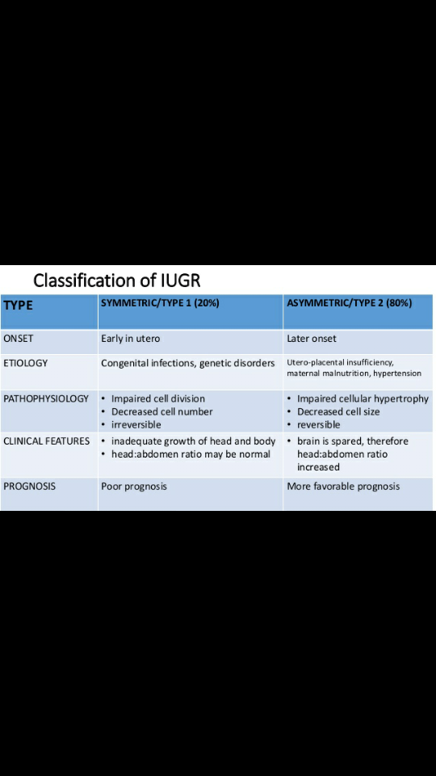

Slide 28
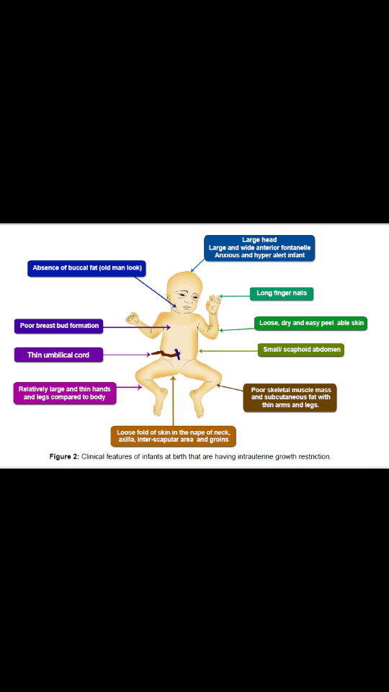

Slide 29
AETIOLOGY
Maternal
Fetal
Placental
Uterine
Environmental & personal
Socioeconomic

Slide 30
MATERNAL
NUTRITIONAL
severe maternal malnutrition
inflammatory bowel diseases
intestinal bypass surgery
HYPOXIA
asthma
cyanotic heart diseases
high altitude
SLE
cystic fibrosis

Slide 31
VASCULAR
pre eclampsia
chronic hypertension
collagen vascular diseases
diabetes with vascular involvement
RENAL
chronic renal diseases
post transplant states
HAEMATOLOGICAL
sickle cell anaemia
Thalassemia
Thromphohillias

Slide 32
FETAL CAUSES
Aneuploidy ___ trisomy 21, 18 , 13
Chromosomal abnormalities ___ autosomal deletions
Genomic imprinting
Uniparentral disomy
Multifoetal gestation
Infection ___TORCH ,
Malformations __ anencephaly , single umbilical artery
Inborn errors of metabolism ___ galactosemia , agenesis of pancreas , phenylketoneuria
Unexplained elevation of alpha fetoprotein

Slide 33
PLACENTAL CAUSES
Placenta previa
Abruption
Circumvallate placenta
Placenta accreta
Small placenta
Single umbilical artery
Uteroplacental insufficiency
Placental haemangioma

Slide 34
UTERINE CAUSE
Submucous fibroids
Septate uterus
Synechia
Decreased uteroplacental flow
Atheromatosis
Atherosclerosis of decidual arteries
Connective tissue disorders
Pre eclampsia
Fibromyoma

Slide 35
ENVIRONMENTAL AND PERSONAL
Smoking
Alcohol
Cocaine adsue
Drugs __ anticonvulsants (trimethadione , phenytoin) , anti coagulants.

Slide 36
SOCIOECONOMIC AND DEMOGRAPHIC
Low socioeconomic status
Previous h/o hypertension , abortion , abruption , IUGR

Slide 37
HISTORY TAKING
Age
Socioeconomic status
Details of previous menstrual cycles, regularity
Confirmation by urine pregnancy test
Ultrasound done in pregnancy

Slide 38
FIRST TRIMESTER
h/o fever
h/o exposture to drugs
SECOND TRIMESTER
Weight gain
h/o preeclampsia
h/o bleeding per vaginum
Perception of foetal movements

Slide 39
OBSTETRIC HISTORY
Parity
Previous h/o low birth weight babies , pre term babies , foetal demise
previous IUGR
Previous pre eclampsia
PAST HISTORY
HYPERTENSION , RENAL DISEASES , INFECTIONS
FAMILY HISTORY
Diabetes , hypertension , bronchial asthma , SLE
PERSONAL HISTORY
Smoking , alcohol , substance abuse

Slide 40
EXAMINATION
General built
Pallor , cyanosis , clubbing , lymphadenopathy , oedema.
Vitals __BP , pulse , BMI , height , weight
Thyroid examination
Systemic examination
Abdominal examination __liver& spleen for malaria
Renal angle tenderness
Obstetric examination
Fundal height , fetal presentation , FHR , amount of liqour clinically.

Slide 41
Thank you

