Slide 1
MULTIPLE GESTATION

Slide 2
Multiple pregnancy
When more than one fetus simultaneously develops in the uterus, it is called multiple pregnancy.
Varieties:
Dizygotic twins(80%)[fraternal,binovular]
Monozygotic twins(20%)[identical,uniovular]

Slide 3
Incidence
Monozygotic twins -1 in 250
Dizygotic twins-incidence varies widely
heighest in Nigeria- 1in 20.In India -1 in 80
Hellin’s rule: Twins 1 in 80
Triplets 1 in (80)²
The actual incidence of the multiple pregnancy has increased significantly at present.
Due to- early detection by USG,increasing use of ovulation induction and ARTs

Slide 4
Risk factors for Dizygotic twin
Race: Highest incidence- Nigeria(1 in 20) and lowest in Japan(1 in 200)
Age and parity
Hereditary
Maternal body weight
Iatrogenic
Assisted reproductive technology

Slide 5
ZYGOSITY AND CHORIONICITY
Zygosity- type of conception
Chorionicity – Placentation or type of placenta.
Dizygotic twins-Fertilisation of two separate ova(Binovular or fraternal)
Monozygotic twins – Division of one fertilised ovum into two separate embryos(uniovular or identical)

Slide 6
DIZYGOTIC TWINS
Fertilisation of two separate ova by two different spermatazoa
Each twin has its own placenta,chorion,amnion.
Hence always Dichorionic diamniotic.
Two placentae when in close proximity may fuse together and give the appearance of a monochorionic placenta.

Slide 7
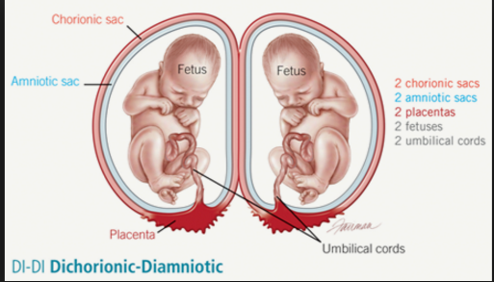

Slide 8
Monozygotic twins
Results from division of single fertilised ovum into two separate embryos.
Incidence-1 in 250 births.
Type of placentation is determined by the time of splitting.
As a rule , once any tissue has differentiated , it is no longer capable of splitting.
The chorion differentiates on day 4 and the amnion on day 8 after fertilisation

Slide 9
Monozygotic twins contd…
Hence if clevage occurs before 4 days-both chorion and amnion split completely –dichorionic-diamniotic placenta.(25%)
4 to 8 days – chorion has already differentiated – Monochorionic diamniotic.(75%)
In less than 1% of monozygotic conceptions , twinning occurs 8 days after fertilisation – Monochorionic monoamniotic placenta.

Slide 10
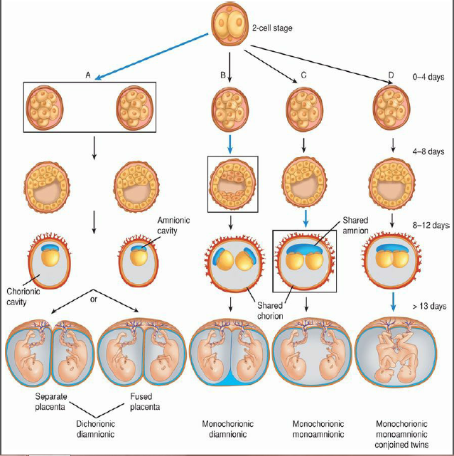

Slide 11
Conjoined twins
If the division occurs after 13 days – it is usually incomplete- conjoined twins(Siamese twins)
Exclusively- monochorionic monoamniotic.
Incidence -1 in 50,000-100,000
40% - stillborn
60% - Live born(only 25% survive to be candidates for surgery)

Slide 12
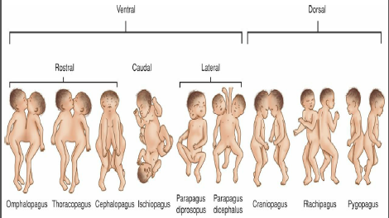

Slide 13
Determination of zygosity
Zygosity | Placenta | Communicating vessels | Intervening membranes | Sex | Genetic features | Skin grafting | Follow up
Monozygotic | one | Present | 2(amnion) | Always identical | Same | Acceptance | Identical
Dizygotic | Two | Absent | 4(2 amnions and 2 chorions) | May differ | Differ | Rejection | Not identical

Slide 14
SUPERFECUNDATION:
Fertilization of two separate ova occurs during the same menstrual cycle by separate act of coitus not necessarily by sperms from same male.
SUPERFETATION:
Twins are derived from separate ovulations as well as separate act of coitus during different intermenstrual periods.

Slide 15
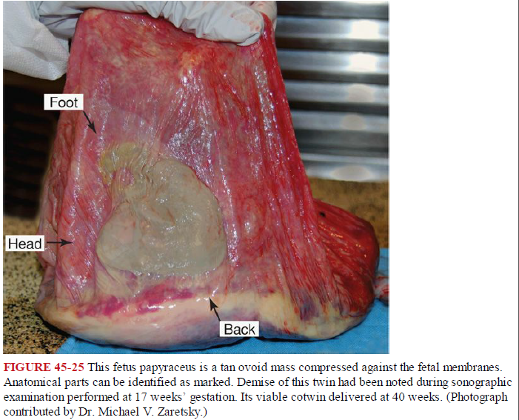
Fetus papyraceous or compressus:
One of the fetuses dies early and is flattened,mummified and compressed between the membranes of the living fetus and uterine wall.

Slide 16
Fetus acardiacus:
occurs only in monozygotic twins.
Part of one fetus remains amorphous and becomes parasitic without a heart.
Vanishing twin

Slide 17
Maternal physiological changes
There is increase in weight gain and cardiac output
Plasma volume is increased by an addition of 500 ml.
But there is no corresponding increase in red cell volume – exaggerated hemodilution and anemia.
There is increased -fetoprotein level,tidal volume and GFR.

Slide 18
Lie and presentation
Lie-longitudinal(90%)
Combination:
Both vertex (50%)
First vertex and second breech(30%)
First breech and second vertex(10%)
Both breech(10%)
Rarest- both transverse

Slide 19
Diagnosis
History :1) H/O ovulation inducing drugs
2)Family h/o twinning
Symptoms:
1)Increased nausea and vomiting
2)Cardiorespiratory embarrassment
3)Tendency of swelling of legs, varicose veins and haemorrhoids are greater

Slide 20
General examination
Anemia is more
Unusual weight gain
Evidence of preeclampsia(25%) is a common association.

Slide 21
Abdominal examination
Inspection
The elongated shape changed to a more “barrel shape”
Palpation
1)height of the uterus is more than the period of amenorrhoea.
2)Palpation of too many fetal parts.
3)Finding of two fetal heads.

Slide 22
Auscultation
Simultaneous hearing of two distinct fetal heart sounds located at separate spots with a silent area in between two observers and the difference of heart rates is atleast 10 beats per minute.

Slide 23
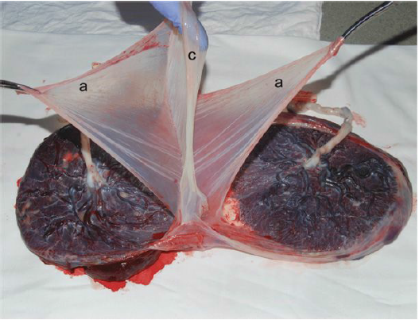
Placental examination

Slide 24
Ultrasound
It is possible to determine chorionicity in twin pregnancy well before the delivery by ultrasound.
The accuracy decreases with increasing gestation.

Slide 25
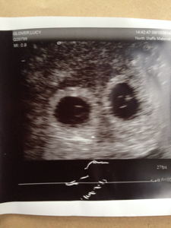
First trimester
Chorionicity and amniocity –in first trimester-90-100% accuracy
1)Two yolk sacs- can be predicted before 8 weeks.
Two yolk sacs confirm diamniocity

Slide 26
Two separate placenta
Indicate dichorionic placenta.
Twin peak or lambda sign
Refers to the triangular projection of trophoblastic tissue isoechoic with the placenta into the intervening membranes from the placental surface.
No of layers in the intervening membrane –high resolution usg-preferably tvs to predict chorionicity.

Slide 27
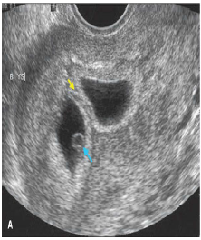
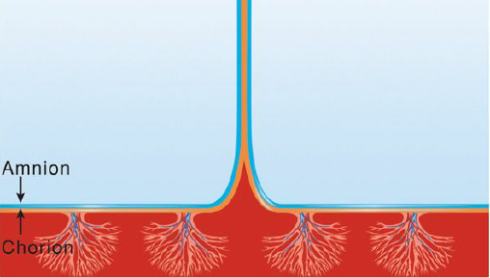

Slide 28
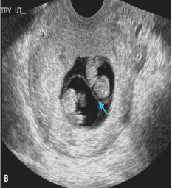
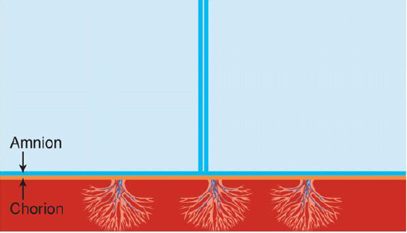
T sign

Slide 29
Second and third trimesters
Chorionicity is detected by fetal gender,placental structure and intervening membrane.
Fetal gender:
Discordant genitalia indicate dichorionicity.
Inter-twin membrane:
Dichorionicity – well defined hyperechoic membrane>2mm
More reliable before 26 weeks

Slide 30
Maternal complications
Pregnancy:
Spontaneous abortion
Excessive nausea and vomiting
Anaemia
Preeclampsia(25%)-superabudence of chorionic villi is the possible explanantion.
Hydramnios (10%)
Gestational diabetes
APH
Acute fatty liver
Malpresentations
Preterm labour
Mechanical distress

Slide 31
During labour
Early rupture of membranes and cord prolapse
Increased operative interference
Intrapartum bleeding
Postpartum hemorrhage

Slide 32
During puerperium
Subinvolution – bigger size of uterus
Infection-operative interference,preexisting anemia and blood loss during delivery.
Lactation failure

