Slide 1
OESTROGENS AND PROGESTERONE

Slide 2
Sex steroids are divided into two groups according to the number of carbon atoms the possess.
21 carbon series +pregnane nucleus=PROGESTINS
18 carbon series +estrane nucleus=OESTROGEN

Slide 3
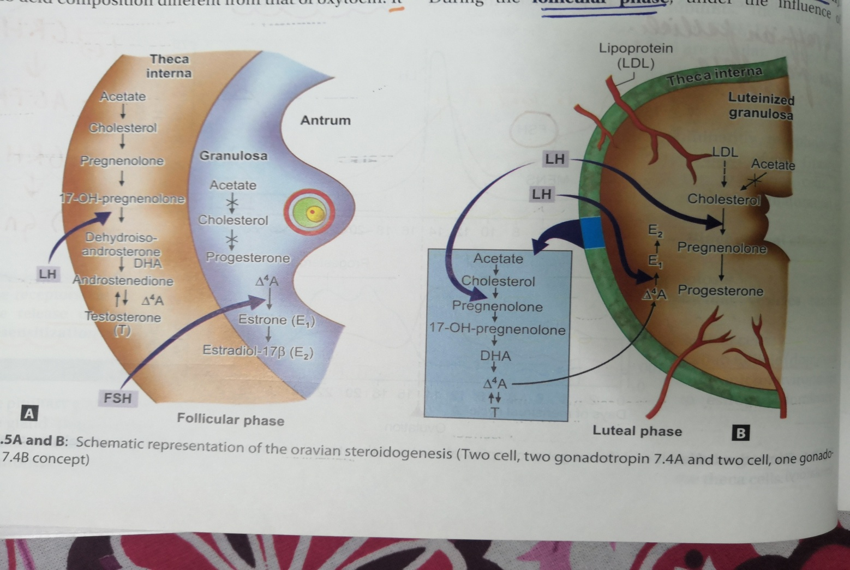
MECHANISM OF STEROID HORMONE PRODUCTION

Slide 4
MECHANISM OF ACTION OF STEROID HORMONE
Diffuse of the steroid hormone through the cell membrane
Steroid hormone receptor complex within the nucleus
Interaction of this complex with the nuclear DNA.
Synthesis of M rna
M rna combines with the ribosome in the cytoplasm
Synthesis of protein and desired action

Slide 5
Sources of estradiol: granulosa cells of developing follicle and the corpus luteum
Sources of progesterone: luteinized theca granulosa cells of corpus luteum
Stimulating agents for steroidogenesis :gonadotropins , FSH,LH
First messenger : gonadotropins activate the enzyme in the cell membrane called adenylate cyclase
Second messenger : cyclic AMP

Slide 6
ESTROGENS
ESTRADIOL: also known as 17B estradiol
-most potent estrogen produced and secreted by the ovary
-principle estrogen in premenopausal women.
ESTRONE: metabolite of estradiol that has approx 1/3 the estrogenic potency of estradiol
-primary circulating estrogen after menopause
-generated mainly from the conversion of androstenedione in peripheral tissue
ESTRIOL: it is a metabolite of estradiol, is significantly less potent than estradiol
-present during pregnancy ,because its principal estrogen produced by the placenta.

Slide 7
METABOLISM OF ESTROGEN
Bound to albumin -30%
Bound to sex hormone binding globulin-69%
Remaining 1% free biologically active
Liver is the most important site for metabolism and inactivation for estrogens.
Before excretion, estradiol is mostly converted to estriol.
Excreted in the faeces and urine in the form of biologically inactive conjugates with glucuronide and sulphate groups

Slide 8
METABOLISM OF PROGESTERONE
Bound to albumin -79%
Bound to corticosteroid binding globulin-17.7%
It is metabolized in the liver and excreted as sodium pregnanediol glucuronide in the urine
This metabolite has no progestational activity
Only 20% of secreted progesterone is conjugated and appears in urine
17 alpha OH progesterone is reduced to pregnanetriol

Slide 10
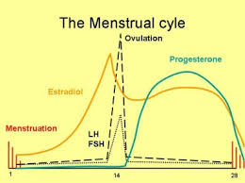

Slide 11
OESTROGEN LEVELS
The levels of estrogen begins to rise from day 7or 8 and reaches peak on day 12
The level falls briefly after ovulation but begins to rise again to reach a second peak during luteal phase.

Slide 12
PROGESTERONE LEVELS
Progesterone level is low in the follicular phase
Starts rising immediately after ovulation and reaches a peak at day 22
The levels fall after that

Slide 13
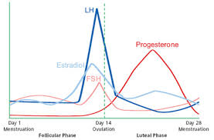

Slide 14
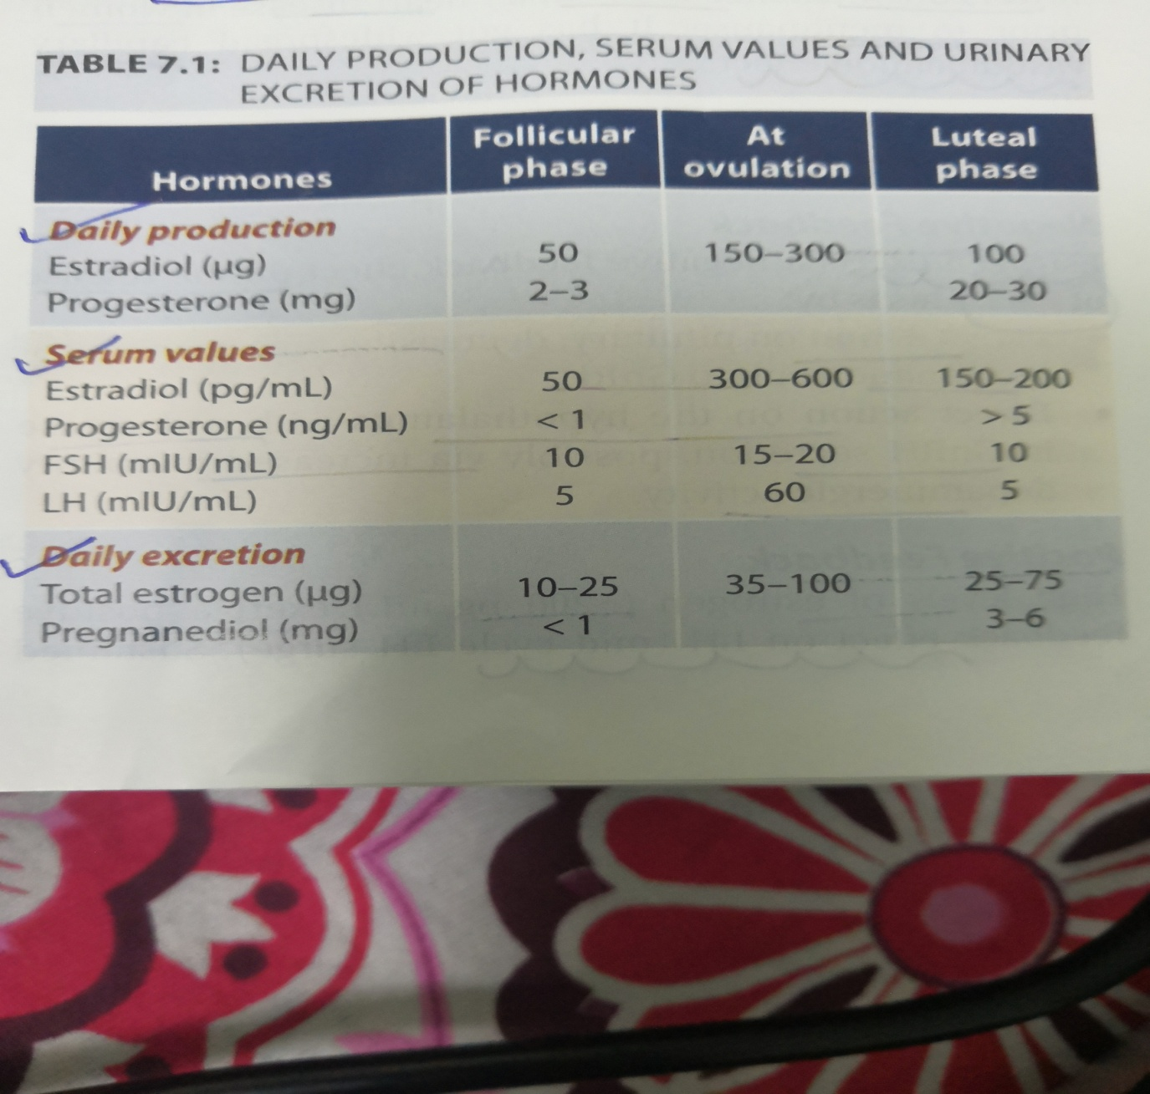

Slide 15
FUNCTIONS OF OESTROGEN
SECONDARY SEXUAL CHARACTERS
VULVA, VAGINA:
1.these structures are influenced by estrogen
2.vaginal vascularity and epithelial activity is related to estrogen
3.vaginal flora is maintained by estrogen
UTERUS:
1.increase in vascularity
2.hypertrophy of endometrium and myometrium
3.at menopause ,its withdrawal leads to atrophy of uterus

Slide 16
FALLOPIAN TUBES: increases the motility and vascularity of the tubes
CERVIX: hypertrophy of the cervix and increases the cervical gland secretion. The secretion is more watery ,alkaline with less protein. This favours penetration of the sperm
BREASTS:
-increased proliferation the ducts and stromal tissues
-vascularity and pigmentation of the areola
-accumulation of fat

Slide 17
BLOOD: it increases the coagubility of the blood
LOCOMOTOR SYSTEM: estrogen conserves calcium and phosphorus and encourages bone formation.
GENERAL:
- increases sodium,nitrogen,fluid retention of the body
-lowers blood cholesterol level and reduces the incidence of coronary heart disease

Slide 18
ENDOCRINE SYSTEM
1.estrogen exerts a negative feedback on the release of FSH
2.high levels of estrogen (>200pg/ml) exert a positive feedback on the LH(mid cycle LH surge)
3.sustained levels (24-48hrs) leads to sustained and elevated LH secretion
THIS POSITIVE FEEDBACK IS NOT SEEN IN THE POSTOVULATORY PHASE BECAUSE OF THE PRESENCE OF PROGESTERONE

Slide 19
FUNCTIONS OF PROGESTERONE
UTERUS:
1.reduces the contractility of the uterus
2.increases the tone of circular muscle fibers at the isthmus
3.produces secretory activity in the endometrium,enhnaces the of glands rich in glycogen

Slide 20
CERVIX:
-Secretions become thick and viscid preventing sperm penetration
VAGINA:
-the maturation the vaginal epithelium is hindered
-more shedding of the cells seen
FALLOPIAN TUBES
- epithelial cells secrete clear mucus which helps in the migration of the ovum
-tubal motility decreased which predisposes to tubal pregnancy
BREASTS
-along with estrogen it produces hypertrophy and growth of the acinus structures

Slide 21
PREPARATIONS OF ESTROGEN
ORAL
GENERIC NAME | DOSES | INDICATION
ETHINYLESTRADIOL | 0.01,0.02,0.03,O.O5.1.0MG | Irregular menses , OC pills
CONJUGATED EQUINE ESTROGEN(PREMARIN) | 0.325,0.625,1.25mg | HRT puberty menorrhagia
MICROIONIZED OESTROGENS(E2) | 1-2mg | Menorrhagia, irregular menses
COMBINED PILLS |  | contraceptives

Slide 22
INJECTABLE
TOPICAL VAGINAL
Conjugated equine estrogen | 25mg slow IV | Puberty menorrhagia, menorrhagia
Dienoestrol cream,evalon cream | 0.01%in cream base | Senile vaginitis,urethral syndrome

Slide 23
TRANSDERMAL PATCHES
17B 0estradiol(3-7days) | 0.03-0.1mg in 24 hrs | HRT
Combined E+MPA | 0.625+5mg | HRT
Oestradiol implant | 25,50,100mg | LONG ACTING HRT-6th monthly

Slide 24
COMMONLY USED ESTROGENS
ETHINYL OESTRADIOL(EE2) AND MESTRENOL: are given orally ,skin patch and gel.
-common component in the OCP
-used in AUB
-the dose of estrogen is reduced to 20-30ug in each pill(reason)
-synthetic estrogen are the most potent
-mestranol is no more used in combined pills ,due to the risk of thrombosis

Slide 25
Ethinyl estradiol(LYNORAL):0.01-0.05mg
Estradiol valerate tablet:1-2mg
Estradiol succinate tablet(EVALON):1-2mg
2.CONJUGATED ESTROGEN:
-natural estrogen
-used in menopausal women to promote bone mineralization and cardio protective effect.

Slide 26
3.DIENOESTROL CREAM
-topical use in senile vaginitis
-kraurosis vulva
-urethral syndrome in menopausal women
-the cream is applied once or twice daily for 2-10days each month for 3-4 months.
4.OESTROGEN PATCH
-applied over the buttocks or lower abdomen
-avoids the first pass metabolism
-lowers triglycerides levels
-the skin patch can cause skin irritation

Slide 27
OTHER INDICATIONS
Short term use for menopausal symptoms.Premarin or evalon once daily for 3 to 4 months is effective
Long term HRT prevents or delays osteoporosis and is cardio protective.
INTERSEX STATE: patients suffering from turners syndrome and testicular feminizing tumor should receive estrogen combined progesterone cyclically throughout life to develop secondary sex characteristics and avoid cardiovascular accidents and osteoporosis

Slide 28
CONTRAINDICATIONS
Suspected malignancy of genital tract
Breast cancer
History of thromboembolism
Liver and gallbladder disease
Lactation-reduced milk production
Sickle cell anemia-thrombosis
With drugs(rif,phenytoin,barbituates,anticoagulants)
Hypertension
Organic heart disease

Slide 29
SIDE EFFECTS
-nausea, vomiting when given orally
-mastaligia,water retention, weight gain
Thromboembolism , cerebral thrombosis
Endometrial and breast cancer if given for a long period without progesterone
Hepatic and gall bladder adenoma

