Slide 1
OVARIAN HYPER STIMULATION SYNDROME

Slide 2
introduction
OHSS is an iatrogenic complication occurring in the luteal phase or early pregnancy i.e after administration of human chorionic gonadotrophic hormone .
It is a life threatening complication in 1-10% .
It results from induction of ovulation in infertility cases .
It is more common in FSH/LH therapy than clomophine and pulsatile GnRH drugs .
OHSS induces massive ovarian enlargement with multiple cycts, hemoconcentration, and third space accumulation of fluid in the forms of ascites, pleural and pericardial effusion, and anasarca.

Slide 3
The syndrome is self-limiting phenomena that resolve spontaneously after several days if the patient is not pregnant.
In case of pregnancy, the syndrome may persist longer and increase in its severity.
Incidence : 100 – 200 of 100000 cycles that occur annually.

Slide 4
Onset of ohss
Depending on the time of onset ohss is of two types
Early onset : occurs on day 3 – day 7 , i.e after hCG administration or within a week of embryo transfer.
Late onset : occurs on day 12 – 17 , is related to pregnancy and even occurs in cycles where the ovarian response has not been very high.

Slide 5
PATHOPHYSIOLOGY
The severity of the symptoms related to OHSS results from an increase capillary permeability which case a fluid shift from the intravascular space to the third space compartments.
It was shown that hCG along with Vascular Endothelial Growth Factor (VEGF), Angiotensin II, Epithelial Growth Factor (EGF), Insulin like Growth Factor I (IGF-I), Transforming Growth Factor (TGF), Platelet-derived Growth Factor (PDGF), Interleukin-1beta and others may play a role in this syndrome.

Slide 6
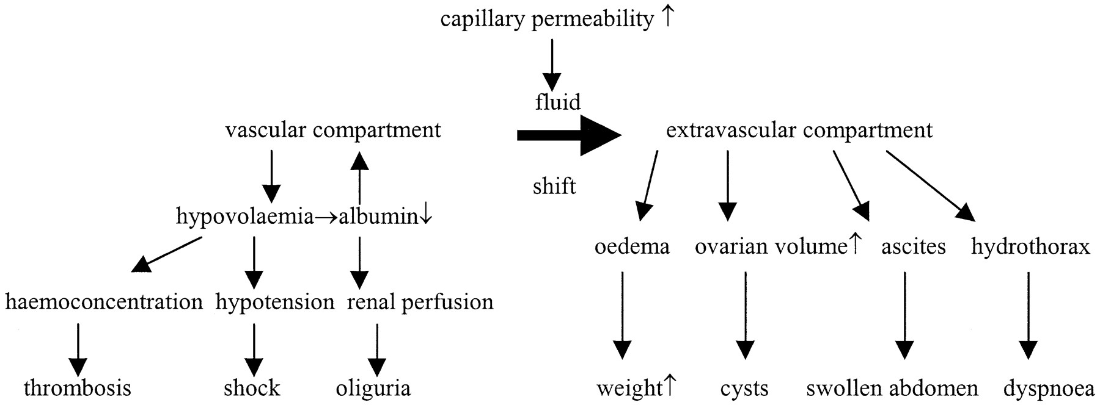

Slide 7
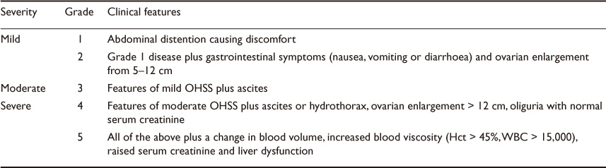
Classification ( golan et al)

Slide 8
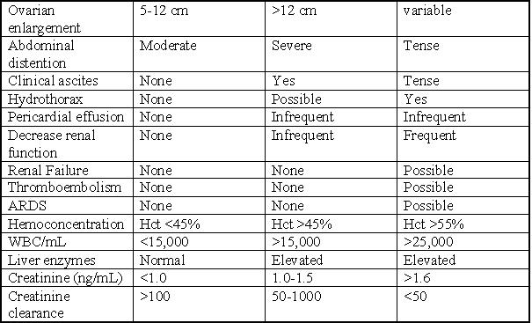
Clinical features

Slide 9
Risk factors
The first step in prevention of OHSS is proper identification of the population at risk.
Patients at high risk are generally:
- Young age
- Low body weight
- PCOD or PCO-like ovaries
- Asthenic habitus
- High serum E2 (>7000 pmol/L)
- Multiple follicles
- Pregnancy
- hCG luteal supplementation
- GnRH-agonist protocol for pituitary down-regulation
- Previous history of OHSS

Slide 10
Risk factors during treatment cycle
hMG
Absolute serum estradiol level > 2500 pg/ml
D9 serum estradiol concentration by 50% or moreover 24 hours.
USG appearance of ovary on day of hCG administration
Serum cytokines
Serum VEGF

Slide 11
prevention
Strict monitoring of cycles or cycle cancellation.
- Reducing the hCG dose (usually to 5,000 IU)
- Triggering the final stage of ovulation with GnRH-agonist.
- Avoidance of hCG for luteal support.
- Withhold the ovulatory dose of hCG.
- Prolonged coasting or ‘drift period’.
Drugs : GnRH analogs and antagonists
recombinant LH
insulin sensitizers ( metformin )
Iv albumin
Glucocorticoids
progestogens
Additional measures should be considered:
- Prophylactic infusion of human albumin solution at the time of egg collection.
- Elective embryo cryopreservation (avoidance of pregnancy).

Slide 12
complications
Vascular – thromboembolic phenomenon , DIC
Abnormal liver functions
Respiratory – adult respiratory distress syndrome secondary to pleural effussion or massive ascites
Renal – prerenal failure , pressure effects like hydroureter due to compression of ureter by enlarged ovaries
Gastrointestinal – ascites, intraperitoneal haemorrhage
Ovarian – torsion , rupture

Slide 13
Initial evaluation and diagnosis
History
Blood pressure,
Pulse
Respiratory rate,
Careful auscultation of the heart and lungs.
Abdominal examination including signs of ascites (shifting dullness) and acute abdomen .
If possible, no speculum examination or palpation of the ovaries and uterus should be performed.
Ultrasound of the pelvis is more informative, much safer and therefore, the preferred examination modality.
Accurate measurement of body weight and abdominal circumference at the umbilical level.

Slide 14
management
Aims of treatment :
For symptomatic relief
To maintain fluid balance
To maintain renal function
To prevent thromoembolism

Slide 15
Mild ohss
This can be managed as outpatient
Limitation of daily activities
Monitor fluid intake and output
Weighing daily at home
Atleast 1 litre of electrolyte balanced fluid
Daily followup on telephone or visit to hospital on worsening of symptoms or increased weight of more than 2lbs.
Analgesia using paracetamol or codeine is appropriate. Nonsteroidal anti-inflammatory drugs should not be used.
Strenuous exercise and sexual intercourse should be avoided for fear of injury or torsion of hyperstimulated ovaries.
Women should continue progesterone luteal support but hCG luteal support is inappropriate.

Slide 16
Indications for hospitalisation ( mild and moderate ohss)
Inability to tolerate oral hydration
haemodynamic instability
respiratory compromise
tense ascites
Haemoconcentration
Leukocytosis
Hyponatremia
Hyperkalemia
Abnormal renal function and lung function
Decreased oxygen saturation

Slide 17
Monitoring of moderate and severe ohss
Vital signs
Regular weighing
Abdominal girth
Urine output
Haematocrit
WBC
Coagulation profile
Liver and renal function tests
Ultrasonography help in knowing severity and progression of disease
Chest xray and ecg
Measurement of plasma prekallikrein levels and Serum cytokine levels

Slide 18
Adequate oral fluids.
Fluid balance by administration of cystalloid and colloid solutions.(1.5 L to > than 3.0 L.)
Pain relief is best provided with paracetamol and if necessary oral or parenteral opiates. Nonsteroidal anti-inflammatory agents are not recommended.
Antiemetic drugs used should be those appropriate for the possibility of early pregnancy, such as prochlorperazine, metoclopramide and cyclizine.
Abdominal girth and weight should be recorded at admission and daily until resolution. Fluid intake and output should be recorded and monitored on at least a daily basis, with more frequent assessment if the woman is dehydrated or receiving intravenous fluids. Urine output of less than 1000 ml/day or a persistent positive fluid balance is a cause for concern.
Diuretics should be avoided as they deplete intravascular volume, although they may have a role with careful haemodynamic monitoring in cases where oliguria persists despite adequate intravascular volume expansion and a normal intraabdominal pressure.
Albumin can be added as 50-100 mg in iv fluids every 4th to 12th hrly.

Slide 19
paracentesis
Paracentesis should be considered in women who are distressed due to abdominal distension or in whom oliguria persists despite adequate volume replacement.
Paracentesis should be performed under ultrasound guidance to avoid inadvertent puncture of vascular ovaries distended by large luteal cysts.
Intravenous colloid replacement should be considered for women who have large volumes of ascitic fluid drained.
Transabdominal or transvaginal route can be considered.

Slide 20
Routine screening for thrombophilia in all women undergoing assisted conception is not warranted, although testing may be for helpful those with a personal or family history of thrombosis.
Thromboprophylaxis should be provided for all women admitted to hospital with OHSS. This should be continued at least until discharge from hospital and possibly longer, depending on other risk factors.
Full-length venous support stockings and prophylactic heparin therapy may be used.
The use of an intermittent pneumatic compression device may be helpful when symptoms prevent ambulation and confine the patient to bed.

Slide 21
Indications for surgery
Ovarian torsion
Ovarian rupture or haemoperitoneum

Slide 22
Ohss and pregnancy
Women should be reassured that pregnancy may continue normally despite OHSS, and there is no evidence of an increased risk of congenital abnormalities.
Pregnancy outcome following OHSS, including miscarriage, hypertension, placental abruption,preterm delivery, low birth weight are usually seen.

