Slide 1
Ovarian steroidogenesis

Slide 2
HORMONES
HORMONES SECRETED BY OVARY
Estrogens
Progesterones
Androgens
Inhibin

Slide 3
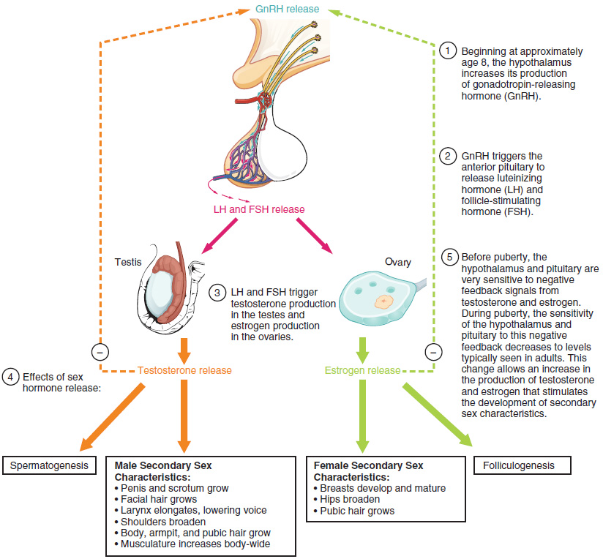

Slide 4
HYPOTHALAMUS
Is located at the base of the brain behind the optic chiasma
GnRH is secreted-it modulates the neural control of FSH&LH by anterior pituitary
GnRH is secreted in a pulsatile manner,its pulsatility and amplitude varies with various phases of menstrual cycle.
In preovulatory phase it pulses once in every 60 min
In luteal phase it slows down to once in 3 hr

Slide 5
GnRH
ACTION
Continous release causes suppression of gonadotrophin ,thereby decreases the ovarian function by the process of down regulation or desensitization
Pulsatile secretion of GnRH causes cyclical release of gonadotrophin ,FSH first&later LH which induces ovulation

Slide 7
PITUITARY GLAND
Lies in the sella turcica below the hypothalamus
3 histologically distinguishable cells
Chromophobe cell
Chromophill cell
B cell or basophil

Slide 8
PITUITARY GLAND
B-cell secretes gonadotrophin
gonadotrophin are
FSH,
LH,
TSH&
CORTICOSTERIOD hormones
All have alpha and beta subunits..
alpha is identical to all hormones and beta is specific

Slide 10
FOLLICLE STIMULATING HORMONE
Water soluble glycoprotein,
Secreted by b-cells of anterior pituitary
Function
Initiates the formation of follicles with in the ovary
Stimulates the follicles to secrete estrogen
Stimulates the sperm production in testis

Slide 11
FOLLICLE STIMULATING HORMONE
IN EARLY FOLLICULAR PHASE- it starts increasing and reaches the peak around 7th day of cycle(40ng/ml) and disappears around 18th day
Another peak occurs after ovulation due to fall of estrogen level in premenstrual phase
LOW FSH
Defective folliculogenesis
Defective corpus luteal phase

Slide 12
LUTEINIZING HORMONE
Water soluble glycoprotein
Secreted by b-cell of pituitary
FUNCTION
Secretion of estrogen
Ovulation from ovary
Secretion of progesterone

Slide 13
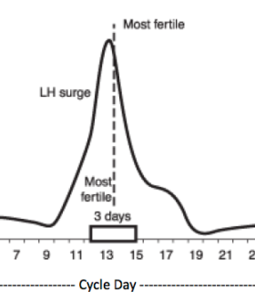
LH-SURGE
Is initiated by estrogen, lasts for 48 hrs and is preceded by a small amount of progesterone 2hrs earlier
LH value doubles in 2hrs and peak plateau for 14 hrs before declining

Slide 15
HORMONES
HORMONES SECRETED BY OVARY
Estrogens
Progesterones
Androgens
Inhibin

Slide 16
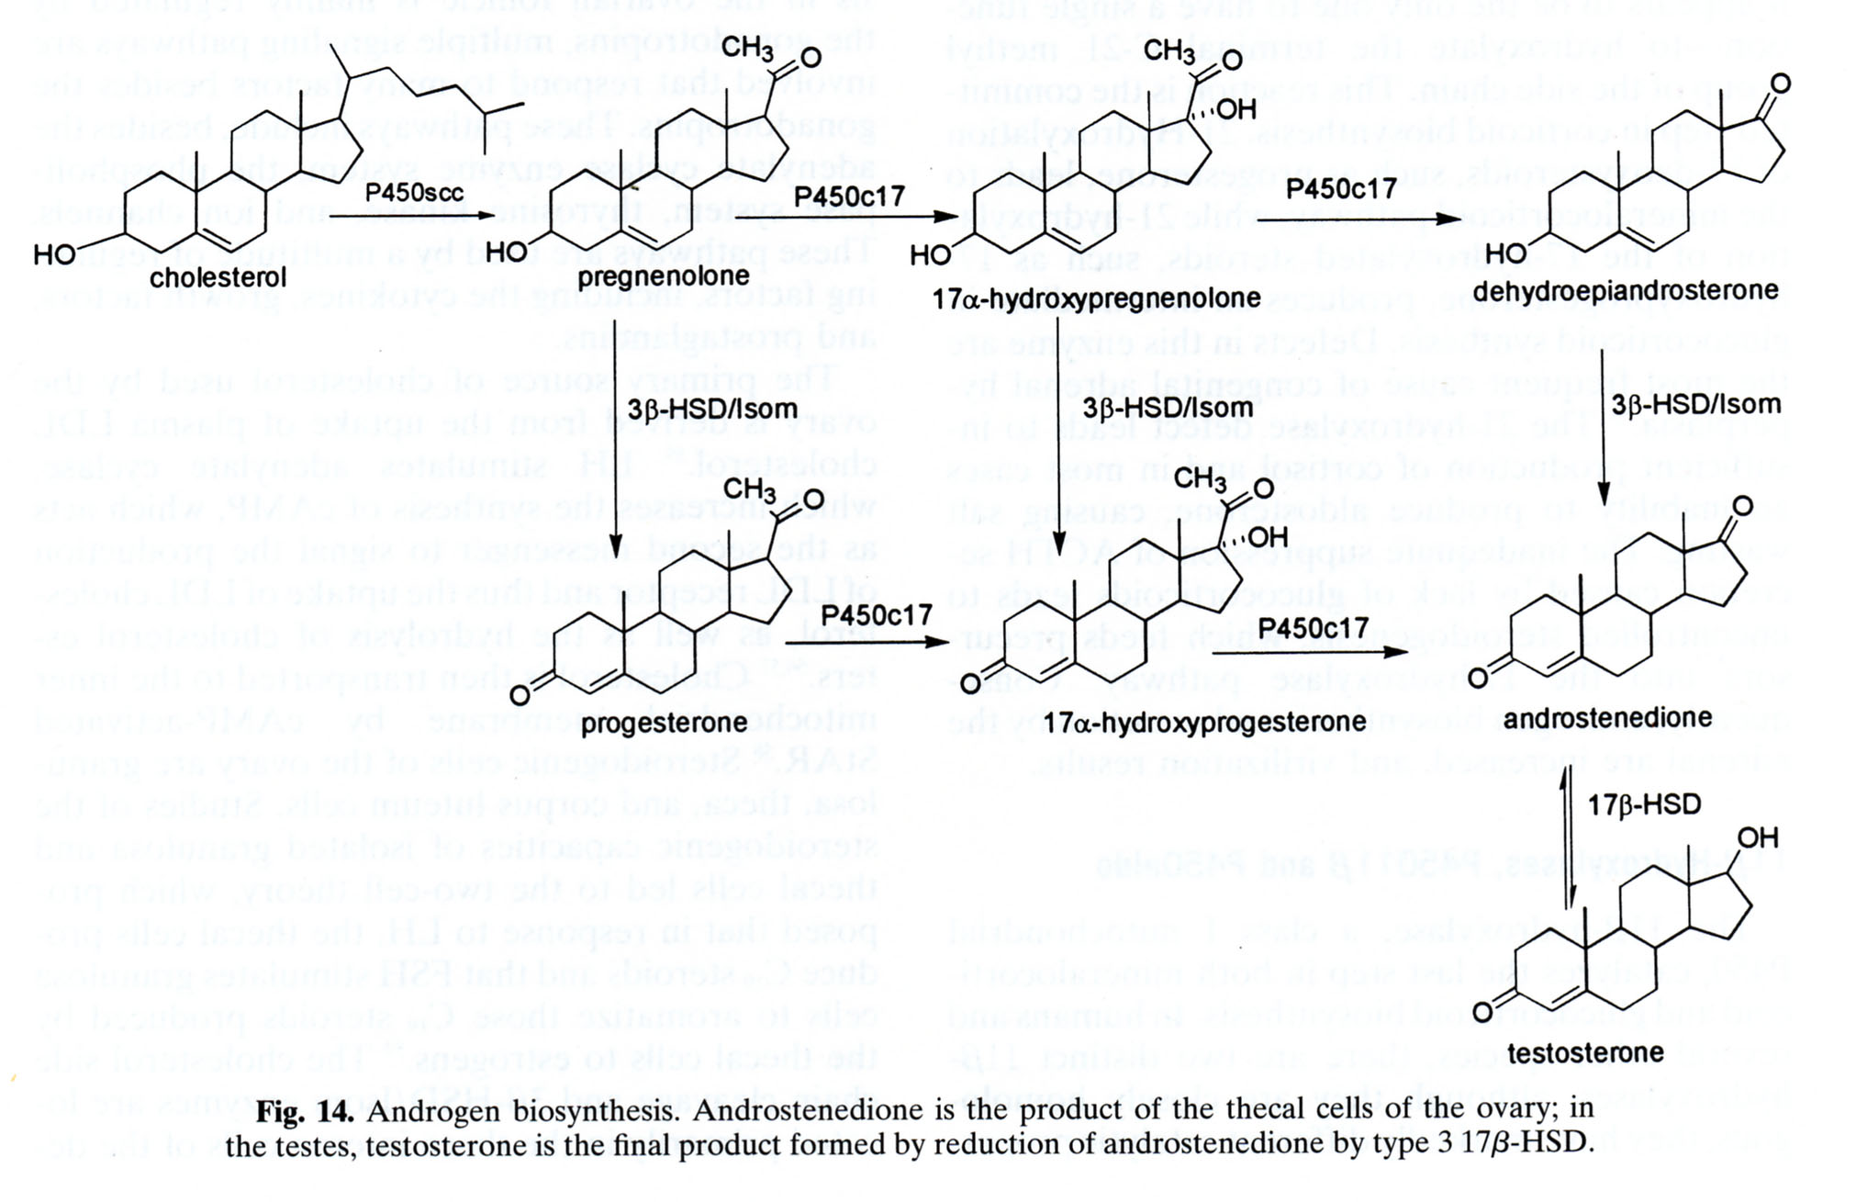

Slide 17
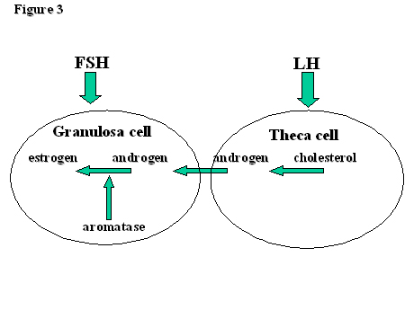

Slide 18
MECHANISM OF STEROID HORMONE PRODUCTION
2 CELL 2 GONADOTROPHIN THEORY
Here the two cells(theca cells and granulosa cells)produces different hormones under the influence of two gonadotrophins(LH&FSH)
During follicular phase

Slide 19
2 CELL 2 GONADOTROPHIN THEORY.
Theca cells
LH
androgens(androstenedione and testosterone)are produced
diffuses into the granulose cells
FSH
aromatization takes place(by aromatase enzyme)
estrone(lesser extent)
estradiol(predominantly)

Slide 20
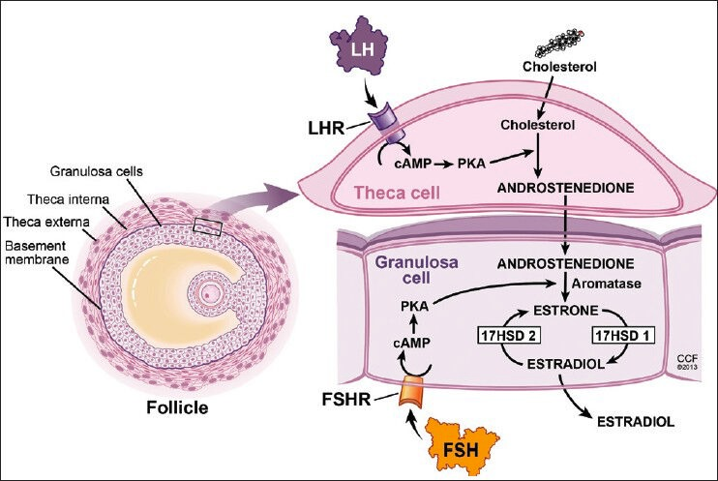
2 CELL 2 GONADOTROPHIN THEORY-

Slide 21
AFTER OVULATION
From granulosa cells
LH
Progesterone is produced

Slide 22
LUTEAL PHASE
Theca luteal cells
Androstenedione is produced
Diffuses into granulosa cells
LH
Converted into estradiol
NO ROLE FOR FSH..
SO IN LUTEAL PHASE 2CELL AND 1 GONADOTROPHIN SYSTEM WORKS FOR ESTRADIOL SYNTHESIS

Slide 23
ESTROGENS
SITE OF PRODUCTION
Granulosa cells of follicles
and small quantity from theca cells and ovarian stroma

Slide 24
METABOLISM OF ESTROGEN
30% is bound to albumin
69%is bound to hormone binding globulin
1%is biologically active
There are 3 classic estrogens
ESTRONE
ESTRADIOL
ESTRIOL

Slide 25
ESTROGEN
Estrone is predominantly seen in menopausal women
Estradiol is seen in reproductive age group
Estriol Placenta is the main source
Is conjucated in liver by glucoronic acid and is excreted in bile and urine
This bile reaches the intestine and acted upon by intestinal flora and reabsorbed as active hormone by enterohepatic circulation

Slide 26
ESTROGEN
AMOUNT OF ESTROGEN PRODUCTION
DURING FOLLICULAR PHASE-50micro gm
DURING OVULATION-150-300micro gm
Total quantity of estradiol is 10mg during a ovulatory cycle

Slide 27
OESTROGENS
PHYSIOLOGICAL CHANGES
For feminine body configuration,change in voice, deposition of fat over breast,thighs,and hip

Slide 28
ACTION OF ESTROGENS
SKELETAL SYSTEM
It increases the calcification of bone,so in menopausal women,decalcification of bone is infact due to estrogen deficiency
WATER AND SODIUM RETENSION
Causes sodium and water retension..eg is premenstrual tension
BLOOD CHOLESTEROL
To smaller extend controlled by estrogen
HDL increases under estrogen influence and is cardioprotective

Slide 29
PROGESTERONE
Needed for the continuation of pregnancy
Seen in proliferative phase
Level of progesterone rises after ovulation and reaches a peak level of 15ng/ml at mid luteal phase
If progesterone is <15ng/ml it suggest corpus luteal phase defect and ovulatory dysfunction

Slide 30
PROGESTERONE
SITE OF PRODUCTION
In non pregnant state-CORPUS LUTEUM is the main source of progesterone
If pregnancy occurs b-HCG is released which maintains the corpus luteum for first 8 weeks
After 10 weeks placenta produces progesterone

Slide 31
PROGESTERONE
WITHDRAWAL of progesterone leads to menstruation
If pregnancy occurs,the corpus luteum persists and secretes progesterone..this high level prevents mensuration and leads to amenorrhoea of pregnancy

Slide 32
PROGESTERONE
Progesterone
Is 80%bound to albumin
20%bound to corticosteroid binding globulin

Slide 33
PROGESTERONE
ACTION OF PROGESTERONE
Fluid and water retention
Relaxes the smooth muscles-thus the uterine musculature relaxes in pregnancy.ureter dilates under this effect
Thermogenic effect-increases the BBT by 0.5degree celsius
When administered, progestogen is metabolized to estrogen and partly to testosterone.if administered to patient during pregnancy it has virulisation effect upon a female fetus

Slide 34
ORGAN | OESTROGEN | PROGESTERONE
Breasts | ductal/stromal growth | alveolar growth
vagina | superficial cells with glycogen | intermediate cells
cervix | abundant mucous,thin,viscous,penetrable to sperms | thick tenacious mucous
uterus | myohyperplasia | myohyperplasia
endometrium | proliferative endometrium | secretory endometrium
fallopian tube | secretion | increased peristaltic movement
ovary | no action | no action

Slide 35
PROGESTERONE
SIDE EFFECTS
Nausea,vomitting,headache,increase in body temperature,water retention,breast engorgement,moderate uterine enlargement,virulisation,
Deep vein thrombosis is associated with 3rd generation synthetic progestogen

Slide 36
TESTOSTERONE
SYNTHESISED
50%from ovaries and
50%from adrenal gland

Slide 37
TESTOSTERONE
OVARIAN STROMAL TISSUES
Secretes
Testosterone androstenidione
dehydroepiandrostenidione

Slide 38
TESTOSTERONE
After menopause
ovarian stromal tissues increases,
so all hormones increases,
so hirsutism occurs

Slide 39
INHIBIN,ACTIVIN&
FOLLISTATIN
These peptides are synthesized by granulosa cells in response to FSH
INHIBIN is a important inhibitor of FSH secretion
ACTIVIN stimulates FSH release in the pituitary and auguments FSH action in ovary
FOLLISTATIN suppresses FSH activity by binding to activin

Slide 40
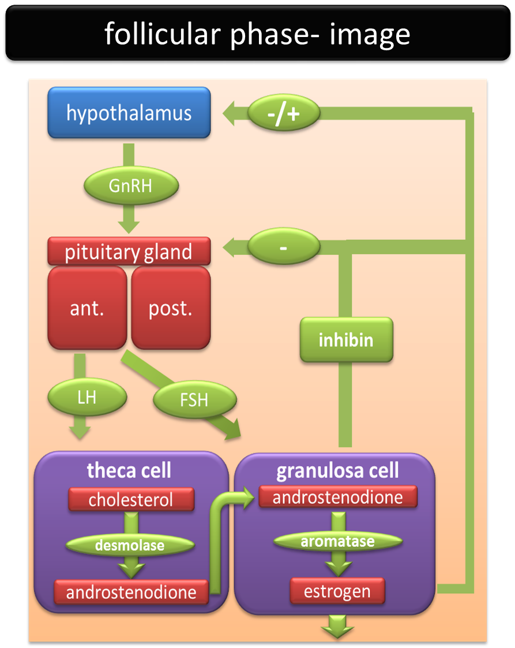

Slide 41
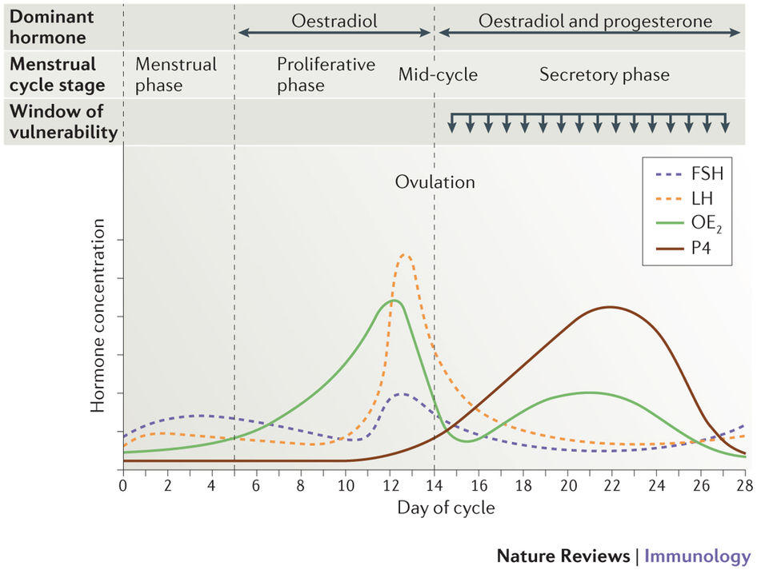

Slide 42
THANK YOU

Slide 43
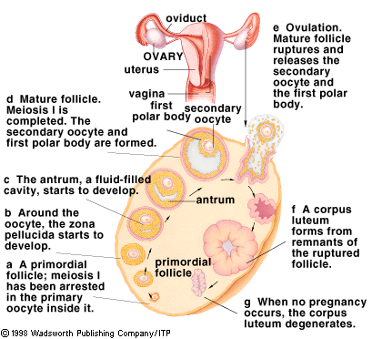

Slide 44
