Slide 1
PELVIC URETER
-

Slide 2
Ureters are a pair of narrow,thick-walled muscular tubes which convey urine from the kidneys to the urinary bladder
Lies deep to the peritoneum
Upper part – posterior abdominal wall
Lower part – Lateral pelvic wall

Slide 3
Abdominal part - Renal pelvis to the bifurcation of the common iliac artery.
Pelvic part - Pelvic brim (at the level of bifurcation of the common iliac artery) to the base of the urinary bladder.

Slide 4
Also divided into 3 parts :
Upper third - Renal pelvis to upper border of Sacrum
Middle third – upper border of Sacrum to lower border of Sacrum
Lower third- lower border of sacrum to thr urinary bladder

Slide 5
DIMENSION
Total length – 25 cm (10 inches)
Upper Half - Posterior abdominal wall
(5 inches)
Lower Half – Lateral pelvic wall (5 inches)
Diameter – 3mm

Slide 6
COURSE
Downward continuance to the renal pelvis
At the lower end of Kidney, runs downwards medially on the psoas major and the traverse of the lumbar vertebrae.
Enters the pelvic cavity by crossing in front of the bifurcation of the common iliac artery in the pelvic brim in front of the sacroiliac joint.

Slide 7
In Pelvis, the ureter first runs downward, backward, and laterally along the anterior margin of the greater sciatic notch.
Opposite to ischial spine, it turns forwards and medially
Enters the bladder wall in the lateral angle of its trigone as ureteric orifice.

Slide 8
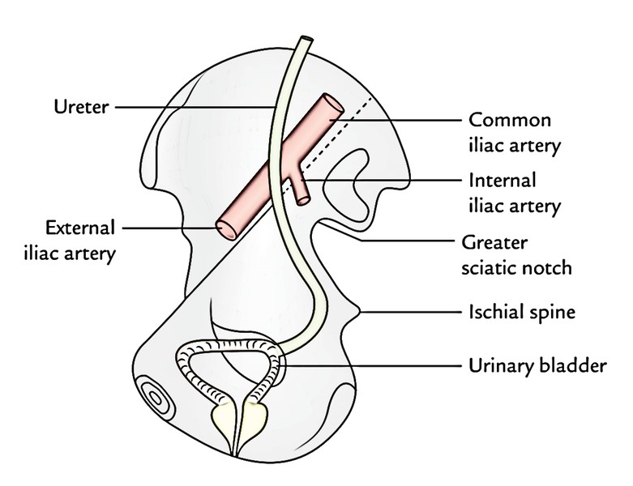

Slide 9
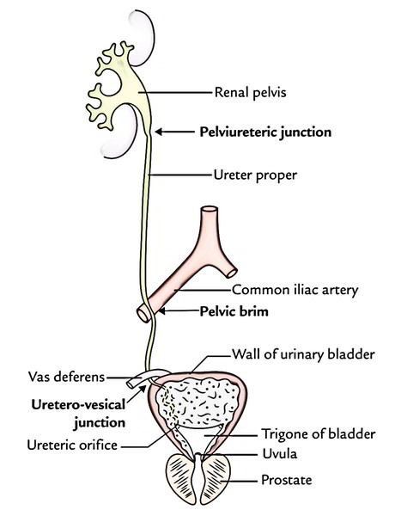
ANATOMICAL CONSTRICTIONS

Slide 10
At the Pelviureteric junction, where the renal pelvis joins the upper end of ureter.
At the pelvic brim, where it crosses the common iliac artery.
Point of crossing of broad ligament
At the uretero-vesical junction (narrow passage through bladder wall).
At the ureteric orifice (its opening in lateral angle of trigone)..

Slide 11
RELATIONS ABDOMINAL PART
 | Anterior relations |  | Posterior relations | Medial Relations
Right ureter | Second part of the duodenum Right colic vessels Ileocolic vessels Right ovarian vessels Root of mesentery |  | Right psoas major Bifurcation of right common iliac artery | Inferior vena cava
Left ureter | Left colic vessels Sigmoidal vessels Left testicular or ovarian vessels Sigmoid mesocolon |  | Left psoas major Bifurcation of left common iliac artery | Inferior mesentric vein Left gonadal vein.

Slide 12
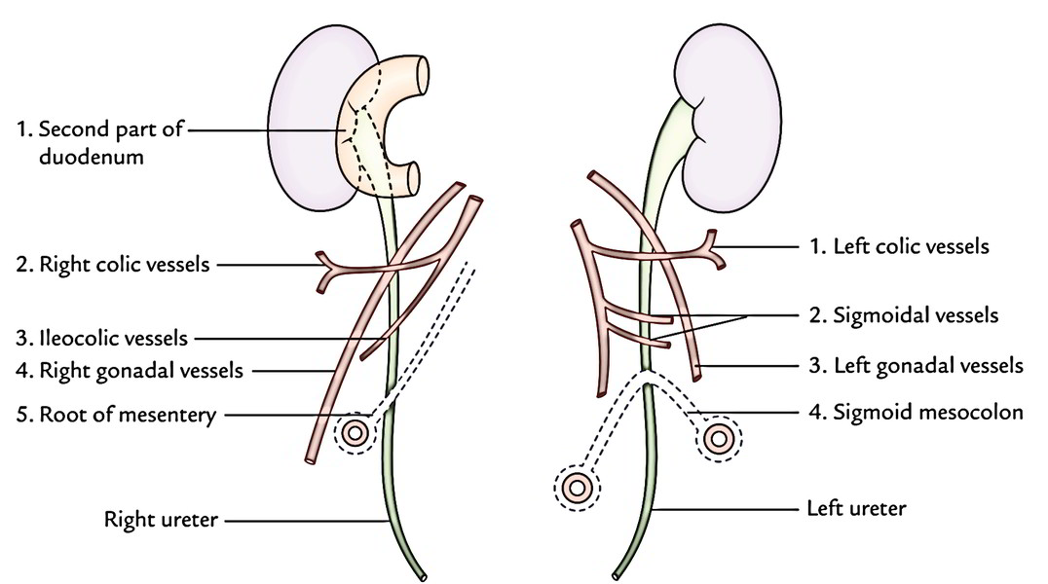

Slide 13
RELATIONS PELVIC PART
Extends from Pelvic brim to the Bladder
Passes in loose areolar tissue on Lateral pelvic wall in close contact with peritoneum
Passes anterior to Internal iliac artery over SI joint,
Lateral to sacrum(obturator neuro-vascular bundles lying laterally),
And Forms posterior boundary of Ovarian fossa

Slide 14
Passes downwards upto ischial spine, medial to Internal iliac artery,
Then, Crossed antro-superiorly by uterine artery (Lateral to medial side)
-1.5cm away from internal cervical os
“BRIDGE OVER THE RIVER”

Slide 15
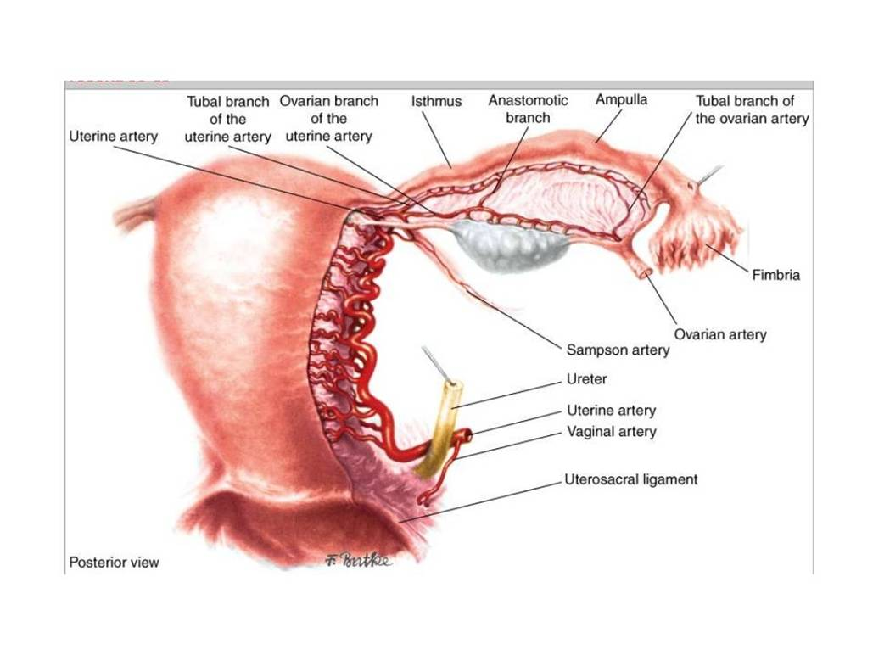
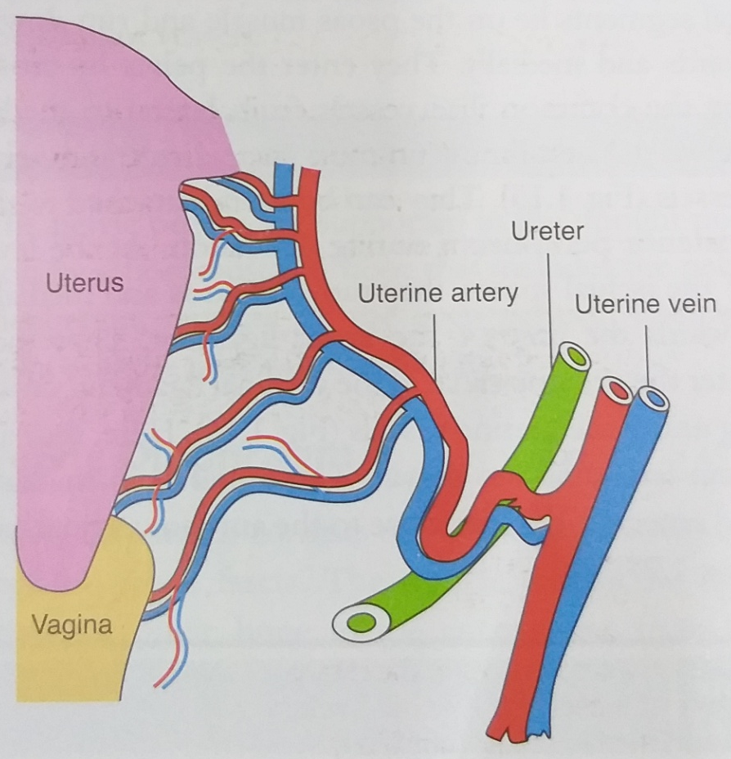

Slide 16
Then, Enters a tunnel of paracervical tissue, referred to as
“ Tunnel of Mackenrodt’s ligament”
”Web tunnel of wertheim”
In the tunnel,, ureter lies medially & anteriorly over anterior vaginal fornix

Slide 17
Enters the bladder, in Supralateral part of trigone,
An angulation in the lowest 1-2cm, called
“Genu/Knee of the ureter”
Inter-ureteric ridge measures 2.5 cm (5cm in distended bladder)

Slide 18
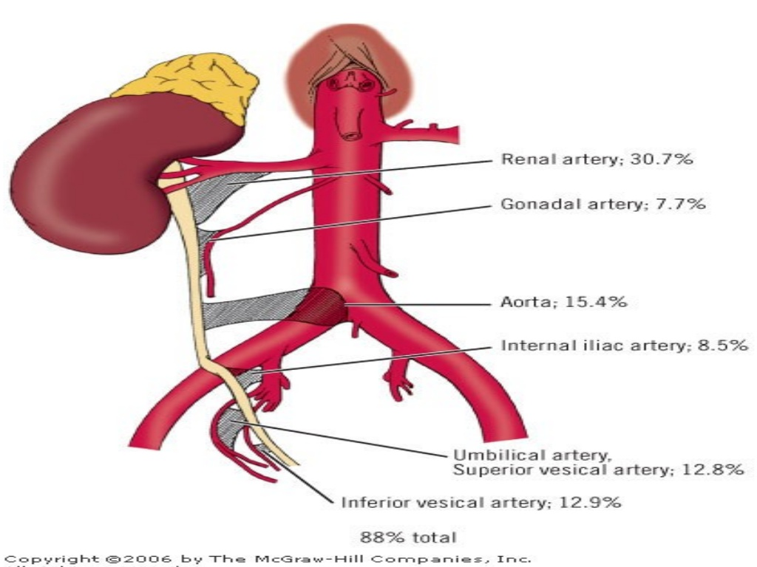
BLOOD SUPPLY

Slide 19
Abdominal part –
Renal vessels
Ovarian vessels.
Direct branches from aorta.
Pelvic part –
Vesical (superior and inferior) .
Middle rectal vessels.
Uterine vessels.

Slide 20
ARTERIAL SUPPLY
Arteries split into ascending and descending branches to create a plexus in the connective tissue sheath on top of ureter then supplies it.
VENOUS DRAINAGE
The venous blood from the ureter is drained into the veins corresponding to the arteries.

Slide 21
NERVE SUPPLY
Sympathetic supply:
T10 to L1 segments
via Hypogastric plexus
Parasympathetic supply:
S2 to S4 segments

Slide 22
LYMPHATIC DRAINAGE
Abdominal part –
Lumbar lymph nodes
Pelvic part-
External & Internal Iliac nodes.

Slide 23
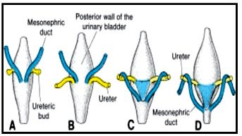
DEVELOPMENT
From Ureteric bud, which is an outgrowth from mesonephric duct

Slide 24
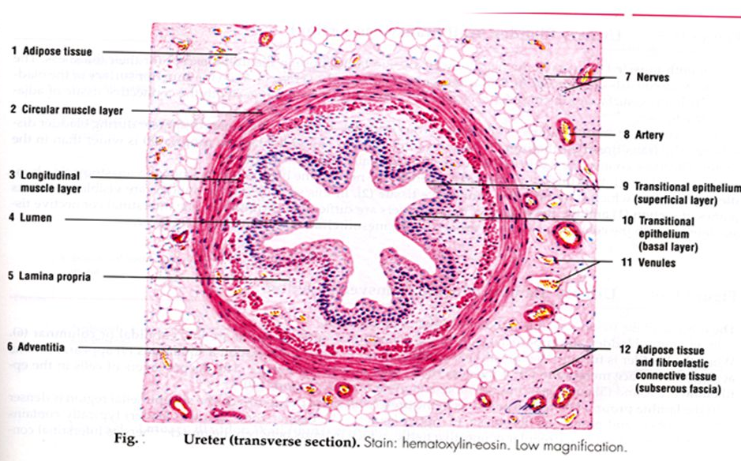
HISTOLOGY

Slide 25
MUCOSA: Innermost layer
Lined by transitional epithelium
Star shaped lumen
No SUBMUCOSA
MUSCLE LAYER:
Below lamina propria
Inner longitudianal layer
Middle circular
Outer longitudinal layer
ADVENTITIA

Slide 26
Functions of Layers:
Transitional epithelium - prevents the entry of urine and its toxic substances into the ureter by diffusion.
Muscular layer is responsible for peristalsis in ureter which pushes the urine from kidney to urinary bladder.
Adventitia is protective and supportive in function.

Slide 27
APPLIED ANATOMY
Ureteric injuries incidence :
0.5 to 1.5% in all pelvic sugeries
Out of which, 75% - Gynaeecological
75 % - Abdominal surgeries
Common surgeries:
Abdominal hysterectomy 0.5 – 1%
Vaginal hysterectomy 0.1%
Broad ligament tumour dissection
Ceserean hysterectomy

Slide 28
Common surgeries:
Abdominal hysterectomy 0.5 – 1%
Wertheim’s hysterectomy
Vaginal hysterectomy 0.1%
Broad ligament tumour dissection
Ceserean hysterectomy
Laproscopic surgeries

Slide 29
Common sites of injury
At the pelvic brim – While clamping Infundibulopelvic ligament &while clamping ovarian vessels
Lateral pelvic wall – devascularisation
Base of broad ligament- while clamping uterine vessels & in dissection broad ligament myomas
Tunnel of mackenrodts ligament (over anterior vaginal fornix) – while dissecting the tunnel
Vaginal vault – while Clamping the vaginal angle

Slide 30
During surgeries,
Ureter is recognised by
Pale glistening appearance
Fine longitudinal plexus of vessels on its surface
Peristaltic movements

Slide 31
RISK FACTORS FOR URETERIC INJURY
Pelvic malignancy - Extensive involvement of parametrium, Stricture of ureter causes HYDRONEPHROSIS
Endometriosis
Chronic PID
Previous surgery
Broad ligament tumours– Large masses displace the anatomical position of ureter
Pelvic organ prolapse

Slide 32
TYPES OF URETERIC INJURY
Crushing
Angulation & Obstruction
Ligation
Transection
Ischaemia
Devascularisation

Slide 33
INTRAOPERATIVE DIAGNOSISOF URETERIC INJURY
Open retroperitoneum
Visualise entire course of ureter in the pelvic to the bladder
IV Indigo carmine

Slide 34
INTRAOPERATIVE FINDINGS OF URETERIC INJURY
Collection of urine in the operative field
Ureter ligated – proximal segment dilates & peristalsis stops
Minor INJURY – No significant leakage of urine

Slide 35
INTRAOPERATIVE MANAGEMENT

Slide 36
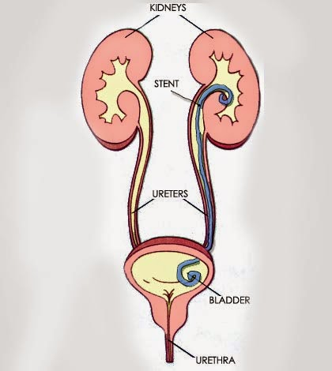
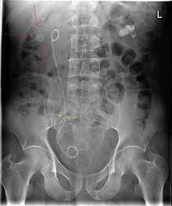
1)In accidental ligation or crush injury to ureter with a clamp or Partial transection
Double pigtail stent placed in the ureter

Slide 37
2) COMPLETE TRANSECTION OF URETER
In Upper third of ureter:
Ureterouretostomy
Ureteroileal interposition

Slide 38
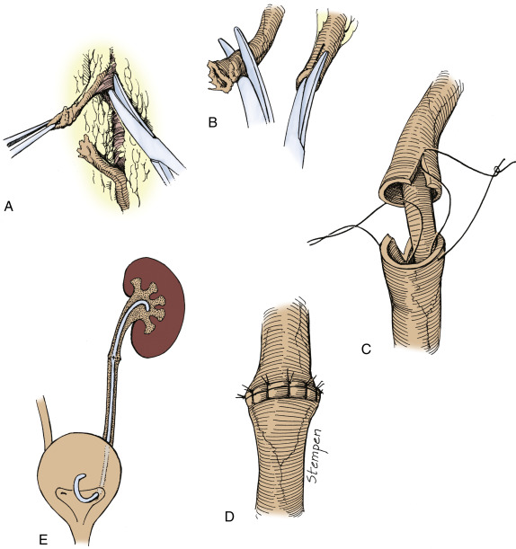
URETEROURETEROSTOMY
Cut ends of ureter are mobilised, spatulated & sutured over an internal stent.

Slide 39
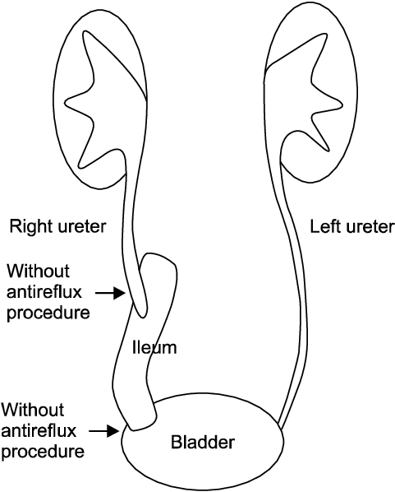
URETERO-ILEAL TRANSPOSITION
When the segment of ureter has to be resected, a distal ileal segment is interposed between the 2 ends of ureter or between ureter & bladder

Slide 40
COMPLETE TRANSECTION OF URETER
In Middle third of ureter:
Ureterouretostomy
Ureteroileal interposition
Transureteroureterostomy

Slide 41
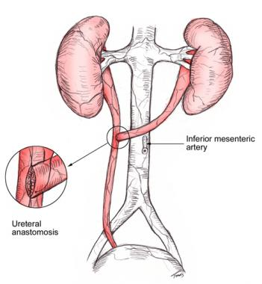
TRANSURETEROURETEROSTOMY
When the length of the segment of the ureter is not adequate, the cut end is anastomised to the ureter on the opposite side.

Slide 42
COMPLETE TRANSECTION OF URETER
In lower third of ureter:
Ureteroneocystostomy with psoas hitch
Boari flap

Slide 43
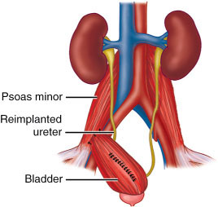
URETERONEOCYSTOSTOMY WITH PSOAS HITCH
Reimplantation of the ureter into the bladder .
Bladder is mobilised & stitched to the psoas muscle to relieve tension after ureteroneocystostomy

Slide 44
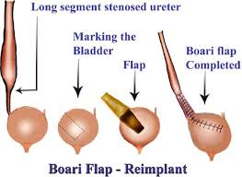
BOARI FLAP
When the ureteric segment is not long enough, a bladder flap is shaped into a tube & the lower end of ureter is attached to this.
Provides extra length to the ureter & prevent tension

Slide 45
INJURIES DIAGNOSED POSTOPERATIVELY
Signs & Symptoms:
Flank pain – Hydronephrosis (0-21 days)
Fever
Sepsis
Fistula
Paralytic ileus
Anuria – In Bilateral ureteric injury (<24 hrs)
Renal failure

Slide 46
Investigations(Postoperatively):
Serum creatinine
Ultrasonogram
Hydronephrosis
Hydroureter
Fluid in the peritoneal cavity
IV Urogram
CT Scan
Methylene blue test – to exclude vesicovaginal fistula
Cystoscopy

Slide 47
Postoperative management
Intra- or extraperitoneal leakage/obstruction:
Stenting
Nephrostomy
Small Ureteric Fistula- Stenting
Large Ureteric fistula & Failure of stenting –
Choice of surgery is based on the site of injury & is same as diagnosed intraoperatively

Slide 48
References
SHAW’s book of Gynaecology
Essentials of gynaecology – Lakshmi sheshadri
Human anatomy- BD Chaurasia

