Slide 1
PHYSIOLOGICAL CHANGES IN PREGNANCY

Slide 2
REPRODUCTIVE SYSTEM

Slide 3
VULVA
Edematous ,vascular, superficial varicosities are seen
Labia minor are pigmented and hypertrophied.
VAGINA
JACQUEMIERS SIGN: bluish coloration of the mucosa
Length of the anterior wall is increased

Slide 4
Secretion:
-copious, thin and curdy white due to marked exfoliated cells.
-ph is acidic 3.5-6(due to conversion of glycogen to lactic acid by the lactobacillus acidophilus
-This high ph prevents the multiplication of the pathogenic organisms
-cells seen in the vagina are the navicular cells(small intermediate cells with elongated nuclei)

Slide 5
UTERUS
In non pregnant state, uterus weighs 6og with a cavity of 5-10ml and measures about 7.5cm in length.
AT TERM , it weighs 900-1000g and measures 35cm in length with a cavity of 5L.
BODY:
-ENLARGEMENT
1.hypertrophy and hyperplasia of the muscle fibers
this occurs due to hormones like estrogen and progesterone
it is pronounced upto 12 weeks

Slide 6
2.STRETCHING
-the muscle fibers undergo elongation
-by term the myometrium is only 1 to 2 cm thick
-the uterus feels soft and elastic in contrast to firm feel of the non gravid uterus.
Uterine enlargement is more pronounced in the fundus
-it is evident as in the early months of pregnancy the fallopian tube and ovarian and round ligaments attach slightly low at the apex of the fundus.
-in later months ,they are located slightly above the middle of the uterus.

Slide 7
ARRANGEMENT OF MUSCLE FIBRES
-outer longitudinal: hood like arrangement over the fundus which extends into the various ligaments.
-inner circular : sphincter like arrangement around the fallopian tubes and the internal os.
-intermediate: the thickest and the strongest
runs in a criss cross fashion through which the blood vessels run.
FIGURE OF 8,LIVING LIGATURES

Slide 8
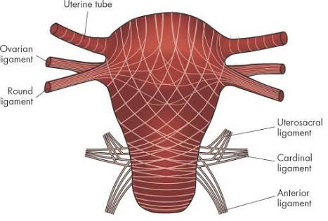

Slide 9
UTERINE SIZE,SHAPE AND POSITION
In early months the non pregnant pyriform shape
It becomes globular/spherical by 12 weeks.
As the uterus enlarges shape becomes pyriform by 28 weeks and changes to spherical beyond 36 weeks
As the uterus ascends it usually rotates to the right(DEXTROROTATION),and the cervix deviated to the left (LEVOROTATION) bringing it closer to the ureter

Slide 10
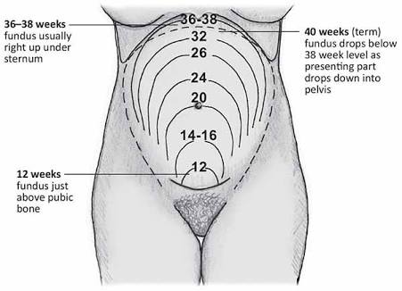

Slide 11
Normal anteverted uterus position is exaggerated upto 8 weeks
This enlarged uterus will lie on the bladder rendering it incapable of filling , and increase frequency of micturartion
With the pregnant women standing , the longitudinal axis of the uterus corresponds to the pelvic inlet axis . The abdominal wall supports the uterus.
With the pregnant women supine ,the uterus falls back to rest on the vertebral column and blood vessels

Slide 12
BRAXTON –HICKS
Uterine contractions in pregnancy
These are spontaneous
Can be excited by rubbing the uterus
These are felt on bimanual palpation of the uterus
Irregular, infrequent ,spasmodic , painless without any effect on dilation of the cervix
In abdominal pregnancy ,braxton hicks contractions are not felt.

Slide 13
UTEROPLACENTAL BLOOD FLOW
Total blood flow at term 450 -650 ml /min.
During contraction complete closure of uterine veins
Partial occlusion of arteries in the intervillous space resulting in stagnation of blood in the space.
This diminishes the placental perfusion causing fetal hypoxia.

Slide 14
UTEROPLACENTAL BLOOD FLOW REGULATION
Maternal placental blood flow increases during gestation by means of vasodilatation.
Uterine artery diameter doubled by 20 weeks.
Vasodilatation is due to estrogen stimulation which causes decrease in vascular resistance.
Other factors : PLGF, VEGF these lead to increase NOS activity and NO production. These factors are further decreased in response to the placental secretion of the soluble receptors SOLUBLE FMS-LIKE TYROSINE KINASE 1

Slide 15
Refractoriness to the pressor effects of infused angiotensin 2 and nor epineprine.
Relaxin
Potassium channels expressed in uterine vascular smooth muscles through several mediators.

Slide 16
CERVIX
As early as one month after conception the cervix begins to undergo softening and cyanosis
STROMA
-hypertrophy and hyperplasia of cervical glands
-Increased vascularity and edema
- Increased amount of connective tissue and less smooth muscle is necessary to maintain pregnancy to term , dilatation to aid delivery , and repair following parturition so that the successful pregnancy can be repeated.

Slide 17
Cervical glands undergo proliferation and by the end of pregnancy they occupy the one half of the entire cervical mass.
This represents an extension or EVERSION of proliferating columnar endocervical glands.
This tends to be red and velvety and bleeds even with minor trauma.

Slide 18
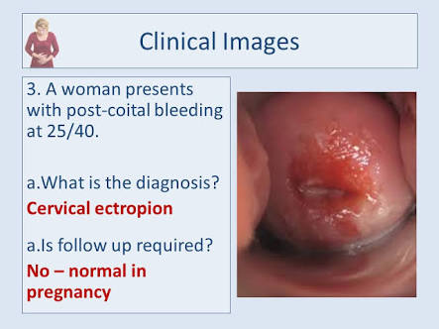

Slide 19
SECRETION
Copious and tenacious also called physiological leucorrhea of pregnancy due to the effect of progesterone.
Mucous fills up the cervical canal forming a seal .
At the onset of labor or before the mucous plug is expelled resulting in bloody show.
When the cervical mucus is spread on a slide crystallization – beading, fragmentation- ferning (result of amniotic fluid leakage)

Slide 20


Slide 21
During pregnancy basal cells near squamous columnar junction are prominent.
These changes are considered to be estrogen induced.
Pregnancy is associated with both endocervical gland hyperplasia and hypersecretory appearance- ARIAS –STELLA REACTION

Slide 22
OVARY
The growth and function of the corpus luteum reaches its max by 8th week and it measures 2.5cm and becomes cystic.
Regression occurs following the decline in secretion of BHCG from the placenta.
Colloidal degeneration occurs at the 12th week
Estrogen and progesterone secreted by the corpus luteum maintain the ovum before action taken over by the placenta.

Slide 23
DECIDUAL REACTION
An extra uterine reaction on and beneath the surface of the ovaries is common in pregnancy.
These elevated patches bleed easily, and resemble torn adhesions

Slide 24
BREASTS
In early pregnancy ,women experience breast tenderness and paresthesias
after the second month, breasts increase in size and delicate veins become visible just beneath the skin.
Nipples more deeply pigmented ,more erectile.
After few months ,a thick yellowish fluid -COLUSTRUM

Slide 25
Prominent , MONTGOMERY TUBERCLES seen in the primary areola
These hypertrophic sebaceous glands.
About the fifth month, a less deeply pigmented area forms around the primary areola know as secondary areola and on this tubercles, secondary montgomery follicles.

Slide 26
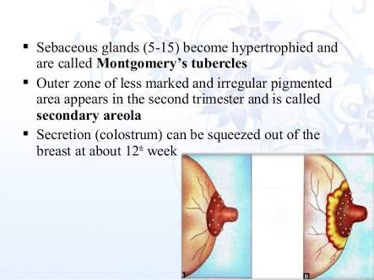

Slide 27
SKIN

Slide 28
ABDOMINAL WALL
STRIAE GRAVIDARUM/STRETCH MARKS reddish, slightly depressed streaks commonly develop in the abdominal skin and sometimes in skin of breast and thighs.
DIASTASIS RECTI: muscles of the abdominal wall do not withstand the tension to which they are subjected, as a result the rectus muscles separate in the midline.

Slide 29
HYPERPIGMENTATION
LINEA ALBA, midline of the anterior abdominal wall skin takes a dark brown pigmentation to form LINEA NIGRA
Irregular brownish patches appear on the face and neck, MELASMA GRAVIDARUM
Pigmentation of areolae and genital skin may also be accentuated.
It is due to MELANOCYTE STIMULATING HORMONE

Slide 30
VASCULAR CHANGES
ANGIOMAS/VASCULAR SPIDERS: common on the face, neck, upper chest and arms , these are minute red skin elevations with radicles branching out from the central lesion.
PALMAR ERYTHEMA

Slide 31
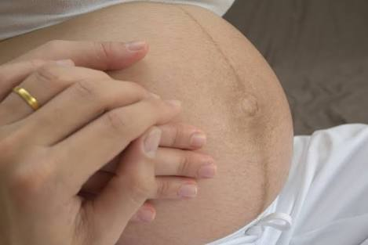

Slide 32
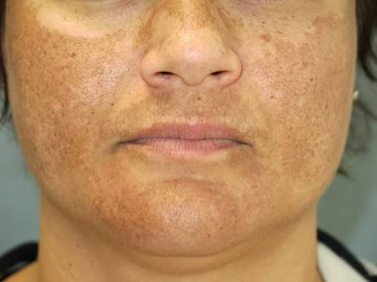

Slide 33
METABOLIC CHANGES

Slide 34
WHO ,estimates that the additional total pregnancy energy demands associated with normal pregnancy are approx 85kcal/day ,285kcal/day and 475kcal/day in first second and third trimester respectively
WEIGHT GAIN: total weight gain in pregnancy is approx 12.5kg
1KG FIRST TRIMESTER
5KG SECOND TRIMESTER
5KG THIRD TRIMESTER

Slide 35
Rapid weight gaiN
-more than o.5kg in a week or more than 2kg in a month :PRE ECLAMPSIA
STATIONERY OR FALLING WEIGHT
-suggests intrauterine death of fetus or growth retardation

Slide 36
Tissues and fluids | Weight gain(g)
Fetus | 3400
Placenta | 650
Amniotic fluid | 800
Uterus | 970
Breasts | 405
Blood | 1450
Ecf | 1480
Maternal fat stores | 3345
total | 12,500

Slide 37
WATER METABOLISM
Increased water retention is a normal physiological alteration in pregnancy
Fall in plasma osmolality by approx 10mOsm/kg(total 6.5L)
the
Source of water | Amount(L)
Fetus,placenta,amniotic fluid | 3.5
Increase in maternal blood volume,uterine size | 3
Increase in venous pressure due to partial occlusion of inferior vena cava | 1

Slide 38
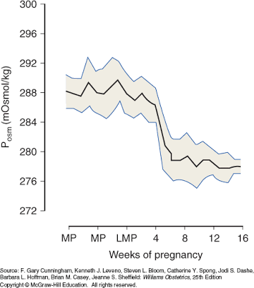

Slide 39
PROTEIN METABOLISM
Metabolism increases during pregnancy
Fetus and placenta contain approx 500g of protein
500g of protein is added to the uterus as contractile protein and to the maternal blood as hemoglobin and plasma proteins
Fetus has more concentration of amino acids than the maternal compartment, this increased concentration is regulated by the placenta

Slide 40
CARBHOHYDRATE METABOLISM
normal pregnancy is characterized by mild fasting hypoglycemia, postprandial hyperglycemia, and hyperinsulinemia
After an oral glucose load, the gravid women demonstrates prolonged hyperglycemia and hyperinsulinemia, because of peripheral resistance to insulin, because of this sustained postprandial supply of glucose to fetus is seen

Slide 41
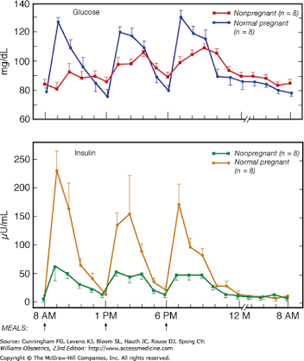

Slide 42
Insulin resistance is due to
-estrogen and progesterone
-placental lactogen: this promotes lipolysis, more release of free fatty acids which antagonises insulin action in the periphery and more glucose to fetus
Accelerated starvation: fasting blood sugar values is lower in pregnancy, this low levels of glucose and high levels of fatty acids in normal pregnant women represent accelerated starvation stage

Slide 43
HEMATOLOGICAL CHANGES

Slide 44
BLOOD VOLUME
The hypervolemic state in pregnancy is more commonly seen after 32 to 34 weeks.
Pregnancy induced hypervolemia has several important functions
-meets the metabolic demand of the enlarged uterus
-supplies nutrients and elements to support the rapidly growing placenta and fetus.
-protects the mother and fetus from the deleterious effects of impaired venous return in the supine and erect position
-protects the mother from the adverse effects of parturition associated blood loss

Slide 45
Blood volume expansion results from an increase in both plasma and erythrocytes
Increase in erythrocyte volume is 450ml
Erythroid hyperplasia in bone marrow is seen
Reticulocyte count is elevated
This occurs under the influence of erythropoietin levels

Slide 46
Hemoglobin concentration and hematocrit decrease slightly during pregnancy
So the blood viscosity decreases
advantages of decreased blood viscosity
optimum gas exchange between maternal and fetal circulation
Protects women against adverse effects of supine posture
Protects mother from the blood loss during pregnancy
HB concentration at term is 12g/dl and in 5% of women it is below 11g/dl
So HB below 11g/dl should be considered abnormal

Slide 47
PHYSIOLOGICAL ANEMIA
Disproportionate increase in plasma and RBC volume produces a state of hemodilution (fall in hematocrit) during pregnancy.
Thus even though the total hemoglobin mass increases during pregnancy to an extent of 18-20% ,there is an apparent fall in Hb concentration.
At term , the fall is 2g% from the non pregnant value.

Slide 48
parameters | Non pregnant | Pregnancy near term | change
Blood volume (ml) | 4000 | 5500 | +30-40%
Plasma volume(ml) | 2500 | 3750 | +40-50%
Red cell volume (ml | 1400 | 1750 | +20-30%
Total HB (g) | 475 | 560 | +18-20%
Hematocrit (whole blood) | 38% | 32%

Slide 49
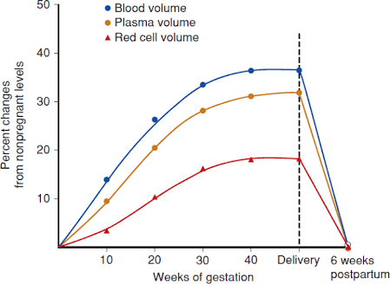

Slide 50
IRON METABOLISM
1000 mg of iron is needed in normal pregnancy 300mg actively transferred to fetus and placenta 200mg lost through excretion routes(GI)
The increase in erythrocyte vol is 450 ml which requires another 500mg(each 1ml of erythrocyte contains 1.1mg of iron)
In the later half of pregnancy max iron is used , so the requirement of iron increases to 6-7mg/day

Slide 51
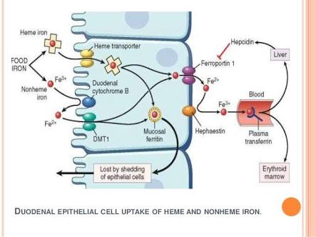
IRON METABOLISM

Slide 52
Thus without supplemental iron the optimal increase in maternal erythrocyte volume will not develop and the hemoglobin and hematocrit values will drop
Serum iron values begin to drop after the 24th week with an increase in total iron binding capacity.

Slide 53
DURING PUERPERIUM
-during a vaginal delivery and first postpartum days only half of the added erythrocytes are lost
-500 -600 ml of blood is lost with vaginal delivery of single fetus
-1000ml of blood is lost with cesaren delivery or vaginal delivery with twins

Slide 54
IMMUNOLOGICAL FUNCTIONS

Slide 55
Pregnancy is associated with suppression of humoral and cell mediated immunological functions.
There is suppression of T HELPER 1 cells and CYTOTOXIC T CELLS which in turn decreases secretion of interleukin 2,inteferon gamma and tumor necrosis factor beta
Helper t cells suppression is needed for the continuation of pregnancy and to prevent preg associated autoimmune disorders :RA MS HT.Also needed to prevent pre eclampsia

Slide 56
With suppression of T helper cells there is up regulation of helper 2 cells to increase secretion of IL 4,6,13
In cervical mucus , immunoglobulin's A and G peak levels of are significantly higher in pregnancy

Slide 57
Leukocyte count are increased upto 15,000/ul
during pregnancy
-during labour and early puerperium values are elevated reaching upto 25,000/ul

Slide 58
INFLAMMATORY MARKERS
-LEUKOCYTE ALKALINE PHOSPHATSE: are used to evaluate myeloproliferative disorders and increased early in pregnancy .
-C REACTIVE PROTEIN : tissue trauma and inflammation
-ESR: elevated in normal pregnancy due to plasma globulins and fibrinogens

Slide 59
Complement factors C3 and C4 are elevated during second and third trimester
Procalcitonin increase in the third trimester and few days postpartum
-values are high in severe bacterial infections but remain low in viral infections
-concluded a threshold 0f 0.25ug/l can be used during the third trimester .

Slide 60
COAGULATION AND FIBRINOLYSIS
-FIBRINOGEN LEVELS: in a normal pregnancy increases by 50%.In a non pregnant women it is 260mg/dl ,in pregnancy at term it ranges between 288mg/dl-576mg/dl
CLOTTING FACTORTS: all factors increase except 11 and 13 increase in pregnancy.
PLATELETS :levels decrease(from 2,50,00u/l to 2,13,000u/l)
CLOTTING TIME AND BLEEDING TIME: are unchanged

Slide 61
The end product of coagulation cascade is fibrin formation ,and the main function of the fibrinolytic system is to remove excess fibrin.
Tissue plasminogen activator(tPA) converts plasminogen to plasmin ,which causes fibrinolysis and produces fibrin-degradation such as D-dimers.
Fibrinolytic activity is actually reduced during pregnancy

Slide 62
tPA activity is reduced
Plasminogen activator inhibitor type 1 and type 2 are increased in pregnancy.
So fibrinolytic activity reduced.

Slide 63
REGULATORY PROTEINS
-protein c s and antithrombin ,natural inhibitors of coagulation, deficiencies of these called THROMBOPHILIAS account for thromboembolic episodes in pregnancy.
Protein C decrease from 2.4 to 1.9u/ml and free S decrease from 0.4 to 0.16 u/ml
Oral contraceptives decrease free protein S
Levels of antithrombin remain constant.

Slide 64
CARDIOVASCULAR SYSTEM

Slide 65
Cardiac changes begin in the first 8 weeks of pregnancy
Cardiac output is increased as early as the 5th week
Pulse rate increases by 10beats/min
Between 10 and 20 weeks plasma vol expansion begins ,so preload increases.

Slide 66
HEART SOUNDS
First heart sound: loud , split
Second heart sound: no change
Third heart sound :due to rapid ventricular filling during the diastole
Systolic ejection murmurs :due to increased blood flow through great vessels
Soft diastolic murmur
Continuous murmur from the breast tissue
All murmurs increase intensity on inspiration

Slide 67
HEART
Diaphragm elevated
The heart is displaced to the left and upward ,rotated on the long axis and apex beat is shifted to the fourth intercostal space and outwards to the left by 3cm in all trimesters
Cardiothoracic diameter is increased
Cardiac volume shows an increase of 75ml

Slide 68
CARDIAC OUTPUT
In pregnancy ,mean arterial pressure and vascular resistance decrease, while blood volume and basal metabolic rate increase.
Cardiac output=stroke vol*HR
Normal cardiac output:4-8L/min
Starts to increase from the 5th week of pregnancy reaches a peak about 30-40 weeks then the output remains static till term
The co returns to normal 1 week after delivery

Slide 69
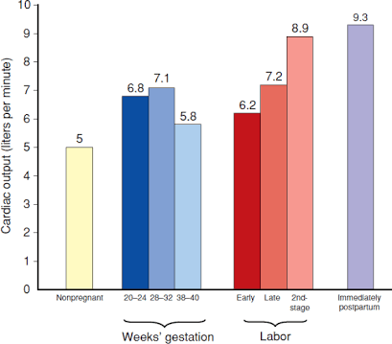

Slide 70
SUPINE HYPOTENSION SYNDROME
-when the patient is in supine position ,the enlarged gravid uterus presses on the inferior vena cava which reduces the venous return to the heart and decreases cardiac output and this cause hypotension.
This can be avoided if patient lies in left lateral position

Slide 71
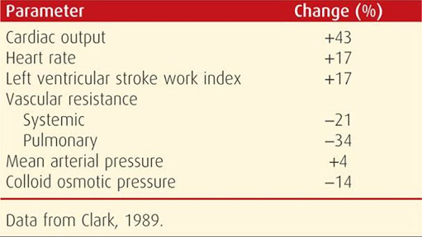

Slide 72
BLOOD PRESSURE
It normally varies 110mmhg and 120 mmhg systolic and between 75mmhg and 85mmhg diastolic
Arterial pressure decreases to a nadir at 24 to 26 weeks and rises thereafter
Diastolic decreases more than systolic
Venous pressure in the veins of the arm is not altered but pressure in femoral and other leg veins are high

Slide 73
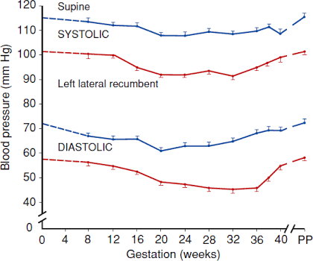

Slide 74
Varicose veins tend to develop in the lower half of the body in pregnant women
The usual sites are legs ,vulva ,rectum , anus and vagina in order.
CAUSES:
-increase in intra abdominal pressure
-obstruction to common iliac veins owing to rush of blood from enlarged hypogastric plexus
-increase in total amount of blood and consequent enlargement of veins to accommodate this increase
-heredity

Slide 75
GASTROINTESTINAL TRACT

Slide 76
PREGNANCY GINGIVITS :during pregnancy gums become hperemic , soft and bleed with mild trauma as with tooth brush
EPULIS GRAVIDARUM:a focal high vascular swelling of the gum ,it is a pyogenic granuloma
As the uterus enlarges the stomach and intestines are displaced .eg: the appendix is displaced more upward and laterally

Slide 77
PYROSIS(HEART BURN):common in pregnancy due to reflux of acid secretions into lower esophageal sphincter
-intra esophageal pressure is low
-intra gastric pressure is high
-lower esophageal sphincter tone is lowered
-esophageal peristalisis Is lowered

Slide 78
B GASRTIC EMPTYING TIME
during labor the time is prolonged. As a result ,one danger of general anesthesia for delivery is regurgitation and aspiration of food and highly acidic contents.
C HEMORRHOIDS
caused by constipation and elevated pressure in veins below the level of enlarged uterus

Slide 79
LIVER
Hepatic arterial and portal venous blood flow are increased
Total alkaline phosphatase levels are increased
AST ALT GGT and bilirubin levels remain unchanged
Serum albumin levels are lowered, but towards the end of the pregnancy the values may be 3g/dl compared to approx 4.3g/dl in non pregnant women
Serum globulin levels are high
Albumin globulin ratio from 1.7:1 to 1:1

Slide 80
5.Leucine aminopeptidase is a proteolytic liver enzyme whose levels are increased with liver disease . its activity is markedly elevated in pregnant women.
GALLBLADDER
-gallbladder contractility reduced leads to stasis of bile
-this occurs due to progesterone which inhibits CCK
-impaired emptying, subsequent stasis and increased bile cholesterol saturation of pregnancy leads to CHOLESTEROL GALLSTONES

Slide 81
Stasis of bile leads to PRURITIS GRAVIDARUM
INTRAHEPATIC CHOLESTASIS has been linked to high levels of estrogen which inhibit the intraductal bile acid transport

Slide 82
Alkaline phosphatase (u/l) | Non pregnant adult | 1st trimester | 2ndtrimrster | 3rd trimester
 | 33-96 | 17-88 | 25-126 | 38-229

Slide 83
URINARY SYSTEM

Slide 84
KIDNEY
-kidney size increase approx to 1.5cm
-dilatation of the renal calyces and ureters is seen due to the progesterone effect before 14 weeks.
-marked dilation being apparent in mid pregnancy because of ureteral compression
-vesicoureteral reflux is seen during pregnancy

Slide 85
GFR and renal plasma flow increase In early pregnancy
-GFR increases as much as 25% by the second week after conception and 50% by the beginning of the second trimester
-this hyperfilteration occurs because of two reasons:

Slide 86
1.hypervolemia induced hemodilution lowers protein concentration and hence lowers the oncotic pressure of plasma entering the glomerular filtration
2.renal plasma flow increases by approx 80 % by the end of the first trimester.
GFR remains elevated till term even though the renal plasma flow decreases during late pregnancy ,therefore 60% of the women report urinary frequency during pregnancy

Slide 87
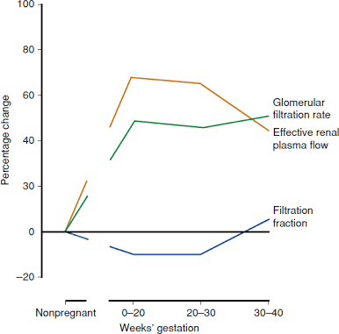

Slide 88
-RELAXIN
-increases the endothelin and nitric oxide production in the renal circulation
Renal vasodilatation and decreased renal afferent and efferent arteriolar resistance
Which leads to increase in renal blood flow and GFR
Relaxin causes increase in vascular gelatinase activity during pregnancy

Slide 89
RENAL FUNCTION TEST
-serum creatinine levels decrease during the normal pregnancy from 0.7 mg/dl to 0.5 mg/dl
Values of more than 0.9mg/dl or greater should suspect renal disease and prompt further evaluation
This test is useful to estimate the renal function , provided that complete urine collection is made

Slide 90
During the day, pregnant women tend to accumulate water as dependent edema and at night while recumbent, they mobilize this fluid causing diuresis and the urine is more dilute.

Slide 91
URINANALYSIS
GLYCOSURIA is more common in pregnancy but is not necessarily pathologic. It is due to increase in GFR without an increase in the tubular reabsorption of the filtered glucose.
The proximal tubule can reabsorb only limited amount of glucose (375mg/min).When the blood glucose levels raise to 160-180mg/dl the proximal tubule of the kidneys begin to extract glucose from the blood and excrete in the urine causing glycosuria.

Slide 92
HEMATURIA is often due to contamination during collection. If not , it mostly suggests urinary tract disease.
-it is more common after difficult labor due to trauma to bladder and urethra

Slide 93
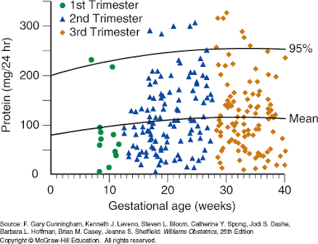
PROTEINURIA
Nonpregnant:>150mg/d
Preg :>300mg/day
Importance
-PRE ECLAMPSIA
1.greater than or equal to 300mg per 24hrs urine collection sample
2.protein/creatinine ratio greater than 0.3
3.dipstick reading of 1+

Slide 94
URETERS
After ureters out of the pelvis, it compresses them at the pelvic brim
This leads to ureteral dilation more on the RIGHT side, as the left ureter is protected by the sigmoid
RIGHT OVARION COMPLEX lies obliquely over the right ureter and contribute to the ureteral dilation
Along with the distension are the elongation kinking and outward displacement of the ureters

Slide 95
BLADDER
-from the fourth month , the bladder shows hyperplasia of its muscle and connective tissue and the trigone of the bladder is elevated
In primi, the bladder pressure increased from 8cm of h20 early in pregnancy to 20 cm at term
To compensate for the reduced bladder capacity the absolute and functional urethral lengths increased by 6.7 and 4.8mm respectively

Slide 96
At the same time ,max urethral pressure increased from 70 to 90 cm of h20 and continence is maintained
But in the third trimester some women experience incontinence and should be considered as the differential diagnosis of ruptured of memebranes.
Toward the end pregnancy ,particularly in nulliparous the presenting part often engages before labor ,the entire base of the bladder is pushed forward and upward converting normal convex to concave

Slide 97
As a result difficulties in diagnostic and therapeutic procedures are increased.
Pressure from the presenting part impairs blood and lymph drainage from the bladder base, often making the area edematous ,easily traumatized and more prone to infection

Slide 98
RESPIRATORY SYSTEM

Slide 99
The lower ribs flare up
Subcostal angle increases from 68 degrees in early pregnancy to 103 degrees at term
The level of diaphragm is raised by 4cm
Transverse diameter of the chest increases by about 2cm

Slide 100
LUNG VOLUMES(changes observed by the 6th month with a progressive decline across pregnancy)
FUNCTIONAL RESIDUAL CAPACITY
-ERV | Decreases by 200-300ml
-RESIDUAL VOLUME | Decreases by 200-400ml
INSPIRATORY CAPACITY | Increases by 200-250ml
TOTAL LUNG CAPACITY | Remains unchanged

Slide 101
tidal volume increase from 0.66 to 0.8l/min
Resting minute ventilation from 10.7 to 14.1l/min
Main cause of the increase is the effect of progesterone and low expiratory reserve volume
Peak epiratory flow rate is increased as gestation advances
Lung compliance unaffected
Total pulmonary resistance reduced

Slide 102
There is increased awareness of desire to breathe even in early pregnancy. The physiological dsypnea is due to increased tidal volume and fall in blood pco2
Which is due to central effect of progesterone on the respiratory centre
Pulmonary arterial pressure is not increased, so to accommodate the augmented flow there is vasodilataion which causes increase vascular markings in lung fields

Slide 103
ENDOCRINE SYSTEM

Slide 104
PITUITARY GLAND
during a normal pregnancy the pituitary enlarges to 135 percent.
The increase size compress the optic chiasma to reduce visual fields, but impaired vision is rare.
The cause for the increase size of the pituitary is ESTROGEN STIMULATED HYPERTROPHY OF LACTOTROPHS.

Slide 105
Gonadotrophs decrease in number
Corticotrophs and thyrotrophs remain constant
Somatotrophs suppressed due to negative feedback by placental production of growth hormone
in post partum, the pituitary size may reach 12mm on MR imaging, but the gland involutes rapidly and comes to normal by 6 months post partum.

Slide 106
the incidence of pitutary prolactinoma is more in pregnancy it’s a macroadenoma that is >10mm,the growth during pregnancy is more likely
SHEEHAN SYNDROME: is called postpartum pituitary gland necrosis caused due to ischemia due to blood loss and hypovolemic shock during and after childbirth

Slide 107
MELANOCYTE STIMULATING HORMONE
Skin changes in pregnancy
E g :- increased pigmentation of areola of the nipple
-darkening of the linea alba
- mask like pigmentation of face(cholasma)

Slide 108
PITUITARY HORMONES
GONADOTROPINS
Both maternal FSH and LH are reduced in pregnancy
So no further ovulation occurs
ADRENOCORTICOTROPHIC HORMONES
Levels increased

Slide 109
GROWTH HORMONE
In the first trimester, GH is produced from the pituitary gland and concentration are within non pregnant values:0.5-7.5ng/ml
At 8 weeks of gestation, GH from the placenta
becomes dectable and by 17 weeks the function is taken over by the placenta
Maternal serum values start increasing from approx 3.5ng/ml at 10 weeks and plateaus at 28weeks at approx 14ng/ml

Slide 110
Placental GH is a major determinant of maternal insulin resistance after mid pregnancy.
This hormone regulates the fetal growth

Slide 111
CAUSES OF INCREASED PROLACTIN
-estrogen acts on the ant pituitary lactotrophs and increase the release of prolactin
-TSH
-serotonin
DOPAMINE inhibits the secretion of prolactin

Slide 112
PROLACTIN
Maternal plasma prolactin levels increase during pregnancy , and at TERM it is about 150ng/ml
After delivery the levels fall ,however there are pulsatile bursts during lactation

Slide 113
FUNCTIONS OF PROLACTIN
-lactation
-initiate DNA synthesis and mitosis of glandular cells and alveolar cells of the breast
-increase the estrogen and prolactin receptors in these cells
-initiate RNA synthesis ,galactopoiesis production of caesin ,lactoalbumin , lactose and lipids

Slide 114
PROLACTIN in amniotic fluid are at peaks of 10,000ng/ml at 20-26 weeks of gestation then the levels fall and then reach a peak after 34 weeks.
This prolactin comes from the uterine decidua
Importance: impairs water transfer from the fetus into maternal compartment thus preventing dehydration

Slide 115
OXYTOCIN AND ANTIDIURETIC HORMONE
-oxytocin stimulates uterine contractions and produces milk ejection during lactation
-at term the uterus responds strongly to oxytocin
-ADH :there is increase of ADH in pregnancy
-deficiency causes DIABETES INSIPIDUS

Slide 116
THYROID GLANDS
Anatomically, the thyroid glands undergoes moderate enlargement during pregnancy caused by glandular hyperplasia and increased vascularity.
Thyroid volume :increases from 12ml in first trimester to 15ml at delivery
This enlargement is not pathological, but normal pregnancy does not cause thyromegaly, hence any goiter must be ruled out.

Slide 117
Values earlier,
According to the recent ACOG guidelines 2017 the upper limit of thyroid function in pregnancy is raised to 4.0
stage | Normal TSH level
First trimester | Less than 2.5mIU/L
Second trimester | Less than 3mIU/L
Third trimester | Less than 3mIU/L

Slide 118
Thyrotropin releasing hormone(trh) is secreted by the hypothalamus ,stimulate the thyrotrope cells of anterior pituitary to release the TSH/thyrotropin
TRH levels are not increased during pregnancy but, this crosses the placenta to stimulate the fetal pituitary to secrete the thyrotropin

Slide 119
TSH and BHCG are glycoprotein's where the alpha subunit are identical but beta subunit differs in the amino acid sequence
Cause of the structural similarity HCG has a thyrotrophic activity and high HCG levels causes thyroid stimulation.

Slide 120
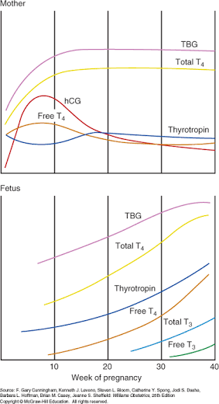

Slide 121
Iodine intake increases in a normal pregnancy.
In women with less intake leads to decrease in thyroxine and increase in TSH.
For the fetus, early exposure to thyroid hormones is essential for development of the nervous system
Severe deficiency leads to CRETINISM

Slide 122
SUBCLINICAL HYPOTHYROIDISM: when TSH levels are either above or below the normal range , but the circulating thyroid hormones(free t3 and t4) are normal

Slide 123
PARATHYROID GLANDS
PARATHYROID HORMONE
Decrease in plasma calcium or magnesium stimulate PTH which increases the calcium and decrease the phosphate levels
For the fetus mineralization 30g of calcium is needed especially in the third trimester.
The excess calcium is obtained by increased maternal calcium absorption

Slide 124
during normal pregnancy(1st trimester) PTH levels are less
This stimulates for 1,25 dihydroxyvutamin D in the mother which increases the calcium absorption

Slide 125
CALCITONIN
Pregnancy and lactation are states of calcium stress.
During these times calcitonin levels are high
Produced by the C cells of the parafollicular areas of the thyroid gland
-calcium
-magnesium
-gastrin pentagastrin glucagon
All increase the calcitonin levels

Slide 126
ADRENAL GLANDS
ALDOSTERONE
By 15 weeks the maternal adrenal glands secrete aldosterone(mineralocorticoid)
By the third trimester approx 1mg/day is secreted
If sodium is restricted ,aldosterone secretion elevated even further ,renin and angiotensin 2 levels are elevated
This acts on the zona glomerulosa of the maternal adrenals which increases the aldosterone secretion

Slide 127
Importance:
- protects from the natriuretic effect of the progesterone and atrial natriuretic peptide
-modulating trophoblast growth and placental size

Slide 128
DEOXYCORTICOSTERONE
-mineralocorticosteroid which progressively increases in pregnancy
-at term 1500pg/ml
-this increase is due to increased kidney production resulting from estrogen stimulation

Slide 129
ANDROGENS
Maternal levels of both androstenedione and testosterone are increased during pregnancy
Both are converted to estradiol in placenta which increases their clearance so nothing reaches the fetus.
Increase in sex hormone binding globulin in pregnant women retards the testosterone clearance.
Maternal serum and urine levels of dehydroepiandrosterone sulfate decreased in pregnancy due to increase metabolic clearnace(metabolic beta hydroxylation) and placental conversion to estrogen

Slide 130
MUSCULOSKELETAL SYSTEM

Slide 131
Vascularity of the pelvis is increased
Pelvic ligaments become lax due to hormones.
Mobilty increases at the sacrococcygeal join,sacroiliac and the pubic bones.
Women complain of pain over the joint, difficulty in walking and discomfort in the lower portion of back

Slide 132
Increased protuberence of abdomen
Center of gravity falls anterioly
Compensatory lordosis
Rotation of the femur
This leads to anterior flexion of neck and slumping of shoulder girdle
This causes traction of on the ulnar and median nerves
Leading to numbness and pain in upper extremity
Joint strengthening begins immediately following delivery and is completed within 3-5 months.

Slide 133
CENTRAL NERVOUS SYSTEM

Slide 134
MEMORY
Women often report problems with attention, concentration and memory .
The memory decline was common in the third trimester
On MRI, the blood flow in the middle and posterior cerebral arteries decreased from 147 and 56ml/min to 118ml/min and 44ml/min in late pregnancy

Slide 135
EYES
Intraocular pressure decreases due to increase in vitreous outflow
Corneal sensitivity decreased
Corneal thickness increased due to edema
Brown opacities on the posterior surface of the cornea is seen: KRUKENBERG SPINDLES
Trasnsient loss of accomodation is seen

Slide 136
SLEEP
12weeks of gestation and extending through the first two months of postpartum
Difficulty in going to sleep , frequent awakenings, fewer hours of night sleep,
Post partum blues or post partum depression
Melancholia( depression , loss of interest in everything) and real psychosis develop.

