Slide 1
PLACENTA

Slide 2
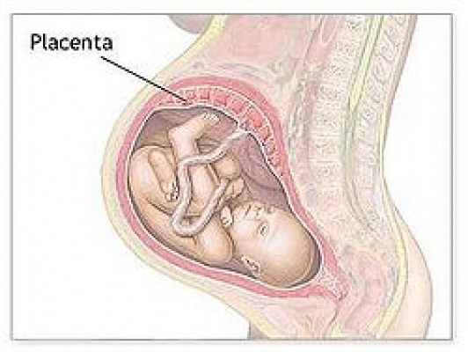
This is a fetomaternal organ.
Placenta is a discoid, chorio-deciduate organ which connects the fetus with the uterine wall of the mother.

Slide 3
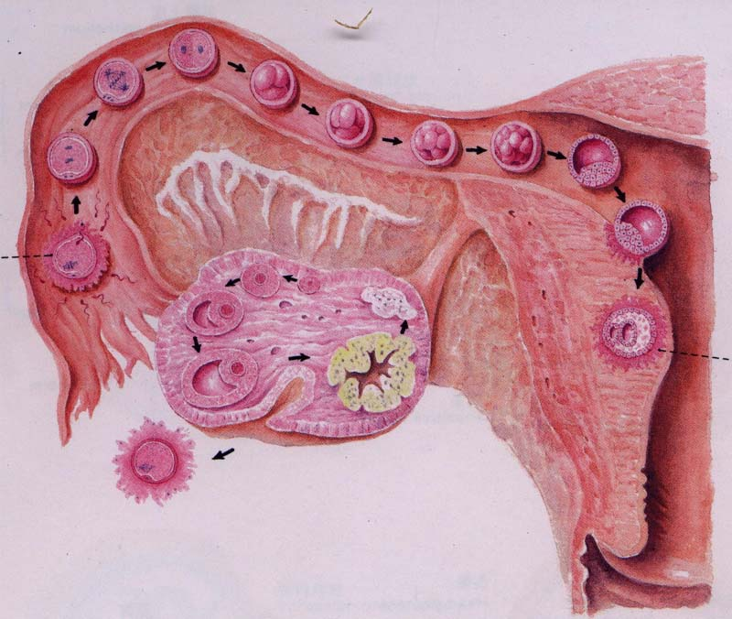

IMPLANTATION
Morula
16-cell stage
The third day
The process by which the blastocyst settles into endometrium.
6th day to 11th day
By the time the fertilized ovum reaches the uterus, it has already become a morula, still surrounded by the zona pellucida

Slide 4
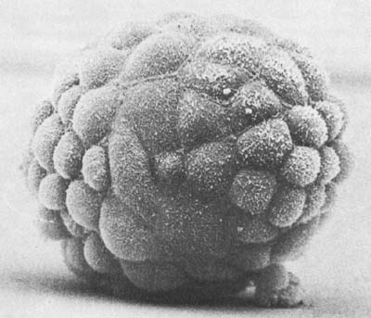
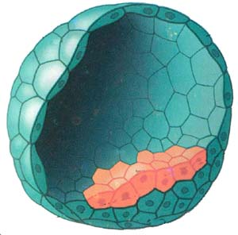
Appearance and inner structure of blastocyst
Appearance
Inner structure
Cells lining the surface of the morula constitute the trophoblast. Once the zona pellucida disappears , the trophoblast has the property of attaching/invading itself to the any tissue it comes in contact with.
The blastocyst burrows deeper and deeper into the uterine mucosa till the whole of it comes to lie within the thickness of the endometrium.

Slide 5
DECIDUA
Endometrium implantation Decidua
DECIDUAL REACTION:
After implantation, the features of the secretory phase of endometrium are maintained and intensified.
The stromal cells enlarge, become vaculated, and store glycogen and lipids

Slide 6
The decidua is divided into three parts according to the association with the embryo:
Decidua Basalis: where the placenta is to be formed
Decidua Capsularis: seperates the embryo from the uterine lumen
Decidua Parietalis: part lining the rest of the uterine cavity

Slide 7
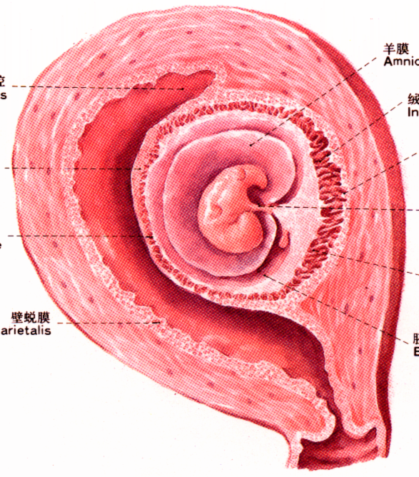
Decidua capsulris
Decidua basalis
Decidua paritalis

Slide 8
CHORIONIC VILLI
Functional elements of the placenta.
Small finger like processes formed as offshoots from the surface of the trophoblast.

Slide 9
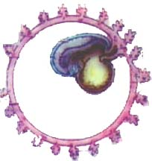
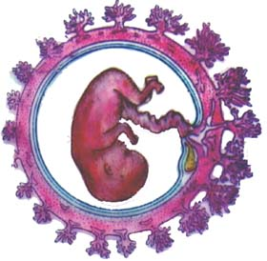
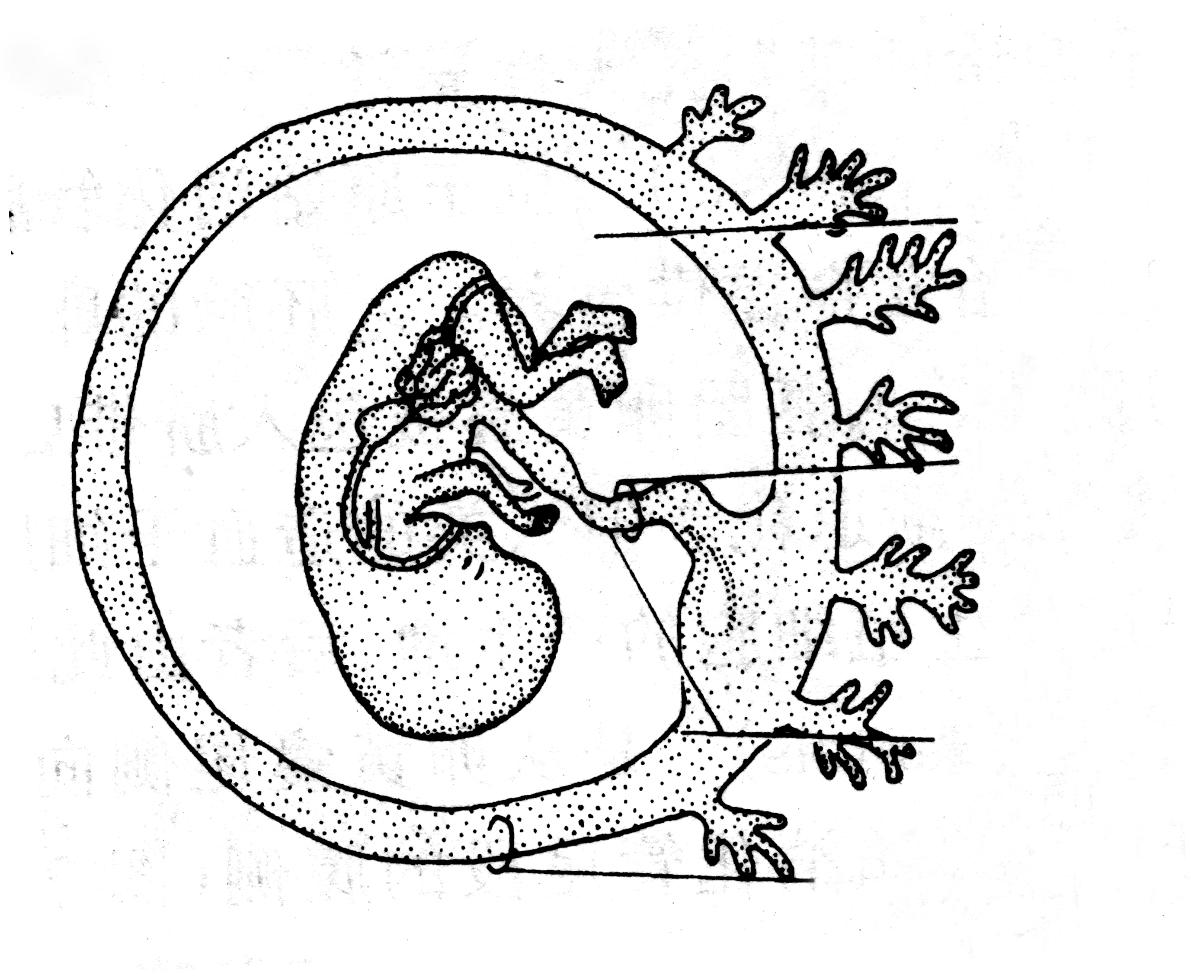
The chorionic villi are first formed all
over the trophoblast and grow into the
surrounding decidua.
Villi related to the decidua capsularis
are transitory and degenerate. This part
of chorion become smooth and is
called CHORION LAEVAE.
Villi related to the decidua basalis undergo
considerable development. Along with the
tissues of decidua basalis these villi form a
disc shaped mass called Placenta. This part of
chorion that forms the placenta is called
CHORION FRONDOSUM.

Slide 10
The trophoblast is made up of single layer of cells. As these cells multiply, 2distinct layers are formed.
SYNCYTIOTROPHOBLAST:
Cells that are nearest to the decidua lose their boundaries, thus continuous sheet of cytoplasm containing many nuclei is formed.
CYTOTROPHOBLAST:
Deep to the syncytium, cells of the trophoblast retain their cell walls and form cytotrophoblast which rests on extra embryonic mesoderm.

Slide 11
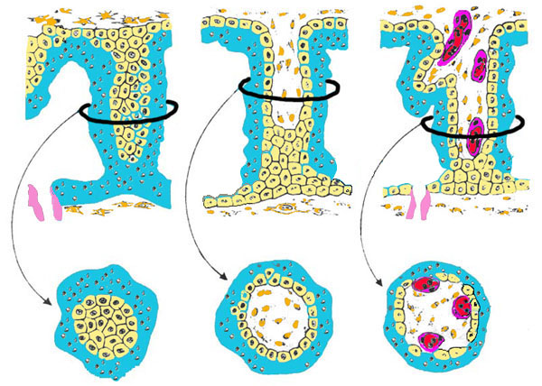
CHORIONIC VILLI
primary villus: central core of cytotrophoblast covered by layer of syncytiotrophoblast
Secondary villus: extra embryonic mesoderm covered successively by cyto-and syncytiotrophoblasts.
Tertiary villus : fetal blood vessels which are surrounded successively from within outwards by primary mesoderm, cyto and syncytiotrophoblasts.

Slide 12
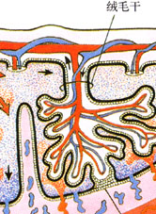
Villi are attached on the fetal side to the embryonic mesoderm and on the maternal side to the cytotrophoblastic shell. They are called anchoring villi.
Each anchoring villus consists of a stem-TRUNCUS CHORII, this divides into number of branches-RAMI CHORII, which inturn divide into finer branches-RAMULI CHORII

Slide 13
Further development of Placenta
Placenta becomes subdivided into number of lobes by septa that grow into the intervillous space from the maternal side. Each such lobe is called MATERNAL COTYLEDON.
The number of lobes varies 15-20.
Each maternal cotyledon contains number of anchoring villi and their branches. Each such villus and its branches constitute a FETAL COTYLEDON.
Fully formed placenta has 60-100 fetal cotyledons

Slide 14
Full term placenta presents the following measurements:
Diameter - 15 to 20 cm.
Thickness - 3cm.(at the center).
Weight - 500-600gms.
Surface area – 4-14 square meters

Slide 15
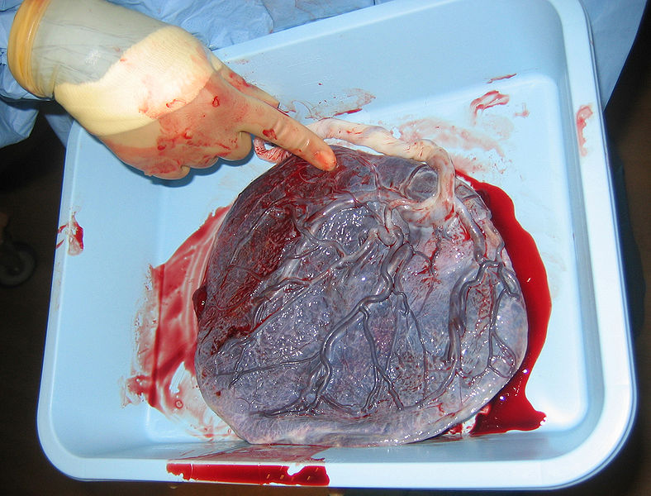
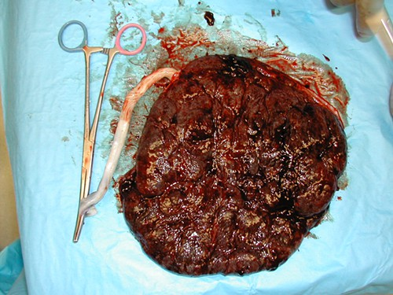
2 Surfaces
Maternal surface: rough, irregular, and is mapped out into 15-20 polygonal areas known as the cotyledons which are limited by fissures. Each fissure is occupied by a placental septum.
Fetal surface: smooth, covered by amnion and presents the attachment of the umbilical cord close to its center. Beneath the amnion umbilical vessels radiate from the cord.

Slide 16
Peripheral margin is continuous with the fetal membrane which consists from outside inwards of fused decidua parietalis and capsularis, chorion laeve and amnion.
Attachment: upper part of the uterus encroaching the fundus adjacent to the anterior or posterior wall

Slide 17
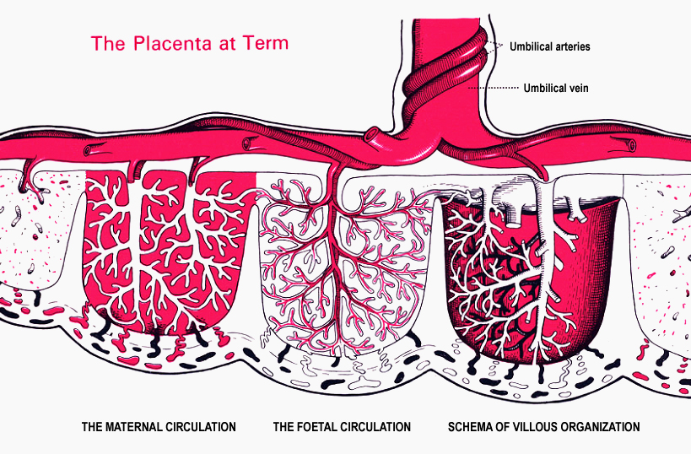
Maternal part: is decidua basalis that usually forms a compact layer known as the basal plate
protrudes between individual cotyledons as placental septa
Placental circulation
Fetoplacental circulation: Deoxygenated blood leaves the fetus and passes through the 2 umbilical arteries to the placenta, arteries branch and ultimately give rise to capillaries of chorionic villi, oxygenated fetal blood returns to the fetus through the one umbilical vein

Slide 18
Maternal-placental circulation: 80 to 100 spiral arteries ( branches of the uterine artery) open in the middle of the placenta; blood flows into the intervillous space and passes over villus surfaces toward the chorionic plate;
the maternal blood leaves the intervillous space through the endometrial veins (located near the periphery of the placenta)

Slide 19
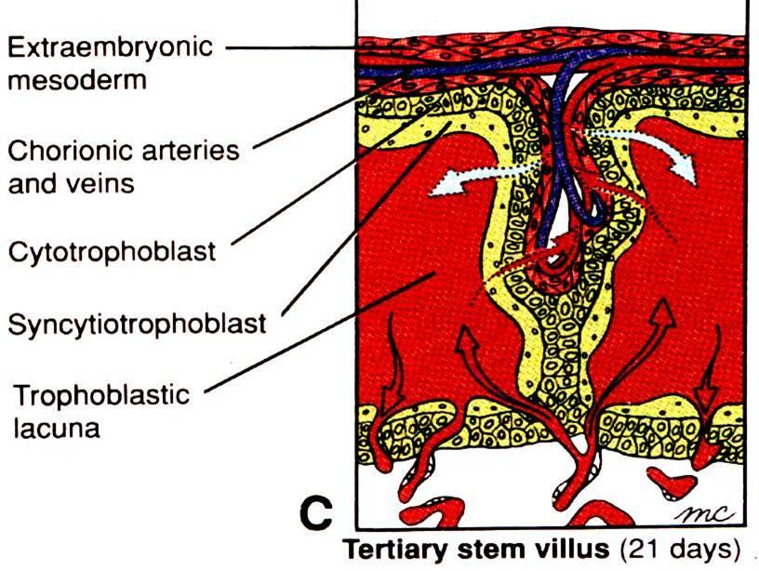
Placental membrane/Barrier:
Structure that constitute the placental barrier are:
①Syncytiotrophoblast
②Cytotrophoblast and its basal lamina
③Connective tissue
④Endothelium of fetal blood vessels and its basal
lamina

Slide 20
Functions of Placenta
1. Substance exchange
Respiratory, Excretory, Nutritive
Capillary of fetus | Blood of mother
 | Ｏ₂
 | Nutrients
Water,salt,others | water,salt,others
ＣＯ₂
Metabolic waste
Placenta membrane

Slide 21

2. Barrier function:
Placenta acts as a barrier and prevents many bacteria & harmful substances reaching the fetus
Capillary of fetus | Blood of mother
 | s
Most of microorganism
No way！
Placenta barrier

Slide 22

2. Barrier function:
However drugs taken by the mother, viruses- poliomyelitis, measles, rubella may enter fetal circulation leading to congenital malformations.
Capillary of fetus | Blood of mother
 | Most of drugs
Most of microorganism
Some of
microorganism
Placenta barrier

Slide 23
3.Endocrine function:
Hormone | Function | Appearance | peak
HCG | Corpus luteum Pregnancy | 3rd week | 8th week
HCS | Mammary gland | 2nd month | 8th month
HPE | Corpus luteum | 4th month | 8th month
HPP | Corpus luteum | 4th month | 8th month

Slide 24
4.Immunological function:
Maternal antibodies IgG, gamma globulins reaching the fetus through the placenta gives the fetus immunity against infections

Slide 25
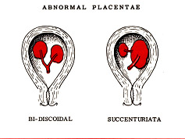
Abnormalities of the placenta
Abnomalities in the size and shape:
Placenta succenturiata -a placenta with one main lobe and one or two small accessory lobes
Placenta duplex, triplex or multiplex - a placenta that is divided in two, three or more completely separate lobes

Slide 26
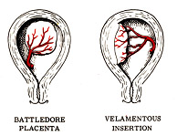
Battledore placenta (marginal insertion - insertio marginalis) - the umbilical cord is attached to the margin of the placenta
Velamentous placenta (insertio velamentosa) - the umbical cord is not attached to the placenta but to the amniochorionic sac (such placenta is hazardous to the fetus because vessels may be compressed during pregnancy or ruptured during the course of labor

Slide 27
placenta fenestrata - a placenta with openings in the chorionic plate and absence of chorionic villi in sites of openings
very small placenta - is found in women suffering from chronic hypertension
very large placenta – is found in fetal hydrops
placenta membranous - extremely thin placenta, the chorionic villi persist on the smooth chorion, which takes part in formation of the placenta.

Slide 28
Circumvallate placenta: peripheral edge of the placenta is covered by a circular fold of decidua
placenta bipartita or tripartita - a placenta with two or three incomplete lobes (after delivery, one or two lobes may be retained in the uterus and may cause postpartum uterine hemorrhage or uterine infection)

Slide 29
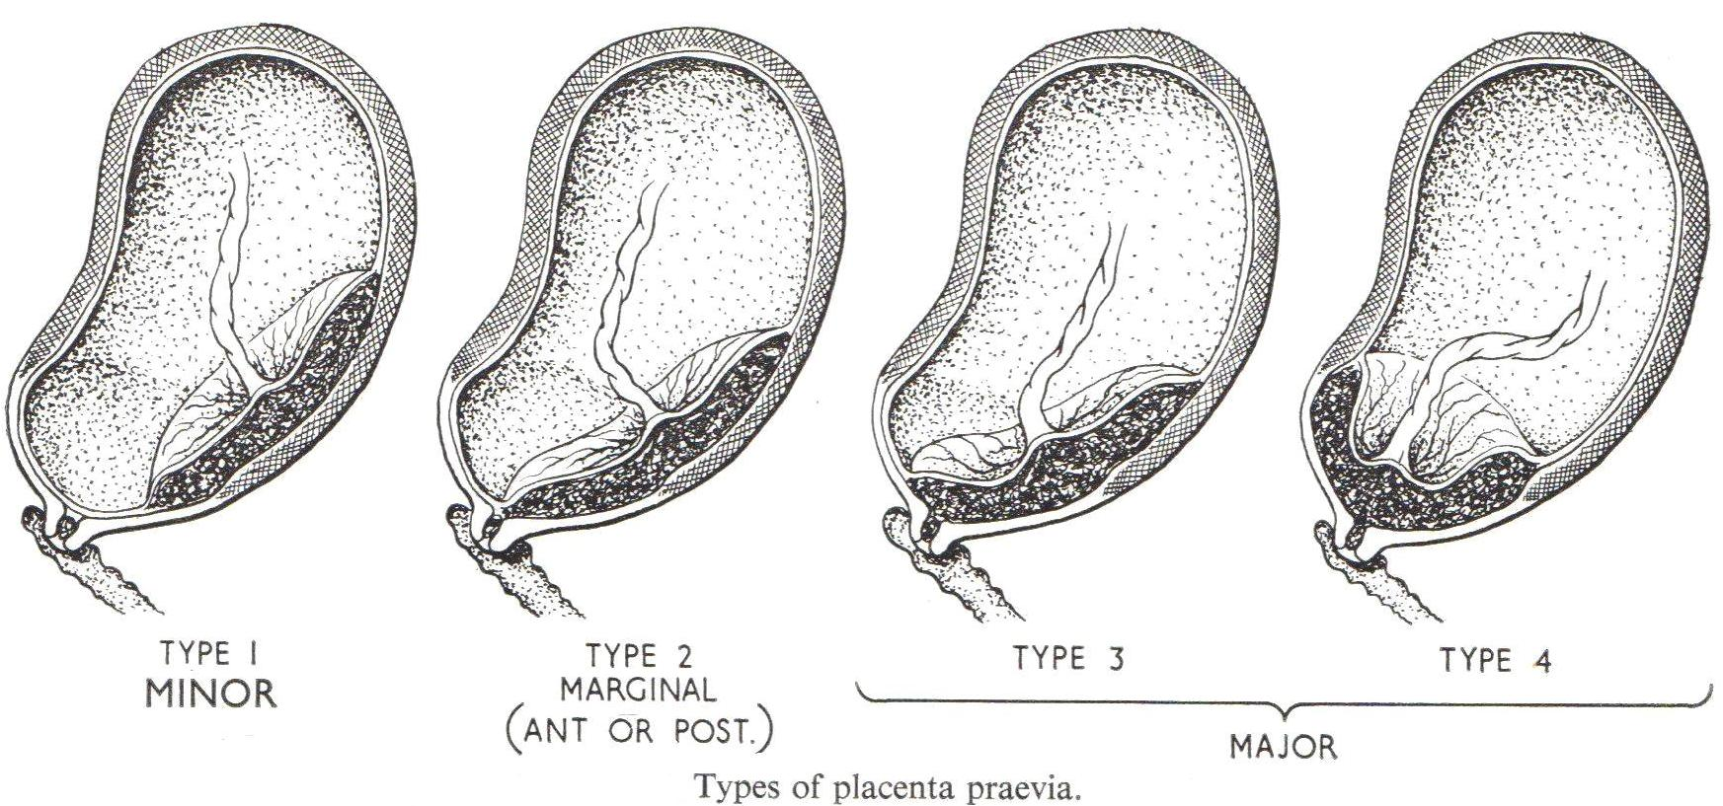
Abnormalities in location of the placenta within the uterus
Placenta praevia: placenta is implanted partially or completely over the lower uterine segment/ over and adjacent to the internal os

Slide 30
Abnormalities in the placenta attachment
Placenta accreta - basal decidua or plate is hypoplastic (poorly developed) and chorionic villi are in direct contact with the myometrium of the uterus to which they are firmly attached
Placenta increta - chorionic villi penetrate the myometrium, spontaneous expulsion of the placenta is not possible (such placenta must be removed by surgery).

Slide 31


