Slide 1
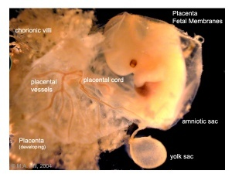
DEVELOPMENT OF PLACENTA AND
PLACENTAL ABNORMALITIES

Slide 2
PLACENTA
Only the eutherian mammals possess placenta.
The human placenta is discoid, haemochorial and deciduate.
The placenta is attached to the uterine wall and establishes connection between the mother and fetus through the umbilical cord

Slide 3
Development of placenta
• Developed from two sources.
• The principal component is fetal which develops from the chorion frondosum and the maternal component consists of decidua basalis.

Slide 4
Development of placenta contd…
• When the interstitial implantation is completed on 11th day, the blastocyst is surrounded on all sides by lacunar spaces around cords of syncytial cells, called trabaculae.
• From the trabaculae develops the stem villi on 13th day which connect the chorionic plate with the basal plate.
• Primary, secondary and tertiary villi are successively developed from the stem villi.
• Arterio-capillary-venous system in the mesenchymal core of each villus is completed on 21st day.
• This ultimately makes connection with the intraembryonic vascular systems through the body walls.

Slide 5
Development of placenta contd…
• Simultaneously, lacunar spaces become confluent with one another and by 3rd-4th week, form a multilocular receptacle lined by syncytium and filled with maternal blood.
• This space becomes the future intervillous space.
• As the growth of the embryo proceeds, decidua capsularis becomes thinner beginning at 6th week and both the villi and the lacunar spaces in the abembryonic area get obliterated.
This is compensated by
– Exuberant growth and proliferation of the decidua basalis – Enormous and exuberant division and subdivision of the chorionic villi in the embryonic pole (chorion frondosum).

Slide 6
Development of placenta contd…
• These two i.e., chorion frondosum and the decidua basalis form the discrete placenta.
It begins at 6th week and is completed by 12th week.
Until the end of 16th week, the placenta grows both in thickness and circumference
Subsequently there is little increase in thickness but it ncreases circumferentially till term.

Slide 7
The placenta at term Gross anatomy
• Circular disc with a diameter of 15-20 cm and thickness of about 2.5 cm at its center.
• It thins off towards the edge.
•It feels spongy and weight about 500 gm
• Proportion to the weight of the baby being roughly 1:6 at term and occupies about 30% of the uterine wall.
• It presents two surfaces, fetal and maternal, and a peripheral margin.

Slide 8
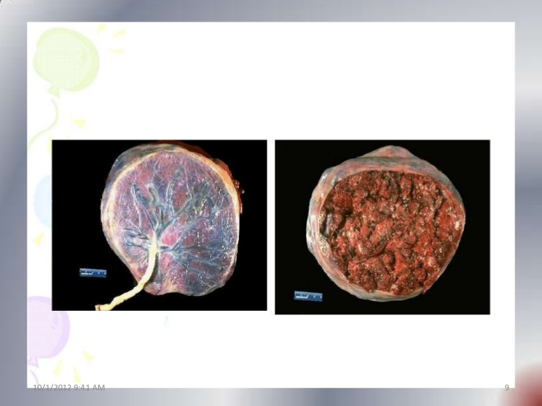
FETAL SURFACE
MATERNAL SURFACE

Slide 9
Structures of placenta
• The placenta is limited internally by the amniotic membrane and chorionic plate; externally by the basal plate and in between these two lies the intervillous space containing the stem villi with their branches, the space being filled with maternal blood.
• Amniotic membrane: It consists of single layer of cubical epithelium loosely attached to the adjacent chorionic plate. It takes no part in formation of placenta.

Slide 10
Structures of placenta contd…
Chorionic plate: From within outwards, it consists of
– Primitive mesenchymal tissue containing branches of umbilical vessels
– A layer of cytotrophoblast and
– Syncytiotrophoblast
Basal plate: It consists of the following structures from outside inwards.
– Part of the compact and spongy layer of the decidua basalis
– Nitabuchs layer of fibrinoid degeneration of the outer syncytiotrophoblast at the junction of the cytotrophoblastic shell and decidua.
– Cytotrophoblastic shell
– Syncytiotrophoblast

Slide 11
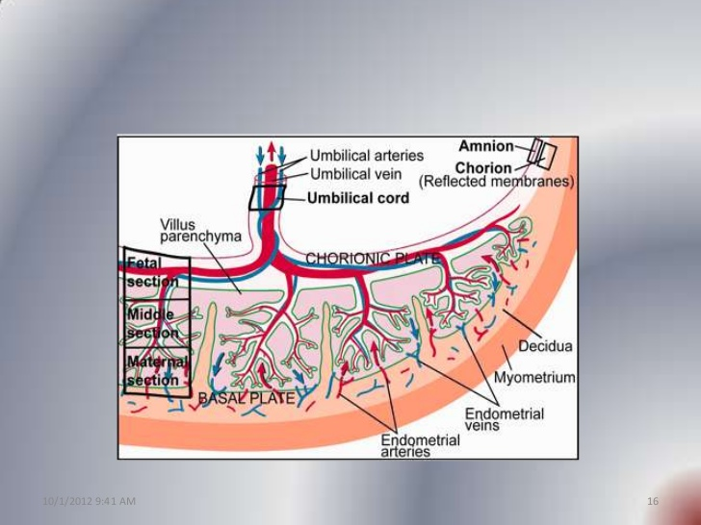

Slide 12
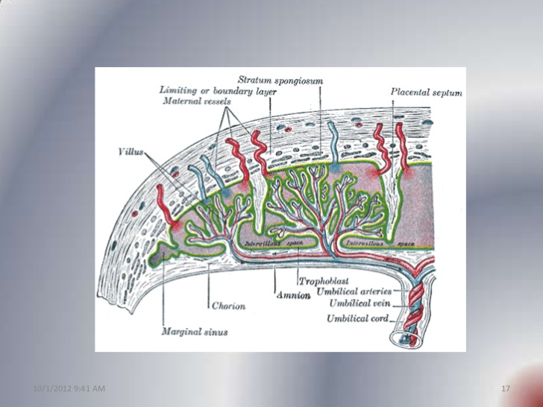

Slide 13
Structures of placenta contd…
• Intervillous space: It is bounded on the inner side by the chorionic plate and the outer side by the basal plate, limited on the periphery by the fusion of the two plates.
• It is lined internally on all sides by the syncytiotrophoblast and is filled with slow flowing maternal blood.
• Numerous branching villi which arise from the stem villi project into the space and constitute chief content of the intervillous space.

Slide 14
Structures of placenta contd…
Stem villi
• Arise from the chorionic plate and extend to the basal plate.
• With the progressive development- primary, secondary and tertiary villi are formed.
• Functional unit of the placenta is called the fetal cotyledon or placentome.
• Major villi pass down through the intervillous space to anchor onto the basal plate.

Slide 15
Stem villi contd…
• Functional subunit is called lobule which is derived from the tertiary stem villi.
• About 60 stem villi persist in human placenta.• Thus, each cotyledon (totaling 15-29) contains 3-4 major stem villi.
• The total surface, for exchange, varies between 4-14 square meters.
• The fetal capillary system within the villi is almost 50 km long.

Slide 16
Structures of placenta contd…
Structure of terminal villus: In the early placenta, each terminal villus has got the following structures from outside inward:
– Outer syncytiotrophoblast
– Cytotrophoblast
– Basement membrane
– Central stroma containing fetal capillaries, primitive mesenchymal cells, connective tissue and a few phagocytic (Hofbauer) cells

Slide 17
Structure of terminal villus contd…
• In the term placenta
the syncytiotrophoblast becomes relatively thin at places overlying the fetal capillaries and thicker at other areas containing extensive endoplasmic reticulum.
• The cytotrophoblast is relatively sparse.
• Basement membrane becomes thicker.
• Stroma contains dilated vessels along with all the constituents and few Hofbauer cells.
• These cells have IgG surface receptors and can express class II MHC molecules.

Slide 18
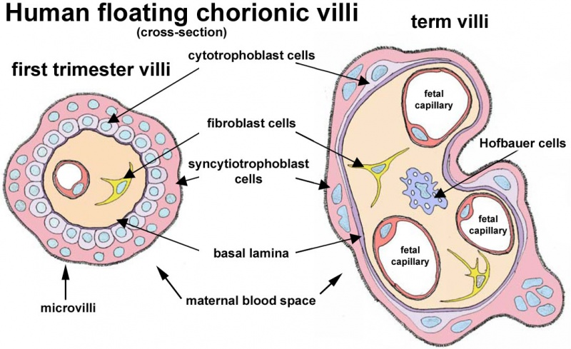

Slide 19
Placental Abnormalities
▪ Abnormal Shape or Implantation
▪ Degenerative Placental Lesions
▪ Circulatory Disturbances
▪ Hypertropic Placental Abnormalities
▪ Placental Inflammation
▪ Tumors of the Placenta

Slide 20
Placental Abnormalities
-Abnormal Shape or Implantation-
Multiple Placentas with a single fetus
Placenta bipartita or bilobata - the placenta is separated into lobes - division is incomplete and the vessels of fetal origin extend from one lobe to the other before uniting to form the umbilical cord
Placenta duplex, triplex - two or three distinct lobes are separated entirely and the vessels remain distinct.
Clinical significance : Bilobed placenta

Slide 21
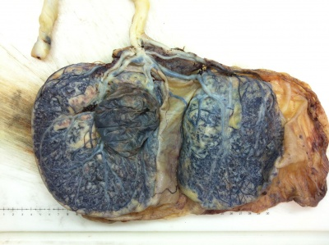

Slide 22
Succenturiate lobes
small accessory lobe ≥1, develop in the membranes at a distant from the periphery of the main placenta, to which they usually have vascular connections of fetal origin
incidence : 5%
Clinical significance :retained in the uterus after delivery and may cause serious hemorrhage accompanying vasa previa - dangerous fetal hemorrhage at delivery

Slide 23
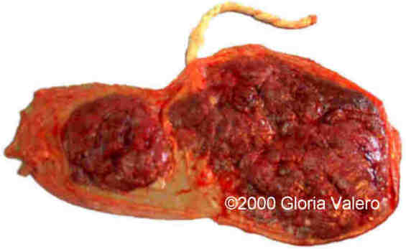

Slide 24
Membranaceous Placenta
all of the fetal membranes are covered by functioning villi and the placental develops as a thin membranous structure occupying the entire periphery of the chorion
Clinical significance :serious hemorrhage d/t associated placenta previa or accreta

Slide 25
Ring – shaped Placenta
Placenta is annular in shape and sometimes a complete ring of placental tissue
Variant of membraceous placenta - tissue atrophy in a portion of the ring a horseshoe shape in more common
Incidence : < 1/6000 deliveries
Clinical significance :Antepartum & postpartum bleeding and fetal growth restriction

Slide 26
Extrachorial Placentation
When the chorionic plate, which is on the fetal side of the placenta, is smaller than the basal plate, which is located on the maternal side, the placental periphery is uncovered
Circumvallate Placenta
Fetal surface of such a placenta presents a central depression surrounded by a thickened, grayish-white ring.
Ring : composed of a double fold of amnion and chorion with degenerated decidua and fibrin in between .Within the ring, the fetal surface presents the usual appearance, except that the large vessels terminate abruptly at the margin of the ring .
Clinical significance : Antepartum hemorrhage - from placental abruption and fetal hemorrhage Preterm delivery Perinatal mortaliy Fetal malformations

Slide 27
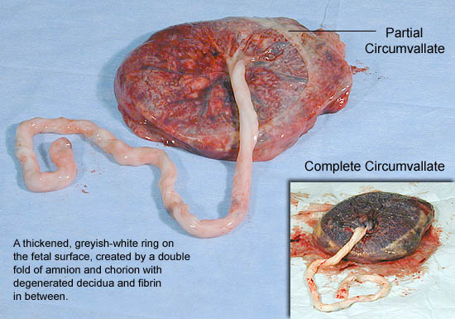

Slide 28
Placenta Accreta Increta Percreta
serious variations in which trophoblastic tissue invade the myometrium to varying depths much more likely with placenta previa or with implantation over a prior uterine incision or perforation
Clinical significance :Torrential hemorrhage

Slide 29
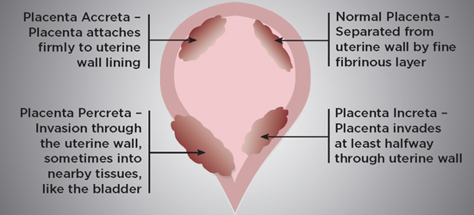

Slide 30
Degenerative Placental Lesions
Causes : trophoblast aging or impairment of uteroplacental circulation with infarction
Deposition of calcium salts is heaviest on the maternal surface in the basal plate. → further deposition occurs along the septa and both increase as pregnancy progresses
Calcification : 10 - 15% of all placentas at term * By GA33wks : some degree of calcification ≥ ½ of placentas

Slide 31
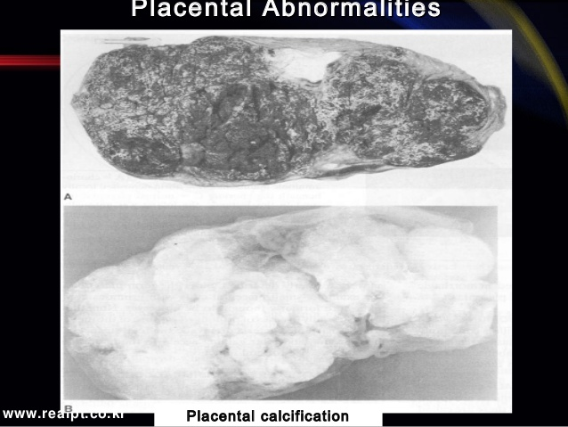

Slide 32
Circulatory Disturbances
Placental infarctions
m/c placental lesions
Etiology : continuum from normal changes to extensive and pathological involvement
Incidence : 10% of 500 consecutive placentas from uncomplicated term pregnancies
Several types (by lesion sites )
- located at the placental margin (90%) , size <1cm(90%)
- underneath the chorionic plate - Subchorionic infarct : downward with their apices the intervillous space
- Intercotyledonary septa : meet and form a column of cartilage – like material extending from the maternal surface to the fetal surface

Slide 33
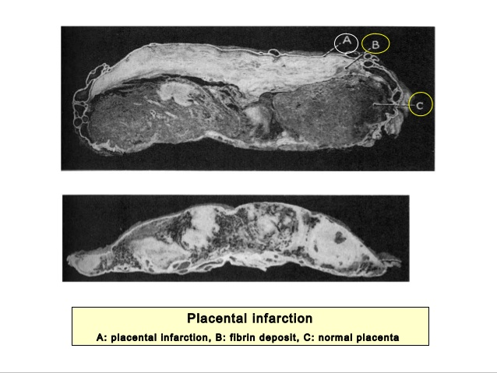

Slide 34
Placental Vessel Thrombosis
When a stem artery from the fetal circulation in the placenta is occluded, it produces a sharply demarcated area of avascularity
Single a thrombosis : 5% of placentas in normal pregnancies 10% of diabetic woman
Thrombosis of a single stem artery will deprive only 5% of the villi of their blood supply
associated with fetal growth restriction and stillbirth

Slide 35
Hypertrophic Lesions of the chorionic villi
- striking enlargement of the chorionic villi is commonly seen in association with
▪ severe erythroblastosis
▪ fetal hydrops.
▪ maternal diabetes
▪ fetal CHF
▪ maternal-fetal syphilis

Slide 36
Microscopic Placental Abnormalities
Syncytial knots: clumps of syncytial nuclei are found to project into the intervillous space
begining after 32wks
The number of cytotrophoblastic cells becomes progressively reduced as pregnancy advances.
By term, such cells are few and inconspicuous
In some maternal or fetal disorders, numerous cytotrophobalstic cells are found in placentas - Gestational hypertension , diabetes and erythroblastosis fetalis

Slide 37
Placental Inflammation
Changes that are now recognized as various forms of degeneration and necrosis were formerly described under the term placentitis e.g.) Small placental cysts with grumous contents were formerly thought to be abscesses.
Nonetheless, especially in cases of preterm and prolonged membrane rupture, bacteria invade the fetal surface of the placenta → chorioamnionitis

Slide 38
Tumors of the Placenta
Gestational Trophoblastic Disease
Chorioangioma(Hemangioma)
Tumors Metastatic to the Placenta
Embolic Fetal Brain Tissue

Slide 39
ABNORMALITIES OF CORD
Battledore placenta : cord insertion at the placental margin
Incidence - 7% at term
significance - Cord being pulled off during delivery of the placenta
Velamentous Insertion
Umbilical vessels separate in the membranes at a distance from the placental margin
Incidence - 1.1%
significance - more frequently with twins
28% of triples

Slide 40
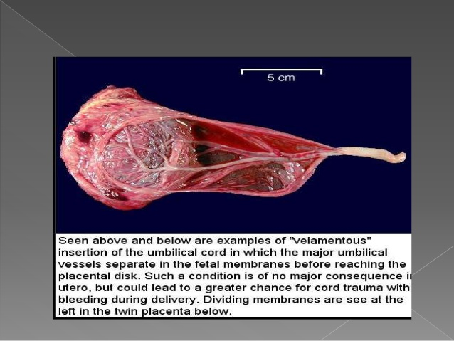
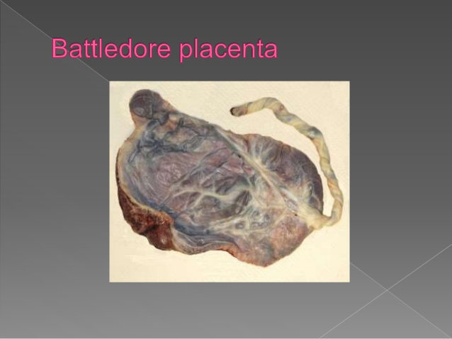

Slide 41
VASA PREVIA
Incidence : 1 in 5200 pregnancies
Assoc with Velamentous insertion when some of the fetal vessels in the membrane cross the region of the internal os & occupy a position of the presenting part
These vessels are not only vulnerable to compression but also to laceration.

Slide 42
VASA PREVIA RISK FACTORS
Bilobate placenta
Succenturiate placenta
2nd trimester placenta praevia
Pregnancies conceived by IVF
Haemorrhage from vasa praevia may lead to instant fetal death and should always be kept as a D/D in all cases with APH. Elective CS is planned in case diagnosis is confirmed .

Slide 43
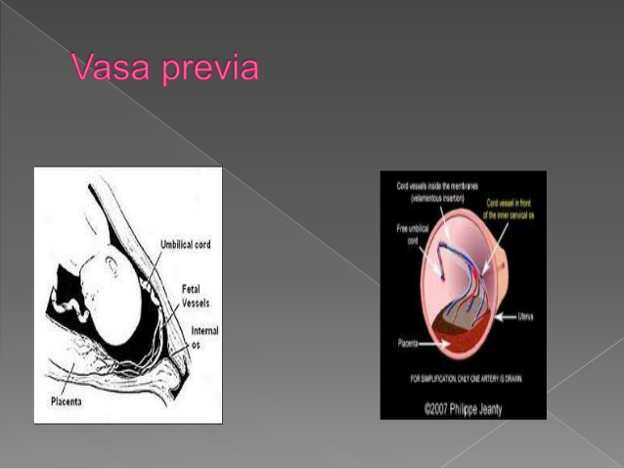

Slide 44
PLACENTA PREVIA
When placenta is implanted partially or completely over the lower uterine segment[over and adjacent to internal os] is called placenta previa.
TYPES
Type 1- low lying
Type 2- marginal
Type 3-incomplete or partial central
Type 4 –central or total

Slide 45
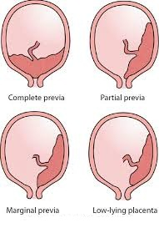

Slide 46
ABRUPTIO PLACENTA
It is one form of antepartum haemorrhage where bleeding occurs due to premature seperation of normally situated placenta.
VARITIES
-Revealed
-Concealed
-mixed

Slide 47
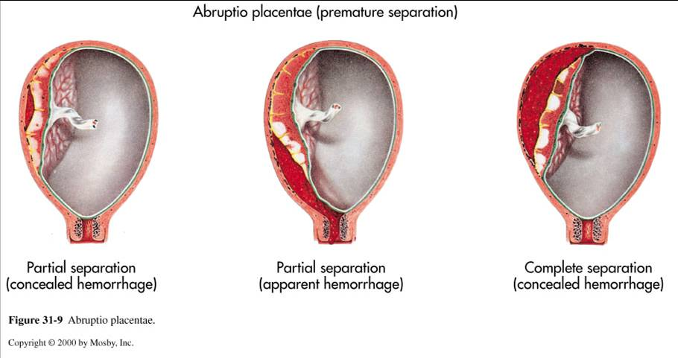

Slide 48
THANK
YOU

