Slide 1
ANATOMY OF FEMALE GENITAL TRACT

Slide 2
CONTENTS
ANTERIOR ABDOMINAL WALL
EXTERNAL GENITAL ORGANS
INTERNAL GENITAL ORGANS

Slide 3
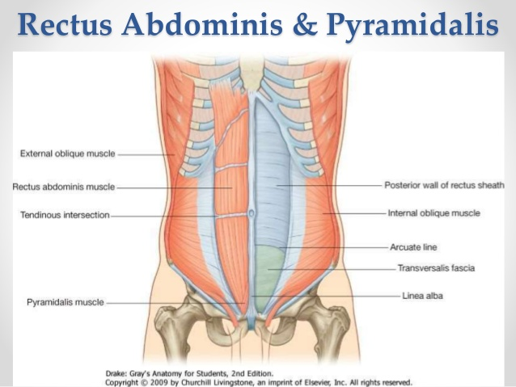
ANTERIOR ABDOMINAL WALL

Slide 4
SKIN
Langer lines describe the orientation of dermal fibers within the skin. In the anterior abdominal wall they are arranged transversely. As a result, vertical skin incisions have more tension and lead to wider scars. In contrast a low transverse incisions, such as a pfannenstiel follow the langer lines and lead to superior cosmetic results.

Slide 5
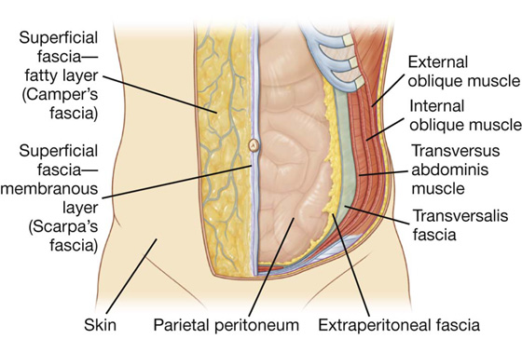
SUBCUTANEOUS LAYER
This layer can be separated into fascia:
-superficial fatty layer:CAMPER
-deep membranous:
SCARPA

Slide 6
RECTUS SHEATH
The fibrous aponeuroses of external oblique,internal oblique and transversus abdominis muscles join in the midline to create the rectus sheath

Slide 7
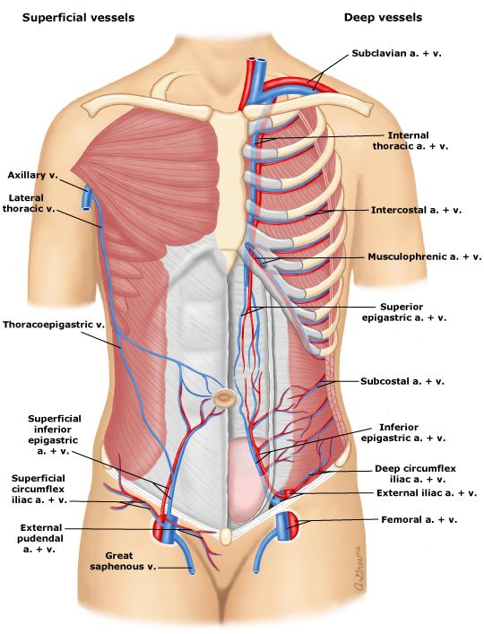
BLOOD SUPPLY
-The femoral artery
*During low transverse incision the superficial epigastric vessels can be identified and ligated , As the course is direct towards the umbilicus.
-The external iliac artery and branches.

Slide 8
INNERVATION
By three nerves,intercostal nerves(T7-T11),the subcostal nerve(T10) the iliohypogastric and ilioinguinal nerves(L1).
*if incisions extend beyond the lateral borders of rectus muscle the iliohypogastric and ilioinguinal nerves can be entrapped and leads to loss of sensations.

Slide 9
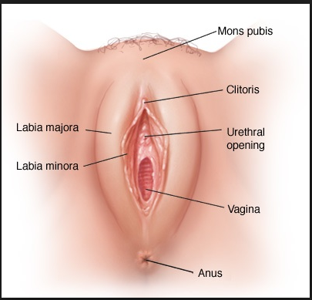
EXTERNAL GENITAL ORGANS

Slide 10
VULVA(PUDENDA)
Mons pubis
Labia mahora
Labia minora
Clitoris
Hymen
Vestibule
Urethral opening
Bartholin glands(greater vestibular gland)
Minor vestibular glands and paraurethral glands

Slide 11
MONS PUBIS/MONS VENERIS
This is a fat filled cushion which overlies the symphysis pubis.
After puberty, the skin is covered by curley hair that forms the escutcheon.
In women, it is distributed in a triangular area,the base of which is formed by the upper margin of symphysis pubis and few hair distributed downward over the outer surface of labia majora.

Slide 12
LABIA MAJORA
Labia majora are homologous with male scrotum.
They meet anterioly in anterior comissure and posterioly in posterior comissure.
It is richly supplied with sebaceous glands.Beneath the skin is dense connective tissue which is divoid of musculature.
*The labia majora is richly supplied with venous plexus.During pregnancy the vasculature commonly develops varicosites,especially is parous women from in creased venous pressure created by advancing uterine weight.

Slide 13
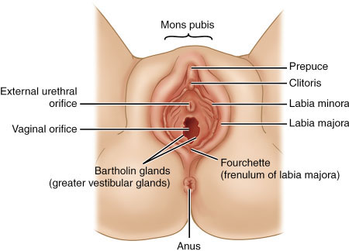
LABIA MINORA
It lies medial to labia majora
It is homologus to ventral shaft of penis males.
Superiorly they divide to form the prepuce and frenulum of clitoris.
Inferiorly they form the fouechette
Between the fourchette and vaginal orifice is a boat like depression,the fossa navicularis.

Slide 14
CLITORIS
It is an erectile homolouge of the penis located below the prepuce and above the urethra.
It has three parts:a glans,a corpus or body with two crura
The glans is richly supplied with nerve endings and highly sensitive
The corpus contain two corpora cavernosa
Each corpora cavernosa diverge laterally to form long narrow crura.
The clitoris has a rich blood supply hence a tear will lead to heavy bleeding.

Slide 15
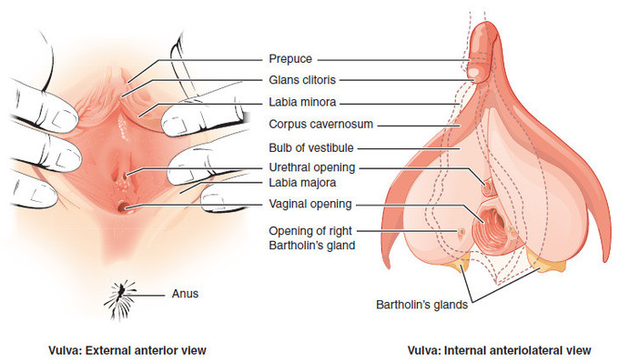
VESTIBULE

Slide 16
The vestibule is an area which extends from the clitoris to the anterior margin of hymen below,laterally to the labia minora
It is perforated by 6 openings:
the urethra
two bartholin gland ducts and at times two ducts of the largest paraurethral ducts :skene glands
*The aggregation of veins in the vestibule will form the vestibular bulb.They correspond to corpus spongiosum of penis
During child birth they can be pushed behind the pubic rami which lead to hemorrhage or hematoma.

Slide 17
VESTIBULAR GLANDS
BARTHOLIN GLANDS:they measure 0.5 to 1cm in diameter.They are inferior to the vestibular bulb.Their ducts are 1.5 to 2 cm long and open distal to the hymen ring.Following a trauma or infection either duct may swelland obstruct to form a cyst or get infected to form abscess

Slide 18
PARAURETHRAL/SKENE GLANDS: whose ducts open predominantly along the entire aspect inferior aspect of urethra. Their ducts lie distally near the urethral meatus. Inflammation and duct obstruction of any of the glands leads to urethral diverticulum formation.

Slide 19
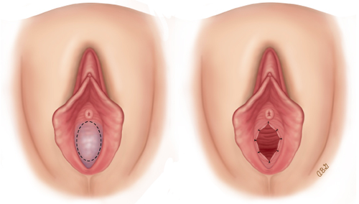
VAGINAL OPENING AND HYMEN

Slide 20
The vaginal opening is rimmed distally by the hymen.The hymen is composed of elastic and collagenous connective tissue.
The aperture ranges from from pin point to one that admits the tip of one or even two fingers
Causes of hymen tear:during first act of coitus,insertion of tampons during mensturation.
*At child birth the hymen is extremly lacerated which is represnted as cicatriced nodules of varying sizes called carunculae myrtiformes.

Slide 21
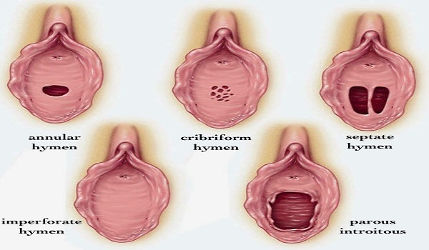
TYPES OF HYMEN
Imperforate:hymen completely covers the vagina,causing retention menstural blood
Septate:hymen has a extra band of tissue in the middle causing two vaginal openings.

Slide 22
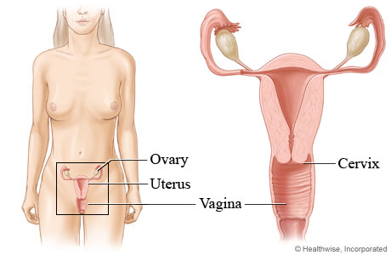
VAGINA
-Musculomembranous structure extends from the vulva to the uterus.
-ant wall:6-8cm
-post wall:7-10cm
-the upper end of the vaginal vault is subdivided into anterior posterior and two lateral fornices by the cervix
-ant:in relation with bladder
-post :in realtion with pouch of douglas and rectum
Rt and left :in close realtion with ureter and uterine artey on that side.

Slide 23
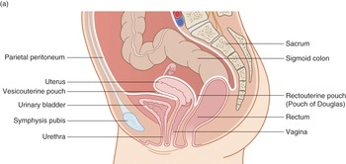
Relations of Vagina

Slide 24
*at the mid portion of the vagina ,the lateral walls are attached to the pelvic walls by connective tissue.These lateral attcahements blend into the fasia of levator ani muscles.In doing so they create the anterior and posterior lateral vaginal sulci.These run the length of the side walls and give the vagina
THE H SHAPE ON CROSS SECTION

Slide 25
HISTOLOGY OF VAGINA
The vaginal lining is composed of non keratinized stratified sq epithelium.
Below this a muscular layer:outer longitudnal and inner circular
No vaginal glands are present.
The vaginal epithelium is rich in glycogen,which is broken down by commensal lactobacilli to lactic acid maintaining the ph ACIDIC.
The vaginal epithelial cells exfoliate into vagina and the vaginal smear of the exfoliated cells explains the hormonal pattern.
*After birth,fragments of the epithelium break down and get burried with keratin debris to form epidermal inclusion cysts.

Slide 26
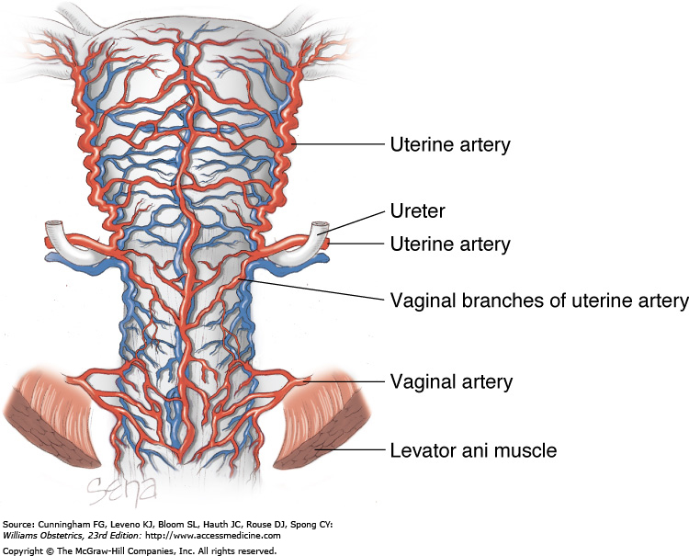
BLOOD SUPPLY OF VAGINA
UPPER THIRD:supplied by cervicovaginal branches of uterine artery and vaginal artery
MIDDLE THIRD:inferior vesical arteries
LOWER THIRD:middle rectal and pudendal arteries

Slide 27
VENOUS DRAINAGE:an extensive venous plexus surrounds the vagina and the vessels follow the course of arteries and eventually drain into the internal iliac veins.

Slide 28
LYMPHATIC DRAINAGE OF VAGINA
Lower third of vagina and vulva drain into inguinal group of lymph nodes.
Middle of vagina drain into internal iliac nodes
Upper two third drain into iliac nodes

Slide 29
NERVE SUPPLY OF VAGINA
From the S2 S3 S4 sacral nerves which is the pudendal nerve.
Sympathetic supply is from the hypogastric plexus

Slide 30
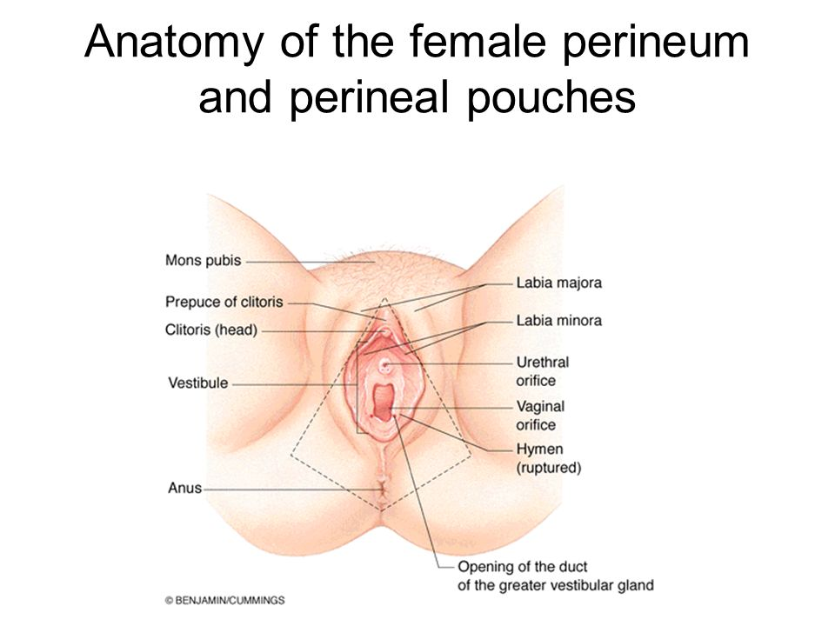
PERINEUM

Slide 31
The perineum is a diamond shaped area between the thighs
An arbitary line joining the ischial tuberosities divides the perineum into ant triangle/urogenital triangle and post triangle/anal triangle.
ANTERIOR TRIANGLE: divided into superficial and deep
POSTERIOR TRIANGLE

Slide 32
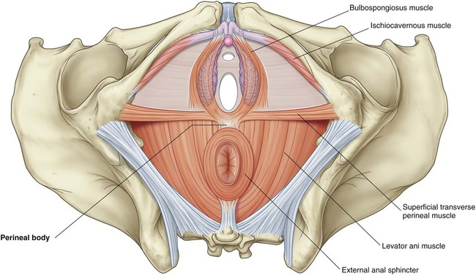
ANTERIOR TRIANGLE

Slide 33
SUPERFICIAL SPACE OF ANT TRIANGLE
It is a closed compartment,infection or blood remains contained in it.
It contains the following:
-ischiocavernosus
-bulbocavernosus
-superficial transverse perineal muscles
-bartholin glands
-vestibular glands
-clitoris
-branches of pudendal nerve

Slide 34
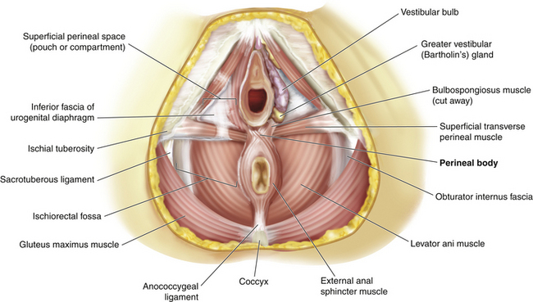
CONTENTS

Slide 35
DEEP SPACE OF ANTERIOR TRIANGLE
It is not a closed compartment and is continuous superiorly with the pelvic space.
Contains
-compressor urethra
-external urethral sphincter
-parts of urethra and vagina
-branches of internal pudendal artery and dorsal nerve and vein of clitoris

Slide 36
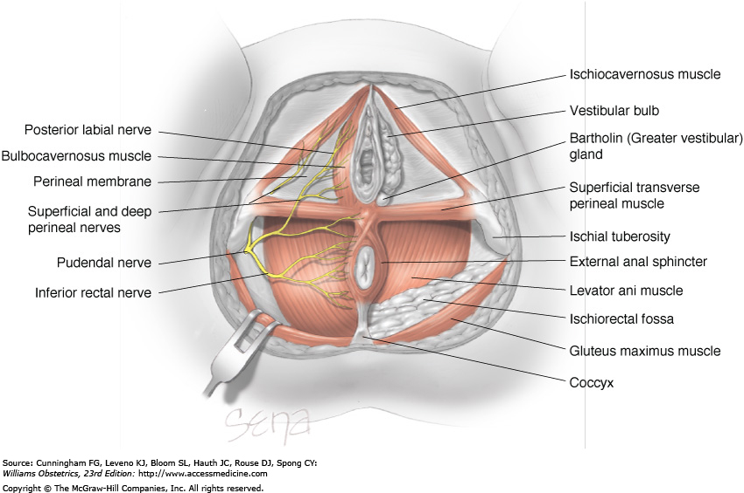
POSTERIOR TRIANGLE

Slide 37
This triangle contains the ischiorectal fossa,anal sphincter,branches of internal pudendal vessels and pudendal nerve.
*ischiorectal fossa:
-fat filled wedge shaped spaces on either side of anal canal.
-they provide support to surrounding organs ,allow distension of rectum during defecation and stretching of vagina during delivery

Slide 38
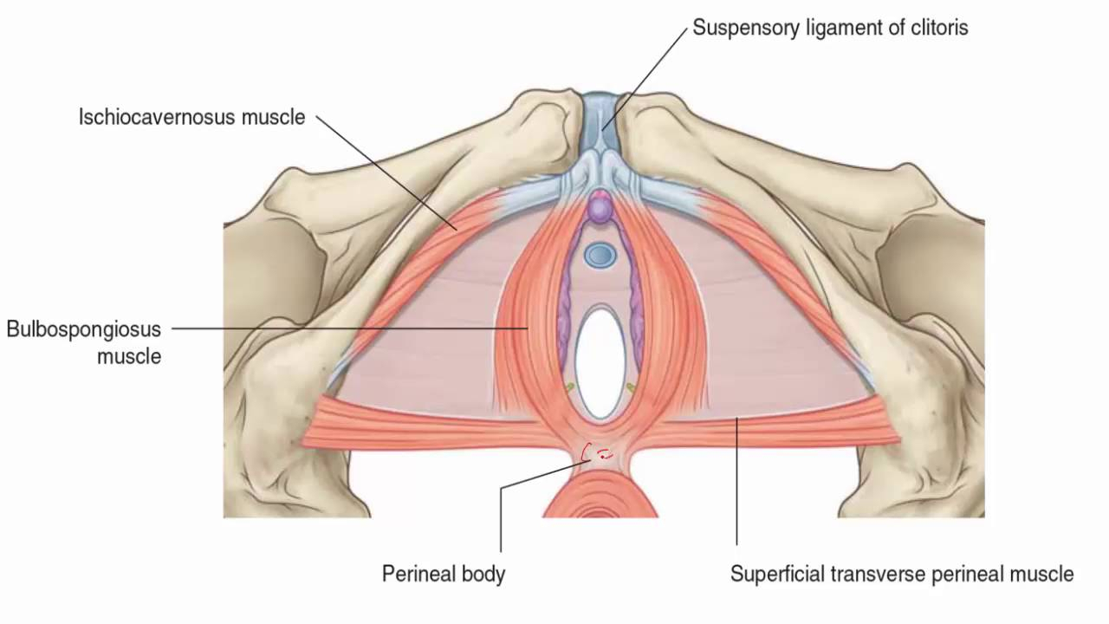
PERINEAL BODY
Attachments
Functions:
-anchors the anorectum
-anchors the vagina
-helps the maintain urinary and fecal incontinence
-maintains the orgasmic platform
-prevents the expansion of urogenital hiatus
-provides physical barrier btw the vagina and rectum.

Slide 39
Potential morbidity
-Episiotomy may injure the perineal body
-pudendal nerve injury may be associated with concurrent perineal body injury
-it is an important structure that weld the pelvis and perineum together,injury dur to prolonged pressure and stretching during delivery or obstetric trauma will weaken the support to the pelvic organs leading to prolapse.

Slide 40
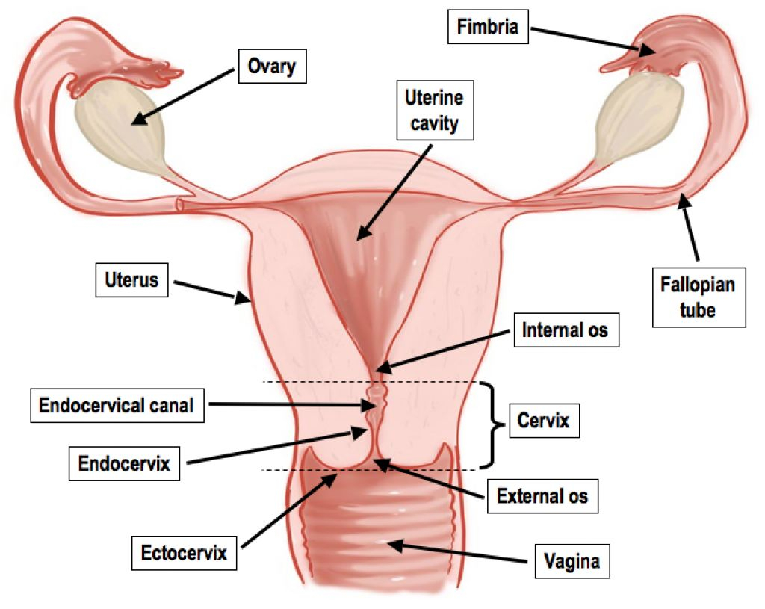
INTERNAL GENITAL ORGANS

Slide 41
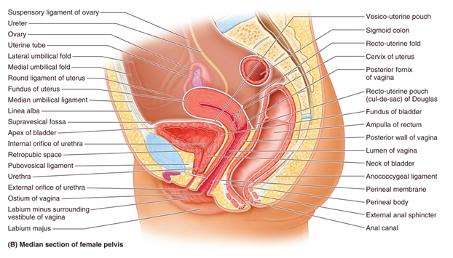
RELATIONS
-ant:bladder
-post:rectum
The peritoneum froms the recto uterine pouch and vesico uterine pouch
-the lower portion of ant uterine wall is attached to the post wall of bladder this is the vesicouterine space
*during cesarean the peritoneum of the vesico uterine pouch is incised and the vesico uterine space is entered

Slide 42
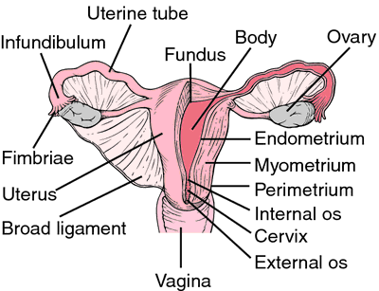
PARTS OF THE UTERUS
Parts:
-body/corpus
-cervix
Isthmus:btw internal cervical os and edometrial cavity.It is of special obstetrical significance because it forms the lower uterine segment pregnancy
Fallopian tubes which emerge from the coruna of uterus
Fundus

Slide 43
Weight of uterus is about 50-70g
Length:
AGE GROUP | LENGTH OF UTERUS(CM)
Pre pubertal female | 2.5-3.5
Adult nulliparous female | 6-8
Multiparous female | 9-10

Slide 44
UTERINE BODY
The uterus has three layers :serous muscular, mucous
SEROUS:formed by the peritoneum which covers the ant two thirds and post surface of uterus
MUSCULAR:MYOMETRIUM-the muscle fibers are arranged in three layers -1.outer longitudinal
2.inner circular fibres
3.btw the two are fibres in the shape of FIGURE OF 8 around the blood vessels.The contraction of these blood vessels act like LIVING LIGATURES to control hemorrhage.
MUCOSAL:ENDOMETRIUM-0.5mm to 5mm

Slide 45
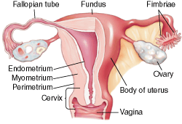

Slide 46
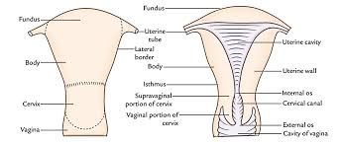
UTERINE CERVIX

Slide 47
The length of the normal cervical canal is about 2.5 cm from the internal os to external os.
The cervical canal is lined by mucosa composed of a single layer of very high columnar that rest upon on basement membrane.Near the external os the columnar epithelium of cervical canal and squamous epithelium of ectocervix meet at squamocolumnar junction.

Slide 48
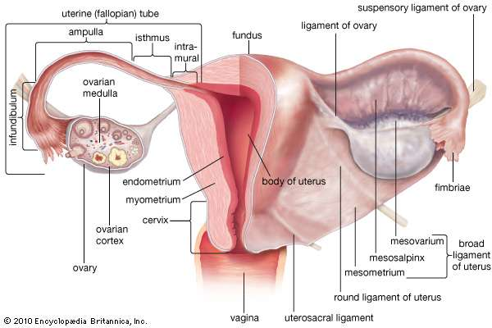
LIGAMENTS OF UTERUS

Slide 49
UTEROSACRAL LIGAMENTS:are condensations of the visceral pelvic fascia.They extend from an attachment posterolaterally to the supravaginal portion of the cervix to encircle the rectum
MACKENRODTS LIGAMENTS:also known as cardinal ligaments.They run at the base of broad ligaments,attaching medialy to the side of the cervix and vagina ,and laterally the wall of pelvis.

Slide 50
BROAD LIGAMENTS: the broad ligament on each side is a double layer of peritoneum directed from lateral margin of uterus to lateral wall of pelvis. The lateral (outer) third of upper free margin forms the infudibulopelvic ligament the medial(inner) two thirds form the mesosalpinx enclosing the fallopian tube and round and ovarian ligaments.It also encloses
-extraperitoneal connective tissue
-true ligament of ovary
-paroophron and epoophron
-blood vessels nerves and ligaments.

Slide 51
ROUND LIGAMENTS:extend on either side from anterolateral angle of the uterus just below and in front of the insertion of fallopian tubes.In non pregnant state it is 3-5 mm in diameter.During pregnancy the ligament undergoes hypertrophy and increase in both length and diameter

Slide 52
BLOOD SUPPLY TO UTERUS
The uterus derives blood from the uterine and ovarian arteries.
The uterine artery is a branch of internal iliac artery.
It gives a branch cervicovaginal artery supplying the lower portion of the cervix and upper portion of vagina.

Slide 53
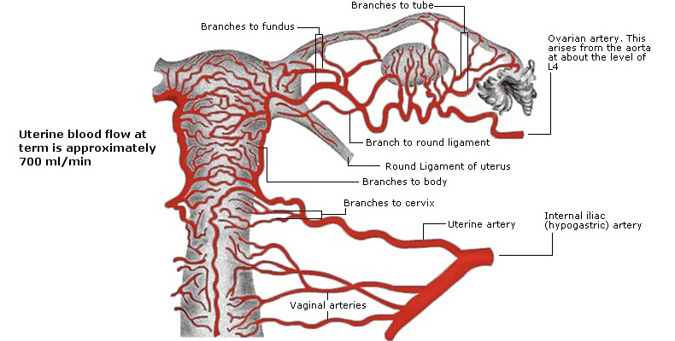

Slide 54
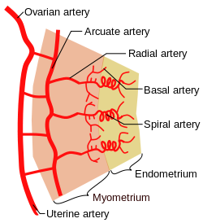
In the walls of the uterus the ovarian artery gives branches
-Arcuate:myo
-Radial:endo
-then divide to short basal(supply the basal endometrium) and long coiled spiral(middle and superficial parts of endometrium)

Slide 55
*in hystrectomy it is important to identify cervicovaginal artery and ligate before removing uterus.
*ligation of uterine artery helps in reducing blood loss when there is excessive post partum hemorrhage

Slide 56
VENOUS DRAINAGE OF UTERUS
Veins from fundus,fallopian tube,ovary form the pampiniform plexus »two ovarian veins which fuse to form one vein»which on the left side join renal vein and right side join the inferior vena cava.»and in the internal iliac vein.

Slide 57
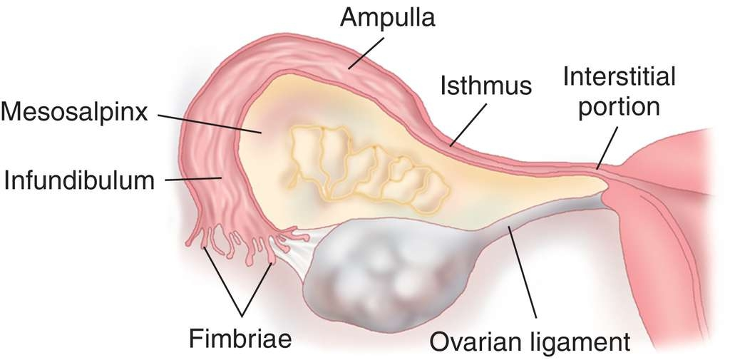
FALLOPIAN TUBES

Slide 58
Normal length of the tube 8-14cm.
Interstial portion refers to the tube which is fused to muscular part uterus.
Isthmus is the narrowest portion.
Ampulla :is the widest and outermost part
Infundibulum:fimbrated end

Slide 59
The wall has two layers of muscles outer longitudnal and inner circular.
The tube is narrowest at isthmus 2-3mm widest at ampulla 5-8mm.
The lumen is lined by single layer of columnar cells some of them ciliated and others scretory.
*tubal sterilisation procedures are preferbaly done at isthmus so tat recanalisation techniques if performed later have a higher success rate due to uniform thickness of muscle layer in this segment.

Slide 60
OVARIES
The ovaries are two almond shaped bodies situated near the fimbrated end on the fallopian tube.
They are attached to the broad ligament by mesovarium and lateral pelvic wall by infundibulopelvic ligament.
Blood supply by ovarian artery

Slide 61
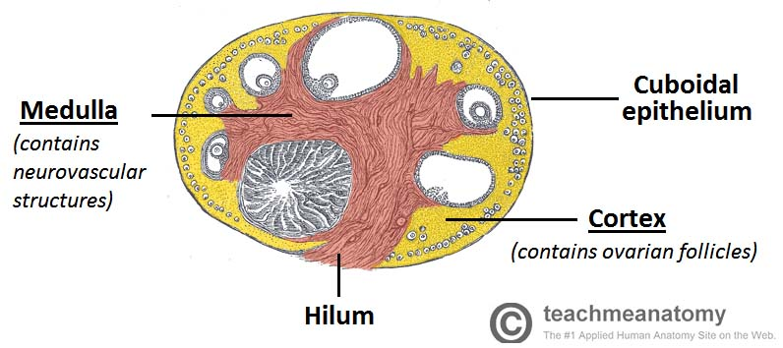

Slide 62
THANK YOU

