Slide 1
Abnormalities in uterine power

Slide 2
Uterine power- Refers to forces generated by the uterine musculature.
Uterine activity- characterised by frequency, amplitude (intensity) and duration of contractions.
Polarity of Uterus – When the upper segment contracts and lower segment relaxes.

Slide 3
Fundal dominance
The activity of myometrium is greatest and longest at the fundus ,shifting and dimnishing towards midline and downwards towards cervix.

Slide 4
Pacemakers- Two pacemakers situated at each cornua of uterus generating the contraction in co-ordinated manner.
Origin and propagation of contractions-
The right pacemaker usually predominates over the left and starts most contractile waves.
Contractions spread from the pacemaker area throughout the uterus at 2cm/sec, depolarising the whole organ within 15 seconds.

Slide 5
This depolarisation wave propagates downward towards the cervix.
Intensity is greatest in the fundus and it diminishes in the lower uterus.
This phenomenon is thought to reflect reductions in myometrial thickness from the fundus to the cervix.
This descending gradient serves to direct fetal descent toward the cervix and to efface the cervix.
Sometimes there is emergence of multiple pace maker foci leading to less efficient contractions and hence causing primary dysfunction labour.

Slide 6
All the parts of the uterus are synchronised and reach their peak pressure almost simultaneously, giving rise to curvilinear waveform as shown here.

Slide 7
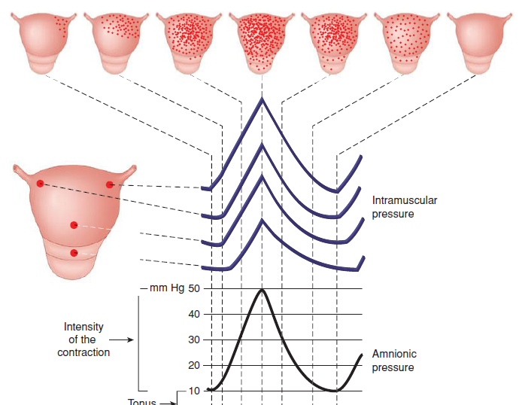
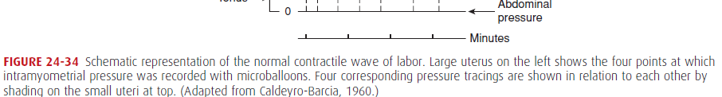

Slide 8
Parameters of uterine contraction
Basal tone: 5-20 mm Hg
Peak Pressure: around 60 mm of Hg
Frequency: adequate uterine contractions are 3-4 contractions each lasting for 45 seconds within 10 minutes.
Tachysystole : more than 5 contractions in 10 minutes.

Slide 9
Assessment of uterine contractions
1.Manual palpation
2.External objective assessment technique by external tocodynamometry.
3.Direct measurement via intrauerine pressure catheter(IUPC)

Slide 10
Manual palpation
The examining hand is placed between umblicus and uterine fundus and the duration and frequency of the uterine contractions is quantified over a ten minute period.

Slide 11
External tocodynamometry
It measures the change in the shape of the abdominal wall as function of uterine contraction.
Hence it is qualitative rather than quantitative
It doesn’t measure contraction intensity or basal intrauterine tone.
Advantage:1.easy to use 2.non invasive 3.low cost 4.same clinical outcome as internal monitoring.

Slide 12
Intrauterine pressure catheter
Most precise method for determination of uterine activity.
Currently there are two main varieties of IUPC
Fluid filled and transducer tipped.

Slide 13
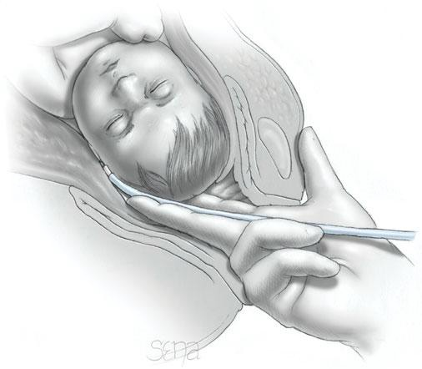
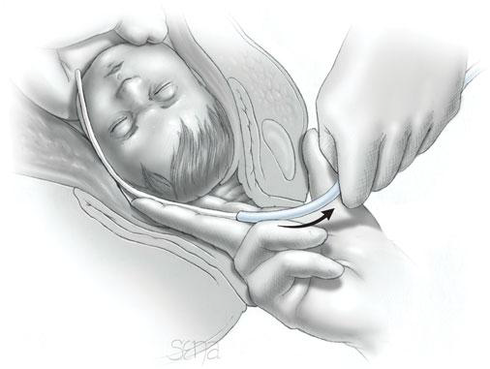

Slide 14
Advantage:
Unaffected by maternal position
Allowing for amnioinfusion if required
Disadvantages:
Invasive- involves rupture of membranes.
It may increase the risk of infection
There have been reports of uterine perforation ,fetal hemorrhage due to puncture of a fetal vessel and placental abruption.

Slide 15
Uterine electromyography
The uterine EMG is the result of electrical activity generated at microscopic level.
These measurements are comparable to IUPC for measuring the strength of uterine contractions.

Slide 16
Ouantification of uterine activity
The precise quantification of uterine activity has not led to improvement in fetal outcome or in caesarean section rates and may not be really required unless very high doses of oxytocin are being used.
However it assists in understanding and interpreting the tocogram and various units of quantification have been described.

Slide 17
Montevideo unit:
By definition ,uterine performance is the product of the intensity –increased intrauterine pressure above basleine tone-of a contraction in mm of Hg multiplied by contraction frequency per 10 minutes.
For example 3 contractions in 10 minutes, each of 50 mm Hg intensity would equal to 150 Montevideo units

Slide 18
During the first 30 weeks of pregnancy,uterine activity is comparitively quiescent.
Contractions are seldom greater than 20 mm Hg.
Uterine activity gradually increases after 30 weeks.
Clinical labour usually commences when uterine cavity reaches values between 80 and 120 Montevideo units.
This translates into approx three contractions of 40 mm Hg every 10 minutes

Slide 19
During first stage of labour: uterine contractions increases progressively in intensity from approx 25 mm Hg at commencement of labour to 50 mm Hg at the end.
At the same time frequency increases from three to five contractions per 10 minutes and uterine basal tone from 8 to 12 mm Hg.
Uterine activity further increases during second stage labour aided by maternal pushing.
Indeed, contractions of 80 to 100 mm Hg are typical and occurs as frequently as 4 to 5 per 10 min

Slide 20
Contd…
Uterine contractions are clinically palpable only after their intensity exceeds 10 mm Hg .
Uterine contractions usually are not associated with pain until their intensity exceeds 15 mm Hg .
Hence braxton hicks contraction exceeding 15 mm Hg may be perceived as uncomfortable because distension of uterus,cervix and birth canal is generally thought to produce discomfort.

Slide 21
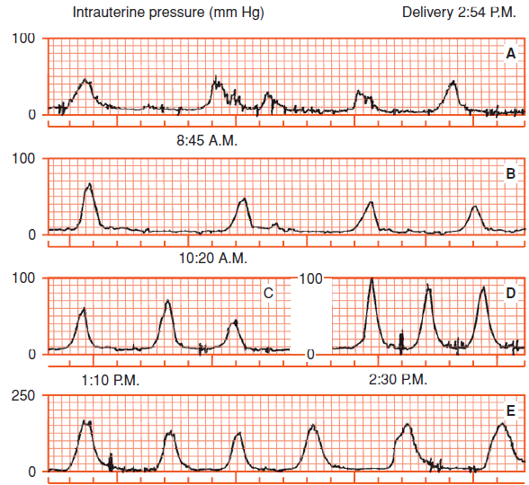
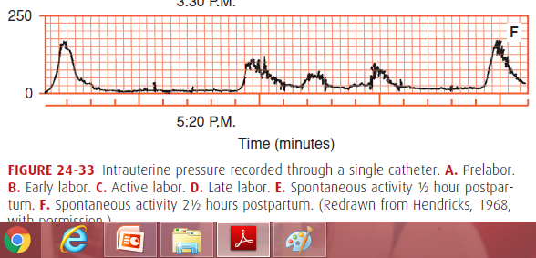

Slide 22
Abnormal uterine action
Any deviation of normal pattern of uterine contractions affecting the course of labour is designated as disordered or abnormal uterine action.

Slide 23
Classification
Normal polarity
- Hypertonic dysfunction
1.precipitate labour in absence of obstruction
2.Tonic contraction and retraction (Bandl’s ring) in the presence of obstruction.
-Hypotonic dysfunction=uterine inertia

Slide 24
Abnormal polarity
Spastic lower segment
Colicky uterus
Constriction ring
Generalised tonic contraction
Cervical dystocia

Slide 25
Precipitate labour
A labour is called precipitate when the combined duration of first and second stage is less than 3 hours.
Rapid expulsion is due to the combined effect of hyperactive uterine contractions and associated with diminished soft tissue resistance.
Labour is short as the rate of cervical dilatation is 5cm/hr or more for the nulliparous woman and 10cm/hr in multiparous.

Slide 26
Maternal risk
Extensive laceration to cervix,vagina and perineum.
PPH due to uterine hypotonia develops subsequent to unusual vigorous contractions.
Inversion
Uterine rupture,infection
Amniotic fluid embolism

Slide 27
Fetal risk
Intracranial haemorrhage because of rapid expulsion without time for moulding of head.
Serious injuries ,bleeding from torn cord.
Treatment:
In case of previous history patient has to be hospitalised prior to labour
During labour,uterine contractions can be suppressed by administrating magnesium sulphate.
Delivery of the head should be controlled.
Liberal episiotomy.
Oxytocin augmentation should be avoided.

Slide 28
Tonic uterine contraction and retraction
This type of uterine contraction is predominately due to obstructed labour.
Pathology:
There is gradual increase in intensity,duration and frequency of uterine contraction.
The relaxation phase becomes less and less
Ultimately a state of tonic contraction develops.
Retraction continues.

Slide 29
Contd….
Progressive thinning and elongation of lower uterine segment.
A circular groove encircling the uterus is formed between the active upper segment and distended lower segment called pathological retraction ring(Bandl’s ring)

Slide 30
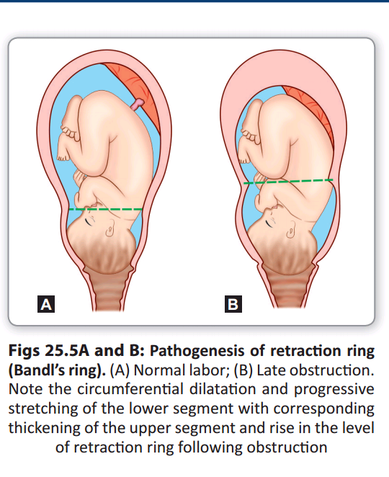

Slide 31
Contd…
In Primi
Further retraction ceases in response to obstruction and labour comes to a stand still-a state of uterine exhaustion.
Contraction may recommence after a brief period of rest.

Slide 32
In multiparae
Retraction continues with progressive circumferential dilatation and thinning of lower segment.
There is progressive rise of the Bandl’s ring ,moving nearer and nearerto the umblicus and ultimately the lower segment ruptures.

Slide 33
Clinical features
Features of maternal exhaustion
P/A: uterus is tense and tender
Not easily felt
Ring is felt as a groove placed obliquely
Round ligaments are taut and tender
FHS usually absent.

Slide 34
Management :
Prevention:
Partograph
Early diagnosis of malpresentation
CPD
Treatment:
Exclude rupture of uterus
Correction of dehydration
Adequate pain relief
Parenteral antibiotic
Caesarean delivery

Slide 35
Uterine inertia
Common type of abnormal uterine action
The intensity is dimnished ,duration is shortened, good relaxation in between contractions and intervals are increased.
Effect on mother and fetus:
Maternal exhaustion and fetal distress are unusual

Slide 36
Management
Case is reassesed to exclude CPD or malpresentations.
LSCS;
contracted pelvis
Malpresentation
Evidence of fetal or maternal distress

Slide 37
Vaginal delivery
General measures:
Empty the bladder
Adequate pain relief
Maintain hydration
Active measures:
Acceleration done by artificial rupture of membranes followed by oxytocin drip.

Slide 38


