Slide 1
Cervical intraepithelial neoplasia

Slide 2
Ca cervix is the most common cancer in women
Screening by pap smear has reduced the incidence in developed countries
Infection with HUMAN PAPILLOMA VIRUS has been identified as the primary etiological factor
Invasive cancer is preceded by preinvasive disease

Slide 3
Prevention of invasive cancer is by screening diagnosis and treatment of preinvasive disease

Slide 4
Transformation zone
Most malignancies occur in the transformation zone
Ectocervix is lined by squamous epithelium
Endocervix is lined by columnar epithelium
Junction between the two is squamocolumnar junction.

Slide 5
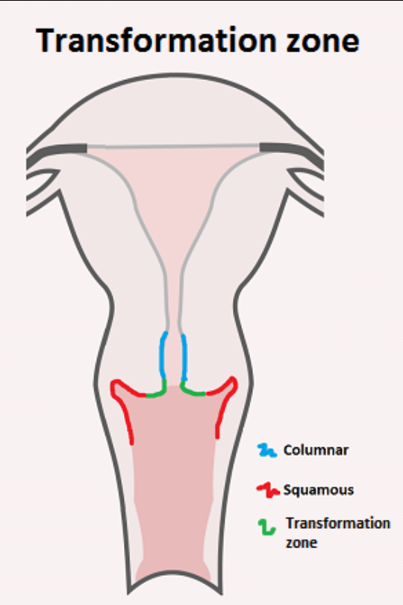

Slide 6
At birth the SCJ is located on the ectocervix – original SCJ
Under the influence of estrogens at puberty and pregnancy ,the endocervix everts to expose the columnar epithelium.
Glycogenisation of epithelium,lactobacilli colonise the epithelium and ph become acidic.
These changes convert columnar epithelium into immature squamous and later nature squamous epithelium.

Slide 7
The junction between the metaplastic squamous epithelium and the columnar epithelium is new SCJ
The area between the original SCJ and the new SCJ is called the transformation zone

Slide 8
Cervical intraepithelial neoplasia
Premalignant lesions of cervix
Cellular changes of malignancy like mitosis , nuclear atypia, altered nuclear/cytoplasmic ratio are seen but are limited to the surface epithelium.
Do not extend beyond the basement membrane

Slide 9
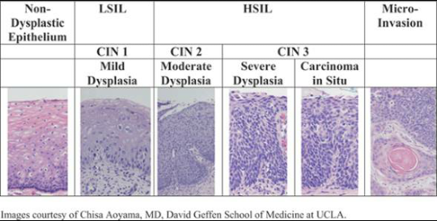

Slide 10
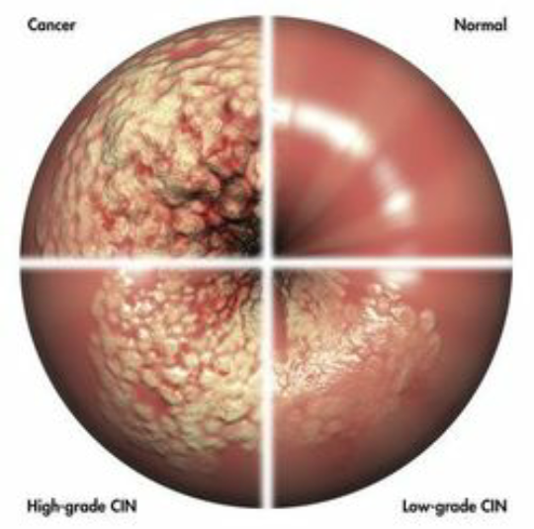

Slide 11
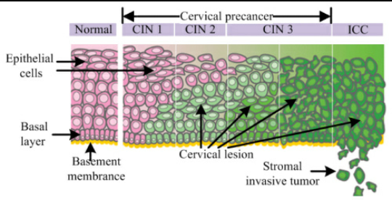

Slide 12
CIN 1
CIN 2
CIN 3
CIN 1 means changes are limited to the lower 1/3rd of epithelium
CIN 2 means extend to middle 1/3 rd
CIN 3 means extend up to upper 1/3rd

Slide 13
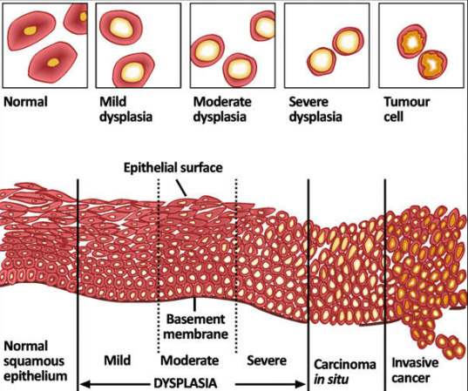

Slide 14
New terminology old terminology
CIN 1 mild dysplasia
CIN 2 moderate dysplasia
CIN 3 severe dysplasia,ca in situ

Slide 15
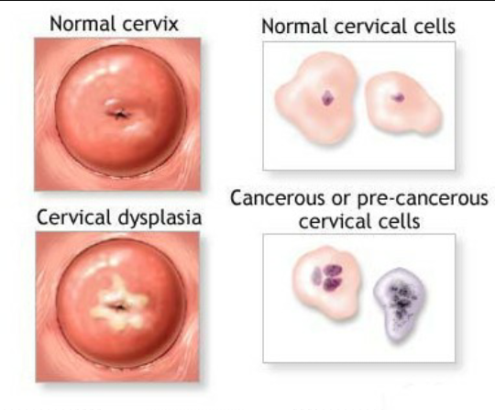

Slide 16
Human papilloma virus
DNA virus
Circular double stranded virus
Exclusively infect epithelial cells
Sexually transmitted
More than 100 serotypes

Slide 17
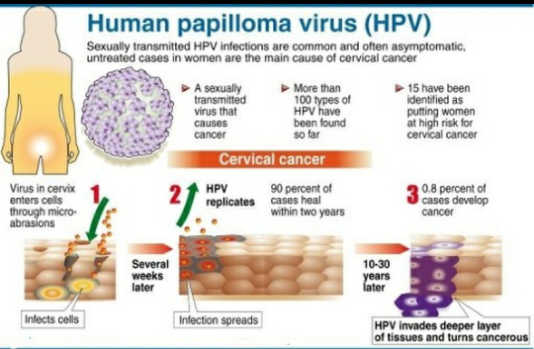

Slide 18
PATHOGENESIS
HPV integrates into host DNA which result in over expression of viral proteins E6 AND E7 .
These proteins cause loss of P53 and pRB ,( the cell proteins with tumour suppressor properties , which breaks in cell proliferation) __ permitting uncontrolled cell proliferation.
These proteins also activate cyclin A and E , which permits further cell proliferation.
These proteins degrade BXA , a proapoptotic gene, which inhibit apopotosis.

Slide 19
Low risk HPV
cause genital warts
Seldom oncogenic
HPV 6 AND 11

Slide 20
HIGH RISK types HPV
16 and 18 -------70%cases of cervical cancer
31,33,52and 58-------70 to 100%of cases of cervical cancer
CIN 1 / LSIL ____flat condyloma with koilocytic atypia.
CIN 2 and CIN 3/ HSIL ___ abnormal atypical pleomorphic squamous cell .

Slide 21
Majority of HPV infections are transient and clear within a few months
Only a small number develop malignancy
Persistent infection and integration of viral DNA into host cell genome are essential for carcinogenesis
Time interval between infection and development of invasive cancer is 10 – 20 yrs

Slide 22
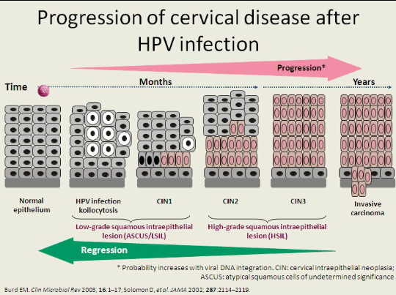

Slide 23
Risk factors
Age
Low socio economic status
Early sexual activity
Multiple sexual partners
Sexually transmitted infections – gonorrhea , chylamydia
Immunosuppression – Hodgkin’s , leukemia
Smoking
Combined OCPills
Deficiency of vitamin A

Slide 24
Prevention
Safe sex
HPV vaccines
Bivalent ( 16,18)
Quadrivalent ( 6,11, 16, 18)
Duration of efficacy – 3.5 – 5 yrs
Protection upto 10 years
Age of administration
9- 13 yrs,can be given upto 25 yrs, must be given before the onset of sexual activity

Slide 25
Dosage – 3 doses at 0, 2 and 6 months
Screening with cytology must continue

Slide 26
downstaging
Process of using clinical approaches for early detection of the disease
Trained paramedical personnel do a speculum examination
Inspect the cervix
Identify the visual abnomalities
Refer cases with suspicious appearance
Useful in developing countries where screening methods are not universally available

Slide 27
Methods used for cervical cancer screening
Cytology
pap smear
liquid based cytology
manual interpretation
automated screening
Visual inspection with acetic acid (VIA)
Visual inspection after acetic acid with magnification ( VIAM)

Slide 28
Visual inspection after Lugol’s iodine (VILI)
HPV DNA testing

Slide 29
Thank you

