Slide 1
Congenital uterine anomalies and their implications
Chair person:Dr.Hemapriya(Assistant professor)
Co- chair person:Dr.Shruthi(Senior resident)
Presenters:Dr.Sreedevi (PG)
Dr.Pavithra (PG)

Slide 2
overview
Normal anatomy
Embryology
Classification
Clinical features
Treatment
Follow up

Slide 3
Anatomy
Uterus is a fibromuscular organ with variable shape, weight, and dimensions
Has two portions: an upper muscular corpus and a lower fibrous cervix
Within the corpus,there is a triangularly shaped endometrial cavity surrounded by a thick muscular wall.
Muscle fibers arranged in more complex pattern.

Slide 4
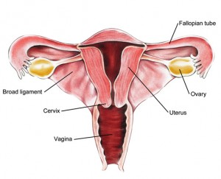
Uterus is lined by a unique mucosa, the endometrium
Cervix is divided into two portions: the portio vaginalis and the portio supravaginalis
Fallopian tubes are paired tubular structures 7 to 12 cm in length.

Slide 5
EMBRYOLOGY
Both male and female embryos have two pairs of genital ducts
The mesonephric ducts (wolffian ducts) play an important role in the development of the male reproductive system
The paramesonephric ducts (mullerian ducts) have a leading role in the development of the female reproductive system
Till the end of sixth week, the genital system is in an indifferent state, when both pairs of genital ducts are present

Slide 6
MULLERIAN DUCTS
Paired ducts derived from intermediate mesoderm.
Known as paramesonephric duct.
Named after Johannes peter mullero-described them in 1830.
Appear between 5-6 wks.
Derived from intermediate mesoderm lateral to wolffian duct as invagination of dorsal coelomic epithelium.
Depends on absence of male determining factor which is present in Y-chromosome

Slide 7
Female development called Basic developmental path of the human embryo –requires not estrogen but the absence of testosterone.
Ambisexual period persist upto 8 wks, thereafter one type of duct system persist & other disappears.

Slide 8
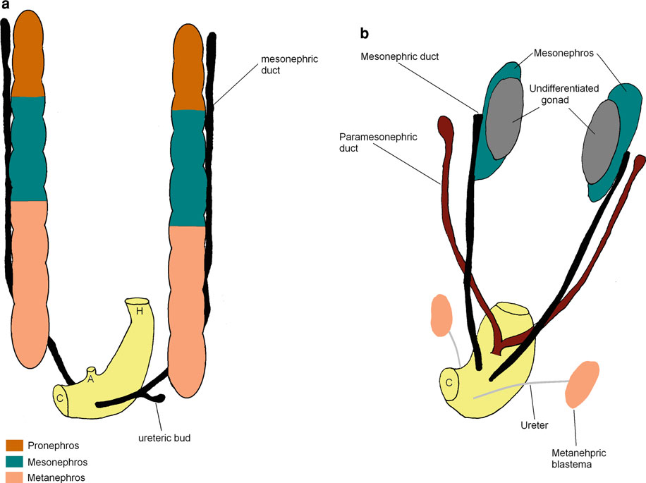

Slide 9
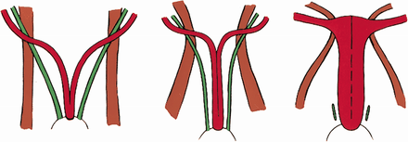
Mullerian ducts form as buds of coelomic epithelium
Grows downward & lateral to corresponding wolffian ducts
Turn inwards & crosses ventrally MD to join its fellow from opposite side to form UVP

Slide 10
Upper vertical part lateral to wolffian duct → fallopian tube.
Middle horizontal part crossing wolffian duct → remaining part of fallopian tube.
Lower vertical part fusing to opposite part → uterus, cervix, upper 1/3rd of vagina.
In forming the uterus, the mullerian ducts fuses from below upwards

Slide 11
Caudal tip of the UVP proliferates and inserts into the dorsal wall of Urogenital sinus and forms Mullerian tubercle.
Paired endodermal invaginations (sinovaginal bulbs) fuse with UVP to form vaginal plate
Vaginal plate canalizes from caudad to cephalad to form vaginal canal

Slide 12
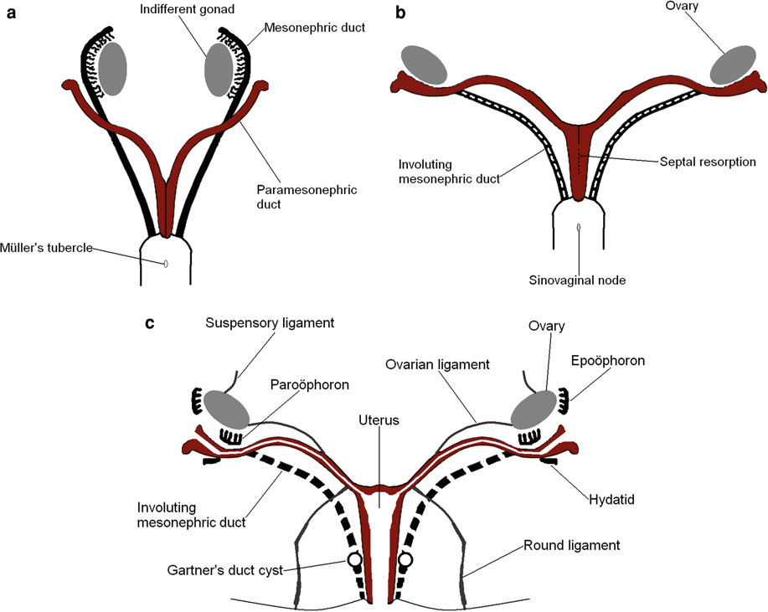

Slide 13
American Fertility Society (AFS)Classification of Müllerian Anomalies
Class I. Segmental, müllerian agenesis–hypoplasia
A. Vaginal
B. Cervical
C. Fundal
D. Tubal
E. Combined anomalies

Slide 14
Class II. Unicornuate
A. Communicating
B. Noncommunicating
C. No cavity
D. No horn
Class III. Didelphys
Class IV. Bicornuate
A. Complete (division down to internal os)
B. Partial

Slide 15
Class V. Septate
A. Complete (septum to internal os)
B. Partial
Class VI. Arcuate
Class VII. Diethylstilbestrol related

Slide 16
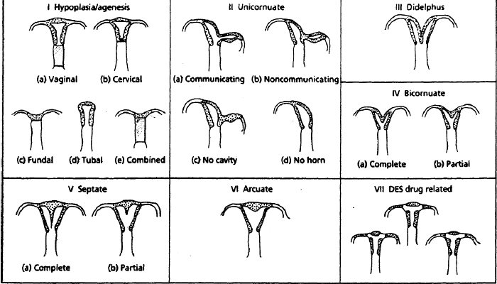

Slide 17
No classification of müllerian maldevelopment can focus entirely on the uterus,
The vagina is often involved, and sometimes the tubes are involved as well
This discussion follows a suggested modification of the AFS classification of uterovaginal anomalies
comprises four groups based on embryologic considerations.

Slide 18
Classification of Uterovaginal Anomalies
Class I. Dysgenesis of the müllerian ducts
Class II. Disorders of vertical fusion of the müllerianducts
A. Transverse vaginal septum
1. Obstructed
2. Unobstructed
B. Cervical agenesis or dysgenesis

Slide 19
Class III. Disorders of lateral fusion of the müllerian
ducts
A. Asymmetric-obstructed disorder of uterus or vagina
usually associated with ipsilateral renal agenesis
1. Unicornuate uterus with a noncommunicating
rudimentary anlage or horn
2. Unilateral obstruction of a cavity of a double uterus
3. Unilateral vaginal obstruction associated with
double uterus

Slide 20
B. Symmetric-unobstructed
1. Didelphic uterus
a. Complete longitudinal vaginal septum
b. Partial longitudinal vaginal septum
c. No longitudinal vaginal septum

Slide 21
2. Septate uterus
a. Complete
1) Complete longitudinal vaginal septum
2) Partial longitudinal vaginal septum
3) No longitudinal vaginal septum
b. Partial
1) Complete longitudinal vaginal septum
2) Partial longitudinal vaginal septum
3) No longitudinal vaginal septum

Slide 22
3. Bicornuate uterus
a. Complete
1) Complete longitudinal vaginal septum
2) Partial longitudinal vaginal septum
3) No longitudinal vaginal septum
b. Partial
1) Complete longitudinal vaginal septum
2) Partial longitudinal vaginal septum
3) No longitudinal vaginal septum

Slide 23
4. T-shaped uterine cavity (diethylstilbestrol related)
5. Unicornuate uterus
a. With a rudimentary horn
1) With endometrial cavity
a) Communicating
b) Noncommunicating
2) Without endometrial cavity
b. Without a rudimentary horn
Class IV. Unusual configurations of vertical-lateral
fusion defects

Slide 24
INCIDENCE
Dates back to 16th century a case utero vaginal agenesis
– Columbo et al (1600)
General population – 0.1-3.5% - Byrene et al
Fertile women – 4.3%
Infertile women – 3.6%
Sterile group - 2.4%
Recurrent Aborters 5 - 13% - Grimbizis et al

Slide 25
ETIOLOGY
Dysregulation occuring in differentiation, migration, fusion and canalisation
Associated with renal anomalies, axial skeletal anomalies and rarely cardiac and auditory anomalies
Probable causes: Intrauterine infection , genetic aberration, Teratogens like DES and Thalidomide.

Slide 26
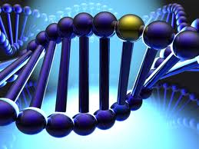
GENETICS
Sporadic
Familial
Multifactorial
Autosomal dominant
Variants of GALT (Galactose 1 phosphate uridyl transferase enzyme defect)
Genes Associated :- HOXA 9, 13 & WNT 4

Slide 27
DISTRIBUTION
Septate uterus- 35%
Bicornuate-26%
Arcuate uterus-18%
Unicornuate uterus-10%
Didelphys uterus-8%

Slide 28
Class I: Dysgenesis of the Müllerian Ducts
Usually referred to as theMayer-Rokitansky-Küster-Hauser (MRKH) syndrome
Rare condition , incidence 1 in 5000 females
Congenital absence of the uterus and vagina (small rudimentary uterine bulbs are usually present with rudimentary fallopian tubes)
Normal ovarian function, including ovulation
Sex of rearing: female

Slide 29
Phenotypic sex: female (normal development of breasts, body proportions, hairdistribution, and external genitalia)
Genetic sex: female (46,XX karyotype)
Frequent association of other congenital anomalies (skeletal, urologic, and
especially renal)
Partial agenesis of the vagina

Slide 30
Presents to gynecologist at age 14 to 15 years, for the absence of menses
Menstruation does not appear at the usual age because the uterus is absent
Functioning endometrial tissue in one or both rudimentary uterine bulbs ,can develop a large hematometra because of cyclic accumulation of trapped blood.
Cyclic abdominal pain is relieved by excision of the active uterine anlagen

Slide 31
47% of patients associated urologic anomalies
12% incidence of skeletal abnormalities
16% incidence of cardiac defects
DD: Testicular feminization syndrome

Slide 32
Work up
Ultrasonography
Complete chromosomal analysis
Intravenous pyelogram ( This also
provides an adequate survey for anomalies of the spine)
magnetic resonance imaging (MRI),
combined with an magnetic resonance urogram

Slide 33
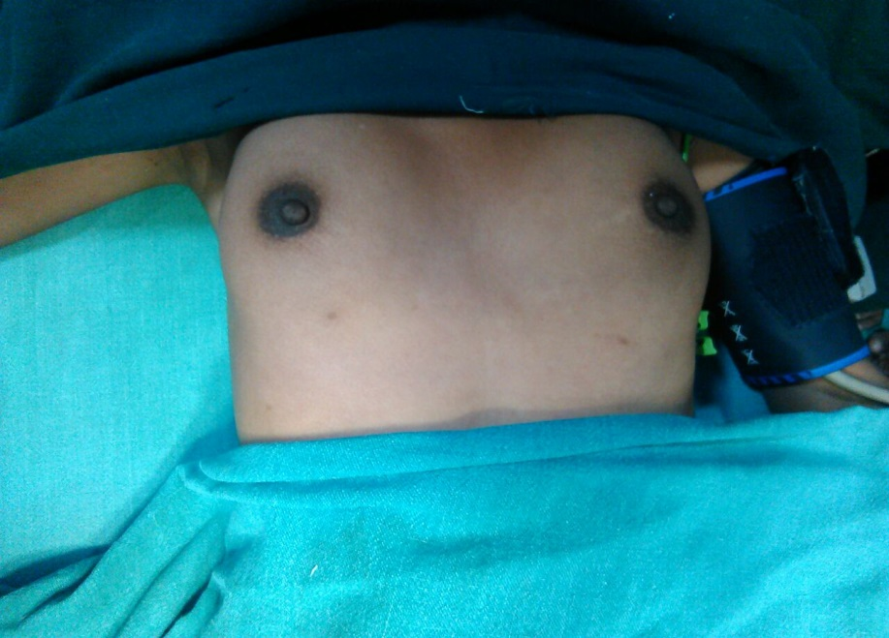
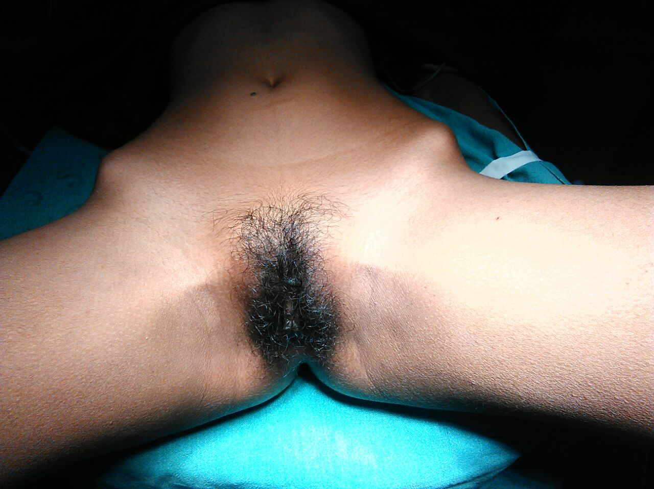
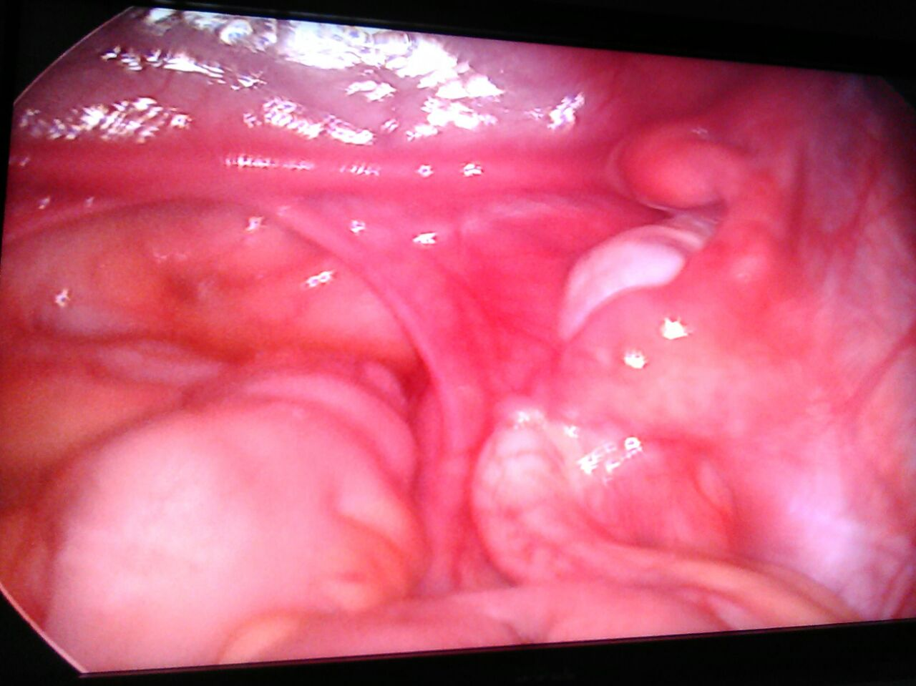
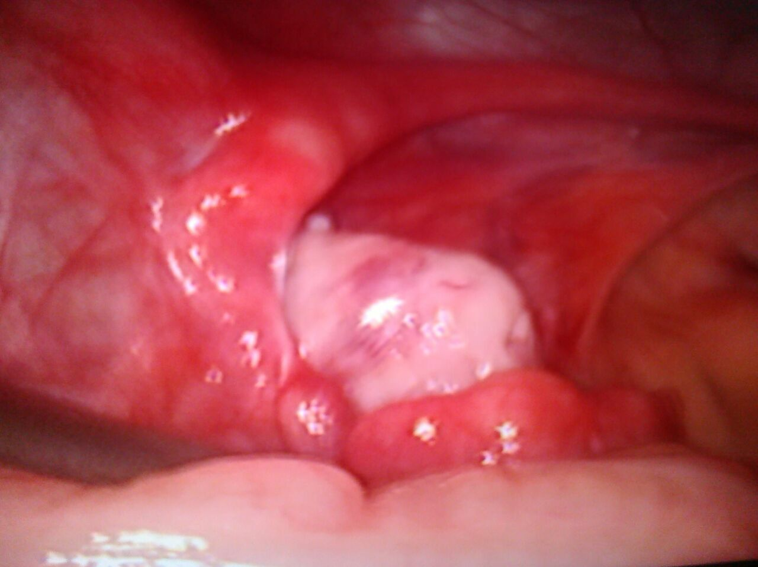

Slide 34
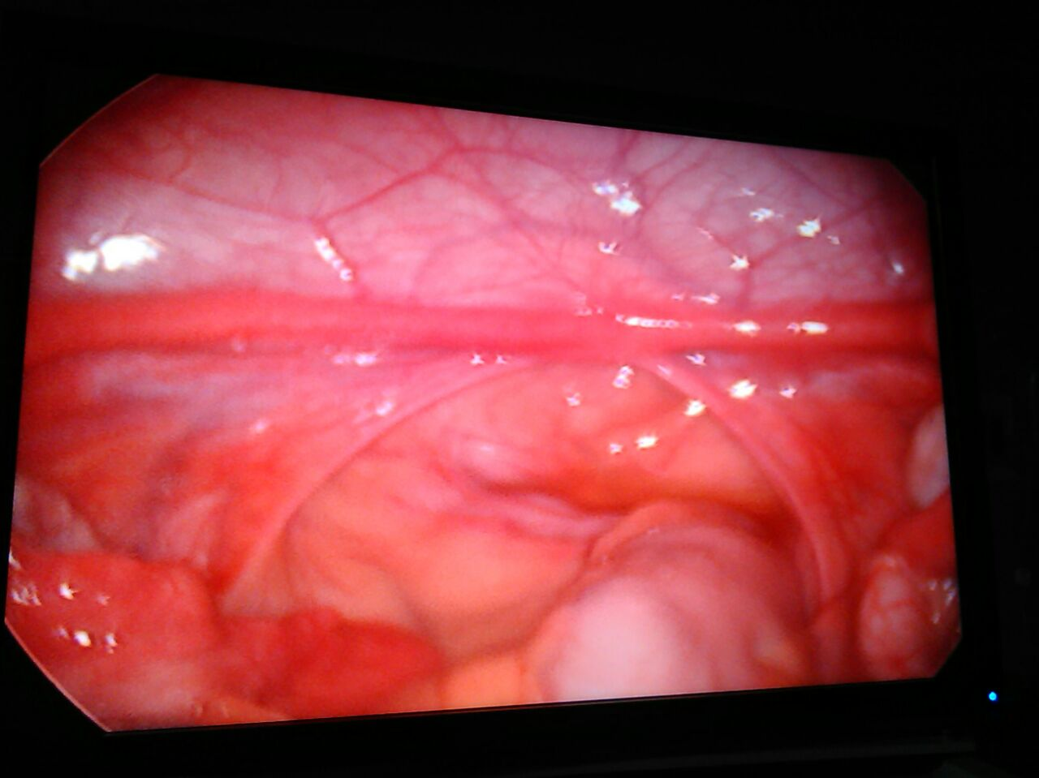
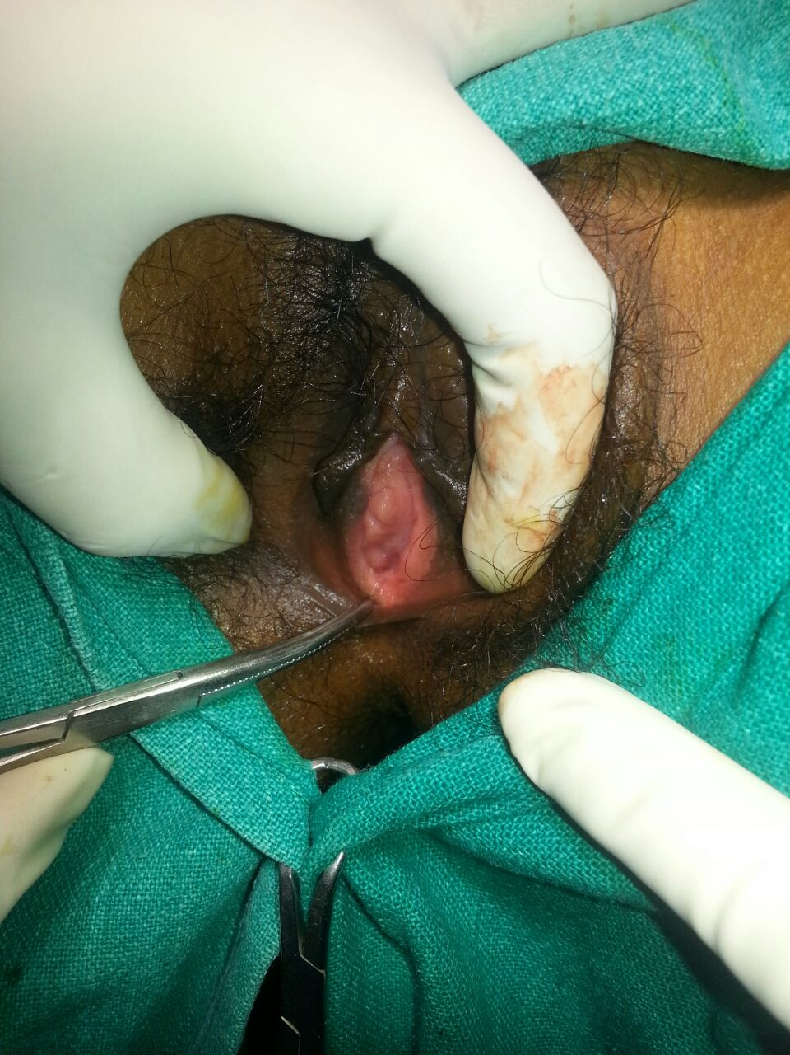

Slide 35
TREATMENT
Psychological Preparation of the Patient
Offer appropriate surgery to establish coital function
Gestational surrogacy should definitely be included in the discussion
Prompt removal of the active uterine bulbs
vaginoplasty

Slide 36
Classification of Methods to Form New Vagina
Nonsurgical (intermittent pressure on the perineum)
Frank (1938) described non surgical method to create neovagina using sequential application of wider & longer dilator.
Series of graduated dilator dilate vaginal space. Creates a functional vagina within 3-6 months.
Patient instructed to sit on racing type bicycle seat for at least 2 hrs/day at interval of 15-30 min.(to apply pressure by leaning forward with dilator in place

Slide 37
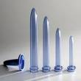
Begin with the smallest dilator
Follow-up is usually at monthly intervals
Patient can expect to graduate to the next size larger dilator about every month
All patients were followed up for at least 2 years and for an average of9.25 years.
Functional success was achieved in 91.9% of those who attempteddilatation

Slide 38
surgical
Without use of abdominal contents-
Without dissecting cavity-
Williams vulvovaginoplasty(1964)
Vecchietti procedure(1965)
Dissecting cavity & lining with graft-
Mc Indoe operation
Dermis graft
Amnion graft
Flaps-Musculocutaneous, fasciocutaneous
With use of abdominal contents-
Peritoneum
Intestinal contents.

Slide 39
Mc Indoe operation
Most common.
Most satisfactory results - Procedure of choice.
Three important principles-
Dissection to create adequate space between bladder & rectum.
Inlay a split thickness skin graft.
Prolonged dilatation during the contractile phase of healing.

Slide 40
Technique
Skin graft taken.
0.018 inch thick, 8-9 cm wide, 16-20 cm in length.
Vaginal form of adequate size is prepared by applying skin graft over it.
Neo vaginal space is created.
Form placed in neo vagina, edge of graft sutured with skin edge.

Slide 41
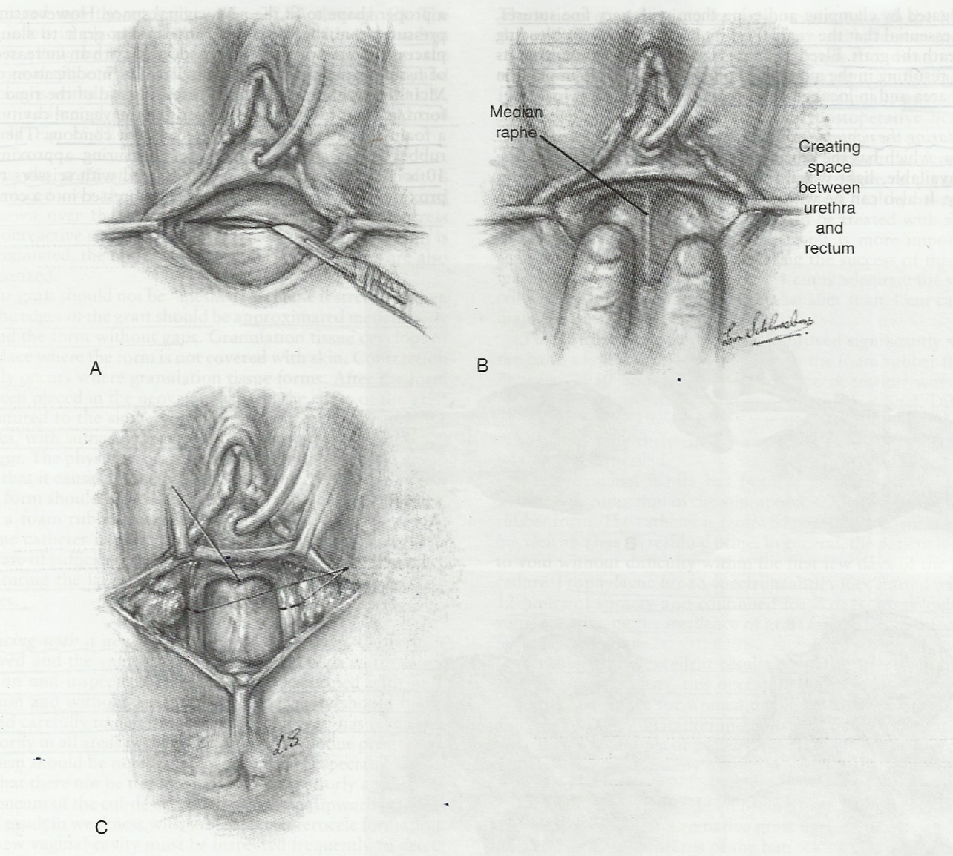

Slide 42
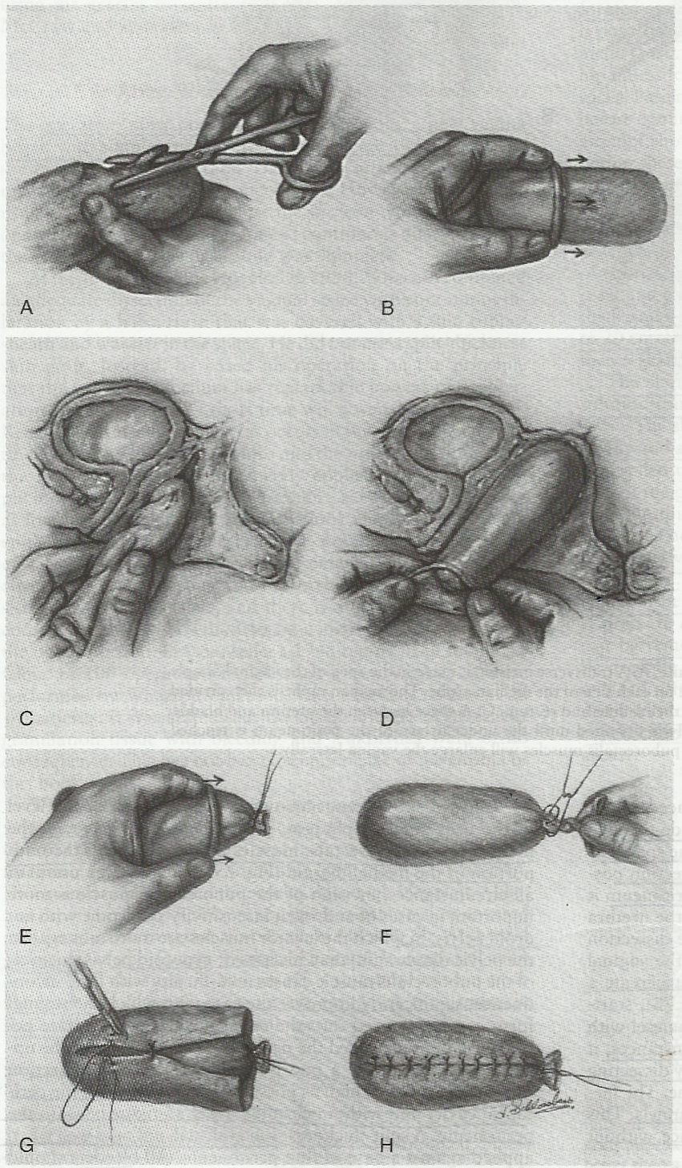

Slide 43
Post operative management
Bed rest
Antibiotics
Replacing with new form-
Removed after 7-10 days. vaginal cavity irrigated with warm saline.
Inspection of cavity to determine the take of graft.
New form applied.
Applied continuously for 6 wks except at the time of urination & defecation.
Next 12 months-new form applied only during night.

Slide 44
Complication
Post operative infection.
Intra – post-op hemorrhage.
Post operative fistula formation with solid mould(due to pressure necrosis). rectovaginal-more common
Failure of graft taken up.
Malignant transformation

Slide 45
Williams Vulvo vaginoplasty
Full thickness skin flap of labia majora to create a vaginal pouch.
Advantages
Technique is simple.
Less local complication.
Early recovery.
Operation of choice for unsatisfactory Mc Indoe operation.
After extensive pelvic surgery or radiation therapy.

Slide 46
Technique
A Horseshoe shaped incision deepened to expose superficial perineal muscle.
B:Inner skin margins united progressively with fine sutures.
C:Vaginal tube completed, admits two fingers and 10-12 cm in length
D: The entrance to the pouch should not cover the external urethral meatus.

Slide 47
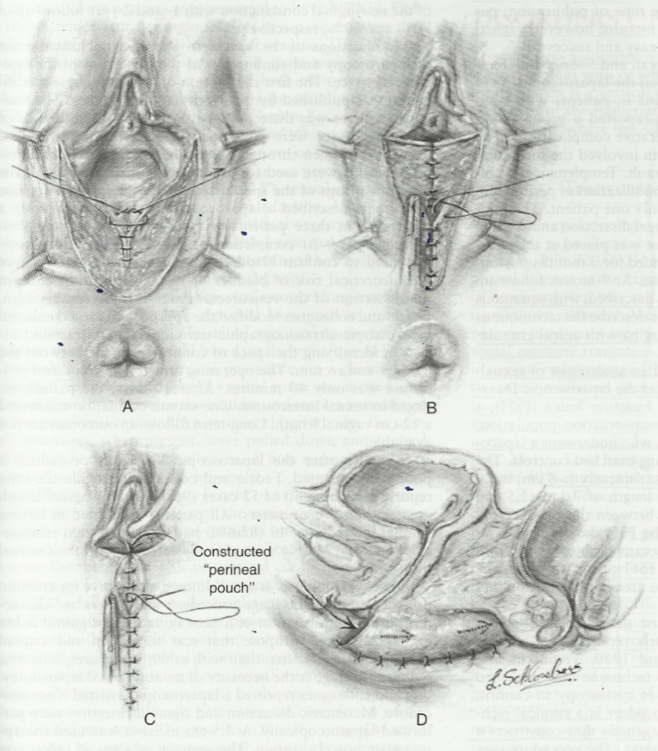

Slide 48
VECCHIETTI OPERATION
An olive-shaped device placed at vaginal opening and with laparoscopic guidance connected to a traction device on lower abdomen. The traction device is tightened every day, gradually pulling the olive-shaped device inward to create a vagina over about a week. Removal needs further manual dilation

Slide 49
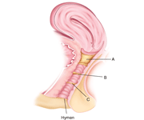
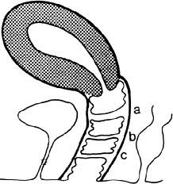
Transverse Vaginal Septum
Developmental defect
Incomplete fusion between the müllerian duct component and the urogenital sinus component of the vagina
Varies in thickness and can be
located at all levels
Superior vagina-46%
Mid vagina-40%
Inferior vagina-14

Slide 50
NEONATES & INFANTS
Rarely diagnosed in neonates & infants – hydromucocolpos.
Unlike imperforate hymen bulging vagina is not seen with valsalva maneuvre.
USG is initial study, MRI is more useful as it clearly defines the length of atretic segment between the upper and lower vagina.
Management : surgical excision of septum

Slide 51
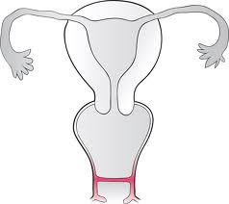
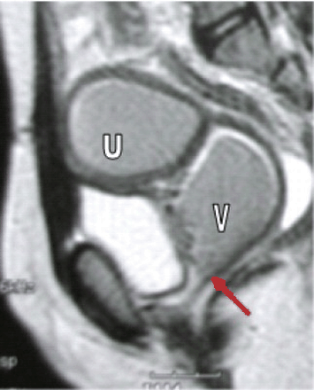
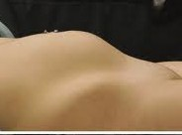
POST MENARCHE
Symptoms depends on whether septum is complete or incomplete.
Presents with primary amenorrhea.
Cyclical pelvic pain
O/E:Palpable central lower abdominal or pelvic mass secondary to hematometra, hematocolpos, ematosalpinx.

Slide 52
Local exam no bulging membrane.
Incomplete TVS allows menstrual flow to escape periodically but hematometra, hematocolpos can later develop.
Temptation to insert a needle for diagnostic purpose must be resisted to avoid the risk of converting a hematocolpos into a pyocolpos
Chronic retrograde menstruation frequently result in pelvic endometriosis and adhesions, which can be severe.

Slide 53
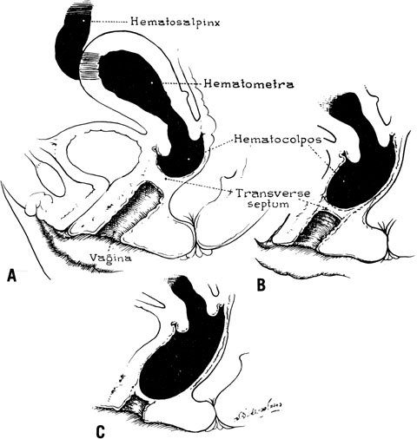

Slide 54
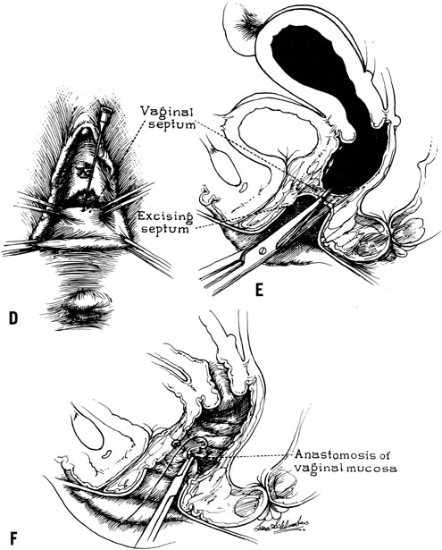
Prompt diagnosis
Early surgical
correction
Preventing sequelae
Preserving the repro-
ductive capacity

Slide 55
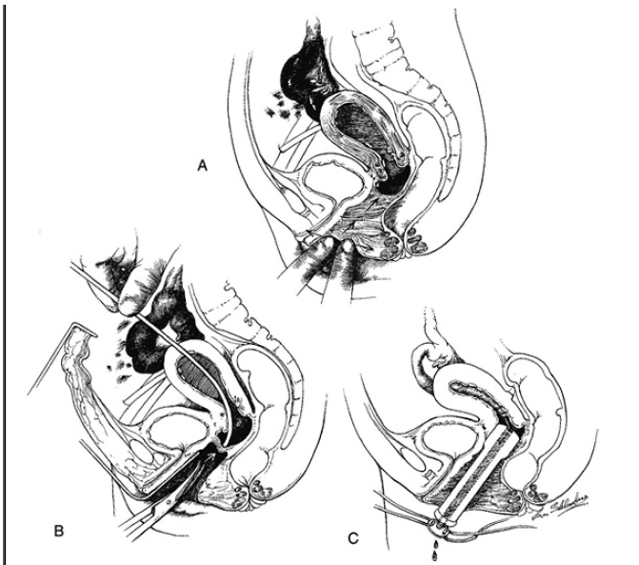
A large portion of atretic vagina is palpated with two fingers, vaginal space is developed
open the abdomen via laparotomy and pass a probe through to the uterine fundus to tent out the septum, safely excised.
An acrylic resin (Lucite) form with a channel is then placed into the vagina and secured with rubber straps.

Slide 56
Congenital Absence or Dysgenesis of the Cervix
Relatively infrequent mülleriananomaly.
Often in association with absence of a
portion or all of the vagina
Retentionof menstrual blood initiates symptoms of cyclic lower abdominal pain withoutmenstrual flow, to seek gynecologic evaluation and care.

Slide 57
Anatomic Variations
A.cervical aplasia, lack a uterine cervix
B.cervical dysgenesis: 4 sub types
1.Cervical body consisting of a fibrous band of variable length and diameter
2. Intact cervical body with obstruction of the cervical os (the cervix is usually well formed, portion of the endocervical lumen is obliterated)
3.cervix is hypoplastic with a bulbous tip and no identifiable cervical lumen)
4. Fragmentation of the cervix

Slide 58
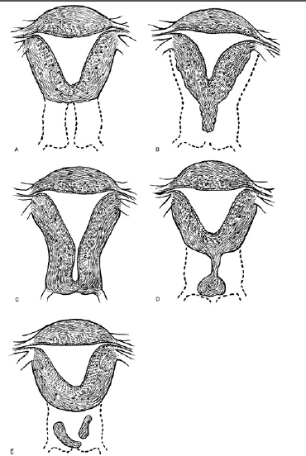

Slide 59
ultrasonography and MRI are most helpful when they are correlated with the findings of careful pelvic examination under anesthesia
Management of obstruction at the level of cervix is most controversial
conservative approach: uterovaginoplasty
Radical approach: hysterectomy

Slide 60
Bicornuate uterus
Partial failure of fusion can result in a single vagina with a single or duplicate cervix and complete or partial duplication of the corpus

Slide 61
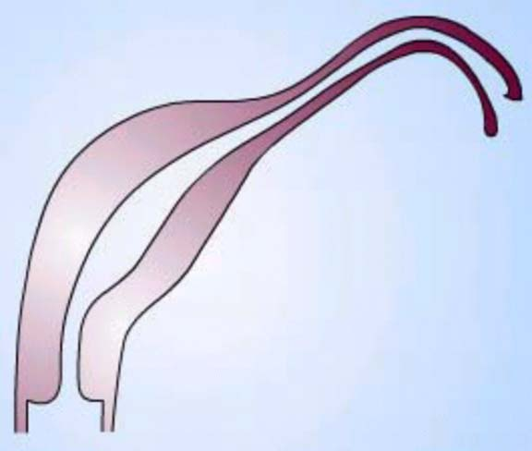
UNICORNUATE UTERUS
One mullerian duct develops normally while opposite fails to develop or develop incompletely.
rudimentary horn-
□ With endometrial cavity-
-communicating
-non communicating
□ Without endometrial cavity-
Without rudimentary horn

Slide 62
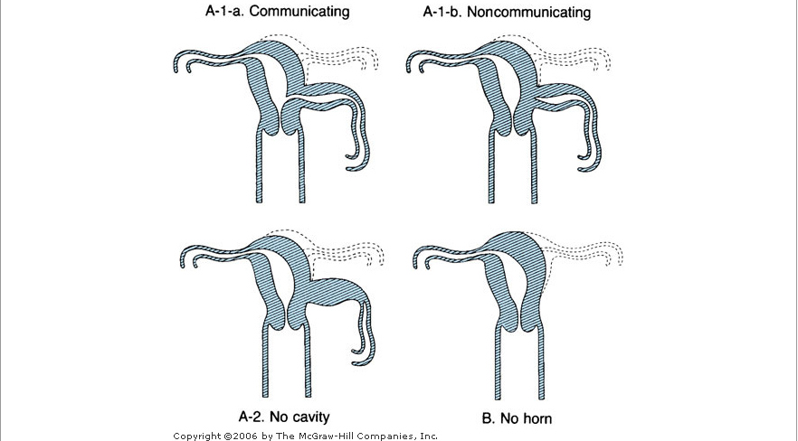

Slide 63
Increased incidence –
- infertility
-endometriosis
- dysmenorrhea
Obstetric complications
- spontaneous abortion
-preterm delivery
-IUGR
-breech presentation
-dysunctional labor
-intrauterine fetal demise
-Caserean section

Slide 64
Poorest fetal survival among all mullerian anomalies –
Insufficient muscular mass.
Decreased uterine volume.
Decreased ability to expand.
vascular anomalies in distribution of uterine artery.
cervical incompetance

Slide 65
Diagnosis
On physical examination – uterus markedly deviated
Imaging modalitis – HSG combined with sonography OR MR imaging – key study

Slide 66
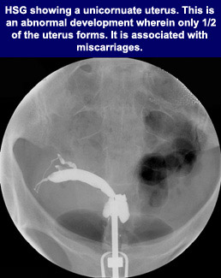
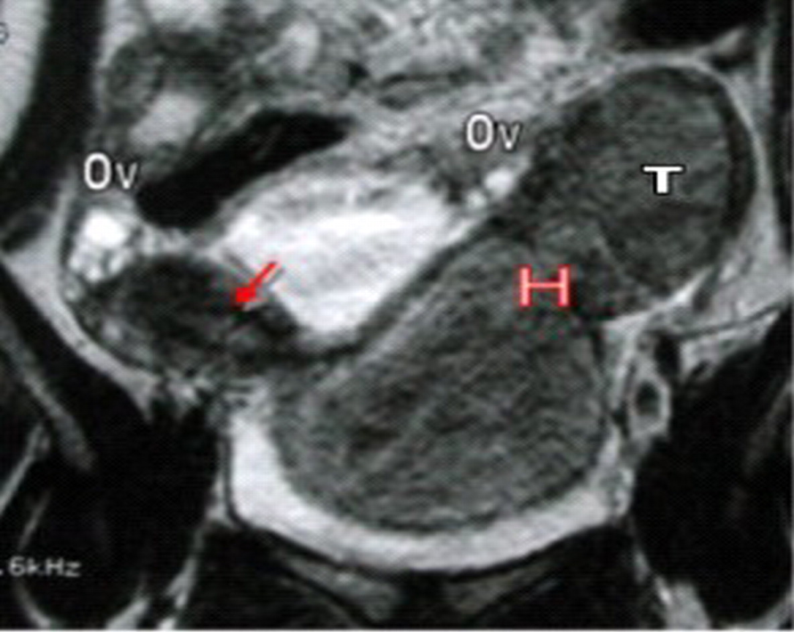
HSG
Useful for diagnosis,
Can not detect non communicating horn.
MRI
Reliable.
Only one fallopian tube identified.
Uterine volume reduced
Accessory horn appears solid
Opacified - endometrium is absent

Slide 67
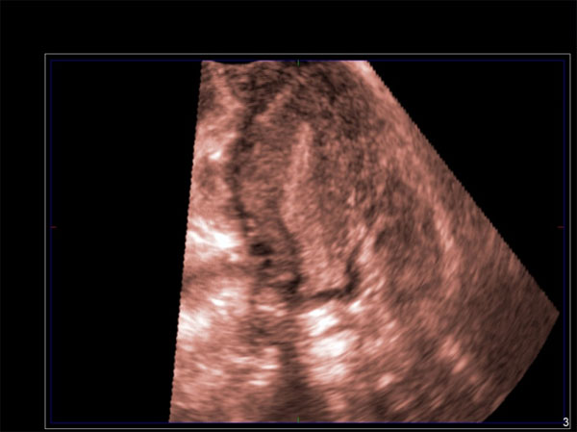
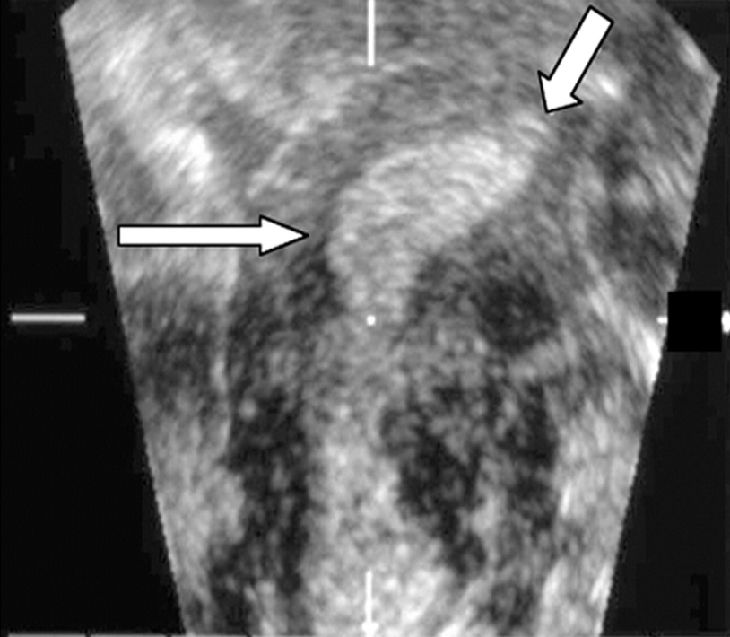
USG
Useful for identifying rudimentary horn.
Can identify communication with main uterine cavity.

Slide 68
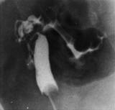
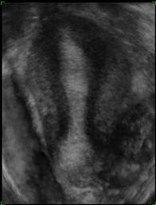
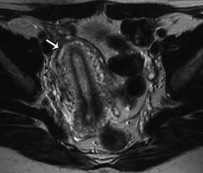
HSG 3D USG MRI

Slide 69
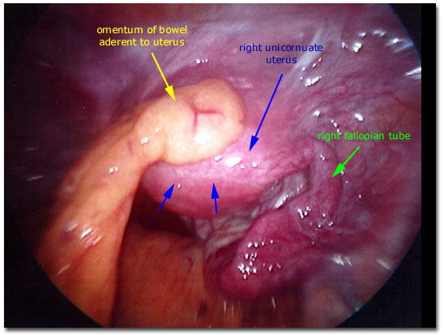
Cont
Laproscopy
Rarely indicated.
Indication of surgery-Presence of accessory horn with endometrium.
Salpingectomy or salpingo oophorectomy on side with rudimentary horn – prevent ectopic pregnancy

Slide 70
Associated with urological anomalies-44%.
Non communicating accessory horn having endometrial cavity- most common & most clinically significant.
-hematometra , endometriosis
-pregnancies associated with high rate of uterine rupture

Slide 71
REPRODUCTIVE OUTCOME IN UNICORNUATE UTERUS
Live birthrate 43.7%
Abortion rate 35-43%
Preterm delivery 27%
Term delivery 31%

Slide 72
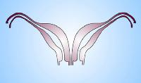
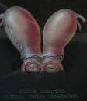
UTERINE DIDELPHYS
Failure of medial fusion of two mullerian ducts.
Charecterzied by 2 hemiuterus, 2 endocervical canal, 2 cervix, vagina can be single or double.
Longitudinal vaginal septum - most cases
Each hemiuterus having one fallopian tube.

Slide 73
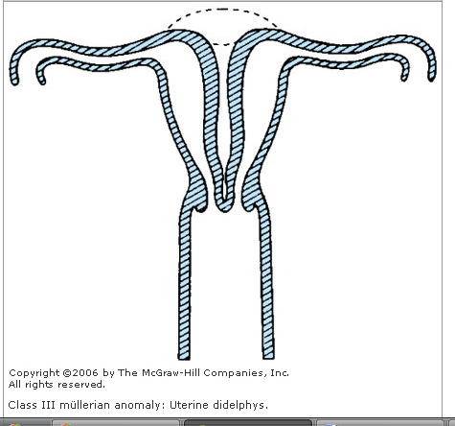

Slide 74
Usually asymptomatic (non obstructive) – diagnosed during pelvic examination-a longitudinal vaginal septum or two cervix seen.
Associated with best possibility of successful pregnancy after arcuate uterus.
May have history of recurrent second trimester abortion.

Slide 75
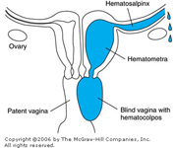
Unilateral vaginal obstruction can cause hematocolpos, hemetometra, endometriosis- can be overlooked as there is cyclical menstruation from opp. Side.

Slide 76
Other associated anomalies :renal anomolies, bladder exstrophy , congenital VVF, cervical agenesis

Slide 77
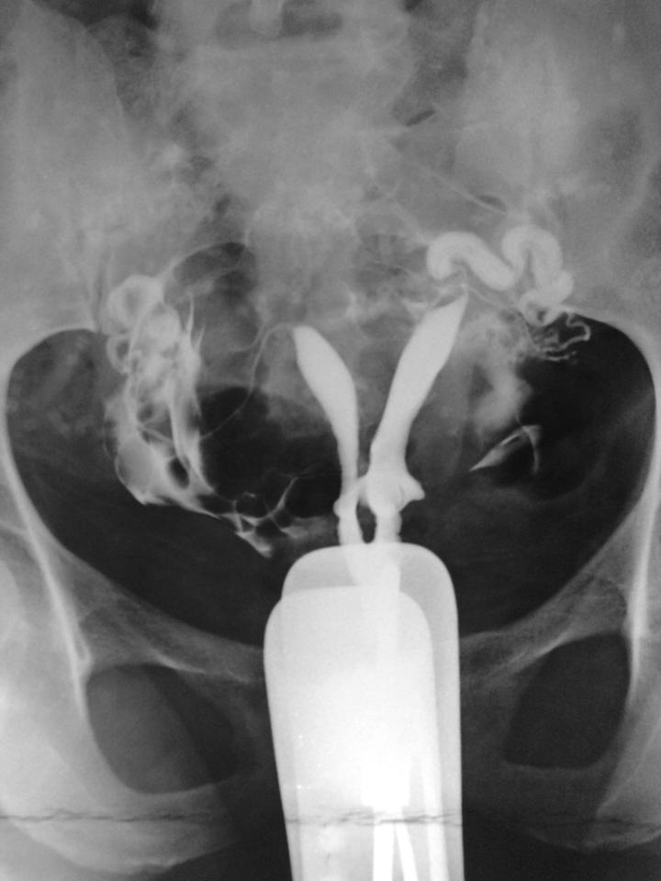
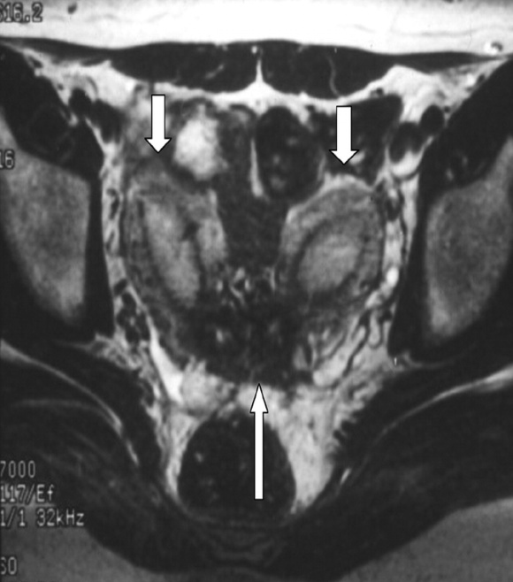
HSG
Two uterine cavity with two cervix with two vagina.
MRI
Two widely separeted uterus.
Two cervix, two vagina.
Associated renal anomaly identified.

Slide 78
Indication of vaginal septum resection-Obstructed unilateral hemivagina to preserve fertility.
In non obstructive vagina – surgical correction is limited.(severe dyspareunia).
Metroplasty – Rarely indicated.

Slide 79
REPRODUCTIVE OUTCOME IN DIDELPHYS
Term delivery 20%
Ectopic 2.3%
Abortion 20%
Live birth 68%
Preterm delivery 24%

Slide 80

BICORNUATE UTERUS
Incomplete lateral fusion of mullerian ducts
Lower uterus & cervix are fused completely.
Two separate commmunicating endometrial cavity, single uterine cervix
Important to differentiate bicornuate uterus from septate uterus –different reproductive outcome & treatment strategies.

Slide 81
Subclassification : depending on septum length.
COMPLETE : Septum upto cervix.
BICORNUATE UNICOLLIS : Septum extends to internal os.
BICORNUATE BICOLLIS : Septum extends to external os.
PARTIAL : Septum confined to fundal region.

Slide 82
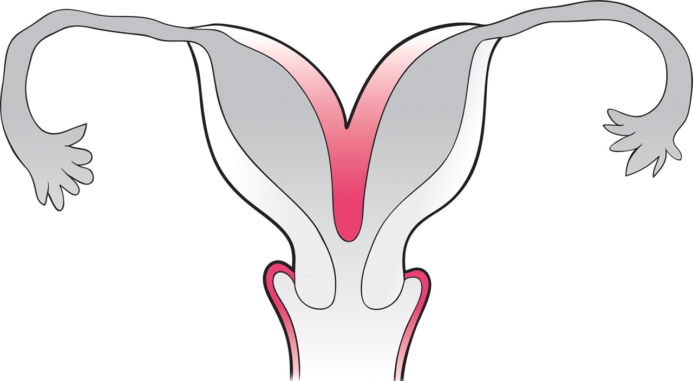
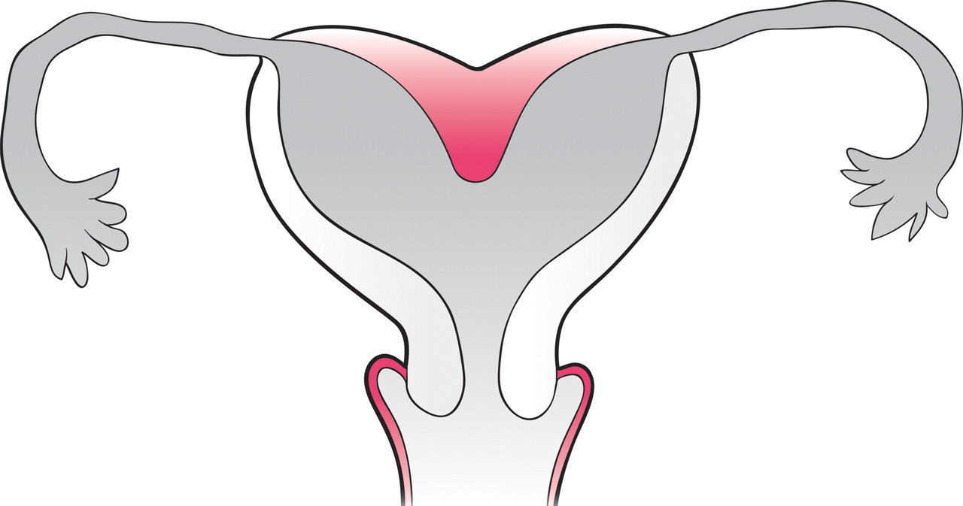
Complete
Partial

Slide 83
Clinical features
Asymptomatic
Abortion 28%
Preterm delivery 25%
Live birth 63%

Slide 84
HSG
Marked divergence
Two chambered uterine cavity.
Septal thickness is important.
Does not differentiate between bicornuate and septate

Slide 85
USG
Should be done in luteal phase- endometrial echo complex is better identified.
useful for distinguising bicornuate uterus form septate uterus.
MRI
Two uterine body with single cervix.
Fundal contour and septal conformation

Slide 86
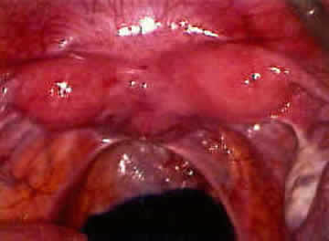
LAPROSCOPY
For definitive diagnosis ,before
Hysteroscopic resection of septum
Surgery seldom required.
Preserved for patients with recurrent spontaneous abortion, preterm birth.
Straussmann Metroplasty –treatment of choice.

Slide 87
Surgery seldom required.
Preserved for pts. with recurrent spontaneous abortion, preterm birth.
Straussmann procedure –treatment of choice- Unify equal sized endometrial cavities
Older procedures –
Jones metroplasty
Thompkins metroplasty

Slide 88
STRASSMANN METROPLASTY
Incision given in medial side of each hemicorpus, deep enough to enter the endometrial cavity.
The incision extends from the superior aspect of each horn, near the interstitial region of the fallopian tubes, to the inferior aspect of the uterus.
The goal is to achieve a single endocervical canal. If 2 cervices are present, their unification is not recommended.

Slide 89
Apposition of the myometrium
After resecting the wedge, the myometrial edges naturally evert. Apposition of the opposing myometrium is achieved using interrupted vertical figure-8 sutures along the posterior and anterior uterine walls.
The final layer is closed using continuous subserosal sutures, without exposing any suture material to the peritoneal cavity.
Transvaginal dilatation of the cervix is performed, assuring proper endometrial cavity drainage.

Slide 90
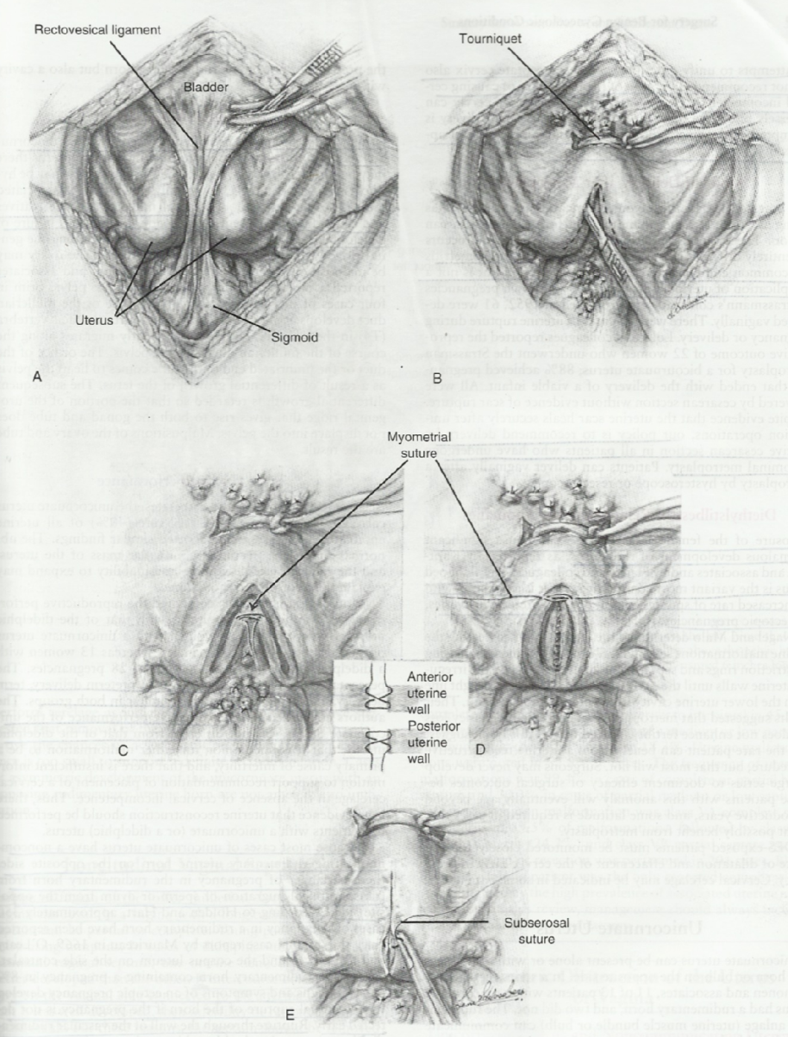
The Strassmann metroplasty with modification. A: If a rectovesical ligament is found, it should be removed. B: An incision is made on the medial side of each hemicorpus and carried deep enough to enter the uterine cavity. The edges of the myometrium will evert to face the opposite side. C and D: The myometrium is approximated by use of interrupted vertical figure-of-eight 3—0 polyglycolic acid sutures. One should avoid placing sutures too lose to the interstitial portion of the fallopian tubes. E: A continuous 3—0 polyglycolic acid subserosal suture is used as a final layer. Tourniquets are removed, and defects in the broad ligament are closed.

Slide 91
Jones Metroplasty
Abdominal approach.
Wedge shaped incision given at the top of fundus within 1 cm of insertion of tubes.
Uterine septum excised as wedge.
Unification of two halves of uterus is done in three layers with interrupted stitches.

Slide 92
THOMPKINS METROPLASTY
Abdominal approach.
Single median incision given- divides uterine corpus in half.
Each lateral half incised to within 1 cm of tubes.
Myometrium is reapproximated.
Leaves the uterotubal junction in a more normal and lateral position.
Less traumatic and cause less bleeding

Slide 93
REPRODUCTIVE OUTCOME IN BICORNUATE UTERUS
Increased incidence in infertile population.
Live birth 65%
Abortion 28%
Preterm 20%

Slide 94
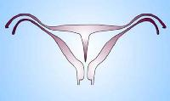
SEPTATE UTERUS
Failure of resorption of medial septum after complete fusion of mullerian duct.
Most common.
Subclassification- depending on septal length.
COMPLETE : Septum upto os( double vagina)
PARTIAL : Septum does’t extend upto os.

Slide 95
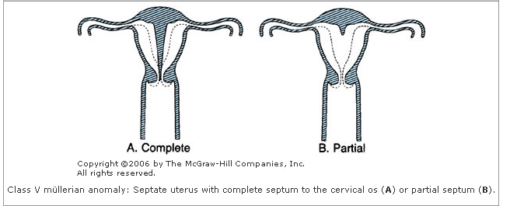
Class V

Slide 96
CLINICAL FEATURES
Dyspareunia
Dysmenorrhoea
Primary or secondary infertility
Poor reproductive performance-partial or complete implantation on the largely avascular septum

Slide 97
REPRODUCTIVE OUTCOME IN SEPTATE UTERUS
Spontaneous abortion 33-75%
Live birth 62%
Term deliveries 51%
Preterm labour 10%
Ectopic 2%

Slide 98
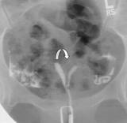
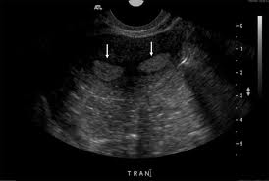
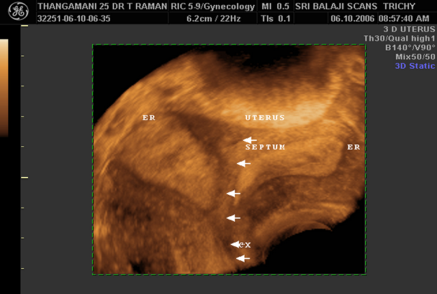

IMAGING MODALITIES IN SEPTATE UTERUS
HSG USG 3DUSG
MRI

Slide 99

HSG
Two chambered uterine cavity.
Length & thickness of septa should be assessed.
MRI
Normal fundal contour with outward convexity.
Low signal intensity for septum.

Slide 100
Cont.
LAPROSCOPY
Best for distinguishing septate from bicornuate uterus.
Normal fundal contour.

Slide 101
Indication of surgery-
Recurrent spontaneous abortion
History of preterm labour.
Procedure of choice- Transcervical hysteroscopic lysis of uterine septum with concurrent laproscopy.

Slide 102

ARCUATE UTERUS
Near complete resorption of uterovaginal septum.
C/by small intrauterine indentation <1 cm in fundal region.
Considered as mild form of bicornuate uterus.

Slide 103


HSG
Single uterine cavity with saddle shaped fundal indentation.
MRI
Convex or flate contour.
Cavity with broad & smooth indentation similar to myometrium.

Slide 104

Diethylstilbestrol-Induced Reproductive Tract Abnormalities
Development of rare vaginal clear cell adenocarcinoma.
Increased risk of developing-
cervical intraepithelial neoplasia
small-cell cervical carcinoma
vaginal adenosis,
non-neoplastic structural abnormalities

Slide 105
Diethylstilbestrol-Induced Reproductive Tract Abnormalities
Structural Abnormalities:
transverse septa
circumferential ridges involving the vagina and cervix
cervical collars
smaller uterine cavities
shortened upper uterine segments
T-shaped and irregular
oviduct abnormalities

Slide 106
Diethylstilbestrol-Induced Reproductive Tract Abnormalities
incidences -miscarriage, ectopic pregnancy, and preterm delivery are also increased, especially in women with structural abnormalities

Slide 107

T SHAPED UTERUS

Slide 108
MANAGEMENT OF T SHAPED UTERUS
Lateral metroplasty
Encerclage is mandatory in the event of pregnancy

Slide 109
CONCLUSION
MDA are not so uncommon
Presents at varying stages of life as primary amenorrhoea , infertility, Recurrent abortion, preterm labour,
MRI helps in accurate diagnosis
Diagnostic Hystero Laparoscopy is indicated only when intervention is needed.
Corrective surgery improves pregnancy outcome

